Slide 1
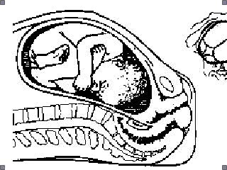
Normal Labor
Haitham A. A. Badr

Slide 2
The ideal conduct of labor and delivery
Two important points to remember
Birthing is a normal physiological process that most women experience without complications.
Maternal or fetal complications can arise very quickly and unexpectedly.
Notes:
Providers must simultaneously make the women and her supporters feel comfortable, yet insure safety for the mother and infant should any complication suddenly develop.

Slide 3
INTRODUCTION
What is the importance of diagnosing dystocia?
Dystocia is the most common indication for 1ry CS
50-60% of CS in USA attributed to dystocia
There has been dramatic ↑ in CS rate with ↑ in maternal mortality, morbidity, neonatal morbidity & health care costs
Reducing Dystocia   CS rate

Slide 4
Diagnosis of Dystocia
It is generally agreed that dystocia is over diagnosed   CS rate
To be able to diagnose dystocia we should be able to understand labor first

Slide 5
Contents of this Presentation
Definition of labor
Stages of labor
Mechanism of labor
Management of Labor
Causes of Inadequate labor
Diagnosing Dystocia
Management of Dystocia

Slide 6
Normal Labor
Definition
“It is defined as progressive cervical effacement, dilatation or both, resulting from regular uterine contractions that occur at least every 5 minutes and last 30 to 60 seconds”

Slide 7
Preparation for labor
Before actual labor begins, these physiological events usually occur:
Lightening
False labor
Cervical effacement

Slide 8
Preparation for labor
Lightening
It is the settling of the fetal head into the brim of the pelvis
Could happen 2 or more weeks before labor in most primigravid mothers
Notes:
Noted by the mother as:
1- flattening of the upper abdomen
2- increased promincence of the lower abdomen
3- increased urination frequency

Slide 9
Preparation for labor
False labor “Braxton Hicks contractions”
Irregular contractions that are normally painless, which are not associated with progressive cervical dilatation or effacement.
They may serve a physiological role in preparing the uterus and cervix for true labor.
Notes:
It’s important to distinguish these contractions if they are early in the third trimester from preterm labor

Slide 10
Preparation for labor
False labor “Braxton Hicks contractions”
True labor False labor
Contractions occur in regular intervals
intervals gradually shorten
Intensity gradually increase
Discomfort is in the back and abdomen
Cervix dilate
discomfort is not stopped with analgesia
contraction occur in irregular intervals
intervals remain long
intensity remains unchanged
discomfort mainly in the lower abdomen
cervix dos not dilate
discomfort is usually relived by sedation

Slide 11
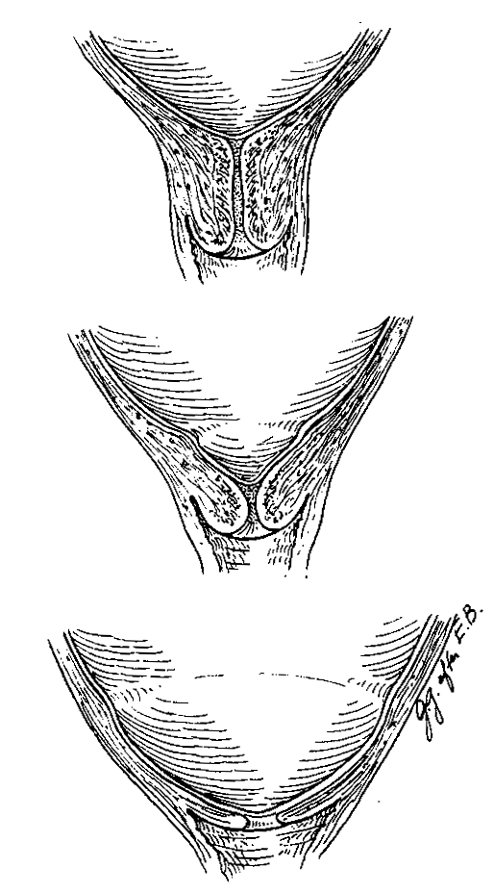
Preparation for labor
Cervical effacement
Softening of the cervix resulting from increased water content and collagen lysis.
Simultaneous effacement, or thinning of the cervix occurs as it is taken up into the lower uterine segment

Slide 12
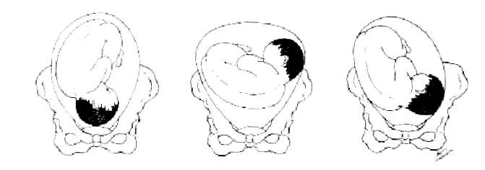
The Fetus
Fetal Lie
  Is the relation of the long axis of the fetus to that of the mother
  Could be Longitudinal, transverse or oblique
  Multiparty, placenta previa, hydramnios or uterine anomalies

Slide 13
The Fetus
Fetal Presentation
  Part of the fetus that is either foremost or closer to the birth canal
  Could be the head, buttocks or legs according to the lie

Slide 14
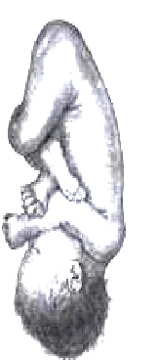
The Fetus
Fetal Attitude (posture)
  The description of the fetal limbs and body in
  relation to each other
  Fetus is usually folded upon itself as follow
    Back is markedly convex
    Head is sharply flexed (chin touching the chest)
    Thighs are flexed over the abdomen
    Legs are bent at the knees
    Arms are crossed over the chest and
    become parallel to the sides
    Cord lies in the space between the upper and
    lower limbs

Slide 15


Slide 16
Stages of labor
There are four stages of labor
First Stage
from the onset of true labor to complete dilatation of the cervix.
Second Stage
from complete dilatation of the cervix to the birth of the baby.
Third Stage
from the birth of the baby till delivery of the placenta.
Fourth Stage
from delivery of the placenta to stabilization of the patients condition.

Slide 17
First Stage of labor
It consists of two phases
Latent Phase
Cervical effacement and early dilatation occurs.
Active Phase
It begins when the cervix is 2 – 4 cm dilated in the presence of regular uterine contractions
More rapid cervical dilatation occurs.

Slide 18
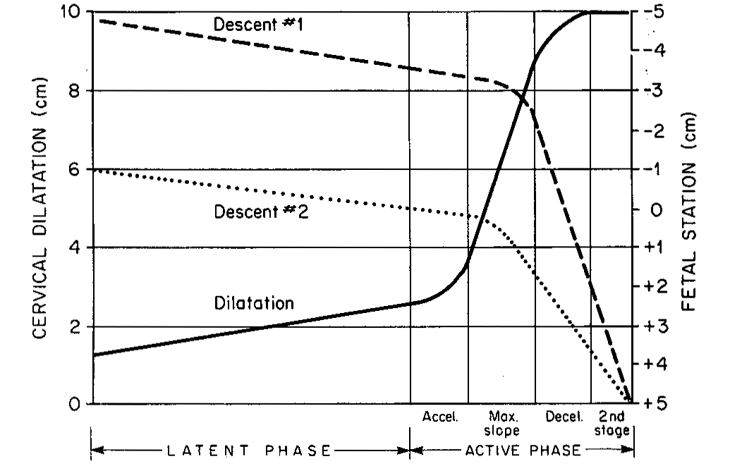
First Stage of labor

Slide 19
First Stage of labor
The latent phase may overlap with the preparatory phase of labor.
It may be influenced by other factors like sedation or stress
The latent phase duration has little effect on the subsequent course of labor

Slide 20
First Stage of labor
Length of the 1st stage
Characteristic Primipara Multipara
Duration of 1st stage 6 - 8 hr. 2 – 10 hr.
Rate of Cervical Dilatation 1 cm/hr. 1.2 cm/hr.
during active phase
Duration of 2nd stage 30 min. to 3 hr. 5 – 30 min.
Duration of 3rd stage 0 – 30 min. 0 – 30 min.
Duration of 4th stage up to 6 hr. Up to 6 hr.

Slide 21
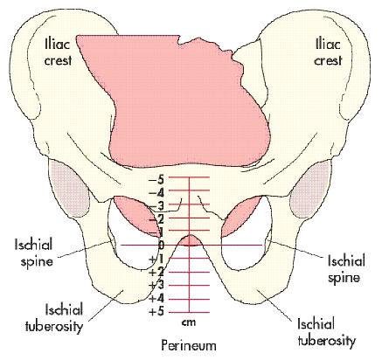
First Stage of labor
Measurement of progress is by
Cervical Dilatation
Cervical Effacement
Descent of the fetal head

Slide 22
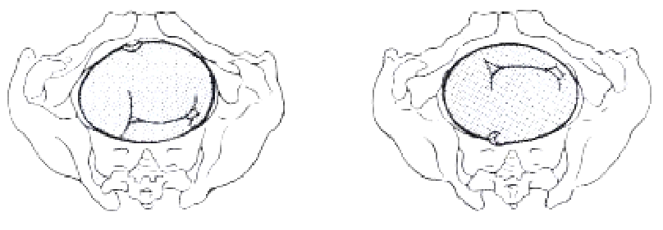
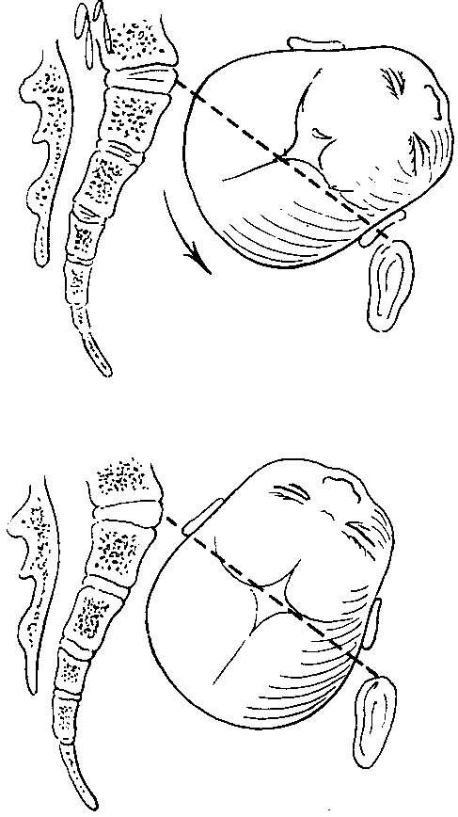
First Stage of labor
Asynclitism
  When the sagittal suture does not lie exactly midway between the symphysis and sacral promontory
  Moderate degrees of asynclitism are the rule in normal labor but if severe the asynclitism may lead to cephalopelvic disproportion even with an otherwise normal size pelvis

Slide 23
First Stage of labor
Management
Maternal Position
Administration of fluids
Investigations
Maternal monitoring
Analgesia
Fetal monitoring
Uterine Activity
Vaginal examination
Amniotomy
The mother may chose to:
Sit,
Recline,
Ambulate,
Lying in bed
The supine position is
discouraged
Recommend not performing routine enemas (Grade 1A)
Not routinely shaving the perineum (Grade 2B)

Slide 24
First Stage of labor
Management
Maternal Position
Administration of fluids
Investigations
Maternal monitoring
Analgesia
Fetal monitoring
Uterine Activity
Vaginal examination
Amniotomy
Placement of a 16 – 18 gauge
venous catheter is advisable
during the active phase
because:
Delayed gastric emptying.
Hydrate patients with
crystalloids
Administer oxytocin after
delivery of the placenta
Treat any unanticipated
emergency

Slide 25
First Stage of labor
Management
Maternal Position
Administration of fluids
Investigations
Maternal monitoring
Analgesia
Fetal monitoring
Uterine Activity
Vaginal examination
Amniotomy
Checking the Blood for
Hb or Hematocrit
Blood grouping
Rhesus type
Antibody screen
Checking the Urine for
Protein
Glucose

Slide 26
First Stage of labor
Management
Maternal Position
Administration of fluids
Investigations
Maternal monitoring
Analgesia
Fetal monitoring
Uterine Activity
Vaginal examination
Amniotomy
Maternal Vital Signs
every 1 – 2 hours in normal
labor
more frequent if indicated
Fluid balance (urine output &
urine output) monitoring

Slide 27
First Stage of labor
Management
Maternal Position
Administration of fluids
Investigations
Maternal monitoring
Analgesia
Fetal monitoring
Uterine Activity
Vaginal examination
Amniotomy
Fetal Monitoring using
DeLee Stethoscope
Doppler equipment
Internal Monitoring with FSE
Evaluation every 30 min. in
patients with no significant
risk
Evaluation every 15 min. in
active phase in patients with
obstetric risk factors

Slide 28
First Stage of labor
Management
Maternal Position
Administration of fluids
Investigations
Maternal monitoring
Analgesia
Fetal monitoring
Uterine Activity
Vaginal examination
Amniotomy
Uterine contractions should
be monitored every 30 min.
for frequency, duration and
intensity
In High-Risk pregnancies,
continuous monitoring
along with the fetal heart
rate
External or Internal monitoring

Slide 29
First Stage of labor
Management
Maternal Position
Administration of fluids
Investigations
Maternal monitoring
Analgesia
Fetal monitoring
Uterine Activity
Vaginal examination
Amniotomy
Latent Phase
Infrequent V.E. specially when
the membranes are ruptured
Active Phase
Assessment every 2 hours to
determine progress of labor
Additional examinations are
Done if the pt. has the urge to
Push, or if decelerations occur

Slide 30
First Stage of labor
Management
Maternal Position
Administration of fluids
Investigations
Maternal monitoring
Analgesia
Fetal monitoring
Uterine Activity
Vaginal examination
Amniotomy
May provide information
Volume of amniotic fluid
presence of meconium
Causes increased contractility
Chorioamnionitis and
Cord Prolapse
are serious complications
Amniotomy should be avoided in women with active hepatitis B, hepatitis C, or HIV infection.
Positive GBS carrier status is not a contraindication to amniotomy, if indicated

Slide 31
First Stage of labor
Monitoring Uterine Activity
  External Monitoring
    An abdominal transducer held against the abdominal wall
    The transducer button is moved in proportion to the strength of the contraction and converted to electrical signals
    Indicates the relative intensity, so it is not accurate

Slide 32
First Stage of labor
Monitoring Uterine Activity
  Internal Monitoring
    A fluid filled plastic catheter with a sensor in the tip is inserted above the presenting part
    It measure the amniotic fluid pressure between and during contractions
    Much accurate compared to the external method

Slide 33
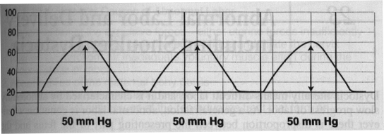
First Stage of labor
Patterns of Uterine Activity
  Expressed in terms of Montevideo Units
  It is the product of intensity of a contraction in mm Hg multiplied by contraction frequency in 10 minutes

Slide 34
Second Stage of labor
The mother has the desire to bear down with each contraction
During this stage fetal descent must be monitored carefully to evaluate progress
The fetal head could be altered, making the assessment of descent more difficult

Slide 35
Second Stage of labor
Molding, the alteration of the relationship of fetal cranial bones to each other in result of compression
Caput, a localized, edematous swelling of the scalp caused by pressure of the cervix on the presenting portion of the head

Slide 36
Second Stage of labor
The development of either or both molding and caput can create a false impression of fetal descent
The accepted upper limit of this stage is 2 hours in nulliparous and 1 hour in multiparous with an additional hour for each in the presence of epidural anesthesia

Slide 37
Second Stage of labor
Length of the 2nd Stage
Characteristic Primipara Multipara
Duration of 1st stage 6 - 8 hr. 2 – 10 hr.
Rate of Cervical Dilatation 1 cm/hr. 1.2 cm/hr.
during active phase
Duration of 2nd stage 30 min. to 3 hr. 5 – 30 min.
Duration of 3rd stage 0 – 30 min. 0 – 30 min.
Duration of 4th stage up to 6 hr. Up to 6 hr.

Slide 38
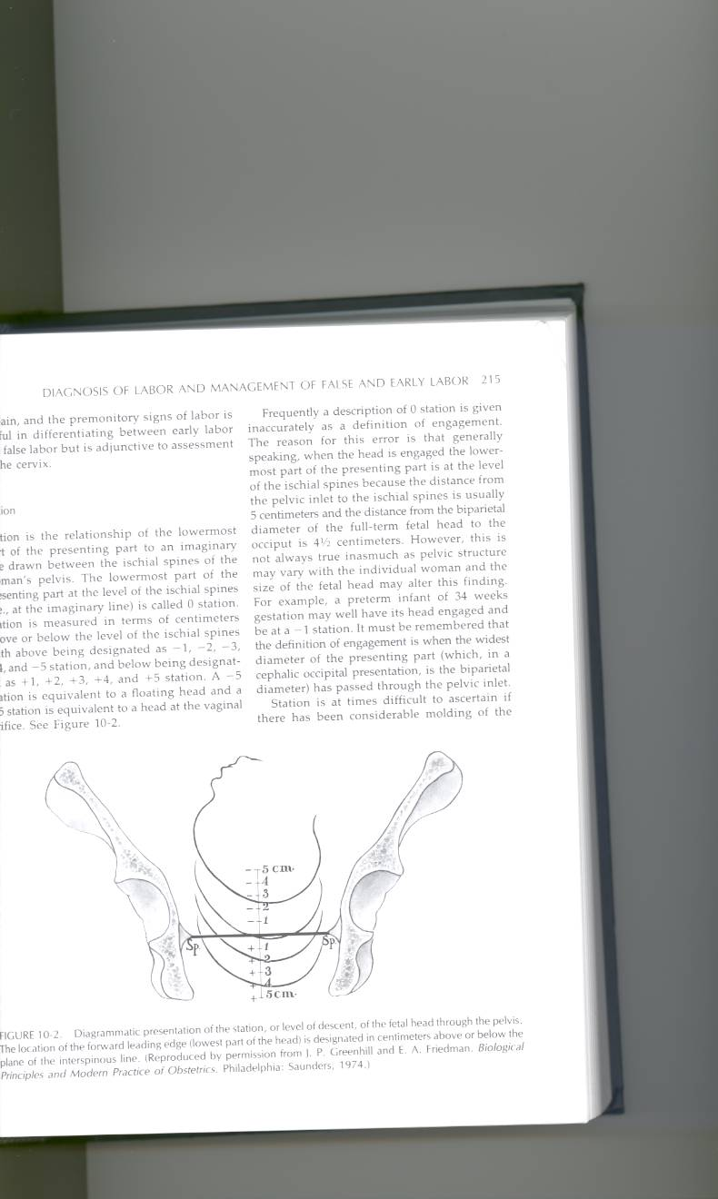
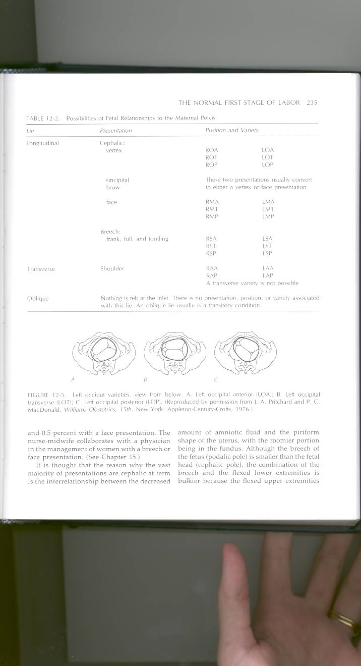
Second Stage of labor
Measurement of progress is by
Descent
Flexion
Rotation

Slide 39
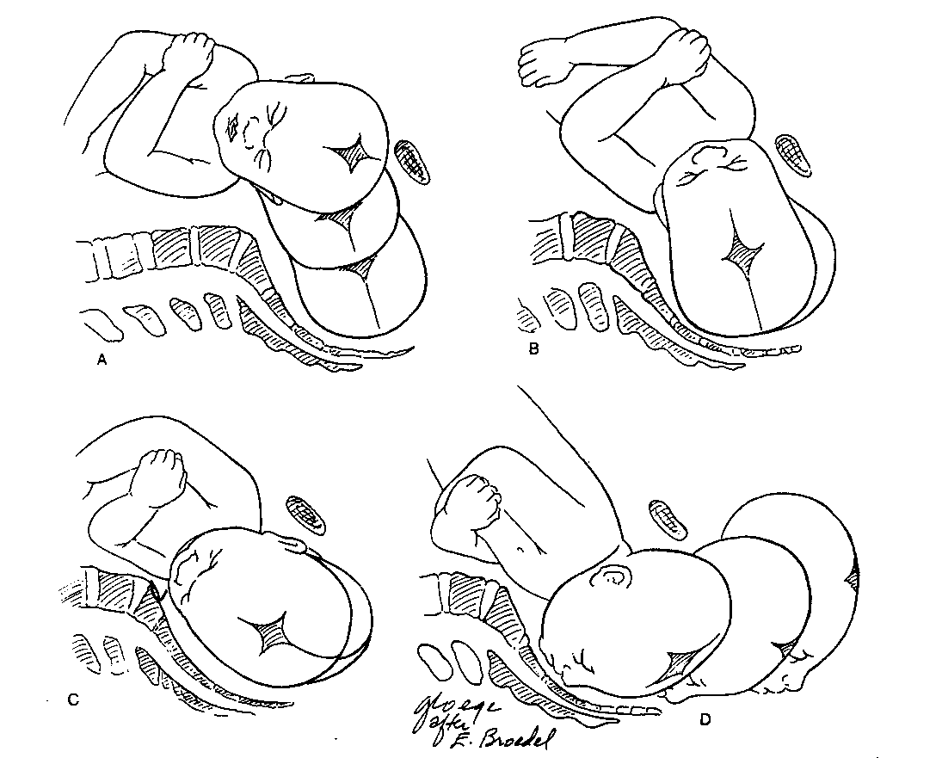
Second Stage of labor
The SIX movements of labor
Descent
Flexion
Internal rotation
Extension
External Rotation
Expulsion

Slide 40
Second Stage of labor
Descent
It is brought about by the force of:
  Uterine Contraction
  Maternal Bearing Down
  Gravity (if patient is upright)
  It continues progressively until the fetus is born, the other movements are superimposed on it.

Slide 41
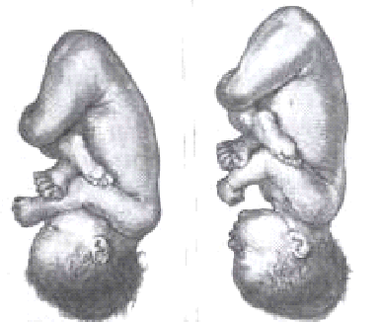
Second Stage of labor
Flexion
Result from:
  Natural muscle tone on the fetus.
  Resistance from the cervix, walls of the pelvis and pelvic floor.

Slide 42
Second Stage of labor
Flexion
Occipitoanterior Position
Occipitofrontal diameter changes to the smaller suboccipitobregmatic
Occipitoposterior Position
Complete flexion may not occur that changes the presentation to brow or even face presentation.

Slide 43
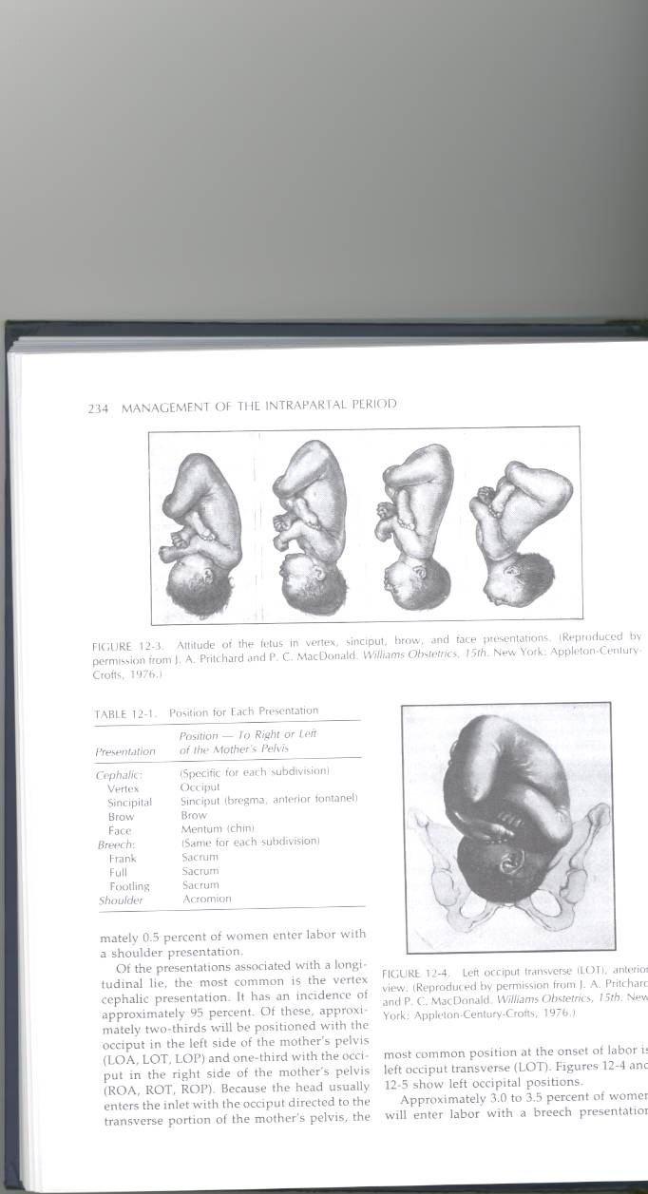
Second Stage of labor
Flexion
Occipitofrontal
11 cm
Submentobregmatic
9.5 cm
Face Presentation
Suboccipitobregmatic
9.5 cm
Vertex or occiput
Supraoccipitomental
13.5 cm
Brow presentation

Slide 44
Second Stage of labor
Internal Rotation
Results in orienting the sagittal suture in the anteroposterior axis of the pelvis
Caused when the fetal head meets the muscular sling of the pelvic floor
Often not accomplished till the presenting part is engaged (zero station)

Slide 45
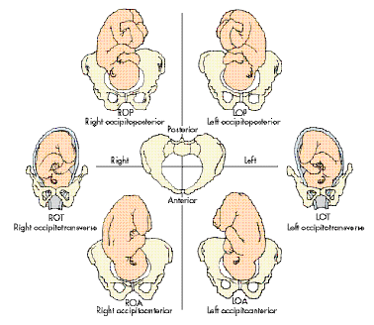
Second Stage of labor
Internal Rotation
Rotation could exceed 90° positioning the occiput under the Symphysis pubis or in the hollow of the sacrum
A significant percentage of fetuses commencing labor in the Occipitoposterior position rotate to the Occipitoanterior position

Slide 46
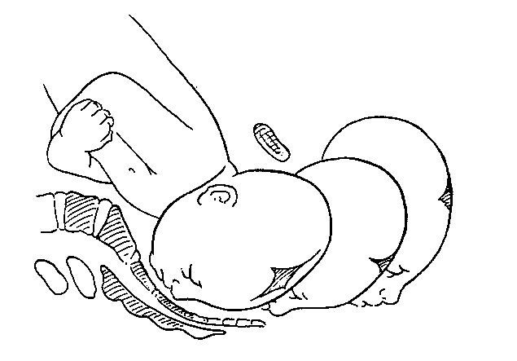
Second Stage of labor
Extension
Occipitoanterior position
Because the vaginal outlet is directed upward and forward, extension must occur before the head can pass through it
As it continues to descend bulging of the perineum followed by crowning occurs
The head is born by rapid extension as the occiput, sinciput, nose, mouth then chin pass over the perineum
Notes:
Crowning occurs when the largest diameter of the fetal head in encircled by the vulvar ring at this time the vertex has reached +5 station

Slide 47
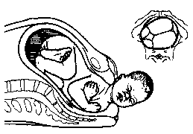
Second Stage of labor
External Rotation
The delivered head returns to it’s original position at time of engagement to align itself with the back and shoulders
Further head rotation may occur as the shoulders undergo an internal rotation to align themselves anteroposteriorly within the pelvis

Slide 48
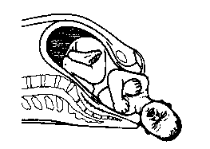
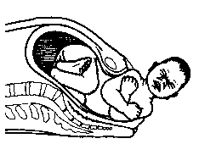
Second Stage of labor
Expulsion
Following external rotation of the head, the anterior shoulder delivers under the Symphysis pubis, followed by the posterior shoulder over the perineal body and the body of the child

Slide 49
Second Stage of labor
Management
Maternal position
Bearing down
Fetal monitoring
Vaginal examination
Delivery of the fetus
With the exception of avoiding
the supine position the mother
may assume any comfortable
position for effective bearing
down.
cleansing with antiseptic
solution and draping is applied
left lateral position in patients
with hip or knee joint
deformities that prevent
adequate flexion or with DVT

Slide 50
Second Stage of labor
Management
Maternal position
Bearing down
Fetal monitoring
Vaginal examination
Delivery of the fetus
the mother should be
encouraged to hold her
breath and bear down
with expulsive effort
this is particularly important
for patients with regional
anesthesia because their
reflexes sensation may be
impaired

Slide 51
Second Stage of labor
Management
Maternal position
Bearing down
Fetal monitoring
Vaginal examination
Delivery of the fetus
the fetal heart rate should be
monitored continuously or
evaluated every 5 minutes
in patients with obstetric risk
factors
Decelerations with recovery
following the uterine contrac-
tion may normally occur
(head or cord compression)

Slide 52
Second Stage of labor
Management
Maternal position
Bearing down
Fetal monitoring
Vaginal examination
Delivery of the fetus
progress should be recorded
every 30 minutes
attention should be paid to
the descent, flexion, extent
of internal rotation and the
development of molding or
caput

Slide 53
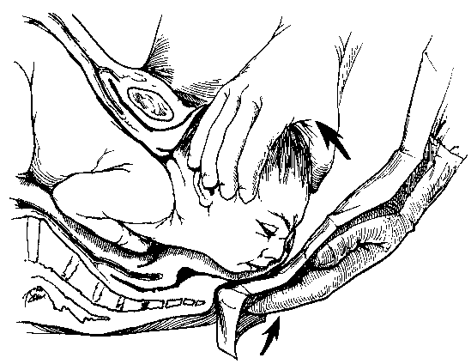
Second Stage of labor
Management
Delivery of the fetus
  An episiotomy may be preformed with flattening of the perineum and crowning of the head
  The Ritgen maneuver is preformed to allow a controlled delivery by
    increasing extension of the head
    prevents it from slipping back between contractions.
    to prevent rapid extension of the head

Slide 54
Second Stage of labor
Management
Delivery of the fetus
  The oral cavity is cleared initially and then the nares are cleared of blood and amniotic fluid using a bulb suction
  Suction of the nares is NOT preformed if FETAL DISTRESS or MECONIUM-STAINED LIQUOR is present because it may result in gasping and aspiration of pharyngeal contents
  A second towel is used to wipe secretions from the face and head

Slide 55
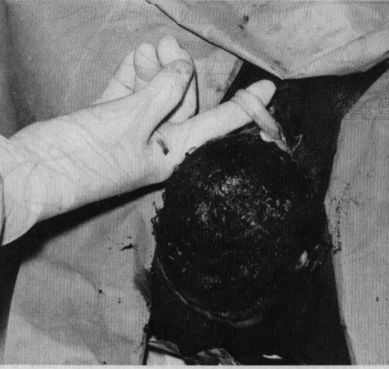
Second Stage of labor
Management
Delivery of the fetus
  An index finger is used to check the presence of Nuchal Cord
  If so, the cord can be slipped over the infants head or it can be cut between two clamps if it was too tight

Slide 56
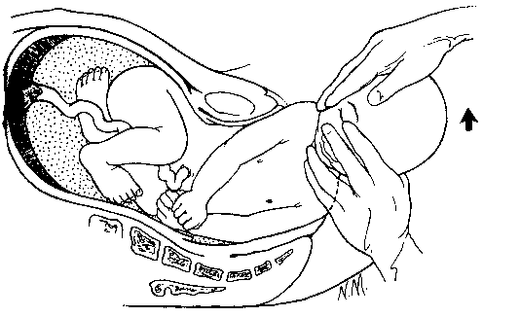
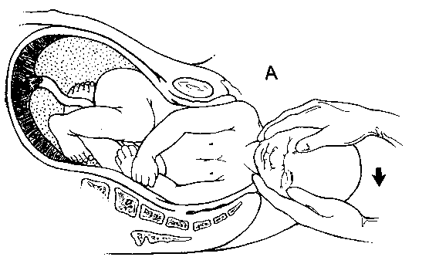
Second Stage of labor
Management
Delivery of the shoulders
  Delivery of the shoulders with gentle traction on the externally rotated head
  The Brachial plexus may be injured if excessive force is used

Slide 57
Second Stage of labor
Management
Delivery of the fetus
  The baby should not be held below the level of the mothers introitus to prevent infusion of blood from the placenta into the newborn.
  Clamping the cord within 15 to 20 seconds. Delay in clamping can result in neonatal hyperbilirubinemia
  Placing the newborn under an infant warmer

Slide 58
Third Stage of labor
Immediately after delivery of the fetus the cervix and vagina should be inspected thoroughly for lacerations and surgical repair preformed if necessary before the separation of the placenta as no uterine bleeding should be present to obscure the visualization at this time

Slide 59
Third Stage of labor
Length of the 3rd Stage
Characteristic Primipara Multipara
Duration of 1st stage 6 - 8 hr. 2 – 10 hr.
Rate of Cervical Dilatation 1 cm/hr. 1.2 cm/hr.
during active phase
Duration of 2nd stage 30 min. to 3 hr. 5 – 30 min.
Duration of 3rd stage 0 – 30 min. 0 – 30 min.
Duration of 4th stage up to 6 hr. Up to 6 hr.

Slide 60
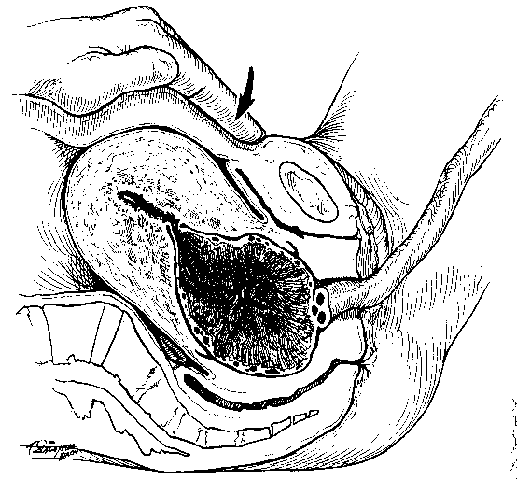
Third Stage of labor
Squeezing of the fundus to help in placental separation is not recommended because it may increase the likelihood of passage of fetal cells into the maternal circulation
Only when signs of placental separation appear should the assistant attempt traction on the cord
  The uterus becomes firm and globular
  Fresh show of blood from the vagina
  Rising up of the uterine fundus
  Lengthening of the cord
Notes:
Brandt-Andrews maneuver (an abdominal hand secures the uterine fundus to prevent uterine inversion while the other hand exerts sustained downward traction on the umbilical cord)
Créde maneuver (the cord is fixed with the lower hand while the uterine fundus is secured and sustained upward traction is applied using the abdominal hand). With both methods, care should be taken to avoid avulsion of the cord. We prefer the Brandt-Andrews maneuver

Slide 61
Third Stage of labor
Attention should be paid to any uterine bleeding after delivery of the placenta
Uterine contractions may be hastened by
  Uterine Massage
  Adding 20 unites of oxytocin to the IV after the baby has been delivered

Slide 62
Third Stage of labor
The placenta should be examined to insure it’s complete removal and to detect placental abnormality
Manual removal of the placenta or manual exploration of the uterus or both may be necessary especially in patients with increased risk of P.P.H.

Slide 63
Fourth Stage of labor
The hour immediately following delivery requires close observation of the patient for
  Uterine blood loss
  Vital signs (especially blood pressure and pulse)
It is during this time that postpartum hemorrhage commonly occur due to
  Uterine atony
  Retained placental fragments
  Un-repaired lacerations

Slide 64
Fourth Stage of labor
Occult bleeding may manifest as pelvic pain
Remember that the first sign of hypovolemia is high pulse rate out of proportion of decreased blood pressure

Slide 65
LABOUR TIME FRAMES
Phases/ Stages of labour |  | Nulliparous | Multiparous
Latent phase | Mean time | 6.4 h | 4.8 h
 | Longest | 20.1 h | 13.6 h
Active phase | Mean rate | 3 cm/h | 5.7cm/h
 | Slowest | 1.2cm/h | 1.5cm/h
2nd Stage | Mean time | 1.1 h | 0.4 h
 | Longest | 2.9 h | 1.1 h

Slide 66
Thank you
Questions?

