Slide 1
Spinal injuries
Given by :
Dr. Abdulmonem Alsiddiky, MD, SSCO
Associate professor and Consultant
Pediatric orthopedic and spinal deformities
Prepared by:
Dr. Waleed M. Awwad, MD. FRCSC
Ass. Prof. & consultant spine surgrgeon

Slide 2
Objectives
The ability to demonstrate knowledge of the following:
Basic anatomy of the spine.
Initial assessment and treatment of spinal injuries at the field.
Principle of spinal stability.
Understanding of neurologic syndromes caused by spinal trauma.
Management of Cauda equina syndrome.

Slide 3
Spine Pathology Red Flag Conditions
Beware of:
1) Cauda Equina/severe neurologic injury (perianal numbness, decreased rectal tone, loss of movement in the extremeties).
2) Tumour weakening the vertebrae (causing cord compression or vertebral fracture).
3) Infection weakening bone (causing disc/vertebral destruction or cord compression).
4) Traumatic Spine Fracture (causing vertebral angulation, pain, or neuro compromise).
Remember that spine fracture can occur without trauma.

Slide 4
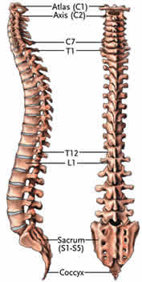
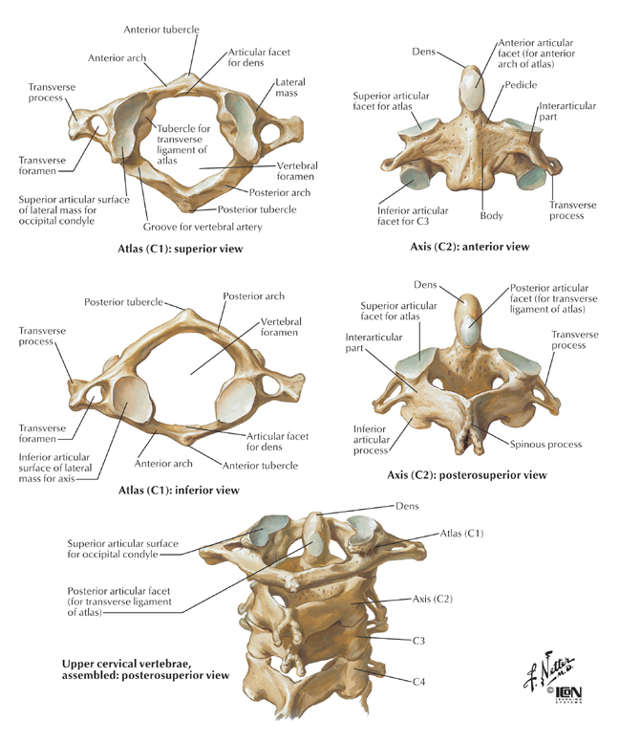
Anatomy

Slide 5
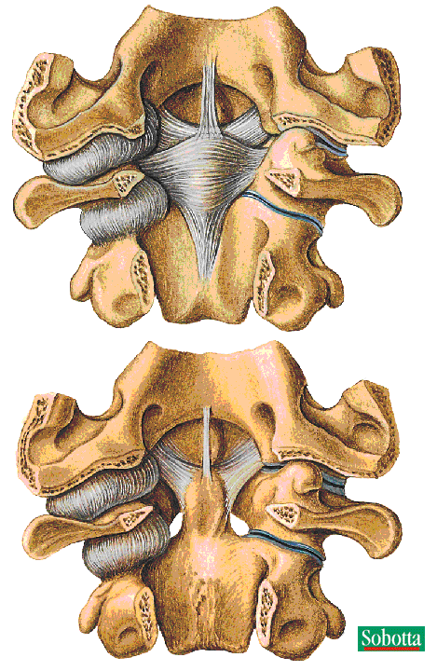
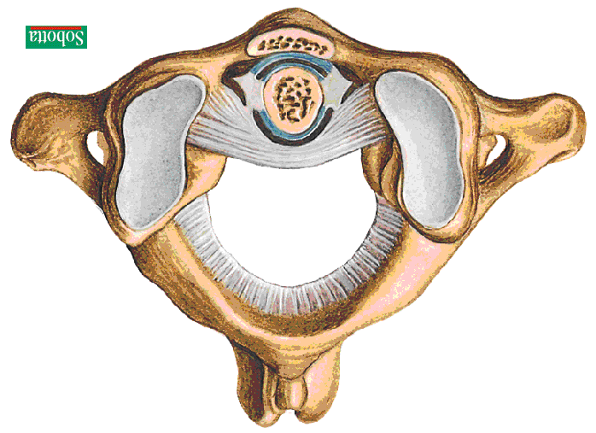
Anatomy

Slide 6
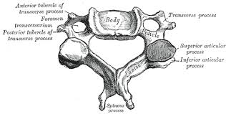
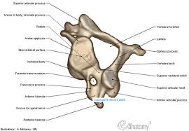
Anatomy

Slide 7
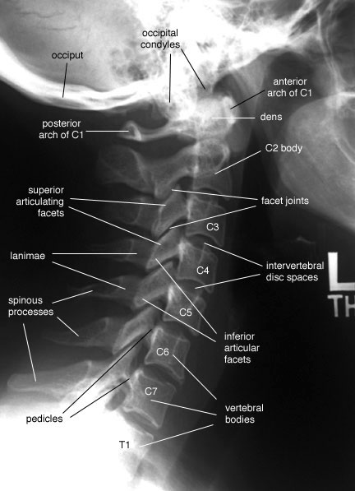
Anatomy

Slide 8
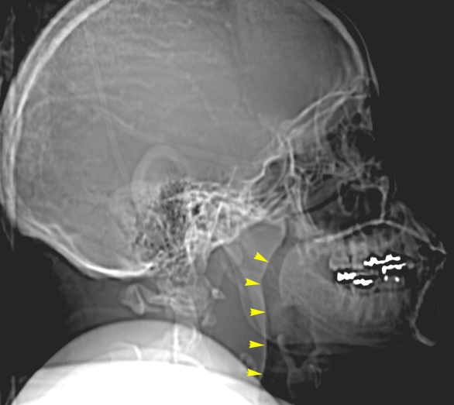
Anatomy

Slide 9
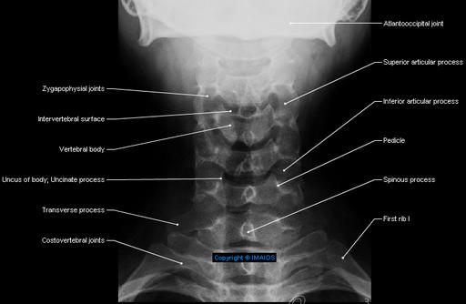
Anatomy

Slide 10
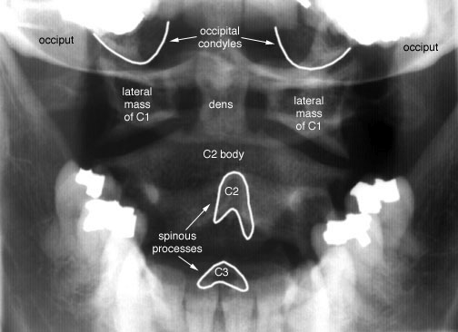
Anatomy

Slide 11
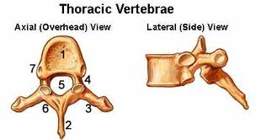
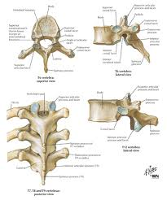
Anatomy

Slide 12
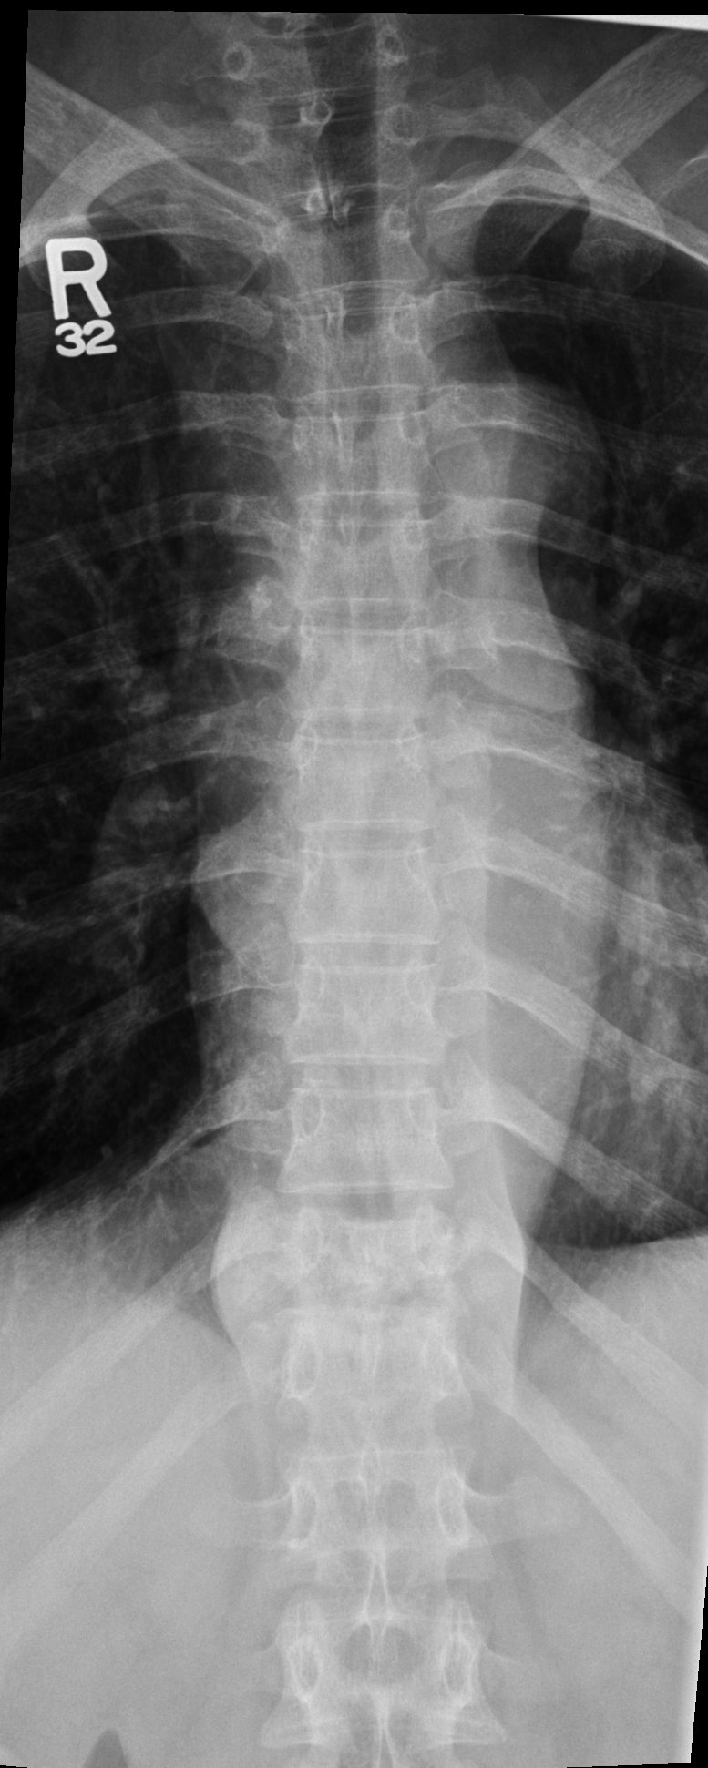
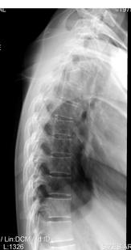
Anatomy

Slide 13
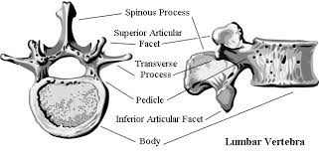
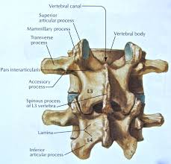
Anatomy

Slide 14
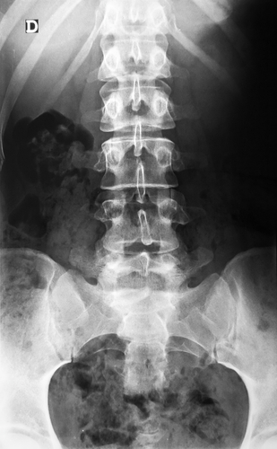
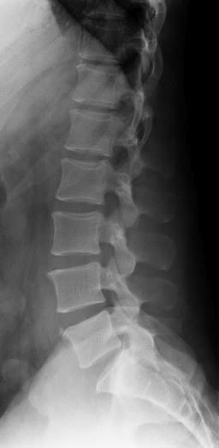
Anatomy

Slide 15
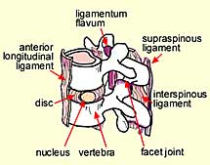
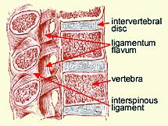
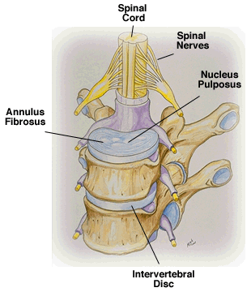
Anatomy

Slide 16
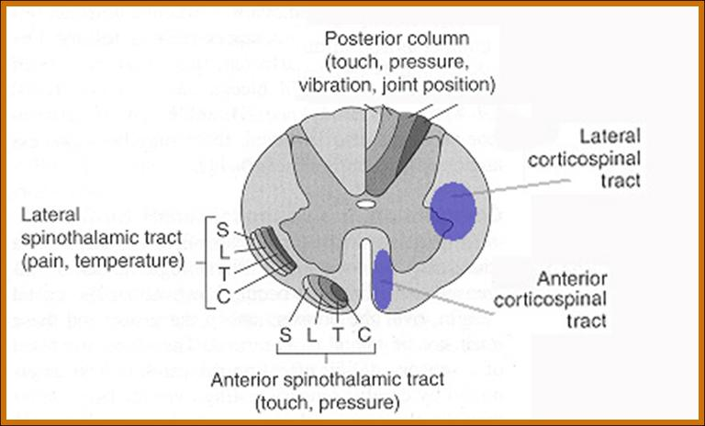
Anatomy

Slide 17
Epidemiology
56000 cases per year.
11000 new spinal cord injuries.
15-20% multiple non-contiguous levels.
10% involving the cervical spine.
90% involving thoracolumbar spine.
25% have neurologic deficit.
Age: mostly between 15-24 years.
Gender: mostly males (4:1).

Slide 18
Mechanism of Injury
High energy trauma such as an MVA or fall from a height or a horse.
MVA: 40-55%
Falls: 20-30%
Sports: 6-12%
Others: 12-21%
Low energy trauma in a high risk patient (ie a patient with known spinal canal compromise such as ankylosing spondylitis, Osteoporosis or metatstatic vertebral lesions)
Penetrating trauma from gunshot or knives.

Slide 19
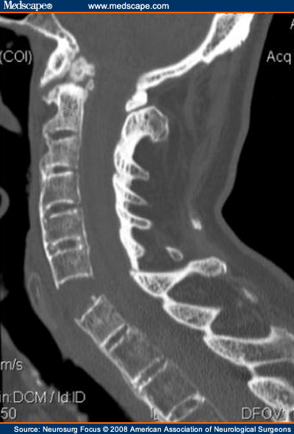
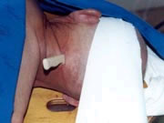
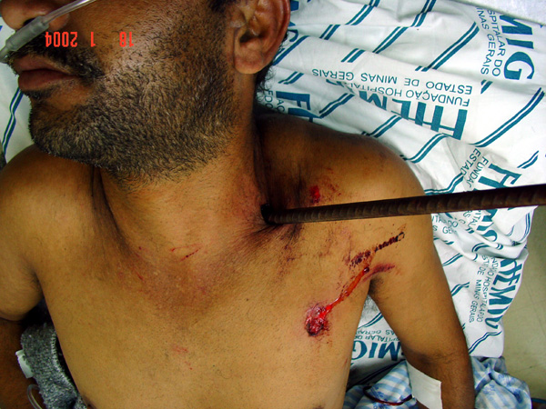
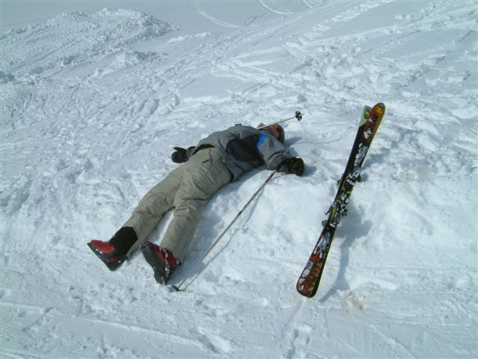
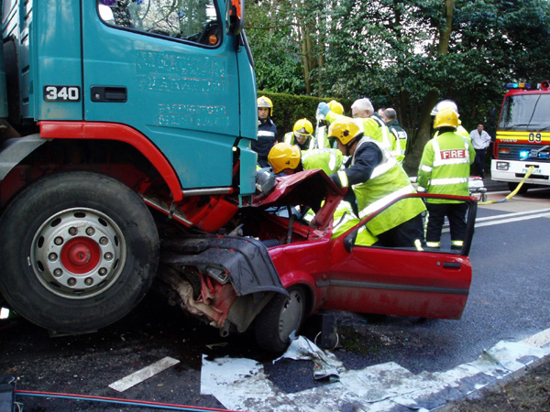

Slide 20
Spine stability
Cervical spine instability:
Compression fracture with 25% loss of height.
Angular displacement > 11 degrees.
Translation > 3.5mm.
Disc space separation >1.7mm.
Thoracic and lumbar spine: Denis three column.

Slide 21
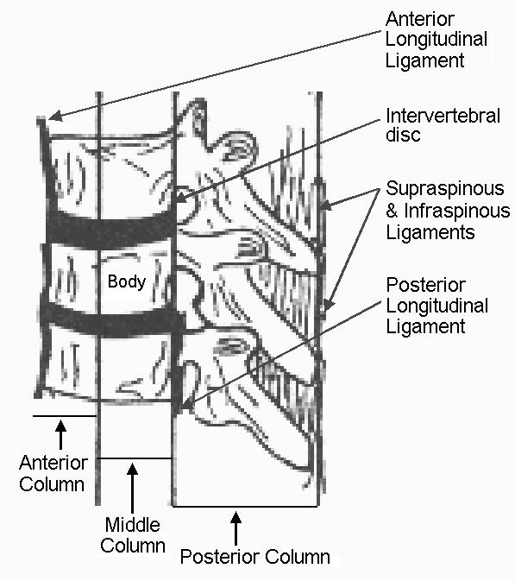
The Three columns
Instability exists with disruption of any two of three columns.

Slide 22
Assessment
In cases of trauma, ABCDE’s must be assessed first and treated appropriately.
Patients should be examined with cervical collar until spinal pathology is excluded.
Careful log rolling keeping the head, neck and pelvis in line should be done to examine the spine properly.

Slide 23
Assessment
Immobilization.
History:
Mechanism of injury:
compression, flexion, extension, distraction
Other injuries.
Seat belt.
Other causes.
Physical examination:
Inspection, palpation.
Neurologic examination.

Slide 24
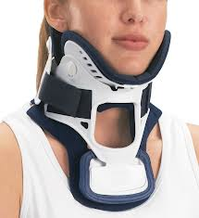
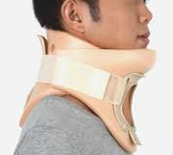
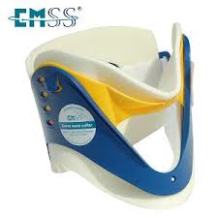
Immobilization

Slide 25
Neurologic
Muscle Test
Sensory exam
light touch, Sharp dull discrimination, Vibration sense, Proprioception and two-point discrimination
Reflexes

Slide 26
Signs of Spinal Trauma
Apnea, lower cranial nerve injury VIII-XII (high C-spine).
Deformity of the spine or neck.
Tenderness on palpation along spinal processes.
Paralysis or muscle weakness (which spinal level).
Loss of sensation (which dermatones).
Loss of rectal tone.
Positive Babinski sign.

Slide 27
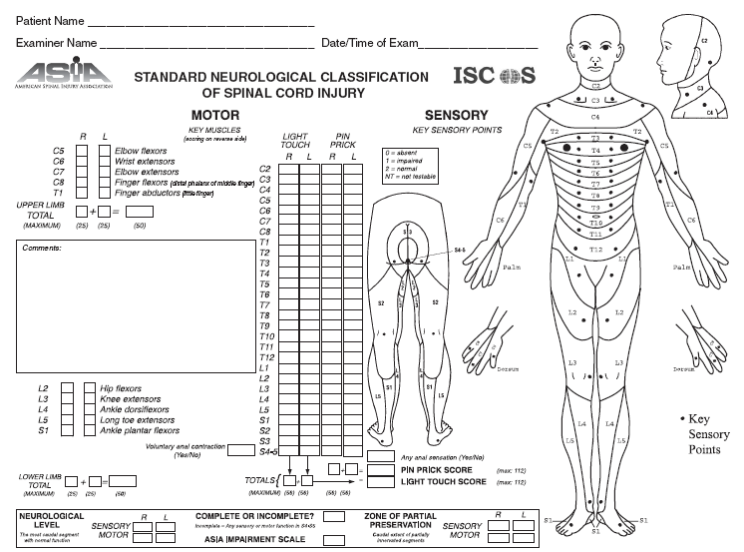
Asia Score: Brief Trauma Neurologic Survey

Slide 28
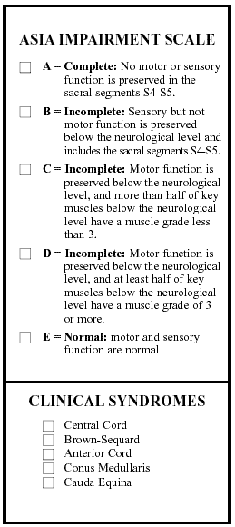
Prognosis for Recovery of spinal Cord Injury:
Level of Cord Injury determines level of function
Poor prognosis for recovery if:
-pt arrives in shock
-pt cannot breath
-pt has a complete injury

Slide 29
Assessment
Severity of neurologic deficit
Complete
Flaccid paralysis below level of injury.
May involve diaphragm if injury above C5.
Sympathetic tone loss if fracture above T6.
Incomplete
? Any sensation.
? Sacral spairing.

Slide 30
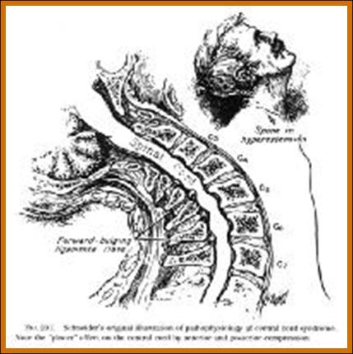
Assessment
Severity of neurologic deficit
Incomplete
Central cord syndrome:
# Characterized by disproportionally (UL>LL).
# Mechanism: hyper-extension.
# Occur with or without fractures.
# Recovery: 50% regaining function.
# Prognosis is fair.

Slide 31
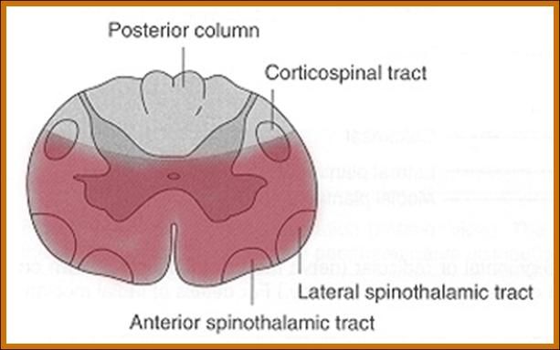
Assessment
Severity of neurologic deficit
Incomplete
Anterior cord syndrome:
# Characterized by loss of corticospinal and spinothalamic tract with preserved posterior column.
# Mechanism: ischemia or infarction to spinal cord..
# Common injury.
# Recovery: 10%.
# Prognosis is good if progressive recovery within 24hrs, absent SS after 24hrs protends a poor outcome.

Slide 32
Assessment
Severity of neurologic deficit
Incomplete
Brown-Sequard syndrome:
# Characterized by hemicord injury with ipsilateral paralysis, loss of proprioception and light touch, and contralateral temperature and sharp pain loss.
# Prognosis is good, with over 90% regaining of bowel and bladder function and ambulatory capacity.

Slide 33
Assessment
Severity of neurologic deficit
Incomplete
Conus Medullaris syndrome:
# Seen in T12-L1 injuries.
# Loss of voluntary bowel and bladder control with preserved lumbar root function.
# Uncommon as pure lesion (mixed conus-cauda).

Slide 34
Assessment
Severity of neurologic deficit
Incomplete
Cauda Equina syndrome:
# Saddle anesthesia, urinary retention and stool incontinence.
# Usually due to large central disc herniation rather than fracture.
Nerve root deficit: LMN

Slide 35
Spinal Shock
Transient loss of spinal reflexes.
Lasts 24-72 hours.
Neurogenic shock
Reduced tissue perfusion due to loss of sympathetic outflow and un-apposed vagal tone. Injury above T6 level.
Peripheral vasodilatation (hypotension and bradycardia).
Rx: fluid resuscitation and vasopressors.

Slide 36
Imaging
X-rays:
Cervical: 3 views.
AP, lateral and open mouth.
Thoraco-lumbar: 2 views.
AP & lateral.
Flexion-Extension views.
CT: best for bony anatomy.
MRI: best to evaluate soft tissue.

Slide 37
Management of Spinal Injuries
Depends on:
Level of injury.
Degree and morphology of injury: STABILITY
Presence of neurologic deficit.
Other factors.

Slide 38
Some general rules:
Stable injuries are usually treated conservatively.
Unstable injuries usually require surgery.
Neurologic compression requires decompression.

Slide 39
Specific Injuries

Slide 40
Cervical spine fractures
Descriptive: depends on mechanism of injury.
Flexion/extension.
Compression/distraction.
Shear.
Presence of subluxation/dislocation
SCI:
High level fracture results in quadriplegia.
Low level fracture results in paraplegia.

Slide 41
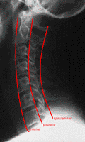
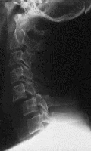
Cervical spine fractures

Slide 42
Thoraco-Lumbar fractures
Spinal cord terminates at L1/2 disc in adult
L2/3 in a child
50% of injuries occur at Thoraco-lumbar junction.
Common fractures:
Wedge fracture (flexion/compression).
Burst (compression).
Chance (flexion/distraction).

Slide 43
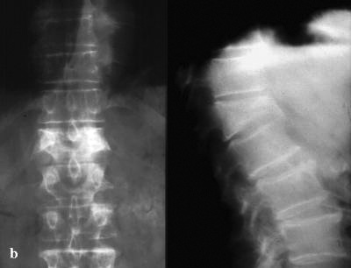
Wedge fracture

Slide 44
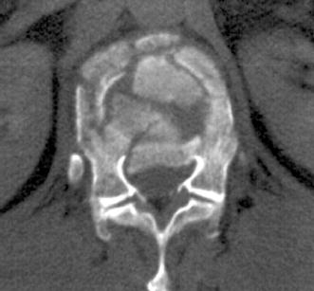
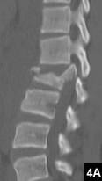
Burst fracture

Slide 45
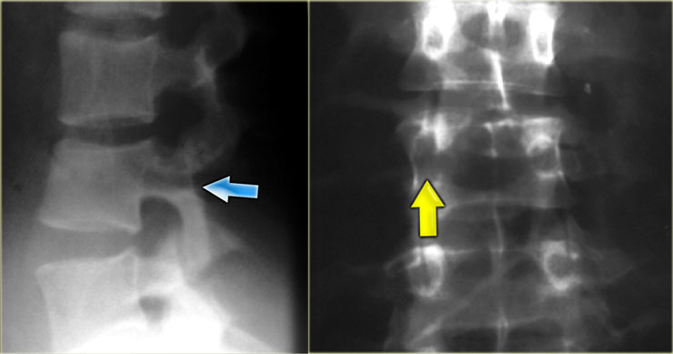
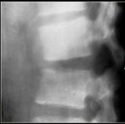
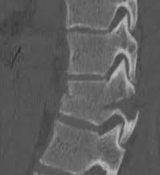
Chance fracture

Slide 46
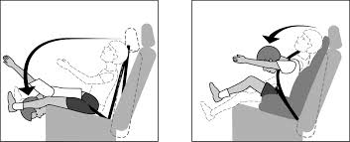
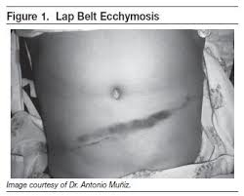
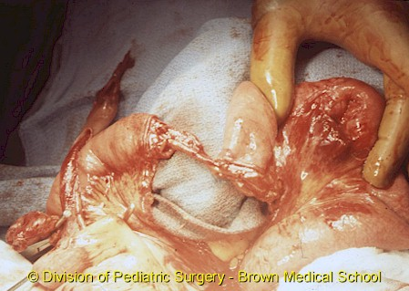
Chance fracture

Slide 47
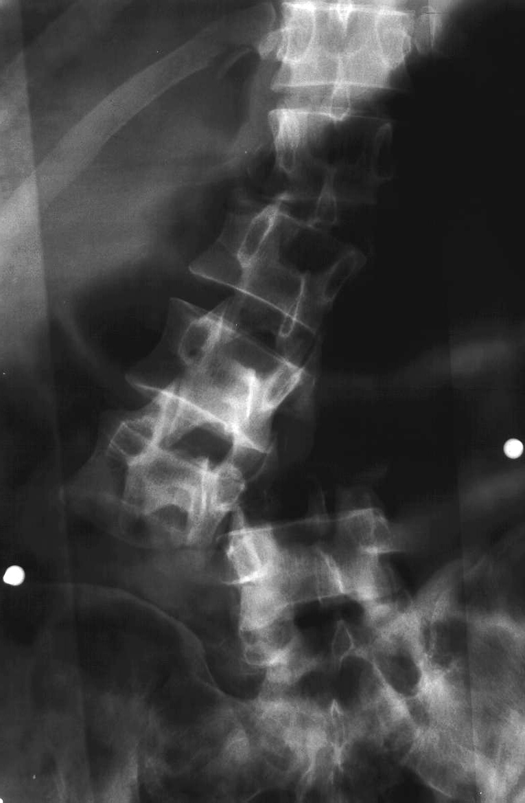
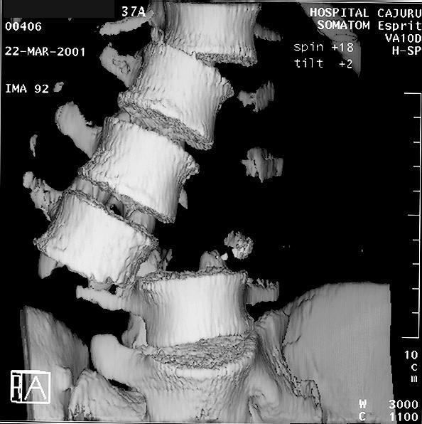
Fracture dislocation

Slide 48
Pathologic fractures
Low-energy fractures.
Osteoporotic is common.
Usually due to infection or tumour.
X-rays: “winking owl” sign.

Slide 49
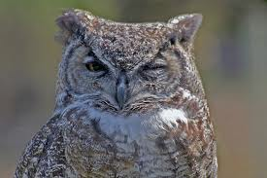
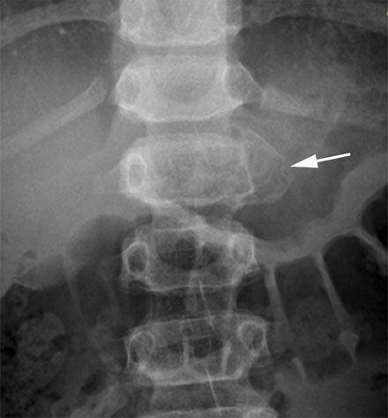
Pathologic fractures

Slide 50
Cauda Equina Syndrome
A surgical emergency.
Requires full neurologic examination including rectal examination for anal tone.
Investigations: X-rays initially, but MRI is mandatory as X-rays are usually unremarkable.
Treatment: Emergency decompression-usually discectomy and wide laminectomy within 24 hours.

Slide 51
Cauda Equina Causes
Disc hernia
Central disc prolapse.
Burst fractures of lumbar spine.
Penetrating injuries such as stab wounds or bullets.
Epidural hematoma from spinal anesthesia, or post surgery(rare).
Tumours compressing the lower spinal nerve roots.
Spinal Stenosis.
Tumor
Burst fracture
Bullet to cauda

Slide 52
Cauda Equina Syndrome

Slide 53
thanks

