Slide 2
فريق المحتوى العلمي
فعاليات اليوم الأول 1436-1437هـ

Slide 3
Fourth Year

Slide 4
What is going to happen?
Learn about different subspecialties.
Divided into two groups.
Year is divided into 3 cycles:
OBGYN, Anesthesia.
ENT, Ophthalmology, Orthopedics.
Primary Health Care, Psychiatry, Dermatology.
One month mandatory elective.

Slide 5
General Tips
What is going to happen?
Lectures and sessions:
Be punctual.
Prepare before hand.
Communicate effectively.
Patient confidentiality:
Don’t tweet, instagram, or share anything on a social media that would identify the patient.
Don’t share anything without the patient’s consent.
Exams
Study as soon as possible, don’t cram.
Practice history and physical examination of every specialty.
Uniform:
Surgery scrubs, white scarf.
Learn about different subspecialties.
Divided into two groups.
Year is divided into 3 cycles:
OBGYN, Anesthesia.
ENT, Ophthalmology, Orthopedics.
Primary Health Care, Psychiatry, Dermatology.
One month mandatory elective.

Slide 6
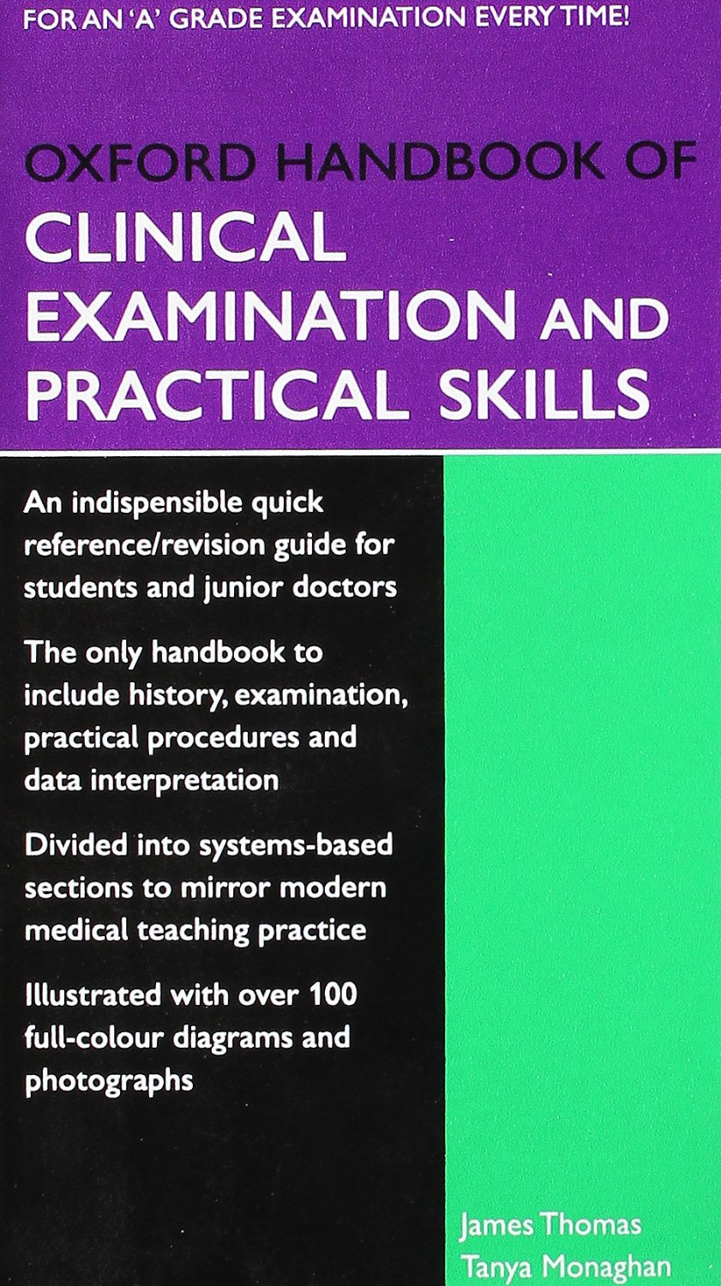
General Format
General Tips
In the Clinics:
You are expected to:
Observe.
Take patient’s history.
Perform a physical examination.
Answer questions: differential diagnosis, treatment, medications, etc.
Each specialty has its own evaluation sheet and log book.
Carry around a pocket book or your tablet with one of the books you’re reading to look up any information.
Ask previous years about the doctors you will be attending with as its important to know what to expect.
You won’t rotate with all the doctors and subspecialties.
Lectures.
Clinical rotations.
Other activities:
PBL.
CBL.
Clinical Skills.
Presentations.
DxR.
Exams:
MCQ.
OSCE.
Written:
SAQ.
MEQ.

Slide 7
General Format
Lectures.
Clinical rotations.
Other activities:
PBL.
CBL.
Clinical Skills.
Presentations.
DxR.
Exams:
MCQ.
OSCE.
Written:
SAQ.
MEQ.
first Cycle

Slide 8
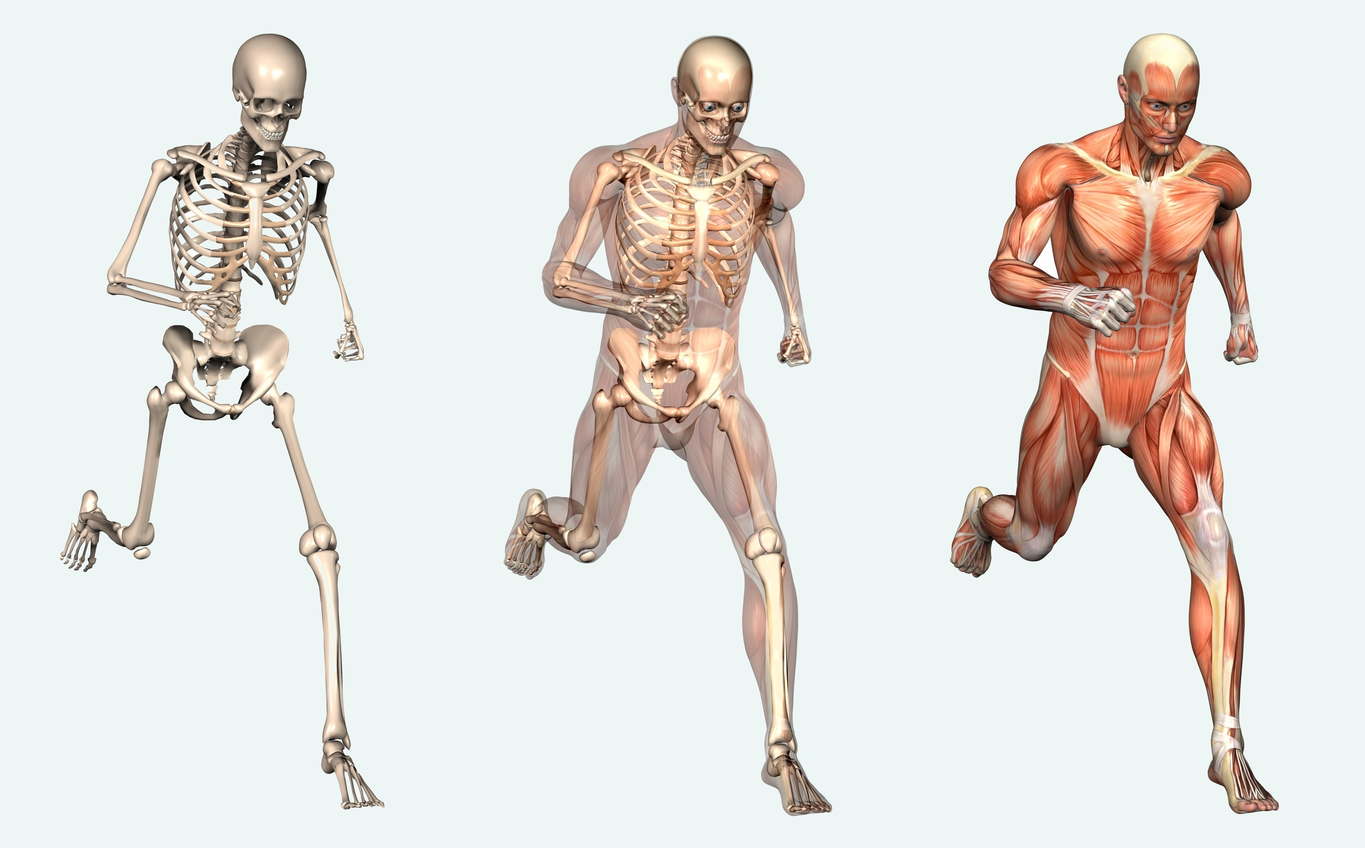
General Format
Orthopedics
Credit hours: 6
Lectures.
Clinical sessions:
History taking.
Physical examination.
Clinical skills:
Casting.
Reduction.
Knee aspiration.
Case based learning.
Lectures.
Clinical rotations.
Other activities:
PBL.
CBL.
Clinical Skills.
Presentations.
DxR.
Exams:
MCQ.
OSCE.
Written:
SAQ.
MEQ.

Slide 9
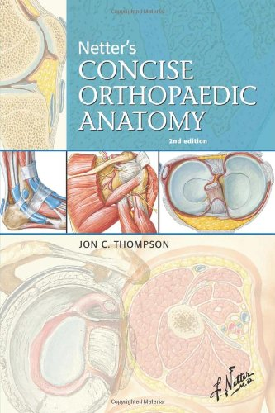
General Format
Orthopedics
Sources
Grades
Lectures.
Clinical rotations.
Other activities:
PBL.
CBL.
Clinical Skills.
Presentations.
DxR.
Exams:
MCQ.
OSCE.
Written:
SAQ.
MEQ.
Final
MCQ (40%) (pictures on a laptop + questions on a paper)
OSCE (40%)
History Taking
Physical examination
Clinical skills
Continuous Assessment
Case based learning (10%) (attendance + presentation)
History taking at OPD (5%)
Hands-on skills sessions (5%)
Lecture notes. (most IMP)
Ortho 430 team notes + 429 team notes in some lectures.
OSCE: (department OSCE checklist + YouTube videos for EX + know who to DX from the lectures) )
Optional:
Apley’s.
Netter’s.

Slide 10
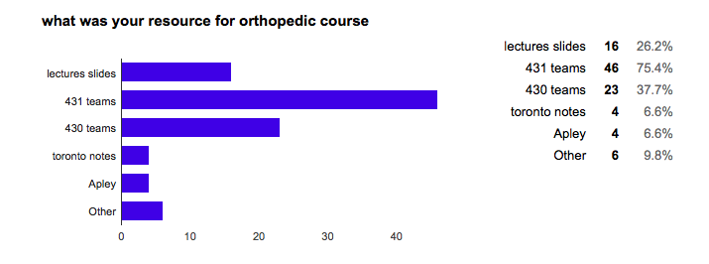
Other: 429, 428 teams, orthobullets.com, Netter’s concise orthopedic anatomy,lectures recording

Slide 11
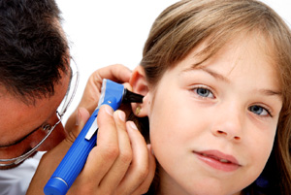
General Format
ENT
Credit hours: 4
Lectures:
First two weeks along with Optha (3 days ENT + 2 days optha)
Clinical sessions:
Attending clinics:
History taking.
Physical examination.
Rounds. (pre/post op)
OR.
Audiology lab.
Communication/Speech disorder clinic.
Lectures.
Clinical rotations.
Other activities:
PBL.
CBL.
Clinical Skills.
Presentations.
DxR.
Exams:
MCQ.
OSCE.
Written:
SAQ.
MEQ.

Slide 12
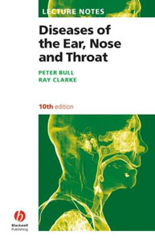
ENT
Grades
Sources
Exams
MCQ (30%)
SAQ (40%)
OSCE (20%)
Clinical evaluation (10%)
Lecture.
430 and 429 team notes.
Toronto notes.
Department objectives handout.
Lecture notes book.
2 stations OSCE: (checklists for Hx and EX + Dr. Manal notes)
SAQ: (Previous SAQs + go back to lectures)
Evaluation: (Toronto notes
Or lectures + OSCE resources)

Slide 13
Other: 428, 429 teams, Lecture notes: diseases of ear nose and throat, Hajar PBL

Slide 14
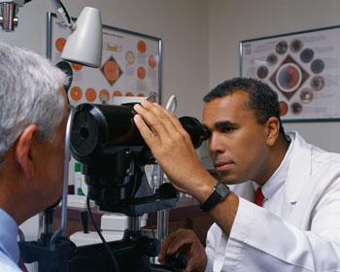
Ophthalmology
Credit hours: 4
Lectures:
First two weeks along with ENT.
Clinical Rounds:
Clinics.
ER.
Clinical Skills.

Slide 15
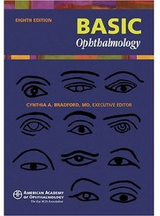
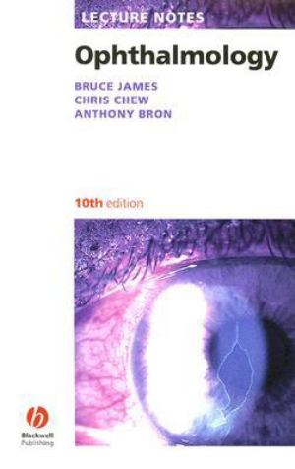
Ophthalmology
Grades
Exams :
MCQ (30%)
SAQ (40%)
OSCE (20%)
Fundoscopy
Complete eye examination
Clinical evaluation (10%)
Sources
Toronto notes.
Lecture Notes.
Basic Ophthalmology.
Essentials of Ophthalmology.

Slide 16
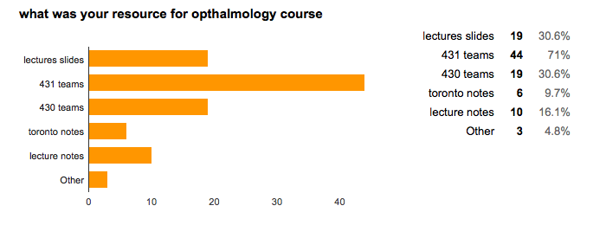
Other: ophtobook, 429 teams

Slide 17
second Cycle

Slide 18
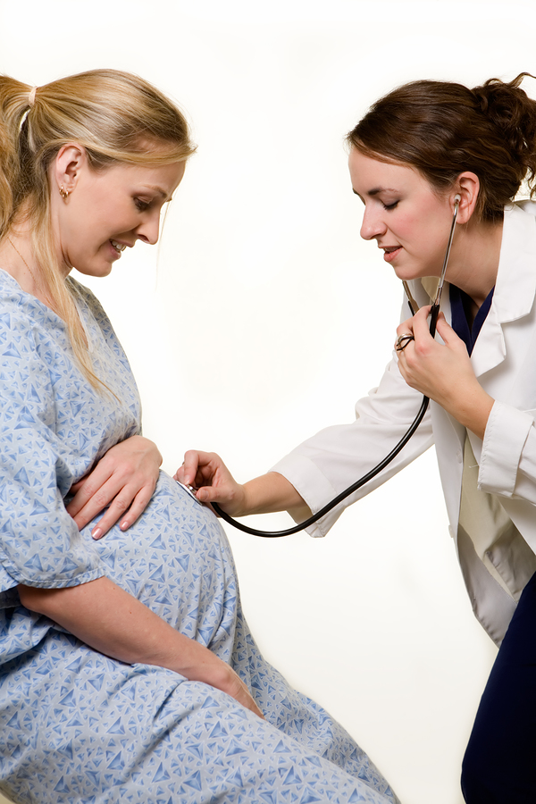
OBGYN
Credit hours: 8
First three Weeks: including the patient safety lectures.
Theory lectures.
Tutorials.
Four weeks: (logbook+ writing cases)
Clinical rotation: history, physical examination.
Sessions with doctors.
Attending clinics.
Attending surgeries.
On call: delivery room, ER. (2 days only)

Slide 19
OBGYN
Grades:
Midterm
Case based MCQs. (20%)
Final (60%)
Case based MCQs. (30%)
OSCE: (30%) :
Oral stations.
Written stations.
DXR. (10%)
Clinical assessment: (10%)
Logbook.
Attendance.

Slide 20
OBGYN
Sources
MCQ 428 + 429 + 430.
Kaplan videos + kaplan book.
Lectures’ slides.
Sakala book. (high yield)
428 team booklet.
OSCE: (quick copy gyneo B OSCE notes + instrument booklet + 430 OSCE team for HX and EX + YouTube PV EX)
Crash course obgyne.
Clinical Sessions.
Optional:
Toronto notes.
Sakala BRS or high yield.
Essentials of Obstetrics and Gynecology (Hacker and Moore’s)
Fundamentals.
All GYNE MCQ.
TEAM 429.

Slide 21
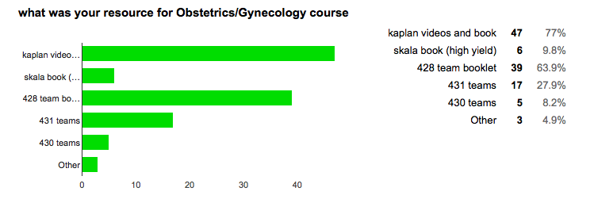
Other: essentials by hacker and moore

Slide 22
Anesthesia
Credit hours: 4
Two weeks:
Morning lectures
Afternoon clinical skills:
Applying theoretical concepts.
Attending OR, recovery room, pro/post op sessions, ER.
Observing procedures.
History taking.
Physical examination.

Slide 23
Anesthesia
Grades
Sources
Final:
MCQ (40%)
OSCE (50%)
Clinical Sessions: (10%)
Logbook
Attendance
MCQ 429 + 430!!.
Revision Session!.
Anesthesia 430 notes. (lecture recording notes)
OSCE: (our logbook + YouTube videos for EX)
Anesthesia booklet and hand out: (IMP)
KwikKopy

Slide 24
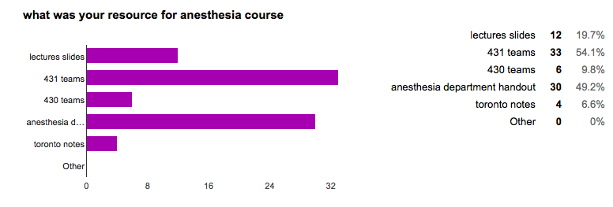

Slide 25
Third cycle

Slide 26
Primary Health Care
Credit hours: 6
Lectures.
Presentations:
Student led seminars.
Case based presentation.
Evidence based presentation.
Clinical Attendance.

Slide 27
Primary Health Care
Grades:
Important Lectures:
Exam
MCQ (30%)
Data interpretation (10%)
OSCE (25%)
Continuous Assessment
SLS (10%)
EBM report and presentaion (10%)
CPD(10%)
Clinics, log book (5%)
Data interpretation.
Diabetes.
Hypertension.
CHD.
Asthma.
Read from the guidelines
Questions are similar to medicine

Slide 28
Other: 430 primary care booklet

Slide 29
Psychiatry
Credit hours: 4
Lectures:
4 weeks along with dermatology.
Clinical Sessions:
Observation.
Fill out logbook.
Clinical Activities Assignment:
History taking.
Physical examination.

Slide 30
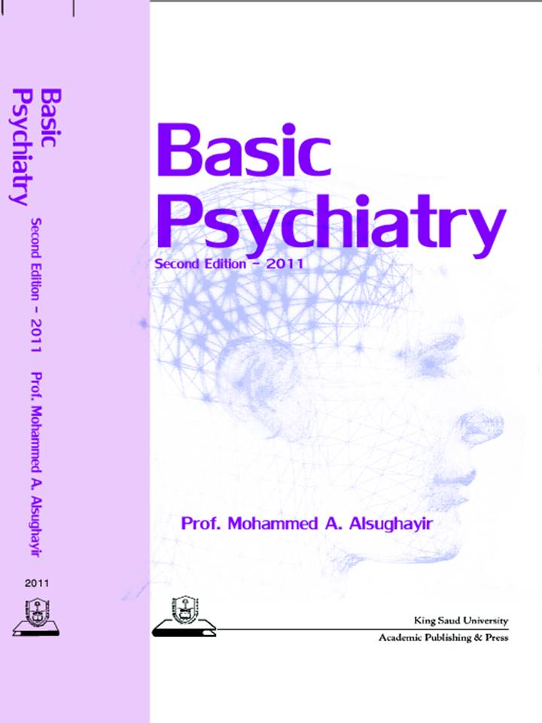
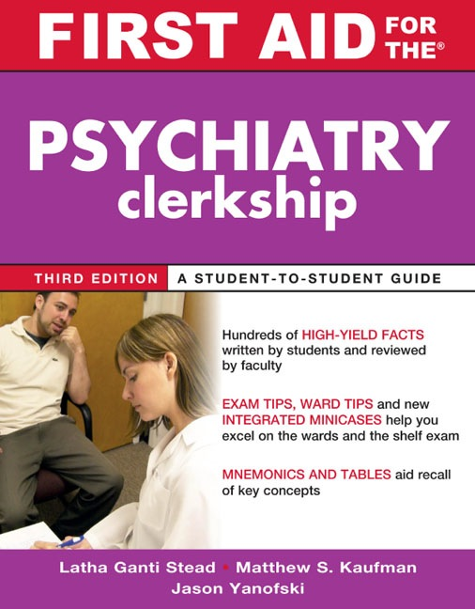
Psychiatry
Grades
Exams:
Quizes(10%)
MEQ (30%)
Final (60%)
MCQ (30%)
OSCE (30%)
1 Video Station.
Simulated patient.
Sources
“Basic Psychiatry” Prof. M.A. SughairManual, Textbook
First Aid for Psychiatry Clerkship.

Slide 31
Other: Lipincott’s pshyciatry

Slide 32
Psychiatry Tips
Avoid psychoanalysing or stereotyping patients, family, friends, or yourself.
People with mental illness are not dangerous.
Anyone can have mental illness.
A diagnosis is not an adjective:
“I keep forgetting, it’s like I have Alzheimer’s”
“You must have ADHD, you can’t concentrate”
Be empathetic not sympathetic.
To understand what a patient is going through, listen to their stories and perspectives:
Eleanor Longden: The voices in my head: http://youtu.be/syjEN3peCJw
A Little bit OCD: http://youtu.be/VszpoKZJO5E
Neil Hilborn - "OCD”: http://youtu.be/vnKZ4pdSU-s

Slide 33
Dermatology
Credit hours: 2
Lectures:
4 weeks along with psychiatry.
Morning lectures.
PBL:
Afternoon session.
Always related to morning lectures.
Clinical rotation:
Tuesdays: morning/afternoon.
Morphology clinic.

Slide 34
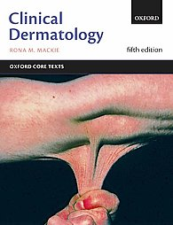
Dermatology
Grades
Sources
Midterm MCQ (30%)
Final
MCQ (30%)
SAQ(30%)
PBL (5%)
Clinical Rotation (5%)
Lectures.
Toronto notes.
Clinical Dermatology
Fitzpatrick Color Atlas

Slide 35
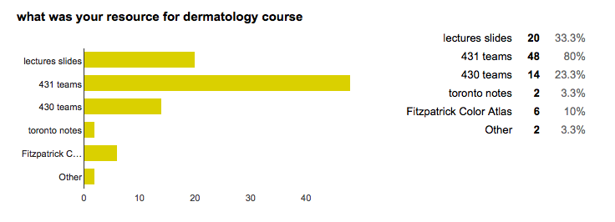
Other: 429 teams

Slide 36
Mandatory elective
Duration: one month.
Credit hours: 3 (supposedly)
A department/specialty/research of your choosing.
Local or abroad.
Advice:
Narrow down your choices to 3 max.
Prepare as soon as possible.
Have a plan B.
If you change your mind, it’s ok.

Slide 37
Writing a Report
Report feedback for the courses to medical education.
Report can include:
Opinions on what you didn’t like about the course and how to change them.
Opinions on what you liked but would like to improve them.
Opinions on what you liked and how you want to keep things the way they are .
Delegate a person to collect comments and feedback to write the report.

Slide 38
In closing
4th year will give you a wider scope of the medical field.
Explore your interests.
Don’t rush to choose a specialty, take your time and experiment.
A lot of information and skills to learn.
Be prepared.
Don’t be afraid to ask for help.
Help each other out.
Work hard and don’t panic.

