Slide 1
Orthopedic Emergencies Compartment Syndrome Acute Joint Dislocation
Saleh WaslAllah Alharbi
Professor
KSU

Slide 2
Objectives Compartment Syndrome (CS)
To explain the pathophysiology of CS.
To identify patients at risk.
To be able to diagnose and manage CS.
To be able to describe the complications of CS.

Slide 3
CS
What is compartment?

Slide 4
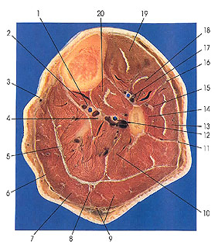
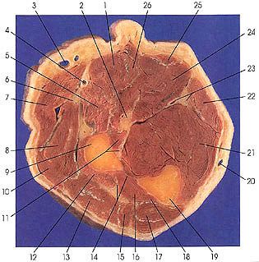
CS
What is compartment?
مقصورة,غرفة, حيز

Slide 5
CS
Normal blood flow is impaired.
Artery- arteriole- capillary- venule- vein.
Tissue perfusion failing.

Slide 6
CS
Hypoxia

Slide 7
CS
BP 120/80 + - 10
Tissue pressure should be less than diastolic pressure by 30 mm Hg.

Slide 8
CS
Definition:
Compartment syndrome develops when there is excessive, sustained increase of local tissue pressure in a closed compartment.

Slide 9
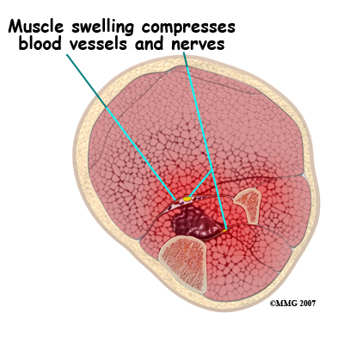
CS
Risk Factors
(edema)
Elevated tissue pressure
Tense tissues
Impaired diffusion / hypoxia
Cell damage
More swelling , more hypoxia
Vicious circle

Slide 11
CS
Local causes:
Trauma (crush, fracture open/closed)
Injection
Bleeding
Prolong vascular occlusion (reperfusion inj)
Burns
Venomous bite
IV extravasation
Post op
Bandages

Slide 12
CS
General causes:
Hypotension
Head injury

Slide 13
CS
Diagnosis
Early
Pain out of proportion to injury
Pain with stretching fingers / toes
Risk factors
High index of suspicion
Measurement of compartment

Slide 15
Diagnosis
Late
Numbness,
parasthesia,
weakness,
Paralysis
Pulseless Tooooo Late

Slide 16
Diagnosis
S/S
Pallor
Altered perfusion
Diminished pulses or pulselessness
Altered capillary refill
Palpable fullness or tenseness of a compartment, the forgotten "P"
Altered sensibility
Pain on passive muscle stretch

Slide 17
CS
Management
Initial ( undeveloped) CS
Remove any bandages/ cast/ brace …
Maintain normal BP
Keep limb at heart level
Regular close monitoring (15-30 min)
Avoid sedation, nerve block ( pt feedback)

Slide 18
CS
Management
Fully developed CS
Above plus
Diuretics to flush kidneys
Urgent surgical decompression (Fasciotomy)

Slide 19
CS

Slide 20
CS

Slide 21
CS
Fasciotomy
Decompress all compartments
Allows muscles to expand
Thus, Reduction compartment pressure
Stops further damage
Should be done very early
If too late, shouldn`t be done

Slide 22
CS
Fasciotomy
Debridement of all necrotic tissue
Second and third debridement needed
Skin closure/graft after few days

Slide 23
CS
Fasciotomy
Indications:
6 hours of ischemia
significant tissue injury
Worsening limb condition
Developed clinical evidence of CS
In doubt

Slide 24
CS
Complications:
Myonecrosis-----Myoglobinuria----kidney tubular damage
Limb contractures/paralysis/sensation loss

Slide 25
CS
Complications:
- Leg: Anterior compartment
(foot drop)
Deep post compartment
(clawed toes/anesthesia sole)
Volar compartment
(acute Volkman’s ischemia/contracture)

Slide 26
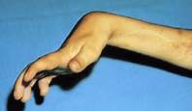
CS

Slide 27
Acute Joint Dislocation AJD
Objectives
To describe mechanisms of joint stability
To be able to diagnose AJD
To know general principles of management
To describe possible complications in major joints (shoulder,hip,knee)

Slide 28
AJD

Slide 29
AJD
Joint stability:
Bony stability
Shape of bone ends (ball and socket/flat)
Soft tissues
Dynamic stabilizers: Tendons/muscles
Static Stabilizers: ligaments/mensci/labrum

Slide 31
Hinge joint

Slide 32
Condylar

Slide 33
Pivot

Slide 34
Plane

Slide 35
Saddle

Slide 36
Ball and socket

Slide 37
Stability
Complex synergy leading to FUNCTIONAL stability

Slide 38
AJD
Higher energy is needed to dislocate a bony stable joint than a joint with mainly soft tissue stability.
Example: Hip and Shoulder

Slide 39
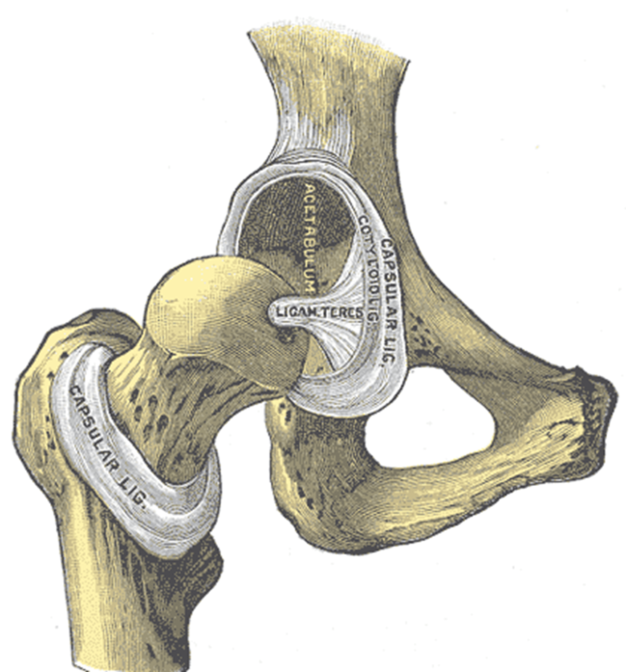
AJD
Dislocation of major joint is associated with other injuries.

Slide 40
AJD
Risk
Major trauma victims
Athletes
Connective tissue disease patients

Slide 41
AJD
When a joint is strained:
it may sprain
it may fracture
it may dislocate
it may fracture and dislocate

Slide 42
AJD
Some joints dislocate in one or two directions depending on the force,,, (hip)
Others may dislocate in different directions (shoulder)

Slide 43
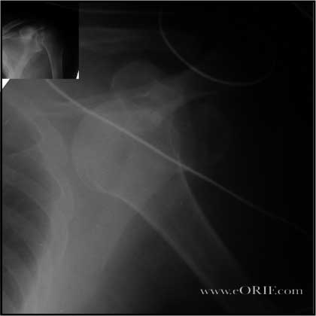
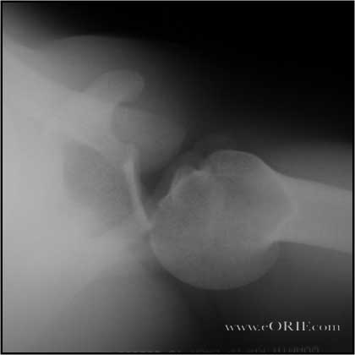
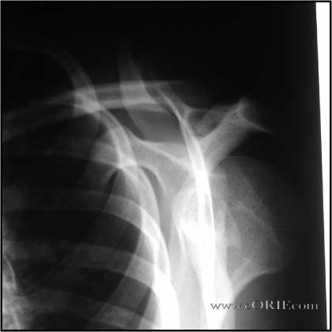
AJD
A joint dislocation is described in reference to the distal segment (shoulder dislocation)

Slide 44
Damage to the labrum Bankart’s lesion, and capsule.
Damage to the head of humerus.

Slide 45
Knee dislocation

Slide 46
Knee dislocation

Slide 47
S/S
History of trauma
Pain and pt is holding limb
Inability to use limb
Deformity loss of contour
Shortening
Malalignment
Malrotation
Check NV status and CS

Slide 48
Diagnosis
History and physical exam
X ray urgent ( no delay) (special views)

Slide 49
AJD
Management principles:
Exclude other injuries
Pain control
Urgent reduction
Check stability
Check NV after reduction
Xray post reduction
Protect the joint
Rehabilitation
Look for late complications

Slide 50
AJD
Management:
Better with anesthesia. WHY
Urgent Closed reduction first
If fail open reduction

Slide 51
AJD
Complications
Early
NV injury
CS
Fractures
Osteochondral lesion/fracture
Heterotopic calcification

Slide 52
AJD
Complications
Late
Stiffness
Chronic instability
AVN/ avascular necrosis
Arthrosis

Slide 53
AJD
Special considrations:
Hip joint
Post dislocation is commonest
Dashboard injury with hip flexed
Sciatic nerve injury common
Late AVN
An orthopedic emergency

Slide 54
AJD
Special consideration:
Shoulder dislocation
Common
Anterior is more common
Pt with seizures prone to posterior dislocation
May cause chronic instability
Chances of axillary nerve injury

Slide 55
AJD
Special consideration:
Knee dislocation
High energy trauma
Three ligaments or more
Popl artery injury (serious emergency)
Peroneal nerve injury
Fracture/CS
Require additional reconstructive surgery
Post reduction arteiogram

