Slide 1
Peripheral nerve injuries
Hisham AbdulAziz Alsanawi
Assistant Professor
Department of Orthopaedics
KSU and KKUH

Slide 2
Compression Neuropathy
Chronic condition with sensory, motor, or mixed involvement
First lost → light touch – pressure – vibration
Last lost → pain - temperature
microvascular compression → neural ischemia → paresthesias → Intraneural edema → more microvascular compression → demyelination --> fibrosis --> axonal loss

Slide 3
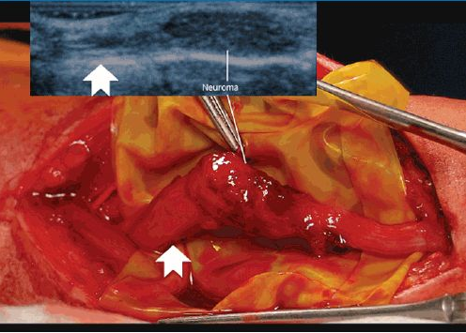

Slide 4
Common systemic conditions leading to compression neuropathy
SYSTEMIC
  Diabetes
  Alcoholism
  renal failure
  Raynaud
INFLAMMATORY
  Rheumatoid arthritis
  Infection
  Gout
  Tenosynovitis
FLUID IMBALANCE
  Pregnancy
  Obesity
ANATOMIC
  Synovial
  fibrosis
  Lumbrical encroachment
  Anomalous tendon
  Median artery
  Fracture deformity
MASS
  Ganglion
  Lipoma
  Hematoma

Slide 5
Symptoms
night symptoms
dropping of objects
clumsiness
weakness
Rule out systemic causes

Slide 6
Physical Exam
Examine individual muscle strength --> grades 0 to 5 --> pinch strength - grip strength
Neurosensory testing -->
  dermatomal distribution
  peripheral nerve distribution

Slide 7
Special Tests
Semmes-Weinstein monofilaments -->
  cutaneous pressure threshold --> function of large nerve fibers --> first to be affected in compression Neuropathy
  Sensing 2.83 monofilament is normal
Two-point discrimination →
  performed with closed eyes
  abnormal → Inability to perceive a difference between points > 6 mm
  late finding

Slide 8
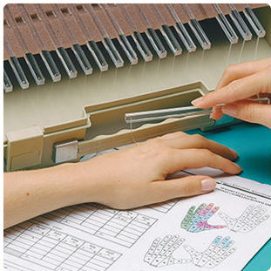

Slide 9
Electrodiagnostic testing
EMG and NCS
Sensory and motor nerve function can be tested
Operator dependent
objective evidence of neuropathic condition
helpful in localizing point of compromise
early disease → High false-negative rate

Slide 10
Electrodiagnostic testing
NCSs →
  conduction velocity and distal latency and amplitude
  Demyelination → ↓conduction velocity + ↑distal latency
  axonal loss → ↓ potential amplitude
EMG →
  muscle electrical activity
  muscle denervation → fibrillations - positive sharp waves - fasciculations

Slide 11
Double-crush phenomenon
blockage of axonal transport at one point makes the entire axon more susceptible to compression elsewhere

Slide 12
Median Nerve Compression
Carpal Tunnel Syndrome
Pronator Syndrome
Anterior Interosseos Neuropathy

Slide 13
CTS
Most common compressive neuropathy in the upper extremity
Anatomy of the carpal tunnel
  Volar → TCL
  radial → scaphoid tubercle +trapezium
  ulnar → pisiform +hook of hamate
  Dorsal → proximal carpal row + deep extrinsic volar carpal ligaments

Slide 14
CTS
Carpal Tunnel Content
  median nerve + FPL + 4 FDS + 4 FDP = 10
Normal pressure → 2.5 mm Hg
>20 mm Hg → ↓↓ epineural blood flow + nerve edema
30 mm Hg → ↓↓ nerve conduction

Slide 15
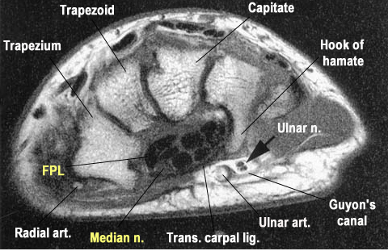

Slide 16
Forms of CTS
Idiopathic → most common in adults
Mucopolysaccharidosis → most common cause in children
anatomic variation
  Persistent median artery
  small carpal canal
  anomalous muscles
  extrinsic mass effect

Slide 17
Risk Factor
obesity
pregnancy
diabetes
thyroid disease
chronic renal failure
Others → inflammatory arthropathy, storage diseases, vitamin deficiency, alcoholism, advanced age, vibratory exposure during occupational activity

Slide 18
Be aware!
no established direct relationship between → repetitive work activities such as keyboarding and CTS

Slide 19
Acute CTS
causes →
  high-energy trauma
  hemorrhage
  infection
Requires emergency decompression

Slide 20
CTS diagnosis
symptoms →
  Paresthesias and pain
  often at night
  volar aspect → thumb - index - long - radial half of ring
provocative test → carpal tunnel compression test -Durkan test → Most sensitive
Other provocative tests include Tinel and Phalen

Slide 21
CTS diagnosis
affected first → light touch + vibration
affected later → pain and temperature
Semmes-Weinstein monofilament testing → early CTS diagnosis
late findings → Weakness - loss of fine motor control - abnormal two-point discrimination
Thenar atrophy → severe denervation

Slide 22
CTS – Electrodiagnostic testing
not necessary for the diagnosis of CTS
Distal sensory latencies > 3.5 msec
motor latencies >4.5 msec
↓ conduction velocity and ↓ peak amplitude → less specific
EMG → ↑ insertional activity - sharp waves -fibrillation - APB fasciculation

Slide 23
CTS - Differential diagnoses
cervical radiculopathy
brachial plexopathy
TOS
pronator syndrome
ulnar neuropathy with Martin-Gruber anastomoses
peripheral neuropathy of multiple etiologies

Slide 24
CTS Treatment
Nonoperative →
  activity modification
  night splints
  NSAIDs
Single corticosteroid injection → transient relief
  80% after 6 weeks
  20% by 1 year
  ineffective corticosteroid injection → poor prognosis → less successful surgery

Slide 25
CTS – Operative
Can be → open - mini-open – endoscopic
internal median neurolysis OR flexor tenosynovectomy → No benefit
too ulnar surgical approach → Ulnar neurovascular injury
too radial surgical approach → recurrent motor branch of median nerve injury
recurrent motor branch variations
  Extraligamentous → 50%
  Subligamentous → 30%
  Transligamentous → 20%

Slide 26
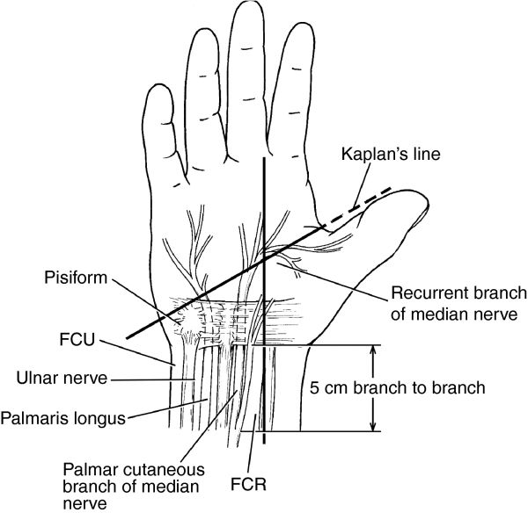

Slide 27
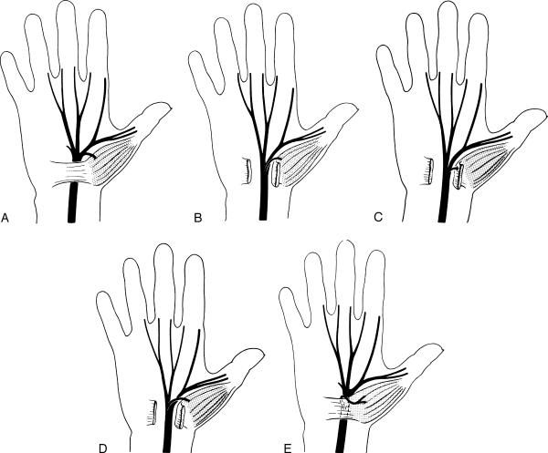

Slide 28
CTS – Endoscopic release
short term:
  less early scar tenderness
  improved short-term grip/pinch strength
  better patient satisfaction scores
Long-term →
  no significant difference
  May have slightly higher complication rate
  incomplete TCL release

Slide 29
CTS – release outcome
pinch strength → 6 weeks
grip strength → 3 months
Persistent symptoms after release →
  incomplete release
  iatrogenic median nerve injury
  missed double-crush phenomenon
  concomitant peripheral neuropathy
  space-occupying lesion
revision success → identify underlying failure cause

Slide 30
Pronator Syndrome
Median nerve compression @ arm/forearm
Symptoms →
  proximal volar forearm pain
  sensory symptoms → palmar cutaneous branch
DDx → AIN syndrome → motor and pain

Slide 31
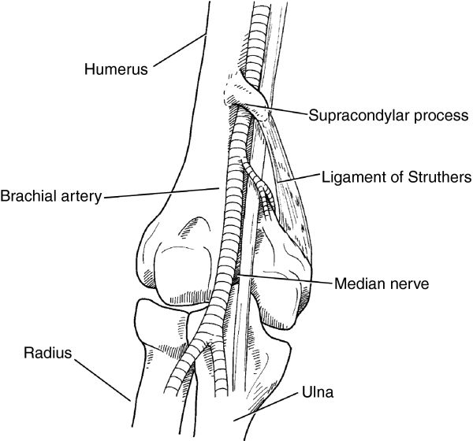

Slide 32
Ulnar Nerve Compression Neuropathy
Cubital Tunnel Syndrome
Ulnar Tunnel Syndrome

Slide 33
Cubital Tunnel Syndrome
Second most common compression neuropathy of the upper extremity
Cubital tunnel borders:
  floor →MCL and capsule
  Walls → medial epicondyle and olecranon
  Roof → FCU fascia and arcuate ligament of Osborne

Slide 34
Cubital tunnel syndrome
Compression sites → many
Symptoms → paresthesias of ulnar half of ring finger and small finger
Provocative tests →
  direct cubital tunnel compression
  Tinel sign
  elbow hyperflexion
Froment sign → thumb IP flexion - FPL during key pinch → weak adductor pollicis

Slide 35
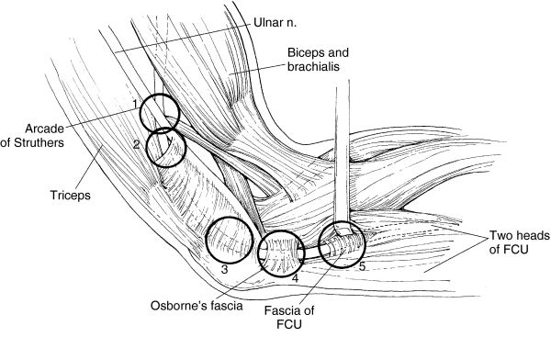

Slide 36
Cubital Tunnel Syndrome - Treatment
Electrodiagnostic tests → diagnosis and prognosis
Nonoperative treatment
  activity modification
  night splints → slight extension
  NSAIDs

Slide 37
Cubital Tunnel Syndrome - Treatment
Surgical Release → Numerous techniques
  In situ decompression, Anterior transposition, Subcutaneous, Submuscular, Intramuscular, Medial epicondylectomy
No significant difference in outcome between simple decompression and transposition

Slide 38
Ulnar Tunnel Syndrome
Compression neuropathy of ulnar nerve in the Guyon canal
Causes → ganglion cyst →80% , hook-of-hamate nonunion, ulnar artery thrombosis

Slide 39
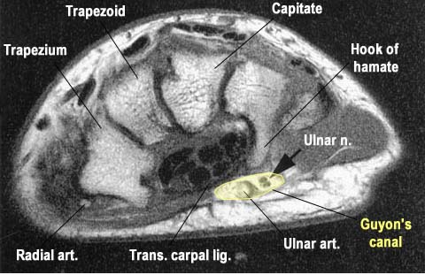

Slide 40
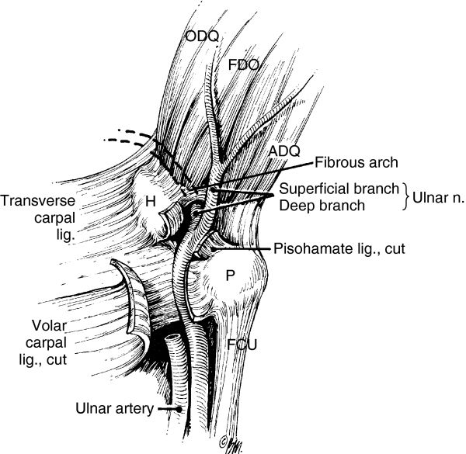

Slide 41
Ulnar Tunnel Syndrome - Invx
CT → hamate hook fracture
MRI → ganglion cyst or other space-occupying lesion
Doppler ultrasonography → ulnar artery thrombosis

Slide 42
Ulnar Tunnel Syndorme
Treatment success → identify cause
Nonoperative treatment
  activity modification
  splints
  NSAIDs
Operative treatment → decompressing by removing underlying cause
ulnar compression @ Guyon + CTS ⇒ CTS release is enough

Slide 43
Radial Nerve
Radial nerve compression → rarely compressed → mainly motor symptoms
PIN compression → lateral elbow pain + muscle weakness
Radial Tunnel Syndrome →
  lateral elbow and radial forearm pain
  no motor or sensory dysfunction
  Cheiralgia paresthetica → superficial sensory radial nerve → pain, numbness, paresthesias over dorso-radial hand

Slide 44
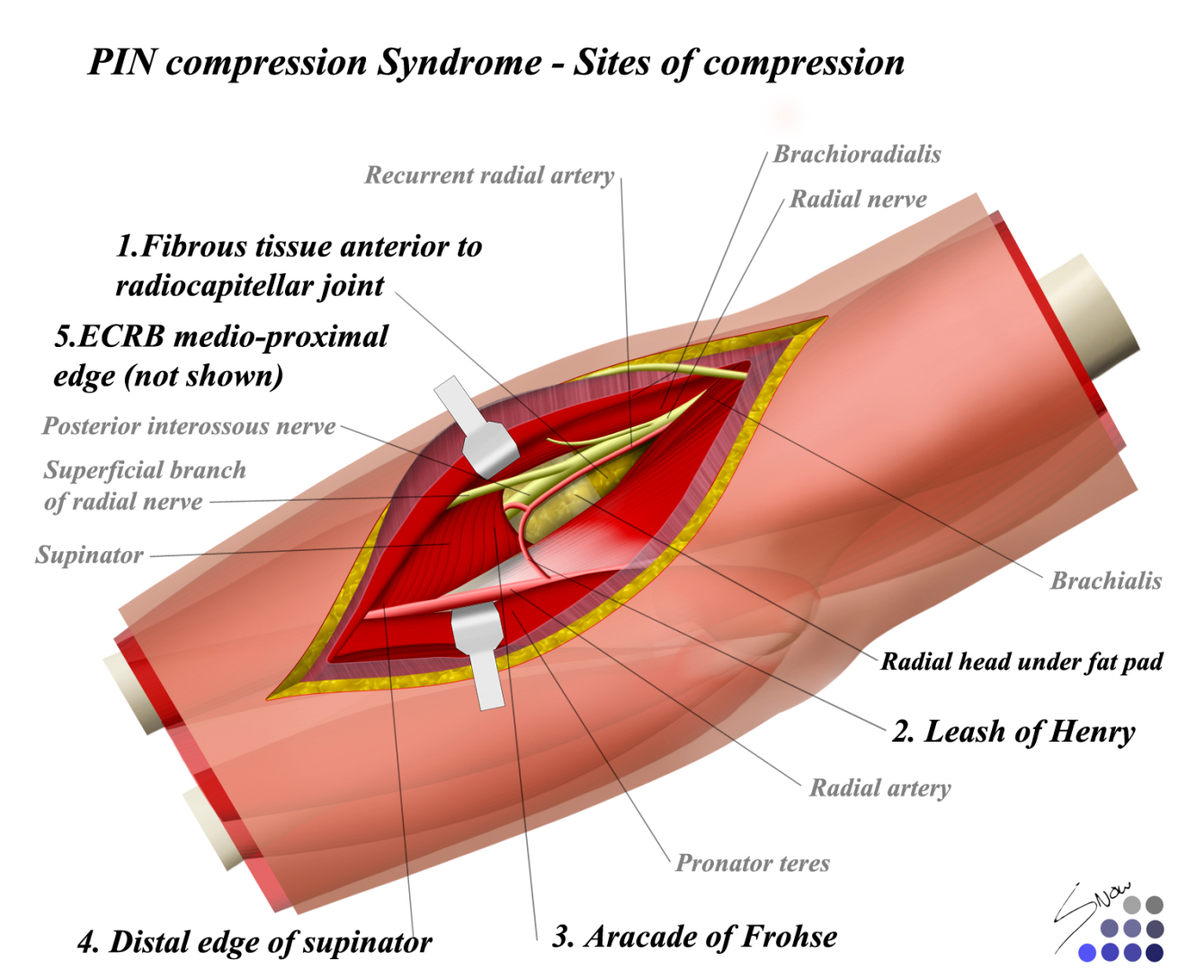

Slide 45
Peripheral nerve injuries
causes →
  compression
  stretch
  blast
  crush
  avulsion
  transection
  tumor invasion

Slide 46
Peripheral nerve injuries
good prognostic factor for recovery:
  young age → most important factor
  stretch injuries
  clean wounds
  after direct surgical repair
poor outcome
  crush or blast injuries
  infected or scarred wounds
  delayed surgical repair.

Slide 47
Classification
Neuropraxia
Axonotmesis
Neurotmesis

Slide 48
Neurapraxia
Mild nerve stretch or contusion
Focal conduction block
No wallerian degeneration
Disruption of myelin sheath
Epineurium, perineurium, endoneurium intact
Prognosis excellent → full recovery

Slide 49
Axonotmesis
Incomplete nerve injury
Focal conduction block
Wallerian degeneration distal to injury
Disruption of axons
Sequential loss of axon, endoneurium, perineurium
May develop neuroma-in-continuity
Recovery unpredictable

Slide 50
Neurotmesis
Complete nerve injury
Focal conduction block
Wallerian degeneration distal to injury
Disruption of all layers, including epineurium
Proximal nerve end forms neuroma
Distal end forms glioma
Worst prognosis

Slide 51
wallerian degeneration
Starts in distal nerve segment
degradation products → removed by phagocytosis
Myelin-producing Schwann cells → proliferate and align → form a tube → receive regenerating axons
Nerve cell body enlarges → increased structural protein production
proximal axon forms sprouts → connect to the distal stump → migrate @ 1 mm/day

Slide 52
Surgical repair
Best performed within 2 weeks of injury
Repair must be free of tension
Repair must be within clean, well-vascularized wound bed
Nerve length may be gained by neurolysis or transposition

Slide 53
Surgical repair
Repair techniques
  Epineurial
  Individual fascicular
  Group fascicular
  No technique deemed superior
nerve conduits → popular for digital nerve gaps >8 mm →polyglycolic acid and collagen based
Larger gaps → grafting

Slide 54
Surgical repair
Autogenous → sural - medial/lateral antebrachial cutaneous - terminal/PIN
Vascularized
Growth factor augmentation → insulin-like and fibroblast → promote nerve regeneration
Chronic peripheral nerve injuries → neurotization and/or tendon transfers
Use of nerve transfers for high radial and ulnar nerve injuries gaining popularity

