Slide 1
Degenerative Joint Disease
Dr. Abdulrahman Algarni, MD, SSC (Ortho), ABOS
Assist. Professor, King Saud University
Consultant Orthopedic and Arthroplasty Surgeon
King Khaled University Hospital, Dallah Hospital

Slide 2
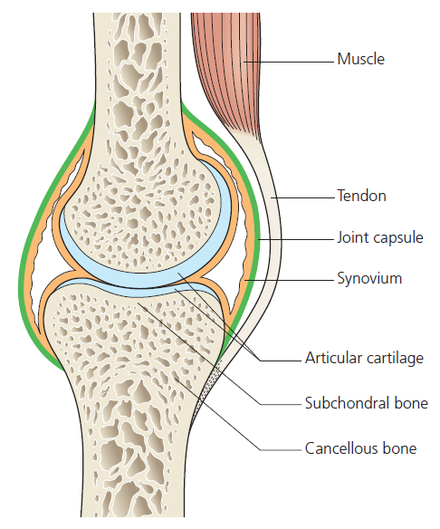
Articular Cartilage
Hyaline cartilage
Viscoelastic material with variable load-bearing properties
Decreases joint friction
Avascular and aneural

Slide 3
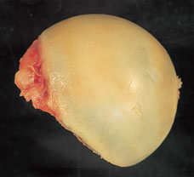
Cartilage Composition

Slide 4
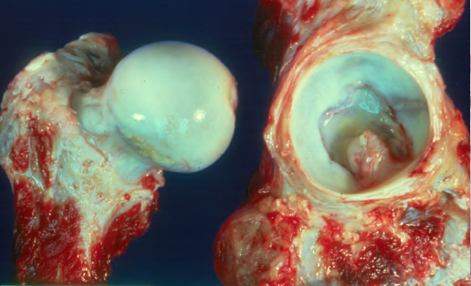
Cartilage Composition
Chondrocytes little capacity for cell division in vivo
Direct damage to the articular surface is poorly repaired, or repaired only with fibro-cartilage
Fibrocartilage has inferior biomechanical properties than hyaline cartilage

Slide 5
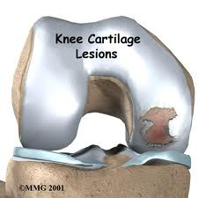
Cartilage Composition
If the collagen network is disrupted, the matrix becomes waterlogged and soft
Followed by loss of proteoglycans, cellular damage and splitting (‘fibrillation’) of the articular cartilage.
Damaged chondrocytes begin to release matrix-degrading enzymes

Slide 6
Capsule and Ligaments
Fibrous structure with tough condensations on its surface (ligaments)
Together with the overlying muscles, help to provide stability.

Slide 7
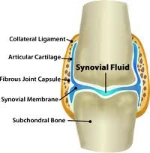
Synovium and synovial fluid
Thin membrane
Richly supplied with blood vessels, lymphatics and nerves.
target tissue in joint infections and autoimmune disorders such as rheumatoid arthritis> IMP
Provides a nonadherent covering for
the articular surfaces
Produces synovial fluid

Slide 8
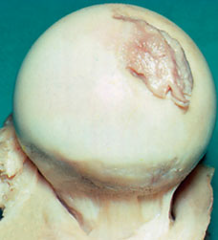
Synovium and synovial fluid
Synovial fluid nourishes the avascular articular cartilage
plays an important part in reducing friction during movement
has slight adhesive properties which assist in maintaining joint stability.
The volume remains fairly constant, regardless of movement.
When a joint is injured fluid increases ( joint effusion)

Slide 9
Degenerative Joint Disease
Primary’ (‘idiopathic’) osteoarthritis (OA)
Chronic disorder
Progressive softening and disintegration of articular cartilage
New growth of cartilage and bone at the joint margins (osteophytes)
Subchondral bone sclerosis and cyst formation
Mild synovitis and capsular fibrosis.

Slide 10
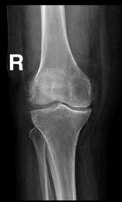
Degenerative Joint Disease
Asymmetrically distributed, often localized
to only one part of a joint
Often associated with abnormal loading
Unaccompanied by any systemic illness
Not primarily an inflammatory disorder
although there are sometimes local signs of inflammation
Not a purely degenerative; dynamic phenomenon; it shows features of both destruction and repair.

Slide 11
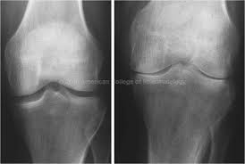
Secondary OA
Metabolic: crystaline deposition disease(gout, CPPD), Paget’s disease
Inflammatory: RA, SLE, Reiter’s syndrome
Neuropathic: DM, tabes dorsalis
Hematologic: SCD, hemophelia
Endocrine: DM, acromegaly
Symmetrical disrupted joint

Slide 12
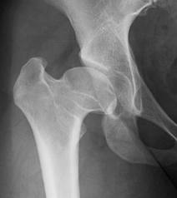
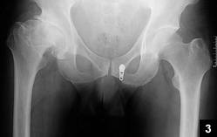
Secondary OA
Trauma: osteochondral, malunion, sport injury
Congenital/developmental: hip dyplasia, multiple epiphyseal dysplasia
Infection
Necrosis: Perthe’s disease, osteonecrosis, steroids

Slide 13
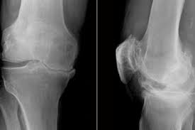
Etiology
Increased mechanical stress in some part of the articular surface
Disparity between the mechanical stress to which articular cartilage is exposed and the ability of the cartilage to withstand that stress.
Varus deformity of the knee
Medial side is most affected*

Slide 14
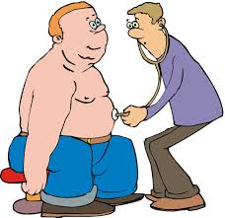
Etiology
More a process than a disease
Increases in frequency with age.
Obesity (hips and knees take 3-4 body weight with each step)
Family history

Slide 15
Prevalence
Osteoarthritis is the commonest of all joint diseases.
Osteoarthritis is much more common in some joints (hip, knee, spine and the fingers) than in others (the elbow, wrist and ankle).
More joints are affected in women than in men.

Slide 16
Prevalence
Common in our community especially knees
Much more in females
Presents earlier than in West
About 90% of those over 40 have asymptomatic degeneration of weight bearing joints
Commonest joints are knee, hip, Cervical spine & Lumbar Spine,1st Carpometacarpal,1st Metatarsophalangeal and Interphalangeal joints

Slide 17
Pathology
Cardinal features
Progressive cartilage destruction
Subarticular cyst formation
Sclerosis of the surrounding bone
Osteophyte formation
Capsular fibrosis.
synovial irritation *

Slide 18
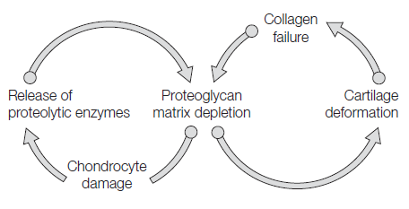
Pathology
Progressive cartilage destruction
Increased water content: swelling and softening of cartilage
Depletion of Proteoglycans

Slide 19
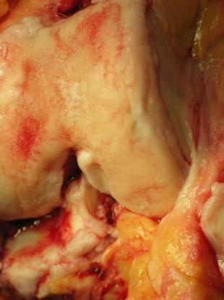
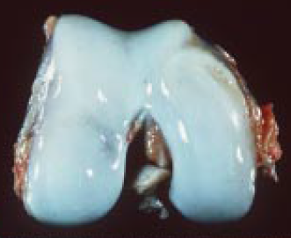
Pathology
Progressive cartilage destruction
Chondrocyte damage and synovitis › proteolytic enzymes› collagen disruption
Fibrillation on weight bearing surfaces

Slide 20
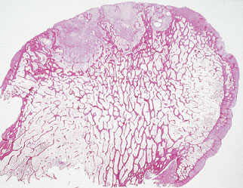
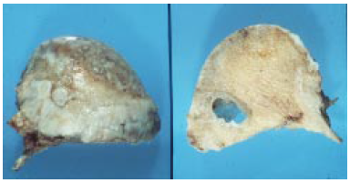
Pathology
Subarticular cyst formation
it could arise from local areas of osteonecrosis
Or from the forceful pumping of synovial fluid through cracks in the subchondral bone plate

Slide 21
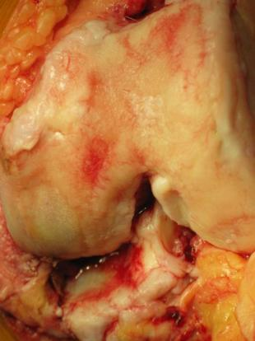
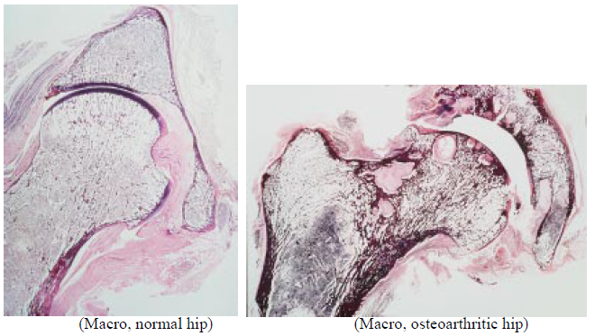
Pathology
Sclerosis of the surrounding bone
Bone becomes exposed
may be polished, or burnished, to ivory-like smoothness (eburnation)

Slide 22
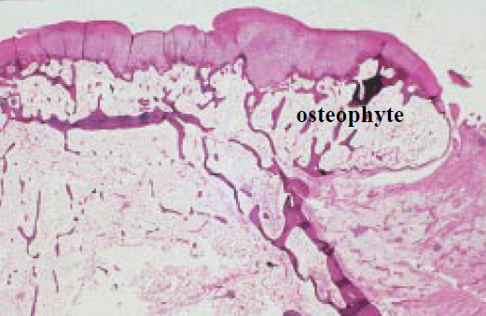
Pathology
Osteophyte formation
Proliferation and remodelling of the adjacent cartilage at the edges
Enchondral ossification

Slide 23
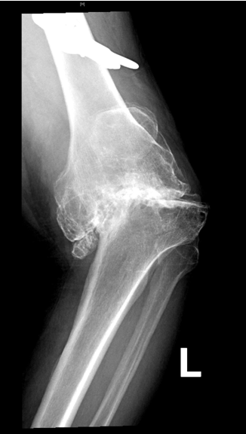
Pathology
Marked vascularity and venous congestion of the subchondral bone
The capsule and synovium are often thickened but cellular activity is slight
Progressive bone erosion› BONE COLLAPSE
Fragmented osteophyte› LOOSE BODIES
Loss of height and ligamentous laxity› MALALIGNMENT

Slide 24
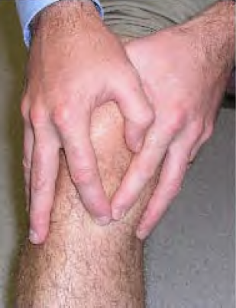
Clinical Features
Intermittent course, with periods of remission sometimes lasting for months.
One or two of the weight-bearing joints (hip or knee)
Symptoms
Pain
Stiffness
Loss of function

Slide 25
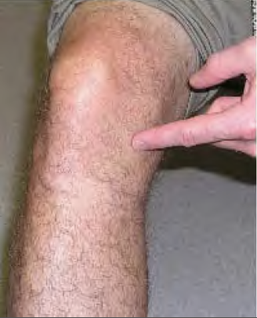
Symptoms
Pain
Localized or rarely referred to a distant site; e.g. pain in the knee from hip osteoarthritis.
Insidious
aggravated by exertion and relieved by rest
Advanced stage, night pain or at rest

Slide 26
Symptoms
Possible causes of pain
Bone pressure due to vascular congestion and intraosseous hypertension; most important
Mild synovial inflammation
Capsular fibrosis with pain on stretching the shrunken tissue
Muscular fatigue

Slide 27
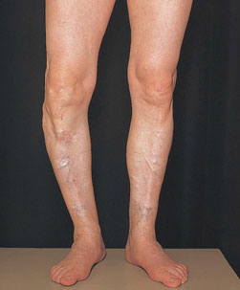
Symptoms
Stiffness
Initially after periods of inactivity
Later, constant and progressive
Loss of function

Slide 28
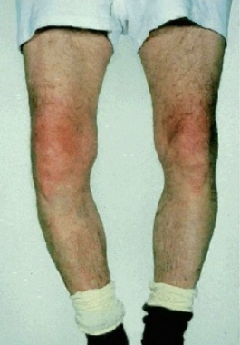
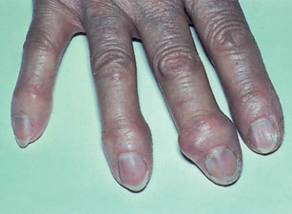
Signs
Swelling
Intermittent (effusion)
continuous (large osteophytes)
Deformity; mal-alignment
Tenderness

Slide 29
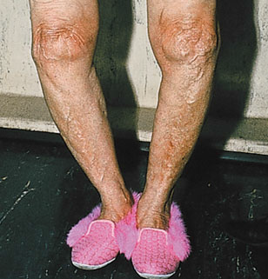
Signs
Limited movement
Crepitus
Instability
Loss of cartilage and bone, asymmetrical capsular contracture and/or muscle weakness

Slide 30
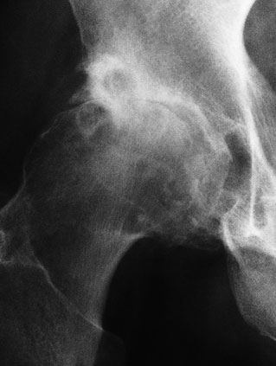
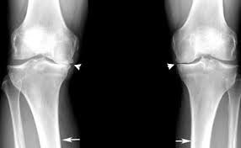
Imaging
Asymmetrical loss of cartilage (narrowing of the ‘joint space’)
Subchondral bone sclerosis
Cysts close to the articular surface

Slide 31
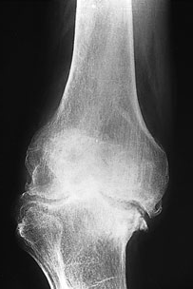
Imaging
Osteophytes at the margins of the joint
Late features
Malalignment
joint subluxation
bone loss
Loose bodies

Slide 32
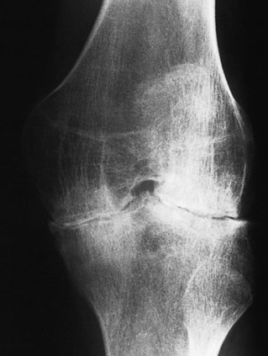
Imaging
Signs of other disorders
Symmetric narrowing in inflammatory OA e.g. RA

Slide 33
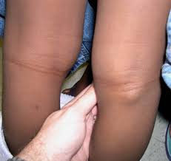
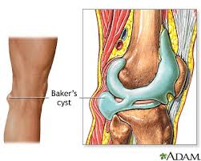
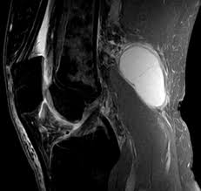
Complications
Capsular herniation: Knee OA; marked effusion and herniation of the posterior capsule (Baker’s cyst).

Slide 34
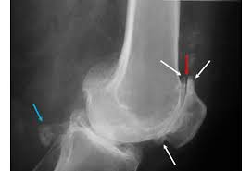
Complications
Loose bodies
Rotator cuff dysfunction: acromioclavicular (AC) joint OA

Slide 35
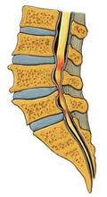
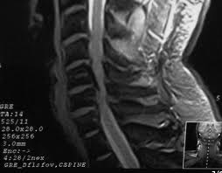
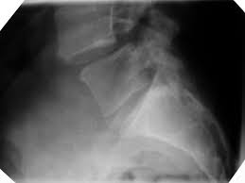
Complications
Spinal stenosis
Spondylolisthesis
severe segmental instability; at L4/5

Slide 36
Management
Joint (or joints) involved
Stage of the disorder
Severity of the symptoms
Age of the patient
Functional needs

Slide 37
Management
EARLY TREATMENT
Maintain movement and muscle strength
Protect the joint from ‘overload
Relieve pain
Modify daily activities

Slide 38
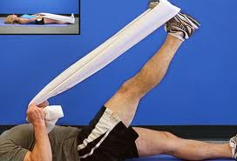
Conservative Treatment
Maintain movement and muscle strength
Physiotherapy (Physical therapy)
Pain relief: massage; application of warmth
Prevent contractures
Muscle strengthening
Range of motion

Slide 39
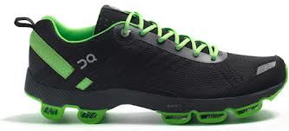
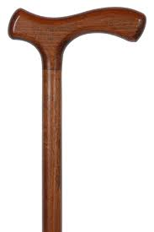
Conservative Treatment
Load reduction
Weight-reduction
Shock-absorbing shoes
Walking stick
Unloading brace

Slide 40
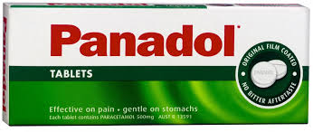
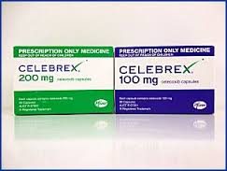
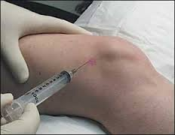
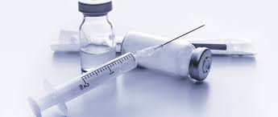
Conservative Treatment
Modify activity
avoiding activities like climbing stairs and squatting*
Medications
Systemic: paracetamol, non-steroidal anti-inflammatory drugs (NSAIDs)
Local: not recommended

Slide 41
Surgical Treatment
Joint Debridement (Arthroscopy)
Corrective Osteotomy
Arthroplasty (Joint Replacement)
Arthrodesis (Fusion)

Slide 42
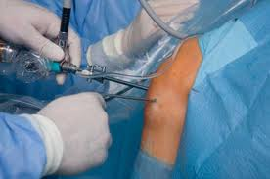
Surgical Treatment
Joint Debridement (Arthroscopy)
Removal of loose bodies
Removal of meniscal or labral tears

Slide 43
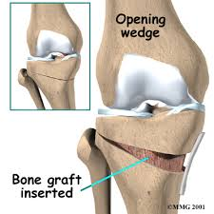
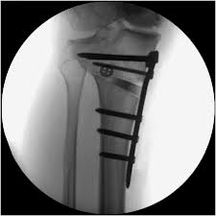
Surgical Treatment
Corrective Osteotomy
Realign axis and redistribute weight
Knee; hip
Young, active, mild OA

Slide 44
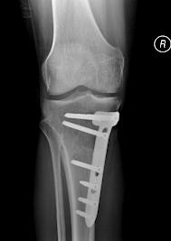
Surgical Treatment
Corrective Osteotomy
Pain relief
Vascular decompression of the subchondral bone
Redistribution of loading forces towards less damaged parts of the joint

Slide 45
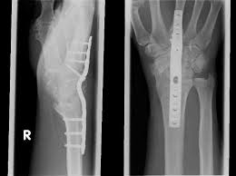
Surgical Treatment
Arthrodesis
Transfer painful stiff into painless stiff joint
Small joints; hand, foot and spine

Slide 46
Surgical Treatment
Arthroplasty (Joint Replacement)
Nowadays the procedure of choice for advanced OA
Total Joint Replacement
Knee, hip, shoulder, ankle and elbow
Painful, deformed stiff joint, old patient

Slide 47
Surgical Treatment
Arthroplasty (Joint Replacement)
Partial Joint Replacement
Same patient as for osteotomy
Knee

