Slide 1
Approach To Bronchial Asthma
Done by:
Ali alfuraydi
Hamad aldossari
Fahad alotaibi

Slide 2
Objectives
Diagnosis of Asthma in children and adults
History
Clinical
Use of PEFR to assess in diagnosis
Investigations “PFT; Spirometry”
Factors trigger Asthma
Highlight on COPD “Diagnosis by PFT and Treatment”
How to assess the severity of Asthma
Exercise induced asthma (triggers and management)
Management of Asthma
Rescue management
Prophylaxis
How to use different types of inhalers
Asthma education for patient and how patient can use inhalers properly
◙ Practical: Examination of Respiratory system (chest), How to do?

Slide 3
Pre-Test
Which of the following genes has been shown to be associated with bronchial hyperresponsiveness in Asthma:-
ADAM 33.
FBN1.
LRRK2
CFTR
Notes:
T1 and T2 ADAM33 single nucleotide polymorphisms and the risk of childhood asthma in a Saudi Arabian population: a pilot study.
Al-Khayyat AI1, Al-Anazi M, Warsy A, Vazquez-Tello A, Alamri AM, Halwani R, Alangari A, Al-Frayh A, Hamid Q, Al-Muhsen S.
A

Slide 4
WHAT IS ASTHMA ?
Asthma is a common chronic disorder of the airways, characterized by variable reversible and recurring symptoms related to airflow obstruction, bronchial hyper-responsiveness, and underlying inflammation.

Slide 5
WHAT IS ASTHMA ?
Asthma is a chronic disease characterized by recurrent attacks of breathlessness and wheezing, which vary in severity and frequency from person to person.

Slide 6
General characteristics
Asthma is a common and potentially serious chronic disease that can be controlled but not cured.
Asthma can begin at any age .
Extrinsic versus intrinsic asthma :
Extrinsic asthma (most cases)
Patients are atopic .i.e. produce immunoglobulin E to environmental antigen. May be associated with eczema and hay fever .
At younger age .
Intrinsic asthma
Not related to atopic or environmental triggers
ADAM 33
Notes:
T1 and T2 ADAM33 single nucleotide polymorphisms and the risk of childhood asthma in a Saudi Arabian population: a pilot study.
Al-Khayyat AI1, Al-Anazi M, Warsy A, Vazquez-Tello A, Alamri AM, Halwani R, Alangari A, Al-Frayh A, Hamid Q, Al-Muhsen S.

Slide 7
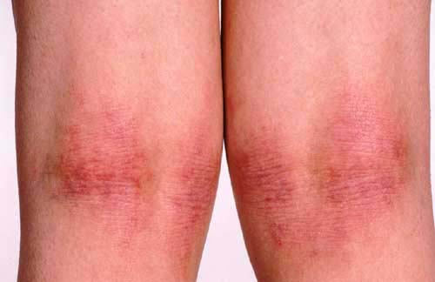
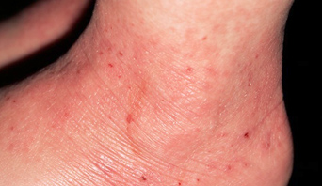
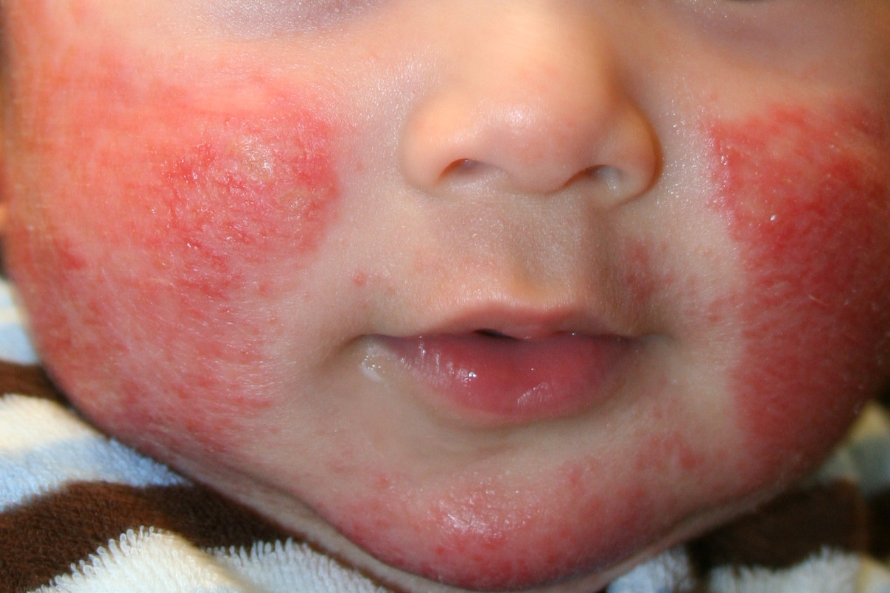
Atopy
Genetic predilection to produce specific IgE following exposure to allergens
Atopic Eczema: children with atopic eczema were at an increased risk of asthma.

Slide 8
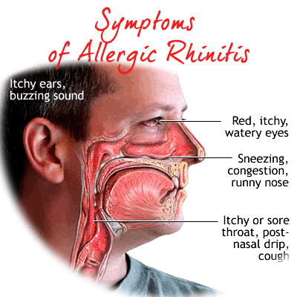
Atopy
Allergic Rhinitis: 2- to 7-fold increased risk of incident asthma in preadolescence, adolescence, or adult life
Family history of allergy: higher risk of developing asthma and a lower chance of remission

Slide 9
Epidemiology

Slide 10
Pre-Test
The prevalence of asthma in children of Saudi Arabia is:
A- 15-20%
B- 2-8%
C- 25-35%
D- 45-50%
Notes:
A

Slide 11
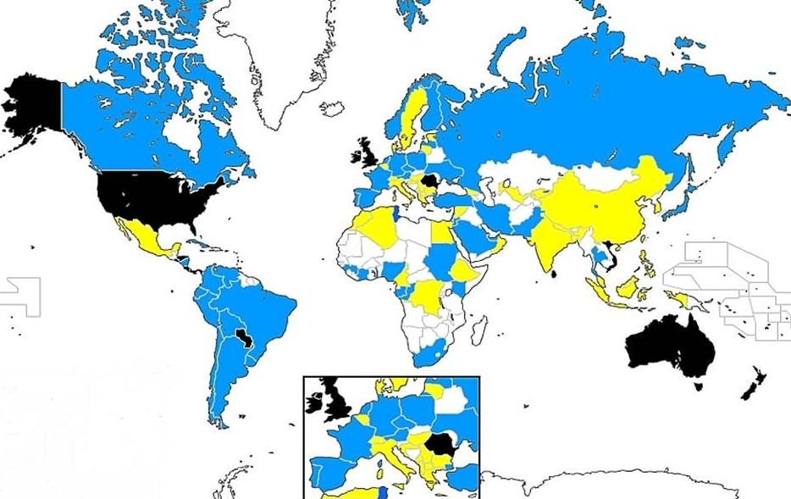
Prevalence in Adults
Notes:
most common chronic disease in childhood

Slide 12
Global Prevalence
The global prevalence of diagnosed asthma in adults is estimated to be 4.3%.
315 million individuals with asthma.
Notes:
Amongst the population living with clinical asthma, almost one in four was a current smoker
one in five had never received asthma treatment
Estimated to rise to 400 million in 2025
The prevalence of asthma in younger adults varies widely as it does in children. Overall, 4.3% of respondents to WHO’s World Health Survey aged 18-45 in 2002-2003

Slide 13
Local
It is one of the most common chronic diseases
In Saudi Arabia, affecting more than 2 million
Saudis !
Although many asthma patients continue to be
under-diagnosed, under-treated …

Slide 14
A Recent Asthma Control Survey Showed

Slide 15
Prevalence
The rate of growth of this disease is very
alarming with its prevalence rates currently
exceeding 20 percent of our population in
certain regions of the Kingdom …

Slide 16
World Allergy Organization Journal: Prevalence of bronchial asthma in children in Saudi Arabia, Al-Frayh, November 2007 - Volume - Issue - pp S167-S168

Slide 17
On average, 3 children in a classroom of 30
are likely to have asthma.*
*Epidemiology and Statistics Unit. Trends in Asthma Morbidity and Mortality. NYC: ALA, July 2006.

Slide 18
Local
Prevalence of diagnosed asthma in children (0-15) was reported to be 25% in 2004
34.4% in males vs 20.3% in females
Prevalence of diagnosed asthma in 16-18 years old is 19.6% in 2014
21.5% in males vs 17.8 in females

Slide 19
Pathogenesis

Slide 20
VEDIO
http://www.youtube.com/watch?v=4aK76DoxKGk#aid=P9s0eXT9g9Y

Slide 21
Pathology of Asthma
Inflammation
Airway Hyper-responsiveness
Airway Obstruction
Symptoms of Asthma

Slide 22
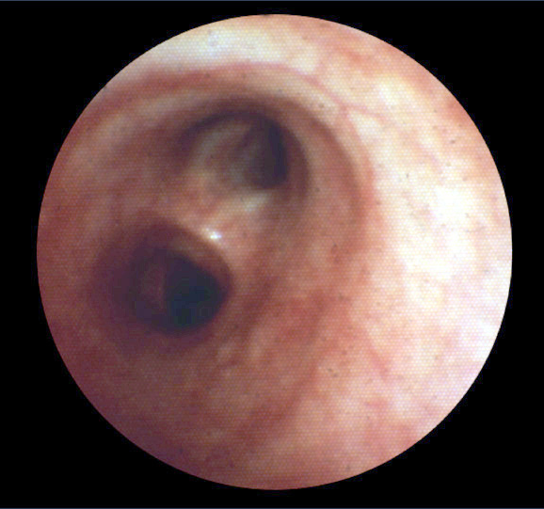
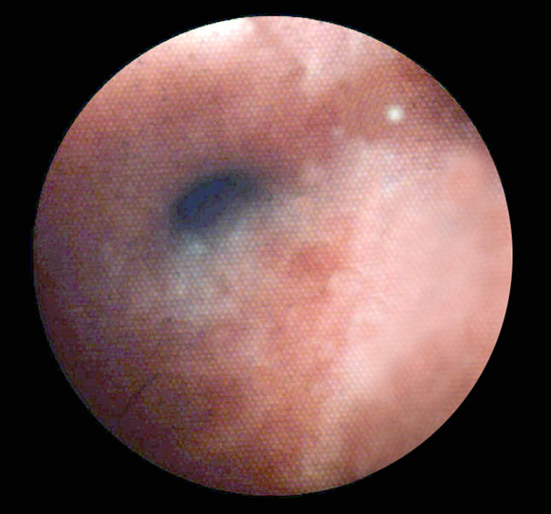
Bronchoconstriction
Before
10 Minutes After Allergen Challenge

Slide 23
Pathophysiology
Airways inflammation:
Asthma is a complex syndrome characterized by
a state of airways hyperresponsiveness and
caused by a multi-cellular inflammatory reaction.
(mast cells, macrophages, antigen-presenting
dendritic cells, neutrophils, eosinophils, and
T-lymphocytes, Type 2 T-helper cells)

Slide 24
Pathophysiology
Airways hyperresponsiveness:
To direct (histamine or methacholine) OR
indirect (exercise, cold air).
It’s give us a relatively good correlation between
the severity of disease and the degree of
Airways hyperresponsiveness.

Slide 25
Pathophysiology
Early and late responses.
Airway remodeling:
Epithelial damage, sub-epithelial fibrosis,
increased airway vasculature, increases in
proteoglycans, and increased smooth-muscle
mass, increase number of secretory glands.

Slide 26
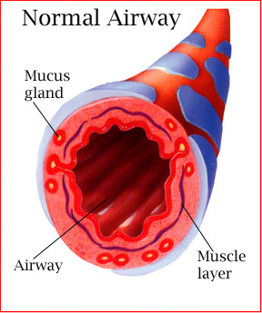
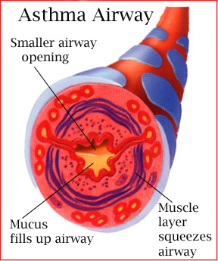
During an asthma attack…
Notes:
26
When exposed to an asthma trigger…
Bronchioles constrict to limit exposure to the trigger.
Mucous membrane becomes irritated and swells.
Mucous is produced to trap the irritant.
Coughing initiated to pop open bronchioles and expel the mucous build-up.
Air retention volume in alveolar sacs increases – can’t get air out or in.
CO2 build-up in alveolar sacs and in system tissues which can lead to acidosis.
The body attempts to blow off the excess CO2 – rapid shallow breathing. (hyperventilation)
Hungry for O2 and trying to get rid of CO2 at the same time.
Fatigued muscles in this effort.
If this continues, the person with asthma can die.
A person with asthma undergoes what is called “airway remodeling” – where there is permanent damage to the airways and decreased overall capacity….airway hyperactivity. A hyperactive airway is more susceptible to triggers.
Taking medication:
Rescue inhaler – dilates bronchioles, doesn’t alleviate mucous or congestion in any appreciable way
Daily corticosteroid –works to reduce airway hyperactivity

Slide 27
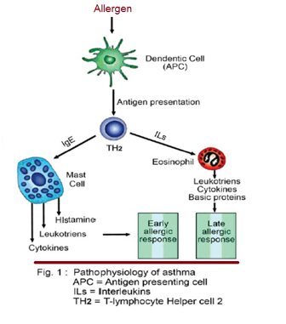
Pathophysiology

Slide 28
“Real Life” Variability in Asthma
Acute
inflammation
symptoms
subclinical
Chronic inflammation
Structural changes
TIME
Barnes PJ. Clin Exp Allergy 1996.
Notes:
28
Multimedia Slide 7
Asthma is a chronic inflammatory disease with a variable course characterized by episodic attacks of acute inflammation.¹ Acute inflammation in asthma is associated with bronchoconstriction, plasma exudation/edema, vasodilatation, and mucus hypersecretion. Chronic inflammation in asthma is associated with subepithelial fibrosis, smooth-muscle hyperplasia/hypertrophy, mucus gland hyperplasia, and new-vessel formation. If asthma remains uncontrolled or poorly controlled, the underlying chronic inflammation may lead to structural changes (remodelling) that reduce the extent of airway response to therapy.
1. Barnes PJ. New drugs for asthma. Clin Exp Allergy 1996;26:738-745.

Slide 29
Causes
No one really knows what causes asthma. What we do know is that asthma is a chronic inflammatory disease of the airways. The causes of asthma symptoms can vary for different people. Still, one thing is consistent with asthma: when airways come into contact with an asthma trigger, the airways become inflamed, narrow, and fill with mucus.

Slide 30
Triggers

Slide 31
What could trigger Asthma?

Slide 32
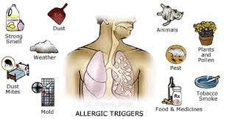
Allergens :
food, pollens, molds, dust mites, and pet dander.
Irritants :
tobacco smoke, smoke from wood-burning, perfumes, cleaning agents.
Physiological factors :
stress, gastroesophageal reflux (GERD), respiratory infection (viral, bacterial) and rhinitis.
Pharmacological factors :
aspirin or other NSAIDs, beta blockers and sulfites.
Physical factors :
exercise, hyperventilation, cold air.

Slide 33
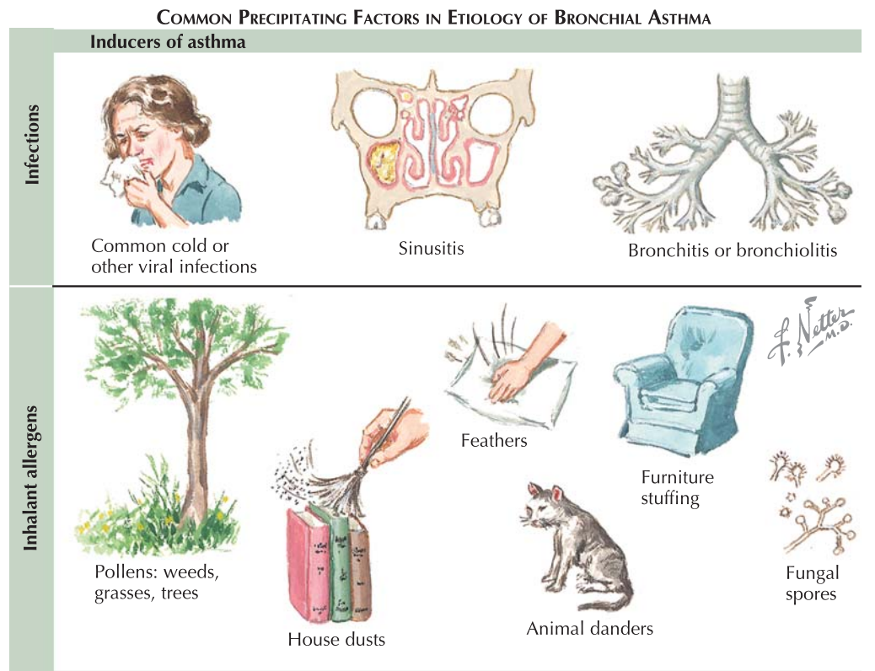
Triggers 1
Notes:
Allergens:
food, pollens, molds, dust mites, and pet dander.
Irritants:
tobacco smoke, smoke from wood-burning, perfumes, cleaning agents.
Physiological factors :
stress, gastroesophageal reflux (GERD), respiratory infection (viral, bacterial) and rhinitis.
Pharmacological factors :
aspirin or other NSAIDs, beta blockers and sulfites.
Physical factors :
exercise, hyperventilation, cold air.
GERD if symptomatic decrease asthma if silent no effect
Samter triad
GINA:
infections, usually those caused by a virus (e.g. colds or flu)
allergens, most commonly from house dust mites, pets or pollen
exercise, especially in cold weather
emotions, such as excitement, fear or anger
irritants, such as air pollution
smoking people with asthma and the parents of asthmatic children should avoid smoking
changes in the weather (e.g. a cold spell)
food additives, such as tartrazine (an artificial food colouring), or food allergens, such as peanuts (sensitised or allergic individuals can have a very severe allergic reaction).
certain medications some people may be allergic to some drugs (e.g. aspirin).

Slide 34
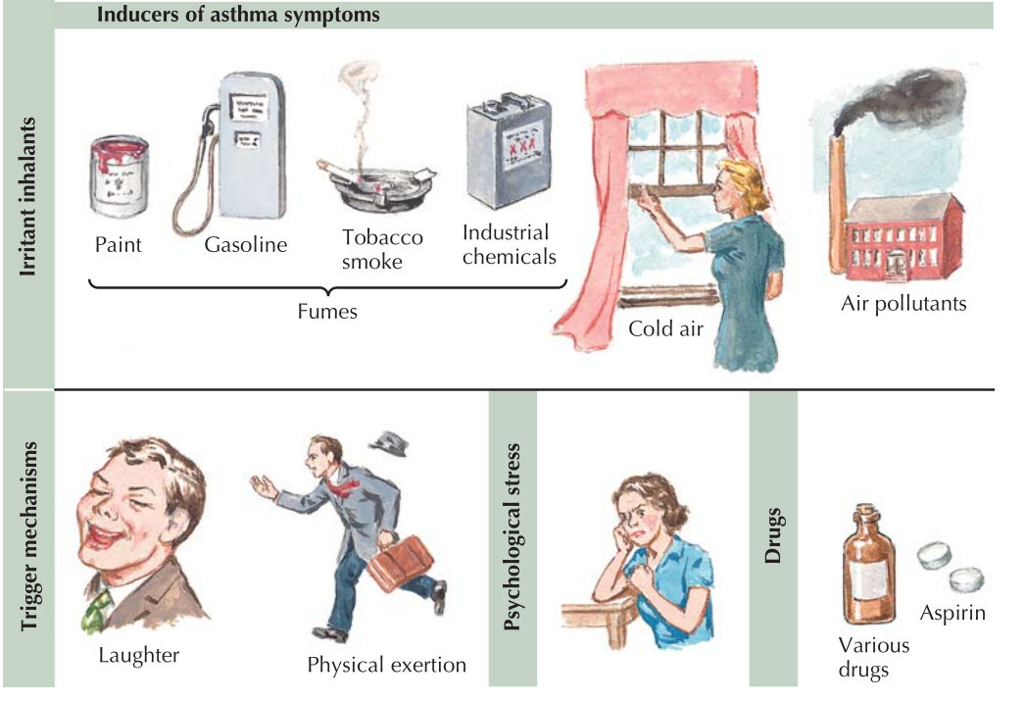
Triggers 2

Slide 35
Classical symptoms of asthma
Wheeze (high-pitched whistling sound, usually upon exhalation)
Cough (often worse at night)
Shortness of breath or difficulty breathing
Chest tightness, pain, or pressure.
Notes:
Chest tightness, pain, or pressure.

Slide 36
Symptoms of Asthma attack :
Are the four classical symptoms plus the following :
-Tightened neck and chest muscles, called retractions.
-Difficulty talking.
-Feelings of anxiety or panic.
-Pale, sweaty face.
-Blue lips or fingernails.

Slide 37
A severe asthma attack often occurs with few warning signs. It can happen quickly and progress rapidly to asphyxiation.
Notes:
Frequent cough, especially at night.
Losing your breath easily or shortness of breath.
Feeling very tired or weak when exercising.
Wheezing or coughing after exercise.
Feeling tired, easily upset, grouchy, or moody.
Decreases or changes in lung function as measured on a peak flow meter.
Signs of a cold or allergies (sneezing, runny nose, cough, nasal congestion, sore throat, and headache).
Trouble sleeping.

Slide 38
Risk factors
Personal history of atopy.
Family history of asthma or atopy.
Inner city environment.
Socio-economic deprivation.
Obesity.
Prematurity and low birth weight.
Viral infections in early childhood.
Smoking.
Early exposure to broad-spectrum antibiotics.
Possible protective factors include:
Breast-feeding.
Increasing sibship.
Growing up on a farm.

Slide 39
Risk Factors
1.Perinatal:
birth before 37 weeks gestation was associated with increased risk for asthma
Breastfeeding: lowered incidence of recurrent wheezing during the first two years of life
2.tobacco smoke :
smoked ≥300 cigarettes per year had a relative risk of 3.9 for developing asthma
Higher relapse rate of childhood-onset asthma during adulthood whether current or former smoker.

Slide 40
Risk Factors
3. Obesity:
Increase risk of asthma
Increase asthma severity
4.Infection :
Lower respiratory tract infections in early childhood.
5.Medcation :
Acetaminophen/ paracetamol use has been postulated to be risk for asthma because this agent induces depletion of the antioxidant glutathione in lung tissue.

Slide 41
Types of Asthma
Exercise Induced Asthma (EIA)
Occupational asthma
Allergic asthma
Aspirin Exacerbated Respiratory Disease (AERD)
Asthma without allergies
Cough variant Asthma
Notes:
1. Allergic asthma
The most common type
This type occurs when an allergy sets off an asthma flare up. Mold, roaches, pollens and pet dander are common allergies but the list can be endless.
“Most of the time we treat this type by finding out what patient’s are allergic to first, so they know what they should avoid,” says Lee. Patients may be prescribed inhaled corticosteroids depending on the severity of their asthma.
2. Asthma without allergies
People may also have asthma not triggered by allergies. Usually an upper respiratory infection (cold, flu, and rhinovirus) sets off their asthma. As soon as cold or flu symptoms appear patients are typically prescribed a short course of inhaled corticosteroids for 10-14 days.
Pescatore has patients eliminate known allergies, any food sensitivities and eat a clean diet of low glycemic index protein, fruits, vegetables and nuts to see if this makes a difference. “Anybody who has asthma has an inflammatory condition,” says Pescatore. “If you decrease inflammation in the body, you decrease your body’s need to ‘act out’ so to speak. When there is less inflammation around there is less need for your bronchials to constrict and your mast cells to activate and all of the things that occur during an asthma attack.”
3. Aspirin Exacerbated Respiratory Disease (AERD)
CLINICAL PRESENTATION — Patients with AERD typically have chronic asthma and rhinosinusitis that are acutely exacerbated by the ingestion of aspirin or other NSAIDs. Reactions typically begin 30 minutes to 3 hours after NSAID ingestion, and may be slow to resolve (figure 1).
The classic reaction following NSAID ingestion consists of one or more of the following:
●Asthmatic symptoms, including wheezing, cough, and chest tightness
●Nasal and ocular symptoms, including nasal congestion/obstruction, rhinorrhea, periorbital edema, and/or injection of the conjunctiva
●Facial flushing/erythema
.
4. Exercise induced asthma
For these asthmatics, any type of physical exertion or sports leads to coughing, difficulty breathing and chest tightness that improves when they stop the exertion. Typical treatment is an inhaled broncodilator medication to open their airway taken about fifteen minutes before exercise.
“There are multiple studies that say taking 2000 mg of vitamin C before exercise can relieve exercise induced asthma,” says Pescatore. Some folks also have cold weather induced asthma. Cold air can be a lung irritant just like perfume or cigarette smoke. This generally occurs in winter.
5. Cough variant
When cough is the only asthma symptom, this is known as cough variant asthma (CVA).
Cough variant is asthma that is characterized by a dry hacking cough. It can occur while awake or asleep and affect both adults and children. Patients usually respond well to inhaled corticosteroids.Vitamin D has also been shown to improve asthma. Studies show there is less incidence of asthma in the south, which may be related to people having less sun exposure and lower vitamin D levels in northern climates.
6. Occupational asthma
Occupational asthma occurs when something on the job sets off an asthma attack. Irritant induced asthma is usually from smoke or inhaled irritants like chlorine. It’s not related to an allergy; the irritant is inhaled and triggers an attack.
In occupations that deal with chemicals like paint or lab animals like rats or mice, patients may also be allergic to their trigger. They must find out exactly what sets off their symptoms and try to avoid it. If you can’t get away from your trigger, you may have to use a corticosteroid inhaler to ease symptoms. Pescatore also likes vitamin A, which has been shown to help get rid of the mucus in the respiratory tract, which can be an irritant.
He also likes Pycnogenol. The pine tree bark extract is an anti-inflammatory and antioxidant that clinical research shows helps to open the bronchial tubes and reduces asthma symptoms.
While corticosteroids and bronchodilators are often necessary in the treatment of asthma, there are many things that can help ease symptoms and prevent the various types of asthma attacks including learning your triggers, finding out what you’re allergic to, discovering food sensitivities, trying vitamins and herbal supplements, as well as lifestyle changes such as eating a healthier diet, removing shoes indoors and using a home air filter.

Slide 42
Early diagnosis of asthma should be made!!!!
WHY ???
Notes:
because when asthma is left untreated and the inflammation persists, permanent narrowing of the airways can occur then this chronic asthma can also be referred to as chronic obstructive pulmonary disease (COPD).

Slide 43
How to diagnose Asthma ??

Slide 45
History
Personal Data
Chief complain
History of presenting illness
Associated symptoms
Medications
Allergies
PMH
PSH
Family Hx
Social Hx
Notes:
The diagnosis of asthma is based on clinical assessment as there is no gold standard diagnostic test for
asthma. This includes a detailed history and physical examination supplemented by spirometry, with
reversibility testing, to support the diagnosis. To date, there is no single diagnostic test of asthma,

Slide 46
History

Slide 47
A 12 year old boy present to PHC with his mother complaining of recurrent SOB and Cough for 3 days

Slide 48
SOB:
Intermittent, getting worse when the weather become dusty and when contact with his cousin cat as well as high temperature. Relieved by avoiding the cat.
His mother believed that evil eye.
Cough:
Non-productive, getting worse at night, relived partially by Oxygen mask.
Associated With wheezing during attacks.

Slide 49
PMHx:
URTI→ 5 days ago.
FHx:
No
SHx:
No
Medication Hx:
No
Allergy:
No known allergy
Social Hx:
Not smoker, lived with his parents, he has two older brother.

Slide 50
Relevant questions
Does the patient or his/her family have a history of asthma or other atopic conditions, such as eczema or allergic rhinitis?
Does the patient have recurrent attacks of wheezing?
Does the patient have a troublesome cough at night?
Does the patient wheeze or cough after exercise?
Does the patient experience wheezing, chest tightness, or cough after exposure to pollens, dust,
feathered or furry animals, exercise, viral infection, or environmental smoke (cigarettes, burning incense “Bukhoor,” or wood?
Notes:
By SINA

Slide 51
Relevant questions
Does the patient experience worsening of symptoms after taking aspirin/non-steroidal anti-inflammatory medication or use of B-blockers?
Does the patient’s cold “go to the chest” or take more than 10 days to clear up?
Are symptoms improved by appropriate asthma treatment?
Are there any features suggestive of occupational asthma?
Notes:
By SINA

Slide 52
Physical examination

Slide 53
EXAMINATION
Vital Signs:
RR, Pulse, BP, and Temperature.
General Examination:
Chest and respiratory Examination:
Inspection, Palpation, Percussion, and Auscultation.

Slide 54
EXAMINATION
1. Inspection:
Shape, Breathing, Deformities, Scars, Apex beat, Skin changes & hair distribution.
2. Palpation:
Apex beat, Tracheal deviation, Tracheal tug, tactile vocal fremitus, Rib fracture, Chest expansion.
3. Percussion:
Over the supraclavicular area, clavicle and intercostal space.
4. Auscultation:
Breathing sound, Added sounds, vocal resonance

Slide 55
EXAMINATION
Possible Findings:
Tachypnea.
Wheeze /Rhonchi.
Widespread, high-pitched, musical wheezes are a characteristic feature of asthma.
Use of accessory muscles of respiration.
paradoxical pulse (a pulse that is weaker during inhalation and stronger during exhalation).
Over-inflation of the chest.
Cyanosis of nails.
signs of allergy in skin, nose, eyes.

Slide 56
EXAMINATION
Physical findings that suggest severe airflow obstruction in asthma include:
1-Tachypnea, tachycardia, prolonged expiratory phase of respiration (decreased I:E ratio),
2- Seated position with use of extended arms to support the upper chest ("tripod position").
3- Use of the accessory muscles of breathing during inspiration
4- Pulsus paradoxus (greater than 12 mmHg fall in systolic blood pressure during inspiration)

Slide 57
Back to our case
Vital Signs :
Respiratory rate : 28/min
Pulse: 100/min
Blood pressure: 128/80 mmhg
Temperature : 36.7 C

Slide 58
Back to our case
General Examination
Height: 160cm
Weight : 55 kg
BMI: 21.5 kg/m² ( normal weight )
He is oriented to person, place and time

Slide 59
Back to our case
Chest and respiratory Examination
1. Inspection:
No deformity, No skin changes , No scars
2. Palpation:
trachea centrally located , Symmetrical chest expansion , Equal Tactile vocal Fremitus.
3. Percussion:
resonant
4. Auscultation:
Widespread, high-pitched, musical wheezes.

Slide 60
Investigations

Slide 61
Pre-Test
Which one of the following tool is used to follow-up asthmatic patient:
A- Spirometery
B- Peak Expiratory Flow
C- CT-chest
Notes:
B

Slide 62
Investigations
Complete Blood Count
Imaging
Spirometry
Peak Expiratory Flow
Bronchoprovocation Challenge Testing
Measurements of allergic status
ECG

Slide 63
Investigations
There is no precise diagnostic test. However, diagnosis is based on symptoms and response to therapy over time.
Parameters of lung function is used to confirm the diagnosis.
Most important parameters are FEV1 and PEF which are measured by Spirometry at forced expiration .

Slide 64
Spirometry
How to use (2:11)
https://www.youtube.com/watch?v=iWFEbjMPqxo

Slide 65
Spirometry
Spirometry is done by asking the patient to take a deep breath and then to blow as hard as th pt. can into a tube connected to a small machine.
It takes two measurements :
The volume of air you can breathe out in one second (FEV1) and the total amount of air breathe out (FVC)
FVC : Forced vital capacity
FEV1 : forced expiratory volume in 1 second
Notes:
Results are usually given in both raw data (litres, litres per second) and percent predicted—the test result as a percent of the "predicted values" for the patients of similar characteristics (height, age, sex, and sometimes race and weight). The interpretation of the results can vary depending on the physician and the source of the predicted values. Generally speaking, results nearest to 100% predicted are the most normal, and results over 80% are often considered normal. Multiple

Slide 66
Spirometry
Recommend by STS for regular screening.
Measure (FEV1) and (FVC) volume-time curve
Normally FEV1/FVC ~ 75%.
An obstructive pattern on spirometry is identified numerically by a reduction in the ratio of FEV1 to FVC.
Recommend spirometry at the time of initial diagnosis, after treatment is initiated and symptoms are stabilized.

Slide 67
FLOW VOLUME LOOP

Slide 68
VOLUME TIME CURVE

Slide 70
Case
Notes:
An increase in FEV1 of 12-15 percent or more, accompanied by an absolute increase in FEV1 of at least 200 mL, can be attributed to bronchodilator responsiveness with 95 percent certainty.
-ve does not exclude asthma

Slide 71
PATIENT RELATED PROBLEMS

Slide 72
PATIENT RELATED PROBLEMS

Slide 73
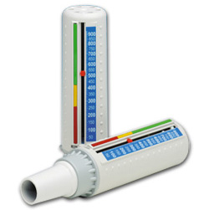
Peak Expiratory Flow
A small hand-held device known as a peak flow meter can be used to measure how fast you can blow air out of your lungs in one breath.
Notes:
The peak expiratory flow (PEF), also called peak expiratory flow rate (PEFR) is a person's maximum speed of expiration, as measured with apeak flow meter, a small, hand-held device used to monitor a person's ability to breathe out air

Slide 74
Peak Expiratory Flow
Recommend in monitoring and long term assessment of patient disease and response to treatment.
The normal predicted value depending on the gender, age and height .
Also in assessment of possible occupational asthma.
PEF is the fastest diagnostic tool in acute SOB.

Slide 76
Peak flow readings are often classified into 3 zones of measurement according to the American Lung Association; green, yellow, and red. Doctors and health practitioners can develop an asthma management plan based on the green-yellow-red zones.
Zone | Reading | Description
Green Zone | 80 to 100 percent of the usual or normal peak flow readings are clear. | A peak flow reading in the green zone indicates that the asthma is under good control.
Yellow Zone | 50 to 79 percent of the usual or normal peak flow readings | Indicates caution. It may mean respiratory airways are narrowing and additional medication may be required.
Red Zone | Less than 50 percent of the usual or normal peak flow readings | Indicates a medical emergency. Severe airway narrowing may be occurring and immediate action needs to be taken. This would usually involve contacting a doctor or hospital.

Slide 77
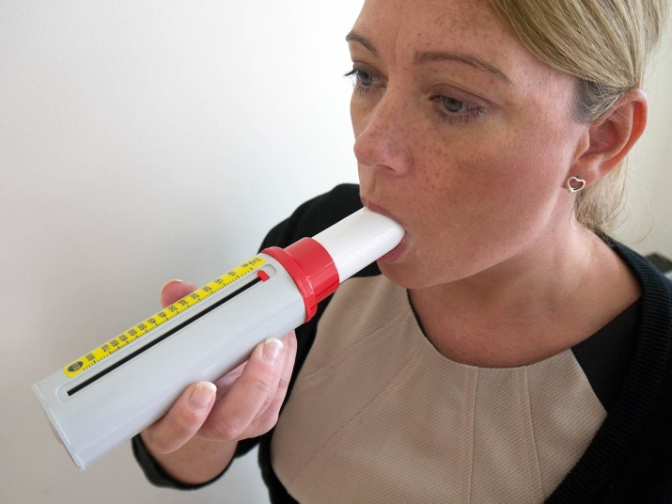
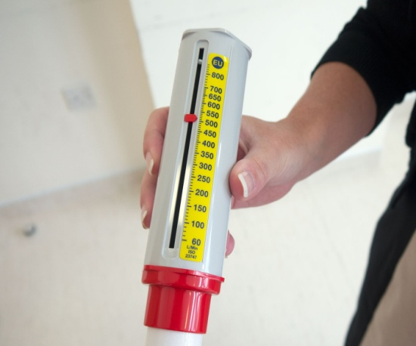
How To Use it
1. Connect a clean mouthpiece
2. Ensure the marker is set to zero
3. Breathe out as hard as you can
4. Observe and record the reading

Slide 78
Case
A 45 years old male asthmatic present to primary care clinic for follow up, his height is 172 . His Peak expiratory flow reading is 580 L/min.
Calculate the normal value for peak expiratory flow.
What the peak flow reading of the patient indicate ?
http://www.uptodate.com/contents/calculator-peak-expiratory-flow-prediction

Slide 79
Case
A 45 years old male asthmatic present to primary care clinic for follow up, his height is 172 . His Peak flow reading is 580 L/min.
Calculate the normal value for peak expiratory flow.
PEF = 625 L/min
What the peak flow reading of the patient indicate ?
The predicted value is 625 L/min
The patient Peak flow reading is 580 L/min.
(580/625)*100 = 93%
A peak flow reading in the green zone indicates that the asthma is under good control.

Slide 80
Bronchoprovocation Challenge Testing
Indications for bronchoprovocation testing include the accurate diagnosis of asthma in selected patients (normal spirometry) , assessment of the response to asthma therapy, and, identification of triggers for cases involving environmental or occupational exposures.
It evaluate the airway narrowing in response to stimuli.

Slide 81
Bronchoprovocation Challenge Testing
How is it done ?
Perform a spirometry test.
Inhale a nebulized aerosol with methacholine or histamine.
Perform another spirometry after nebulized the aerosol.
See if there is decrease in FEV1.

Slide 82
Other Supportive tests
Arterial Blood Gases considered in severe respiratory distress when respiratory rate elevates and the hypocarbia leading to hypoxemia.
BUT what If PCO2 is normal or increased??
Respiratory muscle fatigue
Sever airway obstruction
You have to hospitalize the patient and to put him on a mechanical ventilation .

Slide 83
Imaging
Not helpful in mild cases
Only Sever asthma reveals hyperinflation
Recommended in the evaluation of severe "difficult-to-control" asthma or in atypical symptoms.

Slide 84
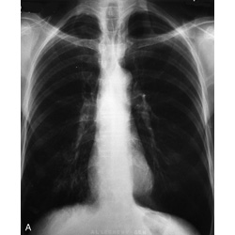
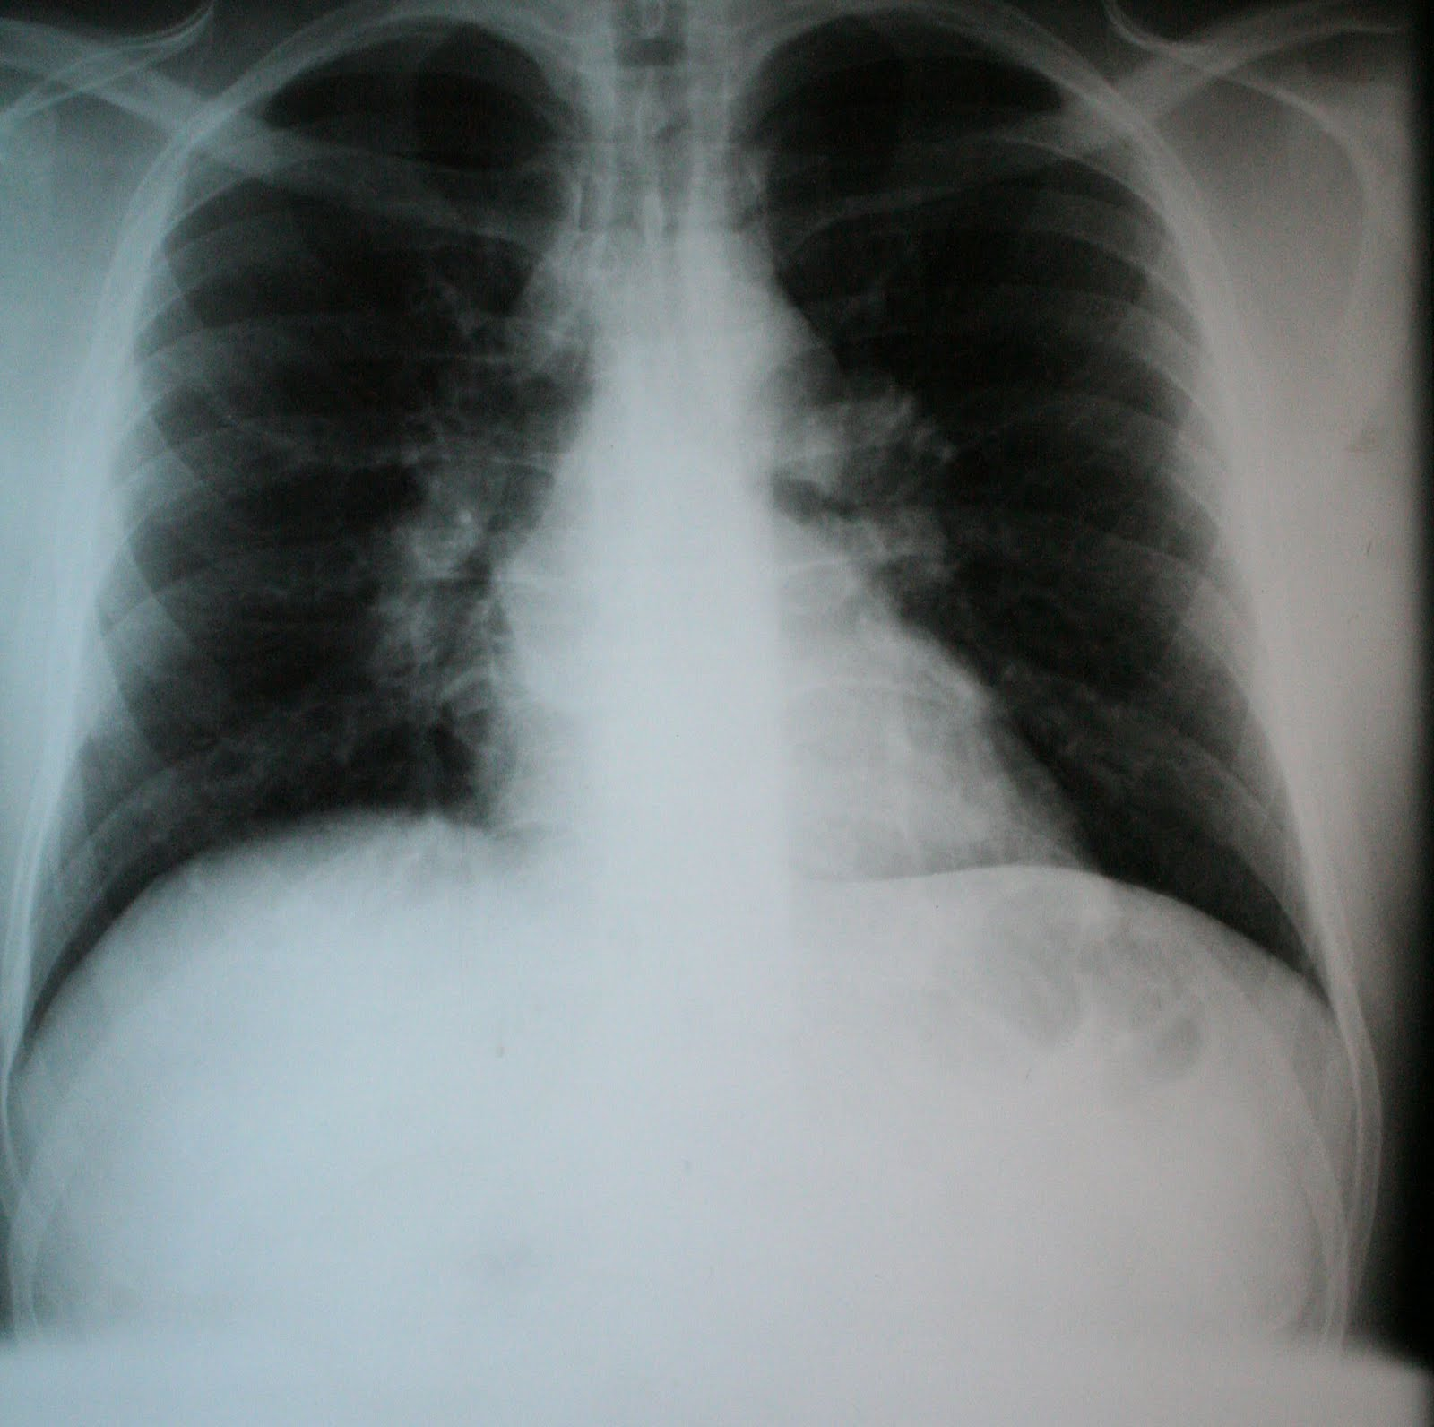

Slide 85
Measurements of allergic status
Allergens can be Identified by :
Skin testing
Level of specific IgE in the serum
- Provocation of the air ways with a suspected allergen especially in the occupational asthma. (But rarely useful and dangerous )

Slide 86
Allergy Skin test
The primary diagnostic tool in determining allergic status.
Simple , rapid , low cost , highly sensitive.
How to do : (3:41)
https://www.youtube.com/watch?v=4BSIRnlTt4M

Slide 87
Chest Examination
https://www.youtube.com/watch?v=GmLvehqi6Yo

Slide 88
Assessment of the severity of Asthma

Slide 89
Pre-Test
Based on NAEPP Guidelines (to assess the severity of asthma), An asthmatic patient with symptoms of asthma that happen >2 days/week but not daily, can be classified as:
Intermittent.
Mild persistent.
Moderate persistent.
Severe persistent.
Notes:
B

Slide 90
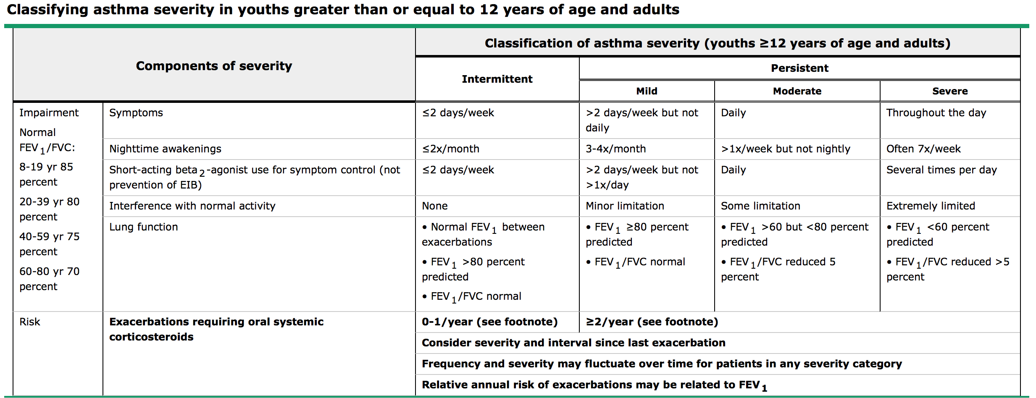
National Asthma Education and Prevention Program (NAEPP) guidelines to stage asthma severity:

Slide 91
Assessment of Acute Asthma severity in Adult:

Slide 92
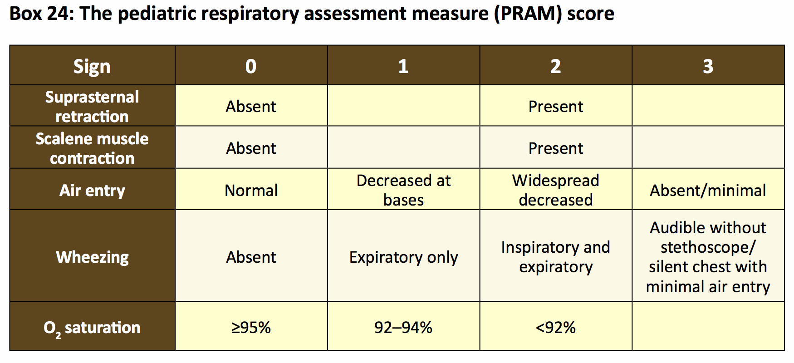
Assessment of Acute Asthma severity in Children

Slide 93
Managements and education of ASTHMA

Slide 94
Pre-Test
Which of the following medications is considered as a QUICK ASTHMA RELIEVER?
Salmeterol
Montelukast
Budesonide
Salbutamol
Notes:
D

Slide 95
The long-term goals of asthma management
Control asthma symptoms (cough, wheezing, or shortness of breath)
Infrequent and minimal use (≤2 days a week) of reliever therapy
Maintain (near) normal pulmonary function
Maintain normal exercise and physical activity levels
Prevent recurrent exacerbations of asthma, and minimize the need for emergency room (ER) visits or hospitalizations
Optimize asthma control with the minimal dose of medications
Reduce mortality
Optimize quality of life

Slide 96
EDUCATION
What is asthma?
What are triggers and How to avoid it (prophylaxisis ?
What are the medication and How to use it?
What are Side effects of medications?
What are the benefit from the medications?
Notes:
The goal of asthma education is to provide a patient with asthma (or the parents of a child with asthma) adequate
training to enhance their knowledge and skills to be able to adjust treatment according to guided self-management
(Evidence A).[90-94] In order to enhance the level of knowledge and skills among asthmatics, education should
include knowledge about asthma and skills related to the devices, as there might be misperceptions about the
use of inhalers and the safety of ICS.[95-97] Asthma education should be conducted by a well-trained healthcare
worker with good communication skills, who is able to create an interactive dialog in a friendly environment. With
the availability of appropriate information, patients will be encouraged to continue on the management plan
and reassured about the control of the disease.[98] It is essential to get the feedback from the patient in order to
maintain a bidirectional rapport and an optimum environment. It has been documented that a well-structured
asthma education program will improve quality of life, reduce cost, and increase the utilization of healthcare
resources.[99-101] Asthma education should be tailored based on the available setting [Box 8].
Q1) Asthma is a disease of the airways or breathing tubes in the lungs. These airways carry air to the lungs. Airways get smaller and smaller like branches of a tree. When asthma is under control, the airways are clear and air flows easily in and out of the lungs.
Q2) Because you have asthma, your airways are very sensitive. They may react to things called triggers (things that can cause asthma episodes). When you are around triggers, your breathing tubes may become swollen, tighten up, and make a lot of mucus. This will make it harder for you to breathe.
It is important to find out what your asthma triggers are and learn ways to avoid them.
Q3) Prevent hospitalization and emergency room visits.
Prevent school absences.
Prevent disturbed sleep.
Allow full participation in activities such as playing, exercise, and sports.

Slide 97
Outcomes of Asthma Education Programs
Ability to differentiate between “reliever” and “controller” medications and their appropriate indications.
Recognition of potential side effects of medications and the appropriate action to minimize them.
Performance of the proper technique of different inhaler devices.
Recognition of the situations that need urgent medical attention

Slide 98
Websites
Notes:
http://www.kaahe.org/health/ar/26378-الربو.html

Slide 102
Asthma medications
Controller medications
long-term basis
Prevent relapse
Reliever medications
used on an as-needed basis that act quickly to reverse bronchoconstriction
relieve symptoms.

Slide 103
Controller medications examples :
Inhaled Corticosteroids (ICS).
Systemic Corticosteroids.
Long Acting Beta 2 Agonists (LABAs).
Leukotriene Receptor Antagonists (LTRAs).
Theophylline.
Anti IgE.

Slide 104
Reliever medications:
Short Acting Beta 2 Agonists.
Anticholinergics
Theophylline

Slide 105
Medications to control Asthma
Quick relievers :
1- Short-acting beta₂-agonists.
2- Anti-muscarinic.
3- Theophylline
Long-term controllers :
1- Corticosteroids.
2- Long-acting beta₂-agonists
3- Leukotriene modifiers
4-Theophylline.

Slide 106
Inhaled Corticosteroids:
E.g. Beclomethasone dipropionate, Fluticasone propionate.
most effective anti-inflammatory medications for the treatment of asthma.
Improve all aspects of asthma
Mechanism of Action: inhibits arachidonic acid synthesis reducing swelling and mucus production in the airways
Side Effects: oropharyngeal candidiasis and dysphonia

Slide 107
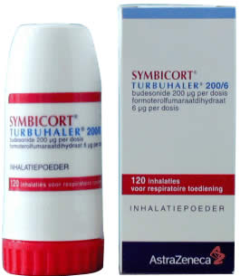
Long-acting inhaled B2-agonists (LABAs):
E.g. Formoterol and Salmeterol.
Mechanism of Action: relaxes smooth muscle lining of the airways. There effects last for 12 hours or more.
Should not be used as monotherapy in asthma. In fact, studies show that it is harmful to use them alone to control asthma^{[23]}.
Good Choice to treat nocturnal asthma.
Side Effects: tachycardia, tremor, headaches, muscle cramps, and sometimes hypokalemia.

Slide 108
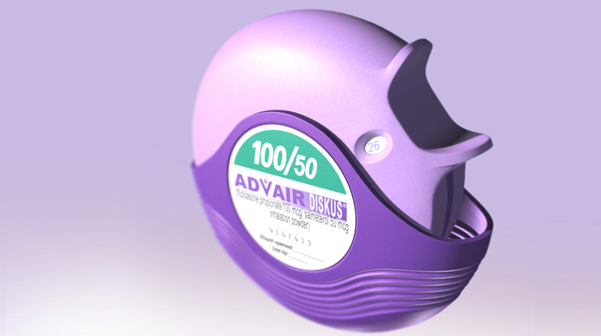
LABAs in combination with ICS :
improvement in symptoms and lung function
Increased number of symptom-free days
Reduction in number of asthma attacks and the use of SABA.
decreased nocturnal asthma
reduced number of exacerbations,
prevention of exercise induce asthma .

Slide 109
Leukotrienes Receptor Antagonist montileukast (LTRAs):
E.g. Montileukast
MOA: Leukotrienes are released from mast cell, eosinophil and basophil and lead to increased inflammation, so it block the leukotienes receptor thus decrease the inflammation.
Less consistent effect on exacerbations when compared to ICS

Slide 110
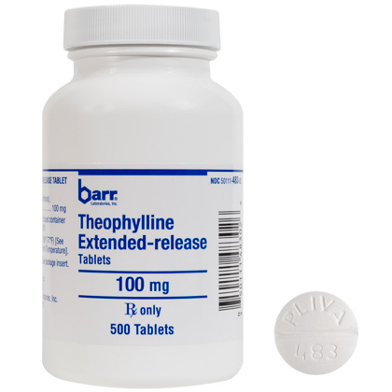
Theophylline:
Mechanism of Action: Bronchodilation via increasing the level of c-AMP by inhibition of phosphodieasterase.
It may provide benefits as an add-on therapy in patients who do not achieve control with ICS alone, but is less effective than LABA and LTRA.
Theophylline is not recommended for use as monotherapy in asthma treatment.
Side Effects: gastrointestinal symptoms, cardiac arrhythmias, seizures, Liver disease, congestive heart failure and even death. Nausea and vomiting are the early symptoms of toxicity.

Slide 111
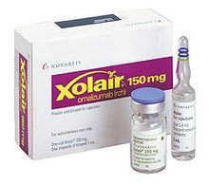
Anti-IgE:
approval by the U.S. Food and Drug Administration (FDA) in 2003.
Recombinant humanized monoclonal antibody; selectively binds to IgE and inhibits binding to IgE receptors on surface of mast cells and basophils.
indicated for patients of 12 years and above with severe allergic asthma uncontrolled on high-dose ICS and other controllers.
pain and bruising at injection site and very rarely anaphylaxis

Slide 112
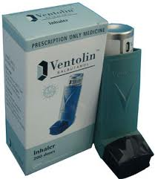
Reliever medications
Short Acting Beta 2 Agonists (SABAs):
E.g. Salbutamol.
Mechanism of Action: Stimulate b2-adrenoceptors leading to smooth muscle relaxation.
medication of choice for relief of symptoms of acute exacerbations of asthma and for the pretreatment of exercise-induced bronchoconstriction.
Side Effects: tachycardia, tremors, anxiety, tolerance.

Slide 113
Reliever medications
Anticholinergics:
E.g. Ipratropium Bromide.
Mechanism of Action: anticholinergic agent that inhibits vagally-mediated reflexes by antagonizing the action of acetylcholine at the cholinergic receptor.
less effective than SABA. However, when used in combination with SABA in acute asthma, they have an additional effect.
It can also be an alternative bronchodilator for patients who experience adverse effects from rapid-acting B2-agonists.
Side Effects: dryness of the mouth and a bitter taste.

Slide 115
Types of Asthma inhalers
Small-volume nebulizer (SVN)
Notes:
a device used to administer medication in the form of a mist that inhaled into the lungs.
It use oxygen, compressed air or ultrasonic power to break up medical solutions/suspensions into small aerosol droplets that can be directly inhaled from the mouthpiece of the device.
Aerosol is a mixture of gas and liquid particles

Slide 116
Types of Asthma inhalers
Pressurized metered dose inhaler (pMDI).
Notes:
It allow the patient to inhale the medication by breathing in slowly and deeply for five to 10 breaths.
Benefits:
-Reduce deposition in the mouth and throat
-Avoids timing issues and make it easier

Slide 117
Types of Asthma inhalers
Dry Powder Inhaler.

Slide 118
pMDI (without spacer):

Slide 119
pMDI (with spacer):

Slide 120
Dry Powder Inhaler:

Slide 121
Pre-Test
In which step of the Asthma stepwise management, is oral steroids are used?
Step 2
Step 3
Step 4
Step 5

Slide 123
Level of Control:
Total: 25
Control: 20-24
Partial control: 16-19
Uncontrolled: < 16

Slide 125
CASE
28 years old female diagnosed with asthma and now we have to select the best step for her In the last 4 week:
Affect her performance in work= some of the time
No shortness of breath at all
doesn't wake her up at night at all
She didn’t use any medications
she said it is a well controlled

Slide 126
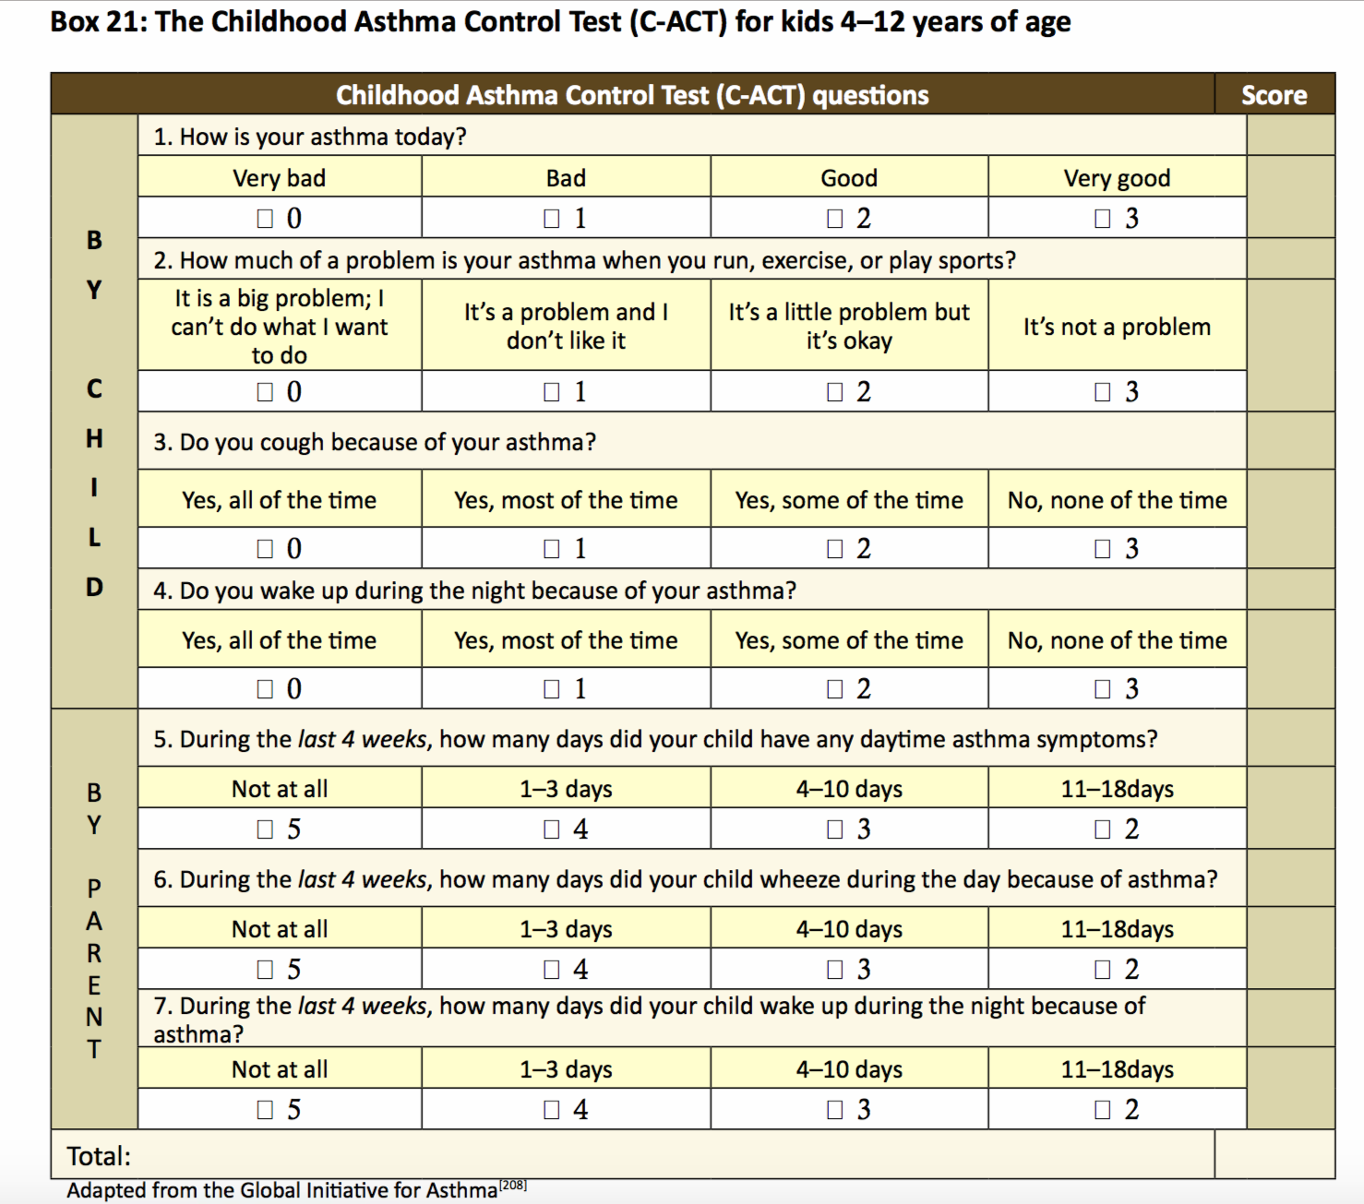

Slide 128
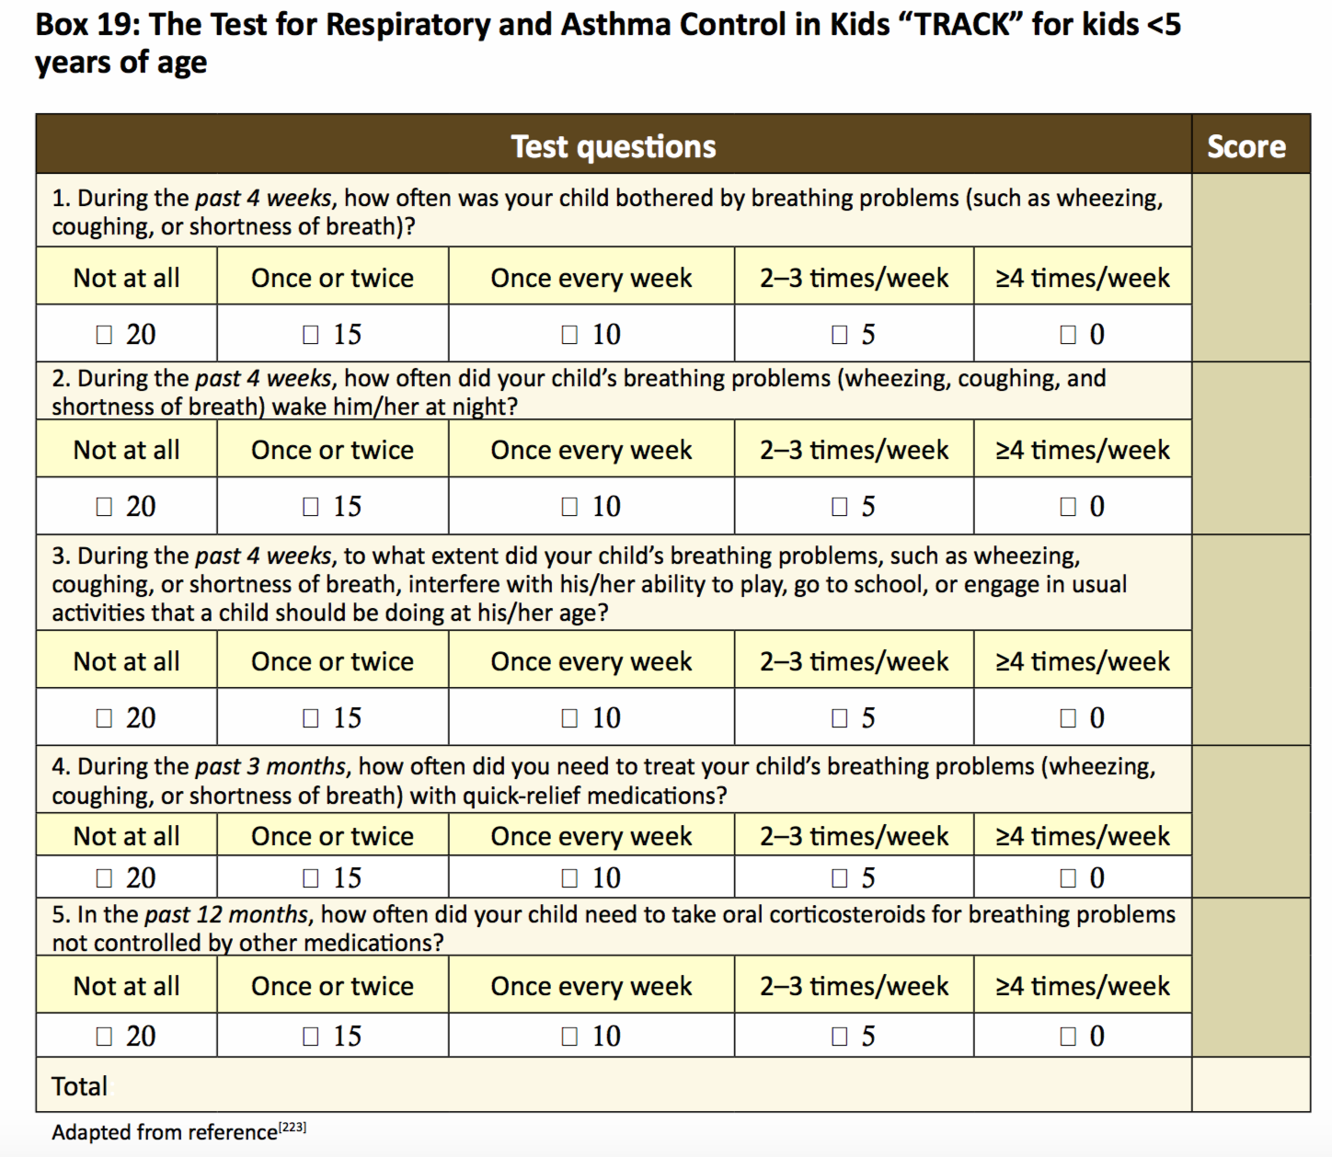

Slide 131
When to refer ?
-The patient has experienced a life-threatening asthma exacerbation
-The patient has required hospitalization or more than two bursts of oral corticosteroids in a year
-The adult and pediatric patient older than five years requires step 4 care or higher or a child under five requires step 3 care or higher
-Asthma is not controlled after three to six months of active therapy and appropriate monitoring
-The patient appears unresponsive to therapy
-The diagnosis of asthma is uncertain
-Other conditions are present which complicate management (nasal polyposis, chronic sinusitis, severe rhinitis, allergic bronchopulmonary aspergillosis, COPD, vocal cord dysfunction, etc)
-Additional diagnostic tests are needed (skin testing for allergies, bronchoscopy, complete pulmonary function tests)
-Patient may be a candidate for allergen immunotherapy

Slide 132
Going back to out patient: the management plan for him will be according to step 1 which is:
SALBUTAMOL

Slide 133
General Consideration

Slide 134
Exercise Induced Asthma (EIA)
- Patients with EIB typically have initial bronchodilation during six to eight minutes of exercise.
- The initial bronchodilation is followed by bronchoconstriction, which begins by three minutes after exercise, generally peaks within 10 to 15 minutes, and resolves by 60 minutes.
- Typical symptoms are shortness of breath, chest tightness, and cough.
Notes:
CLINICAL MANIFESTATIONS — Patients with EIB typically have initial bronchodilation during six to eight minutes of exercise [24,25]. The initial bronchodilation is followed by bronchoconstriction, which begins by three minutes after exercise, generally peaks within 10 to 15 minutes, and resolves by 60 minutes (figure 1). Typical symptoms are shortness of breath, chest tightness, and cough. Associated hoarseness or stridor should raise the possibility of paradoxical vocal cord motion. (See "Paradoxical vocal fold motion".)
In most patients with EIB, bronchoconstriction is followed by a refractory period, during which repeated exertion causes less bronchoconstriction [26]. This refractory period is generally less than four hours. Inhibitory prostaglandins (particularly prostaglandin E2) released during the refractory period probably protect against repeated episodes of EIB (figure 2) [27].
Acute bronchoconstriction was previously believed to be followed by late phase bronchoconstriction in some patients [28]. Findings in subsequent studies have been variable [29,30]; however, it does appear that the risk and severity of late phase bronchoconstriction due to EIB is substantially less than that associated with allergen-induced asthma [31,32]

Slide 135
People with exercise-induced asthma are believed to be more sensitive to changes in the temperature and humidity of the air.
Notes:
Sensitive to cold and dry air

Slide 136
What happens?
When you are at rest, you breathe through your nose, which serves to warm, humidify, and cleanse the air you inhale to make it more like the air in the lungs.
BUT
When you are exercising, you breathe through your mouth, and the air that hits your lungs is colder and drier. The contrast between the warm air in the lungs and the cold inhaled air or the dry inhaled air and moist air in the lungs can trigger an attack.

Slide 137
EDUCATION
How to prevent an attack while exercising
What to do when an asthma attack occurs.
When to come to the hospital (EMERGENCY!).
When to call the health-care professional
Notes:
If you think you have exercise-induced asthma, you should immediately make an appointment with your health-care professional.

Slide 138
Management of exercise induce Asthma
-The combination of general measures and pharmacologic intervention can prevent EIB in almost all asthmatics.
-A major goal is to ensure that exercise is not avoided by patients with EIB.
Notes:
-Asthmatics should exercise as much as desired
.

Slide 139
General measures:
Improved understanding of the pathophysiology of EIB has resulted in general recommendations that can help reduce its severity. These measures are based upon observed relationships between the severity of bronchoconstriction and
the following factors:
●The magnitude of minute ventilation
●The temperature and humidity of the inspired air
Notes:
Improving a patient's cardiovascular fitness reduces the minute ventilation required for a given level of exercise, thereby decreasing the stimulus for bronchoconstriction. Similarly, bronchoconstriction is lessened when the inspired gas is warmer and more humid. Patients should be instructed to breathe through a loosely fitting scarf or mask when exercising in cold, dry condition

Slide 140
Highlight on COPD

Slide 141
Chronic obstructive pulmonary disease, is a condition in which the lung airways (bronchial tubes) become inflamed and narrowed and the air sacs become damaged. Smoking cigarettes is the most common cause of lung injury.
Symptoms include:
Coughing and spitting up phlegm (mucus)
Wheezing (a whistling or squeaking noise as you breathe).
Shortness of breath at first with activity and, as disease worsens, at rest.
Fatigue.

Slide 142
COPD diagnosis
Abnormal FEV1/FVC ratio
Use a bronchodilator
Repeat the test
Asthmatic patient will show 12% or more improvement
COPD patient will show only partial improvement
Pulmonary function test (PFT):
Spirometry:
Serum alpha-1 antitrypsin:
All adults who have symptoms of COPD should be tested for alpha-1 antitrypsin deficiency
Radiological imaging:
X-Ray has no roll unless the disease is very sever.
The CT scan is a very sensitive test to detect the presence of emphysema

Slide 143
Difference between asthma & COPD
Notes:
Symptoms Both asthma and COPD may cause shortness of breath and cough. A daily morning cough that produces phlegm is particularly characteristic of chronic bronchitis, a type of COPD. Episodes of wheezing and chest tightness (especially at night) is more common with asthma.
In addition, patients with asthma are more likely to have allergies such as allergic rhinitis (hay fever) or atopic dermatitis (eczema).
History of Smoking COPD is almost always associated with a long history of smoking, while asthma occurs in non-smokers as well as smokers. Smoking can also make asthma worse; and smokers are particularly likely to suffer from a combination of both asthma and COPD.
Differing Treatments Although it may take some time and effort, it is important to distinguish between asthma and COPD. The treatment for the two conditions is different, and you will greatly benefit from an accurate diagnosis and appropriate treatment plan. Whether you have asthma, COPD, or both, make sure you see your doctor regularly.

Slide 144
COPD
Diagnosis by Spirometry :
Forced Expiratory Volume (FEV1) Changes. In asthma, decreases in FEV1 return to normal between asthma attacks, while changes in FEV1 in COPD are generally not reversible.

Slide 145
COPD
Treatment :
COPD can't be cured, but it can be treated. Proper COPD treatment includes these steps:
Quit smoking to slow down your COPD
Take COPD medications to prevent and lessen symptoms such as bronchodilators for shortness of breath.
Make changes to your lifestyle to stay healthy, and fight germs to prevent infections
Join a pulmonary rehabilitation program to learn how to breathe better and exercise.
Prevent and control your COPD flare-ups
Work with your healthcare team
Notes:
Medication bronchodilators treat shortness of breath
combination medicines and corticosteroid pills prevent and treat COPD flare-ups
antibiotics treat some infections that cause flare-ups
flu and pneumonia vaccines prevent some infections that cause flare-ups
supplemental oxygen boosts your oxygen level

Slide 146
COPD Management:
Stop smoking.
If hypoxemic give oxygen.
Pharmacological treatment:
Short acting bronchodilators:
1- Short-acting beta agonists .
2- Short-acting anticholinergics.
3- Short-acting combination inhaler.
Long acting bronchodilators:
1- Long-acting beta agonists .
2- Long-acting anticholinergics.
3- Long-acting combination inhaler.
Glucocorticoids
Surgical intervention.

Slide 147
Post-Test
Which of the following genes has been shown to be associated with bronchial hyperresponsiveness in Asthma:-
ADAM 33.
FBN1.
LRRK2
CFTR
Notes:
T1 and T2 ADAM33 single nucleotide polymorphisms and the risk of childhood asthma in a Saudi Arabian population: a pilot study.
Al-Khayyat AI1, Al-Anazi M, Warsy A, Vazquez-Tello A, Alamri AM, Halwani R, Alangari A, Al-Frayh A, Hamid Q, Al-Muhsen S.
A

Slide 148
Post-Test
The prevalence of asthma in Saudi population is:
A- 15-20%
B- 2-8%
C- 25-35%
D-45-50%
Notes:
A

Slide 149
Post-Test
Which one of the following tool is used to follow-up asthmatic patient
A- Spirometery
B- Peak Expiratory Flow
C- CT-chest
Notes:
B

Slide 150
Post-Test
Based on NAEPP Guidelines (to assess the severity of asthma), An asthmatic patient with symptoms of asthma that happen >2 days/week but not daily, can be classified as:
Intermittent.
Mild persistent.
Moderate persistent.
Severe persistent.
Notes:
B

Slide 151
Post-Test
Which of the following medications is considered as a QUICK ASTHMA RELIEVER?
Salmeterol
Montelukast
Budesonide
Salbutamol
Notes:
D

Slide 152
Post-Test
In which step of the Asthma stepwise management, is oral steroids are used?
Step 2
Step 3
Step 4
Step 5
Notes:
D

Slide 153
References
Saudi Initiative for Asthma (2014).
Global initiative for Asthma (2015).
World Health Organization (WHO)
T1 and T2 ADAM33 single nucleotide polymorphisms and the risk of childhood asthma in a Saudi Arabian population: a pilot study.
Prevalence of bronchial asthma in children in Saudi Arabia, Al-Frayh, November 2007 - Volume - Issue - pp S167-S168.
Saudi Thoracic Society (STS).
American Lung Association.
http://www.uptodate.com/contents/calculator-peak-expiratory-flow-prediction
National Asthma Education and Prevention Program (NAEPP) guidelines to stage asthma severity.
http://www.kaahe.org/health/ar/26378-الربو.html
Pauwels RA, Pedersen S, Busse WW, Tan WC, Chen YZ, Ohlsson SV, et al. Early intervention with budesonide in mild persistent asthma: A randomised, double-blind trial. Lancet 2003;361:1071-6.
Cates CJ, Wieland LS, Oleszczuk M, Kew KM. Safety of regular formoterol or salmeterol in adults with asthma: an overview of Cochrane reviews. Cochrane Database of Systematic Reviews 2014, Issue 2. Art. No.: CD010314. DOI: 10.1002/14651858.CD010314.pub2.

