Slide 1
Introduction to EBM
DR. HUSSEIN SAAD
MRCP(UK)
Assistant Professor & Consultant
DEPT. OF Family and Community Medicine
COLLEGE OF MEDICINE
KING SAUD UNIVERSITY
Notes:
Will start with brainstorming as: Our experience in PCC with
Will start with brainstorming as:Why Ask Qs? *? benefits
Our experience in PCC with
Why Ask Qs? *? benefits

Slide 2
Road-Map
Evidence-based Medicine
Five Steps in EBM
Skills of asking clinical Qs
Clinical Application
Literature Search
Example
Conclusion

Slide 3
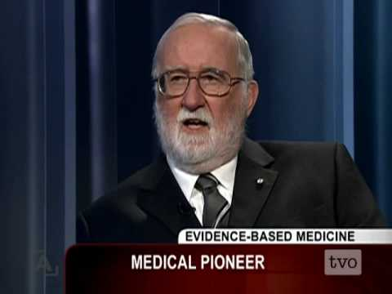
WHAT IS EBM ?
The conscientious, explicit and judicious use of current best evidence in making decisions about the care of individual
patients .
DAVID SACKETT

Slide 4
What is EBM ?
Integration of best research evidence with clinical experience & patient values.

Slide 5
Clinical expertise
Research evidence
Patient preferences

Slide 6
HOW TO PRACTICE EBM??

Slide 7
THE STEPS IN THE EBM
THE PATIENT 1. Start with the patient – a clinical
problem/question arises out of
the care of the patient.
THE QUESTION 2. Construct a well built clinical question
derived from the case.
THE SOURCE 3. Select the appropriate resource(s) and conduct a search.
THE EVALUATION 4. Appraise that evidence for its validity
and applicability

Slide 8
Five steps process ?
1. Asking the right question.
2. Searching for information.
3. Evaluating the evidence for
validity and usefulness.
4. Implement useful findings in
clinical practice
5. Evaluate the whole process

Slide 9
Five steps process ?
Asking the right question.
2. Searching for information.

Slide 10
Step 1:
Formulating an Answerable question

Slide 11
Give us some example for
clinical questions:

Slide 12
Some examples:
Questions from our clinics
What to do with H. pylori +ve patients?
Management of premenopausal women.
Shoud we give statins to all diabetic patients.
Should we treat patients with asymptomatic hyperuricaemia.
Does SSRI improve patients with IBS ?
Should we treat hypertensive patients with diabetes with ACEi?
Is PSA the only marker to detect cancer prostate?

Slide 13
Every patient seen in clinic , needs new information about their
Diagnosis ,
Prognosis or
Management.

Slide 14
Benefits:
First step in the practicing EBM
Good questions are backbone of practicing EBM.
Asking questions is an important step to keep up-to-date.
It is directly relevant to our patients' clinical needs.

Slide 15
Studies
Why do residents fail to answer their clinical questions?
Acad Med. 2005 Feb;80(2):176-82
EBM barriers: including access to medical information, skills in searching information resources, clinical question tracking, time, clinical question priority, personal initiative, team dynamics, and institutional culture.

Slide 16
Types of questions
Focused & Unfocused

Slide 17
Asking Questions
Foreground
Questions
Background
Questions
Novice (Beginner)
Expert

Slide 18
The Question
Background (general information)
Anatomy and Physiology
Pathophysiology
Pharmacology and Toxicology
Differential diagnosis
Diagnostic testing
Treatment
Textbooks, reviews, lectures, experts

Slide 19
The Clinical Question
Foreground (spotlight)
Detailed information
Patient focus
Evidence-based process

Slide 20
How To Ask A Clinical Question (cont)
First, the question should be directly relevant to the problem at hand.
Next, the question should be phrased to facilitate searching for a precise answer.

Slide 21
How To Ask A Clinical Question
The questions :
diagnosis,
prognosis,
treatment,
iatrogenic harm,
quality of care,
or health economics
etc

Slide 22
How To Ask A Clinical Question
The questions :
As specific as possible :
the type of patient, problem, population
the clinical intervention + comparison
the clinical outcome of interest.

Slide 23
Anatomy of a question
Patient/
Population
Intervention
+
Comparison
Outcome
PICO

Slide 24
P I C O
P : Population/Pt
I :Intervention or exposure
C : Comparison intervention
( if relevant )
O : Outcome.

Slide 25
PICO
P : Population : Who is the patient and / or
problem ?
I :Intervention or exposure (diagnostic tests , foods ,
drugs , surgical procedures, etc).
C : Comparison intervention ( if relevant ). For issues of
therapy or harm, there will always a control
(placebo)or alternative intervention (s) or exposure (s).
O : Outcome. What are the patient-relevant consequences
of the exposure in which we are interested or clinical
outcomes.

Slide 26
PICO
P : Population : Who is the patient and / or problem ?
I :Intervention or exposure (diagnostic tests ,
foods , drugs , surgical procedures, etc).
C : Comparison intervention ( if relevant ). For issues of
therapy or harm, there will always a control
(placebo)or alternative intervention (s) or exposure (s).
O : Outcome. What are the patient-relevant consequences
of the exposure in which we are interested or clinical
outcomes.

Slide 27
PICO
P : Population : Who is the patient and / or problem ?
I :Intervention or exposure (diagnostic tests , foods ,
drugs , surgical procedures, etc).
C : Comparison intervention ( if relevant ). For issues of
therapy or harm, there is always a control
(placebo) or alternative intervention (s) or exposure (s).
O of the exposure in which : Outcome. What are the patient-relevant consequences
we are interested or clinical
outcomes.

Slide 28
PICO
P : Population : Who is the patient and / or problem ?
I :Intervention or exposure (diagnostic tests , foods ,
drugs , surgical procedures, etc).
C : Comparison intervention ( if relevant ). For issues of
therapy or harm, there will always a control
(placebo)or alternative intervention (s) or exposure (s).
O : Outcome: What are the patient-relevant
consequences of the exposure in which we are
interested or clinical outcomes.

Slide 29
Scenario and Question
A healthy adult presents to the clinic inquiring about the aspirin that it might prevent heart attack ?

Slide 30
The Question
“In an asymptomatic adult and no risk factors, would the use of aspirin reduce the incidence of cardiovascular events?

Slide 31
Aspirin and Primary Prevention
1. Patient population.
2. Intervention.
3. Comparison intervention.
4. Outcomes.
Asymptomatic adults with no risk factors
Aspirin
Placebo
Incidence of CV events
“In asymptomatic adults no risk factors, would the use of aspirin reduce the incidence of cardiovascular events?

Slide 32
Scenario and Questions (Cont’d)
Scenario
A 32-year-old man, single, teacher in primary school, known to have IBS for last 3 years with no response to conventional medication. I decided to search for effect of TCA in patients with IBS.

Slide 33
Use of TCA in IBS
1. Patient population.
2. Intervention
3. Comparison intervention.
4. Outcomes.
Middle age adults with IBS
Using of TCA
Dietary fibers, Bulking
agents and Mebeverne
Relieving of symptoms
“In middle age adults with IBS, would the use of TCA reduce the pain and improve symptoms?

Slide 34
Step 2

Slide 35
SEARCHING FOR THE Best EVIDENCE

Slide 36
Finding the Evidence
Textbooks – NOT!
Always out of date
Recommendations often not referenced

Slide 37
Finding the Evidence
Textbooks
Clinical Evidence
Published twice yearly
Full version 1900 pages
Concise version 400 pages
CD ROM
Online Access
www.clinicalevidence.com

Slide 38
Identifying The Evidence
Medline
Embase
Primary Sources
Secondary Sources
Systematic Reviews
EBM Guidelines

Slide 39
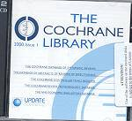

Slide 40
Medline search

Slide 41
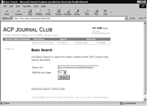
Where to Find the Best Evidence ?
Using Prefiltered sources

Slide 42
Secondary Sources (Prefiltered)?
Focus on relevant information
Evaluate its validity
Come up with valid conclusion for busy clinicians

Slide 43
Secondary sources of Evidence
Examples:

Slide 44
SECONDARY SOURCES A Unique Source…
Its contents are driven by questions rather than by the availability of research evidence.
It is updated every 6 months.

Slide 45
Clinical Evidence
Produced by the BMJ Publishing Group
Updated every six months
www.clinicalevidence.org

Slide 46
The Cochrane Library http://www.cochrane.org

Slide 47
The Cochrane Library
http://www.thecochranelibrary.com

Slide 48
The Cochrane Database of Systematic Reviews (CDSR)
Include more than 50 review groups.
Contains over 3540 completed reviews and review protocols.
The CDSR abstracts are free
The collection is updated quarterly.
Reviews are updated every 2 years.

Slide 50
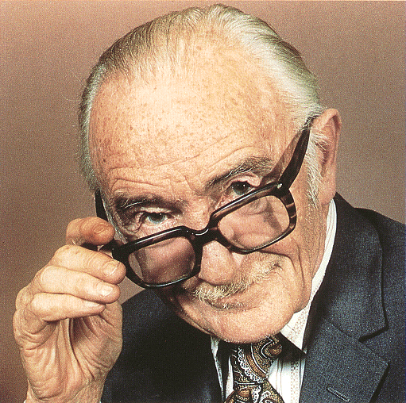
Archie Cochrane
“It is surely a great criticism of our profession that we have not organised a critical summary, by specialty or subspecialty, adapted periodically, of all relevant randomised controlled trials.”

Slide 51
SECONDARY SOURCES
Bandolier is an Oxford based appraisal site with lots of good material.
http://www.jr2.ox.ac.uk/bandolier/bformHJ.html

Slide 53
TRIP Database
The TRIP Database searches 70 sites of high-quality medical information.
The site is updated monthly.
http://www.tripdatabase.com/

Slide 54
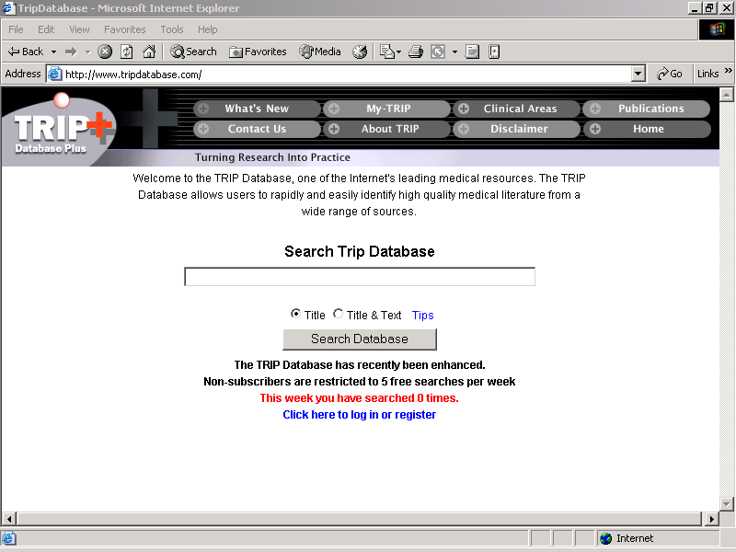

Slide 55
Medline search Primary Source

Slide 56
Role of Statins in patients with diabetes.

Slide 57
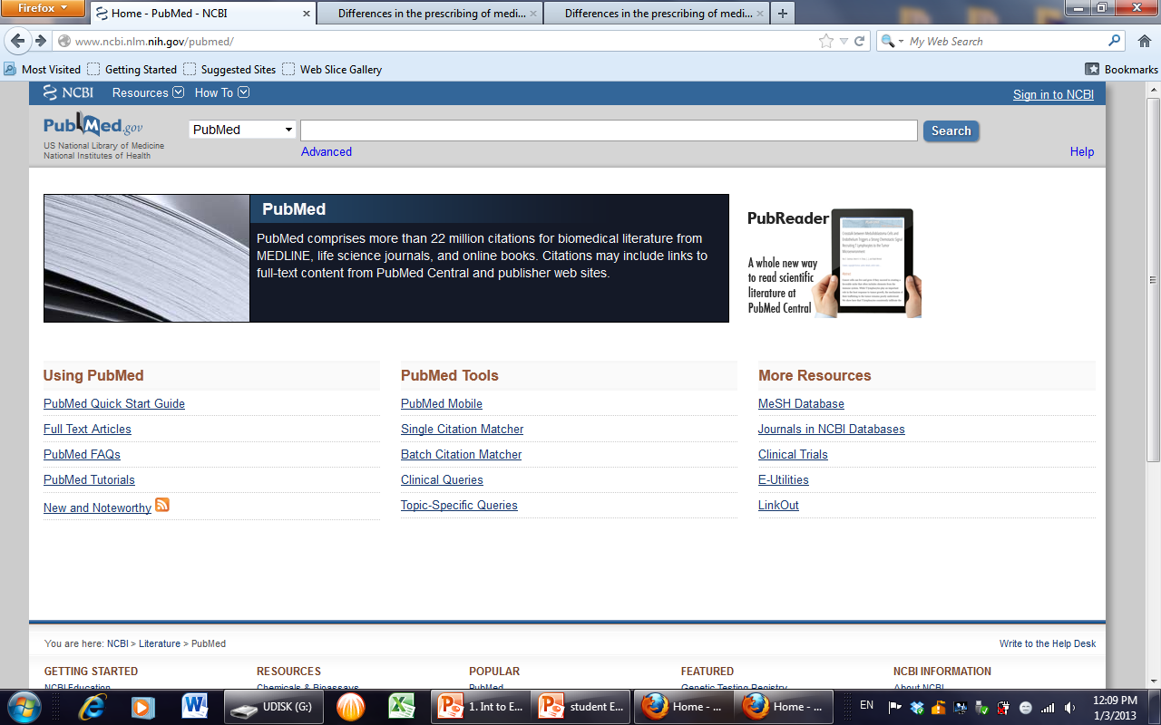

Slide 58
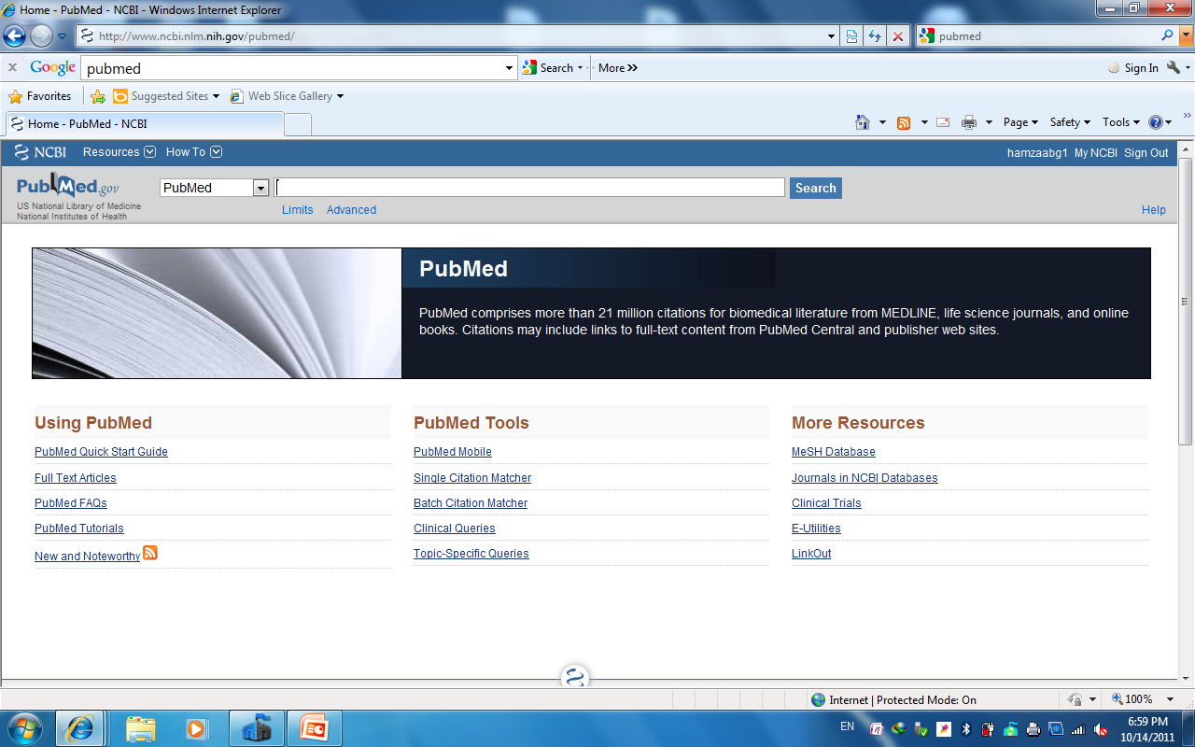

Slide 59
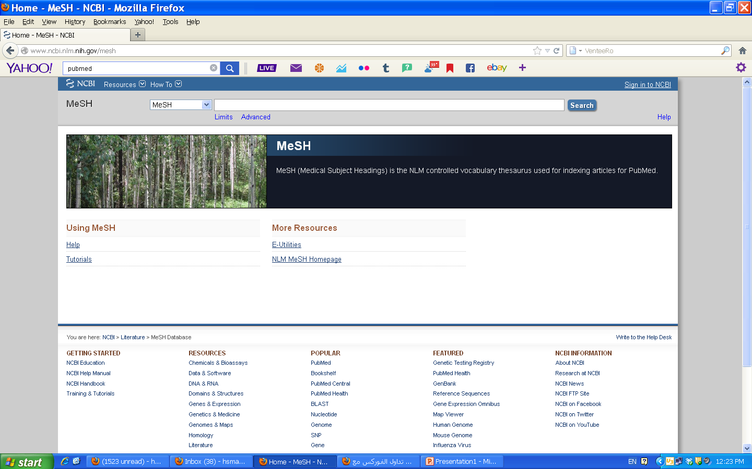

Slide 60
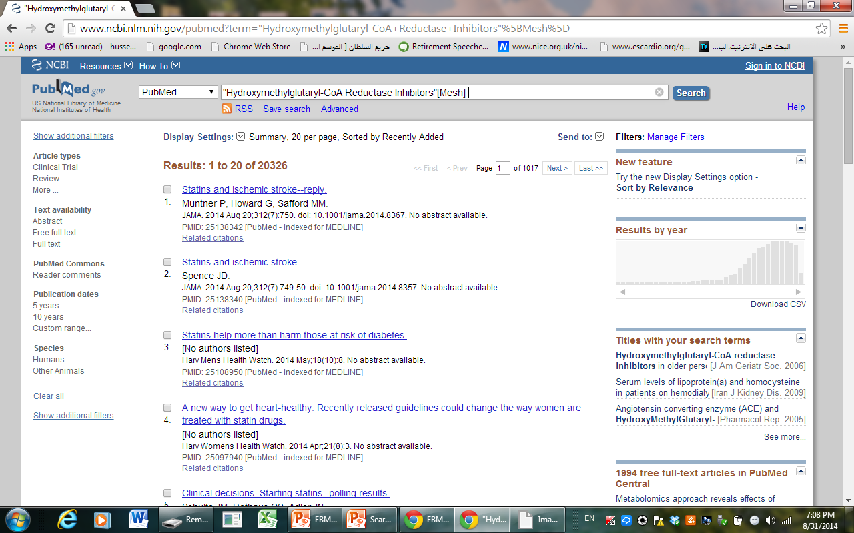

Slide 61
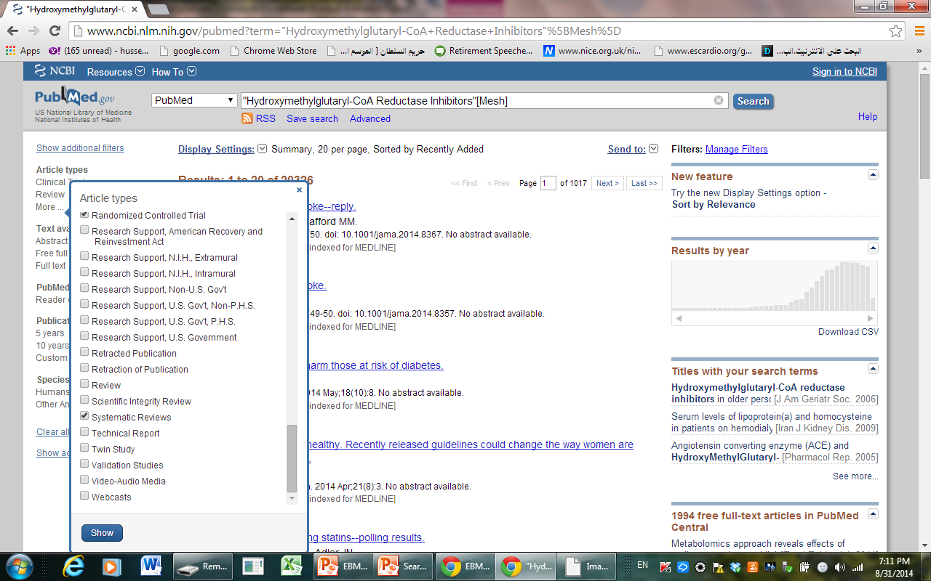

Slide 62
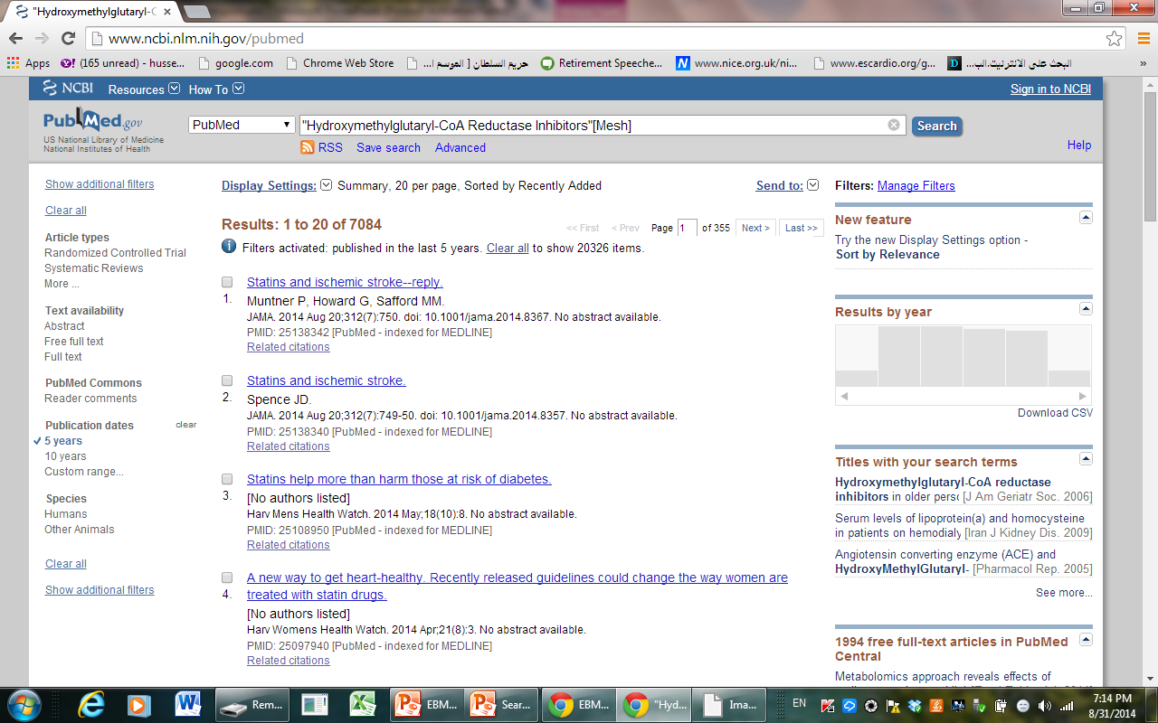

Slide 63
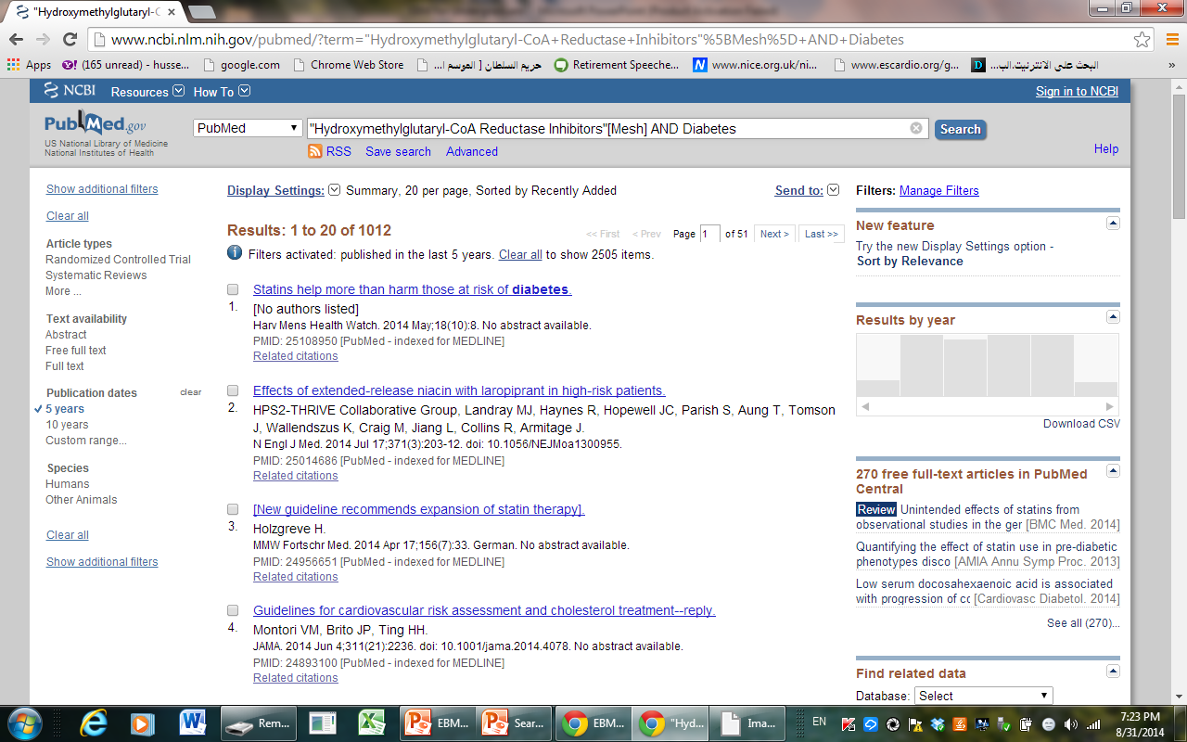

Slide 64
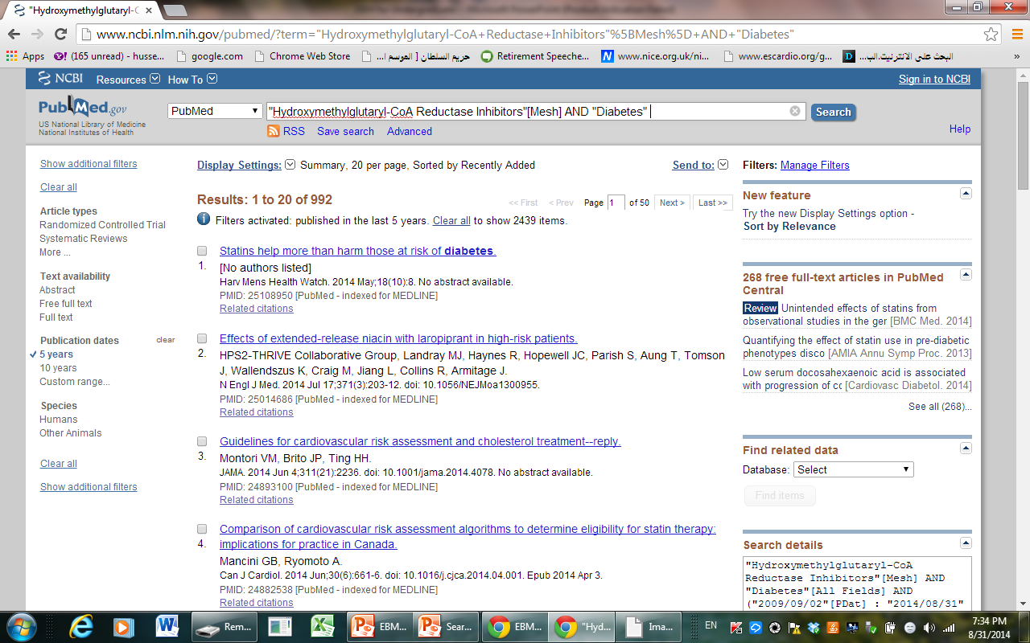

Slide 65
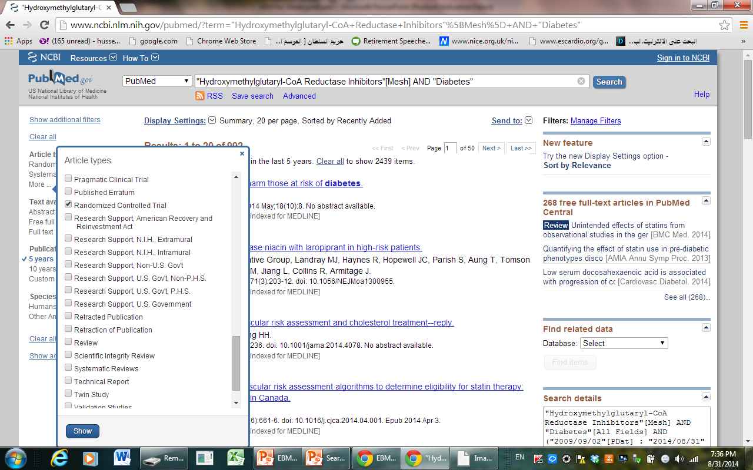

Slide 66
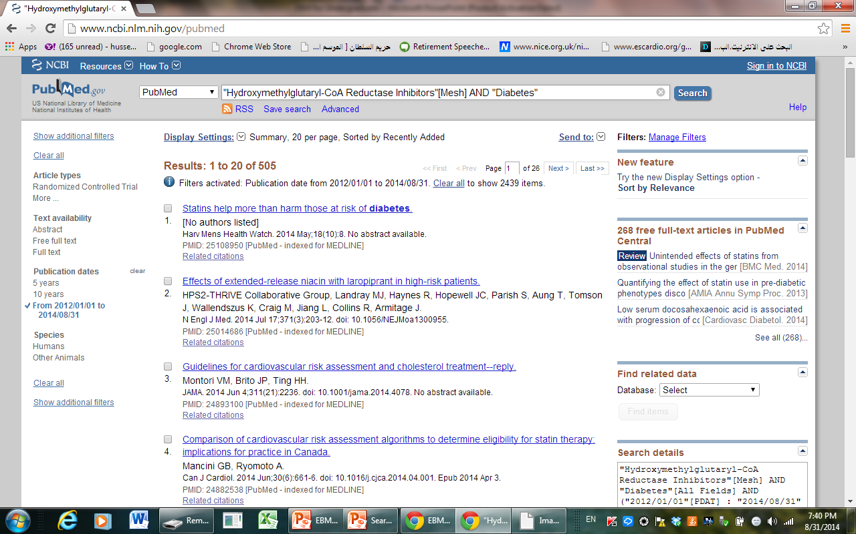

Slide 67
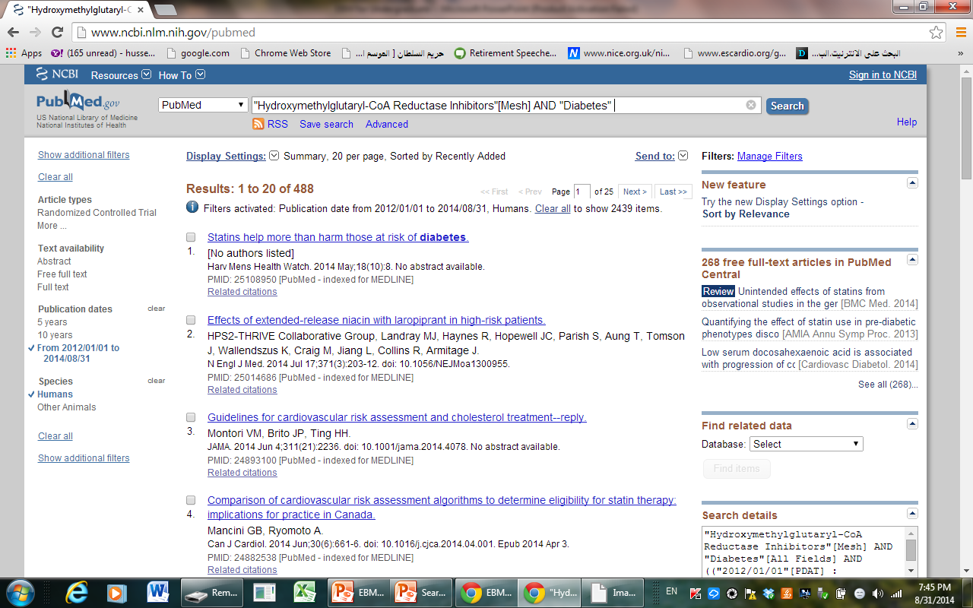

Slide 68
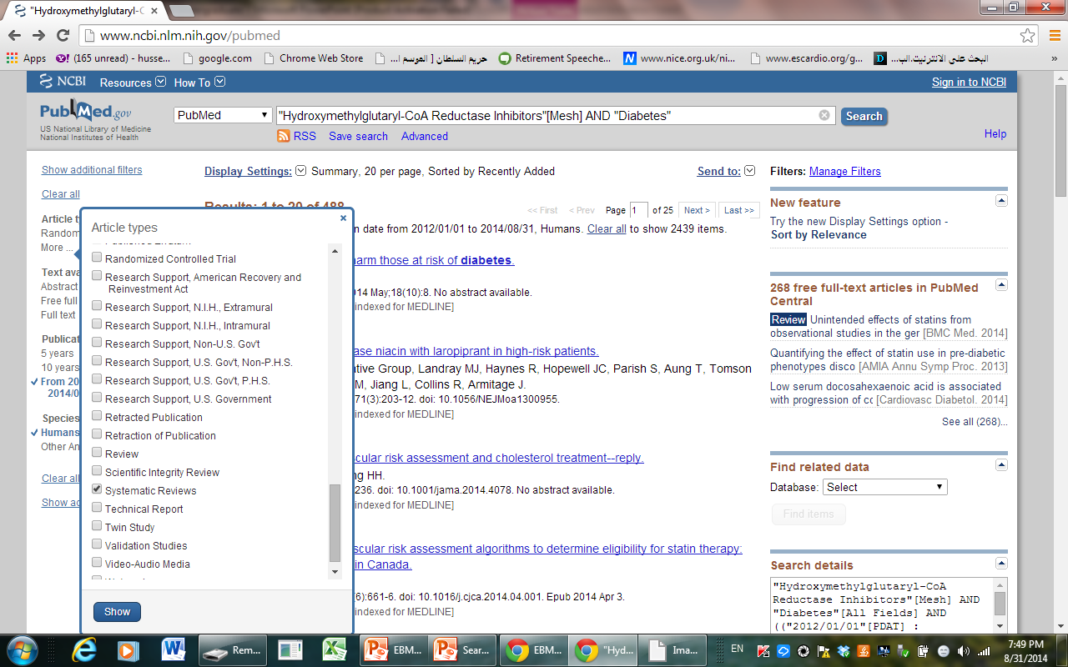

Slide 69
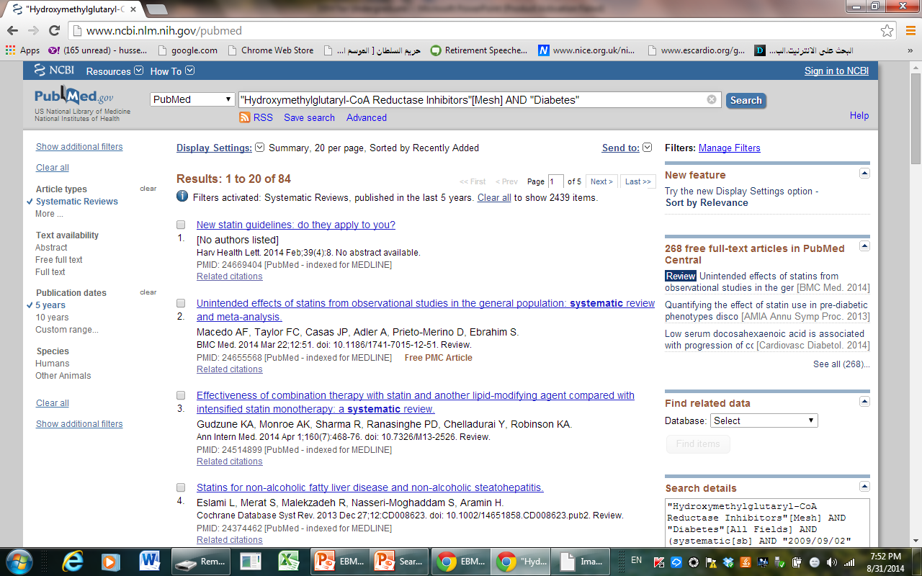

Slide 71
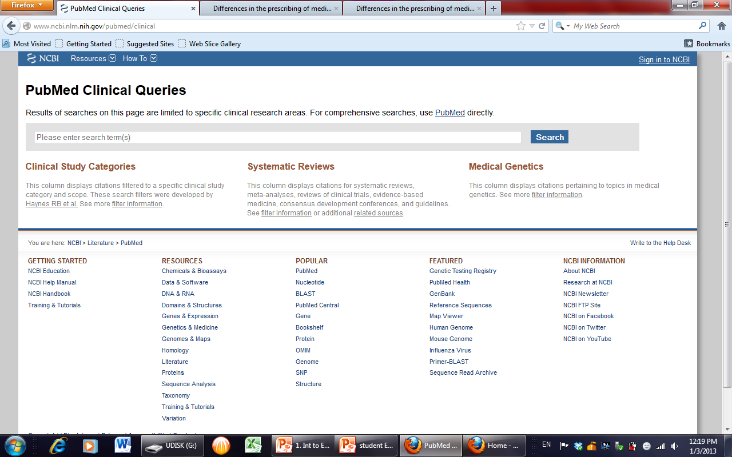

Slide 72
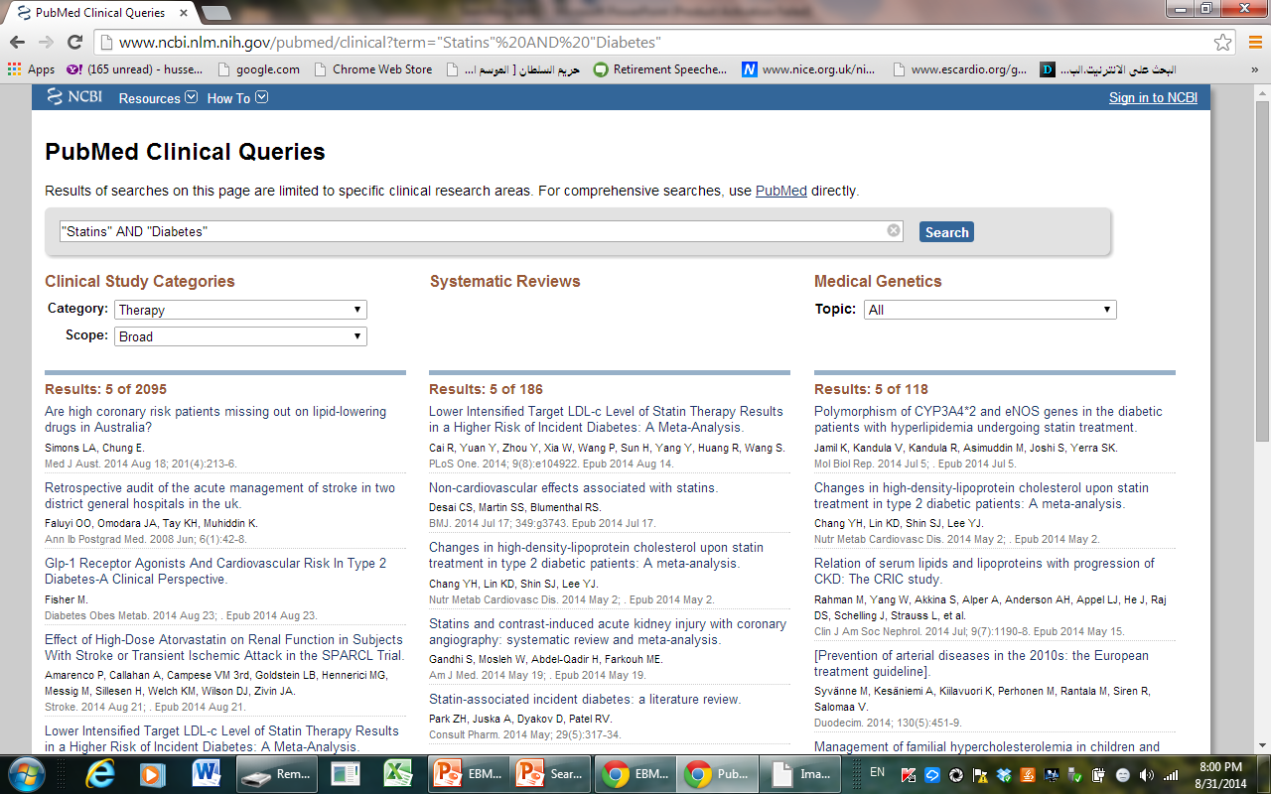

Slide 73
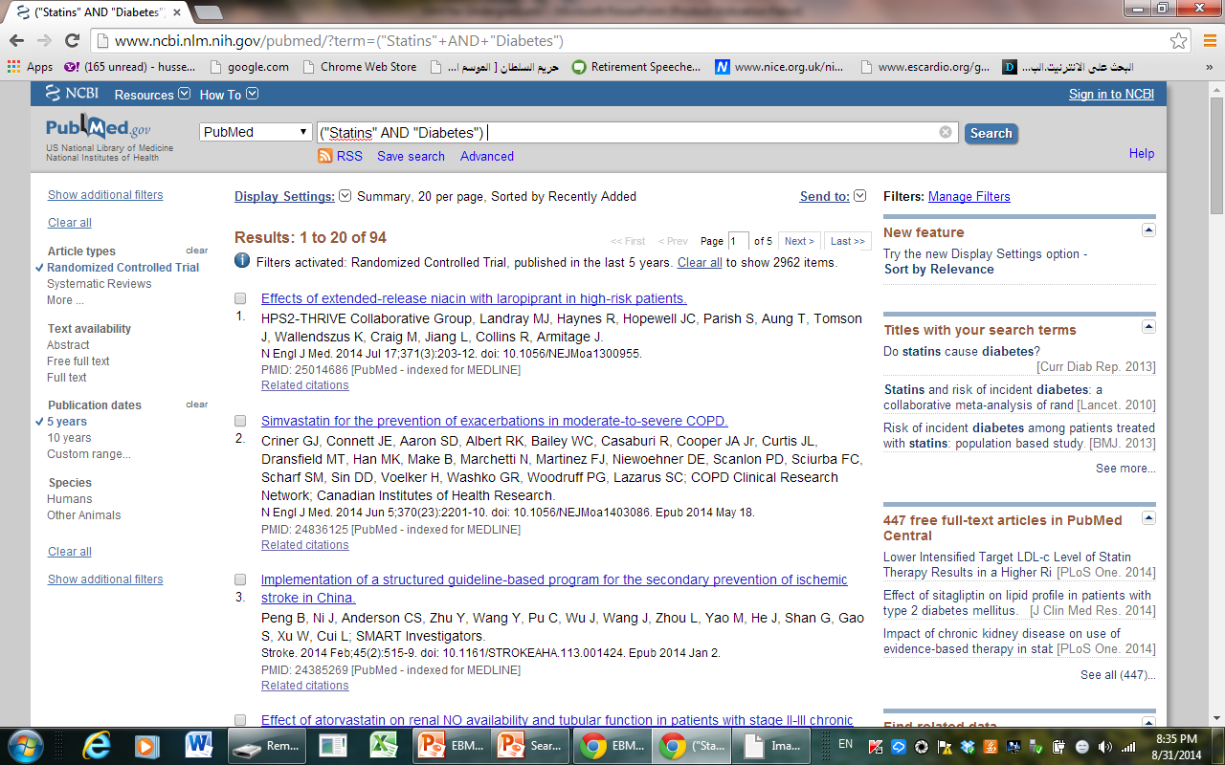

Slide 74
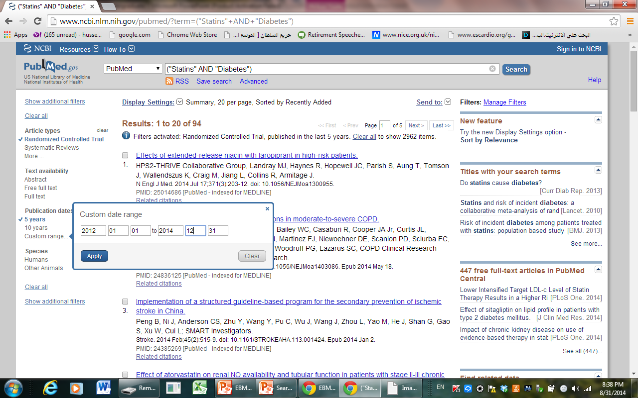

Slide 75
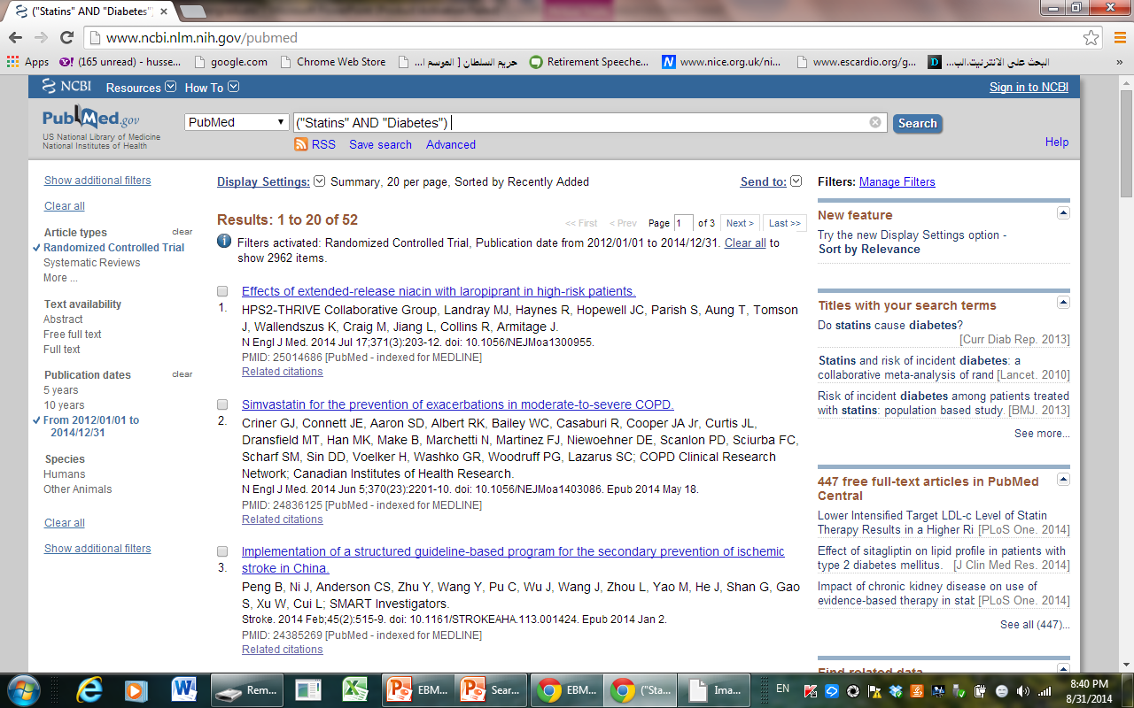

Slide 76
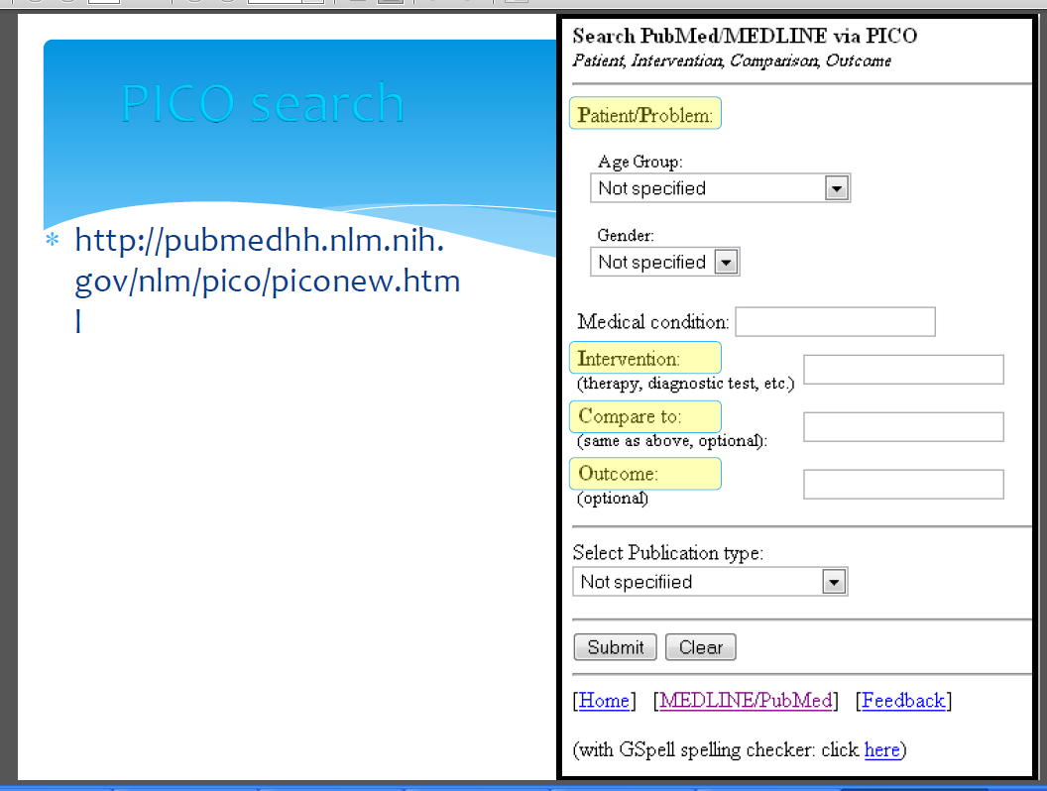

Slide 77
Systematic Review

Slide 78
Step (3): Critical Appraisal of the Evidence
For Systematic Review and Meta Analysis
How Data are collected
Inclusion and exclusion criteria
Type of studies and numbers
Sample size (Exper. And Cont.)
What are the findings
Statistical significance (Yes or No) mention P value or CI.
Conclusion

Slide 79
Step (3): Critical Appraisal of the Evidence
For Randomized Controlled Trials
Check the validity of the evidence (study).

Slide 80
Evaluation of the validity of the attached study: RCT/Therapy
Q1. Was the assignment of patients to treatments Randomized?
Q2. Were all patients who entered the trial properly accounted for and attributed at its conclusion?
Was follow up Complete?
Were patients analyzed in the groups to which they were randomized?
Q3. Were patients, health workers and study personnel “Blind” to treatment?
Q4. Were the groups are similar at the start of the trial?
Q5. A side from the experimental intervention, were the groups are treated equally?

Slide 81
STEP (4)
Calculate ARR and NNT or NNH
Interpret what does it means.
Applied only for RCT
NNT if < 10 Good
> 10 – 100 Moderate
> 100 Poor
If there is no difference between Exper. and Cont.
(P value is not significant) do not calculate NNT.

Slide 82
STEP (5)
Write the conclusion of evidence and if it is applicable for your patient.

Slide 83
UpToDate
A collection of well-referenced reviews.
Includes 40,000 pages of text, 8,000 graphics, and an extensive drug database.
Updates are made three times a year.
Contains specialty-focused information and includes multiple specialties.

Slide 84
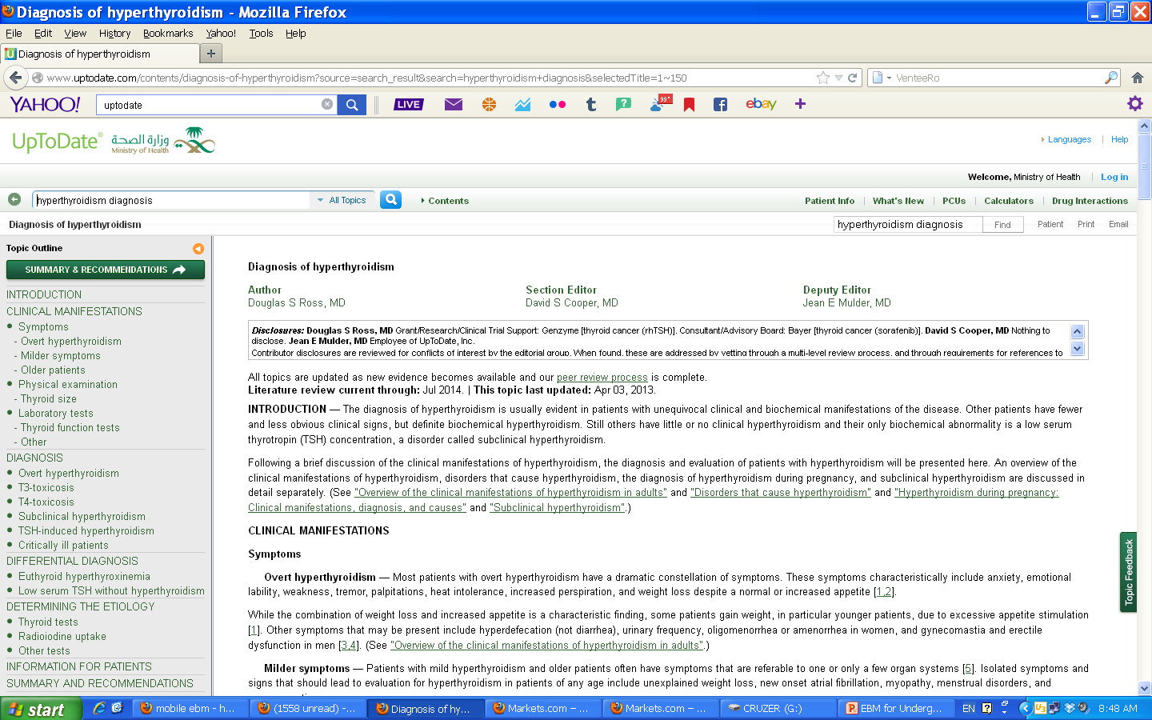

Slide 85
Finding the Evidence

Slide 87
Agency for Health Research and Quality

Slide 88
Conclusion
The practicing EBM is the asking of a well built clinical answerable question.
Asking questions is an important step to keep up-to-date.
Finding the Evidence /Search

Slide 89
Take Home Message
To Have an answer for our question we Have
to have a
Well built question

Slide 90
What should be included in EBM presentation by Student
Case Scenario
Clinical Question
Formulate the Question PICO
Search Strategy (Pubmed; RCT, Systematic R.)
The Study selected (RCT and Recent within the last 3 years)
Critical Appraisal, Validity
NNT or NNH has to be included and to be interpreted when applicable.
Conclusion and whether applied to your patient

Slide 91
What should be included in EBM REPORT by Student
1. All what presented in EBM Presentation
2. The Study should be included
Write your Name and Computer number
Write the name of Supervisor
Submit the report to supervisor in the session

Slide 92
THANK YOU

Slide 93
Evidence Based Medicine Varenicline And Smokeless Tobacco Cessation
Abdulaziz Khalid Alhujairy
Supervisor
Dr. Hussain Sa’ad

Slide 94
Question Scenario
Mr. Mohammed is 46-year-old Saudi man came to PHC for regular check up . He’s a long distance truck driver and he used to chew tobacco to alert him during his travelling and to reduce his weight as he claims . He wants to quit chewing tobacco because it causes bad infected ulcers in his mouth and bad breath that his family can’t tolerate any more .
He asked help for a good medicine that can help him to stop using tobacco .
I thought about Varenicline if it could help him to stop chewing tobacco or not ?

Slide 95
Question Formulation
P I C O
P: Tobacco chewer
I: Varenicline
C: Placebo
O: Varenicline is effective to stop
chewing tobacco

Slide 96
EBM Question
Is Varenicline effective in stopping tobacco chewing (Using) ?

Slide 97
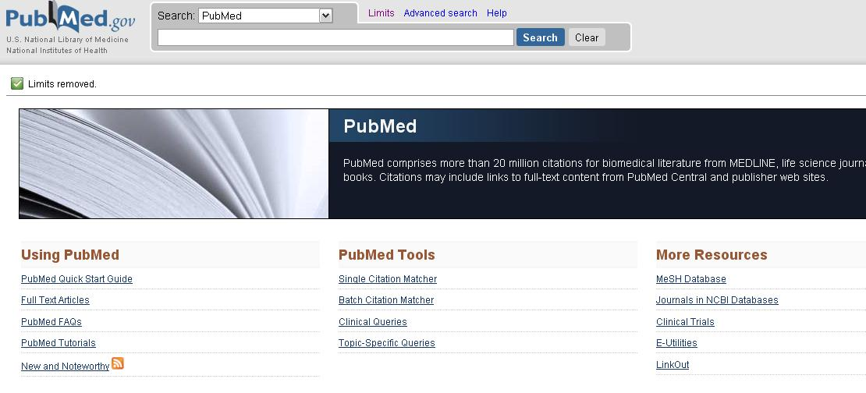
Search Strategy
I used PubMed.
Clinical Queries manner:

Slide 98
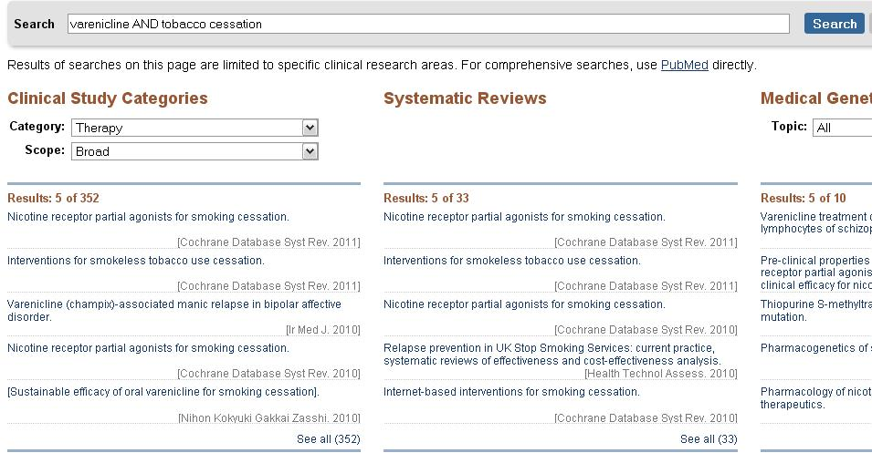
Search Strategy
keywords: Varenicline AND tobacco cessation
Category: therapy.
Scope: broad .

Slide 99
Search Strategy
I found 352 Articles

Slide 100
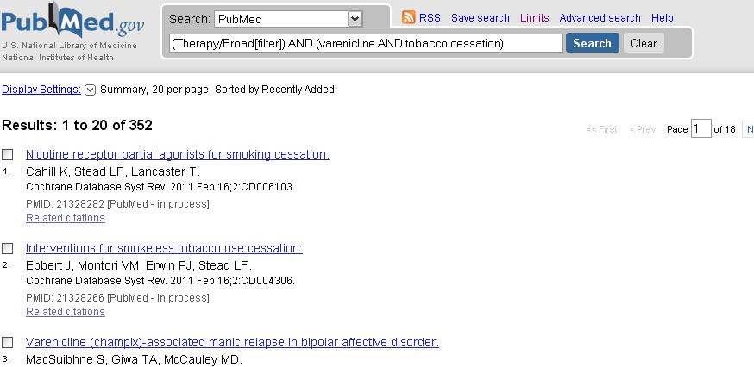
Search Strategy
Then I pressed see all under clinical study category to see all the results

Slide 101
Search Strategy
By limitation:
Choosing Randomized Control Trials type.
Last 3 years

Slide 102
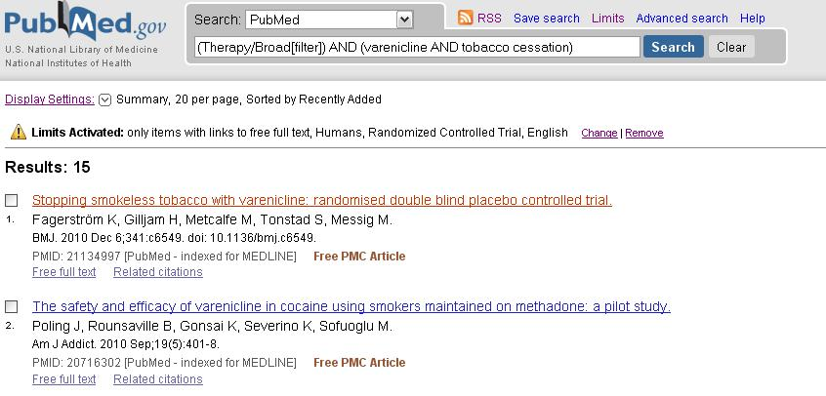
Search Strategy
I got 15 articles
Then I choose: Stopping smokeless tobacco with varenicline: randomised double blind placebo controlled trial

Slide 103
Search Strategy

Slide 104
Critical Appraisal
The patient were randomized in 1:1 ratio using a telephone interactive voice response system (IVRS) and the randomization list is concealed .
A total of 447 volunteers screened for this trial, 432 were randomized into one of two groups (214 on active treatment + 218 on placebo)
One patient dropped out from active group before receiving any treatment after randomization .
The follow up wasn’t complete because 91 subjects withdrew from the study (43 on active and 48 on placebo). 180 patients in each group completed the study .

Slide 105
Critical Appraisal
19 patients on active compound and 9 on placebo discontinued due to side effects
Duration 12 weeks of treatment + 14 weeks of follow up (26 weeks)
patients were analyzed in the groups to which they were randomized (intention to treat)
The patients and clinicians were blind to the treatment (double-blind)
the groups similar at the start of the trial
Both groups treated equally

Slide 106
Critical Appraisal

Slide 107
According the primary end point at the end of the treatment : Last 4 weeks of 12 weeks treatment period
 | Stopped chewing | Didn’t stop | Total
varenicline | 125 | 88 | 213
placebo | 85 | 133 | 218
Total | 210 | 221 | 431
Experimental event rate EER = 125/213 = 0.587
Control event rate CER = 85/218 = 0.390
Absolute risk reduction ARR = EER – CER
Absolute risk reduction ARR = 0.587 − 0.390 = 0.197
Number need to treat NNT = 1/ARR
Number need to treat NNT = 1/0.197
Number need to treat NNT = 5.08 ≈ 5

Slide 108
Results
We need to treat 5 tobacco users for 12 weeks with varenicline to make 1 more patient stop chewing tobacco compared to placebo

Slide 109
According the secondary end point of long term of Continuous abstinence (weeks 9-26)
 | Stopped chewing | Didn’t stop | Total
varenicline | 95 | 118 | 213
placebo | 73 | 145 | 218
Total | 168 | 263 | 431
Experimental event rate EER = 95/213 = 0.446
Control event rate CER = 73/218 = 0.335
Absolute risk reduction ARR = EER – CER Absolute risk reduction ARR = 0.446 − 0.335 = 0.111
Number need to treat NNT = 1/ARR Number need to treat NNT = 1/0.111 Number need to treat NNT = 9.01 ≈ 9

Slide 110
Results
We need to treat 9 tobacco users for 12 weeks with varenicline and follow them up for another 14 weeks to make 1 more patient stop chewing tobacco compared to placebo

Slide 111
Conclusion
This study for tobacco chewer . Show significant cessation of using tobacco when using varenicline compared with placebo for at the end of the treatment period week 12 and Continuous abstinence at the end of the study week 26 . There is no significant adverse event with Varenicline and it was well tolerated . So varenicline is very effective and safe for cessation of tobacco using .

Slide 112
Thank You

