Slide 1
Osteoporosis & Vitamin D deficiency
Done by :
hussam alorabi,
Abdullah alzahrani
Mohammed al jarbou

Slide 2
objectives
Definition of Oteoporosis and Osteomalacia / Rickets
Highlight on Vitamin D deficiency
Prevalence in world / Saudi Arabia
Factors lead to Osteoporosis and Vitamin D deficiency
Vitamin D and Comorbidities
How patients could be presented
Common fractures with osteoporosis
Diagnosis
Management & Prevention of Osteoporosis

Slide 4
Question 1:
Osteoporosis is :
1- A disease of children caused by vitamin D deficiency .
2- A condition in which the bones become brittle and fragile from loss of tissue .
3- A condition in which the bones become soft due to decreased in mineralization .
4- All of the above

Slide 5
Question 2:
after menopause
Osteoporosis is most likely to strike:
1- In childe hood
2- during perimenopause
3- after menopause
4- in adolescence

Slide 6
Question 3:
Osteoporosis is a common and disabling disease, prevalence of post menopausal osteoporosis in Saudi Arabia is:
A- 10% to 20%
B- 20% to 30%
C-30% to 40%
D-40% to 50%

Slide 7
Question 4:
The increased incidence of Osteoporosis in post-menopausal women is caused by:
A- Decreased Progesterone
B- Decreased Estrogen
C- Sedentary lifestyle
D- None of the above

Slide 8
Question 5:
To diagnose osteoporosis, bone mineral density must be:
A-1.5 Standard deviations below the mean.
B- 2.0 Standard deviations below the mean.
C- 2.5 Standard deviations below the mean.
D- 3.0 Standard deviations below the mean.

Slide 9
Objectives :
Definition of Oteoporosis and Osteomalacia / Rickets
Highlight on Vitamin D deficiency
Prevalence in world / Saudi Arabia
Factors lead to Osteoporosis and Vitamin D deficiency
Vitamin D and Comorbidities
How patients could be presented
Common fractures with osteoporosis
Diagnosis
Management & Prevention of Osteoporosis

Slide 10
Osteoporosis:
A medical condition in which the bones become brittle and fragile from loss of tissue, typically as a result of hormonal changes, or deficiency of calcium or vitamin D.
-Osteopenia :
Condition in which the protein and mineral content of bone tissue is reduced, but less severely than in osteoporosis
-Osteomalcia:
Softening of the bones, typically through a deficiency of vitamin D or calcium.
-Rickets:
A disease of children caused by vitamin D deficiency, characterized by imperfect calcification, softening, and distortion of the bones typically resulting in bow legs.

Slide 11
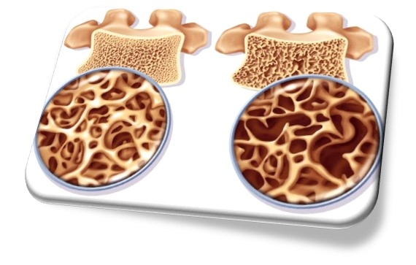
What is Osteoporosis
Osteoporosis, is a systemic disease characterized by low bone mass and structural deterioration of bone tissue, leading to bone fragility and an increased risk of fractures . Men and women are affected by osteoporosis .
https://www.youtube.com/watch?v=rHyeZhcoZcQ

Slide 12
Objectives :
Definition of Oteoporosis and Osteomalacia / Rickets
Highlight on Vitamin D deficiency
Prevalence in world / Saudi Arabia
Factors lead to Osteoporosis and Vitamin D deficiency
Vitamin D and Comorbidities
How patients could be presented
Common fractures with osteoporosis
Diagnosis
Management & Prevention of Osteoporosis

Slide 13
Notes:
dermal synthesis is the major natural source of the vitamin. Vitamin D from the diet or dermal synthesis is biologically inactive and requires enzymatic conversion to active metabolites (figure 1). Vitamin D is converted enzymatically in the liver to 25-hydroxyvitamin D (25[OH]D), the major circulating form of vitamin D, and then in the kidney to 1,25-dihydroxyvitamin D, the active form of vitamin D.
Vitamin D and its metabolites have a significant clinical role because of their interrelationship with calcium homeostasis and bone metabolism. Rickets (children) and osteomalacia (children and adults) due to severe vitamin D deficiency are now uncommon except in populations with unusually low sun exposure, lack of vitamin D in fortified foods, and malabsorptive syndromes. Subclinical vitamin D deficiency, as measured by low serum 25(OH)D, is very common. In the National Health and Nutrition Examination SURVEY (NHANES) 2005 to 2006, 41.6 percent of adult participants (≥20 years) had 25(OH)D levels below 20 ng/mL (50 nmol/L) [1]. This degree of vitamin D deficiency may contribute to the development of osteoporosis and an increased risk of fractures and falls in the elderly. Vitamin D may also regulate many other cellular functions.

Slide 14
Vitamin D
Source: Skin and diet
Stores: 25 OH Vitamin D3 (calcidiol)
Active form: 1,25(OH)2 Vitamin D (calcitriol)
Functions:
Calcium absorption in the intestines and is required for the efficient utilization of dietary calcium. Calcium and phosphate are two minerals that are essential for normal bone formation.
Notes:
25-hydroxyvitamin D (25[OH]D) is the major circulating form of vitamin D. It has a half-life of two to three weeks, compared with 24 hours for parent vitamin D [2]. It has activity at bone and intestine, but is less than 1 percent as potent as 1,25-dihydroxyvitamin D, the most active form of vitamin D. The half-life of 1,25-dihydroxyvitamin D is approximately four to six hours. 1,25-dihydroxyvitamin D binds to intracellular receptors in target tissues and regulates gene transcription [3]. It appears to function through a single vitamin D receptor (VDR), which is nearly universally expressed in nucleated cells. The receptor is a member of the class II steroid hormone receptor, and is closely related to the retinoic acid and thyroid hormone receptors [4]. Its most important biological action is to promote enterocyte differentiation and the intestinal absorption of calcium. Other effects include a lesser stimulation of intestinal phosphate absorption, direct suppression of parathyroid hormone (PTH) release from the parathyroid gland, regulation of osteoblast function, and permissively allowing PTH-induced osteoclast activation and bone resorption (figure 1).

Slide 15
Importance of osteoporosis

Slide 16
Importance of osteoporosis
Osteoporosis is the most common metabolic bone disorder.
Fractures due to osteoporosis have a serious impact on a person’s health, happiness and quality of life. They can result in chronic pain, long-term disability and death.
At least one in three women and one in five men over the age of fifty around the world will suffer an osteoporotic fracture.

Slide 17
Continue…
Osteoporosis has a dormant course until complicated by fractures that occur following minimal trauma. These fractures are common and place an enormous burden on aging individuals and a major economic toll on the nation.
Osteoporotic fractures are those occurring from a fall from a standing height or less, (low impact trauma)

Slide 18
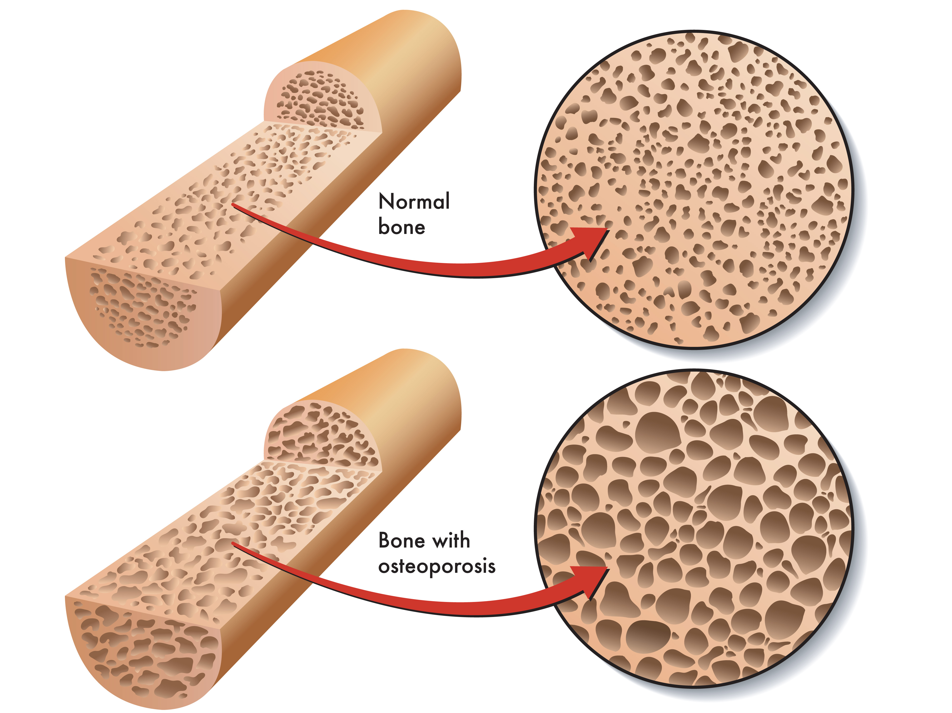

Slide 19
Objectives :
Definition of Oteoporosis and Osteomalacia / Rickets
Highlight on Vitamin D deficiency
Prevalence in world / Saudi Arabia
Factors lead to Osteoporosis and Vitamin D deficiency
Vitamin D and Comorbidities
How patients could be presented
Common fractures with osteoporosis
Diagnosis
Management & Prevention of Osteoporosis

Slide 20
Prevalence in world
Osteoporosis is considered a serious public health concern.
it is estimated that over 200 million people worldwide suffer from this disease.
Worldwide, osteoporosis causes more than 8.9 million fractures annually, resulting in an osteoporotic fracture every 3 seconds

Slide 21
Continue…
Approximately 30% of all postmenopausal women have osteoporosis in the United States and in Europe. At least 40% of these women² and 15-30% of men³ will sustain one or more fragility fractures in their remaining lifetime.

Slide 22
Prevalence in Saudi Arabia
In Saudi Arabia, osteoporosis is already a serious issue a report in the eastern region of Saudi Arabia indicates an incidence of postmenopausal osteoporosis (PMO) of 30 percent to 40 percent, with over 60 percent of postmenopausal women already having some degree of osteopenia.
Saudi Med J. 2004 Oct;25(10):1423-7.
Lifestyle factors play a significant role in the high prevalence of this disease, with low calcium intake, lack of physical activity and a high prevalence of vitamin D deficiency, being amongst the main culprits.

Slide 23
Continue…
Despite the fact that post-menopausal women are considered a high risk group in terms of osteoporosis, awareness of the disease still remains low.
Nearly half the women in Saudi are at risk of developing osteoporosis, and already have the warning signs, such as low bone density levels.
If we are to truly address this issue in Saudi, we must start to educate citizens on the best ways to prevent the development of this disease.

Slide 25
Financial burden
In Europe a rise from €98 billion in 2010 to €120 billion in 2025, corresponding to an increase of 22%.
With the Kingdom’s population of 1,461,401 aged 50 or over, it is estimated that approximately 8,768 suffer from femoral fractures each year, costing the state $1.14 billion.

Slide 27
Objectives :
Definition of Oteoporosis and Osteomalacia / Rickets
Highlight on Vitamin D deficiency
Prevalence in world / Saudi Arabia
Factors lead to Osteoporosis and Vitamin D deficiency
Vitamin D and Comorbidities
How patients could be presented
Common fractures with osteoporosis
Diagnosis
Management & Prevention of Osteoporosis

Slide 28
Risk factors

Slide 29
Non-Modifiable
Gender (female)
Advanced Age
Family History
Previous Fracture
Race (Asian, European)
Body build (Small stature)

Slide 30
Modifiable
Secondary to Medical disease
Drug induced Osteoporosis
Smoking
Low calcium intake
Vitamin D deficiency
High Alcohol intake
Physical inactivity
Endurance training in females (Amenorrhea)

Slide 31
Calcium Intake
According to the National Osteoporosis Foundation (NOF):
Adults under age 50 need a total of 1,000 mg of calcium from all sources every day.
Adults 50 and older need a total of 1,200 mg of calcium from all sources every day.
Food remains the best source of calcium.
Calcium supplements should only be used when adequate dietary intake cannot be achieved
Notes:
Calcium is important for preventing osteoporosis and bone disease, as it's a major building-block of our bone tissue - our skeleton houses 99 % of our body's calcium stores. The calcium in our bones also acts as a reservoir for maintaining calcium levels in the blood, which is essential for healthy nerves and muscles.

Slide 32
Source of Calcium
Produce | Serving Size | Estimated Calcium*
Oranges | 1 whole | 55 mg
Yogurt, plain, low-fat | 6 oz | 310 mg
Yogurt with fruit, low-fat | 6 oz | 260 mg
Mozzarella, part-skim | 1 oz | 210 mg
Cheddar | 1 oz | 205 mg
Salmon, canned with bones | 3 oz | 180 mg
Sardines, canned with bones | 3 oz | 325 mg
Soy Beans, green, boiled | 8 oz | 175 mg
Broccoli rabe | 8 oz | 200 mg
Orange juice and other fruit juices, fortified | 8 oz | 300 mg
Beans, baked, canned | 4 oz | 160 mg
National Osteoporosis Foundation (NOF)

Slide 33
Vitamin D Intake
Age Group | Recommended Dietary Allowance (IU/day)
Infants 0-6 months | 400
Infants 6-12 months | 400
1-70 years | 600 **
>70 years | 800
** IOF recommendations for adults aged 60 years and over are 800 to 1000 IU/day for falls and fracture protection
Notes:
Vitamin D is essential for the development and maintenance of bone, both for its role in assisting calcium absorption from food in the intestine, and for ensuring the correct renewal and mineralization of bone tissue.

Slide 34
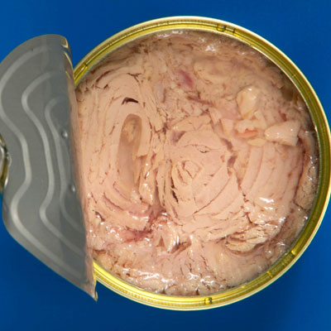
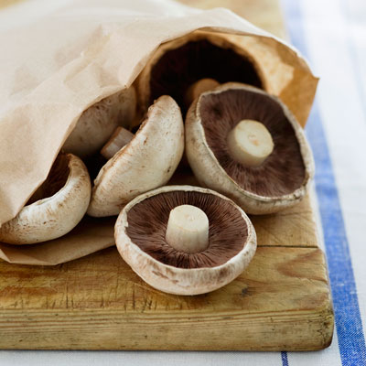
Source of Vitamin D
Sunlight
3-ounce sockeye salmon fillet contains about 450
Canned light tuna has the most vitamin D—about 150 IUs per 4 ounces.
Certain mushrooms will give you 400 IUs of vitamin D per 3-ounce

Slide 35
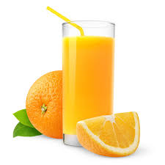
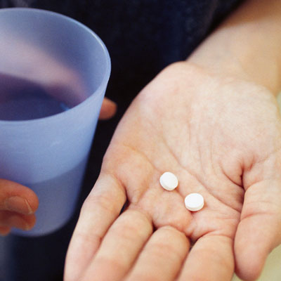
Source of Vitamin D
8-ounce glass of milk contains at least 100 IUs of vitamin D.
One 8-ounce glass of fortified juice usually has around 100 IUs of vitamin D
Too much vitamin D can be toxic, however. The IOM sets the upper limit at 4,000 IUs for people aged 9 and older.
One yolk will give you about 40 Ius.

Slide 36
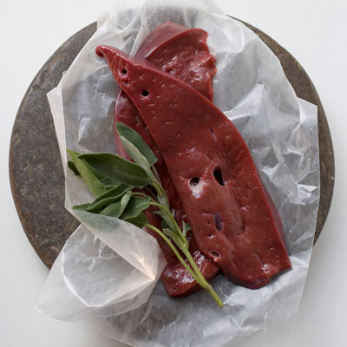
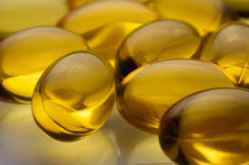
Source of Vitamin D
Fortified cereal: A 1-cup (29 gram) serving of Multi Grain Cheerios with one-half cup of fortified milk is 90 IUs
Beef liver: 3.5-ounce serving of cooked beef liver contains about 50 IUs
Cod liver oil: One tablespoon contains about 1,300 IUs of vitamin D which is more than twice the recommended dietary allowance of 600 IUs per day.

Slide 37
Vitamin D Deficiency
Inadequate exposure to sunlight
Low vitamin intake
Chronic Kidney Disease
Fat Malabsorption
Dark Skin
Obesity
Medications (Anti-Epileptic, Corticosteroids,...)

Slide 39
Objectives :
Definition of Oteoporosis and Osteomalacia / Rickets
Highlight on Vitamin D deficiency
Prevalence in world / Saudi Arabia
Factors lead to Osteoporosis and Vitamin D deficiency
Vitamin D and Comorbidities
How patients could be presented
Common fractures with osteoporosis
Diagnosis
Management & Prevention of Osteoporosis

Slide 40
Consequences of Vitamin D Deficiency
Low blood calcium (hypocalcemia).
Low blood phosphate (hypophosphatemia)
Rickets (softening of the bones during childhood)
Osteomalacia (softening of the bones in adults).
Vitamin D insufficiency is often associated with reduced bone density an increased risk of falls, and possibly fractures, all of which can seriously affect a person's quality of life.
Notes:
Increased risk of death from cardiovascular disease
Cognitive impairment in older adults
Severe asthma in children
Cancer
Research suggests that vitamin D could play a role in the prevention and treatment of a number of different conditions, including type1 and type 2 diabetes, hypertension, glucose intolerance, and multiple sclerosis

Slide 41
Smoking
Cigarette smoking was first identified as a risk factor for osteoporosis more than 20 years ago.
Recent studies have shown a direct relationship between tobacco use and decreased bone density.
How does smoking affect bon health?
Cigarette smoke generates huge amounts of free radical and disturb balance of hormones (like estrogen ) that bones need to stay strong.
Increased levels of the hormone cortisol, which leads to bone breakdown.
Smoking also damages blood vessels, so there is poor blood supply of oxygen.

Slide 42
Physical Inactivity
People who spend a lot of time sitting have a higher risk of osteoporosis than do those who are more active.
Physical activity prevent osteoporosis is based on evidence that it can regulate bone maintenance and stimulate bone formation and this reducing the overall risk of falls and fractures.
Any weight-bearing exercise and activities that promote balance and good posture are beneficial for your bones, but walking, running, jumping, dancing and weightlifting seem particularly helpful.
Most experts recommend exercising for at least 30 minutes three times per week.
Notes:
is based on evidence that it can regulate bone maintenance and stimulate bone formation including the accumulation of mineral, in addition to strengthening muscles, improving balance, and thus reducing the overall risk of falls and fractures.

Slide 43
Medical Diseases
Endocrine Disorders:
Hyperthyroidism, Hyperparathyroidism, Cushing syndrome, Adrenal insufficiency, Diabetes mellitus.
Androgen insensitivity, Hyperprolactinemia, Turner and Klinefelter syndrome.
Rheumatic Diseases:
Rheumatic arthritis, Ankylosing spondylitis, SLE.

Slide 44
Medical Diseases
Inherited Disorders:
Cystic fibrosis, Marfan syndrome, Ehlers-Danlos syndrome, Glycogen storage Diseases, Gaucher’s Disease.
Hematologic Diseases:
Leukemia, Lymphoma, Sickle cell, Thalassemia, Hemophilia.
Gastrointestinal Diseases:
Celiac disease, Inflammatory bowel disease, Lactose intolerance.
Inherited Disorders:
Cystic fibrosis, Marfan syndrome, Ehlers-Danlos syndrome, Glycogen storage Diseases, Gaucher’s Disease.

Slide 45
Medications
Steroids induced Osteoporosis
L-Thyroxine(hight ammount)
Phenytoin and Barbiturates
Aromatase Inhibitors and methotrexate
Thiazolidinediones
Chronic Lithium use

Slide 46
Osteoporosis risk factors (summary)

Slide 47
The FRAX Osteoporosis Risk Calculator
The FRAX was developed by the World Health Organization (WHO)
"FRAX is a computer-based algorithm that employs bone density, age, and a number of clinical risk factors to help patients and their doctors predict the likelihood of having a fracture in the next 10 years .

Slide 48
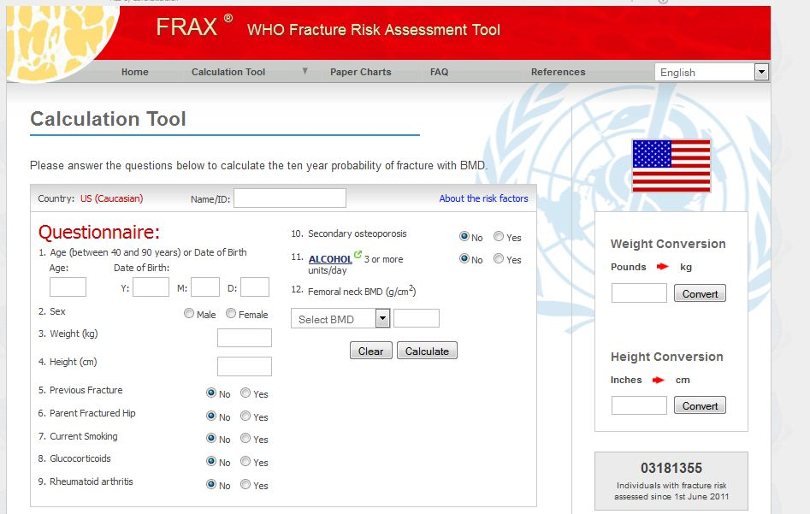
http://www.shef.ac.uk/FRAX/
Notes:
To use the tool, all you need is a computer with Internet access. Here’s how to assess your osteoporosis risk for free

Slide 49
Objectives :
Definition of Oteoporosis and Osteomalacia / Rickets
Highlight on Vitamin D deficiency
Prevalence in world / Saudi Arabia
Factors lead to Osteoporosis and Vitamin D deficiency
Vitamin D and Comorbidities
How patients could be presented
Common fractures with osteoporosis
Diagnosis
Management & Prevention of Osteoporosis

Slide 50
How patients could be presented
There typically are no symptoms in the early stages of bone loss. But once bones have been weakened by osteoporosis, you may have signs and symptoms that include:
Back pain, caused by a fractured or collapsed vertebra
Loss of height over time
A stooped posture
A bone fracture that occurs much more easily than expected

Slide 51
Clinical case

Slide 52
Case
Fatima 70 years old presented to the clinic complaining of back pain.
Approach by :
1- history
2- examination
3- Investigation

Slide 53
History
Patient has no significant past medical or surgical history.
Patient isn’t on any medication.
Patients has been smoking 1 pack a day for 30 years.
Her height is 160 cmand weight is 80, BMI 31.2.
Menopause occurred at the age of 51.
Family History of frequent fractures.
Notes:
No significant PMH or PSH , not taking any medications. She is a smoker. Her height is 155cm and weight is (43kg). menopause at age 51 yrs.
FHx her mother had osteoporosis and had a hip fracture.

Slide 54
Summary
Factors indicating possible osteoporosis:
Smoking
Advanced age and menopause
Family History
Female

Slide 55
Objectives :
Definition of Oteoporosis and Osteomalacia / Rickets
Highlight on Vitamin D deficiency
Prevalence in world / Saudi Arabia
Factors lead to Osteoporosis and Vitamin D deficiency
Vitamin D and Comorbidities
How patients could be presented
Common fractures with osteoporosis
Diagnosis
Management & Prevention of Osteoporosis

Slide 56
Common fractures of osteoporosis
Notes:
Almost any of the body’s 206 adult bones can be affected by osteoporosis, and therefore more easily
fractured than would normally be the case. However, fractures are more likely to occur at some sites
than at others. The most common fractures in people with osteoporosis include bones that are under
strain because they bear weight (such as the spine, pelvis and hips) or that take the stress when a
person catches him- or herself when falling (such as the wrists, forearms and upper arms). Some
features of these common fracture sites are described below.

Slide 57
Spine
The most common type of spinal fracture (also known as a ‘vertebral fracture’) in people with osteoporosis is called a wedge or compression fracture.
Notes:
Complications of fractures include pain, deformity, disability, and loss of height
Osteoporosis is an intermediate outcome for
fractures and is a risk factor for fracture just as hypertension is for stroke

Slide 58
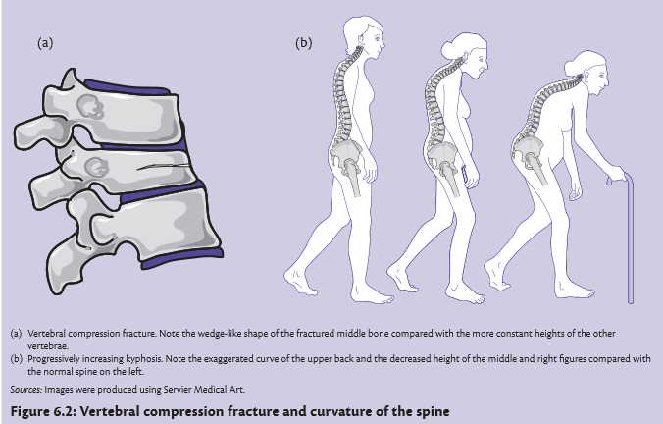
Spine (continue)
This can cause curvature of the spine, and people who have had a number of spinal compression fractures may display a characteristic bent-forward, hunched posture known as kyphosis and have a noticeable loss of height
In people with severe osteoporosis, a spinal fracture may be caused by simple movements such as lifting a light object, sneezing, or even just bending forward.
In people with moderate osteoporosis, more force may be required, for example, a fall or lifting a heavy object. In many cases, compression

Slide 59
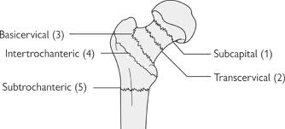
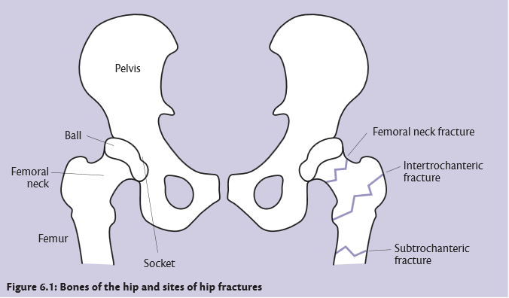
Hip and pelvis
the most mobile type of joint in the body.
The two most common types of hip fractures
femoral neck fractures :, occurring in the narrow section of bone between the main shaft of the femur and the ball
intertrochanteric hip fractures, where the shaft of the femur breaks just below the femoral neck.
Notes:
Fractures to the hip or pelvis are normally caused by a fall, but may also result from impact to the hip. In people whose bones are weakened from osteoporosis, relatively minor impacts (such as bumping into a piece of furniture) may be enough to cause a hip fracture. This type of fracture is the most serious osteoporotic fracture, and has the most complications.

Slide 60
Hip and pelvis (continue)
Fractures to the hip or pelvis are normally caused by a fall, but may also result from impact to the hip. In people whose bones are weakened from osteoporosis, relatively minor impacts (such as bumping into a piece of furniture) may be enough to cause a hip fracture. This type of fracture is the most serious osteoporotic fracture, and has the most complications.
About 20-30% of patients who have a femur neck fracture die in the year following the fracture. Half of the survivors remain disabled to some degree

Slide 61
Wrist and forearm
Falls are the most common cause of fractures of the wrist and forearm.
The two most common types of wrist fracture are:
Colles’ fracture—this is a fracture to the lower end of the radius, and very common in people with osteoporosis.
Scaphoid fracture —the scaphoid is a wedge-shaped bone located on the thumb side of the wrist, just where it meets the radius. These fractures are less commonly related to osteoporosis.
Notes:
Stress fractures are also not considered fragility fractures, as they are due to repetitive injury

Slide 62
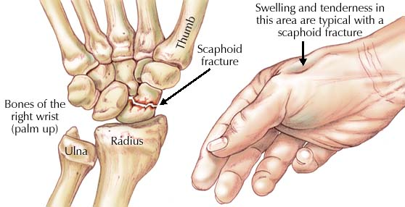
Wrist and forearm (continue)
Colles’ fracture
Scaphoid fracture

Slide 63
Objectives :
Definition of Oteoporosis and Osteomalacia / Rickets
Highlight on Vitamin D deficiency
Prevalence in world / Saudi Arabia
Factors lead to Osteoporosis and Vitamin D deficiency
How patients could be presented
Common fractures with osteoporosis
Vitamin D and Comorbidities
Diagnosis
Management & Prevention of Osteoporosis

Slide 64
Investigations:
X-Ray
Bone Mineral Density testing :Dexa Scan
Blood Markers

Slide 65
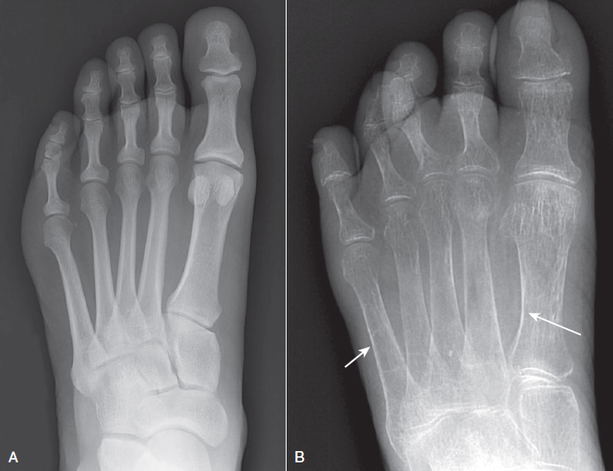
X-ray
1-Cortical thinning
2-Increased radiolucency.
Notes:
Cortical thining of the bones on x-ray:
If the case is complicated we will see vertebral fractures

Slide 66
DEXA (dual energy x-ray absorptiometry)
How does it work ?
Two X-ray beams, each with different energy levels. One is absorbed mainly by soft tissue and the other by bone. The soft tissue amount can be subtracted from the total and what remains is a patient's bone mineral density. Special software then calculates bone mineral content (BMC, in grams) and bone area (BA, in square centimeters), areal" BMD in g/cm² by dividing BMC by BA.

Slide 67
DEXA (dual energy x-ray absorptiometry)
Which bones to measure ?
Femoral Neck, Hip, Lumbar spine or Radius.
Diagnostic test of Choice for Osteoporosis.

Slide 68
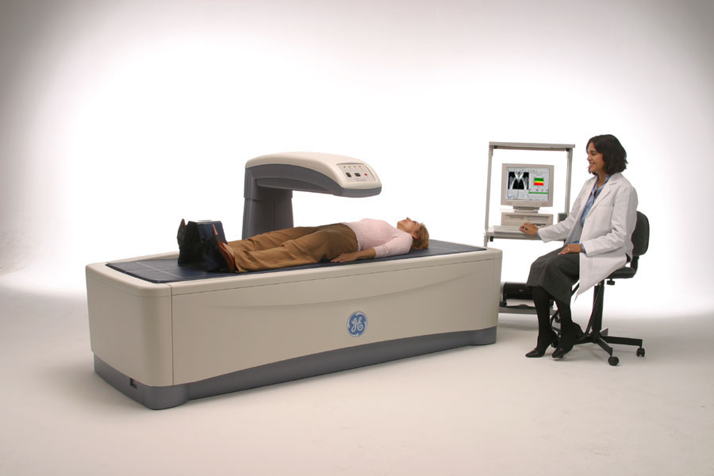
DEXA
Position supine.
Takes 10-15 minutes.
Very low radiation exposure.

Slide 70
Bone Mineral Density
T-score : standard deviation (SD) difference between a patient's BMD and that of a healthy young-adult population.
(T-score is your bone density compared with what is normally expected in a healthy 30-years old adult of your sex)
Z-score : standard deviation (SD) difference between a patient's BMD and that of an age matched population.
(Z-score is your bone density compared with what is normally expected for someone of your age, sex & body size)
Diagnosis of Osteoporosis is based on T-score.

Slide 71
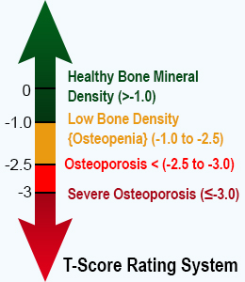
How to interpret ?
Scores indicate the amount one's bone mineral density varies from the mean.
Negative scores indicate lower bone density, and positive scores indicate higher bone density.
(osteopenia) is the term used to describe bone density that is lower than normal but that has not yet reached the low levels seen with osteoporosis. (-1 to -2.5)
A t-score value of less than 2.5 standard deviations is considered osteoporosis.

Slide 72
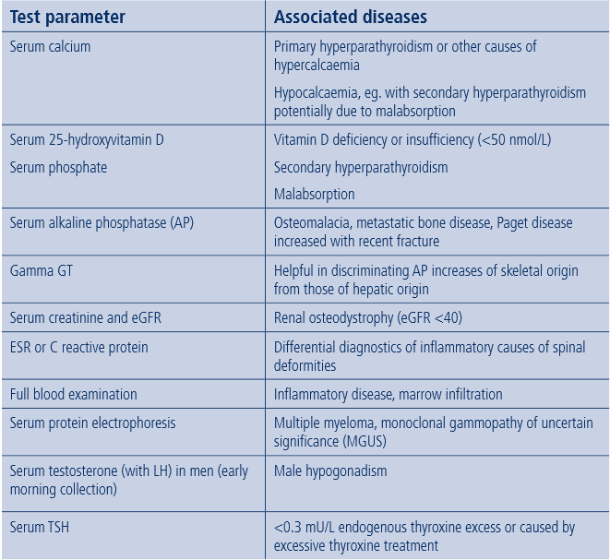
Blood test marker
Blood tests are carried out to look for evidence of secondary causes of osteoporosis
Notes:
All blood tests are normal in 1ry osteoporosis. Calcium, phosphate, and parathyroid
hormone levels are normal.

Slide 73
Investigation :
Measurement of 25(OH) vitamin D serum levels best reflects the vitamin D status of an individual.

Slide 74
Objectives :
Definition of Oteoporosis and Osteomalacia / Rickets
Highlight on Vitamin D deficiency
Prevalence in world / Saudi Arabia
Factors lead to Osteoporosis and Vitamin D deficiency
How patients could be presented
Common fractures with osteoporosis
Vitamin D and Comorbidities
Diagnosis
Management & Prevention of Osteoporosis

Slide 75
Objectives :
Management: (Osteopenia and Osteoporosis)
Prevention and advice
Role of Vitamin D and Calcium
Vitamin deficiency in pregnancy
Role of medications for osteoporosis like Alendronate, Stronitium Ranelate, …

Slide 76
Prevention
Lifestyle modification
Prevention starts at adolescents, by having a healthy lifestyle and good amount of exercise.
Adequate Calcium and Vitamin D intake.
Regular exercise.
Maintaining normal body weight.
Cigarette smoking cessation.
Reduce Alcohol & caffeine intake.
Stop/avoid drugs induced osteoporosis.
Fall prevention especially in elderly.

Slide 77
Requirement

Slide 78
Role of vitamin D and calcium
Calcium and vitamin D work together to protect your bones—calcium helps build and maintain bones, while vitamin D helps your body effectively absorb calcium
So even if you’re taking in enough calcium, it could be going to waste if you’re deficient in vitamin D

Slide 79
Vitamin D deficiency in pregnancy
Pregnant women need vitamin D to help build their babies’ skeletons as well as maintain their own.
A pregnant woman with a vitamin D deficiency raises the risk of developing:
Hypertension
Pre-eclampsia
gestational diabetes
preterm birth
impaired fetal skeletal formation (Rickets)

Slide 80
Management goals:
Prevent fractures
Stabilize or increase bone mass
Relieve symptoms of fractures
Maximize physical function
Improve quality of life

Slide 81
TREATMENT
Postmenopausal women and men age 50 and older presenting with the following should be considered for treatment:
A hip or vertebral (clinical or morphometric) fracture
T-score ≤ -2.5 at the femoral neck or spine after appropriate evaluation to exclude secondary causes
Low bone mass (T-score between -1.0 and -2.5 at the femoral neck or spine)

Slide 82
Pharmacology
ANTIRESORPTIVE THERAPY
Calcium Supplementation
increase BMD
Vitamin D Supplementation
maximizes intestinal calcium absorption and BMD
reduce fractures and falls
Bisphosphonates : Alendronate, risedronate, ibandronate and IV zoledronic acid
Inhibit osteoclastic resorption and  BMD
S/E: GI disturbance (ulcer rarely)
Alendronate, risedronate and IV zoledronic acid
indicated for:
postmenopausal, male, and glucocorticoid-induced osteoporosis
Oral/IV ibandronate
Indicated only for:
Postmenopausal osteoporosis

Slide 83
Pharmacology
ANTIRESORPTIVE THERAPY
RANK ligand inhibitor: (Denosumab)
inhibits osteoclast formation and increases osteoclast apoptosis
indicated for: treatment of osteoporosis in women and men at high risk for fracture
Estrogen Agonists/Antagonists: (Raloxifene)
approved for prevention and treatment of postmenopausal osteoporosis
decreases vertebral fractures and increases spine and hip BMD
Calcitonin
indicated for osteoporosis treatment for women at least 5 years past menopause.
Decrease vertebral fracture
Hormone Replacement (Estrogen) Therapy
- Indicated for: prevention of osteoporosis in women at significant
risk and for whom other osteoporosis medications cannot be used
-Long-term risks of HRT outweigh the benefits (CAD, breast CA, stroke)
Strontium renelate
↓ Bone resorption & bone formation
Effective in preventing vertebral and non-vertebral fractures

Slide 84
Pharmacology
ANABOLIC THERAPIES
Teriparatide (PTH Analogue)
Increases bone formation, bone remodeling rate, and osteoblast number and activity
Reduces fracture risk in postmenopausal women
Approved for use for only up to 2 years (osteosarcoma)
Indicated for:
treatment of postmenopausal women at high risk for fracture
increase in BMD in men with idiopathic or hypogonadal osteoporosis at high fracture risk
men or women intolerant to other osteoporosis medications
patients with glucocorticoid-induced osteoporosis

Slide 85
Post test

Slide 86
Question 1:
Osteoporosis is :
A-A disease of children caused by vitamin D deficiency .
B-A condition in which the bones become brittle and fragile from loss of tissue .
C-A condition in which the bones become soft due to decreased in mineralization .
D-All of the above
Notes:
C

Slide 87
Question 2:
after menopause
Osteoporosis is most likely to strike:
A-In childe hood
B-during perimenopause
C-after menopause
D-in adolescence
Notes:
C

Slide 88
Question 3:
Osteoporosis is a common and disabling disease, prevalence of post menopausal osteoporosis in Saudi Arabia is:
A- 10% to 20%
B- 20% to 30%
C-30% to 40%
D-40% to 50%
Notes:
c

Slide 89
Question 4:
The increased incidence of Osteoporosis in post-menopausal women is caused by:
A- Decreased Progesterone
B- Decreased Estrogen
C- Sedentary lifestyle
D- None of the above
Notes:
B

Slide 90
Question 5:
To diagnose osteoporosis, bone mineral density must be:
A-1.5 Standard deviations below the mean.
B- 2.0 Standard deviations below the mean.
C- 2.5 Standard deviations below the mean.
D- 3.0 Standard deviations below the mean.
Notes:
C

Slide 91
Take home message
Fractures due to osteoporosis have a serious impact on a person’s health, happiness and quality of life.
An exercise program with calcium and vitamin D supplements is the mainstay of the therapy for prevention or treatment of osteoporosis.
Prevention, detection and treatment of osteoporosis should be a prime care providers.

Slide 92
References :
1-Prevention and management of osteoporosis. Report of a WHO Scientific Group. Geneva,World Health Organization.
2. Bone Density Testing, beyond the basics http://www.uptodate.com/contents/bone-density-testing-beyond-the-basics
3. The National Osteoporosis Foundation indications for bone density testing. http://www.uptodate.com/contents/image?imageKey=ENDO%2F58752&topicKey=ENDO%2F2056&rank=1~116&source=see_link&search=dexa+scan

Slide 93
Continue…
4.Clinician’s Guide to Prevention & Treatment of Osteoporosis from the National Osteoporosis Foundation.
5. Prevalence of osteoporosis among postmenopausal females with diabetes mellitus.
Al-Maatouq MA, El-Desouki MI, Othman SA, Mattar EH, Babay ZA, Addar M
6. Guide lines for diagnosis and management of osteoporosis in Saudi Arabia.
http://www.ncbi.nlm.nih.gov/pmc/articles/PMC3102469/
7. Vitamin D supplementation in pregnant women - WHO
http://apps.who.int/iris/bitstream/10665/85313/1/9789241504935_eng.pdf?ua=1

Slide 94
THNAK YOU

