Slide 1
UPPER RESPIRATORY TRACT INFECTIONS
Abdulrahman Alfawaz
Abdulaziz almontshri
Mohammed alqithmi

Slide 2
Objectives
How can we differentiate between viral and bacterial infections?
Sore throat (clinical features, differential diagnosis, complications, management)
Sinusitis including allergic rhinitis (Clinical features and management)
Otitis media in children (AOM and Secretory OM, Features, management)
How can we modify help seeking behavior of patients with flu illness?

Slide 3
Pre Test Qs

Slide 4
Q1
The most important step in managing allergic rhinitis is:
Avoidance of allergy
Usage for antibiotic for long time
Drinking fresh orange juice
Topical corticosteroid
Notes:
A

Slide 5
Q2
3 year old child diagnosed with acute otitis media , what is the drug of choice to treat him :
Amoxicillin
Cephalosporin
Macrolides
Doxycycline
Notes:
A

Slide 6
Q3
Ahmad is 30 year old gentleman complaining of headache increase on leaning forward during praying and mucopurulent post nasal discharge ,For the last 2 weeks . On examination, there was nasal discharge in both nasal fossae. What is the most likely?
Acute Bacterial Rhinosinusitis .
Acute Viral Rhinosinusitis
Common Cold .
Chronic Bacterial Rhino Sinusitis
Notes:
A

Slide 7
Q4
A patient came in with sore throat, cough and low grade fever and muscle stiffness. After the doctor diagnosed her with her flu and prescribed her the treatment the patient asked the doctor what is the most common cause of sore throat.
The doctor answered:
Fungal
Bacterial
Viral
Allergy
Notes:
C

Slide 8
Q5
Mother brghout her chiled to the clinic complaining of mild earache mild deafness and there is no fever he was dignosed with acut otitis media .
which stage of AOM this chiled have?
tubal occlusion
pre-suppuration
suppuration

Slide 9
How to differentiate between viral and bacterial infection ?
Bacterial infection.
Discolored or purulent discharge (with unilateral predominance).
A fever greater than 38°C.
Severe local pain (with unilateral predominance).
Elevated ESR/CRP (although the practicality of this criterion is limited).
A marked deterioration after an initial milder form of the illness (so-called 'double-sickening').
Viral infection :
Warty discharge

Slide 10
Case
3 year old female complaining of right earache, fever and decrease of hearing on the same ear. She had a history of URTI one week ago.
What is the most likely diagnosis ?

Slide 11
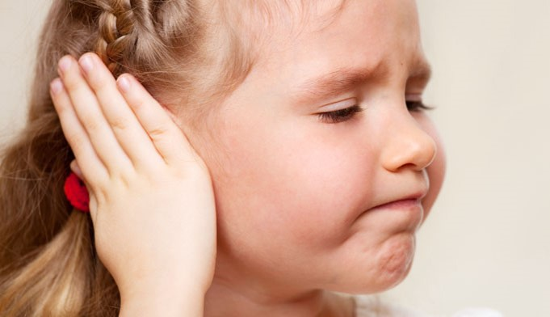
Otitis Media

Slide 12
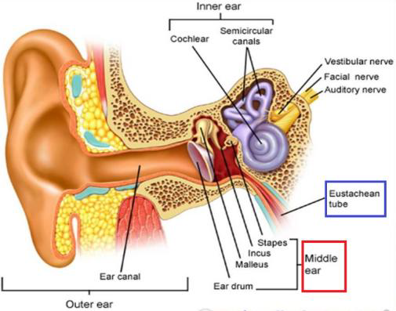
Notes:
Audiotory tube :
is a tube that links the nasopharynx to the middle ear. It is a part of the middle ear and function as Pressure equalization

Slide 13
Definition
Acute otitis media (AOM) is Acute infection of the mucous membrane lining of the middle ear
Secretory otitis media is Collection of fluid within the middle ear as a result of negative pressure produced by alterd eustachian tube function
Notes:
Peak incidence in the first two years of life (esp. 6-12 months)
Occurs more frequently in the winter months
One of the most common reason for visit to pediatrician

Slide 14
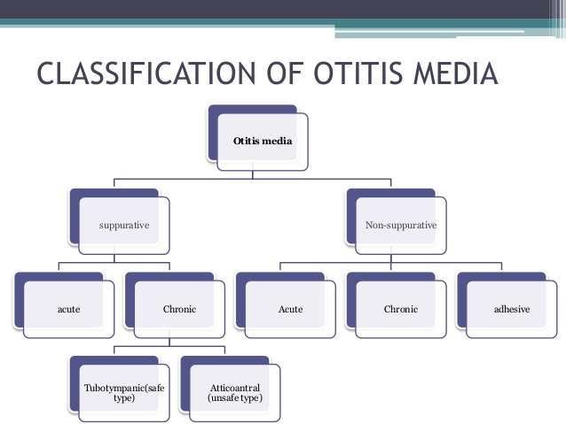

Slide 15
Timeline
- Acute OM
< 3 weeks
- Subacute OM
3 weeks to 3 months
- Chronic OM
3 months or longer

Slide 16
Predisposing Factors
Age (children)
Gender (girls)
Seasons (winter)
Breast-feeding
Smoke exposure
Other Medical conditions
Notes:
Associated conditions: cleft palate, immunodeficiency, ciliary dyskinesia, Down syndrome, and cystic fibrosis
Most common in infants 6 – 18 months old ( 2/3 of cases) , because of :
-the Eustachian tube is shorter and at more of a horizontal angle than in the adult ear

Slide 17
Route of infection
Eustachian tube
External auditory canal
Blood borne

Slide 18
Etiology
Bacteria:-
S. pneumoniae - 30-35%
H. influenzae - 20-25%
M. catarrhalis - 10-15%
Group A strep - 2-4%
Viruses:-
Respiratory syncytial virus (RSV)
Rhinovirus
Parainfluenza virus
Influenza virus

Slide 19
Stages of AOM
1-tubal occlusion
2-pre-suppuration
3-suppuration
5-complication
4-resolution

Slide 20
1-tubal occlusion
Edema and hyperemia of nasophargeal end of the eustachian tube→block the tube →absorbtion of air and –ve pressure →retraction and some degree of effusion
Symptoms:
1- mild earach
2-mild deafness
3-no fever
Sign:
1-tympanic membrane retracted
2-loss of light reflex
3- tunning fork show (CHL)

Slide 21
2-pre-suppuration
If tubal occlusion is prolonged →pyogenic organism invade
Symptoms:
1-earach
2-deafness
3-tinnitus
4- fever
Sign:
1-congestion and redness of the tympanic membrane
2-tunning fork (CHL)

Slide 22
3-suppuration
1-formation of pus
2-bulging of tympanic membrane
Symptoms:
1- very sever earach
2-marked deafness
3-very high fever+vomiting
Sign:
Redness +bulging of tympanic membrane+loss of land mark

Slide 23
4-Resolution
Note:
If the treatment is started early→ resolution may start without rapture of TM
Rapture of TM
release of pus
subsidace of symptoms
Sign:
1-small perforation in antero-infero of para tensa
2- return normal color and land mark of TM
Symptoms:
1- earach is relived
2-pus discharge from the ear
3- fever comes down
(child feel better)

Slide 24
5- Complications of OM :
Intracranial :
Meningitis
Epidural abscess
Brain abscess
Cavernous sinus thrombosis
Lateral sinus thrombosis
Subdural empyema
Carotid artery thrombosis

Slide 25
5- Complications of OM :
Intratemporal :
Hearing loss
Balance and motor problems.
TM perforation.
Cholesteatoma
Adhesive otitis media
Extension of the suppurative process to adjacent structures (mastoiditis, petrositis, labyrinthitis)

Slide 26
Diagnosis
Main Symptoms:
Otalgia
Fever
deafness
facial paralysis

Slide 27
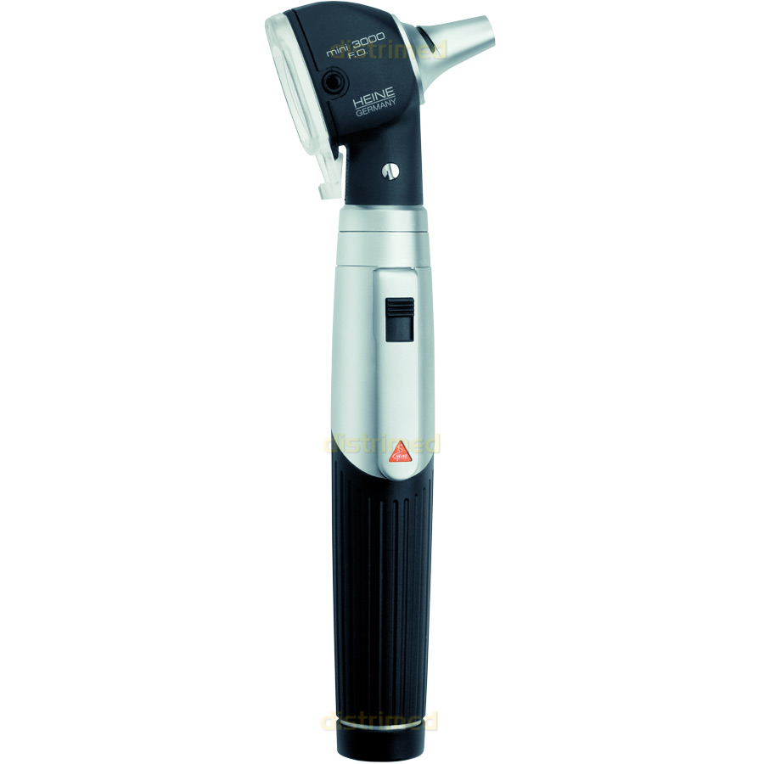
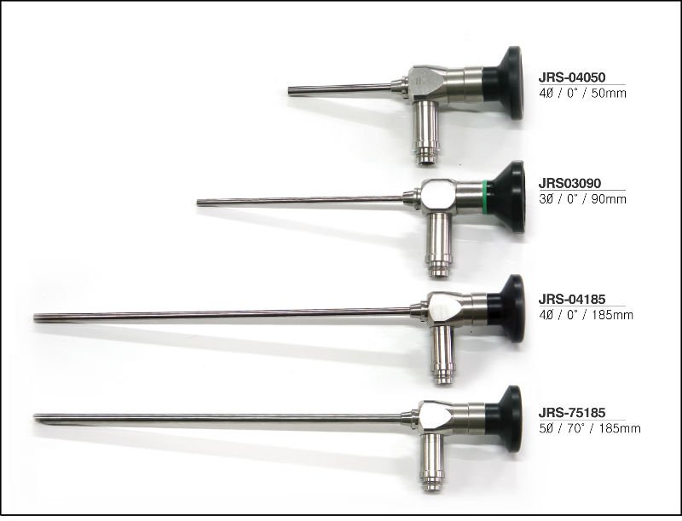
Physical Examination
Notes:
We use otoscopy to see the signs of ottits media like : Erythematic, opaque, bulging tympanic membrane and whitish discoloration .

Slide 28
Physical Examination

Slide 29
Investigations
When?
Tests include:
Tympanometry
Tympanocentesis
CT scans
Notes:
Treatment is not working
Complications develop

Slide 30
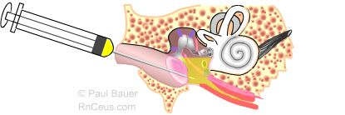
Tympanocentesis
Notes:
Tympanocentesis is the drainage of fluid from the middle ear

Slide 31
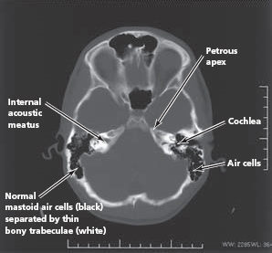
CT Scan

Slide 32
Treatment
1.Observation, most cases resolve within 2-3 days
2. Symptomatic treatment with Paracetamol
3. Antibiotics undicated:
A child has a serious health condition that makes them more vulnerable to infection.
A child is under the age of three months
A child’s symptoms show no signs of improvement after four days
Recurrent OM (Three or more attacks over a 6-months period)

Slide 33
Antibiotics**
Amoxicillin : is the drug of choice
under 2 years, 125mg three times daily
10 years, 250 mg three times daily
over 10 years, 500 mg three times daily
However, Amoxicillin-clavulanate should be considered for patients with severe otalgia or elevated temperature to cover the possibility of beta-lactamase producing H. influenzae.
If your child is allergic to amoxicillin, alternative antibiotics such as Erythromycin can be used

Slide 34
Case
35 year male came to PHC complaining of several episodes of headache associated with fever, nasal congestion and discharge, The headache concentrated in front of the head aggravated by bending forward.
What is the most likely diagnosis ?

Slide 35
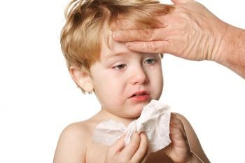
Sinusitis

Slide 36
Definition
Inflammation of the lining of the paranasal sinuses.

Slide 37
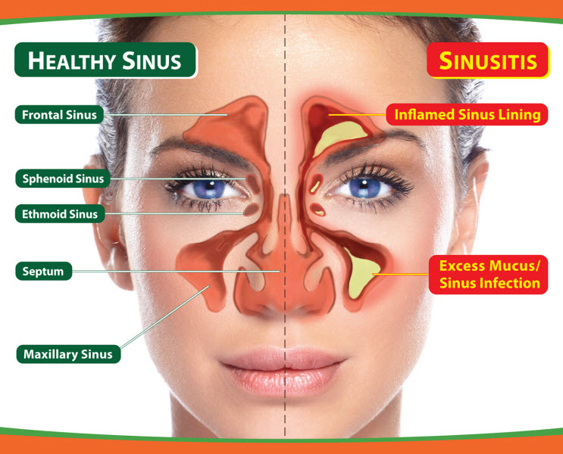

Slide 38
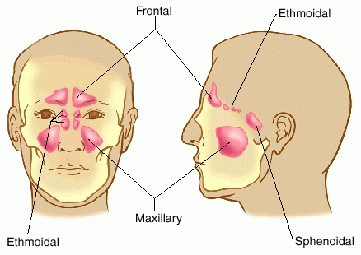
The maxillary sinuses are the most common site (85%), followed by ethmoidal (65%), sphenoidal (39%), and frontal (32%) involvement.
4th
1st
2nd
3rd

Slide 39
Classification
Acute sinusitis
  < 4 Weeks
Subacute sinusitis
  4 Weeks and < 3 months
Chronic sinusitis
  > 3 Months
Recurrent acute sinusitis
  Diagnosed when 2-4 episodes of infection occur per year.

Slide 40
Etiology
Infection
Viral ( rhinovirus, influenza virus)
Bacterial (Streptococcus pneumonia)
Fungal ( Rare )
Cilia in the sinuses do not work properly due to some medical conditions (kartegner syndrome).
Colds and allergies may cause too much mucus to be made or block the opening of the sinuses.
A deviated nasal septum, nasal bone spur, or nasal polyps may block the opening of the sinuses.

Slide 41
Clinical Presentaion
• Day and night cough
• Purulent nasal discharge (v. imp) (diagnostic )
• Nasal airway obstruction
• Headache, irritability, or facial pain
• Fever
• Postnasal drip.

Slide 42
Physical Examination
Press over the air sinuses to check for:
  Tenderness
  Yellow to yellow-green nasal discharge.
Check the inside of the nasal passages by torch to check the mucus and look for any structural abnormalities.

Slide 43
If signs and symptoms are not typical of sinusitis, rule out an alternative diagnosis .
DDx
Allergic rhinitis.
Nasal foreign body.
Adenoiditis and tonsillitis.
Sinonasal tumour.
Other causes of facial pain or headache

Slide 44
Investigations
Usually not necessary:
  Diagnosis- Sinus Aspiration
  Mucus culture
  Nasal endoscopy
  X-ray
  Allergy testing
  CT
  Blood work
Notes:
Patients in intensive care or with immunocompromise
Children not responding to appropriate medical management
Patients with complications of sinusitis

Slide 45
Management
Abx
Amoxicillin/potassium clavunate (Augmentin)
Erythromycin-sulfisoxazole
Other Medications (facilitate drinage):
• Antihistamines if there is allergy
• Decongestants
• Anti-inflammatory agents ex. Steroids which will decrease the edema.

Slide 46
Non-pharmacological
    Humidifier to relieve the drying of mucous membranes associated with mouth breathing
    Increase oral fluid intake
    Saline irrigation of the nostrils
    Moist heat over affected sinus

Slide 47
Intracranial Complications
Meningitis (the most imp)
Epidural abscess
Subdural abscess
Intracerebral abscess
Cavernous sinus, venous sinus thrombosis

Slide 48
When to advise the patient to follow-up?
If symptoms rapidly deteriorate.
If they develop a high temperature.
Marked local pain that is predominately unilateral.

Slide 49
Case
Mr. Saleh a 35 year old Saudi gentleman came to the clinic complaining of pain in his throat for 4 days which is worse upon swallowing and talking. He also have runny congested nose and cough.
What is the most likely dignosis?

Slide 50
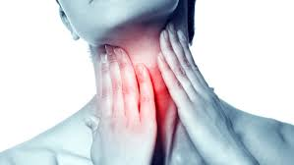
Sore Throat

Slide 51
Causes of sore throat
viral
  common cold
  flu
bacterial
  strep throat
tonsillitis
thyroiditis
persistent cough
GERD
foreign body
smoking

Slide 52
Differential diagnosis
•Infectious pharyngitis
oBacterial pharyngitis
•GABHS 10% in adults
•Others <1% each
oViral pharyngitis
•Rhinovirus, coronovirus, parainfluenza virus (common cold) 25%
•Influenza types A and B (influenza) 4%
•Adenovirus (phryngoconjunctival fever) 4%
•Others
•Non infectious causes
(physical irritation, inflammation secondary to radiotherapy or chemotherapy).
•Pharyngeal abscess
•Epiglottitis
Notes:
group A beta-hemolytic streptococca

Slide 53
Red Flags
•Epiglottitis
•If suspected, do not examine the throat, immediately take the patient to the O.R unless there are facilities for immediate intubation/tracheotomy because of the possibility of precipitating complete airway obstruction or cardiopulmonary arrest
•Progress very fast secure airway first
•Pathogen: Haemophilus influenzae
•Clinical feature: high grade fever , toxic very bad stridor , drooling of saliva, difficulty of breathing

Slide 54
When to Admit ?
•Stridor or respiratory difficulty
•Upper airway obstruction
•Dehydration
•Severe suppurative complications
•Immunocompromised patient
Notes:
high-pitched sound produced by turbulent

Slide 55
Pharyngitis
One of the commonest conditions encountered by family physicians.
It can be difficult to determine whether you have a viral or bacterial infection because the symptoms are often similar
Identifying the cause of pharyngitis, especially group A beta-hemolytic streptococcus (GABHS), is important to prevent potential life-threatening complications

Slide 56
Viral:
the most common cause of sore throat
Clinical features:
o Coryza.
o Conjunctivitis.
o Malaise or fatigue.
o Hoarseness.
o Low-grade fever
Children with viral pharyngitis also can present with atypical symptoms, such as:-
o Mouth-breathing.
o Vomiting.
o Abdominal pain.
o Diarrhea.

Slide 57
Pharyngitis
Bacterial:
o Patients generally do not have rhinorrhea, cough, or conjunctivitis.
o There is often a history of streptococcal throat infection within the past year.
o Group A beta-hemolytic streptococcus (GABHS) is the most common bacterial cause of pharyngitis.
•GABHS infection:
- Signs of strep throat may include
o Pharyngeal erythema.
o Tonsillar exudate.
o Edematous uvula.
o Anterior cervical lymphadenopathy .

Slide 58
GABHS Pharyngitis Complications
Supportive:-
peritonsillar abscess
retropharyngeal abscess
cervical lymphadenitis
bacteremia
otitis media
sinusitis
Mastoiditis
nonsuppurative:-
rheumatic fever
acute poststreptococcal glomerulonephritis

Slide 59
Diagnosis
GENERAL APPROACH
- When a patient presents with sore throat, physician must consider a wide range of illnesses. Infectious range from generally benign viruses to GABHS. Inflammatory presentations may be the result of allergy.
- In determining the underlying cause the physician must integrate information from the history and physical examination. Environmental and epidemiologic factors may need to be assessed

Slide 60
History
o Onset.
o Duration.
o Progression.
o Severity of the associated symptoms (e.g., fever, cough, respiratory difficulty, swollen lymph nodes).
o Exposure to infections.
o Presence of comorbid conditions (e.g. diabetes).

Slide 61
Physical examination
examine the pharynx for:-
erythema
hypertrophy
foreign body
exudates
masses
adenopathy
also assess the patient for:-
fever
rash
cervical adenopathy

Slide 62
Laboratory
1- THROAT CULTURE
Sensitivity: 97 percent; Specificity: 99 percent
It takes approximately 24 hours for the culture results to become available
2- RAPID ANTIGEN DETECTION TESTS
Detects presence of group A streptococcal carbohydrate
results available within minutes
Specificity: > 95 percent; sensitivity: 80 to 97 percent, depending on the test
3-Monospot test
for mononucleosis
sensitivity: 86 percent; specificity: 99 percent

Slide 63
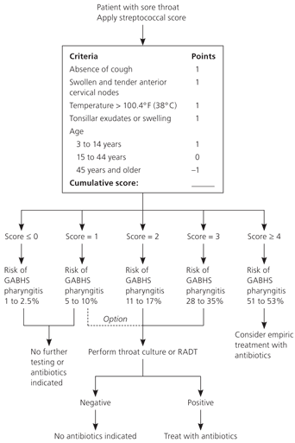
Clinical Decision Rule for Management of Sore Throat

Slide 64
ANTIBIOTICS
Penicillin, penicillin congeners (ampicillin or amoxicillin), clindamycin (Cleocin), and certain cephalosporins and macrolides are effective against GABHS.
First line treatment is penicillin.
Oral amoxicillin suspension is often substituted for penicillin

Slide 65
Prevention
The germs that cause viral and bacterial infections are contagious. Therefore, the best prevention is to practice good hygiene.
Avoid smoking or being exposed to second hand smoking.
Avoid being in close contact with people who are sick.
Avoid breathing dry air. Consider using a humidifier at home and work to increase the moisture in the air.

Slide 66
Question
How can we modify help seeking behavior of patients with flu illness?

Slide 67
MCQ’s (again)

Slide 68
Q1
The most important step in managing allergic rhinitis is:
Avoidance of allergy
Usage for antibiotic for long time
Drinking fresh orange juice
Topical corticosteroid
Notes:
A

Slide 69
Q2
3 year old child diagnosed with acute otitis media , what is the drug of choice to treat him :
Amoxicillin
Cephalosporin
Macrolides
Doxycycline
Notes:
A

Slide 70
Q3
Ahmad is 30 year old gentleman complaining of headache increase on leaning forward during praying and mucopurulent post nasal discharge ,For the last 2 weeks . On examination, there was nasal discharge in both nasal fossae. What is the most likely?
Acute Bacterial Rhinosinusitis .
Acute Viral Rhinosinusitis
Common Cold .
Chronic Bacterial Rhino Sinusitis
Notes:
A

Slide 71
Q4
A patient came in with sore throat, cough and low grade fever and muscle stiffness. After the doctor diagnosed her with her flu and prescribed her the treatment the patient asked the doctor what is the most common cause of sore throat.
The doctor answered:
Fungal
Bacterial
Viral
Allergy
Notes:
C

Slide 72
Q5
Mother brghout her chiled to the clinic complaining of mild earache mild deafness and there is no fever he was dignosed with acut otitis media .
which stage of AOM this chiled have?
tubal occlusion
pre-suppuration
suppuration
Notes:
A

Slide 73
Take Home Message
URTI is usually self limiting
It is not recommended to use antibiotics in the treatment of uncomplicated upper respiratory tract infections.
The common cold is a benign self-limited upper respiratory viral infection.
The common cold is a separate and distinct entity, distinguishable from influenza and bacterial pharyngitis.

Slide 74
References
American Academy of Pediatrics - Subcommittee on Management of Sinusitis and Committee on Quality Management. Clinical practice guideline: management of sinusitis. Pediatrics. Sep 2001;108(3):798-808.
Lanza DC, Kennedy DW. Adult rhinosinusitis defined. Otolaryngol Head Neck Surg. Sep 1997;117(3 Pt 2):S1-7.
ENT Course Lecture Slides
http://www.aafp.org/afp/2004/0315/p1465.html
http://articles2day.org/2012/11/gabhs-pharyngitis-diagnosis-complications-and-treatment.html
http://www.bhchp.org/BHCHP%20Manual/pdf_files/Part1_PDF/Strep.pdf
http://www.ncbi.nlm.nih.gov/pmc/articles/PMC153141/

Slide 75
Thank You

