Slide 1
Approach to patient with Arthritis
Done by:-
Zaid Alhamdan
Abdulaziz Alshabibi
Abdulmajeed Altammami
Supervised by:-
Prof. Mohammed Al-Rukban

Slide 2
Objectives
Common causes of arthritis encountered in general practice.
What does it means by arthropathy and arthritis.
Highlight on osteoarthritis, Septic arthritis, Gout, Rheumatoid arthritis.
Important aspects in History, Clinical examination, Investigations and Management.
Red Flags for patient with arthritis.
When to refer to specialty clinic.

Slide 3
MCQ
RA is characterized by which of the following patterns of joint involvement?
a) Episodic monoarthritis
b) Symmetrical polyarthritis
c) Migratory oligoarthritis
d) Spondylitis
Notes:
B

Slide 4
MCQ
The most specific test used in diagnosis of gout:
a) MRI
b) x-ray
c) synovial fluid analysis
d) serum uric acid
Notes:
C

Slide 5
MCQ
The most common offending organism in septic arthritis in adults is:
a) S. aureus
b) Streptococcus pyogenes
c) S. pneumoniae
d) H. influenzae
Notes:
A

Slide 6
MCQ
Which one of the following is a characteristic x-ray finding in case of osteoarthritis ?
a) chondrocalcinosis
b) osteopenia
c) Narrowing of joint space
d) sequestra
Notes:
C

Slide 7
Case
Lesail a 39 yo female, a filipina housemaid gradually developed painful wrists over 3 months; she consulted the doctor only when the pain and early morning stiffness stopped her from work.
Medical history:-
Lesail’s medical history is unremarkable. Her current medications are iron ,Vitamin D and calcium supplement.

Slide 8
Case
Physical examination:-
On examination, both wrists and the metacarpophalangeal joints of both hands were swollen and tender but not deformed. There were no nodules or vasculitic lesions
Investigation:-
On investigation, she was found to have a raised C-reactive protein (CRP) level (27mg/l) (NR <10) but a normal haemoglobin and white-cell count. A latex test for rheumatoid factor was negative and antinuclear antibodies were not detected.

Slide 9
Case
Six months after initial presentation, she developed two subcutaneous nodules on the left elbow; these were small, painless, firm and immobile but not tender. A test for rheumatoid factor was now positive (titre 1/64). X-rays of the hands showed bony erosions in the metacarpal heads. She still had a raised CRP (43mg/l) but normal serum complement (C3 and C4) levels and, she had a biopsy, pannus would have been demonstrable histologically.
This woman now had definite X-ray evidence of rheumatoid arthritis and, in view of the continuing arthropathy, her treatment was changed to weekly low-dose methotrexate. This has controlled the arthritis for several years and no further erosions have developed.

Slide 10
Terminology
Arthritis:
Ankylosis:
Arthrocentesis:
Arthroscope:
inflammation of the joints.
stiffness of joint.
clinical procedure of using a syringe to collect synovial fluid from a joint capsule.
endoscope that's inserted into joint for visual examination.

Slide 11
Overview
NHIS 2010-2012 data analysis showed that 50 million US adults had reported doctor-diagnosed arthritis.
In 2007, CDC estimated that 294,000 U.S. children under age 18 have been diagnosed with arthritis or other rheumatic conditions .
A major cause of lost work time and serious disability for many people.
Its mainly a disease of adults, but it can also effect children.

Slide 12
Causes
Injuries: Leading to degenerative arthritis
Abnormal metabolism : Gout
Inheritance: Osteoarthritis
Infection: Lyme disease
Over active immune system : RA and SLE

Slide 13
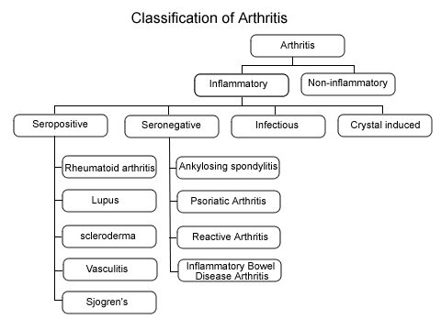

Slide 14
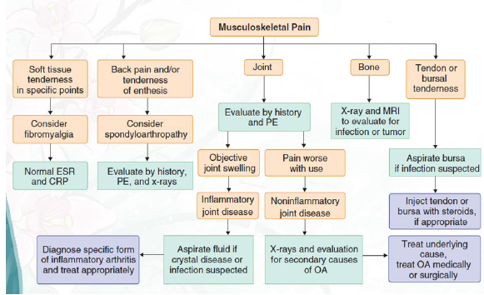
Diagnostic Approach to Musculoskeletal Pain

Slide 15
Important aspects in History
Duration of Complaints
Number of Joints Involved
Distribution of Joints Involved
Pattern of Involvement
Morning Stiffness

Slide 16
Important aspects in History
History of Joint Swelling.
Extra-articular Complaints.
Associated Medical Illness.
Significant Past History.
Family History of Rheumatic Disease.

Slide 17
Importance of Physical Examination
Local Warmth
Joint effusion
Redness
Range of Motion
Any Deformity

Slide 18
Symptoms
1.Pain
Inflammatory joint disease
present both at rest and with motion
worse at the beginning than at the end of usage.
Non-inflammatory
pain occurs mainly or only during motion and improves quickly with rest
Pain that arises from small peripheral joints
more accurately localized than pain arising from larger proximal joints.

Slide 19
Con.
2.Stiffness
sensation of tightness when attempting to move joints after a period of inactivity
subsides over time
Inflammatory arthritis
present upon waking
typically lasts 30-60 minutes or longer.
Non-inflammatory arthritis
experienced briefly (eg, 15 min) upon waking in the morning
following periods of inactivity.

Slide 20
Con.
3.Swelling
Inflammatory arthritis
synovial hypertrophy
synovial effusion
inflammation of periarticular structures
Non-inflammatory arthritis
formation of osteophytes
synovial cysts
Thickening
effusions

Slide 21
Con.
4.Limitation of motion
structural damage
Inflammation
contracture of surrounding soft tissues

Slide 22
Con.
5.Weakness
result of disuse atrophy
Weakness with pain
musculoskeletal cause (eg, arthritis, tendonitis)

Slide 23
Temporal pattern of arthritis
Abrupt onset
symptoms develop over minutes to hours
occur in trauma, crystalline synovitis, or infection.
Insidious pattern
symptoms develop over weeks to months
rheumatoid arthritis (RA) and osteoarthritis.

Slide 24
Duration of symptoms:
Acute <6 weeks in duration;
chronic is 6 or more weeks in duration.
Number of involved joints:
Monoarthritis - one joint.
Oligoarthritis - 2-4 joints.
Polyarthritis -5 or more joints.

Slide 25
Temporal Patterns in Polyarthritis
Migratory pattern
joints are sequentially affected where, as one joint settles, another becomes inflamed (e.g., acute rheumatic fever, disseminated gonococcal infection).
Additive pattern
subsequent joints are involved while preceding ones are still inflamed (e.g. RA )
Intermittent pattern
the same joint is involved in different episodes of inflammation, but the joint is quiescent during intervening periods (e.g., gout).

Slide 26
Symmetry of joint involvement
Symmetric arthritis
involvement of the same joints on each side of the body.
RA and SLE.
Asymmetric arthritis
psoriatic arthritis, reactive arthritis (Reiter syndrome), and Lyme arthritis.

Slide 27
Distribution of affected joints
The DIP joints of the fingers
involved in psoriatic arthritis, gout, or osteoarthritis
spared in RA.
Joints of the lumbar spine
involved in ankylosing spondylitis
spared in RA.

Slide 28
Extra-articular manifestations
Constitutional symptoms
underlying systemic disorder.
include fatigue, fever, and weight loss.
Skin lesions
SLE, dermatomyositis, scleroderma, Lyme disease, psoriasis and Henoch-Schönlein purpura.
Ocular symptoms or signs
Episcleritis and Keratoconjunctivitis sicca -RA.
Anterior uveitis - ankylosing spondylitis,
Conjunctivitis -reactive arthritis

Slide 29
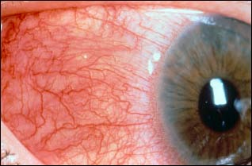
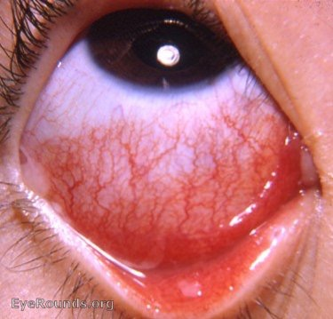
Ocular signs
Episcleritis and scleritis
Conjunctivitis

Slide 30
Signs of inflammatory joint disease
- Joint effusions
- Erythema and warmth
- Joint tenderness
- Bony overgrowth of the joints (osteophytes)
At the DIP joints - Heberden nodes.
At the PIP joints are called Bouchard nodes.
- Limited range of motion:
Crepitus during active or passive range of motion
Joint deformity

Slide 31
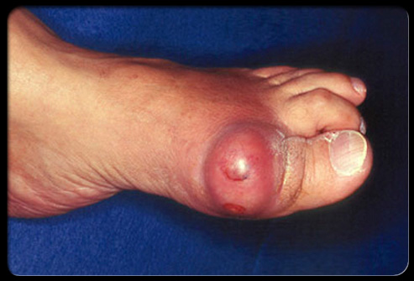
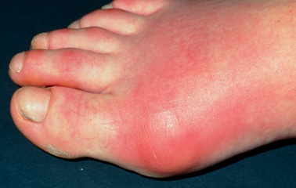

Slide 32
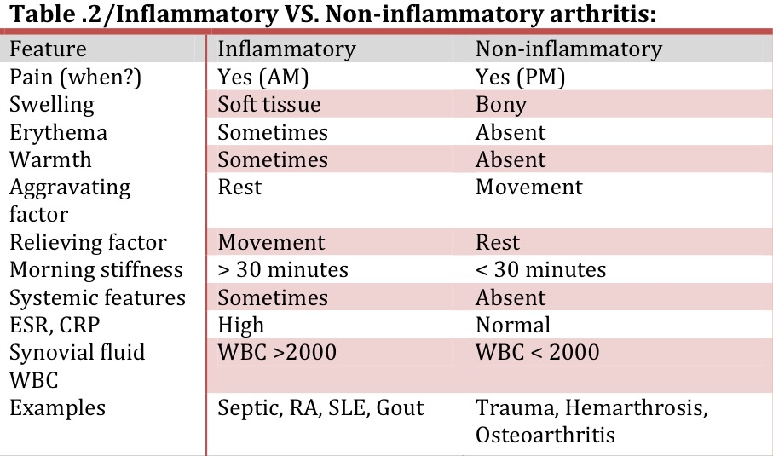

Slide 33
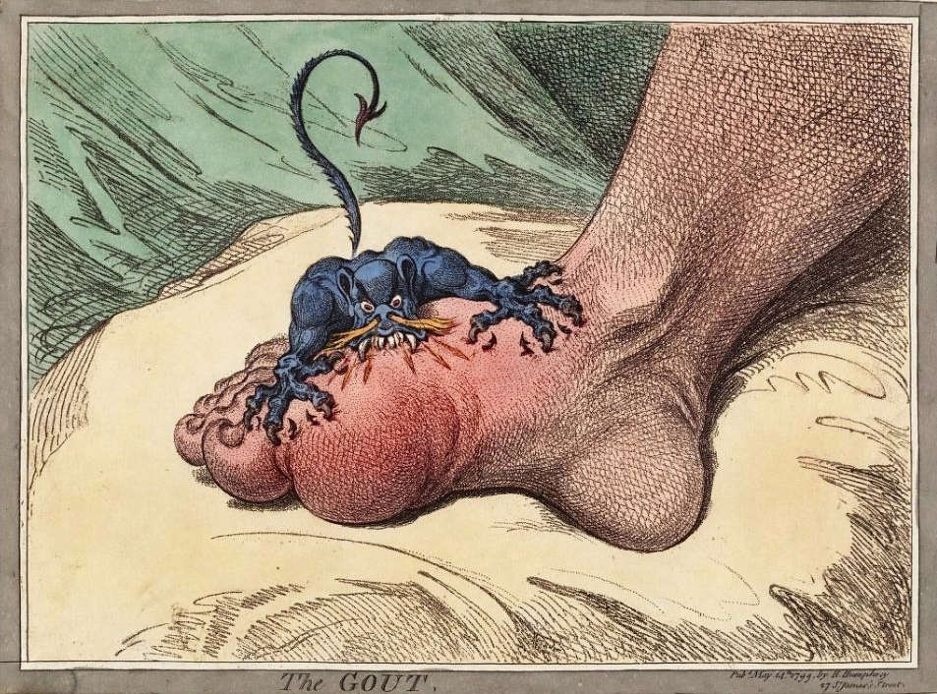

Slide 34
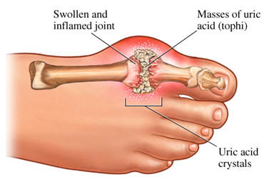
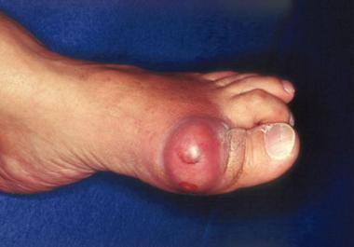
Highlight on Gout
Its an Intermittent attacks of acute joint pain due to deposition of uric
acid crystals.
Usually affect men (10:1), rare in premenopausal female.
Most common joint affected is 1st MTP joint
Prevalence is approximately 20% in patients with a family history of gout.

Slide 35
Gout cont.
Causes:
Hyperuricemia is the most common cause and it could be because of:
1. Impaired excretion (90%):
renal disease, diuretics, NSAID use, and acidosis.
2. Increase production: like chemotherapy, chronic hemolysis, and blood cancers.
Risk factors:
Alcohol - Dehydration - Urate stones - Diuretics use

Slide 36
Types
Acute :
common in the late course of untreated gout
Chronic :
- Chronic tophaceous gout is characterized by collections of solid urate accompanied by chronic inflammatory and often destructive changes in the surrounding connective tissue
- often visible and/or palpable
- typically not painful or tender

Slide 37
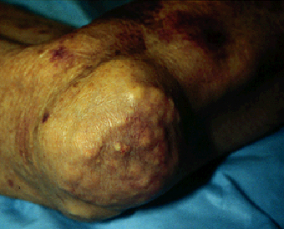
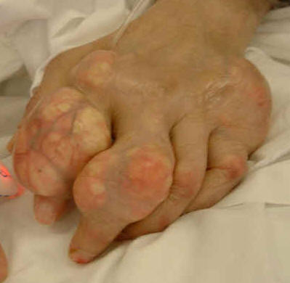
Chronic
Tophus of the knee
Acute
Large tophus and multiple superficial tophi of the knee in patient with chronic uncontrolled gout.

Slide 38
Pathophysiology

Slide 39
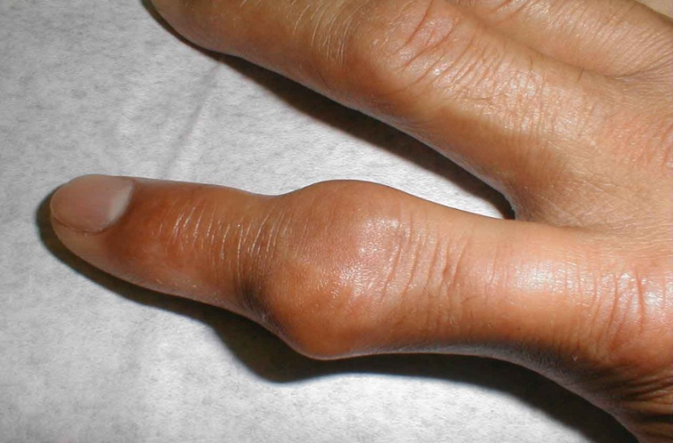
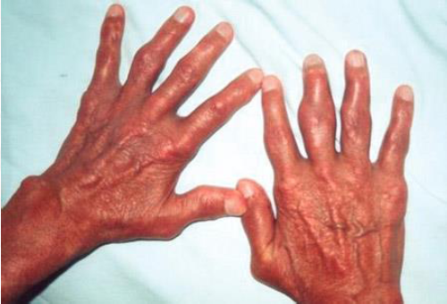
History
Mostly involve single joint.
Severe pain:
Often cannot wear socks.
Peak within 24 to 48 hours.
Swelling.
Redness.

Slide 40
Examination
ACUTE GOUT:
Fever
Mostly involve single joint.
Most commonly the first metatarsophalangeal joint "podagra".
Severe pain.
Erythema.
Cellulitis.
Chronic Gout:
Tophaceous gout. "deposits of monosodium urate crystals in soft tissue

Slide 41
Diagnosis
Blood: increase WBC, ESR and Urate
X-Ray: Next slide
synovial fluid or tophus aspiration with identification of:
light microscopy : needle shape crystal
compensated polarized light microscopy : positive birefringence with negative elongation

Slide 42
Criteria Diagnosis from American college of Rheumatology (6 in 12)

Slide 43
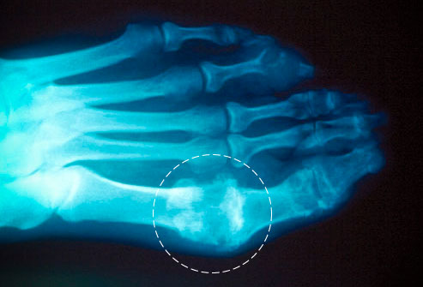
X-ray

Slide 44
Management
Gout is managed in the following 3 stages:
Treating the acute attack
Providing prophylaxis to prevent acute flares
Lowering excess stores of urate to prevent flares of gouty arthritis and to prevent tissue deposition of urate crystals

Slide 45
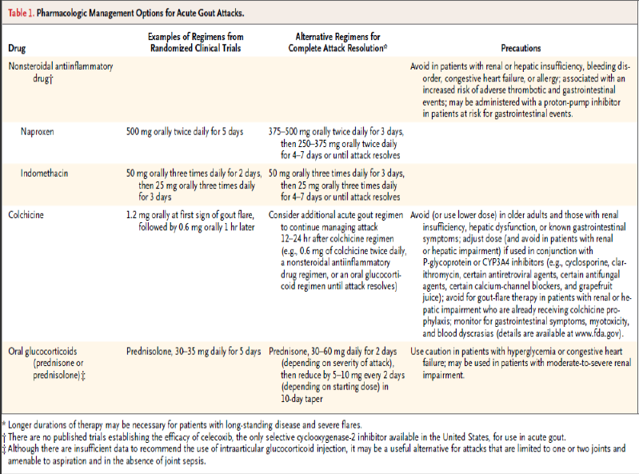

Slide 46
Follow up the person 4–6 weeks after an acute attack of gout has resolved, and:
- Check the serum uric acid level.
- Measure their blood pressure and take blood for fasting glucose, renal and function.
Consider the need to start prophylactic medication if the person is having two or more attacks of gout in a year.

Slide 47
Rheumatoid Arthritis

Slide 48
Rheumatoid Arthritis
It is a chronic systemic disease primarily of the joints, usually polyarticular, marked by inflammatory changes in the synovial membranes and articular structures and by atrophy and rarefaction of the bones. In late stages, deformity and ankylosis develop
- annual incidence of rheumatoid arthritis (RA) has been reported to be around 40 per 100,000.
Women are affected two to three times more often than men female: male ration 3:1
Can present at any age—most common in middle age

Slide 49
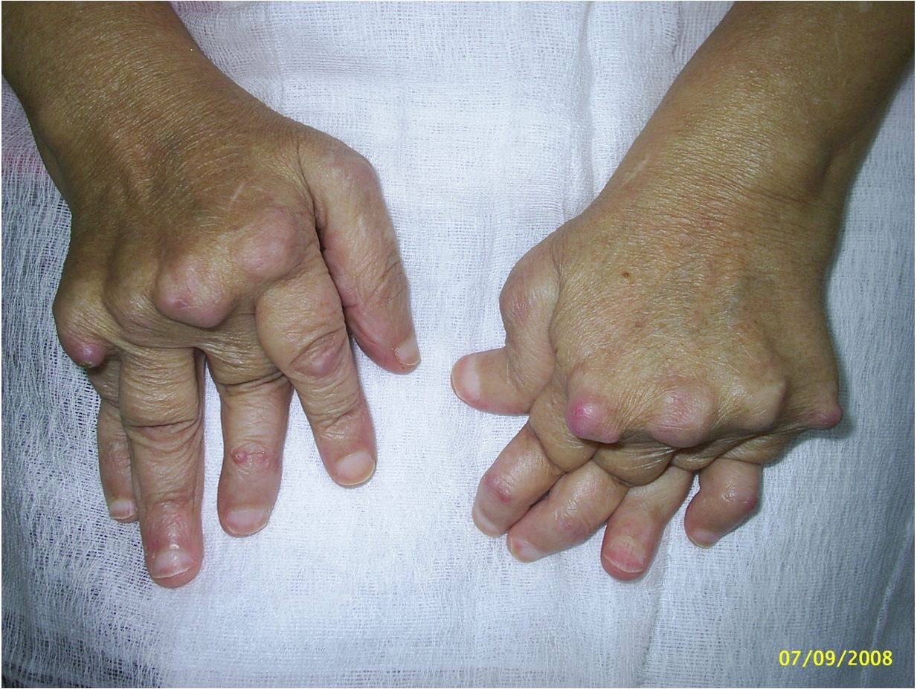

Slide 50
Autoimmune disorder - Unknown etiology
Genetics – Environmental – Possible infectious component
Characterized by:
synovial inflammation and hyperplasia (“swelling”)
autoantibody production (rheumatoid factor and Anti-cyclic citrullinated peptide [ACCP])
cartilage and bone destruction (“deformity”)
Systemic features, including :
cardiovascular, pulmonary, psychological, and skeletal disorders.

Slide 51
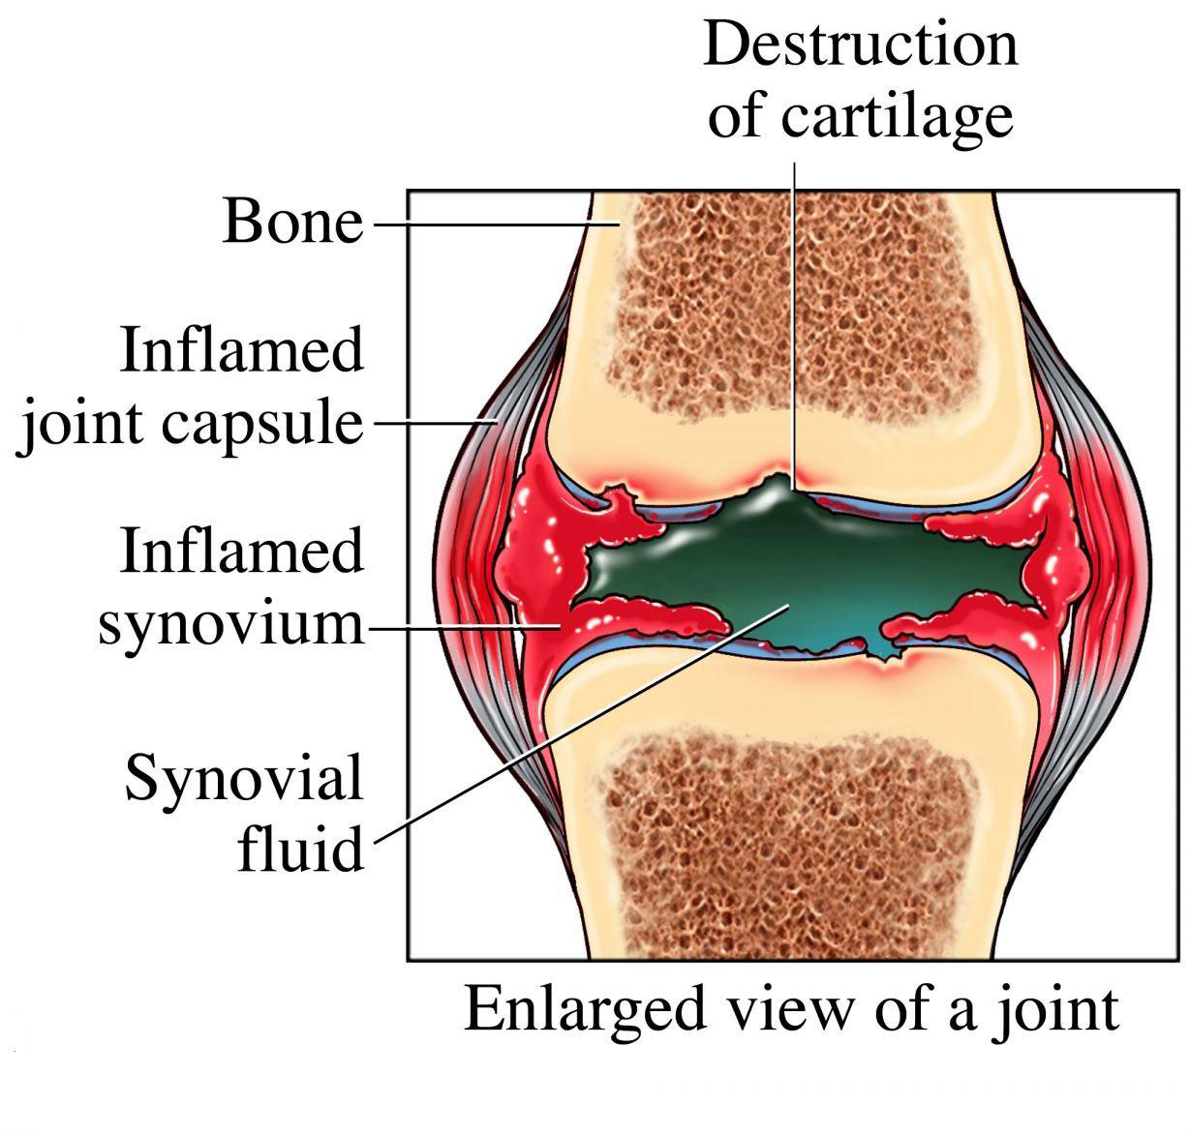
Notes:
Pannus = part of the thickned synovia that will invade the bony cartilage and bone (will show in x-ray)

Slide 52
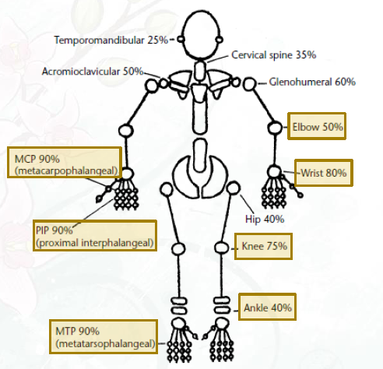

Slide 53
Extra-articular Manifistation

Slide 54
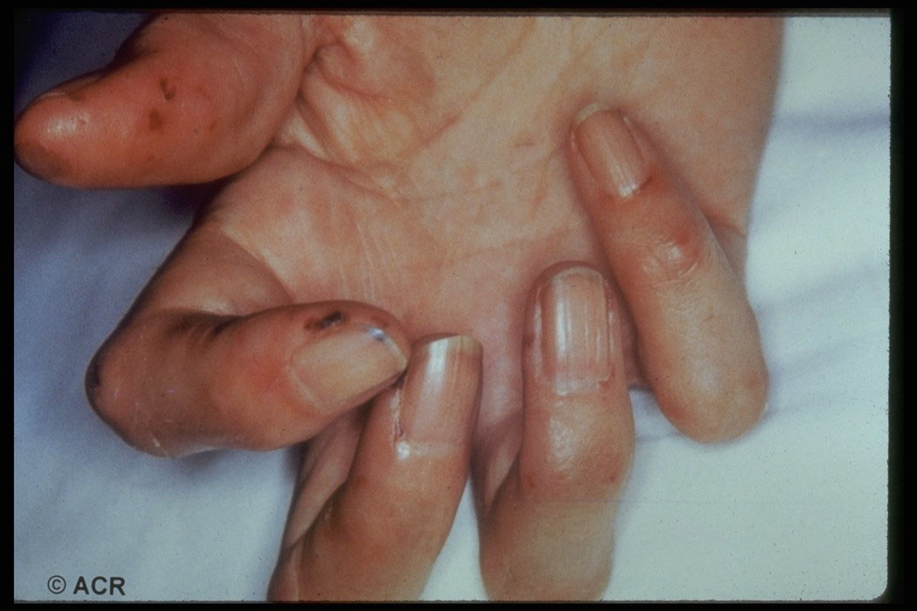
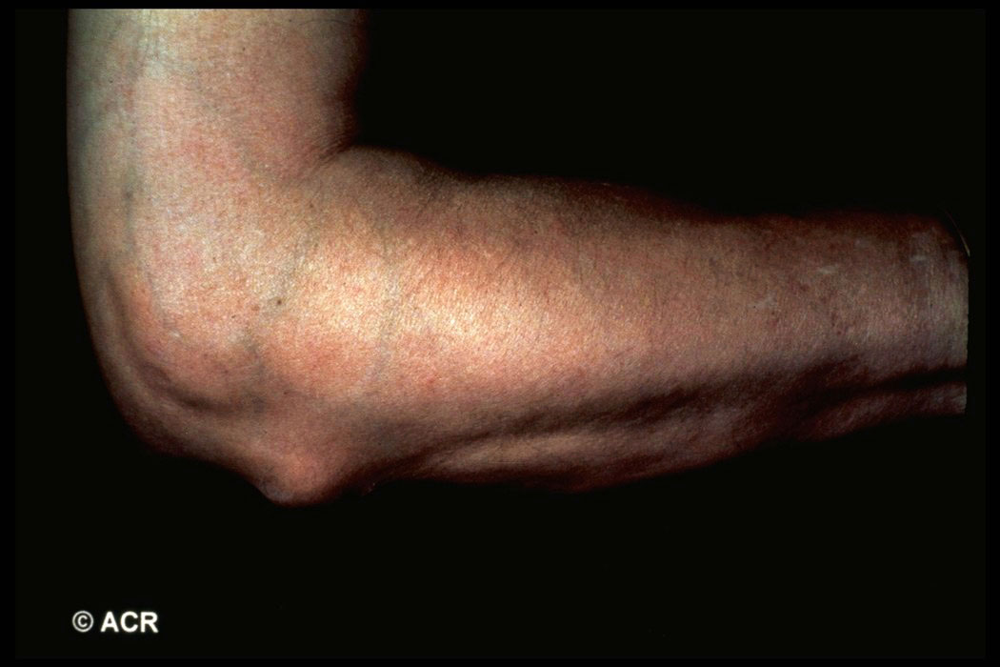
Small vessels Vasculitis
Subcutaneous nodule

Slide 55
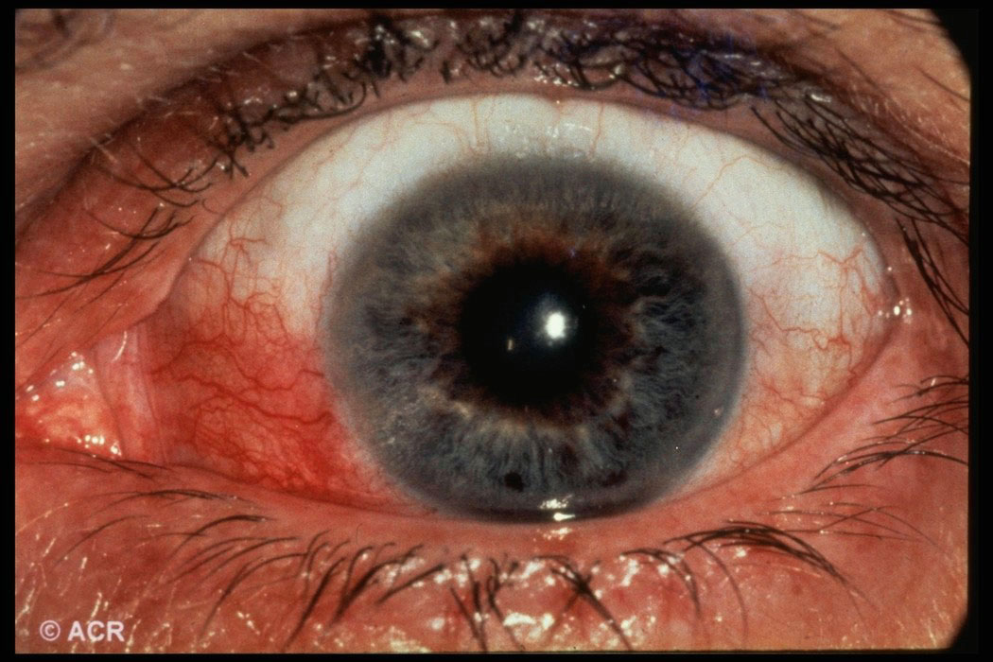
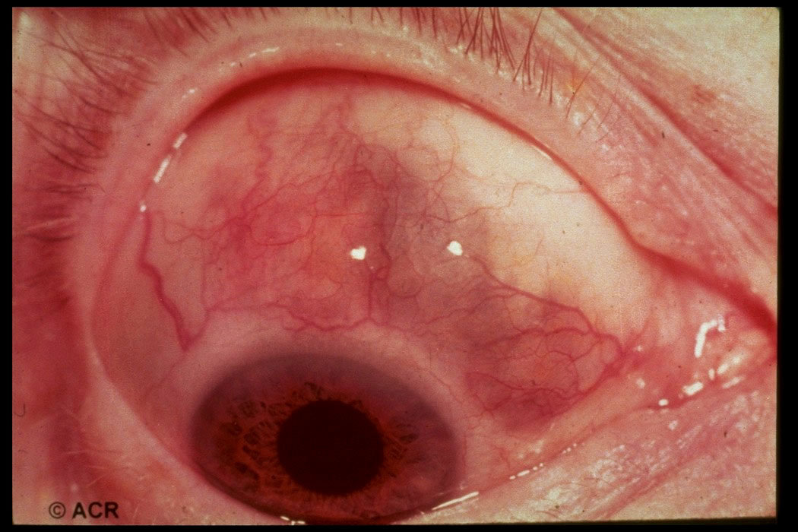
Episcleritis (blood vessels congestion)
Episcleritis + scleritis

Slide 56
History
1. Duration of the complaint: Acute (less than 6 weeks) OR chronic (6 weeks or more)
2. Number of joints involved: rheumatoid arthritis patients have a polyarticular joint involvement.
3. Distribution of Joints Involved: RA has a symmetrical joint involvement.
4. Pattern of involvement: Inflammation persists in involved joints as new ones become affected (Additive).
5. Duration of morning stiffness: Usually morning stiffness last for more than 30 minutes (it can reach one hour).
6. Aggravating and relieving factors: Pain worse after a period of inactivity and relieved by movement.
7. History of joint swelling , Extra-articular complaints Family history

Slide 57
Physical Examination
During the physical examination, it is important to assess the following:
Stiffness (may improve with heat and active exercise, but they do not prevent the return of stiffness).
Tenderness
Pain on motion
Swelling
Deformities (ulnar deviation, boutonniere and swan-neck deformities, hammer toes, and joint ankylosis)
Limitation of motion
Extra-articular manifestations
Rheumatoid nodules (occur in approximately 25% of patients with RA and most commonly found on extensor surfaces [proximal ulna])

Slide 58
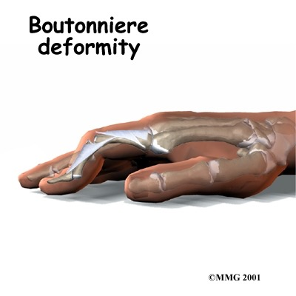
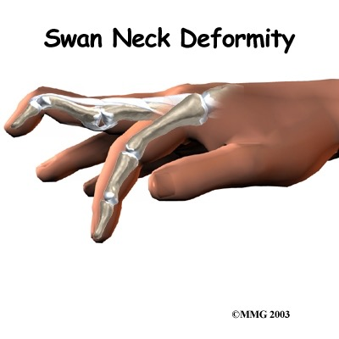
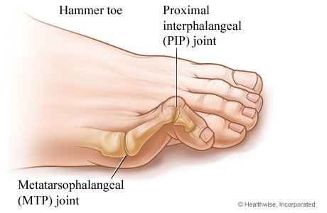
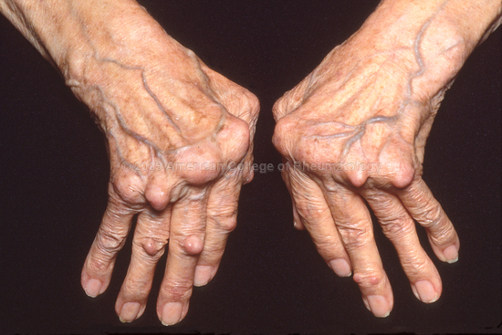

Slide 59
Diagnosis
Notes:
ACR(American college of rheumatology),, 6/10 is needed to classify patient as having definite RA

Slide 60
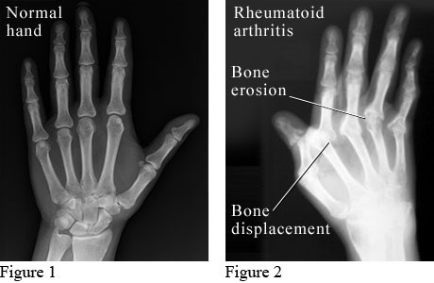
X-Ray

Slide 61
Cont.
RA is a clinical diagnosis; no laboratory test is diagnostic
1. Rheumatoid factor:
a. Auto antibodies to the Fc portion of IgG
b. Support a diagnosis of Rheumatoid Arthritis but not diagnostic.
c. seen in about 75% to 80% of patients with RA.
d. associated with a poor prognosis.
e. seen in conditions other than RA like hepatitis C, sarcoidosis, pulmonary fibrosis, and many others.
2. Anti-citrullinated protein antibodies (ACPA):
a. These are auto antibodies directed against an individual’s own proteins, can be detected by ELISA.
b. Accuracy (Anti-CCP Assay) Specificity 79% .. Sensitivity 96-98%.
c. Diagnosis more accurate when combined with RF.

Slide 62
Management :
- Confirm your diagnosis of RA form (history, Physical exams, and investigations).
- As soon as the diagnosis of RA is confirmed combined care should be started:
a. Start DMARD(s): Methotrexate within 3 months Control symptoms and delay progression of the disease
b. Consider NSAIDs (if mild>> To relieve pain and inflammation)
c. Consider Local / Low-dose Steroid
d. Patient Education
e.Physical / Occupational Therapy.
f. Referral to rheumatology clinic.
* Follow-UP

Slide 63
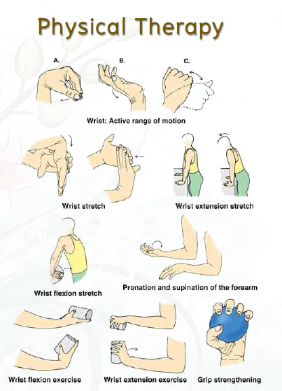

Slide 64
Degenerative Arthritis: Osteoarthritis (OA)
Definition:-
• progressive deterioration of cartilage and bone due to failed repair of joint damage caused by stresses on the joint.
Risk Factors:-
• genetic predisposition, advanced age, obesity (for knee OA), female, trauma.
Signs and Symptoms:-
localized to affected joints (not a systemic disease).-
-pain is often insidious, gradually progressive, with intermittent flares and remissions.

Slide 66
Classification (based on etiology)
1. primary (idiopathic):-
most common, unknown etiology.
2. secondary
post-traumatic or mechanical
post-inflammatory (e.g. RA) or post-infectious
heritable skeletal disorders (e.g. scoliosis)
endocrine disorders (e.g. acromegaly, hyperparathyroidism, hypothyroidism)
metabolic disorders (e.g. gout, pseudogout, hemochromatosis, Wilson’s disease, ochronosis)
neuropathic (e.g. Charcot joints)
atypical joint trauma due to peripheral neuropathy (e.g. diabetes, syphilis)
avascular necrosis
other (e.g. congenital malformation)

Slide 67
Pathophysiology:-
deterioration of articular cartilage due to local biomechanical factors and release of proteolytic
and collagenolytic enzymes
OA develops when cartilage catabolism > synthesis
loss of proteoglycans and water exposes underlying bone
abnormal local bone metabolism further damages joint
altered joint function and damage
synovitis is secondary to cartilage damage; therefore, may see small effusions in OA

Slide 69
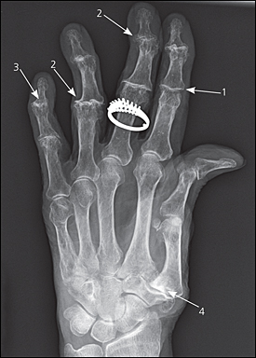
x-ray finding :
1/ joint space narrowing
2/ osteophytes formation
3/ joint destruction
4/ carpometacarpal joint

Slide 70
Septic Arthritis
Septic arthritis is an infection, usually bacterial, in the joint cavity. Since septic arthritis can lead to rapid joint destruction, immediate accurate diagnosis is essential The joint cavity is normally sterile with synovial fluid and cellular matter including a few white blood cells The majority of patients with bacterial septic arthritis will present with acute monoarthritis.
The incidence of septic arthritis has been estimated at 2 to 10 cases per 100,000 in the general population and as high as 30 to 70 cases per 100,000 in patients with rheumatoid arthritis. The most common mode of spread hematogenous, with predisposing factors including intravenous drug use presence of indwelling states.

Slide 72
Neisseria gonorrhea remains the most common pathogen (75% of cases) among younger sexually active individuals, Staphylococcus aureus infection is the cause of the vast majority of cases of acute bacterial arthritis in adults and in children older than 2 years.
Pay attention to the following symptoms:
-Acuteness of onset of the joint pain.
-Previous history of joint disease or trauma.
-The presence of extra-articular symptoms.

Slide 73
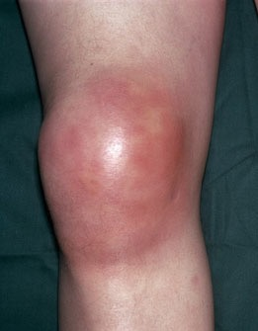
The most commonly involved joint in septic arthritis is the knee (50% of cases)

Slide 74
A classic presentation for septic arthritis is a febrile patient who has rigors, an increased leukocyte count, and elevated sedimentation rate. However, none of these is highly sensitive or specific for septic arthritis. In one series:,
40% to 60% of patients with septic arthritis were febrile.
25% to 60% had an elevated leukocyte count.
and 60% to 80% had a sedimentation rate greater than 50 mm/hr.
Signs and symptoms of infection may be muted in elderly, those who are immunocompromised (especially those with rheumatoid arthritis) and who abuse intravenous drugs.

Slide 75
Investigations of SA
Joint Fluid Analysis and Culture:
Normal synovial fluid is clear and colorless
- Culture results in patients with non gonococcal septic arthritis are almost always positive. - Cultures of the joint fluid in gonococcal infections yield positive results in only about 25-50% of cases.
Blood Cultures:
By Obtaining at least 2 sets of blood cultures to rule out a bacteremic origin of the septic joint.
Polymerase chain reaction:
For detection of bacterial DNA in joint fluid and synovial tissue.
Radiography and Ultrasonography:
it is most useful in ruling out underlying osteomyelitis caused by the joint infection itself Ultrasonography may be used to diagnose effusions in chronically distorted joints.
MRI and CT scanning:
More sensitive for distinguishing osteomyelitis, periarticular abscesses and joint effusions.

Slide 76
Synovial Fluid Analysis

Slide 77
Treatment and Management of septic arthritis
Medical management of infective arthritis focuses on adequate and timely drainage of the infected synovial fluid, administration of appropriate antimicrobial therapy, and immobilization of the joint to control pain
Antibiotic Therapy:
In native joint infections, antibiotics usually need to be administered parenterally for at least 2 weeks. However, each case must be evaluated independently.

Slide 78
Synovial Fluid Drainage
Aspirating the joint 2-3 times a day may be necessary during the first few days
https://www.youtube.com/watch?v=y_Jxr_MoBzE

Slide 79
Joint Immobilization and Physical Therapy
Usually, immobilization of the infected joint to control pain is not necessary after the first few days.
Initial physical therapy consists of maintaining the joint in its functional position and providing passive range-of-motion exercises.
- The joint should bear no weight until the clinical signs and symptoms of synovitis have resolved.

Slide 80
Red Flags in patient with Arthritis
1: Bumps Arthritis sufferers commonly have small lumps on their finger joints. These are actually bone protrusions or bone spurs that tend to result in swelling of the finger joints. Though these are especially common in women, they also tend to run in families, and may not produce any pain.

Slide 81
2: Pain Causing Lack of Sleep While normal aches and pains are common as we get older, persistent pain in the joints that interferes with regular sleep patterns is a warning sign of arthritis. Osteoarthritis pain comes because the cartilage in your joints wears away and can cause your bones to grind against one another. This persistent pain can lead you to lose considerable sleep.

Slide 82
3: Achy Hands If you begin experiencing a loss of fine motor skills, such as an inability to use a fork and knife, this may be a sign of arthritis. Pain in the knuckles and the finger joints, or at the base of the thumb, is very common in osteoarthritis sufferers.

Slide 83
Referral criteria
Patients with suspected inflammatory arthritis should be referred urgently if symptoms have been present for more than six weeks and any of the following apply:
swelling is present in two or more joints
the small joints of the hands or feet are affected
there is a positive MCPJ or MTPJ squeeze test (pain produced by gentle pressure across the metacarpophalangeal or metatarsophalangeal joints).
Other features which should raise suspicion of inflammatory arthritis include:
early morning joint stiffness for more than 30 minutes
joint stiffness following periods of immobility
constitutional upset, such as loss of appetite, weight loss, fatigue
the presence of other conditions associated with inflammatory arthritis such as psoriasis, iritis or uveitis, inflammatory bowel disease.

Slide 84
Conclusion
Arthritis is a major cause of lost work time and serious disability for many people.
Temporal pattern of arthritis could be Abrupt (develop over minutes to hours),or Insidious (develop over weeks to months)
Rheumatoid Arthritis is a chronic systemic disease that can be presented with Extra-articular Manifestation
ACR(American college of rheumatology) has a special criteria for diagnosing RA

Slide 85
MCQ
RA is characterized by which of the following patterns of joint involvement?
a) Episodic monoarthritis
b) Symmetrical polyarthritis
c) Migratory oligoarthritis
d) Spondylitis
Notes:
B

Slide 86
MCQ
The most specific test used in diagnosis of gout:
a) MRI
b) x-ray
c) synovial fluid analysis
d) serum uric acid
Notes:
C

Slide 87
MCQ
The most common offending organism in septic arthritis in adults is:
a) S. aureus
b) Streptococcus pyogenes
c) S. pneumoniae
d) H. influenzae
Notes:
A

Slide 88
MCQ
Which one of the following is a characteristic x-ray finding in case of osteoarthritis ?
a) chondrocalcinosis
b) osteopenia
c) Narrowing of joint space
d) sequestra
Notes:
C

Slide 89
Refrences
1-Prevalence of Doctor-Diagnosed Arthritis and Arthritis-Attributable Activity Limitation United States .
National and State Estimates of Childhood Arthritis and Other Rheumatic Conditions.
3- Clarson LE, Hider SL, Belcher J, Heneghan C, Roddy E, Mallen CD. Increased risk of vascular disease associated with gout: a retrospective, matched cohort study in the UK Clinical Practice Research Datalink.Ann Rheum Dis. 2014 Aug 27.
4- Dalbeth N, Kalluru R, Aati O, et al. Tendon involvement in the feet of patients with gout: a dual-energy CT study. Ann Rheum Dis 2013; 72:1545.
5- Singh JA, Reddy SG, Kundukulam J. Risk factors for gout and prevention: a systematic review of the literature. Curr Opin Rheumatol. 2011 Mar. 23(2):192-202. [Medline].
6-McAdams-Demarco MA, Maynard JW, Coresh J, Baer AN. Anemia and the onset of gout in a population-based cohort of adults: Atherosclerosis Risk in Communities study. Arthritis Res Ther. 2012 Aug 20. 14(4):R193. [Medline]. 5. oxford handbook of general oractice, 4th ed.

Slide 90
Thank You..

