Slide 1
Sexually Transmitted disease
Done by : Nasser alhowaish, Saud alsaloum , Hamad Aljutaili .

Slide 2
Questions

Slide 3
Question 1
Most common STIs in KSA ?
HIV
Chlamydia
Gonorrhea
Syphilis

Slide 4
Question 2
A patient went 3 days ago to one of the gulf countries. He complains of urethral discharge. What you expect:
HIV
Chlamydia
Gonorrhea
Syphilis

Slide 5
Question 3
Patient comes to you complaining of urinary frequency. When you examined him, you found Frothy yellowish vaginal discharge and strawberry cervix:
HIV
Trichomoniasis
Gonorrhea
Syphilis

Slide 6
Question 4
Which of the following is required to diagnose a patient with AIDS?
A CD4 count of less than 200 cells/mm3
A CD4 count of less than 1000 cells/mm3
A CD4 count of less than 2000 cells/mm3
A CD4 count of less than 100 cells/mm3

Slide 7
Question 5
Which of the following HPV types is known to caue cervical cancer?
HPV 6
HPV 11
HPV 16
HPV 33

Slide 8
At the end of the session the student should be able to:
1- Brief discussion about taking history and examination for sexual transmitted infections
2- List common sexual transmitted infections.
3- Discus the differential diagnosis of:
Vaginal and urethral discharge.
Ulcerative and non-ulcerative genitalia.
Pelvic pain and dysuria.
4- List the possible sexual transmitted infections among heterosexual and homosexual person.
5- Discus the investigation, diagnosis and management of sexual transmitted infections.
6- Discus the methods of prevention.
7- Discus the complications of sexual transmitted disease.
8- Dermatological pictures of different sexual transmitted infection.

Slide 9
Why Sexual History is Important?
Diagnosis & treatment
Detection of asymptomatic disease
Prevent serious complication (i.e. infertility, PID…)
Promote behavior changes to prevent future infections

Slide 10
Taking Sexual History
Open with reassuring statement to put patient at ease, reassuring that everything is confidential.
Play the helper rule, not the judge rule.
Reassure the patient that they don’t have to answer questions that they don’t want to answer.
History must cover the 5Ps:
Past STIs
Sexual Partners(men, women, or both+number)
Sexual Practices(vaginal, anal, oral)
Prevention of STIs and HIV.
Pregnancy history and plans

Slide 11
Method of Taking History
Use open ended questions.
Relieve pressure off patients.
Avoid medical jargon.
Encourage patients.
Don’t make assumptions: e.g. if he is married that doesn’t mean he doesn’t have extramarital sex.
Specific sexual practices: ask about anal, oral, or vaginal sex.
Condom use is NOT a yes/no question. (It’s a must)

Slide 12
Physicians Attitude
Maintain non judgmental attitude.
Avoid value laden language “You should..”..etc
Nonjudgmental ≠ Condoning the behavior
# Patient is coming for medical consultation NOT for religious guidance

Slide 13
Examination 1
General examination must include the mouth, throat, skin and lymph nodes in all patients
The inguinal, genital and perianal areas should be examined with a good light source.
The groins should be palpated for lymphadenopathy, lymph node tenderness and hernias.
The pubic hair must be examined for lice

Slide 14
Examination 2
The external genitalia must be examined for signs of erythema, fissures, ulcers, chancres, pigmented or hypopigmented areas and warts.
Where the urethral meatus is located and the presence of discharge noted
The cervix should be inspected for ulceration, discharge, bleeding and ectopy and the walls of the vagina for warts.

Slide 15
At the end of the session the student should be able to:
1- Brief discussion about taking history and examination for sexual transmitted infections
2- List common sexual transmitted infections.
3- Discus the differential diagnosis of:
Vaginal and urethral discharge.
Ulcerative and non-ulcerative genitalia.
Pelvic pain and dysuria.
4- List the possible sexual transmitted infections among heterosexual and homosexual person.
5- Discus the investigation, diagnosis and management of sexual transmitted infections.
6- Discus the methods of prevention.
7- Discus the complications of sexual transmitted disease.
8- Dermatological pictures of different sexual transmitted infection.

Slide 16
Most Common Sexual Infections
Bacterial infections :
Chlamydia trachomatis (causes chlamydial infections)
Neisseria gonorrhoeae (causes gonorrhoea or gonococcal infection)
Treponema pallidum (causes syphilis)
Haemophilus ducreyi (causes chancroid)
Klebsiella granulomatis (causes granuloma inguinale or donovanosis).

Slide 17
Most Common Sexual Infections
Viral infections:
Human papillomavirus (causes genital warts and certain subtypes lead to cervical cancer in women)
Herpes simplex virus type 1 and type 2 (causes genital herpes)
Human Immunodeficiency Virus (causes HIV infection)
Hepatitis B virus (causes hepatitis and chronic cases may lead to cancer of the liver)
Parasitic infections:
Trichomonas vaginalis (causes trichomoniasis)

Slide 18
Definition of STIs
“Sexually transmitted infections (STIs) are infections that are spread primarily through person-to-person sexual contact. There are more than 30 different sexually transmissible bacteria, viruses and parasites.”
World Health Organization

Slide 19
Common STIs

Slide 20
Chlamydia Trachomatis
Bacterial Infection

Slide 21
Chlamydia Trachomatis
It is the most common bacterial STI in the world.
It is the most common STI in KSA
Etiology:
It is caused by the bacterium Chlamydia trachomatis.
It has an incubation period of 1–3 weeks.
Mode of transmission:
Sexual contact
It is mostly asymptomatic ( 70% of women, 50% of men)

Slide 22
Clinical Presentation of Chlamydial Infection
Males (asymptotic in 50%) | Female (asymptotic in 70%)
Painful urination
Burning Sensation on the genitalia
Cloudy or clear discharge from the penis | Abnormal vaginal discharge
Painful and swollen testicles | Pain during intercourse
 | Abdominal pain with fever
 | Intermenstrual bleeding

Slide 23
Diagnosis
Diagnosis: Using the following methods after a urine sample (specimen of choice) or swab is obtained:
Nucleic acid amplification test (NAAT)
Direct fluorescent antibody test
Enzyme immunoassays (EIAs)

Slide 24
Treatment
Tetracyclines or Macrolides antibiotics such as Azithromycin or Doxycycline
In pregnancy, Erythromycin is the drug of choice.

Slide 25
Complications
Women
Pelvic inflammatory disease (PID)
Cervicitis
Salpingitis (causing ectopic pregnancy)
Men
Urethritis
Epididymitis
Reactive arthritis

Slide 26
Mucopurulent discharge in Cervix Proctitis
Notes:
Proctitis =inflammation of the rectum and anus

Slide 27
Trichomoniasis
Parasitic Infection

Slide 28
Trichomoniasis
Etiology:
Trichomonas Vaginalis (Flagellated protozoa), it can attach to the squamous epithelium infecting the vagina and urethra.
Mode of transmission:
Sexual contact.
Perinatally, from mother to child.

Slide 29
Signs and symptoms
Men:
usually present as the asymptomtic sexual partners of infected women.
They may complain of urethral discharge, irritation or urinary frequency.
Women:
The major complaint are vaginal discharge
Local irritation.
Examination often reveals a frothy yellowish vaginal discharge and erythematous vaginal walls.
The cervix may have multiple small hemorrhagic areas which lead to the description ‘strawberry cervix’.

Slide 30
Strawberry cervix

Slide 31
Diagnosis and Treatment
Diagnosis:
Dark-ground microscopy.
Positive in 40-80% of women.
Positive in 30% of men.
Culture techniques are good and confirm the diagnosis.
Treatment:
Metronidazole is the treatment of choice.

Slide 32
Complications
Genital inflammation, making it easier to get infected with other STIs
During pregnancy
Preterm delivery
Low birth weight

Slide 33
Gonorrhea
Bacterial Infection

Slide 34
Gonorrhea
Etiology:
Neisseria gonorrhea (Gram -ve intracellular diplococcus) infecting the epithelium particularly of the urogenital tract, rectum, pharynx and conjunctivae.
Incubation period is 2-14 days.
Modes of transmission:
Sexual contact (most symptoms present between 2-5 days)
Mother to child transmission

Slide 35
Gonorrhea Presentation
 | Men | Women
Asymptomatic | 10% | 50%
Signs and symptoms | Dysuria Urethral discharge In MSM rectal infection may produce proctitis. | Dysuria Pelvic pain vaginal discharge Intermenstrual bleeding Conjunctival infection: seen in neonates born to infected mothers.
Notes:
MSM = men who have sex with men

Slide 36
Diagnosis of Gonorrhea
Gram stain of discharge (intracellular pathogen)
Culture and treat empirically
Blood culture and synovial fluid investigations should be performed in cases of disseminated GC
Notes:
disseminated GC = Gonococcal infection

Slide 37
Treatment of Gonorrhea
Ceftriaxone: one dose IM (also effective against syphilis)
Azithromycin or Doxycycline to cover Chlamydia

Slide 38
Complications of Gonorrhea
Women
Bartholin’s abscess
Pelvic inflammatory disease
Infertility
Perihepatitis (rare)
Men
Epididymitis
Prostatitis

Slide 39
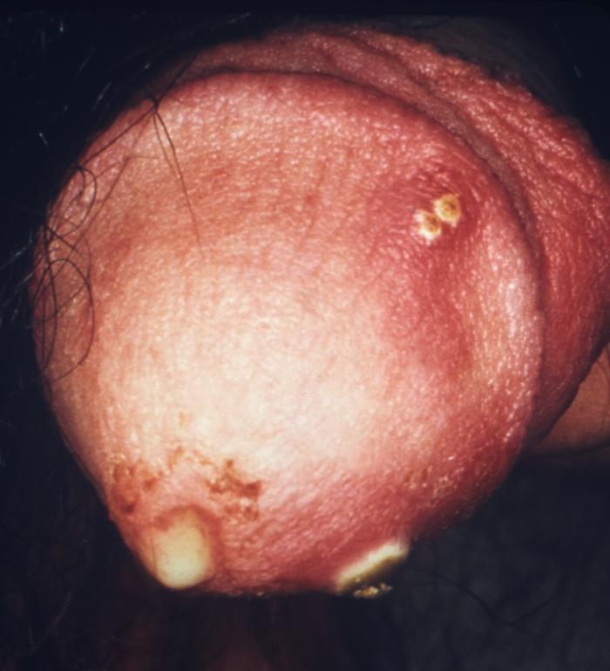
purulent penile discharge due to gonorrhea with an overlying penile pyodermal lesion.

Slide 40
Conjunctival gonorrhea

Slide 41
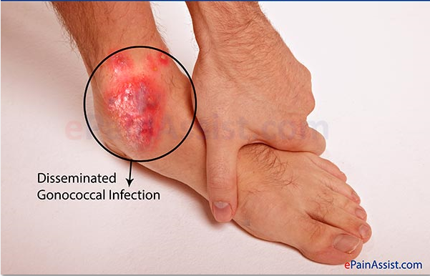
Disseminated gonococcal infection
Arthritis caused by disseminated gonococcal gonorrhea (More common in women)

Slide 42
Primary Syphilis
The first stage present with chancre (a firm, painless, non-itchy skin ulceration) form at the site of infection about 2-3 weeks after you are first infected.
Patient may not notice the sores or any symptoms, particularly if the sores are inside the rectum or cervix.
The sores disappear in about 4-6 weeks, even without treatment. The bacteria become dormant (inactive) in the system at this stage.

Slide 43
Primary syphilis

Slide 44
Secondary Syphilis
Occurs about 2-8 weeks after the first sores form.
About 33% of those who do not have their primary syphilis treated will develop this second stage.
These symptoms (diffuse rash which frequently involves the palms of the hands and soles of the feet) will often also go away without treatment and again, the bacteria become dormant (inactive) in your system.

Slide 45
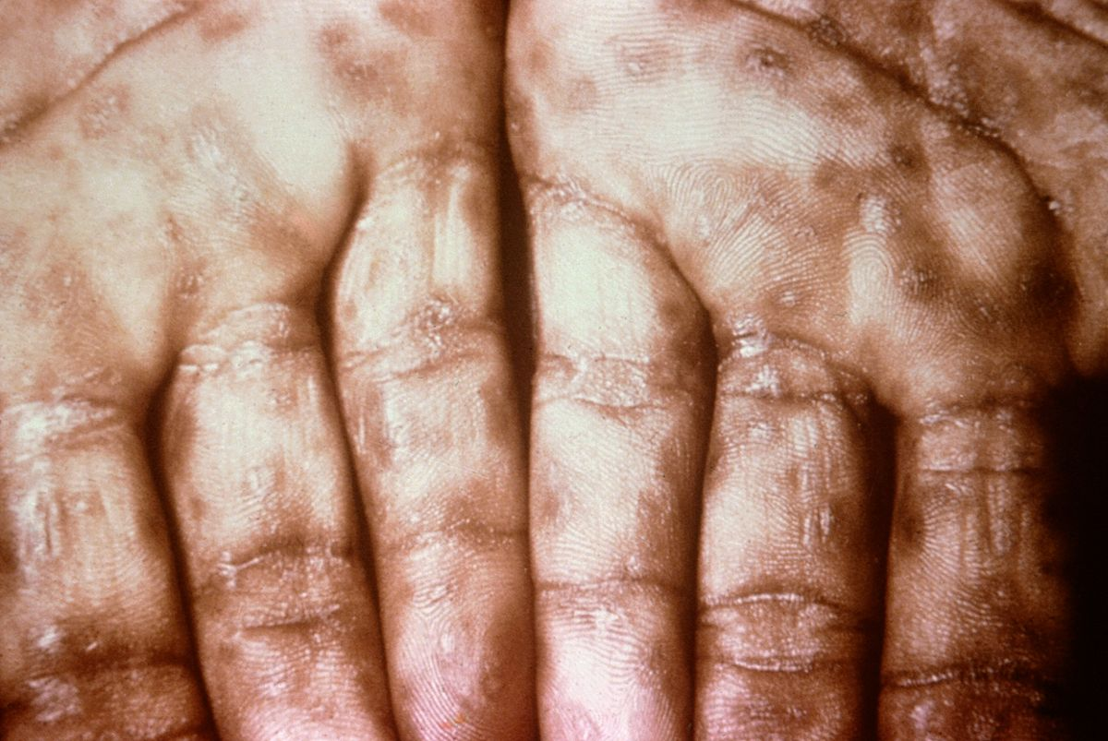
Secondary syphilis

Slide 46
Latent syphilis
Latent syphilis is defined as having serologic proof of infection without symptoms of disease
It can be:
Early:
less than 2 years after secondary syphilis.
Early latent syphilis may have a relapse of symptoms.
Late:
more than 2 years after secondary syphilis.
Late latent syphilis is asymptomatic.
not as contagious as early latent syphilis.

Slide 47
Tertiary Syphilis
Final stage of syphilis.
The infection generally involves the skin and bones but can also spreads to the brain, nervous system, heart.
The dormant bacteria may be detectable either by seeing the damage they cause to a part of the body, or through a blood test for syphilis.
Appearance of Gumma (charactaristic granulomatous lesions) commonly found on skull and legs.

Slide 48
Tertiary Syphilis

Slide 49
Treatment of syphilis
Antibiotics: effective early
Benzathine penicillin (1 dose, IM), if allergic: doxycycline (2 weeks)
If latent/tertiary: Benzathine penicillin (3 doses, IM)

Slide 50
HIV
Etiology:
Retrovirus, either HIV-1 or HIV-2
HIV-2 is almost entirely confined to West Africa
Modes of Transmission:
Sexual intercourse (Vaginal or Anal)
Mother-to-child (transplacental, perinatal, breastfeeding).
Contaminated blood, blood products and organ transplantation
Contaminated needles

Slide 51
Estimated Per-Act Probability of Acquiring HIV from an Infected Source
Type of Exposure | Risk per 10,000 Exposures
Parenteral³
Blood Transfusion | 9,250
Needle-sharing during injection drug use | 63
Percutaneous (needle-stick) | 23
Sexual³
Receptive anal intercourse | 138
Insertive anal intercourse | 11
Receptive penile-vaginal intercourse | 8
Insertive penile-vaginal intercourse | 4
Receptive oral intercourse | low
Insertive oral intercourse | low

Slide 52
Estimated Per-Act Probability of Acquiring HIV from an Infected Source
Other^
Biting | negligible⁴
Spitting | negligible
Throwing body fluids (including semen or saliva) | negligible
Sharing sex toys | negligible

Slide 53
Transmission of HIV from mother to child
In the absence of any interventions transmission rates range from 15-45%. This rate can be reduced to levels below 5% with effective interventions.

Slide 54
Risk factors and stages of HIV infection
Risk factors:
STIs (due to open sores)
Unprotected sex
Multiple sexual partners
Uncircumcised males
Stages of HIV infection
Acute HIV infection
Chronic HIV infection
AIDS

Slide 55
Acute HIV infection
Acute HIV infection generally develops within 2 to 4 weeks after a person is infected with HIV.
During acute stage, many people have flu-like symptoms.
In the acute stage, HIV multiplies rapidly and spreads throughout the body. The virus attacks and destroys the infection-fighting CD4 cells of the immune system.
HIV can be transmitted during any stage of infection, but the risk is greatest during acute HIV infection

Slide 56
Chronic HIV infection
HIV continues to multiply in the body but at very low rate.
People with chronic HIV infection may not have any HIV-related symptoms, but they can still spread HIV to others.
Without treatment, chronic HIV infection usually advances to AIDS in 10 to 12 years.

Slide 57
AIDS
AIDS is diagnosed when a person with HIV has a CD4 count of less than 200 cells/mm3 and/or one or more opportunistic infections.
Without treatment, people with AIDS typically survive about 3 years.
Mortality in HIV patients is mostly due to infections, cancers, or wasting.

Slide 58
Diagnosis of HIV
ELISA
Screening
High sensitivity
PCR
Measure the viral load
Western Blot
Confirmatory test

Slide 59
When to use ELISA
This test is the initial test to detect infection with HIV
2 weeks after infection and lasted 3-5 months
If antibodies to HIV are present (positive), if not (negative) the test is usually repeated to confirm the diagnosis.

Slide 60
When to use Western blot
it is done to confirm the results of two positive ELISA tests.

Slide 61
When to use PCR
This test may be done in the days or weeks after exposure to the virus, before development of the antibodies .

Slide 62
Treatment of HIV
Antiviral Therapy
Triple therapy HAART:
2 nucleoside reverse transcriptase inhibitors
Zidovudine, Nevirapine
Protease inhibitor
Saquinavir, Indiniavir
Opportunistic infection prophylaxis
TB
PCP
Toxoplasmosis

Slide 63
Treatments to prevent mother-to-baby transmission
UK guidelines recommend that you start taking AZT (zidovudine) in the final three months (third trimester) of your pregnancy.
You will also need to take an intravenous injection of AZT during delivery and have a caesarean .

Slide 64
Genital Warts
Etiology:
Over 90% are caused by HPV types 6 and 11.
HPV types 16 and 18 are known to cause cancer
In females, warts occur around mostly in the vagina, anus, and cervix. In males, genital warts are less common but might present on the tip of the penis
Mode of transmission:
Sexual contact
Direct skin contact

Slide 65
Signs, Symptoms and Complications of genital warts
Signs and symptoms:
Genital warts present as soft, moist, pink/flesh-colored bumps.
Usually painless.
Complications
HPV is the main risk factor for cervical cancer, as such we have to perform a Pap smear screening test for early detection of cervical cancer in females

Slide 66
Treatment and prevention of genital warts
Podofilox topical solution
Can be applied at home
Podophylin resin
Applied under medical supervision
Cryotherapy
Electro-cauterization
Surgical removal
Laser ablation

Slide 67
Vaccines of genital warts
There are two vaccines currently in use:
Gardasil: the FDA approved vaccine for prevention of HPV types 6, 11, 16, 18. It is therapeutic and it has to be used prophylactically.
Cervarix: Protects against HPV types 16 and 18.

Slide 68
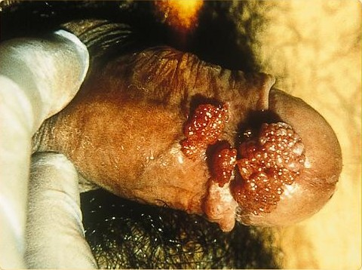
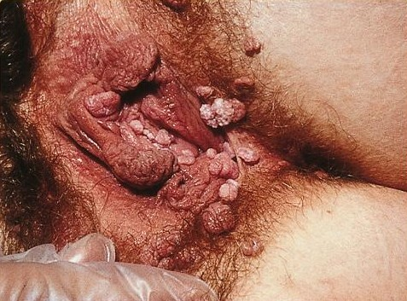
Genital warts

Slide 69
Genital Herpes
Etiology
Genital Herpes caused by Herpes Simplex Virus type 2 (HSV-2)
Oral Herpes caused by HSV-1
HSV-1 can cause genital lesions
Mode of transmission
Contact with person who is shedding (either sexual contact of regular physical contact)
Vertical transmission (very rare)
Through the birth canal

Slide 70
Signs and symptoms of Genital Herpes
It is a lifelong infection with exacerbations and remissions
Primary Herpes Infection:
Painful shallow ulcers (Around the mouth or on genitalia)
In Immunocompromised patients, symptoms are more severe with increased instances of shedding
Herpes encephalitis
Herpes viral meningitis
Herpes esophagitis

Slide 71
Diagnosis and Complications of Genital Herpes
Diagnosis:
Clinical presentation and history
Swab is taken from the base of the lesions
PCR
Complications:
Rectal infection may lead to proctitis
Aseptic meningitis
Involvement of sacral autonomic plexus leading to urine retention

Slide 72
Transmission of Genital Herpes from mother to son
If a woman with genital herpes has virus present in the birth canal during delivery, herpes simplex virus (HSV) can be spread to an infant, causing neonatal herpes, a serious and sometimes fatal condition. Neonatal herpes can cause an overwhelming infection resulting in lasting damage to the central nervous system, mental retardation, or death. Medication, if given early, may help prevent the infection .

Slide 73
Transmission of Genital Herpes from mother to son
it is also very rare. Less than 0.1% of babies born in the United States each year get neonatal herpes. By contrast, some 25-30% of pregnant women have genital herpes. This means that most women with genital herpes give birth to healthy babies.

Slide 74
Delivery in a m mother with genital herpes
If you have an active outbreak at the time of delivery, the safest course is a Cesarean section to prevent the baby from coming into contact with virus in the birth canal. If you do not have an active outbreak, you can have a vaginal delivery.

Slide 75
Treatment and management of Genital Herpes
Primary
Acyclovir for 5 days when new lesions are still forming
Treatment will do little to change clinical course if lesions are already crusting
Recurrence
Caring for patients mental health
Long term suppressive therapy (Acyclovir 6-12 months) therapy should be discontinued after 12 months

Slide 76
Consultation
Patient must be advised that they are infectious when lesions are present.
Sexual intercourse must be avoided during times of exacerbations
Condoms may not be effective (Lesions may be present outside the covered area)
Partners must be tested
Mothers who are expecting are encouraged to give birth via Caesarean section

Slide 77
Genital Herpes

Slide 78
Oral Herpes

Slide 79
At the end of the session the student should be able to:
1- Brief discussion about taking history and examination for sexual transmitted infections
2- List common sexual transmitted infections.
3- Discus the differential diagnosis of:
Vaginal and urethral discharge.
Ulcerative and non-ulcerative genitalia.
Pelvic pain and dysuria.
4- List the possible sexual transmitted infections among heterosexual and homosexual person.
5- Discus the investigation, diagnosis and management of sexual transmitted infections.
6- Discus the methods of prevention.
7- Discus the complications of sexual transmitted disease.
8- Dermatological pictures of different sexual transmitted infection.

Slide 80
Clinical presentation and DDx
Vaginal discharge
Trichomonas Vaginalis
Neisseria gonorrhoea
Chlamydia trachomatis
Bacterial vaginosis
Urethral discharge
Neisseria gonorrhoea
Trichomonas Vaginalis (rare in men)
Chlamydia trachomatis

Slide 81
Clinical presentation and DDx
Genital ulcers
Syphilis
Herpes
Chancroid
Granuloma inguinale
Lympho-granuloma venereum
Pelvic pain
Untreated STIs ( ex. chlamydia )
Past physical or sexual abuse
Prostatitis
Urinary tract infection
Pelvic Inflammatory Disease

Slide 82
STDs Genital Ulcers
 | Multiple |  | Single
Painful | Herpes simplex virus | Chancroid (women usually) | Chancroid(Men usually )
Painless | Lympho-granuloma venereum (Papule may ulcerate) | Granuloma inguinale (donovanosis ) |  | Primary Syphilis (chancre)

Slide 83
At the end of the session the student should be able to:
1- Brief discussion about taking history and examination for sexual transmitted infections
2- List common sexual transmitted infections.
3- Discus the differential diagnosis of:
Vaginal and urethral discharge.
Ulcerative and non-ulcerative genitalia.
Pelvic pain and dysuria.
4- List the possible sexual transmitted infections among heterosexual and homosexual person.
5- Discus the investigation, diagnosis and management of sexual transmitted infections.
6- Discus the methods of prevention.
7- Discus the complications of sexual transmitted disease.
8- Dermatological pictures of different sexual transmitted infection.

Slide 84
Comparison between homosexual and heterosexual
 | Homosexual | Heterosexual
Gonorrhea | 30.31 | 19.83
Early syphilis | 1.08 | 0.34
Anal warts | 2.9 | 0.26

Slide 85
Comparison between homosexual and heterosexual for HIV infection
Men who have sex with men (MSM) represent about 4% of the male population in the United States,
in 2010, MSM accounted for 78% of new HIV infections among males and 63% of all new infections. MSM accounted for 54% of all people living with HIV infection in 2011.

Slide 86
At the end of the session the student should be able to:
1- Brief discussion about taking history and examination for sexual transmitted infections
2- List common sexual transmitted infections.
3- Discus the differential diagnosis of:
Vaginal and urethral discharge.
Ulcerative and non-ulcerative genitalia.
Pelvic pain and dysuria.
4- List the possible sexual transmitted infections among heterosexual and homosexual person.
5- Discus the investigation, diagnosis and management of sexual transmitted infections.
6- Discus the methods of prevention.
7- Discus the complications of sexual transmitted disease.
8- Dermatological pictures of different sexual transmitted infection.

Slide 87
Prevention Of STDs
Sexual Behavior
Vaccination
Screening
Notes:
Sexual behavior :
Abstinence.
Mutual monogamy.
Consistent use of latex condom.
Using condoms are highly effective in reducing STIs transmission, but they do not guarantee 100% prevention. (e.g. Herpes, HPV)
Reduce number of sex partners.
Vaccination:
Vaccines are a recommended way to prevent hepatitis B, and HPV
Screening :
First identify population at risk : Young age (15-35)
Recent travel history
Sexual practices:
New partner
Multiple partners
Partner with multiple partners
Symptoms need to check :
Sores or bumps anywhere on the body
Recurrent genital sores
Generalized skin rash
Pain during intercourse
Scrotal pain, redness and swelling
Pelvic pain

Slide 88
At the end of the session the student should be able to:
1- Brief discussion about taking history and examination for sexual transmitted infections
2- List common sexual transmitted infections.
3- Discus the differential diagnosis of:
Vaginal and urethral discharge.
Ulcerative and non-ulcerative genitalia.
Pelvic pain and dysuria.
4- List the possible sexual transmitted infections among heterosexual and homosexual person.
5- Discus the investigation, diagnosis and management of sexual transmitted infections.
6- Discus the methods of prevention.
7- Discus the complications of sexual transmitted disease.
8- Dermatological pictures of different sexual transmitted infection.

Slide 89
Investigation
Discharge
Men
Urethral swabs: microscopy, GC culture, Chlamydia NAAT
Women
Cervical swabs: microscopy and culture for GC and Chlamydia NAATs
Vaginal swabs: microscopy and culture for Candida, Trichomonas and bacterial vaginosis.
NAATS for Chlamydia and GC if no other material
For both
Serology for syphilis.
HIV: EIA

Slide 90
Investigation
Ulcers
Material from the ulcer:
microscopy for evidence of early syphilis (dark ground microscopy), chancroid or LGV
PCR techniques where available, for herpes, syphilis and LGV
Culture for herpes simplex, Haemophilus ducreyi ( the main cause of Chanchroid )
Blood tests
Syphilis: EIA (IgM & IgG),TPPA and cardiolipin tests
Herpes simplex virus: IgG by type-specific EIA, Immunoblot or Western blot
Notes:
EIA Enzyme ImmunoAssay , The Treponema pallidum particle agglutination assay (also called TPPA test)

Slide 91
Cases

Slide 92
Case 1
Sarah, a 32 year old female presents to the out patient clinic with 4 days history of vaginal discharge.
The discharge is associated:
with discomfort
foul smell

Slide 93
Differential diagnosis
Infectious
Candida albicans
Trichomonas vaginalis
Bacterial vaginosis
N. gonorrhea
Herpes simplex virus
Non-infectious
Chemical irritation
Foreign body
Neoplasm
Cervical Polyps

Slide 94
Examination & investigation
Physical examination
No apparent lesion were available
Investigation
Examination of the discharge
Thin, greyish discharge with a fishy odor
Wet prep
Microscopic examination of the discharge
Can detect Trichomonas or yeast
Culture the discharge

Slide 95
Discharge overview
Yeast | Trichomonas | Bacterial Vaginosis
thick, whitish, and having a cottage-cheese-like appearance | thin, frothy, and has a greenish-yellow tint. | thin, frothy, and has a greenish-white tint.

Slide 96
Diagnosis & treatment
Diagnosis
A diagnosis of bacterial vaginosis was reached based on history, examination, and negative lab results.
Bacterial vaginosis is a form of vaginitis that results from an imbalance of the normal bacteria present in the vagina and an overgrowth of certain bacterial types
Treatment
Metronidazole or applied as a vaginal gel by vaginal
clindamycin cream (Cleocin)

Slide 97
Case 2
Khalid a 25 year old came to the hospital complaining of an ulcer in his genital area for the past 5 days
It Is associated with:
Pain
Itching
Burning
fever
Khalid gave history of frequent travelling and unprotected sexual relations

Slide 98
Differential diagnosis
Infectious
Herpes Simplex virus
Syphilis
Chancriod
Candida
Non-infectious
Sexual trauma
Fixed drug eruptions
Wegner’s granulomatosis

Slide 99
Examination & investigation
Physical examination
the patient had 4 round ulcers around the penis and the scrotum and palpable lymph nodes in the inguinal area.
Investigation
Lab test confirmed the diagnosis of Herpes
What further information from the history would support your diagnosis?
Multiple Ulcers
Painful ulcers
Palpable lymph nodes

Slide 100
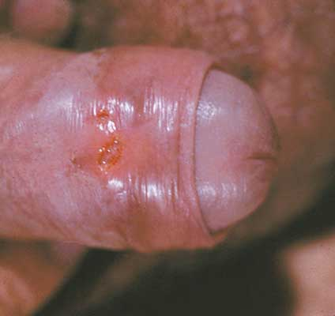
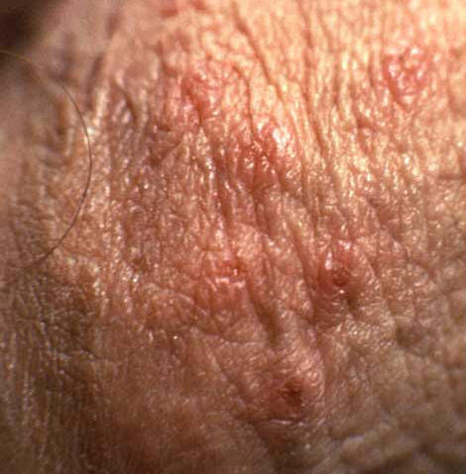
Example

Slide 101
Case 3
Ali is 29-year-old male who presents to his doctor reporting a pain while urinating and urethral discharge and for three days .
He describes the pain as burning sensation and the discharge as purulent discharge .
His last sexual contact was 5 days ago .

Slide 102
Differential diagnosis
Infectious
Chlamydia trachomatis
N. gonorrhea
Non-infectious
Chemical irritation

Slide 103
Examination & investigation
Examination
On genital examination there is reddened urethral meatus, with a purulent discharge. No lesions or ulcers .
There is no pelvic or abdominal pain
Investigation
Nucleic acid amplification test (NAAT) was negative
Gram stain shows WBCs containing intracellular Gram-negative diplococci.
Urethral culture shows growth of oxidase positive gram negative diplococci .

Slide 104
Diagnosis & treatment
Diagnosis
A diagnosis of Urethritis cause by N. gonorrhea was reached based on history, examination, and lab results.
Treatment
Ceftriaxone: one dose IM
Azithromycin or Doxycycline may added cover Chlamydia

Slide 105
Questions

Slide 106
Question 1
Most common STIs in KSA ?
HIV
Chlamydia
Gonorrhea
Syphilis

Slide 107
Question 2
A patient went 3 days ago to one of the gulf countries. He complains of urethral discharge. What you expect:
HIV
Chlamydia
Gonorrhea
Syphilis

Slide 108
Question 3
Patient comes to you complaining of urinary frequency. When you examined him, you found Frothy yellowish vaginal discharge and strawberry cervix:
HIV
Trichomoniasis
Gonorrhea
Syphilis

Slide 109
Question 4
Which of the following is required to diagnose a patient with AIDS?
A CD4 count of less than 200 cells/mm3
A CD4 count of less than 1000 cells/mm3
A CD4 count of less than 2000 cells/mm3
A CD4 count of less than 100 cells/mm3

Slide 110
Question 5
Which of the following HPV types is known to caue cervical cancer?
HPV 6
HPV 11
HPV 16
HPV 33

Slide 111
Take home massage
The physician must Maintain non judgmental attitude.
Chlamydia is the most common STI in KSA , it is asymptomatic disease, and has IP of 1-3 weeks.
Trichomoniasis has frothy yellowish vaginal discharge and causes Strawberry cervix.
Gonorrhea has shorter IP than chlamydia and characterized by dysuria and discharge.

Slide 112
References
Chlamydia trachomatis UK Testing Guidelines http://www.bashh.org/documents/3352.pdf
Kumar and Clark's Clinical Medicine (8th Ed)
CDC website
AVERT.org
Madani, T. A. (2006). Sexually transmitted infections in Saudi Arabia. BMC Infectious Diseases .
World Health Organization
AVERT. (2011). STD Pictures. Retrieved 2012, from AVERT: http://www.avert.org/std-pictures.htm
http://www.ncbi.nlm.nih.gov/pubmed/6893897
American Academy of Family Physicians
http://www.webmd.com/hiv-aids/human-immunodeficiency-virus-hiv-test
http://www.aidsmap.com/Mother-to-baby-transmission/page/1044918/

Slide 113
Thank you
Any questions ?

