Slide 1
B r e a k i n g B a d N e w s
Hossam alshehri, Ibrahim alqasir and abdulaziz alanazi

Slide 2
Objectives
Definition of bad news.
Importance and difficulty of breaking bad news.
To know what to do, how to do it, and what not to do as a future physician.
Family and Patient Perspective towards terminal illness.
Role of primary care physicians.
Examples how to break news.

Slide 3
quiz:
Q1. what is the second stage in a Patients reaction toward terminal illnesses
A. denial
B. acceptance
C. anger
D. depression

Slide 4
quiz:
Q2. which of the following scenarios will the physician be required to display some life-altering bad news to the patient?
A. telling an 18 y.o. male student that he has a dislocated shoulder.
B. A 50 y.o. female diagnosed with rheumatoid arthritis.
C. A 30 y.o. female diagnosed with peptic ulcer.
D. diagnosing a 45 y.o. male with gout.

Slide 5
quiz:
Q3. Bad news should be displayed to the patient __________?
A. in the least amount of time.
B. using medical and scientific terminology.
C. slowly and one by one.
D. 1 week after the results appearance.

Slide 6
quiz:
Q4. when I deliver some bad news to a patient I should ?
A. hurry because I don’t have time
B. lie to him about some information because maybe he doesn't understand me
C. warn the patient that bad news is coming
D. Give him all information in one go

Slide 7
What is Bad News?
“Any news that drastically and negatively alters the patients view towards his future.”
-Buckman R. BMJ1984

Slide 8
Other
“information that has an adverse and serious effect on an individual’s view of his or her future, noting that bad news is always a subjective appraisal by the individual receiving the news” (Baile et al. Oncologist, 2000).
“any information that produces a negative alteration to a person’s expectations about their present and future” (Fallowfield, Lancet, 2004).

Slide 9
Your Bad News may not be my Bad News.
Bad News doesn’t have to be fatal
Bad News doesn’t have to seem so bad to the medical practitioner

Slide 10
The Prophet (Peace be upon him) said :
عن أبي يحيى صهيب بن سنان رضي الله عنه قال: قال رسول الله صلى الله عليه وسلم: (( عجبا لأمر المؤمن إن أمره كله له خير وليس ذلك إلا للمؤمن: إن أصابته سراء شكر فكان خيرا له، وإن أصابته ضراء صبر فكان خيرا له)) رواه مسلم

Slide 11
Quotes about breaking bad news:
It alters one’s self-image : “I left my house as one person & came home another.
-Professional cyclist Lance Armstrong’s recollection
“There’s no way to tell you the bad news without saying it, so I’ll say it with body language.”
-jarod Kintz

Slide 12
Examples of conditions requiring breaking bad news:
Examples of Illnesses
Category | Examples
Life-limiting serious illnesses | cancer, hematological malignancies, advanced heart disease of any etiology, advanced lung disease of any etiology, advanced neurological disease of any etiology, advanced renal disease of any etiology, advanced liver disease of any etiology and Acquired Immuno Deficiency Syndrome
Life-altering chronic illnesses | diabetes, hypertension, rheumatologic illnesses (rheumatoid arthritis, lupus, fibromyalgia), chronic heart failure, coronary heart disease, cirrhosis, chronic renal failure, chronic lung diseases (chronic obstructive pulmonary disease, cystic fibrosis)

Slide 13
Why is it important ?
“ It is not an isolated skill but a Particular form of communication.”
- Frank A. Eur J of Palliat care 1997
“Delivering bad news influences patient adjustment to illness, anxiety, depression, hope, and decision making.”
-Anthony L Back, J Randall Curtis West J Med. 2002 May.

Slide 14
Why is it important ?
“A difficult & an essential task for all health care professionals.”
Prof.Riaz Qureshi.Family Medicine, King Saud University.
“ The patient can recall in detail how his/her diagnosis was revealed.”
Tony Back, MD. Medical Ethics, University of Washington.
“ Patient-doctor trust , gathering data, and applying a treatment plan are all
based on that.”
Richard T.Penson et al. Breaking Bad News: A Patient’s Perspective 2003

Slide 15
Why is it difficult ?
- It is an unpleasant task.
- Doctor’s don’t generally like taking away patients’ hopes.
- Doctors may fear a patient or family’s reaction to the news, or may be uncertain how to deal with an intense emotional response.

Slide 16
It is more difficult when the clinician:
Has a long-standing relationship with the patient.
When the patient is young.
When strong optimism had been expressed for a successful outcome.
- Vijayakumar Narayanan, Bibek Bista, and Cheriyan Koshy, Indian J Palliat Care. 2010 May-Aug.

Slide 17
Why is it difficult ? [Common Barriers to effective disclosure]
Physician’s fears
Being blamed by patient.
Not knowing all the answers.
Inflicting pain & sufferings.
Own illness & death.

Slide 18
Why is it difficult ? [Common Barriers to effective disclosure]
2. Lack of training
3. Lack of time.
4. Multiple physicians
[who should perform the task].

Slide 20
Psychosocial Context
How a patient responds to bad news can be influenced by the patient’s psychosocial context. It might be:
1- Diagnosis that comes at an inopportune time:
e.g. unstable angina requiring angioplasty during the week of a daughter’s wedding.
2- Diagnosis incompatible with one’s employment:
e.g. coarse tremor developing in a cardiovascular surgeon.
3- Varying needs of patient & family:
e.g. Patient asks not tell the family about the diagnosis and vice versa

Slide 22
What do you think ?

Slide 23
Steps of breaking bad news:
Rabow & Mcphee (West J. Med 1999):
Synthesized comprehensive model from multiple resources that uses a simple mnemonic of
Advance Preparation
Build a therapeutic environment/relationship
Communicate well
Deal with patient & family reactions
Encourage and validate emotions
ABCDE

Slide 24
Advance Preparation:
Familiarize yourself with the relevant clinical information (investigations, hospital report)
Arrange for adequate time in private, comfortable environment
Instruct staff not to interrupt
Be prepared to provide at least basic information about prognosis and treatment options
(so do read it up)
Mentally rehearse how you will deliver the news. You may wish to practice out loud.
Script specific words & phrases to use or to avoid
Be prepared emotionally

Slide 25
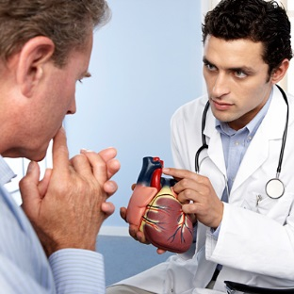
Build a Therapeutic Environment/Relationship
Introduce yourself to everyone present.
Determine the patient’s preferences for what and how much he/she wants to know (In the patients with breast cancer or melanoma, 57% wanted to discuss life expectancy, although only 27% of physicians actually did. 63% wanted to discuss the effects of cancer on other aspects of life, yet only 35% reported having these discussions).
-Anthony L Back, J Randall Curtis. West J Med. 2002 May
When possible, have family members or other supportive persons present.
Foreshadow the bad news, “I'm sorry, but I have bad news.”
Use touch where appropriate.
Avoid inappropriate humour.
Assure the patient you will be available

Slide 26
Communicate Well
Speak frankly but compassionately.
Avoid medical jargon.
Allow silence & tears; proceed at patient’s pace.
Have the patient describe his/her understanding of the information given.
Encourage questions.
Write things down & provide written information.
Conclude each visit with a summary & follow up plan.

Slide 27
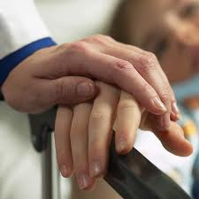
Deal With Patient and Family Reactions
Assess & respond to emotional reactions.
Be aware of cognitive coping (denial, blame, guilt, disbelief, acceptance, intellectualization).
Be empathetic; it is appropriate to say: “I’m sorry”
.قال الله سبحانه وتعالى : {الَّذِينَ إِذَا أَصَابَتْهُم مُّصِيبَةٌ قَالُواْ إِنَّا لِلّهِ وَإِنَّـا إِلَيْهِ رَاجِعونَ }البقرة156
Don’t argue or criticize colleagues.

Slide 28
Encourage and Validate Emotions
Offer realistic hope.
Give adequate information to facilitate decision making.
Inquire about the support systems in place.
Attend to your own needs during and following the delivery of bad news (counter-transference can be harmful).
Use interdisciplinary services to enhance patient care (e.g., hospice), but avoid using these as a means of disengaging from the relationship.

Slide 29
What to do?
Introduce yourself.
Look to comfort and privacy.
Determine what the patient already knows.
Determine what the patient would like to know.
Warn the patient that bad news is coming.
Break the Bad News.

Slide 30
What to do?
Ask if the pt, has something to share and LISTEN.
Identify the patient’s main concern
Summarize and check understanding.
Offer realistic hope.
Arrange follow up and ensure that there is some one with the patient when he leaves.

Slide 31
What not to do ?
Don’t be in a Hurry.
Don’t Give all the information in one go.
Don’t Give too much information.
Don’t Use medical jargon or unclear language/words.
Don’t Lie or be economical with the truth.
Don’t Be blunt.
Don’t Guess the prognosis (She has got 6 months, may be 7).
فقد روى البخاري (3936) عن سعد بن أبي وقاص رضي الله عنه قال : " عَادَنِي النَّبِيُّ صَلَّى اللَّهُ عَلَيْهِ وَسَلَّمَ عَامَ حَجَّةِ الْوَدَاعِ مِنْ مَرَضٍ أَشْفَيْتُ مِنْهُ عَلَى الْمَوْتِ ( أي : قاربت ) ..... فقال له عليه الصلاة السلام : ( وَلَعَلَّكَ تُخَلَّفُ حَتَّى يَنْتَفِعَ بِكَ أَقْوَامٌ وَيُضَرَّ بِكَ آخَرُونَ ... الحديث ) .

Slide 32
How to do it ?
Give the patient time to respond. Do not be afraid of silence or tears.
Explore patient’s emotions.
Use physical contact if appropriate.
Be honest if you are unsure about something.
Summarize.
Be sensitive.
Be empathic.
Maintain eye contact.
Give information in small chunks.
Repeat and clarify.
Regularly check understanding.

Slide 33
A demonstration..

Slide 34
Patient reaction toward terminal illnesses
Patient\Relative reaction | Stage
It can't be true It's a mistake It's not really happening | 1- Denial
How could this happen to me? What have I done to deserve it? Someone’s to blame probably the doctor | 2- Anger
Perhaps if I had prayed regularly’ ‘Perhaps if I had taken those tablets’ ‘Perhaps if I had given up smoking’ | 3- Bargaining

Slide 35
Patient reaction toward terminal illnesses
Patient\Relative reaction | Stage
It really is true What am I going to do? What is going to happen to my family I do not matter anymore | 4- Depression
Life goes on I must prepare for my family | 5- Acceptance

Slide 36
Patient’s Perspective
Patients prefer:
Physician’s competence, honesty & attention.
Time for questions.
Straightforward & understandable diagnosis.
The use of clear language.
Parker PA, Baile WF j.clinical onc 2001

Slide 37
Family’s Perspective
Family members prefer:
Privacy.
Good attitude from the bearer.
Clarity of the information given.
Physician competency.
Time for questions.
Jurkovich GJ, et al. J Trauma 200

Slide 38
Role of primary care physicians in breaking bad news:
Breaking bad news is a sentinel skill of the family physician.
Family physicians who provide continuity care to patients are in an ideal position to compassionately, yet clearly, convey devastating news.
The importance of the physician-patient relationship in such engagements is critical.
Having already developed a sense of mutual trust, the family physician is often in the position to break such news.

Slide 39
Perception and Attitude towards Breaking Bad News in the Saudi Population (by Prof. Mohammed O. Alrukban and others)
A cross sectional community based survey was conducted in Riyadh city during the month of April, 2009.
The study included 1086 participants. 48% males
Almost two-third of them defined bad news as related to the diseases that are highly fatal.
Most of the participants (71.1%) want detailed information about the disease. Most of the them also (88.2%) appreciates more those who tell them the truth.
The acceptance of the bad news was significantly different between older (35.0%) and younger (17.0%) participants. ( male 28% > female 17% )
the younger participants showed significantly more sadness and depression compared to the older participants. ( females > males )

Slide 40
Preferences and attitudes of the Saudi population toward receiving medical bad news: A primary study from Riyadh city (by Prof. Mohammed O. Alrukban and others)
A cross sectional community based survey was conducted in Riyadh city during the month of April, 2009.
The study included 1013 participants. 53% were females
Almost two-third of the participants preferred to be the first to receive the bad news.
Almost 70% of the participants preferred to be told the bad news at a private place.
Approximately half of the participants would like
the one who breaks the bad news to remain with them
to give them some more information about the disease

Slide 42
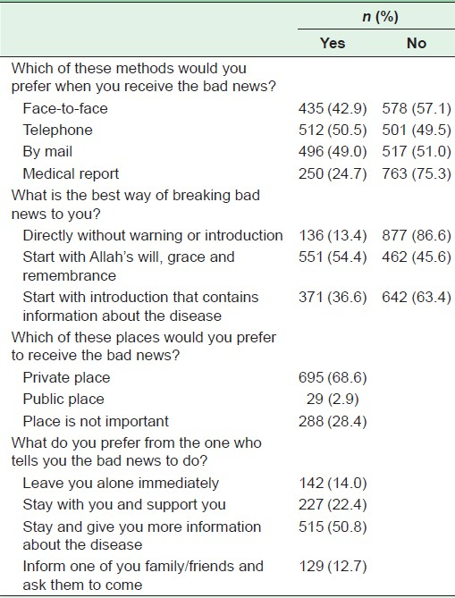

Slide 43
Summary
Delivering bad news is very stressful for clinicians with the after effects lasting for hours to days.
Competence is a great stress reliever. The clinician who is adequately trained in communication skills is more likely to break bad news both sensitively and efficiently.
Hearing bad news is very stressful and distressing to patients. Patients with previous history of mental illness, patients with poor social and financial support systems are especially vulnerable to the after effects of bad news.
Ask before you tell: First ask the patient “What is your understanding of your illness?”
Deliver the bad news in simple clear sentences. Avoid jargon.
Arrange for follow-up care.
Debrief your staff and allow time for self-reflection

Slide 44
quiz:
Q2. which of the following scenarios will the physician be required to display some life-altering bad news to the patient?
A. telling an 18 y.o. male student that he has a dislocated shoulder.
B. A 50 y.o. female diagnosed with rheumatoid arthritis.
C. A 30 y.o. female diagnosed with peptic ulcer.
D. diagnosing a 45 y.o. male with gout.

Slide 45
quiz:
Q3. Bad news should be displayed to the patient __________?
A. in the least amount of time.
B. using medical and scientific terminology.
C. slowly and one by one.
D. 1 week after the results appearance.

Slide 46
quiz:
Q1. what is the second stage in a Patients reaction toward terminal illnesses
A. denial
B. acceptance
C. anger
D. depression

Slide 47
quiz:
Q4. when I deliver some bad news to a patient I should ?
A. hurry because I don’t have time
B. lie to him about some information because maybe he doesn't understand me
C. warn the patient that bad news is coming
D. Give him all information in one go

Slide 48
Example:
Fatima 31 years old, pregnant in her 3rd trimester came in to check up on her baby, examination showed absent fetal heart sounds…
ABCDE
Don’t do what you shouldn’t
You were assigned to tell her the bad news

Slide 49
References:
Communicating bad news, Anthony L Back, Associate professor1 and J Randall Curtis, Associate professor2
BREAKS’ Protocol for Breaking Bad News, Vijayakumar Narayanan, Bibek Bista, and Cheriyan Koshy, Indian J Palliat Care. 2010 May-Aug
Communicating bad news, Anthony L Back, J Randall Curtis, West J Med. 2002 May
Prof. Riaz Qureshi Presentation, Breaking Bad News
Breaking Bad News: The Many Roles of the Family Physician http://www.aafp.org/afp/2001/1215/p1946.html
الاسلام سؤال و جواب http://islamqa.info/ar/188991
Preferences and attitudes of the Saudi population toward receiving medical bad news: A primary study from Riyadh city (by Prof. Mohammed O. Alrukban and others)
Perception and Attitude towards Breaking Bad News in the Saudi Population (by Prof. Mohammed O. Alrukban and others)

Slide 50
Thank you
The good news is, we are done…

