Slide 1
HEADACHE
Supervised by
prof/Jamal Jarallah
Yasser Alhazzani
Mohammad khan
Zeyad alhozaimy

Slide 2
Objective
Definition and epidemiology
Common types of headache “Migraine, Tension headache, Cluster headache”
How to approach a patient with headache
Red Flags and indications for further investigations like CT brain, MRI
Brief comment on Migraine, Tension Headache, Cluster headache, benign intracranial tension, temporal arteritis, space occupying headaches.
What is the role of primary health care physician in management “Drug treatment and Prophylaxis”
What investigations could be requested if needed
When to refer to specialist

Slide 3
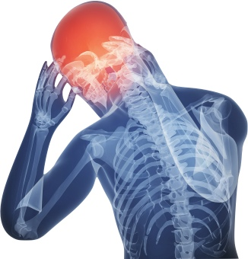
Pre-Test

Slide 4
1-A 30-year-old lady, presented with C/O headache, unilateral, pulsating in nature, severe, lasts for few hours and increases by daily routine physical activities. Past H/O having similar attacks on and off past few years. Not known to have any other problem.
What is the most likely diagnosis?
A) Cluster headache.
B) Migraine.
C) Subarachnoid hemorrhage.
D) Tension headache.

Slide 5
2-A 35-years-old male comes to your office with a 6-month history of recurrent daily headaches, usually in the late afternoon. The headaches are described by the patient as compressing in nature.
The headaches are not associated with nausea, vomiting, or malaise. The patient describe some dizziness and light headedness with these headaches.
On examination: unremarkable
What is the likely type of headache in this patient?
A) Chronic daily headache: tension type.
B) Episodic tension-type headache.
C) Migraine without aurea.
D) Cluster headache.

Slide 6
3-A 19-years-old woman with a BMI of 34, presents to her physician with a 6-month history of intermittent headaches associated with visual blurring. She also gives history of vague menstrual irregularities. Fundoscopy shows papilloedema. Routine investigations including ESR, CT head scan and lumbar puncture are normal.
The most likely diagnosis is:
A) Benign intracranial hypertension.
B) Giant cell arteritis.
c) Subdural haemorrhage.
D) Tension headache.

Slide 7
4-The first-line treatments of Cluster Headache is:
A) Sumatriptan injections
B) Zolmitriptan nasal spray
c) Oxygen
D) All of the above.

Slide 8
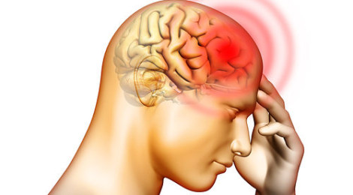
Definition and epidemiology

Slide 9
Definition:
Headache :
is pain anywhere in the region of the head or neck. It can be a symptom of a number of different conditions of the head and neck.

Slide 10
Epidemiology:
the most prevalent symptoms seen in general.
The prevalence of migraine and tension headache in KSA is 12.1%
Tension Headache > Migraine.
Equal in Tension Headache.
Female: Male 2-3:1 in Migraine.
Female: Male1:10 in Cluster Headache

Slide 11
Common types of headache “Migraine, Tension headache, Cluster headache”

Slide 12
Classification:
Primary:
Tension-type headache (TTH)
Migraine
Cluster headache
Secondary:
Medication overuse
Cervicogenic headache
Infection
Vascular
Raised intracranial pressure.
Trauma

Slide 13
How to approach a patient with headache
https://youtu.be/qRqYIHpem9M
https://youtu.be/_6_OzASXgQs

Slide 14
Approach to a patient with headache:
History:
SOCRATES (for HEADACHE)
(site, onset, character, radiation, associated symptoms, time, aggrevating & releiving, severity)
Past medical (history of head trauma, anurysm..)
Family history (+ve of migrain)
Drug history (overdose)
Social history (stress)

Slide 15
Examination:
A- Vital signs.
b. General appearance.
c. General examination, with a focus on the head and neck, Palpate (skull base, TMJs, temporal arteries, upper cervical facets, pericranial muscles, paranasal sinuses).
d. Full neurological examination.

Slide 16
Investigations:
When headache does not clearly fit into one of the recognized primary headache or if there are atypical symptoms.
Non-Contrast CT Scan:
Decreased level of consciousness
one sided weakness
pupil size difference

Slide 17
Red Flags in patient with headache

Slide 18
:Red Flag
Worsening headache with fever.
Sudden-onset headache reaching maximum intensity within 5 minutes.
New-onset neurological deficit.
New-onset cognitive dysfunction.
Change in personality.
Impaired level of consciousness.
Recent (typically within the past 3 months) head trauma.

Slide 19
Cont:
Headache triggered by cough.
Headache triggered by exercise.
Orthostatic headache (headache that changes with posture).
Symptoms suggestive of Giant cell artritis.

Slide 20
When to refer to specialist
Notes:
https://youtu.be/LIi7ojQCymY

Slide 21
Who needs a referral?
compromised immunity, caused for example by HIV or immunosuppressive drugs.
age under 20 years and a history of malignancy
a history of malignancy known to metastasise to the brain
vomiting without other obvious cause.

Slide 22
Brief comment on Migraine, Tension Headache, Cluster headache, benign intracranial tension, temporal arteritis, space occupying headaches.

Slide 23
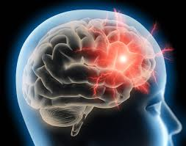
Migraine:
Migraine is a chronic neurological disorder characterized by recurrent moderate to severe unilateral, throbbing headache
Associated with nausea, vomiting, or photo- and phonophobia.
It usually lasts 4 to 72 hours.
Notes:
Vasodilatation causes the release of chemicals from nerve fibers that coil around the large arteries of the brain.
The chemicals cause inflammation, pain, and further enlargement of the artery

Slide 24
Phases:
1. The prodrome, which occurs hours or days before the headache
2. The aura, which immediately precedes the headache
3. The pain phase, also known as headache phase
4. The postdrome, the effects experienced following the end of a migraine attack
Notes:
Prodrome phase[edit]
Prodromal or premonitory symptoms occur in ~60% of those with migraines^{[14][15]} with an onset of two hours to two days before the start of pain or the aura ^{[16]} These symptoms may include a wide variety of phenomena^{[17]} including: altered mood, irritability, depression or euphoria, fatigue, craving for certain food, stiff muscles (especially in the neck), constipation or diarrhea, and sensitivity to smells or noise.^{[14]} This may occur in those with either migraine with aura or migraine without aura.[

Slide 25
Management:
prevent the trigger factors:
Stress factors:
Food factors: caffeine, chocolate, meat, alcohol, aged cheese
Sleep factors:
Environmental factors: Exposure to flashing, bright or fluorescent lights, Weather changes \ Pollution.
Drugs: HRT, Antibiotics, SSRIs, OCP, Antihypertensive, Vasodilators, Benzodizepine withdrawal and Nitrates.

Slide 26
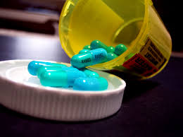
Con…:
Acute Treatment:
oral triptan and an NSAID.
an oral triptan and paracetamol.
For people aged 12–17 years consider a nasal triptan in preference to an oral triptan.
DO NOT give an opioids.
Notes:
Offer combination therapy with an oral triptan¹ and an NSAID, or an oral triptan¹ and paracetamol, for the acute treatment of migraine, taking into account the person's preference, comorbidities and risk of adverse events. For people aged 12–17 years consider a nasal triptan in preference to an oral triptan¹.
For people who prefer to take only one drug, consider monotherapy with an oral triptan¹, NSAID, aspirin² (900 mg) or paracetamol for the acute treatment of migraine, taking into account the person's preference, comorbidities and risk of adverse events.
When prescribing a triptan¹, start with the one with the lowest acquisition cost; if this is consistently ineffective, try one or more alternative triptans.
Consider an anti-emetic in addition to other acute treatment for migraine even in the absence of nausea and vomiting.
Do not offer ergots or opioids for the acute treatment of migraine.
For people in whom oral preparations (or nasal preparations in young people aged 12–17 years) for the acute treatment of migraine are ineffective or not tolerated:
offer a non-oral preparation of metoclopramide or prochlorperazine³ and
consider adding a non-oral NSAID or triptan¹ if these have not been tried.

Slide 27
Cont:
Chronic Treatment:
1st line : Beta blocker or TCA before bed
2nd line: Topiramate (antiepileptic)
3rd line: Gabapentin (antiepileptic)
Notes:
Discuss the benefits and risks of prophylactic treatment for migraine with the person, taking into account the person's preference, comorbidities, risk of adverse events and the impact of the headache on their quality of life.
Offer topiramate¹ or propranolol for the prophylactic treatment of migraine according to the person's preference, comorbidities and risk of adverse events. Advise women and girls of childbearing potential that topiramate is associated with a risk of fetal malformations and can impair the effectiveness of hormonal contraceptives. Ensure they are offered suitable contraception.
If both topiramate¹ and propranolol are unsuitable or ineffective, consider a course of up to 10 sessions of acupuncture over 5–8 weeks or gabapentin² (up to 1200 mg per day) according to the person's preference, comorbidities and risk of adverse events.
For people who are already having treatment with another form of prophylaxis such as amitriptyline³, and whose migraine is well controlled, continue the current treatment as required.
Review the need for continuing migraine prophylaxis 6 months after the start of prophylactic treatment.
Advise people with migraine that riboflavin (400 mg⁴ once a day) may be effective in reducing migraine frequency and intensity for some people.
Botulinum toxin type A
Botulinum toxin type A is recommended as an option for the prophylaxis of headaches in adults with chronic migraine (defined as headaches on at least 15 days per month of which at least 8 days are with migraine):
that has not responded to

Slide 28
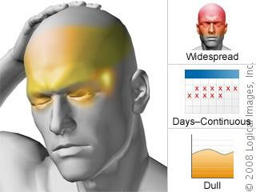
Tension Type Headache (TTH):
Typically bilateral, non-throbbing, and described with such words as pressure, squeezing, or tightness. This is usually due to stress, neck strain.
TTH is the most common primary headache disorder. chronic TTH affects 1-3% of adults.

Slide 29
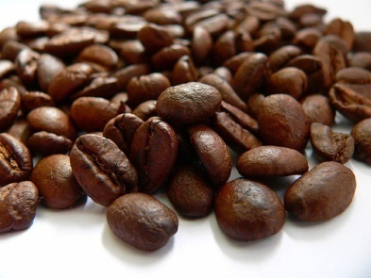
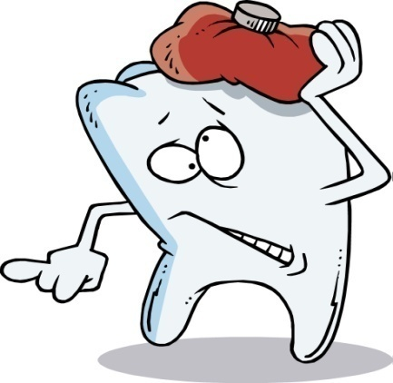
Causes:
head to be held in one position for a long time without moving.
Other triggers of tension headaches include:
Alcohol use.
Caffeine (too much or withdrawal)
Common cold, sinusitis.
Dental problems
Eye strain
Excessive smoking
Fatigue or overexertion

Slide 30
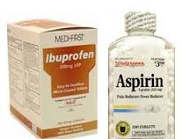
Management:
Acute
aspirin, paracetamol or an NSAID.

Slide 31
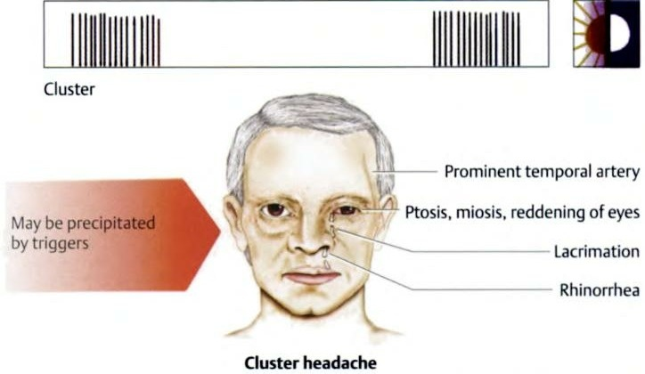
Cluster Headache (CT):
Characterized by excruciating peri- orbital pain.. Unilateral .
Pain may be so sever , the patient may even become suicidal.
Accompanied by cranial autonomic symptoms such as a rhinorrhea, reddening of the eye, and lacrimation, all ipsilateral to the pain.
It typically lasts 30-90 minutes

Slide 32
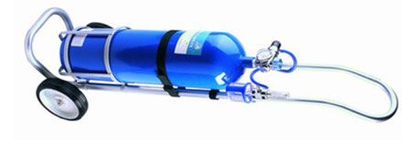
Management:
Acute cluster attacks: are best treated with high-flow oxygen and parenteral Sumatriptan.

Slide 33
Cont:
Prophylaxis:
Of all headache types, cluster headache are the most responsive to Prophylactic treatment .
Should seek for specialist:
Verapamil. Drug of choice
during pregnancy.
Notes:
Consider verapamil³ for prophylactic treatment during a bout of cluster headache. If unfamiliar with its use for cluster headache, seek specialist advice before starting verapamil, including advice on electrocardiogram monitoring.
Seek specialist advice for cluster headache that does not respond to verapamil³.
Seek specialist advice if treatment for cluster headache is needed during pregnancy.

Slide 34
Benign intracranial tension:
is a neurological disorder that is characterized by increased intracranial pressure (pressure around the brain) in the absence of a tumor or other diseases.
Notes:
(Idiopathic intracranial hypertension-pseudotumor cerebri) : it is disorder of unknown etiology affecting obese women of childbearing age. The most neurological manifestation is papilledema which may lead to progressive optic atrophy then result of blindness.
The most significant physical finding is bilateral disc edema secondary to the increased ICP.

Slide 35
Cont:
Symptoms are headache, pulsatile tinnitus,
double vision, nausea and vomiting.
It may lead to swelling of the optic disc in the eye, which can progress to vision loss.
Notes:
Headaches, typically nonspecific and varying in type, location, and frequency
Diplopia, usually horizontal
Nonspecific symptoms : …

Slide 36
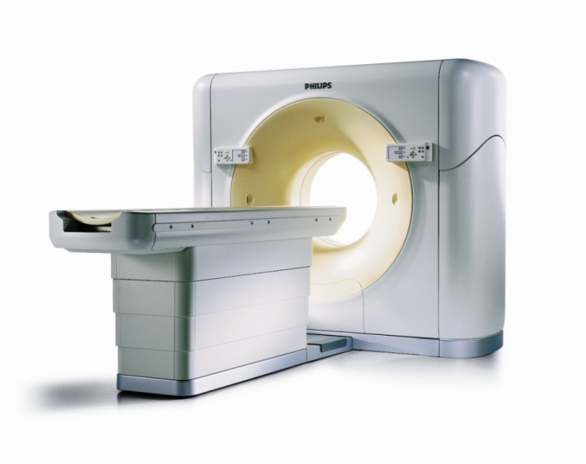
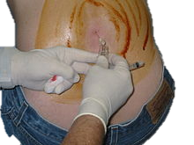
Cont:
Diagnosed by CT scan and Lumbar Puncture.
Treated by acetazolamide or surgical.
Notes:
Visual function tests are the most important parts of the neurologic examination for diagnosing and monitoring patients with IIH:
Ophthalmoscopy-Visual field assessment-Ocular motility examination
Once an intracranial mass lesion is ruled out, lumbar puncture is indicated.
Acetazolamide (the most effective agent for lowering ICP).
If visual function deteriorates, surgical intervention is considered.

Slide 37
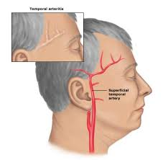
Temporal Arteritis:
Form of vasculitis.
is an inflammatory disease of blood vessels most commonly involving large and medium arteries of the head.
Headache, bruit, fever and jaw claudication.
Biopsy is the gold standard to diagnosis.
treated by Corticosteroids.
Notes:
the most common form of a systemic inflammatory vasculitis. It’s unknown etiology that occurs in elderly people. It can result in a wide variety of systemic, neurologic, and ophthalmologic complications.
(Horton disease-granulomatous arteritis)
typically affects the superficial temporal arteries.
risk factors for GCA: aging, female, genetic component, infections.
Sign & symptoms : visual disturbances, headache, jaw claudication, neck pain, and scalp tenderness.
Corticosteroids are the mainstay of therapy.

Slide 40
Pattern:
Migraine
recurrent attack : 4 hours to 3 days
1-2 times / month
Tension Headache
hours to a few days
a) Episodic TH : 1-14 days /month
b) Chronic TH : ≥15 days /month (daily)
Cluster Headache
short-lasting attacks : 15-180 minutes
≥1 time daily in 6-12 weeks

Slide 41
Character:
Migraine
Unilateral
TH
Generalized and radiate to the neck
CH
unilateral
pulsating
moderate to severe
Pressure or tightness
mild to moderate
around the eye
very severe

Slide 42
Associated symptoms:
Migraine
nausea and/or vomiting
TTH
mild nausea, but no vomiting
CH
red and watering eye
photo- and/or phonophobia
in chronic TH only
Running or blocked nostril
Ptosis

Slide 43
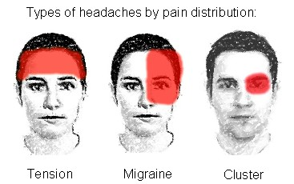

Slide 44
What is the role of primary health care physician in management “Drug treatment and Prophylaxis”

Slide 45
Role of Primary Health Care Physician:
To arrange specific consultations for headache.
To institute a system of detailed history taking, patient education at the outset of the consultation.
To institute a process of management that is individualized for each patient, using a new algorithm. Assessing the impact on the patient's daily life is a key aspect of diagnosis and management.

Slide 46
Cont:
To prescribe only treatments that have objective evidence of favorable efficacy and tolerability.
To utilize prospective follow-up procedures to monitor the success of treatment.
To organize a team approach to headache management in primary care

Slide 47
Pre-Test

Slide 48
1-A 30-year-old lady, presented with C/O headache, unilateral, pulsating in nature, severe, lasts for few hours and increases by daily routine physical activities. Past H/O having similar attacks on and off past few years. Not known to have any other problem.
What is the most likely diagnosis?
A) Cluster headache.
B) Migraine.
C) Subarachnoid hemorrhage.
D) Tension headache.
B

Slide 49
2-A 35-years-old male comes to your office with a 6-month history of recurrent daily headaches, usually in the late afternoon. The headaches are described by the patient as compressing in nature.
The headaches are not associated with nausea, vomiting, or malaise. The patient describe some dizziness and light headedness with these headaches.
On examination: unremarkable
What is the likely type of headache in this patient?
A) Chronic daily headache: tension type.
B) Episodic tension-type headache.
C) Migraine without aurea.
D) Cluster headache.
A

Slide 50
3-A 19-years-old woman with a BMI of 34, presents to her physician with a 6-month history of intermittent headaches associated with visual blurring. She also gives history of vague menstrual irregularities. Fundoscopy shows papilloedema. Routine investigations including ESR, CT head scan and lumbar puncture are normal.
The most likely diagnosis is:
A) Benign intracranial hypertension.
B) Giant cell arteritis.
c) Subdural haemorrhage.
D) Tension headache.
A

Slide 51
4-The first-line treatments of Cluster Headache is:
A) Sumatriptan injections
B) Zolmitriptan nasal spray
c) Oxygen
D) All of the above.
D

Slide 52
RESOURCES:
http://www.nice.org.uk/
http://www.medscape.com/
http://www.mayoclinic.com/health/migraine-headache/DS00120/DSECTION=treatments-and-drugs
http://www.medicinenet.com/migraine_headache/article.htm
http://www.ncbi.nlm.nih.gov/pubmed/26252584
http://www.who.int/mediacentre/factsheets/fs277/en/
http://www.ncbi.nlm.nih.gov/pubmed/19949829

