Slide 1
Smoking

Slide 2
Smoking
Smoking
Done by:
Abdullah Ahmad Alfaifi Ayedh Khalaf Alamri
Mohammed Abdullah Alghammass

Slide 3
objectives
Epidemiology of smoking in Saudi Arabia
Risks of smoking (Morbidity and Mortality)
Effect of passive smoking
How are you going to help the smoker to quit
How to overcome withdrawal symptoms
Role of PHC physician “smoking cessation clinic’
Update in pharmacological management, smoking cessation medication Nicotine preparations, Varniciline, Bupropion

Slide 4
Q1
What is the main cause of death due to smoking?
CVD
COPD
Lung Cancer
Bladder cancer

Slide 5
Q2
Smoking can increase risk of having coronary artery disease (CHD) than non-smoking by?
0 times
0-1 times
1-2 times
2-4 times

Slide 6
Q3
A pregnant lady came to the clinic for getting advice on her pregnancy, while talking she admitted that she is a heavy smoker. What is your advice to her?
Smoking has no effect and she can smoke as much as she wants.
Smoking is dangerous and she must reduce her smoking habit.
Smoking has a very harmful effect on the baby and she has to quit immediately.
Smoking has harmful effect but as long as she takes the right medications and the appropriate medication her baby will be safe.

Slide 7
Q4
Which of the following is a CONTRAINDICATION of using Bupropion to qiut smoking:
Old age.
Post menopausal woman
Epileptic Patient
Patients with Patent foramen Ovale.

Slide 8
Q5
What is the primary reason which prevent many smokers from stopping smoking:
Old age.
Its cheap cost
Not harmful.
Dependence on nicotine.

Slide 9
Definition
Smoking is the exposure to a substance, most commonly tobacco, that is burned and the smoke either tasted or inhaled.
Notes:
Smoking is the inhalation of the smoke of burning tobacco that is used mostly in three forms: cigarettes, pipes, and cigars. Read more: http://www.healthofchildren.com/S/Smoking.html#ixzz3l8Snm0rw

Slide 10
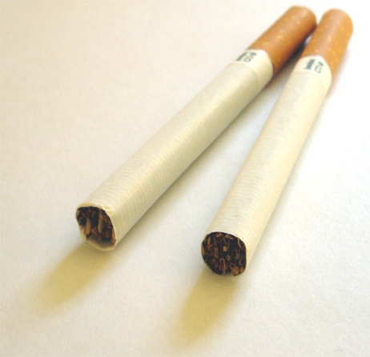
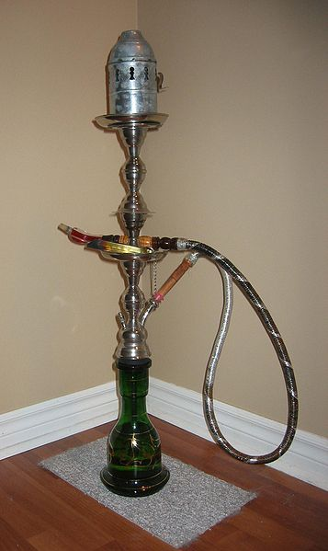
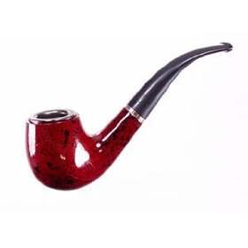
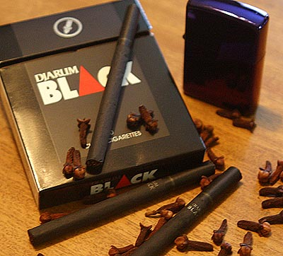
Types of tobacco product
Cigars Cigarettes hookah(shesha)
Kretek Pipe smoking
Notes:
A single large cigar can contain more than a 1/2 ounce of tobacco -- as much tobacco as an entire pack of cigarettes. One cigar also contains 100 to 200 milligrams of nicotine, while a cigarette averages only about 8 milligrams. That extra nicotine may be why smoking just a few cigars a week is enough to trigger nicotine cravings
Cigars: They are generally not inhaled because the high alkalinity of the smoke, which can quickly become irritating to the trachea and lungs.
Cigarettes: are a product consumed through smoking, often combined with other additives.
Different in seveerity b\c of amount of tobaco differ
No filter like in cigrate to filtre some of toxin at least
More smoke than cigrate
The charcoal used to heat tobacco in the hookah increases the health risks by producing smoke that contains high levels of carbon monoxide, metals, and cancer-causing chemicals.
A typical 1-hour-long hookah smoking session involves 200 puffs, while an average cigarette is 20 puffs. The volume of smoke inhaled during a typical hookah session is about 90,000 milliliters, compared with 500 to 600 milliliters inhaled when smoking a cigarette.
Using a hookah to smoke tobacco poses a serious potential health hazard to smokers and others exposed to the emitted smoke.

Slide 11
Cigarettes Components

Slide 12
objectives
Epidemiology of smoking in Saudi Arabia
Risks of smoking (Morbidity and Mortality)
Effect of passive smoking
How are you going to help the smoker to quit
How to overcome withdrawal symptoms
Role of PHC physician “smoking cessation clinic’
Update in pharmacological management, smoking cessation medication Nicotine preparations, Varniciline, Bupropion

Slide 13
Epidemiology of smoking in Saudi Arabia
A study was conducted in September 2005 to asses the prevalence of smoking habits among male medical students at the College of Medicine, King Saud University and it shows that
13% of male medical students were currently active smokers.
5.3% were ex-smokers, and 38.2% were passive smokers.

Slide 14
Epidemiology of smoking in Saudi Arabia
The types of smoking included sheesha 44.1%, cigarette 32.2%, and both 23.7%.
The common reason given for the smoking behavior was the influence of friends (35.6%). The study shows that 57.1% of current smokers were motivated to stop smoking.
Al-Turki, Y. (2006). Smoking habits among medical students in Central Saudi Arabia. Retrieved 2006.

Slide 15
Epidemiology of smoking in Saudi Arabia
In a study puplishied 2009 aims to determine the factors of smoking among the Saudi youth in the Northern Border Region of the Kingdom of Saudi Arabia, besides studying the impact of Smoking on expenses, savings and smoker sensitivity to price the result show.
Kilase, M. (2013, September 1). PREVALENCE AND FACTORS OF SMOKING AMONG THE SAUDI YOUTH IN THE NORTHERN BORDER REGION: THE ROLE OF THE TOBACCO CONTROL PROGRAM IN THE REGION. Retrieved June 1, 2013.

Slide 16
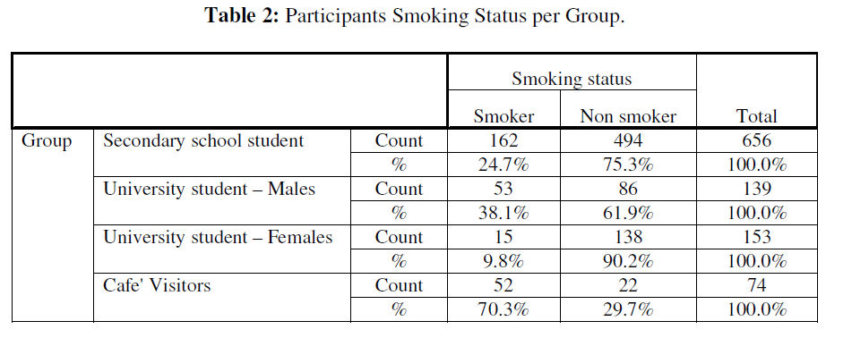
Kilase, M. (2013, September 1). PREVALENCE AND FACTORS OF SMOKING AMONG THE SAUDI YOUTH IN THE NORTHERN BORDER REGION: THE ROLE OF THE TOBACCO CONTROL PROGRAM IN THE REGION. Retrieved June 1, 2013.

Slide 17
Epidemiology of smoking in Saudi Arabia
In a community based study, during 5 year period between 1995 and 2000, cigarette smoking was shown to be significantly associated with.
coronary artery diseases among Saudi patients.*
*(Al-Nozha M, Arafah M, Al-mazrou Y, Al-Maatouq M, khan N, Khalil M, etal. Coronary artery disease in Saudi Arabia. Saudi Med J 2004;25:1165-71.)

Slide 18
Epidemiology of smoking in Saudi Arabia
In Saudi Arabia’ family health survey in 1996, an estimate of 9% of those aged 15 years or more was current cigarette smokers: 18% of men and less than one percent of women.*
*(khoja T, Farid S. Saudi Arabia family health survey. Council of Health Ministries of GCC states;2000.

Slide 19
Epidemiology of smoking in Saudi Arabia…
Local study was carried out among health staffs in a primary care unit at a general hospital in Riyadh region, which showed that there were 19% smokers, 14% ex-smokers.*
*Siddiqui S, Ogbeide D. Profile of smoking amongst health staff in a primary care unit at a general hospital in Riyadh, Saudi Arabia. Saudi Med J 2001; 22:1101-04.

Slide 20
Epidemiology of smoking in Saudi Arabia…
Another local study showed that 17% of primary health care physicians in Riyadh city were current smokers, 20% ex-smoker.*
*Al- shahri M, Al Almaie S. promotion of non-smoking: The role of primary health care physicians. Ann Saudi Med 1997;17:515-17

Slide 21
Epidemiology of smoking in Saudi Arabia
This study from WHO shows the prevalence of the smoking worldwide.

Slide 22
objectives
Epidemiology of smoking in Saudi Arabia
Risks of smoking (Morbidity and Mortality)
Effect of passive smoking
How are you going to help the smoker to quit
How to overcome withdrawal symptoms
Role of PHC physician “smoking cessation clinic’
Update in pharmacological management, smoking cessation medication Nicotine preparations, Varniciline, Bupropion

Slide 23
Risks of smoking
Tobacco use is the LEADING PREVENTABLE cause of death!
Smoking causes more deaths each year than all of these combined:
Human immunodeficiency virus (HIV)
Illegal drug use
Alcohol use
Motor vehicle injuries
Firearm-related incidents
Every 6.5 seconds someone dies from tobacco use!
[72] World Health Organization (May 2012) Tobacco: Fact sheet N°339, Available at: 2012 (Accessed: January 30th 2013).

Slide 24
Death
[73] Mokdad AH, Marks JS (2000) Actual causes of death in the United States, Available at: 2000 (Accessed: January 30th 2013)

Slide 25
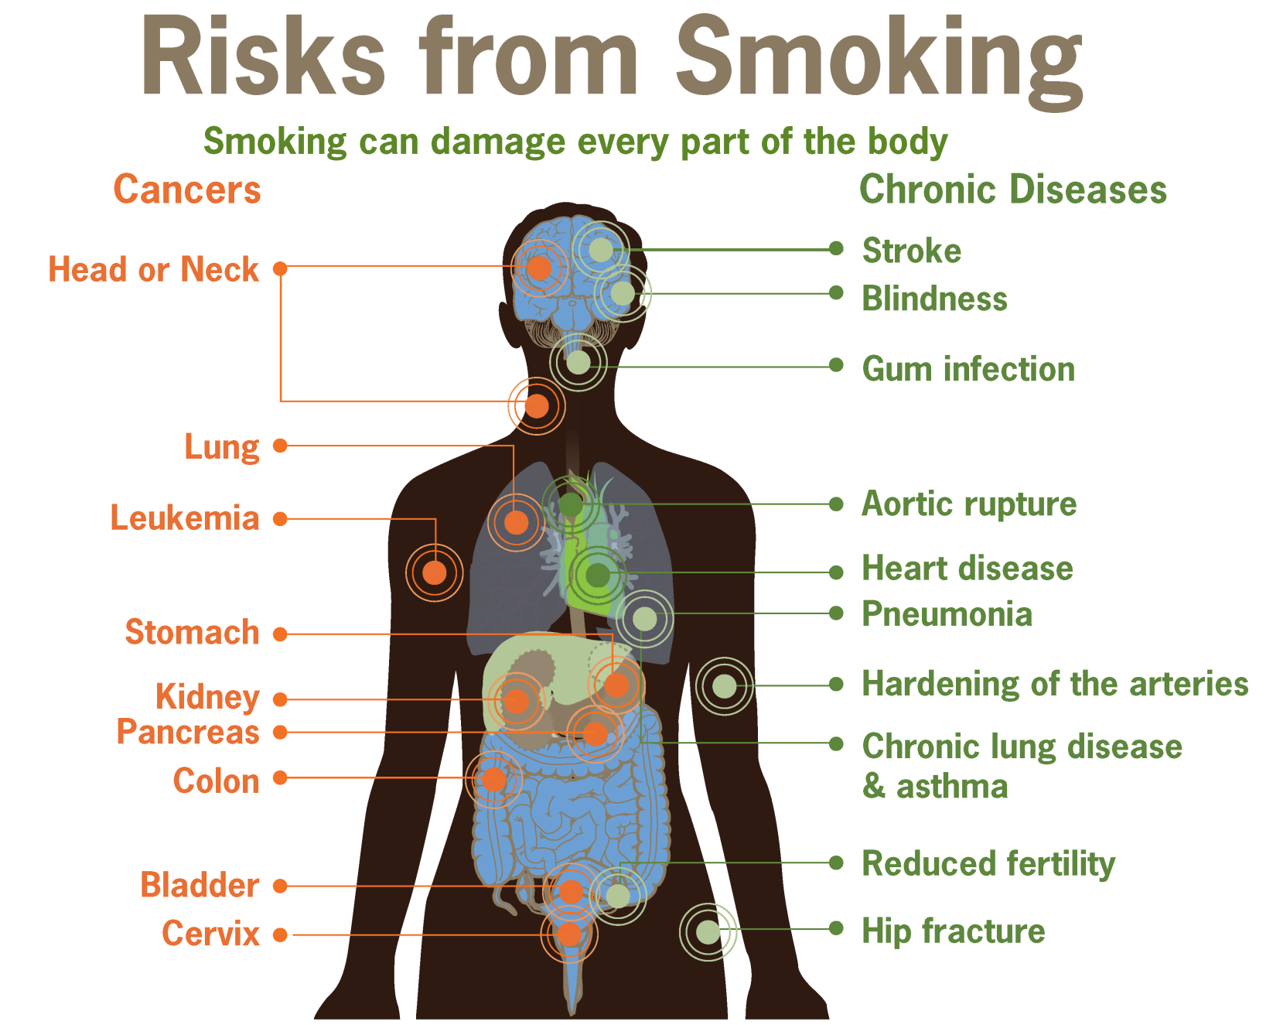

Slide 26
Risks of smoking
Smoking can cause cancer almost anywhere in your body:
Trachea, bronchus, and lung
Bladder
Esophagus
Larynx
Oropharynx (includes parts of the throat, tongue, soft palate, and the tonsils)

Slide 27
cancer

Slide 28
Risks of smoking
Cardiovascular diseases is the main cause of death due to smoking.
Cigarette smokers are two to four times more likely to develop coronary heart disease (CHD), than non-smokers.
http://www.uptodate.com/contents/cardiovascular-risk-of-smoking-and-benefits-of-smoking-cessation?source=search_result&search=smoking&selectedTitle=2~150
Notes:
Some smoking effects:
Increases in blood pressure and heart rate
Reduces cardiac output and coronary blood flow
Reduces the amount of oxygen that reaches the body's tissues.
Coronary Artery diseases.
Stroke.
Aneurysm.
When the blood supply to the heart is interrupted, it sometimes causes the chest pain known as angina. When the blood supply is cut off completely, a myocardial infarction or heart attack occurs, which may cause permanent damage to the heart muscle.

Slide 29
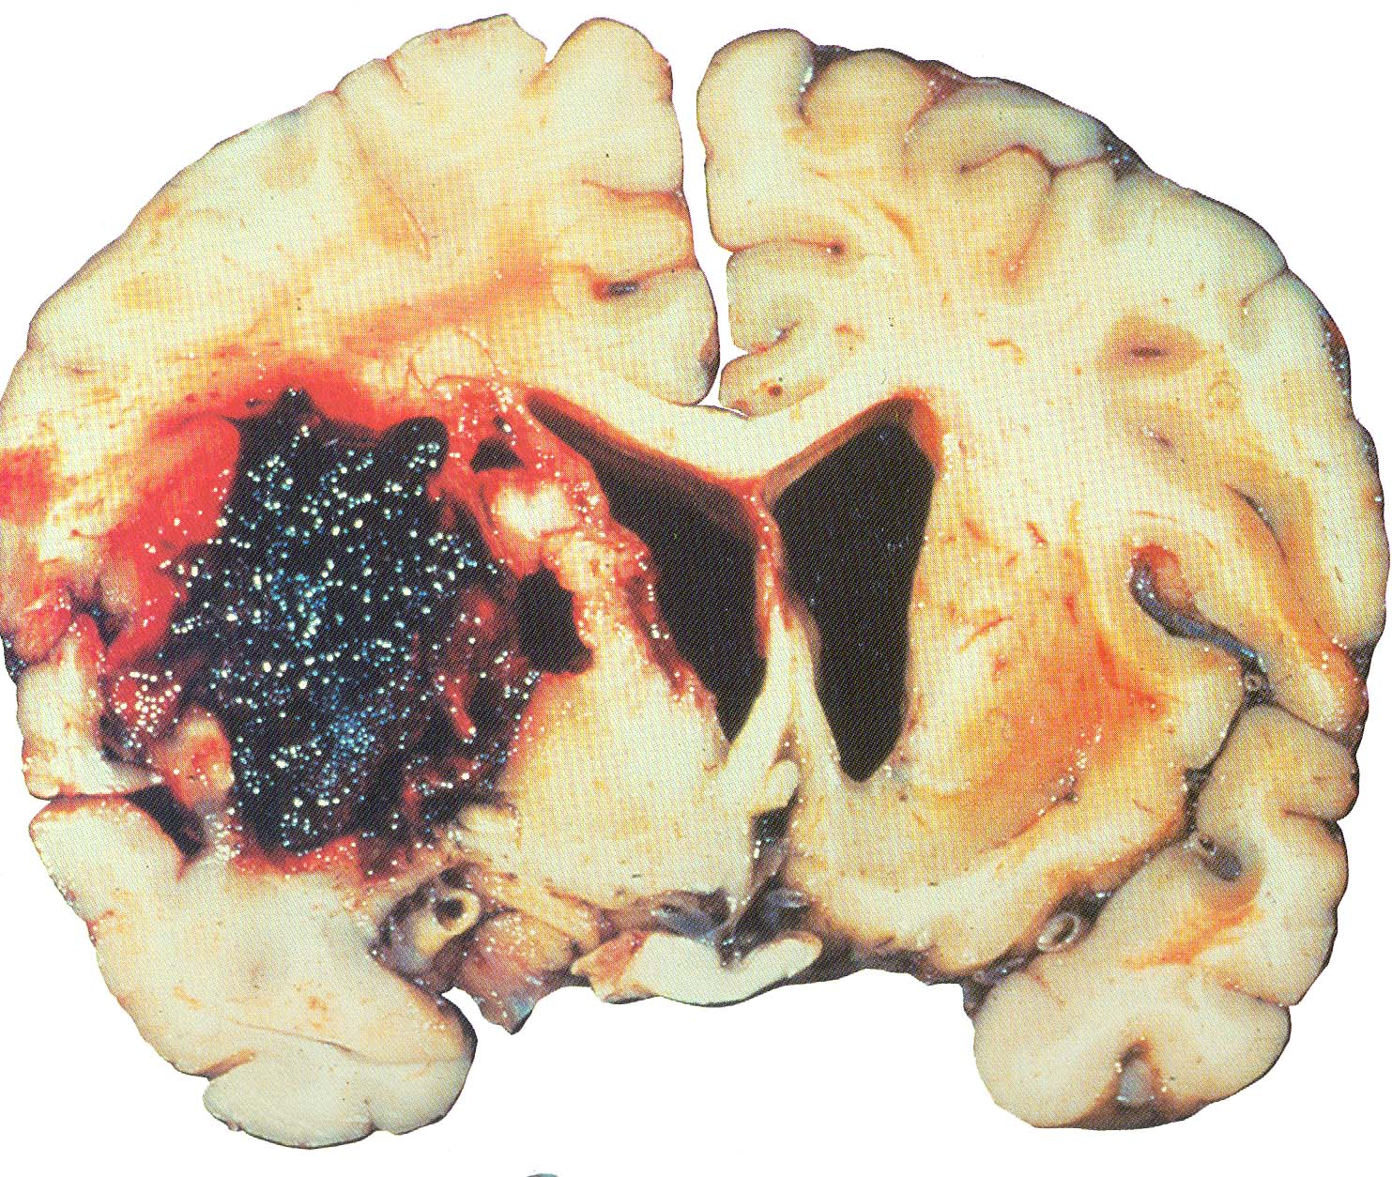
Risks of smoking
It is currently the second most common cause of death world-wide after heart disease.
Smokers are more likely to have a stroke than non-smokers.
Heavy smokers (consuming 20 or more cigarettes a day) have 2-4 times greater risk of stroke than non-smokers.
http://www.uptodate.com/contents/cardiovascular-risk-of-smoking-and-benefits-of-smoking-cessation?source=search_result&search=smoking&selectedTitle=2~150
Notes:
occurs when blood flow to the brain is interrupted causing brain cells to become damaged or die.

Slide 30
Risks of smoking
About 80% of all deaths from chronic obstructive pulmonary disease (COPD) are caused by smoking.
impaired lung growth during childhood and adolescence.
increased susceptibility to pneumonia
http://www.cdc.gov/tobacco/data_statistics/fact_sheets/health_effects/effects_cig_smoking/#estimates

Slide 31
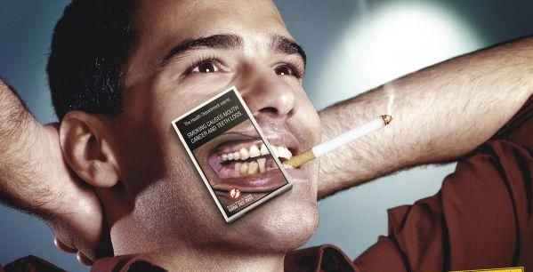
Risks of smoking
Stained teeth.
Gum inflammation.
Black hairy tongue.
Oral cancer.
Delayed healing of the gums.
Notes:
http://www.cdc.gov/tobacco/data_statistics/fact_sheets/health_effects/effects_cig_smoking/#estimates

Slide 32
Risks of smoking
Smokers are 60% more likely to be infertile than non smokers .
http://www.uptodate.com/contents/cigarette-smoking-and-pregnancy?source=search_result&search=smoking&selectedTitle=6~150

Slide 33
Risks of smoking
Smoking increases risks for:
Placenta previa
Abrupto Placenta
Preterm delivery
Stillbirth
Low birth weight
Sudden infant death syndrome
Ectopic pregnancy
Facial clefts in infants.
http://www.uptodate.com/contents/cigarette-smoking-and-pregnancy?source=search_result&search=smoking&selectedTitle=6~150
Notes:
Smoking in pregnancy causes impaired oxygen delivery to the fetus by several possible mechanisms. Pathologic evaluations of the placentas of smokers have shown structural changes, including a reduction in the fraction of capillary volume and increased thickness of the villous membrane when compared with nonsmokers contribute to abnormal gas exchange within the placenta.
decreases intervillous perfusion, possibly via nicotine-induced vasospasm
The release of carbon monoxide during smoking results in the formation of carboxyhemoglobin, which has multiple effects on systemic and fetal oxygen delivery. Carboxyhemoglobin is cleared slowly from the fetal circulation, and diminishes tissue oxygenation via competitive inhibition with oxyhemoglobin and a left-shift of the oxyhemoglobin dissociation curve
In addition to impairing fetal oxygen delivery, nicotine use during pregnancy impacts fetal development. In animal models, nicotine increases vascular resistance and reduces uterine blood flow [23,24]. Chronic prenatal exposure to nicotine in these models results in abnormal secretion of neurochemical mediators in the brain, as well as pathologic behavior among the offspring [25]. Further, animal models suggest that nicotine can directly impair lung development due to interaction with nicotinic acetylcholine receptors (nAChR)
Not understood
lacenta previa (pluh-SEN-tuh PREH-vee-uh) occurs when a baby's placenta partially or totally covers the opening in the mother's cervix — the lower end of the uterus that connects to the top of the vagina. Placenta previa can cause severe bleeding before or during delivery.
premature separation of the placenta from the uterus. Patients with abruptio placentae, also called placental abruption, typically present with bleeding, uterine contractions, and fetal distress

Slide 34
objectives
Epidemiology of smoking in Saudi Arabia
Risks of smoking (Morbidity and Mortality)
Effect of passive smoking
How are you going to help the smoker to quit
How to overcome withdrawal symptoms
Role of PHC physician “smoking cessation clinic’
Update in pharmacological management, smoking cessation medication Nicotine preparations, Varniciline, Bupropion

Slide 35
Types of smoking
1)Active smoking:
is the intentional inhalation of smoke using the methods of smoking such as: cigarettes and cigars.
2)Passive smoking(second-hand smoking):
is the inhalation of smoke by persons other than the intended 'active' smoker.

Slide 36
Effect of passive smoking
Secondhand smoke (also called passive smoke or environmental tobacco smoke) is the combination of smoke from a burning cigarette and smoke exhaled by a smoker.
The smoke that burns off the end of a cigarette or cigar actually contains more harmful substances (tar, carbon monoxide, nicotine, and others) than the smoke inhaled by the smoker.

Slide 37
Effect of passive smoking
Pooled evidence has indicated a relationship between secondhand smoke and both lung cancer and CHD.
Nonsmokers exposed to secondhand smoke at home or at work have about :
25% to 30% increased risk of heart disease
20% to 30% increased risk of lung cancer.

Slide 38
Continue..
Kids are particularly at risk for the effects of secondhand smoke because their bodies are still growing and they breathe at a faster rate than adults.
Conditions have been linked to secondhand smoke exposure in children:
Sudden infant death syndrome (SIDS)
More respiratory infections (such as bronchitis and pneumonia)
More severe and frequent asthma attacks
Ear infections
Chronic cough

Slide 39
objectives
Epidemiology of smoking in Saudi Arabia
Risks of smoking (Morbidity and Mortality)
Effect of passive smoking
How are you going to help the smoker to quit
How to overcome withdrawal symptoms
Role of PHC physician “smoking cessation clinic’
Update in pharmacological management, smoking cessation medication Nicotine preparations, Varniciline, Bupropion

Slide 40
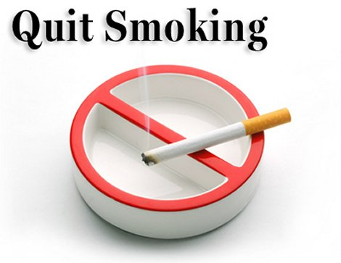
Notes:
الى هنا عايض

Slide 41
video
https://www.youtube.com/watch?v=z16vhtjWKL0

Slide 42
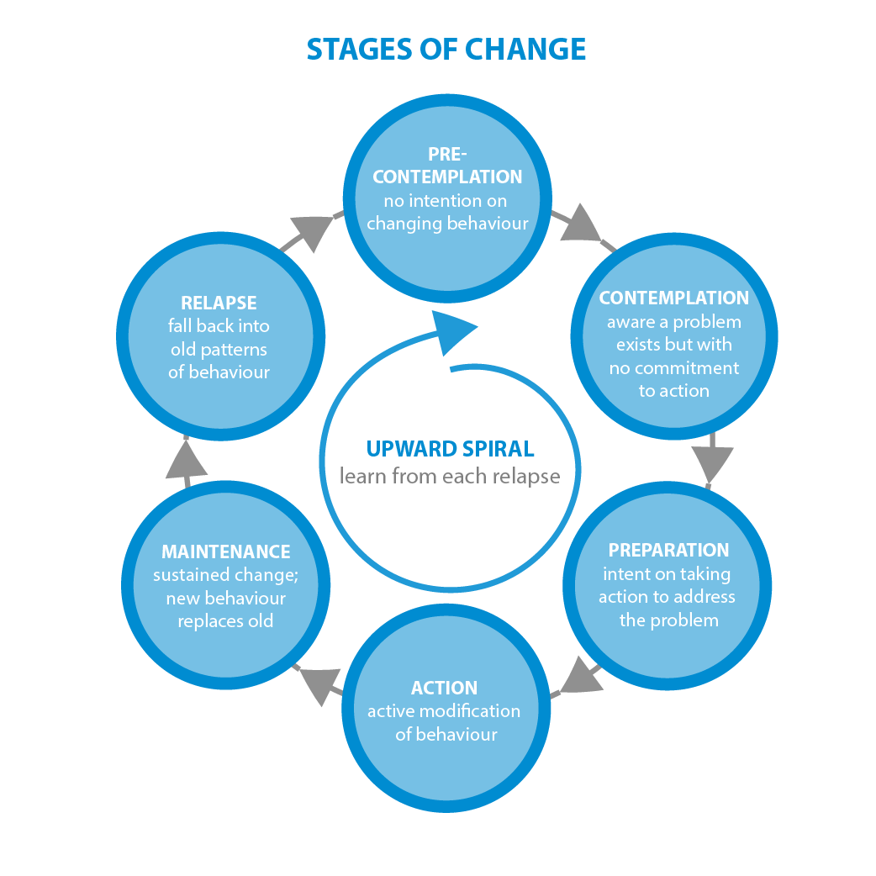
Quit smoking
Five-stage Trans-theoretical Model

Slide 43
Model for treatment of tobacco use and dependence
General Population
Patient presents to healthcare setting
Relapse
Current users
Yes, willing
ASK: screen all patients for tobacco use
ADVISE to quit
ASSESS willingness to quit
ASSIST with quitting
ARRANGE a follow-up
Non users
No, unwilling
Promote motivation to quit
Patient now willing to quit
Abstinent
Primary prevention
Prevent relapse
Notes:
Source:
Tobacco Use and Dependence Guideline Panel. Treating Tobacco Use and Dependence: 2008 Update. Rockville (MD): US Department of Health and Human Services; 2008 May. Clinical Interventions for Tobacco Use and Dependence.

Slide 44
Model for treatment of tobacco use and dependence
General Population
Patient presents to healthcare setting
Relapse
Current users
Yes, willing
ASK: screen all patients for tobacco use
ADVISE to quit
ASSESS willingness to quit
ASSIST with quitting
ARRANGE a follow-up
Non users
No, unwilling
Promote motivation to quit
Patient now willing to quit
Abstinent
Primary prevention
Prevent relapse
Notes:
Source:
Tobacco Use and Dependence Guideline Panel. Treating Tobacco Use and Dependence: 2008 Update. Rockville (MD): US Department of Health and Human Services; 2008 May. Clinical Interventions for Tobacco Use and Dependence.

Slide 45
Quit smoking
Ask:
Identify and document tobacco use status for every patient at every visit.

Slide 46
Model for treatment of tobacco use and dependence
General Population
Patient presents to healthcare setting
Relapse
Current users
Yes, willing
ASK: screen all patients for tobacco use
ADVISE to quit
ASSESS willingness to quit
ASSIST with quitting
ARRANGE a follow-up
Non users
No, unwilling
Promote motivation to quit
Patient now willing to quit
Abstinent
Primary prevention
Prevent relapse
Notes:
Source:
Tobacco Use and Dependence Guideline Panel. Treating Tobacco Use and Dependence: 2008 Update. Rockville (MD): US Department of Health and Human Services; 2008 May. Clinical Interventions for Tobacco Use and Dependence.

Slide 47
Quit smoking
Advise:
In a clear, strong, and personalized manner, urge every tobacco user to quit.

Slide 48
Model for treatment of tobacco use and dependence
General Population
Patient presents to healthcare setting
Relapse
Current users
Yes, willing
ASK: screen all patients for tobacco use
ADVISE to quit
ASSESS willingness to quit
ASSIST with quitting
ARRANGE a follow-up
Non users
No, unwilling
Promote motivation to quit
Patient now willing to quit
Abstinent
Primary prevention
Prevent relapse
Notes:
Source:
Tobacco Use and Dependence Guideline Panel. Treating Tobacco Use and Dependence: 2008 Update. Rockville (MD): US Department of Health and Human Services; 2008 May. Clinical Interventions for Tobacco Use and Dependence.

Slide 49
Quit smoking
Assess:
Is the tobacco user willing to make a quit attempt at this time?

Slide 50
Model for treatment of tobacco use and dependence
General Population
Patient presents to healthcare setting
Relapse
Current users
Yes, willing
ASK: screen all patients for tobacco use
ADVISE to quit
ASSESS willingness to quit
ASSIST with quitting
ARRANGE a follow-up
Non users
No, unwilling
Promote motivation to quit
Patient now willing to quit
Abstinent
Primary prevention
Prevent relapse
Notes:
Source:
Tobacco Use and Dependence Guideline Panel. Treating Tobacco Use and Dependence: 2008 Update. Rockville (MD): US Department of Health and Human Services; 2008 May. Clinical Interventions for Tobacco Use and Dependence.

Slide 51
Motivation to quit
Your Reasons to Quit :
It is important to understand your reasons for wanting to quit smoking.
A major one is to live longer and live better.
Significantly reduce risk of having a heart attack, stroke ,or cancer.
Reduce risk of causing health problems for your family, especially your children, through secondhand smoke.

Slide 52
Model for treatment of tobacco use and dependence
General Population
Patient presents to healthcare setting
Relapse
Current users
Yes, willing
ASK: screen all patients for tobacco use
ADVISE to quit
ASSESS willingness to quit
ASSIST with quitting
ARRANGE a follow-up
Non users
No, unwilling
Promote motivation to quit
Patient now willing to quit
Abstinent
Primary prevention
Prevent relapse
Notes:
Source:
Tobacco Use and Dependence Guideline Panel. Treating Tobacco Use and Dependence: 2008 Update. Rockville (MD): US Department of Health and Human Services; 2008 May. Clinical Interventions for Tobacco Use and Dependence.

Slide 53
Quit smoking
Assist:
For the patient willing to make a quit attempt, use counseling and pharmacotherapy to help him or her quit.

Slide 54
Model for treatment of tobacco use and dependence
General Population
Patient presents to healthcare setting
Relapse
Current users
Yes, willing
ASK: screen all patients for tobacco use
ADVISE to quit
ASSESS willingness to quit
ASSIST with quitting
ARRANGE a follow-up
Non users
No, unwilling
Promote motivation to quit
Patient now willing to quit
Abstinent
Primary prevention
Prevent relapse
Notes:
Source:
Tobacco Use and Dependence Guideline Panel. Treating Tobacco Use and Dependence: 2008 Update. Rockville (MD): US Department of Health and Human Services; 2008 May. Clinical Interventions for Tobacco Use and Dependence.

Slide 55
Quit smoking
Arrange:
Schedule follow up contact, in person or by telephone, preferably within the first week after the quit date.

Slide 56
Getting Ready To Quit
Change Your Environment:
Here are some things you can do to create a smoke-free environment
Physical change The first step is to search your
home, office, and car for cigarettes, and throw out every one you find.
Social changes . Many social situations trigger an urge to smoke.

Slide 57
Getting Ready To Quit
Make Plans to Control Trigger Situations:
Your list of triggers should give you some clues about what situations create the greatest problems for you.

Slide 58
Quitting
Make a Commitment to Quit
Research shows that people who make a clean break with smoking are more successful at quitting than those who try to stop by gradually cutting back on the number of cigarettes they smoke each day

Slide 59
Quitting
Your Quit Date:
You could quit smoking today, but that wouldn’t give you time to prepare. Research shows that proper preparation will improve your chances of staying quit. Most people need at least a week to make all of their preparations, so select a quit date within the next two weeks.

Slide 60
Quitting
Get Support and Encouragement
Help From Your Doctor
Help From Family and Friends
Research shows that help from friends and family makes it easier to quit smoking. It’s a good idea to enlist this support before you actually quit.
Counseling and Quitting Programs

Slide 61
video
https://www.youtube.com/watch?v=xkKYVVxxksw

Slide 62
Withdrawal symptoms

Slide 63
objectives
Epidemiology of smoking in Saudi Arabia
Risks of smoking (Morbidity and Mortality)
Effect of passive smoking
How are you going to help the smoker to quit
How to overcome withdrawal symptoms
Role of PHC physician “smoking cessation clinic’
Update in pharmacological management, smoking cessation medication Nicotine preparations, Varniciline, Bupropion

Slide 64
Role of PHC
Smoking Cessation Clinic
Assessing the smoker referred from other clinics or walking by taking medical History, measuring Height and Weight, Measuring the lung functions by the Spirometer.
Counseling the smokers by a Physician to cut down the number of cigarettes gradually.

Slide 65
Role of PHC
​Smoking Cessation Clinic
Prescribe nicotine replacement treatments for the smokers.
Follow up with the Quit smokers to avoid any relapses.

Slide 66
PHC role in saudi arabia
As many as 28 new centers for smoking cessation were inaugurated in the Kingdom during three years (1430-1432H), bringing the total number of anti-smoking centers to 70 clinics.
Training courses were offered for health staff (physicians and nurses) in the year of 1432H, benefiting more than 300 physicians, nurses and administrative officials.
Medicines helping to quit smoking were provided.

Slide 67
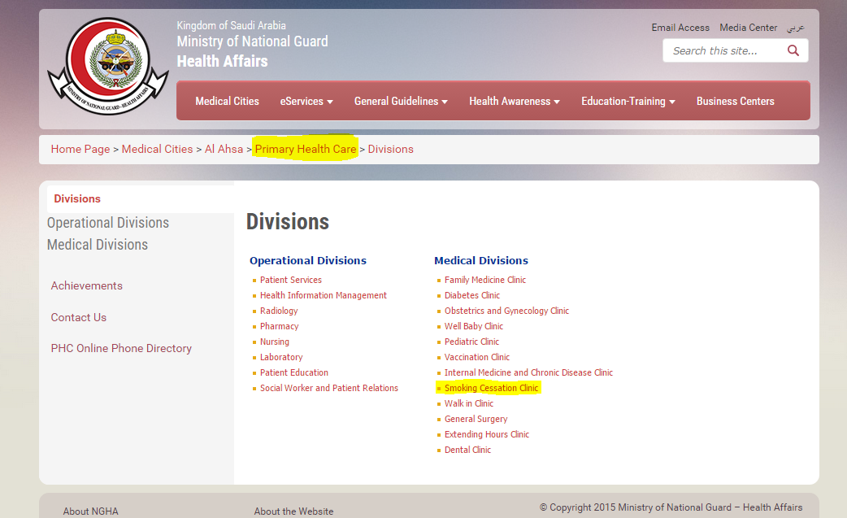
PHC role in saudi arabia
Notes:
الى هنا محمد

Slide 68
objectives
Epidemiology of smoking in Saudi Arabia
Risks of smoking (Morbidity and Mortality)
Effect of passive smoking
How are you going to help the smoker to quit
How to overcome withdrawal symptoms
Role of PHC physician “smoking cessation clinic’
Update in pharmacological management, smoking cessation medication Nicotine preparations, Varniciline, Bupropion

Slide 69
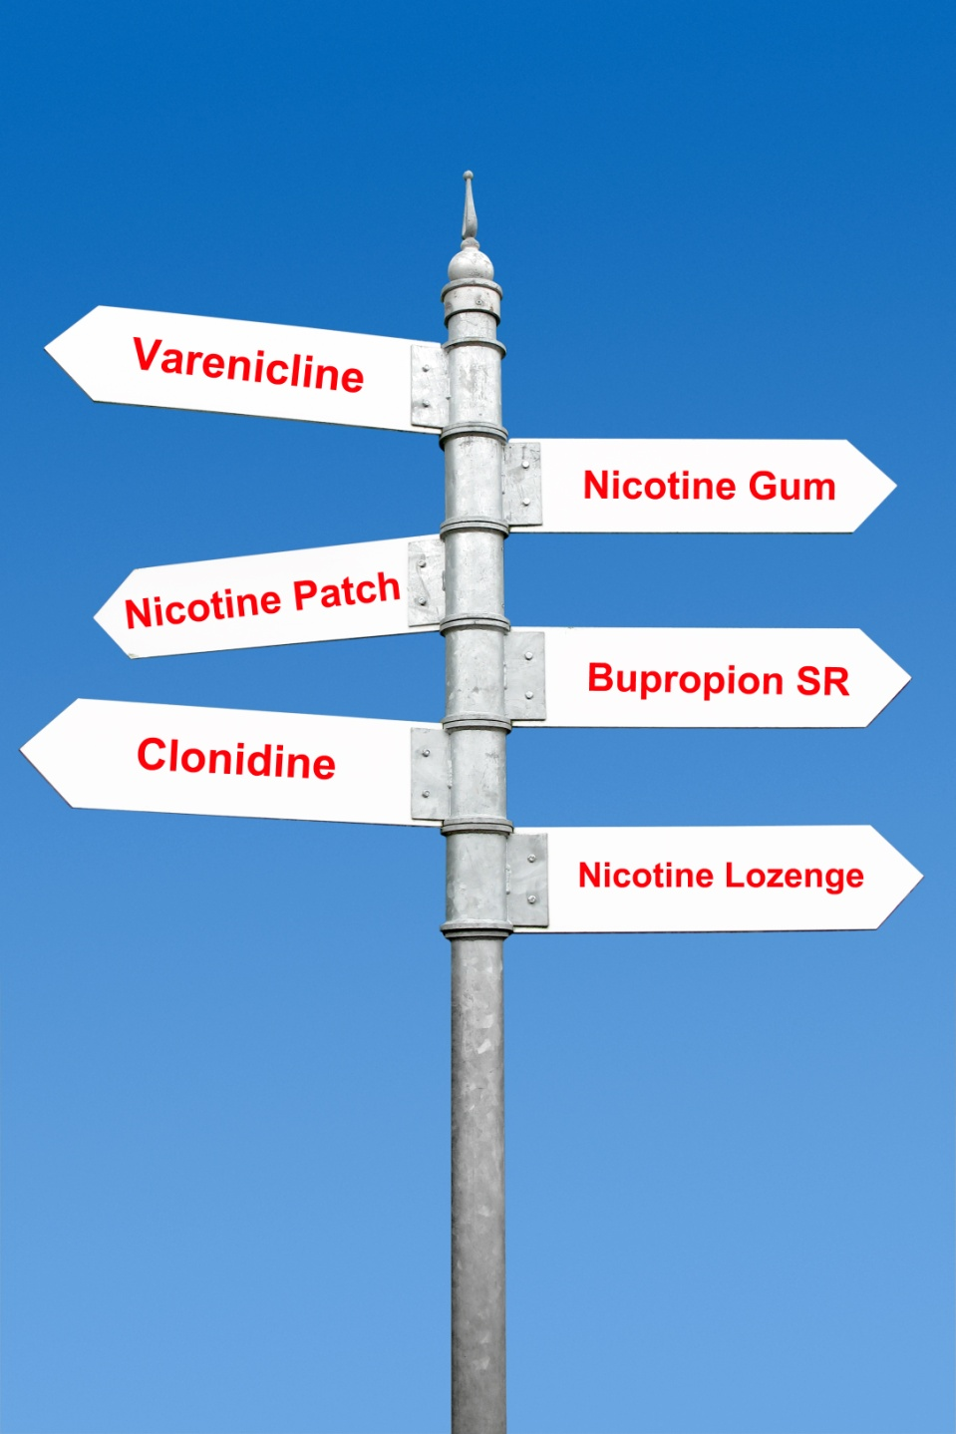
pharmacological management
All smokers trying to quit should be offered medication.
Notes:
هنا يبدا عبدالله

Slide 70
pharmacological management
In general, pharmacotherapy is not offered to people smoking less than 10 cigarettes per day, as there is a lack of evidence for effectiveness below
At This level of smoking. The choice of therapy is based on clinical suitability and patient preference
Cunningham, M., et al. "Smoking cessation guidelines for Australian general practice." Australian family physician 34.6 (2005): 461.

Slide 71
What are the first-line recommended medications ???
All seven of the FDA-approved medications for treating tobacco use are recommended:
bupropion SR.
Nicotine Replacement Therapy
(nicotine gum, nicotine inhaler, nicotine lozenge, nicotine nasal spray and nicotine patch).
varenicline.
There are no well-accepted guidelines for optimal selection among the first-line medications, the clinician should consider the first-line medications shown to be more effective.
Use, Tobacco, and Dependence Guideline Panel. "Treating tobacco use and dependence: 2008 update." (2008).

Slide 72
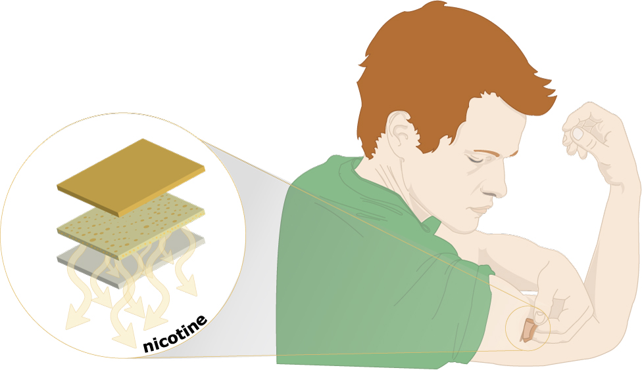
nicotine skin patch
The nicotine skin patch is the easiest to use.
Side effects : Skin reactions, insomnia and vivid dreams
http://www.uptodate.com/contents/pharmacotherapy-for-smoking-cessation-in-adults

Slide 73
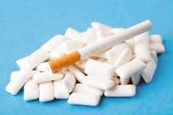
Nicotine gum
The taste can be unpleasant at first but most people get used to it in a week or so.
Side effects
mouth soreness, hiccups, dyspepsia, jaw ache, mouth irritation and excessive salivation.
http://www.uptodate.com/contents/pharmacotherapy-for-smoking-cessation-in-adults

Slide 74
Nicotine gum
Chewing technique
“chew and park” – It is important to chew slowly to get the most out of the gum because any nicotine that is swallowed is wasted. The nicotine has to be absorbed through the mouth.
Use, Tobacco, and Dependence Guideline Panel. "Treating tobacco use and dependence: 2008 update." (2008).

Slide 75
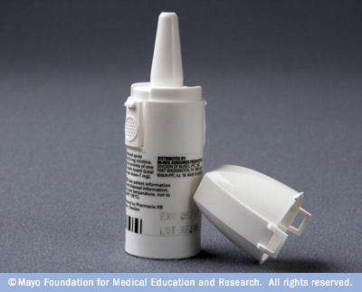
Nicotine nasal spray
Nicotine is absorbed faster.
Side Effects :
Nasal/airway reactions.
Dependency.
Rhinitis and tearing.
http://www.uptodate.com/contents/pharmacotherapy-for-smoking-cessation-in-adults

Slide 76
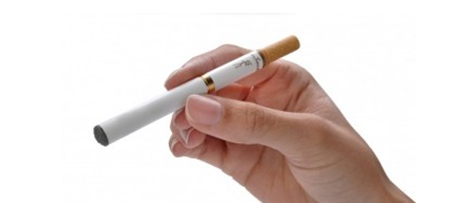
nicotine inhalator
Despite its name, the nicotine does not reach the lungs but stops in the mouth and throat.
Side effects:
Local irritation reactions, Coughing and rhinitis .
http://www.uptodate.com/contents/pharmacotherapy-for-smoking-cessation-in-adults

Slide 77
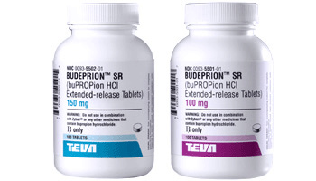
Bupropion
Side effects – The most common reported side effects were insomnia (35–40%) and dry mouth (10%).
Neuropsychiatric effects - risks of suicidal/self-injurious.
Contraindications – Bupropion SR is contraindicated in individuals who have a history of seizures or eating disorders.
Dosage :
Patients should begin bupropion SR treatment 1–2 weeks before they quit smoking.
It should be continued for 7–12 weeks.
http://www.uptodate.com/contents/pharmacotherapy-for-smoking-cessation-in-adults
Notes:
Source:
Tobacco Use and Dependence Guideline Panel. Treating Tobacco Use and Dependence: 2008 Update. Rockville (MD): US Department of Health and Human Services; 2008 May. Clinical Interventions for Tobacco Use and Dependence.

Slide 78
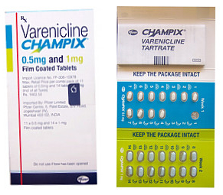
Varenicline
Side effects :
Neuropsychiatric effects
Abnormal dreams
Cardiovascular effects - based on limited evidence
headache
nausea
insomnia
visual disturbances
Dosage :
Start varenicline 1 week before the quit date.
Varenicline is approved for a maintenance indication for up to 6 months.
http://www.uptodate.com/contents/pharmacotherapy-for-smoking-cessation-in-adults
Notes:
Source:
Tobacco Use and Dependence Guideline Panel. Treating Tobacco Use and Dependence: 2008 Update. Rockville (MD): US Department of Health and Human Services; 2008 May. Clinical Interventions for Tobacco Use and Dependence.

Slide 79
First Line Medications
http://www.uptodate.com/contents/pharmacotherapy-for-smoking-cessation-in-adults

Slide 80
guidelines for optimal selection
What medications should a clinician use with a patient who is highly nicotine dependent?
The higher-dose preparations of nicotine gum, patch, and lozenge have been shown to be effective in highly dependent smokers
Which medications should be considered with patients particularly concerned about weight gain?
Data show that bupropion SR and nicotine replacement therapies delay—but do not prevent—weight gain.
Should nicotine replacement therapies be avoided in patients with a history of cardiovascular disease?
No. The nicotine patch in particular has been demonstrated as safe for cardiovascular patients.
May tobacco dependence medications be used long-term (e.g., up to 6 months)?
Yes. This approach may be helpful with smokers who report persistent withdrawal symptoms during the course of medications
Use, Tobacco, and Dependence Guideline Panel. "Treating tobacco use and dependence: 2008 update." (2008).

Slide 81
Pregnant and lactating women
Smoking cessation advice
Pharmacotherapy (with NRT or bupropion) if a pregnant woman is unable to quit.
The effects of low nicotine exposure on the human fetus are unclear (ADEC category D)
Where the benefit of using NRT may outweigh the risk.
Cunningham, M., et al. "Smoking cessation guidelines for Australian general practice." Australian family physician 34.6 (2005): 461.

Slide 82
Q1
What is the main cause of death due to smoking?
CVD
COPD
Lung Cancer
Bladder cancer

Slide 83
Q2
Smoking can increase risk of having coronary artery disease or CHD than non-smoking by?
0 times
0-1 times
1-2 times
2-4 times

Slide 84
Q3
A pregnant lady came to the clinic for getting advice on her pregnancy, while talking she admitted that she is a heavy smoker. What is your advice to her?
Smoking has no effect and she can smoke as much as she wants.
Smoking is dangerous and she must reduce her smoking habit.
Smoking has a very harmful effect on the baby and she has to quit immediately.
Smoking has harmful effect but as long as she takes the right medications and the appropriate medication her baby will be safe.

Slide 85
Q4
Which of the following is a CONTRAINDICATION of using Bupropion to qiut smoking:
Old age.
Post menopausal woman
Epileptic Patient
Patients with Patent foramen Ovale.

Slide 86
Q5
What is the primary reason which prevent many smokers from stopping smoking:
Old age.
Its cheap cost
Not harmful.
Dependence on nicotine.

Slide 88
References
http://www.aafp.org/afp/2002/0315/p1107.html
http://www.aafp.org/dam/AAFP/documents/patient_care/tobacco/AAFPStopSmokeGuide2012.pdf
http://www.cdc.gov/tobacco/data_statistics/fact_sheets/health_effects/effects_cig_smoking/
http://emedicine.medscape.com/article/287555-overview#aw2aab6b2b2
http://www.aafp.org/afp/2012/0315/p591.html\
http://www.moh.gov.sa/endepts/TCP/Pages/Achievements.aspx
Tobacco Use and Dependence Guideline Panel. Treating Tobacco Use and Dependence: 2008 Update. Rockville (MD): US Department of Health and Human Services; 2008 May. Clinical Interventions for Tobacco Use and Dependence.
Bassiony, Medhat M. "Smoking in Saudi Arabia." Saudi medical journal 30.7 (2009): 876-881

