Slide 1
Approach To Low Back Pain
Yazeed Alhusainy
Rakan Alshweir
Ismail Kariz
Professor. Sulaiman Alshammari

Slide 2
Objectives
Brief introduction.
Common causes and risk factors.
Diagnosis including history, Red Flags, Examination
Practical: How to do examination of Back including lower limbs?
Brief comment on Mechanical, Inflammatory, Root nerve compression, Malignancy
Role of primary health care in management
When to refer to specialist
Prevention and Education

Slide 3
MCQ #1
Which of the following is the most common radiculopathy affecting the lumbosacral spine?
L2
L3
L4
S1

Slide 4
MCQ #2
Which of the following is a red flag sign/symptom of back pain?
History of cancer.
Kyphosis.
Age less than 50.
Shingel.

Slide 5
MCQ #3
Which of the following elements is the most important in evaluating back pain?
Lumbar x-ray.
Acupuncture.
Taking a history.
Prescribing a medication and waiting for an effect.

Slide 6
MCQ #4
In a patient with acute low back pain without the presence of red flags or signs of systemic diseases, the most initial investigation is:
X-ray
Computed tomography scan
No need for any investigation.
Magnetic resonance imaging.

Slide 7
MCQ #5
A patient came with lower back pain with morning stiffness, exacerbated by rest and relieved by activity. Which of the following etiologies this presentation considered to be?
Mechanical back pain
Inflammatory back pain
Tumor
Nerve root compression

Slide 8
Introduction
Low back pain is one of the most common reasons for visits to physicians in the ambulatory care setting.
Low back pain is a common aliment that affects most people at least once in their lives.
The total cost related to back pain is estimated to be >$100 billion per year in the United States.¹
If approach is not systematic, cost, identification of non-clinically significant lesions and worsening of psychological condition will all be affected.

Slide 9
Epidemiology
Two thirds of all adults experience back pain.
It is the second most common reason for physician visits after respiratory tract infection.
A study conducted in Al-Qaseem region, and a response was obtained from 5,743 and Back pain was reported by 1,081 (18.8%). 8.8% were men, and 10% were women. ²
In United Kingdom, around 2.6 million people seeking advice about back pain from their general practitioner each year.³

Slide 10
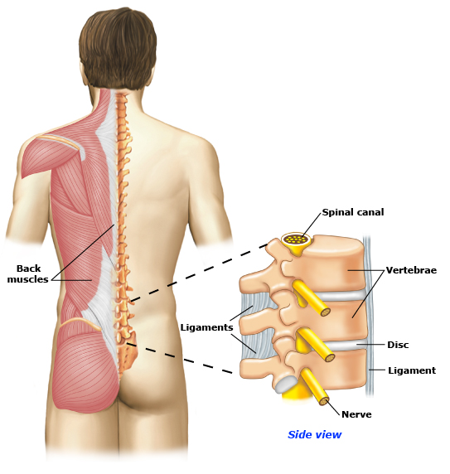
Low back pain can be caused by problems with the muscles, ligaments, discs, bones (vertebrae), or nerves. Often back pain is caused by strains or sprains involving the muscles or ligaments. These problems cannot always be seen on imaging tests, such as MRIs or CAT scans.
Notes:
Back pain is classified as Acute and Chronic .
Acute back pain is usually the result of an injury or a sudden jolt and can last from a few days to a few weeks; it is generally resolved within 6 to 12 weeks.
Back pain becomes chronic when it persist for 3 to 6 months beyond the expected healing time.
About 15% of low back pain cases progress from acute to chronic.
Age- as people age, bone strength lessens, as do muscle elasticity and tone. The discs in between the vertebrae lose fluid and flexibilitiy which decrease their ability to cushion spinal compression.
Physically strenuous work- back sprains, strains, spasms, or disc ruptures can be caused by lifting items that are too heavy or by using improper lifting techniques.
Overstretching.
Poor physical condition- due to factors such as sedentary life style or unhealthy amounts of exercise (either too little or too much).
Other contributing factors related to non-specific back pain include:
Obesity
Inappropriate posture
Poor sleeping position
Weight gain during pregnancy
Smoking
Stress
Anxiety and/ or depression
Build up of scar tissue from repeat injuries.

Slide 11
Risk factors
Modifiable:
Obesity
Smoking
Occupational hazards
Deformity
Previous injury
Non-modifiable:
Genetics
Aging

Slide 12
Classification
Back pain is classified as Acute and Chronic:
Acute back pain is usually the result of an injury or a sudden jolt and can last from a few days to a few weeks; it is generally resolved within 6 to 12 weeks.
Back pain becomes chronic when it persist for 3 to 6 months beyond the expected healing time.
About 15% of low back pain cases progress from acute to chronic.

Slide 13
Acute | Subacute | Chronic
< 6 weeks | 6 weeks - 3 months | > 3 months

Slide 14
Causes of Back Pain
MECHANICAL
NON-MECHANICAL
Herniated Disc
Spinal Stenosis
Inflammatory
Infections
Tumors
Spondylolisthesis
Psychological
“Malingering”
Notes:
The most common causes of back pain are muscular injuries and age related degenerative processes in the intervertebral
It is an intentional deceptive behavior, not a medical or psychiatric disorder.
What is Malingering pain?
The diagnosis of malingering rests upon the identification of an external or “secondary” gain.
Common motivating factors are:
Avoidance of going to jail or release from jail, avoidance of work or family responsibility.
Desire to obtain narcotics.
Desire to be awarded money in litigation.
Need for attention.
Clues for detecting Malingering Pain
A medical condition is fabricated, and the patient claims to have a series of unexisting problems.
A medical condition or injury is exaggerated for financial gain.
The accident is staged so that the injury is deliberately caused.
There is a marked discrepancy between the person’s claimed symptoms and the medical findings.
The plaintiff displays a lack of cooperation during the physician’s evaluation and noncompliance with treatment.
The plaintiff has an anti-social or borderline personality.
The individual may consciously and intentionally fake poor responses on neuropsychological tests.

Slide 15
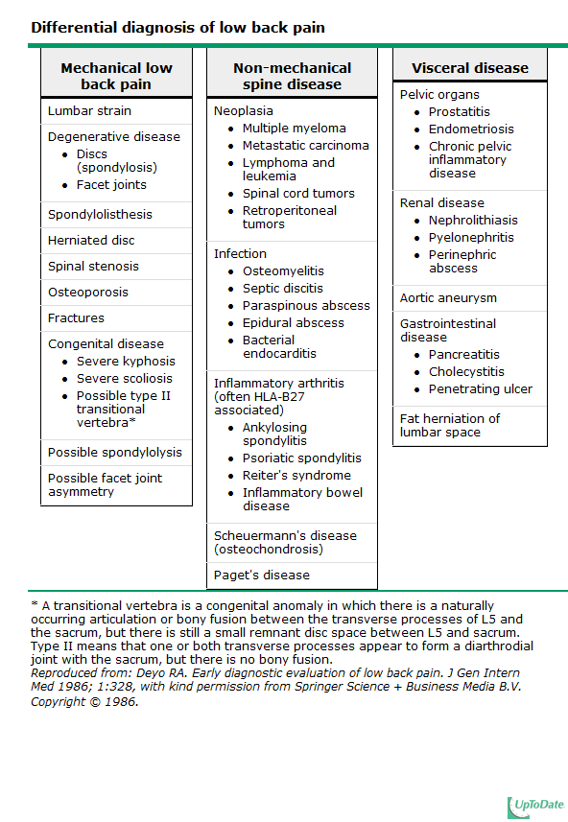

Slide 16
History
During taking history, you must cover the following:
The course of pain.
Is there evidence of a systemic disease?
Is there evidence of neurologic problems?
Occupational history.
Red flags.

Slide 17
Personal History
Age
Gender
Occupation
Chief Complaint
Onset
Duration
Route of Admission
Time of Admission

Slide 18
History Of Presenting Illness
Site.
Onset.
Character
Radiation.
Associated symptoms Constitutional Symptoms and red flags
Time
Exacerbation & Relieving factors.
Severity

Slide 19
Past History
Medical
Surgical
Drugs and Allergies
Family
Social

Slide 20
Red flags⁴
Age more than 50 years
History of cancer
Unexplained weight loss
Persistent fever
History of intravenous drug use
Immunocompromised state
Recent bacterial infection
Urinary or stool incontinence
Urinary retention
Extremity weakness
Neurologic deficit
Trauma

Slide 21
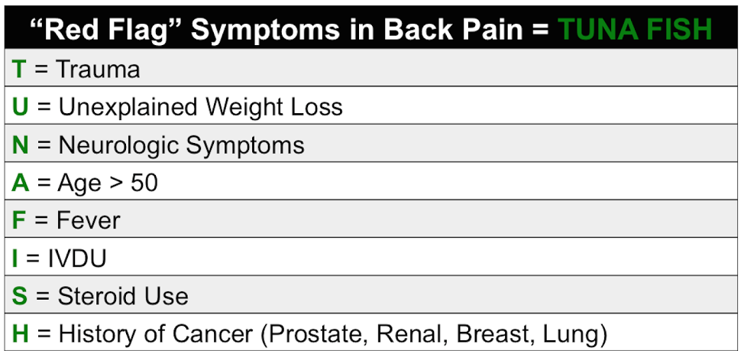

Slide 22
Differentiation
Mechanical Back Pain
Diffuse and unilateral.
Deep and dull.
Moderate intensity.
Relived by Rest.
Increased by Activity and at the end of the day.
History of previous episodes.
Cause:
Injury.
Poorly designed chairs.
Inflammatory Back Pain
Chronic Pain.
Insidious onset.
Throbbing, Aching.
Exacerbated by Rest.
Relieved by Activity and is worst at morning and end of the day.
Morning Stiffness.

Slide 23
Examination
https://www.youtube.com/watch?v=MsUmSdHxR8E

Slide 24
Brief comment on Mechanical, Inflammatory, Root nerve compression and Malignancy

Slide 25
Simple back pain
Simple back pain accounts for more the 60% of all causes of back pain.
Causes mostly originate from musculoskeletal for example: strained muscle , sprained ligament and herniated disc etc…
No signs or symptoms of systemic diseases or presence of red flags.
Treatment usually Non-steroidal anti-inflammatory drugs and muscle relaxant.

Slide 26
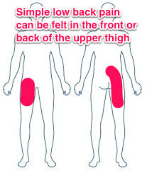
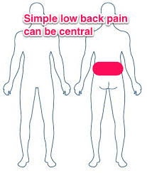

Slide 27
Scenario
A 25-year-old male works as a teacher came to the primary health care clinic complaining of lower back pain for several months.
He reports that his symptoms began gradually several months ago. The pain is located in the lower back and buttock area, alternating in two sides, worse in the morning and is associated with stiffness. It gets better throughout the day and with activity. There is a history of fever 1 month ago. He denies radiation or neurological symptoms. No history of malignancy, weight loss, trauma or intravenous drug use.

Slide 28
Examination
Position: Standing
Exposure: trunk and lower extremities.
- Look:
no scars, swelling or deformities.
Gait: -normal gait. -Normal heal and toe walking
- Feel:
Mild tenderness over the lumbar and sacroiliac joints
- Move:
limited and painful active range of motion in all directions.
- Special test:
Adams Forward bending test is negative.

Slide 29
Examination
Position: supine
Look
no muscle wasting in the lower limbs.
Feel:
negative leg length discrepancy test.
Special test:
negative straight leg raising test.

Slide 30
Neurovascular examination
Neurological examination
Motor: 5/5
Sensory: no sensory deficit
Tone: normal
Reflexes: normal knee and ankle reflexes
vascular examination:
palpable posterior tibial and dorsalis pedis arteries
Normal capillary refill time.

Slide 31
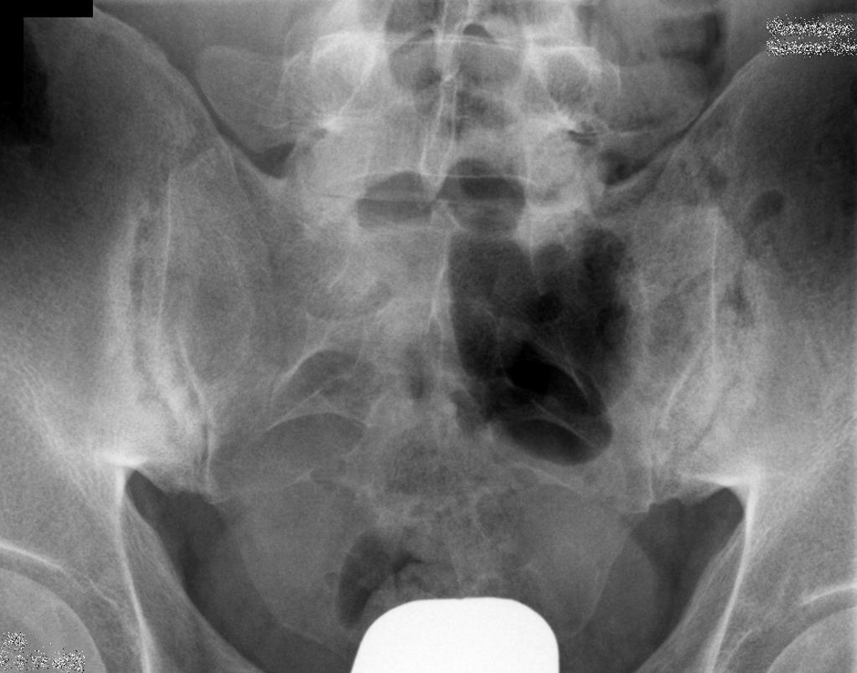
Investigations
Plain x-ray of the sacroiliac joint.
HLA-B27.
Notes:
Bilateral erosions and subchondral sclerosis of the sacroiliac joint

Slide 32
Treatment
Nonsteroidal anti-inflammatory drugs has a dramatic response in patient with Ankylosing spondylitis.
Referral

Slide 33
Complicated back pain
Accounts for 37% of all causes of back pain.
Presence of systemic signs, symptoms or risk factor e.g. fever, weight loss, history of prior cancer..etc.
Most common causes include:
Inflammatory arthritis e.g. ankylosing spondylitis , rheumatoid arthritis.
Neoplastic
Infection: can cause pain when they involve the vertebrae, leading to osteomyelitis.
Plain film and ESR is needed, if either abnormal consider magnetic resonance imaging or computed tomography.

Slide 34
Radiculopathy
Lumbosacral radiculopathy is a condition in which a disease process affects the function of one or more lumbosacral nerve roots.
Depending upon the nature and location of intraspinal compression, roots may be injured at any disc level, from the L1-2 level to the level of their exit into their neural foramina

Slide 36
Pathophysiology and etiology:
Disc herniation.
Spondylosis (spinal stenosis due to degenerative arthritis of the spine).
Non-skeletal nerve root compression and noncompressive mechanisms such as infection, inflammation, neoplasm and vascular disease.

Slide 37
Pain:
Classic radiating pain (spinal nerve injury).
Localized lumbosacral pain (Blood vessels, dura mater and longitudinal ligaments).
Nonlocalized, nonradiating pain (muscle, bone and ligaments outside spinal canal).
Referred pain (abdominal viscera).

Slide 38
Degenerative changes
Resulting bony overgrowth (osteophytes) or disc herniation may directly impinge on spinal nerve roots or the spinal cord, or their effect may be primarily to produce instability and misalignment of the spine (ie, degenerative spondylolisthesis) that in turn produces pain and neurologic deficits.

Slide 39
Disc herniation
Also called disc degeneration, is the usual cause of a herniated disc, as we age the discs in our back lose some of the fluid that helps them stay flexible. The outer layer of the discs can form tiny tears or cracks. The thick gel inside the disc may be forced out through those cracks and cause the disc to bulge or break open.
Depending upon the nature and location of intraspinal compression, roots may be injured at any disc level.
Most frequent presentation is L5 and S1 radiculopathies.

Slide 41
Video :
https://www.youtube.com/watch?v=jZUwtSXpPgg

Slide 42
Root | Pain | Sensory loss | Weakness | Stretch reflex loss
L1 | Inguinal region | Inguinal region | Rarely hip flexion | None
L2-L3-L4 | Back, radiating into anterior thigh, and at times medial lower leg | Anterior thigh, occasionally medial lower leg | Hip flexion, hip adduction, knee extension | Patellar tendon
L5 | Back, radiating into buttock, lateral thigh, lateral calf and dorsum foot, great toe | Lateral calf, dorsum foot, web space between first and second toe | Hip abduction, knee flexion, foot dorsiflexion, toe extension and flexion, foot inversion and eversion | Semitendinosus/semibranosus (internal hamstrings) tendon

Slide 43
Root | Pain | Sensory loss | Weakness | Stretch reflex loss
S1 | Back, radiating into buttock, lateral or posterior thigh, posterior calf, lateral or plantar foot | Posterior calf, lateral or plantar aspect of foot | Hip extension, knee flexion, plantar flexion of the foot | Achilles tendon
S2-S3-S4 | Sacral or buttock pain radiating into the posterior aspect of the leg or the perineum | Medial buttock, perineal, and perianal regions | Weakness may be minimal, with urinary and fecal incontinence as well as sexual dysfunction | Bulbocavernosus, anal wink

Slide 44
Disc herniation and foraminal stenosis due to spondylotic degeneration are the most common etiologies for lumbosacral radiculopathy, and clinical symptoms are self-limited in most cases.
Immediate diagnostic testing is not necessary for patients with suspected radiculopathy who are neurologically intact and at low risk for neoplastic, infectious, or inflammatory etiologies

Slide 45
Investigations:
Not needed unless there is a presence of red flags, or the patient at a high risk of neoplasia, inflammation or infection.⁵
If so, magnetic resonance imaging is recommended.

Slide 46
Treatment:
The objectives of treatment are to ameliorate pain and to address the specific underlying process if necessary.
Nonsteroidal anti-inflammatory drugs or acetaminophen and activity modification are the mainstay of treatment.
Physical therapy is often tried for patients with mild to moderate persistent symptoms, but evidence of effectiveness is lacking.
Opioids and muscle relaxant to treat acute, severe pain.
Surgery is preserved for patients who have persistent, disabling radiculopathy due to a herniated lumbar disc

Slide 47
Urgent situation
Bowel or bladder dysfunction may be a symptom of severe compression of the cauda equina, which is a medical emergency. Urinary retention with overflow incontinence is typically present, often with associated saddle anesthesia, bilateral sciatica, and leg weakness.
The cauda equina syndrome is most commonly caused by tumor or a massive midline disk herniation.

Slide 48
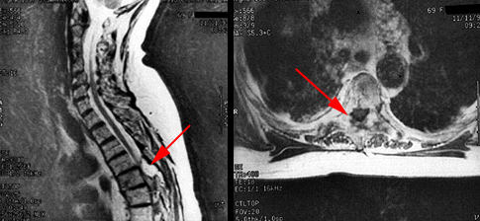
Investigation:
Magnetic resonance imaging.
The scans demonstrate a large epidural lesion compressing the spinal cord

Slide 49
Management
The management of true cauda equina syndrome frequently involves surgical decompression. When cauda equina syndrome is caused by a herniated disk early surgical decompression is recommended.

Slide 50
Role of primary health care in management

Slide 51
Goals for Treatment
Educate patient about the natural history of back pain.
Ask about and address the patient’s concerns and goals.
Maximize functional status.
Relief the pain.
Improve associated symptoms, such as sleep or mood disturbances or fatigue.
Referral of complicated cases.
Prevention.

Slide 52
Important to know ..
Usually gets better without any treatment.
Exercise and surgery are not usually used to treat acute back pain.
The majority of episodes are due to a muscular strain which usually resolve with time - because muscles have a good blood supply to bring the necessary nutrients and proteins for healing to take place. -

Slide 53
Approach to the Treatment of Nonspecific Acute Low Back Pain
Nonspecific low back pain (LBP) - describes LBP symptoms lacking clear, specific cause.
First visit ..
Patient education
Reassure the patient that the prognosis is often good, with most cases resolving with little intervention.
Advise the patient to stay active, avoiding bed rest as much as possible, and to return to normal activities as soon as possible.
Advise the patient to avoid twisting and bending.

Slide 54
Initiate trial of a no steroidal anti-inflammatory drug or acetaminophen.
Consider a muscle relaxant based on pain
severity
e.g., cyclobenzaprine [Flexeril], tizanidine [Zanaflex], metaxalone [Skelaxin] are beneficial in the treatment of acute low back pain.
Because all muscle relaxants have adverse effects, such as
drowsiness, dizziness, and nausea, they should be used cautiously

Slide 55
Second visit:
Two to four weeks after the initial visit, if the patient has not significantly improved…
Changing to a different non steroidal anti-inflammatory drug
Referral for physical therapy :McKenzie method and/or spine stabilization if it is not the first episode
Referral to a spine subspecialist if pain is severe or limits function

Slide 56
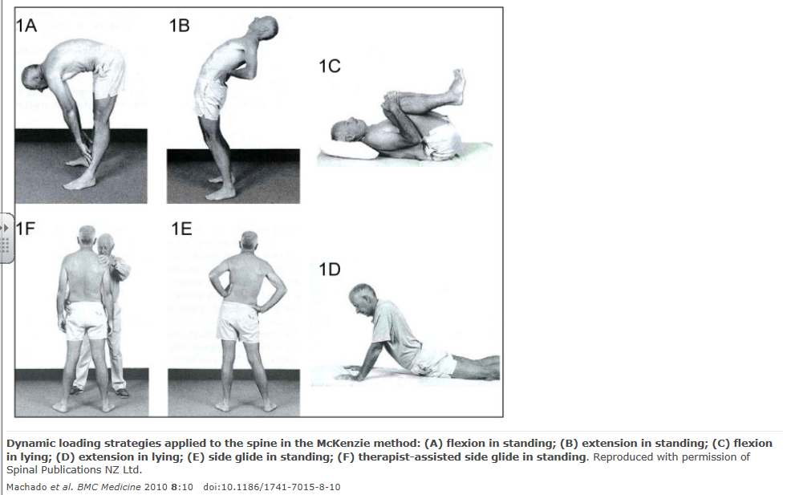

Slide 58
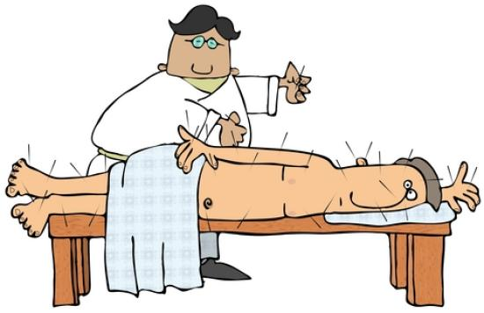
Management
1. Physical Therapy:
Physical therapists often recommend the McKenzie method or spine stabilization exercises for the treatment of low back pain.
2. Application of Ice or Heat
3.Unsupported management:
Oral Steroids.
Acupuncture.
Exercise.
Lumbar Support.
Massage.
Spinal Manipulation and Chiropractic Techniques.

Slide 59
INADVISABLE !
Bed Rest:
Bed rest should not be recommended for patients with nonspecific acute low back pain.
Prolonged bed rest can also cause adverse effects such as joint stiffness, muscle wasting, and loss of bone mineral density, pressure ulcers, and venous thromboembolism.

Slide 60
When to refer to specialist?

Slide 61
When to refer to specialist?
Emergency: referral within hours
Urgent: referral within 24 - 48 hours
Soon: referral within weeks
Depending on the clinical situation, consider communicating with the specialist consultant to determine the urgency and timelines for referral.

Slide 62
1- Level of low back pain and/or leg pain:
If pain is not alleviated by non-surgical treatments and has continued for a few weeks or months, it may be time to see a spine surgeon.
If the pain is severe, then it may be advisable to consult with a spine specialist sooner.

Slide 63
2- Ability to function with the low back pain:
Perhaps even more important than the level of low back pain and/or leg pain is the patient's ability to continue to function in everyday activities.
If one is not able to go to work, drive to the store, and complete other activities of daily living, it may be advisable to consider specialist sooner rather than later.

Slide 64
While patient is waiting to be seen by specialist ..
General advice is analgesia. Advise patient tests are needed to clarify the diagnosis but that results may be inconclusive.

Slide 65
When to refer to specialist urgently?
Cauda Equina Syndrome
Sudden onset of new urinary retention
fecal incontinence
saddle(perineal) anesthesia
radicular (leg) pain often bilateral
loss of voluntary rectal sphincter contraction.
EMERGENCY referral to ER .
infection or tumor
Severe unremitting (non-mechanical) worsening of pain at night and pain when laying down.
Significant trauma.. consider fractures
Check for instability and refer URGENTLY to spinal surgery, if indicated.
URGENT referral to ER for pain control, will need prompt investigation

Slide 66
Use of IV drugs or steroids.. consider infection or compression fracture:
URGENT investigation required.
In case of suspected infection, consider blood work (CBC, ESR and CRP). If blood work is positive, proceed to MRI, if available.
In case of suspected compression fracture, proceed to standing AP and lateral X-rays. Risk factors for compression fractures include: severe onset of pain with minor trauma

Slide 67
Weight loss, fever, loss of appetite .. Cancer or infections is considered:
Refer URGENTLY for MRI Scan and to spinal surgery, if
indicated.
Widespread neurological signs.. consider tumor or neurological disease:
Investigate further and refer SOON if indicated

Slide 69
Prevention and Education
there are some things you can do that may help to prevent back pain . And they can prepare you for faster recovery if you do have back pain.

Slide 70
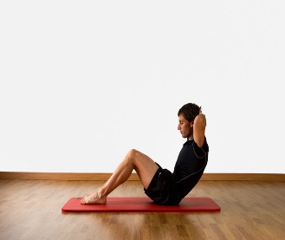
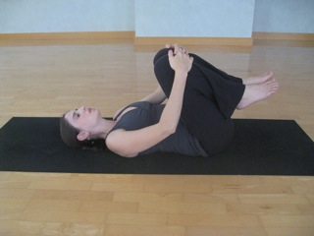
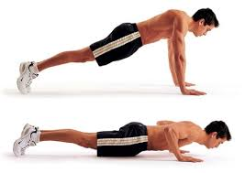
What can I do to avoid back pain at work
1) Include physical activity in your daily routine:
Exercise is both an excellent way of preventing back pain and of reducing it.
Stretching and strengthening: e.g:
Partial sit-up. With bent knee, slowly raise your head and shoulders off the floor,
and hold for 10 seconds.
Knee-to-Chest Raise. Lie down. Slowly pull knees to chest, relaxing your neck and back, hold for 10 seconds. Repeat 10 times.
Press-up. Lie down with hands near shoulders and pelvis on floor. Press up painlessly, hold for 10 seconds, and repeat 10 times.
However, if you have had back pain for more than six weeks, you should
consult a healthcare professional before starting any exercise program.

Slide 71
For most healthy adults, the Department of Health and Human Services recommends at least 150 minutes a week of moderate aerobic activity or 75 minutes a week of vigorous aerobic activity and strength training exercises at least twice a week.
Combine aerobic exercise, such as swimming or walking, with exercises that strengthen and stretch your back muscles and abdomen.

Slide 72
2) Pay attention to posture:
How you sit, stand and lie down can have an important effect on your back.
Standing:
Stand upright, with your head facing forward and your back straight. Balance your weight evenly on both feet and keep your legs straight . if knees slightly bent, the pressure of your low back will reduce.

Slide 73
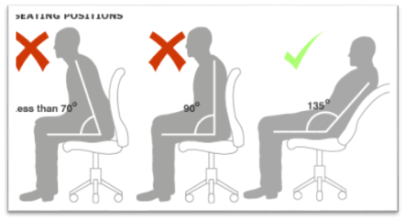
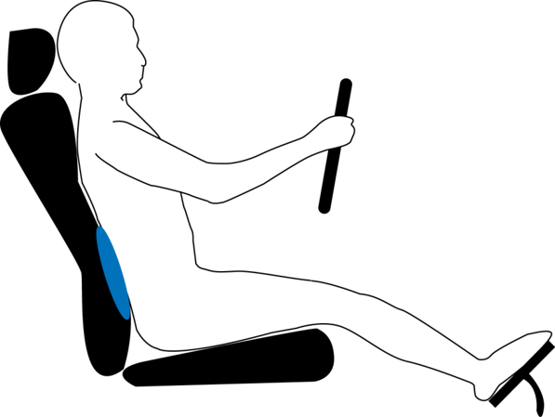
Sitting:
choose a chair that allows you to rest both feet flat on the floor while keeping your knees level with your hips. Some people find it useful to use a small cushion to support the small of the back.
Driving:
Make sure that your lower back is properly supported.
Correctly positioning your wing mirrors will prevent you from having to twist around.
Your foot controls should be squarely in front of your feet.
If you are driving long distances,
take regular breaks so that you can stretch your legs.

Slide 74
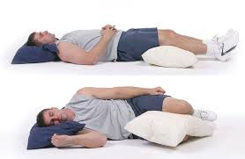
Sleeping:
Sleeping on your back puts 55 lbs of pressure on your back! Putting a couple of pillows under your knees cuts the pressure in half.
Lying on your side with a pillow between your knees also reduces the pressure.
Sleeping on your abdomen can be hard on your back .If you can't sleep any other way, reduce the strain on your back by placing a pillow under your pelvis and lower abdomen.

Slide 75
Lifting:
kneel down on one knee with the other foot flat on the floor as near as possible to the item you are lifting. Lift with your legs, not your back, keeping the object close to your body at all times.

Slide 76
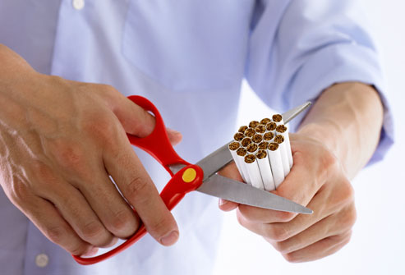
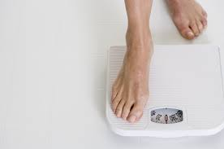
3)Listen to your body:
If you must sit for a prolonged period, change your position occasionally, stand up or stretch
whenever you feel tired.
4) Quit smoking
5) lose weight
too much upper body weight can strain
the lower back

Slide 77
Education
Explain to your patient about non specific causes of low back pain. Encourage active life style and to make exercise a regular thing in their daily schedule, such as, walking, jogging, swimming… etc.
Occupational health must be emphasized on to prevent lots of diseases and one of them is back pain.

Slide 78
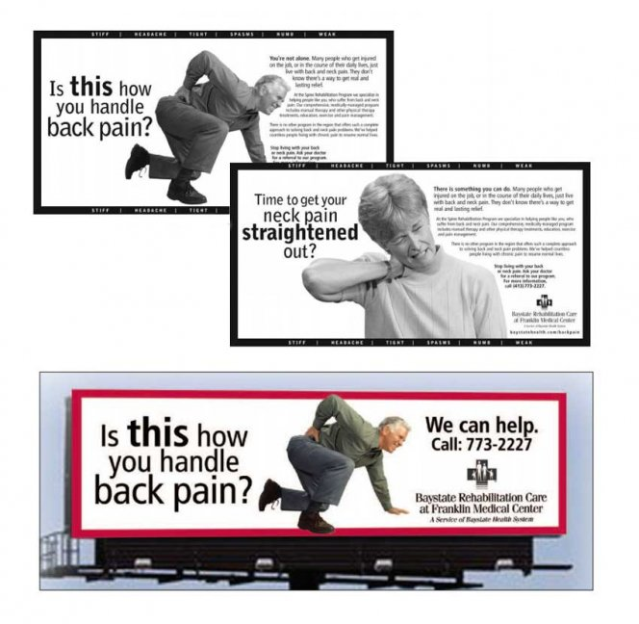
http://www.knowyourback.org/Pages/Default.aspx

Slide 79
MCQ #1
Which of the following is the most common radiculopathy affecting the lumbosacral spine?
L2
L3
L4
S1

Slide 80
MCQ #2
Which of the following is a red flag sign/symptom of back pain?
History of cancer.
Kyphosis.
Age less than 50.
Shingel.

Slide 81
MCQ #3
Which of the following elements is the most important in evaluating back pain?
Lumbar x-ray.
Acupuncture.
Taking a history.
Prescribing a medication and waiting for an effect

Slide 82
MCQ #4
In a patient with acute low back pain without the presence of red flags or signs of systemic diseases, the most initial investigation is:
X-ray
CT scan
No need for any investigation.
MRI

Slide 83
MCQ #5
A patient came with lower back pain with morning stiffness exacerbates by rest and relived by activity :
Mechanical back pain
Inflammatory back pain
Tumor
Nerve root compression

Slide 84
References
^{Figure.1} A joint clinical practice guideline from the American College of Physicians and the American Pain Society.
¹ Katz et al. J Bone Joint Surg 2006;88:21-4
²Al-Arfaj AS et al. Saudi Med J. 2003 Feb;24(2):170-3
³Arthritis Research Campaign., 2002.
⁴Treatment: current treatment recommendations for acute and chronic undifferentiated low back pain. Prim Care. 2012 Sep;39(3):481-6. (review article).
5 Chou R, Qaseem A, Owens DK, et al. Diagnostic imaging for low back pain: Advice for high-value health care from the American College of Physicians. Ann Intern Med 2011; 154:181
Chou R, Qaseem A, Snow V, Casey D, Cross JT Jr, Shekelle P, Owens DK, Clinical Efficacy Assessment Subcommittee of the American College of Physicians, American College of Physicians, American Pain Society Low Back Pain Guidelines Panel

Slide 85
Thank you ..

