Slide 1
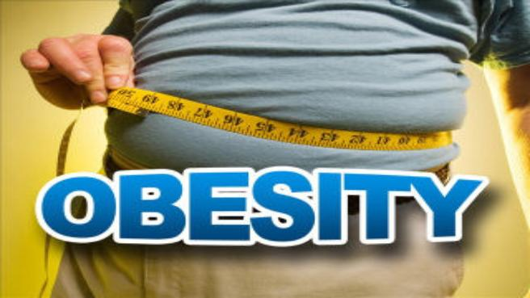
Approach to obese patient
Abdulaziz Bin yahya
Naif Al eid

Slide 2
Objectives :
#Define obesity and classify the degree of obesity (BMI, Waist circum. And Waist to Hip ratio)
#Highlight the prevalence of obesity in Saudi Arabia
#Discuss how to prevent obesity in the community
#Discuss the common causes of obesity in the community
#Morbidity “common health problems due to obesity”
#Discuss the evidence based approach to decrease weight (Exercise, Dieting, Drug treatment, and Bariatric Surgical Intervention like gastric banding, Sleeve gastrectomy and gastric bypass.
#Role of health team, medical students, and school health in dealing with obesity in the community

Slide 3
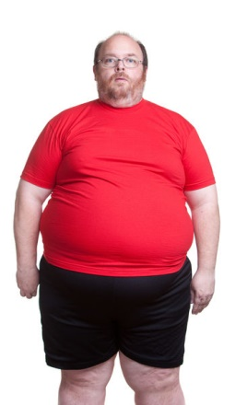
Definition
Simply, obesity is a complex disorder involving an excessive amount of body fat ☺
Harvard School of Public Health Obesity Prevention
Overweight and obesity ?

Slide 4
Degree of Obesity
Body mass index (BMI) is a simple index of weight-for-height that is commonly used to classify overweight and obesity in adults. Body mass index is an indirect measure of body fat content as it correlates positively with amount of fat in general
BMI
kg/m² is obtained simply by dividing the weight (Kilograms) by the highlight (Meters) squared. An adult BMI kg/m² between 25 and 29.9 is considered overweight and a BMI kg/m² of 30 and over is considered obese.
BMI=weight (kg) / [ height (m)² ]

Slide 5
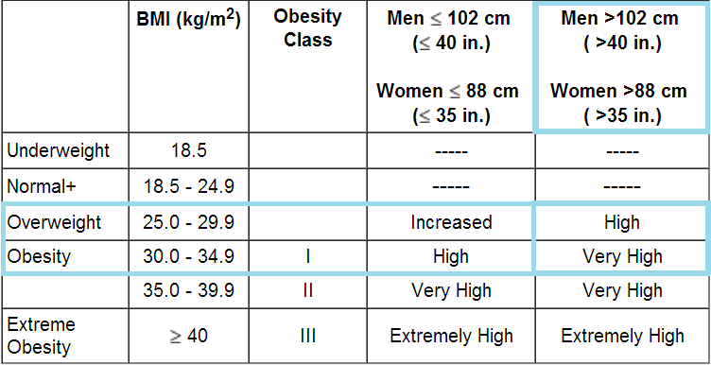
Waist Circumference
For men it suppose to be >102 cm (40 in.) and for women >88 cm (35 in. )

Slide 6
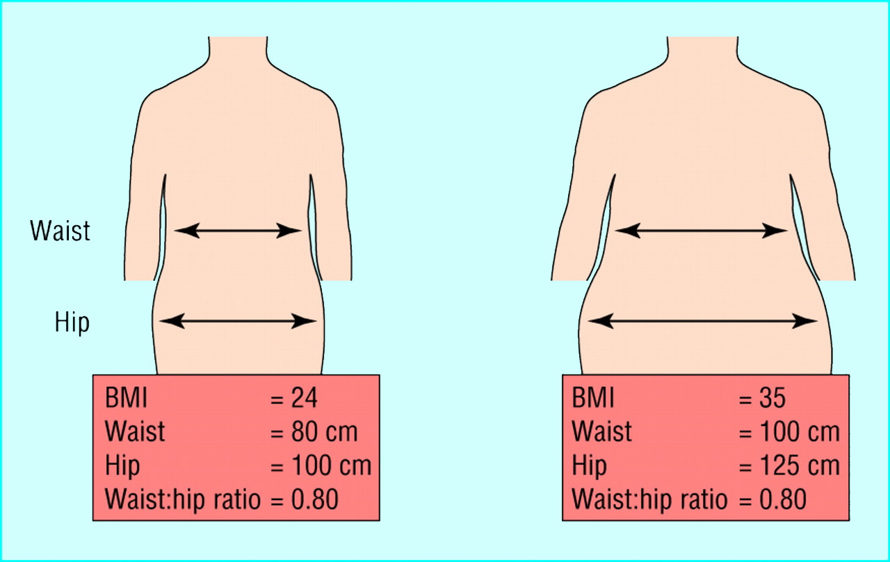
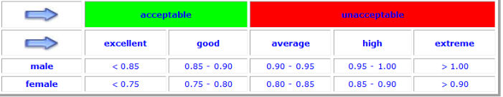
Waist to Hip ratio
This is calculated as waist measurement divided by hip measurement (W/H). For example, a person with a 25" waist and 38" hips has a waist-hip ratio of about 0.66.

Slide 7
Prevalence of obesity in Saudi Arabia
Based on the National Nutrition Survey of 2007, the prevalence of obesity in the KSA was 23.6% in women and 14% in men. The prevalence of overweight in the community was determined to be 30.7% for men as compared to 28.4% for the women. Similarly, the Coronary Artery Disease in Saudis Study (CADISS) of 2005 estimated an overall obesity prevalence of 35.5% in the Kingdom: in other words one in every three people in the country is obese.
Obesity Research Center , King Saud University

Slide 8



How can we prevent obesity in our community ?
Why it is important ?
Improve social physical activity
Enhance Healthy Food

Slide 9
Causes

Slide 10
The fundamental cause of obesity and overweight is an energy imbalance between calories consumed and calories expended. Globally, there has been:
an increased intake of energy-dense foods that are high in fat, salt and sugars but low in vitamins, minerals and other micronutrients; and
a decrease in physical activity due to the increasingly sedentary nature of many forms of work, changing modes of transportation, and increasing urbanization.

Slide 11
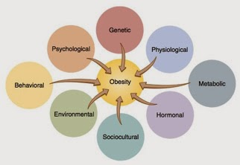

Slide 12
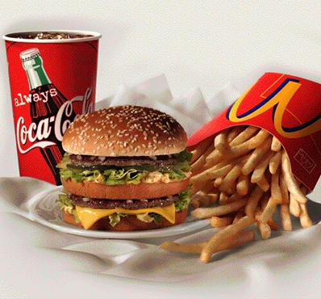
1- Diet
The average calories available per person per day increased in all parts of the world except Eastern Europe.
Total calorie consumption has been found to be related to obesity.

Slide 13
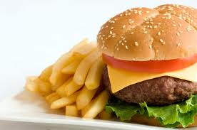
Diet
Settings in which dietary factors become important:
1- Overeating and restrained eating:
Many people have a pattern of conscious limitation of food intake, termed "restrained" eating.
Overeating relative to energy expenditure will uniformly cause obesity; most obese subjects have lost control of their eating.

Slide 14
2- Frequency of eating:
A five meal-a-day pattern was associated with significantly lower risk of overweight and obesity.
Eating breakfast is associated with lower risk of overweight.
One explanation for the effects of frequent small meals versus a few large meals could be the difference in insulin secretion associated with these meal sizes (eg, increased with large meals).

Slide 15
3- Dietary habits:
Epidemiological data suggest that a diet high in fat is associated with obesity.
In contrast, intake of vegetables, whole grains, fruits, nuts, and yogurt was inversely associated with weight gain.
Sugar-sweetened beverages.
4- Fast food:
Comparison between subjects who ate fast food infrequently (<once per week), with subjects who consumed fast food frequently (>twice per week) at baseline and follow-up gained an extra 4.5 kg of weight and had a twofold increase in insulin resistance.

Slide 16
5-Night-eating syndrome:
Night-eating syndrome is defined as consumption of at least 25 percent (and usually more than 50 percent) of energy between the evening meal and the next morning.
6- Binge-eating disorder:
Binge-eating disorder is a psychiatric illness characterized by uncontrolled episodes of eating that usually occur in the evening.

Slide 17
Age. Obesity can occur at any age but hormonal changes and a less active lifestyle increase your risk of obesity. In addition, the amount of muscle in your body tends to decrease with age.
Quitting smoking: It can lead to a weight gain of as much as several pounds a week for several months, which can result in obesity. In the long run, however, quitting smoking is still a greater benefit to your health than continuing to smoke.
Pregnancy. During pregnancy, a woman's weight necessarily increases. Some women find this weight difficult to lose after the baby is born. This weight gain may contribute to the development of obesity in women.
Sleep deprivation: Sleep restriction, when compared to sleep extension, was associated with a decrease in serum leptin , an increase in serum ghrelin and increased hunger and appetite. Inadequate sleep could result in excessive eating, obesity, and altered response to dietary therapy.

Slide 18


Life Style
1-Physical inactivity:
A sedentary lifestyle lowers energy expenditure and promotes weight gain.
Television — Television viewing is perhaps the best established environmental influence on the development of obesity during childhood.
In both children and adults, there is an association between television viewing time and the risk of obesity.
A review found 63 of 73 studies (86%) showed an increased rate of childhood obesity with increased media exposure, with rates increasing proportionally to time spent watching television

Slide 19

Drugs
1- Antipsychotics:
Conventional (first generation) antipsychotics, like thioridazine.
Atypical (second generation) antipsychotics, clozapine and olanzapine.
2- Antidepressants :
Tricyclic antidepressants, in particular, clomipramine, doxepin,and imipramine are associated with significant weight gain.
Short-term use of fluoxetine and sertraline has been associated with weight loss

Slide 20
3- Antiepileptic drugs:
The antiepileptic drugs for example valproate (valproic acid), which commonly used in the management of bipolar disorder, are associated with weight gain.
4- Diabetes drugs:
Insulin stimulates weight gain, possibly through hypoglycemia, and the sulfonylureas that increase insulin release also increase weight.

Slide 21
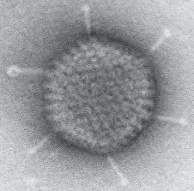
Infections
Human studies, including a small study in twins, have shown an association between adenovirus 36 antibodies and obesity status in adults.
Genetics
Obesity is a feature of at least 24 genetic disorders, most commonly known ones:
Prader-Willi syndrome
Bardet-Biedl syndrome

Slide 22
Other causes
Hypothyroidism, Cushing's syndrome, growth hormone deficiency.
Eating disorders: binge-eating disorder and Night eating syndrome.

Slide 23
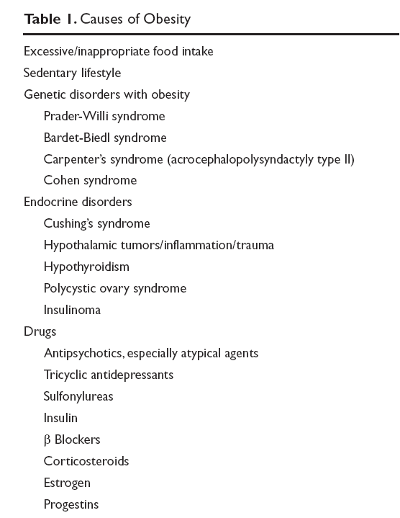

Slide 24
What are the common health problems that may develop?

Slide 25
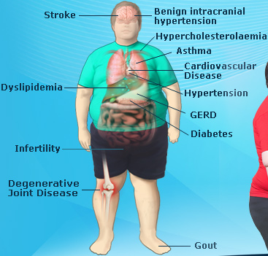
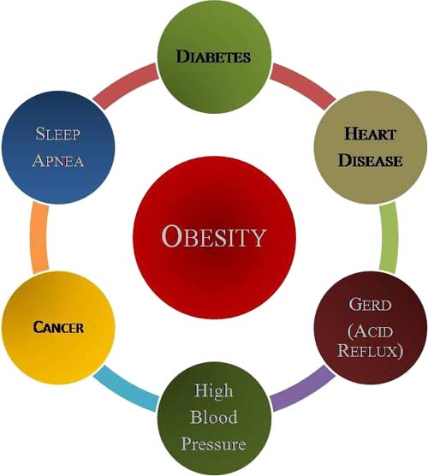
Comorbidities

Slide 26
obesity is one of the leading preventable causes of
death.
Large scale American and European study showed that mortality risk is lowest at a BMI between 20-25
kg\m2 in non-smokers.
In the United States, roughly 300,000 deaths per year are directly related to obesity, and more than 80% of these deaths are in patients with a BMI over 30. For patients with a BMI over 40, life expectancy is reduces significantly.

Slide 27
1-Diabetes
Type 2 (adult-onset) diabetes:
The risk of type 2 diabetes increases with the degree and duration of obesity.
2-Hypertension
Hypertension is common among obese adults.
A Norwegian study showed that weight gain tended to increase blood pressure in women more significantly

Slide 28
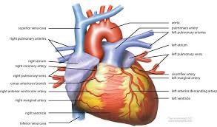
3-Dyslipidemia
Reduction in serum (HDL) cholesterol of about 5 percent .
4-Heart Disease
1) Coronary disease.
2) Heart failure.
3) Myocardial Steatosis.
4) Atrial fibrillation/flutter.

Slide 29
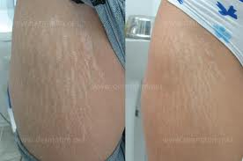
5- Skin changes
Stretch marks (striae). are common and reflect the tension on the skin from expanding subcutaneous deposits of fat.
Acanthosis nigricans (hyper pig.).
Hirsutism
Striae

Slide 30
6- colon cancer
Obesity has been linked to cancer of the colon in men and women, cancer of the rectum and prostate in men, and cancer of the gallbladder and uterus in women.
Obesity may also be associated with breast cancer, particularly in postmenopausal women.

Slide 31
Gallstones
Gout and gouty arthritis
Osteoarthritis (degenerative arthritis) of the knees, hips, and the lower back.
Sleep apnea

Slide 32
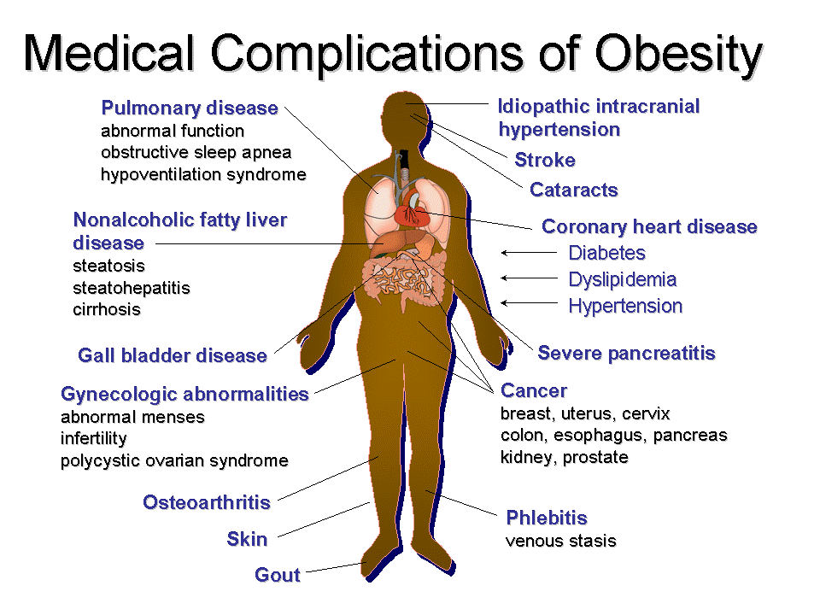

Slide 33
Management

Slide 34
PREVENTION
Primary
Secondary
Tertiary
Notes:
Tertiary
Slow down or reverse the increase in BMI and to prevent the complications of overweight
Secondary
Identification and intervention of asymptomatic children who are at risk for overweight
Primary
Prevention efforts occurring before individuals are overweight

Slide 35
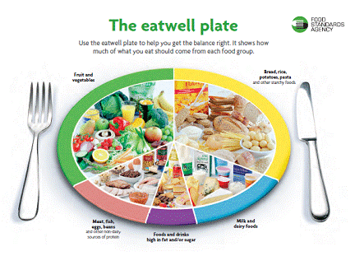

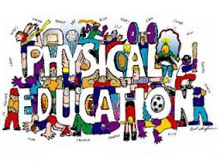
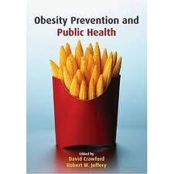
Primary prevention: focusing on healthy life style behaviors related to maintaining normal weight
.
Notes:
Primary prevention means preventing the illness before it happens
Primary prevention efforts include focusing on healthy lifestyle behaviors
related to maintaining a normal weight.
methods of preventing obesity are :
1-practicing good nutrition and having regular physical activity
2-educating community about how to avoid overweight and obesity

Slide 36
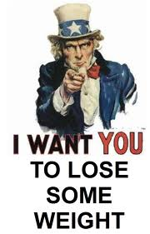
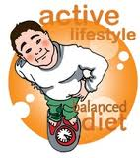
Secondary prevention
Notes:
Efforts aimed at individuals who are already
overweight in order to prevent them from
becoming obese by two ways :
1-Diet therapy.
2-Increased Physical Activity.

Slide 37
Tertiary prevention
  1- Slow down or reverse the increase in BMI.
  2- Prevent the complications of overweight.

Slide 38
How could have prevented this problem?
Going back to our patient

Slide 39
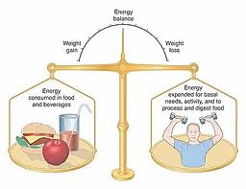
prevention
Prevention
Healthy Diet
Daily Exercise

Slide 40
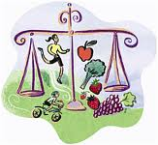
Prevention

Slide 41
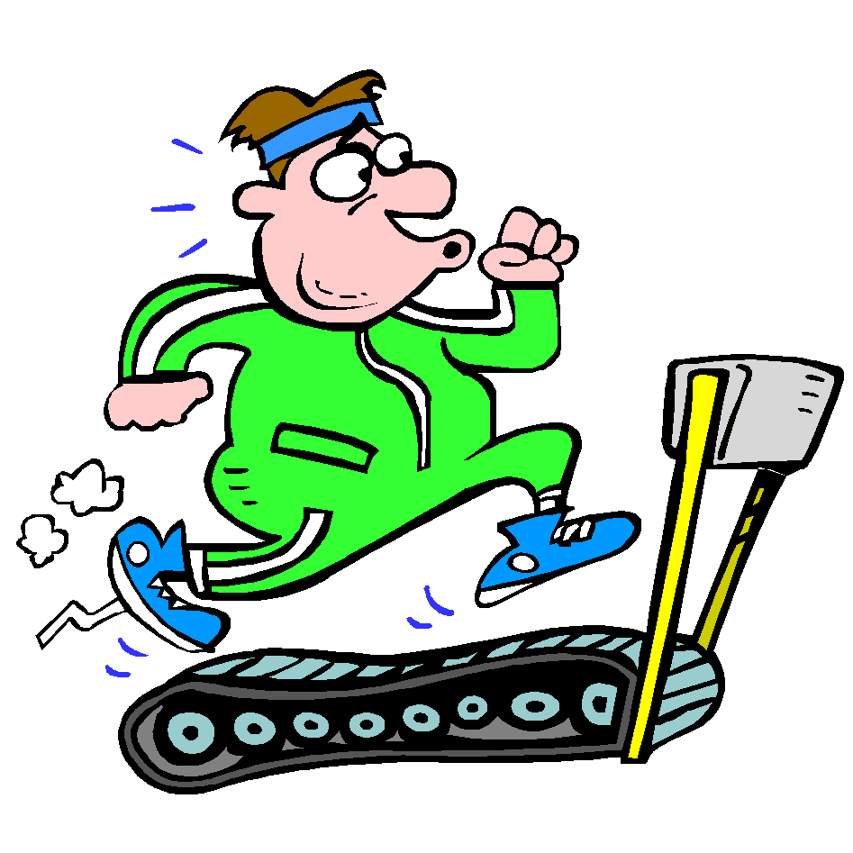
Prevention
Exercise regularly.
you need to get 150 to 250 minutes of moderate-intensity activity a week to prevent weight gain.

Slide 42
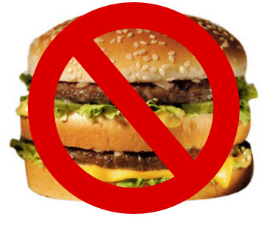

Eat healthy meals
Focus on
Avoid
low-calorie, nutrient-dense foods, such as fruits, vegetables and whole grains.
saturated fat, alcohol and limit sweets.

Slide 43
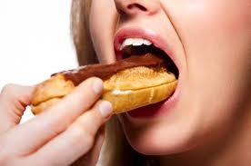
Beware of emotional eating

Slide 44

Prevention
*Drink plenty of water.

Slide 45
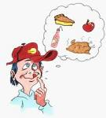
* Eat only when you are hungry.

Slide 46
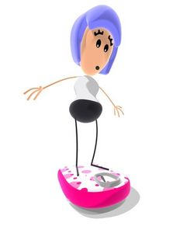
Prevention
Monitor your weight regularly

Slide 47

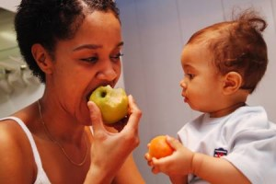
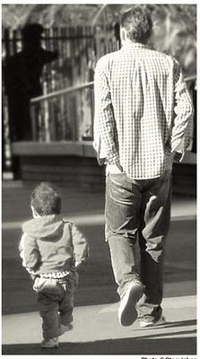

In children
Prevention

Slide 48
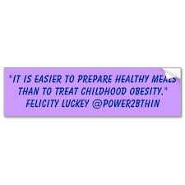

Slide 49
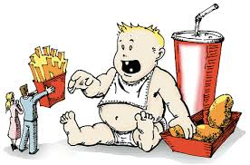
Prevention
* Change family eating habits and activity levels.

Slide 50
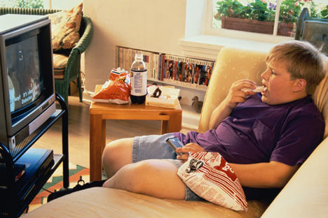
* Reduce time spent in front of TV and computer.

Slide 51

* Avoid using food as a reward.

Slide 52

What's the role of medical students and health team in the community?

Slide 53
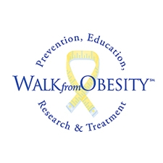
Prevention
Role of health team, medical students, and school health in dealing with obesity in the community

Slide 54
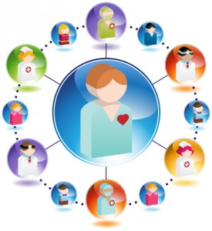
Health team
Prevention
- health professionals have an important role in promoting preventive measures and encouraging positive lifestyle
Behaviors.
- also have a role in counseling patients about safe and effective weight loss and weight maintenance programs.

Slide 55
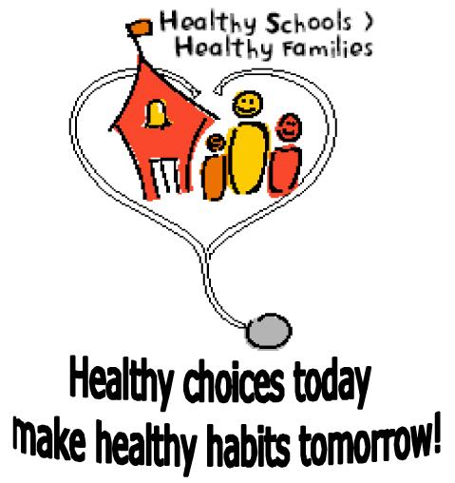
Role of schools

Slide 56
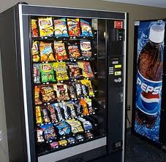
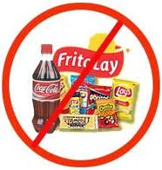
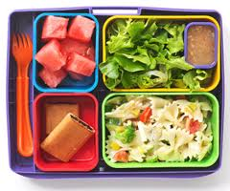

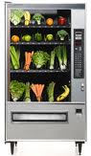
Role of schools
Prevention
health education
physical education
health services
nutrition services
staff health promotion
health educations for family

Slide 57
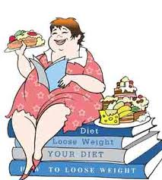
Prevention

Slide 58
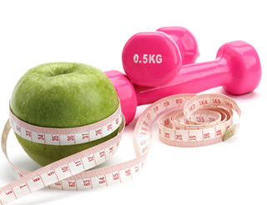
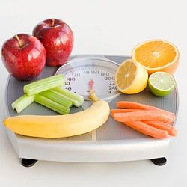
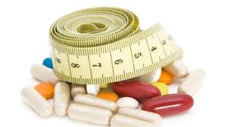

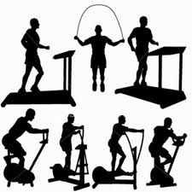
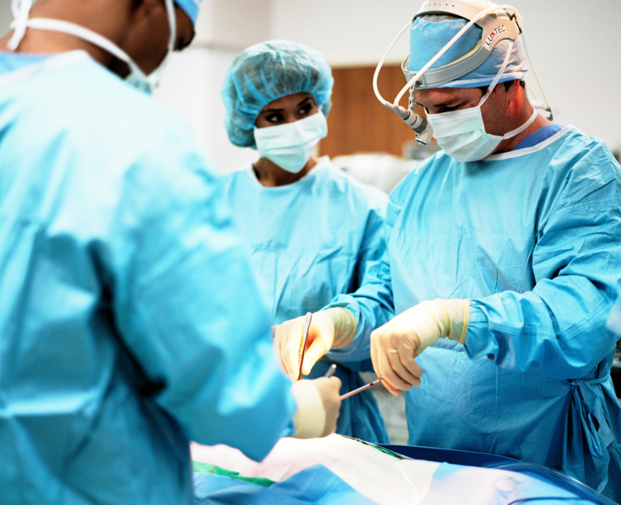
How would you approach a patient ?

Slide 59
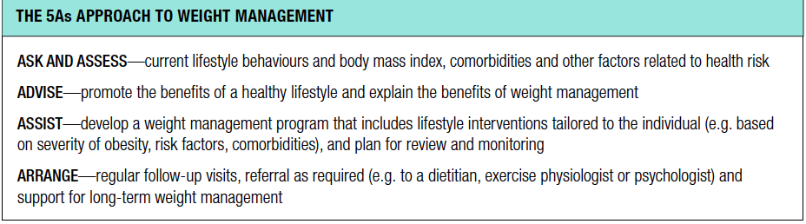
5As

Slide 60
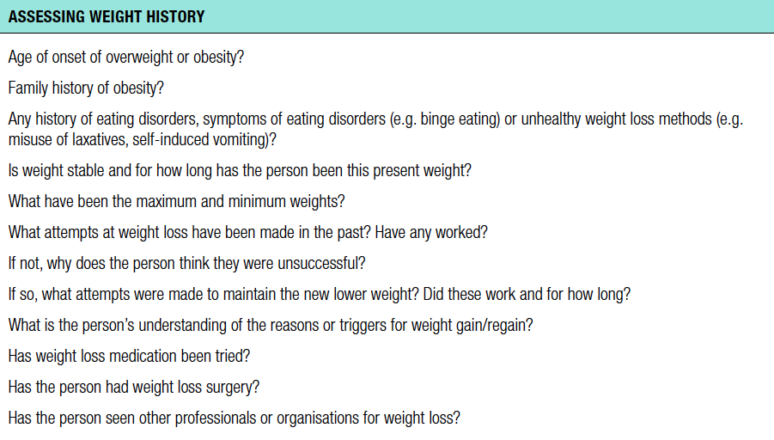
Weight history

Slide 61
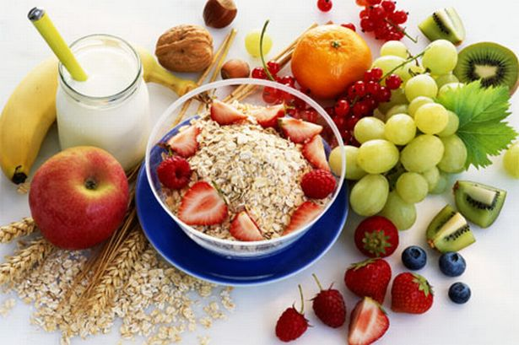
Dietary approaches to weight loss
low-calorie diet, eat 500 to 1,000 fewer calories each day.
Reduce intake of foods that are high in energy (e.g.fats, sugar)
Include more fruits and veggies
Limit salt and sugar intake
Drink plenty of water
Notes:
Lifestyle interventions
The three key lifestyle areas related to overweight and obesity are nutrition, physical activity and behavioral change.

Slide 62
Exercise
You'll probably need to do at least 30 minutes of physical activity on most days.
The goal is to use about 2,000 extra calories a week.
Gardening
5 hours
Cycling 22 miles
Running
11 miles
Walking
12 miles
Dancing 3 hours

Slide 63
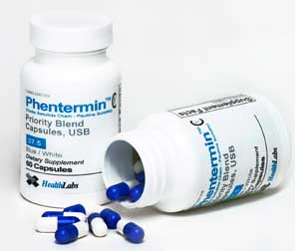
Medications
The use of weight loss medications in addition to lifestyle approaches has been found to increase weight reduction in adults who are overweight or obese.
When to use?
Failure of diet and exercise
BMI > 30
BMI > 27 and associated with medical problems related to obesity

Slide 64
Medication
Drug | Action | Side Effects
Diethylpropion (Tenuate) | Decreases appetite, increases feeling of fullness | Increased blood pressure and heart rate, insomnia, dizziness
Lorcaserin (Belviq) | Decreases appetite, increases feeling of fullness | Headache, dizziness, fatigue, nausea, dry mouth, constipation
Phentermine (Adipex) | Decreases appetite, increases feeling of fullness | Increased blood pressure and heart rate, insomnia, dizziness
Orlistat (Xenical) | Blocks absorption of fat | Intestinal cramps, gas, diarrhea, oily spotting
Phentermine and extended-release topiramate (Qsymia) | Decreases appetite, increases feeling of fullness | Increased heart rate, birth defects, tingling of hands and feet, insomnia, dizziness, constipation, dry mouth

Slide 65

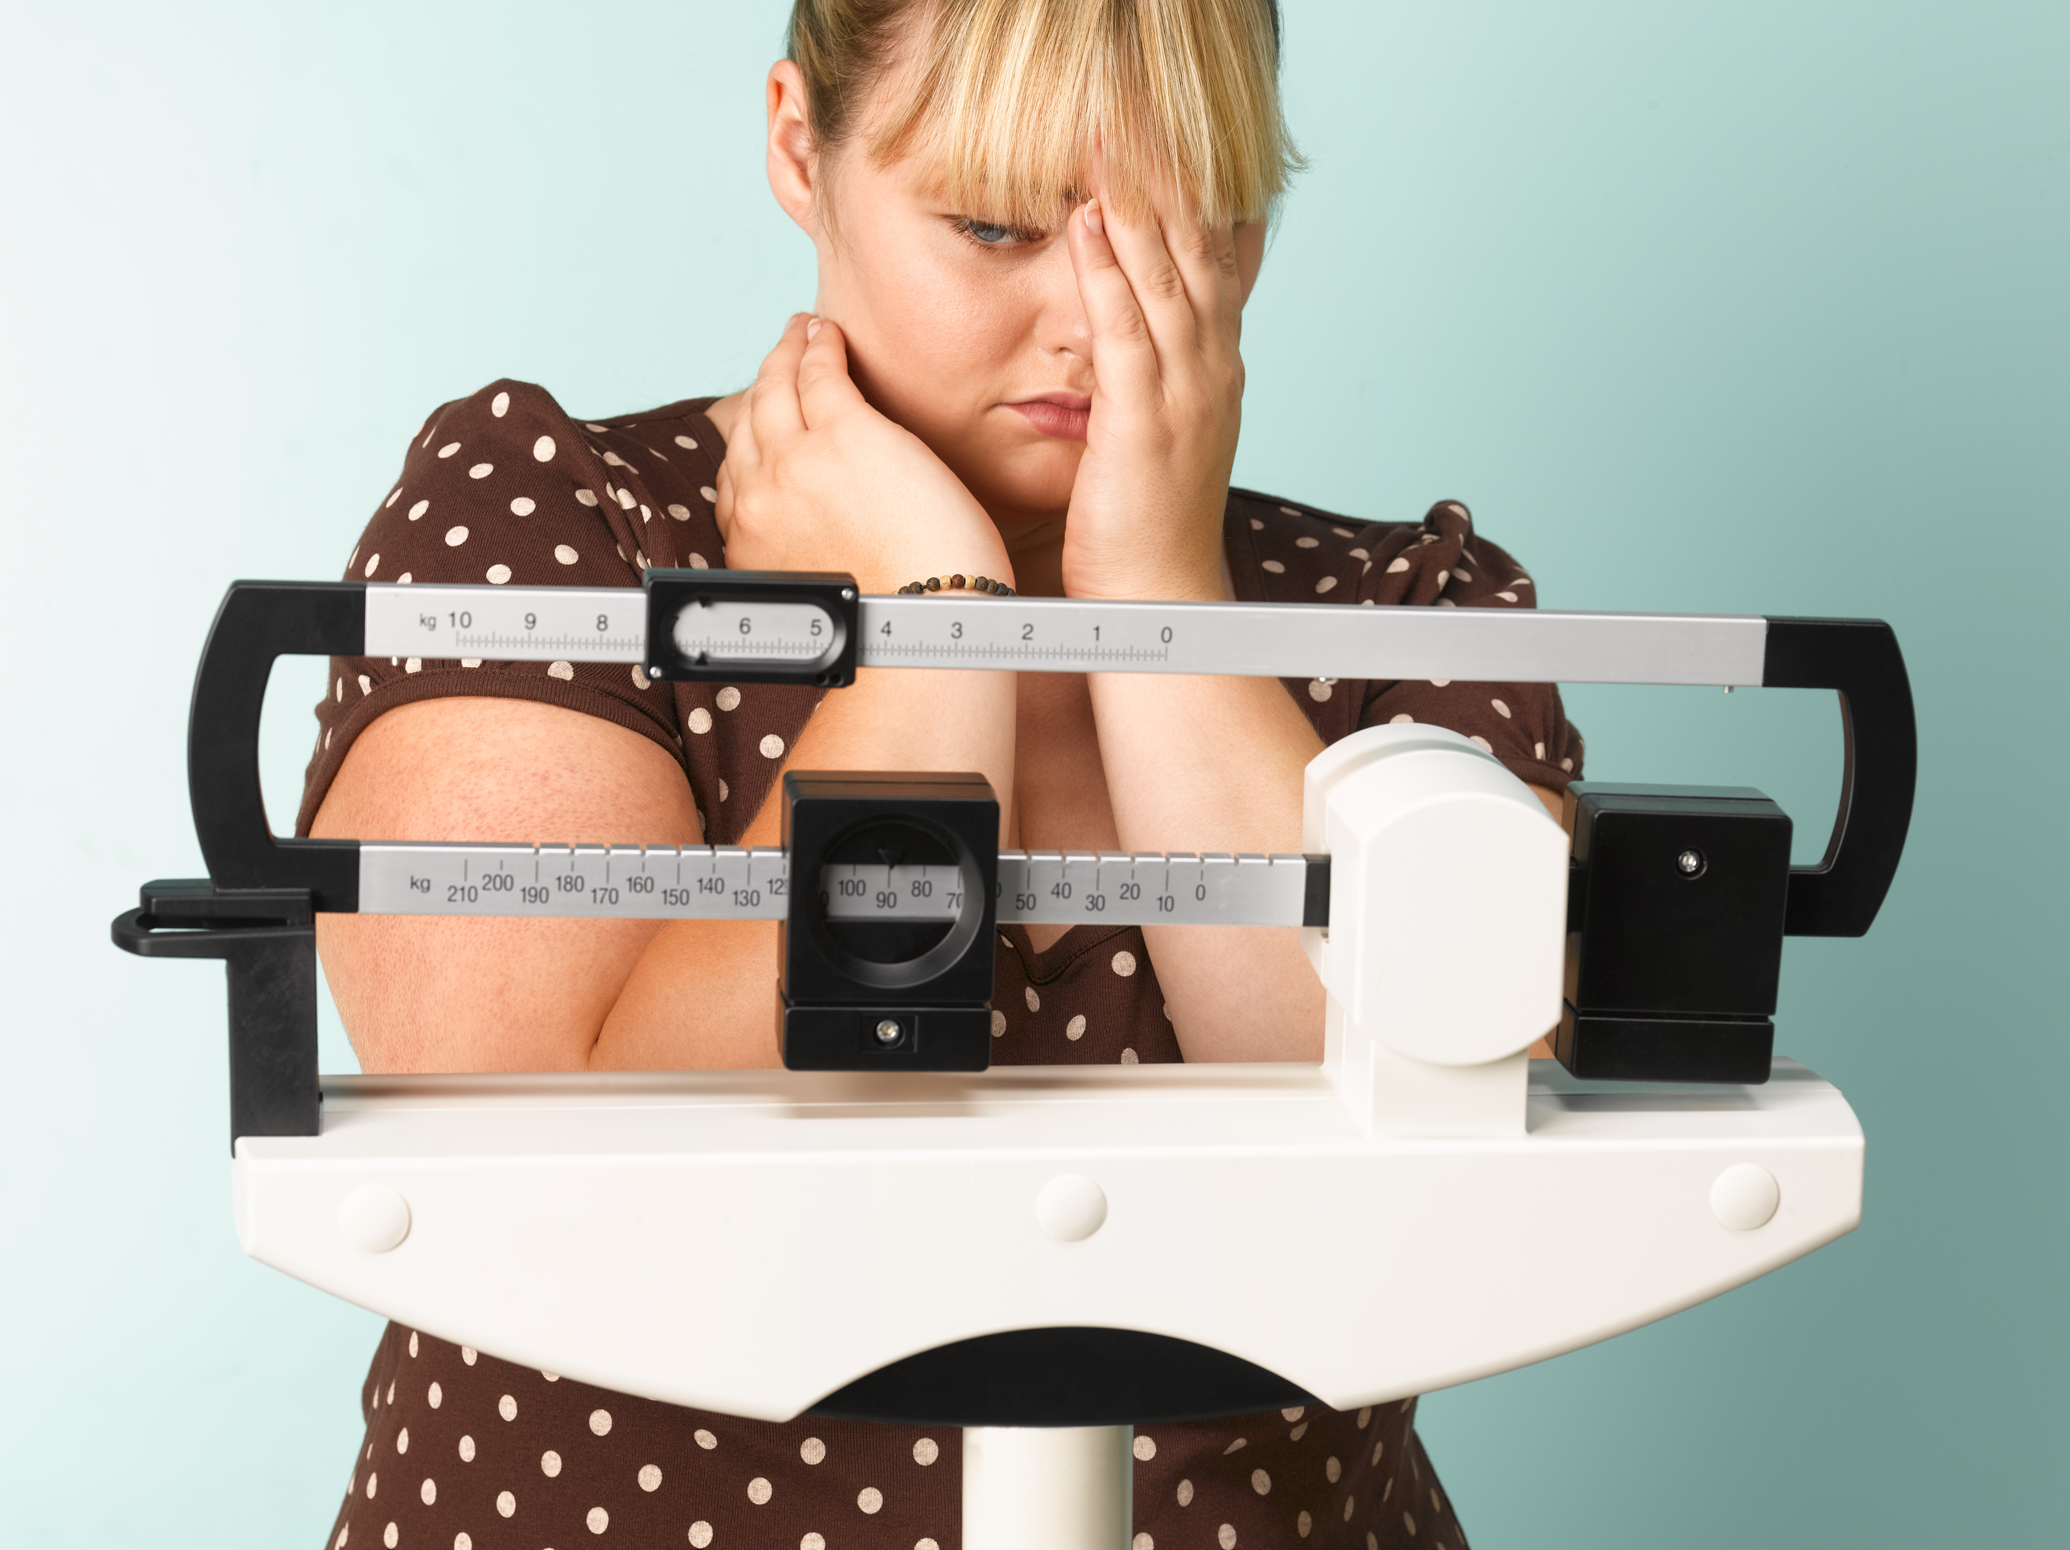

Bariatric Surgical Intervention
When to consider?

Slide 66

Bariatric Surgical Intervention
Laparoscopic adjustable gastric banding (LAGB)
involves placing a band around the stomach near its upper end to create a small pouch. This restricts intake of food. The band can be tightened or loosened over time to change the extent of restriction.

Slide 67

Bariatric Surgical Intervention
Sleeve gastrectomy
involves removing the greater portion of the fundus and body of the stomach, reducing its volume from up to 2.5 L to about 200 mL. This procedure provides fixed restriction and does not require adjustment like LAGB.

Slide 68


Bariatric Surgical Intervention
Roux-en-Y gastric bypass (RYGB)
is a combination procedure in which a small stomach pouch is created to restrict food intake and the lower stomach, duodenum and first portion of the jejunum are bypassed to produce modest malabsorption of nutrients and thereby kilojoule intake.

Slide 69

Bariatric Surgical Intervention
Biliopancreatic diversion (BPD)
is also a combination procedure that involves removing the lower part of the stomach, and bypassing the duodenum and jejunum to produce significant malabsorption. This procedure tends to be performed in subspecialty centres.
Notes:
The choice of surgical technique is individualised and involves discussion between the surgeon and the person.

Slide 70

How can we approach an obese child?
For children and adolescents focus lifestyle programs on parents.
Weight loss is not recommended for most of children, as weight maintenance during growth will allow a gradual decline in BMI.
Weight management in children and adolescents focuses on changes in health behaviors that influence weight, dietary behavior and physical activity.
Lifestyle intervention is the first line of weight management in children and adolescents such as dietary modifications, physical activity and family behavioral intervention.
For sever obesity and associated comorbidities in postpubertal adolescents intensive interventions may be required such as very low-energy diet, orlistat, metformin or surgery (LAGB).

Slide 71

Approach/Managment

Slide 72


Slide 73
Q1. Which one of the following BMIs is considered to be obese?
A. ≥ 25
B. ≥ 30
C. ≥ 18
D. ≥ 29

Slide 74
Q2. Which one of the following is a complication of obesity?
A. IBS
B. Hyperthyroidism
C. coronary heart disease
D. TB

Slide 75
Q3. What causes obesity?
A. Heredity
B. Poor eating habits
C. Lack of physical activity
D. All of the above

Slide 76
Q4. For most people, the best type of diet for losing weight is?
A. Choosing sensibly from the five major food groups, with an emphasis on whole grains, fruits and vegetables, accompanied by an effort to moderate fat intake and reduce sugar intake
B. The newest thing to come down the pike, whether it's all protein or eight grapefruits a day
C. A Crash diet
D. Fasting

Slide 77
Q5. What is the common way to measure obesity in both adults and children?
A. BMI.
B. Waist circumference.
C. Waist to hip ratio.
D. All of the above.

Slide 78
Q 6. What is the first line of weight management in children and adolescents?
Surgical intervention
Lifestyle intervention
weight loss medications
Intensive exercise program

Slide 79
Take Home Message
BMI, Waist Circumference and Waist To Hip Ratio can all be used to identify and classify obesity.
The local studies suggest an increase in the prevalence of obesity.
Diet, Life Style, Neuroendocrine diseases, Drugs, Psychological influenses ,Genetics, Socioeconomics and some Infections can lead to obesity.

Slide 80
Take Home Message
Diabetes, Hypertension, Dyslipidemia, Gout, Heart Diseases, Stroke, Sleep apnoea and specific Skin Changes are well known complications of obesity.
Obesity should be managed initially with diet and life style modification followed by pharmacotherapy and surgery as a last option.

Slide 81
References :
WHO | Obesity and overweight. 2013. [ONLINE] Available at: http://www.who.int/mediacentre/factsheets/fs311/en/.
Management of Overweight and Obesity in Adults, Adolescents and Children clinical Practice Guidelines for Primary Care Health Professional ,Australia. May 2013.
www.youtube.com
Obesity Management Interventions: A Review of the Evidence ,Joseph Yaskin, Richard W. Toner, and Neil Goldfarb
Our Colleagues previous presentations.

Slide 82
Thank You
Any questions … ?

