Slide 1
Common Psychiatric problems
Saad Aldawsari
Fahad Alqahtani
Naif Alajji

Slide 2
MCQ
Q1- prevalence of psychiatric illness in primary care in Saudi Arabia is :
A-50%
B-18%
C- 30%

Slide 3
MCQ
Q2- A 29-year-old woman has been suffering lack of enjoyment, low self-esteem, insomnia, poor concentration, and fatigue for more than 3 years. She has no medical diseases.
The most likely diagnosis is;
A- Major Depressive disorder
B- Bipolar II mood disorder.
C- Bipolar I mood disorder.
D- Cyclothymic disorder.
E- Dysthymic disorder.

Slide 4
MCQ
Q3- Major depression disorder diagnistic criteria :
A-Chronic mild low mood or loss of interest for at least 2 years.
B- Onset can begin 24 hours to several months after delivery
C- Characterized by one or more episodes of low mood or loss of interest for at least two weeks

Slide 5
MCQ
Q4- the treatment of somatoform disorders based on ?
A- medications
B-Cognitive Behavioral Therapy
C- there is no need to treat the patients

Slide 6
MCQ
Q5- In order to diagnose General Anxiety Disorder (GAD), the symptoms of anxiety and excessive worrying must be present of at least:
A- Month
B- 3 Months
C- 6 Months
D- 1 Year

Slide 7
Depression

Slide 8
Case scenario
Salwa is a 39year-old Saudi woman who presents to the primary care clinic with symptoms of difficulty concentrating, problems sleeping, and complains of having a "jumpy" feeling all the time. she is seeking help, because these symptoms are interfering with her ability to perform her work .
she has also had a lack of interest for his hobbies and is finding it difficult to be able to enjoy everyday activities .

Slide 9
How you will manage this patient?

Slide 10
Definition
Depressive disorders are characterized by persistent low mood, loss of interest and enjoyment and reduced energy, causing varying levels of social and occupational dysfunction.

Slide 11
Prevalence
Globally, more than 350 million people have depression, a mental disorder that prevents people from functioning well.

Slide 12
Five of the ten leading causes of disability are mental health problems; major depression is the ﬁfth contributor to the global burden of disease and may be second by 2020.
A new study found that the Middle East, including Saudi Arabia has a very high rate of MDD compared with the rest of the world- almost
7%.

Slide 13
Sex — 2 Female : 1 Male Race — Whites was 18 %, Caribbean blacks was 13 %, and African Americans was 10 %. Age — Major depression is less common in older than younger adults living in the community. Marital Status — More in single people.

Slide 14
Etiology of depression
GENETIC FACTORS
BIOLOGICAL
PSYCHOLOGICAL
DEPPRESSION

Slide 15
Symptoms
SIG E CAPS
Sleep – hypersomnia / insomnia
Interest – loss of interest or pleasure in activities
Guilt – a feeling of worthlessness or inappropriate guilt
Energy – low energy
Concentration – poor concentration
Appetite – increase or decrease appetite
Psychomotor agitation or retardation
Suicidal ideation

Slide 16
Classifications of Depression
According to the DSM Classification :
Major Depressive Disorder MDD.
Dysthymic Disorder (Chronic Depression).
Postpartum Depressive Disorder.
Seasonal Depressive Disorder (Usually in Winter)
Unspecified Depressive Disorder

Slide 17
Diagnostic Criteria
Diagnostic and statistical manual of mental disorders, fifth edition (DSM-5)
-The DSM-5 classifies depression into:
Major depression disorder (MDD) (> 5 symptoms for at least 2 weeks)
-Sub-threshold depressive disorder (2-4 symptoms for at least 2 weeks)
-Persistent depressive disorder (formerly dysthymia) (3-4 dysthymic symptoms for >2 years)

Slide 18
1-Major Depressive Disorder MDD
Characterized by one or more episodes of low mood or loss of interest for at least two weeks
N.B: Not due to substance abuse , a medication or a medical condition (e.g., hypothyroidism).

Slide 19
2-DYSTHYMIC DISORDER
Diagnostic Criteria:
2 of the mentioned clinical features for at least 2 years.
During the 2 years the has to be no major depressive episode.
There has never been a manic episode, a mixed episode, or a hypomanic episode.
The symptoms are not due to the direct physiological effects drug or hypothyroid

Slide 20
Examination and investigation
Serum TSH and free T4 ?
FBC and differential
Urine drug screen

Slide 21
Treatment Aims
The goals of treatment :
eradicate symptoms of depression
Improve daily functioning and quality of life
Reduce suicidality
Minimize treatment adverse effects
Prevent relapse
Do we admit them ?

Slide 22
When to admit ?
Danger to self
Danger to others
Total inability to function
Drug resistance cases
Observation and clarify Diagnosis

Slide 23
Management plan
Electroconvulsive Therapy (ECT): | Pharmacological | Non-pharmacological
Primary used for patient who shows a lack of response to several antidepressant Sever depression with psychosis , A higher risk of suicide Prior response to ECT MORE EFFECTIVE THAN ANTIDEPRESSANTS (80%) . | Selective Serotonin Reuptake Inhibitors (SSRI). Selective Serotonin – Norepinephrine Reuptake Inhibitors (e.g. Venlafaxine, Duloxetine). Monoamine Oxidase Inhibitors (MAOI) : Drug should be continued for four weeks before change to another drug , and could be used as longer as nine months to avoid relapse | Counsel patient about condition, management and duration & side effects of drug Cognitive behavioral therapy (CBT) Inter-personal therapy

Slide 24
Full clinical response in 6-8 weeks in major depression disorder.

Slide 25
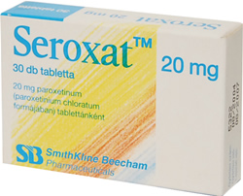
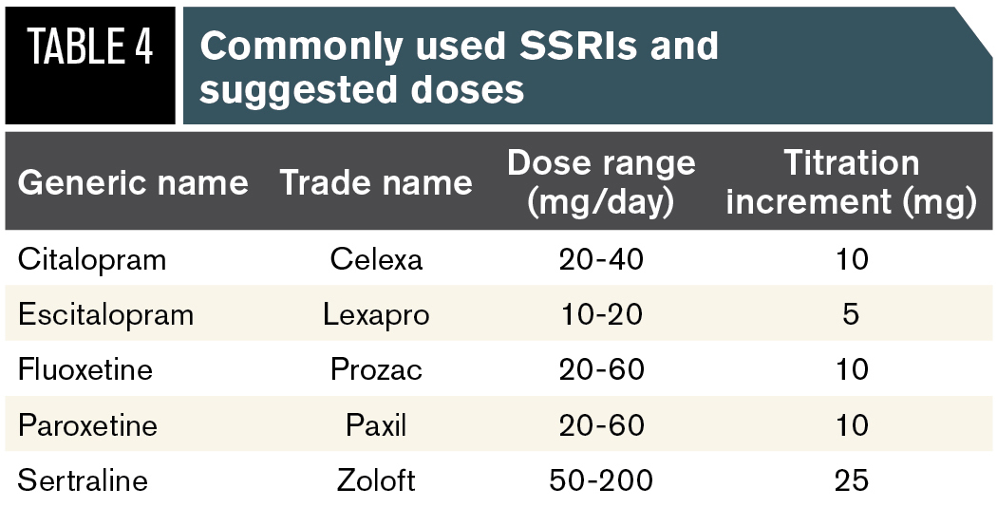
ssri
Uses:
Depressive disorders.
Anxiety
phobia
panic disorders.
Obsessive compulsive disorder.
Premature ejaculation.
S/E
• Headache
• Nausea
• Stomach ache
• Decrease libido
• Wight gain
• Sedation

Slide 26
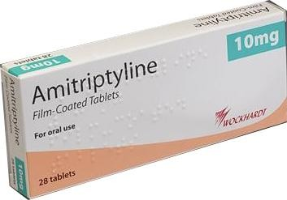
tca
Uses:
Depressive disorders.
Anxiety.
Obsessive compulsive disorder.
Tricyclics are dangerous in overdose and should be avoided with suicidal patients.
S/E
Headache
Nausea / vomiting
Dry mouth
Constipation
Cardiac problems
Decrease libido
sedation

Slide 27
When to refer ?
If patient have severe symptoms which need admission If patient had suicidal ideation If patient need electroconclusive therapy (ECT) If there predominant psychomotor disturbance or mixed psychatric disorders If no good response after four weeks. | REFERRAL

Slide 28
3-postpartum major depression
A major depression episode associated with childbirth . Affects one in ten child bearing women.
Onset can begin 24 hours to several months after delivery
Management by group therapy or pharmacological therapy ( SSRI, TCA)

Slide 29
ANXIETY

Slide 30
ANXIETY DISORDER
are abnormal states in which the most striking features are worry , fear. physical symptoms of anxiety that indicate a hyperactive autonomic nervous system and not caused by organic brain disease , medical illness nor Psychiatric disorder.
an abnormal and overwhelming sense of apprehension and fear often marked by physiological signs, by doubt concerning the reality and nature of the threat, and by self-doubt about one’s capacity to cope with it.

Slide 31
PREVALENCE
Anxiety disorders are the most common mental illness in the U.S., affecting 40 million adults in the United States age 18 and older, or 18% of the population
Studies in Saudi Arabia have revealed low detection rates for mental disorders. In the city of Al- Khobar, 22% of health clinic patients had mental disorders such as depression and anxiety, however only 8% were diagnosed.
Notes:
It's not uncommon for someone with an anxiety disorder to also suffer from depression or vice versa. Nearly one-half of those diagnosed with depression are also diagnosed with an anxiety disorder.

Slide 32
study was conducted to estimate the prevalence of mental health problems among Saudi university students in Saudi Arabia (N=1692)
Study result: generalized anxiety disorder was reported in 14% of the Saudi students.

Slide 33
Etiology of Anxiety
Many factors can cause anxiety, including mental conditions as well as external factors like personal finances or marital problems.
Anxiety may be caused by a physical condition, the effects of drugs, or a combination of these.

Slide 34
TYPES OF ANXIETY DISORDERS:
Generalized Anxiety Disorder (GAD)
Panic Disorder.
Social anxiety disorder
Specific phobias

Slide 35
GENERALIZED ANXIETY DISORDER (GAD)
excessive worry that is difficult to control by patient cause functional impairment and or psychological distress for more than 6 months.

Slide 36
DIAGNOSTIC CRITERIA
3 out of 6 criteria must be met (1 for a child)
(1) restlessness or feeling keyed up or on edge (2) being easily fatigued (3) difficulty concentrating or mind going blank (4) irritability (5) muscle tension (6) sleep disturbance (difficulty falling or staying asleep, or restless unsatisfying sleep)

Slide 37
PANIC DISORDER.
Recurrent unexpected panic attacks, with fear of additional ones occurring.
PANIC ATTACK:
A panic attack is a sudden, intense fear or anxiety that may make you short of breath or dizzy or make your heart pound. You may feel out of control.

Slide 38
SYMPTOMS
Palpitation
Tachycardia
chest discomfort
shortness of breath
Nausea - choking sensation
Trembling
sweating
fear of losing control or death

Slide 39
SOCIAL ANXIETY DISORDER
also called social phobia, is an anxiety disorder in which a person has an excessive and unreasonable fear of social situations. Anxiety (intense nervousness) arise from a fear of being closely watched, judged, and criticized by others.

Slide 40
Many people with social anxiety disorder feel that there is "something wrong" but don't recognize their feeling as a sign of illness.
Symptoms Of Social Anxiety Disorder Can Include:
Intense anxiety in social situations.
Avoidance of social situations.
Physical symptoms of anxiety, including confusion, pounding heart, sweating, shaking, blushing, muscle tension, upset stomach, and diarrhea.

Slide 41
MANAGEMENT
An important part of any intervention in patient with an anxiety disorder is education.
Rule out medical causes.

Slide 42
In general, anxiety disorders are treated with Cognitive-Behavior Therapy (CBT), medication or both.
Treatment choices depend on the problem and the person’s preference.

Slide 43
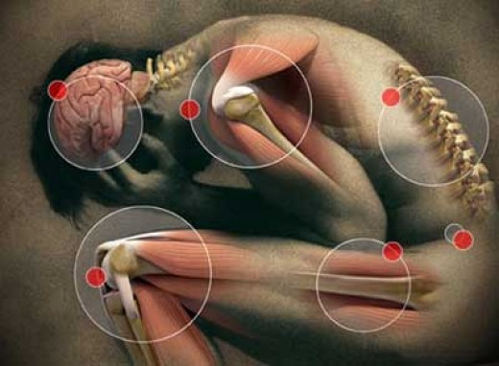
Somatoform disorder

Slide 44
Definition
The somatoform disorders are a group of psychiatric disorders that cause unexplained physical symptoms.

Slide 45
Prevalence
A study was conducted in a primary health care in Saudi Arabia to assess the prevalence of somatization disorder. The sample size was 224, About half of the sample had one or more psychological disorders. The prevalence of somatization was 16%.
Women displayed higher levels of somatization than men

Slide 46
ETIOLOGY
Genetic
History of physical or sexual abuse
Environmental

Slide 47
RISK FACTORS
History of sexual/physical abuse (>in childhood) 50-75%
History of unstable childhood
History of trauma-related disorders
Female gender (75%)

Slide 48
CLINICAL PRESENTATION
Pain symptoms
1- headache.
2- back pain
3- dysuria
4- joint pain
5- diffuse pain

Slide 49
CLINICAL PRESENTATION
Gastrointestinal symptoms
1- nausea.
2- vomiting
3- abdominal pain
4- bloating
5- gas
6- diarrhea

Slide 50
CLINICAL PRESENTATION
Cardiopulmonary symptoms
1-chest pain.
2-Dizziness.
3-shortness of breath.
4-palpitations.
Neurologic symptoms and Reproductive symptoms

Slide 51
Types of Somatoform Disorders
Somatization Disorder
Undifferentiated Somatoform Disorder
Conversion Disorder
Pain Disorder
Hypochondriasis

Slide 52
Diagnosis
The DSM establishes the following five criteria for the diagnosis of this disorder :
a history of somatic symptoms prior to the age of 30
pain in at least four different sites on the body
two gastrointestinal problems
one sexual symptom .
one pseudoneurological symptom

Slide 53
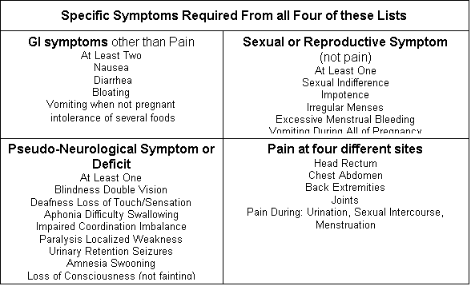

Slide 54
DIFFERENTIAL DIAGNOSES
Depression (+somatoform complaints)
Panic/Anxiety disorder
Factitious/Malingering
Substance use
Non-psychiatric medical conditions
Syndromes of unclear etiology
Other somatoform disorders

Slide 55
Management
strong physician-patient relationship is CRUICIAL to managing somatoform disorders.
Stress reduction is often an important part of getting better
Counseling for family and friends may also be useful.

Slide 56
Management
Cognitive Behavioral Therapy
which focuses on helping people identify and change errors in their thinking
Cognitive Behavioral Therapy one of the most effective types of therapy for these disorders.

Slide 57
Management
Do | AVOID
Allow patient role Concentrate on functions Frequent, short visits Single doctor Group therapy May individual Tx Drug treatment for psych co-morbidity. SSRIs, high doses for Hypochondraisis and BDD | Concentrating on Symptoms. Say (It’s just in your mind, take it easy..) Tests or Rx without Dx Unnecessary Referrals / consults.

Slide 58
Counseling
counseling helps people to solve stressful problems by decision making.
helping the patient to choose decision among alternative courses of actions

Slide 59
Psychotherapy
is a therapy used to treat people with a mental disorder by teaching them strategies and giving them tools to deal with stress and unhealthy thoughts and behaviors.

Slide 60
Psychotherapy
Cognitive Behavioral Therapy (CBT): is one of psychotherapy types and it aims to change a person's thinking to be more adaptive and healthy. Behavioral therapy focuses on a person's actions and aims to change unhealthy behavior patterns.
Cognitive behavioral therapy can be applied to treat many mental disorders such as:
Depression.
Anxiety disorder.
Somatiform disorder.

Slide 61
When to refer a patient to a psychiatrist?
Suicidality
Psychotic symptoms
Diagnostic questions
Developmental problems (children/adolescents)
Management review
Psychopharmacology assessment/advice
Substance abuse/addiction
Signs of dementia
Sleep problems
Sexual dysfunction
Abnormal bereavement
Family dysfunction

Slide 62
MCQ
Q1- prevalence of psychiatric illness in primary care in Saudi Arabia is :
A-50%
B-18%
C- 30%

Slide 63
MCQ
Q2- A 29-year-old woman has been suffering lack of enjoyment, low self-esteem, insomnia, poor concentration, and fatigue for more than 3 years. She has no medical diseases.
The most likely diagnosis is;
A- Major Depressive disorder
B- Bipolar II mood disorder.
C- Bipolar I mood disorder.
D- Cyclothymic disorder.
E- Dysthymic disorder.

Slide 64
MCQ
Q3- Major depression disorder diagnistic criteria :
A-Chronic mild low mood or loss of interest for at least 2 years.
B- Onset can begin 24 hours to several months after delivery
C- Characterized by one or more episodes of low mood or loss of interest for at least two weeks

Slide 65
MCQ
Q4- the treatment of somatoform disorders based on ?
A- medications
B-Cognitive Behavioral Therapy
C- there is no need to treat the patients

Slide 66
MCQ
Q5- In order to diagnose General Anxiety Disorder (GAD), the symptoms of anxiety and excessive worrying must be present of at least:
A- Month
B- 3 Months
C- 6 Months
D- 1 Year

Slide 67
REFERENCES
http://bestpractice.bmj.com/best-practice/monograph/805/diagnosis/criteria.html
American Psychiatric Association. Task Force on DSM-IV (2000). Diagnostic and statistical manual of mental disorders: DSM-IV-TR. American Psychiatric Pub. p. 485.
Prevalence of mental illness among Saudi adult primary-care patients in Central Saudi Arabia Abdallah D. Al-Khathami, MBBS, ABFM, Danny O. Ogbeide, FWACP, FRCGPSaudi Med J 2002; Vol. 23 (6) www.smj.org.sa
National Institute For Health And Clinical Excellence www.nice.org.uk/nicemedia/live/13476/59320/59320.pdf
The WHO Mental Health Policy & Service Development Guidance Package.
http://www.aafp.org/afp/1998/1101/p1617.html
http://www.bmjbestpractice.com/depression
Donna, BG. (last updated Jan 16, 2014). Somatization: Treatment and Prognosis. http://www.uptodate.com/contents/somatization-treatment-and-prognosis

