Slide 1
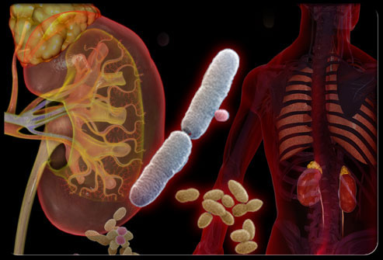
Approach to patient with UTI
Hossam Khalid Alsahabi
Waleed Khalid AL Shammari
Mazen Ayidh Alotaibi

Slide 2
Objectives
Types of UTI (Cystitis, Pyelonephritis)
Causes
Common organisms
How patient presents
VesicoUreteral Reflux in children
Asymptomatic Pyuria in pregnancy
Diagnosis
When to start full investigations
When to refer to specialist
Management
Prophylaxis
Education

Slide 3
Question 1
What is the most common organism causing UTI?
proteus mirabilis
E.coli
Klibsiella pneumoniae
Pseudomonas aeruginosa
Notes:
2

Slide 4
Question 2
Which of the following is considered as a risk factor for complicated UTI?
High grade fever
Severe flank pain
Urinary tract obstruction
Female gender
Notes:
3

Slide 5
Question 3
Which one of the following is considered contraindicated in pregnant woman?
Penicillin
Cephalexin
Fosfomycin
Fluoroquinolone
Notes:
4

Slide 6
Question 4
How to differentiate between cystitis and pyelonephritis in urinalysis?
Nitrite
WBC Casts
RBC
WBC
Notes:
2

Slide 7
What is UTI definition ?
Urinary tract infections happen when bacteria get into the urethra and travel up into the bladder.
If the infection in the urethra, it is called a urethral infection or ”urethritis .”
If the infection stays just in the bladder, it is a called a bladder infection, or "cystitis."
If the infection travels up past the bladder and into the kidneys, it is called a kidney infection or "pyelonephritis.”
UTI occur more commonly in women than men, with half of women having at least one infection at some point in their lives .

Slide 8
Types
Location
Lower | Upper
Cystitis Urethritis Prostatitis | Pyelonephritis Abscess (Intrarenal & Perinephric)
Symptoms
Symptomatic | Asymptomatic
Recurrence
Sporadic < 1 UTI / 6 m | Recurrent ≥ 1 UTI / 6m
Complication Factors
Complicated | Uncomplicated
Infection in a urinary tract with functional or structural abnormalities. | Infection in a structurally and neurologically normal urinary tract.

Slide 9
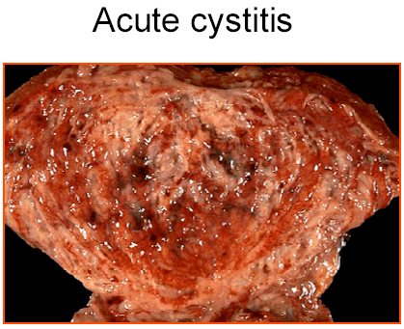
Cystitis
It can caused by :
Infection (which is usually happens )
Damage or irritation of the bladder (During sex)
Women > Men (why?)
Women tend to get them more often because their urethra is shorter and closer to the anus than in men.
It can be more serious in men because it could be caused by:
An underlying bladder or prostate infection, such as prostatitis.
An obstruction in the urinary tract, such as a tumour, or an enlarged prostate.

Slide 10
Causes of Cystitis
Usually caused by bacterial infection such as :
E.Coli (most common G-ve)
How its getting inside the Urinary system :
Sex ( especially in young sexually active women it cause 75-90%)
Urinary catheter .
Poor hygiene is a common cause
Diabetes ( Sugary urine encourage the bacteria to grow up )
Postmenopausal women ( lower hormones lead to lowering the defense of urethra )
Kidney stones or Bladder stones .

Slide 11
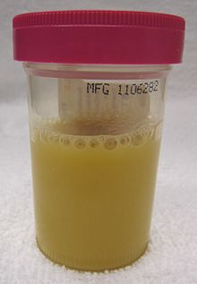
Presentation of cystitis patient
It takes several hours to a day .
Common Symptoms include :
Dysuria ( Burning urination )
Frequent and Urgent need to urinate.
Pain in lower abdomen or lower back.
Pain during sexual intercourse
Cloudy, dark or strong smelling urine
blood in urine (Haematuria )
Low grade fever

Slide 12
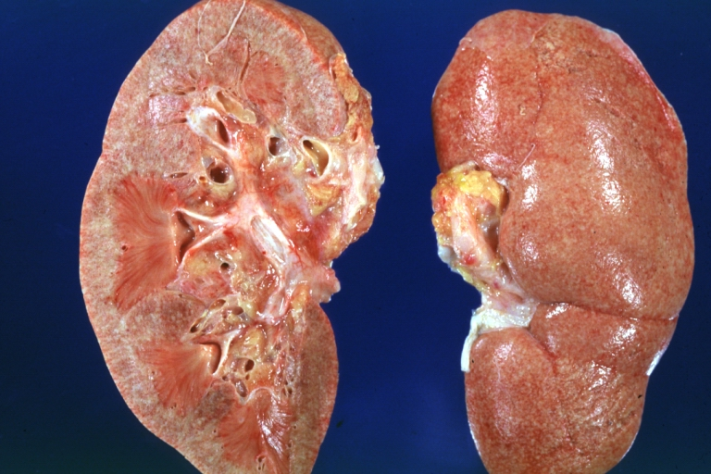
Pyelonephritis
potentially organ or life-threatening infection that often leads to renal scarring.
Its ascending from the lower part of urinary system
Reach the pelvic of the kidney
It cant reach the kidney by bloodstream .
Its more common after a catheterization less than a month .
The faster diagnosed and managed the better prognosis .

Slide 13
Causes
E.Coli the most common organism as cystitis.
Its carried by the bloodstream
Presentation
Vary from one and another depending on the age and the gender :
Same as Cystitis symptoms ±
Chills and fever .
Nausea/Vomiting, diarrhea, tachycardia.
Urine microscopy: Pyuria + WBC casts, bacteria and Hematuria
Leucocytosis.
Costo-vertebral (renal) angle Tenderness or deep abdominal tenderness .

Slide 14
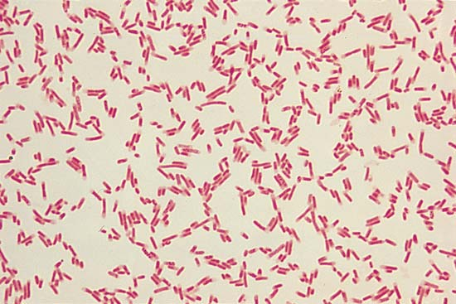
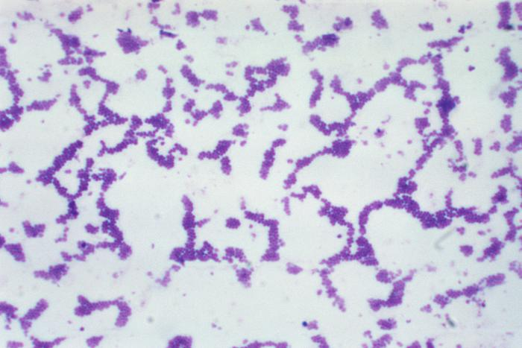
Most Common Organisms
Gram -ve | Gram +ve
E.Coli (Most Common) | Enterococci
Proteus mirabilis | Group B streptococci
Klebsiella spp | Staphylococcus aureus
E.Coli
Staph.Aureus

Slide 15
Source:
Ascending (commonest)
Hematogenous (TB, perinephric abscess)
Lymphatic
Direct (IBD fistulas)

Slide 16
Predisposing Factors:
Stasis and obstruction
posterior urethral valves
Reflux
drugs (anticholinergics)
Decreased resistance
diabetes mellitus
malignancy
immunosuppression
Other factors
trauma
anatomic variance (congenital)
Foreign body
catheter
stone
Instrumentation

Slide 17
History:
irritative symptoms (fund)
obstructive symptoms (wise)
previous UTIs
renal calculi
sexual activity
personal hygiene
Hematuria
pain
tenderness
costovertebral
abdominal
Rectal
+/– fever, chills, nausea, vomiting
sepsis/shock
Notes:
irritative symptoms (FUND)
obstructive symptoms (wise)

Slide 18
Vesicoureteral Reflux in children
a condition in which urine flows from the bladder, back towards or into the upper urinary tract.
The refluxing urine increases the pressure within the kidneys and may contain bacteria that can lead to infection. Long term increased pressure and repeated infections can lead to kidney dysplasia.

Slide 19
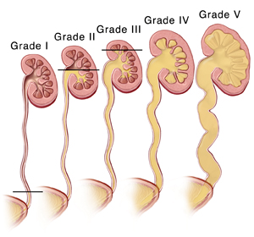
The study to rule out reflux is MCUG and it is also used for grading:
Notes:
Micturating cystourethrogram
Normal: contrast in bladder
Vesicoureteral reflux is graded 1 – 5, with 1 being the mildest and 5 being the most severe:
o Grade I: confined to ureter, contrast is in the distal part of the ureter
o Grade II: contrast reaches the kidney but there is no dilation
o Grade III: Mild dilation of the renal pelvis and ureter without loss of calyces
o Grade IV: moderate dilation but there is loss of calyces
o Grade V: severe dilation and tortuous dilated ureter”
mkn

Slide 20
VUR occurs in approximately 1/100 children. The majority of children with the condition will not require any treatment and will grow out of the condition in childhood; however a small number will require surgery to correct the condition.

Slide 21
As with the history, few findings on physical examination suggest VUR or UTI. Fever, flank or abdominal tenderness, or an enlarged palpable kidney may be present.
The standard imaging tests include renal and bladder (US) and (VCUG).

Slide 22
Signs and symptoms
Vesicoureteral reflux in itself does not produce any symptoms. These occur when infection of the urinary tract is present. Other symptoms commonly experienced include:
Bedwetting (nocturnal enuresis).
Lower abdominal pain.
Hematuria and/or Pyuria (pus in the urine).

Slide 23
Children and VUR
Prophylactic low dose ABX
Indications for Surgical correction :
Poor compliance with medical ragmen
breakthrough infection despite antibiotic prophylaxis
Progressive renal scarring
Sever reflux (Grade IV or V) FIRST manage the new-borns medically until they be old enough for surgery.

Slide 24
Asymptomatic Bacteriuria in Pregnant Women
Occurs in 2% to 7% of pregnancies.
More than 80% of cases the infecting organism E.coli.
ABU in pregnancy is significant because 20-30% of untreated cases progress to acute pyelonephritis.
Notes:
cefotaxime & Ceftriaxone

Slide 25
Cont.
Treatment of ABU in pregnancy consists of oral antibiotics for 14 days. One of the following agents may be used:
Ampicillin & cephalosporins are generally safe and effective during any phase of pregnancy
Treatment of ABU in pregnancy reduces the frequency of acute pyelonephritis to 2-3%.
Notes:
cefotaxime & Ceftriaxone

Slide 26
Diagnosis
Notes:
http://www.ncbi.nlm.nih.gov/pmc/articles/PMC2894375/
The aim is to obtain a sample (specimen) of urine from the middle of your bladder

Slide 27
In straightforward cases, a diagnosis may be made and treatment given based on symptoms alone without further laboratory confirmation

Slide 28
Investigations
midstream urine M, C&S (routine)
urine cytology (if indicated)
IVP/ultrasound (if indicated)
cystoscopy (if indicated)
spiral CT (if indicated)
voiding cystourethrogram (VCUG) if recurrent and/or hydronephrosis

Slide 29
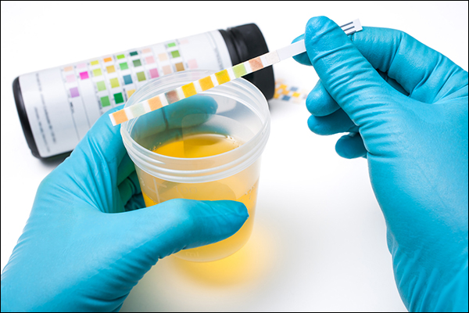
Dipstick Urinalysis (Midstream urine)
- Leukocyte esterase, nitrates, protein, and blood are the important features in evaluating for UTI.
- A highly alkaline PH > 8 suggests infection
Notes:
Nitrates in the urine are converted to nitrites in the presence of Gram-negative bacteria such as E.coli and Klebsiella

Slide 30
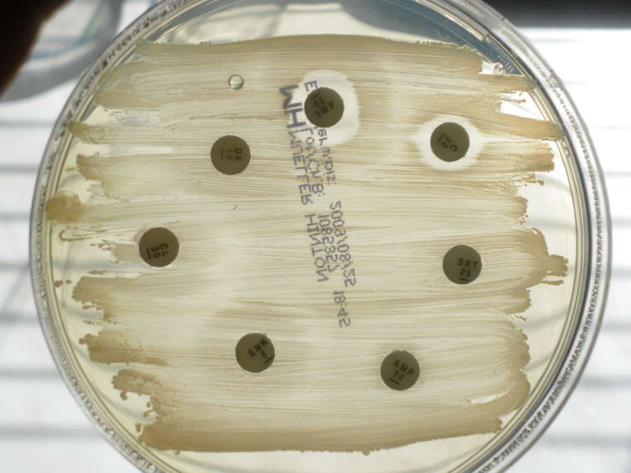
urine culture (Midstream urine)
Urine in the bladder normally is sterile
If the urine culture is positive
Sensitivity analysis, helps find the right antibiotic to kill an infecting microorganism. This test determines the “sensitivity” of a colony of bacteria to an antibiotic
Notes:
http://www.ncbi.nlm.nih.gov/pmc/articles/PMC2894375/
The aim is to obtain a sample (specimen) of urine from the middle of your bladder
lithotomy position

Slide 31
Microscopy Urinalysis
- Looks for the presence of red blood cells, white blood cells, or bacteria.
When coupled with classic symptoms, a finding of 2-5 WBCs or ≥ 15 bacteria per hpf in a centrifuged urine sediment is consistent with UTI.
The presence of many epithelial cells usually indicates a contaminated specimen.

Slide 32
The presence of ≥ 10⁵ CFU/mL of bacteria is the traditional diagnostic indicator for UTI.
However, in the presence of dysuria and other symptoms for UTI, 10² CFU/mL confirms the diagnosis.

Slide 33
When to start full investigations

Slide 34
Imaging and urologic intervention should be considered in the following patients:
1- Patients with a history of kidney stones .
2- Patients with diabetes.
3- Patients with polycystic kidneys are prone to abscess formation.
4- Patients with tuberculosis Have persistently not responded to treatment.
5- Patients have a history of renal tract disease or anomaly.
6- Patients have hematuria.
7- Patients are women with more than three confirmed infections in the preceding year (two confirmed infections in the case of men) with no known contributing comorbidity
Notes:
http://www.ncbi.nlm.nih.gov/pmc/articles/PMC3202002/

Slide 35
Imaging in the emergency department is typically not necessary unless concomitant obstructive uropathy is suspected, as this is an emergent condition that requires prompt intervention.
Modalities for this include ultrasonography, intravenous pyelography (IVP), contrasted (CT) scanning, or helical CT scanning of the urinary system.

Slide 36
When to refer to specialist

Slide 37
Referral for assessment should be considered for men who have : - Symptoms of upper urinary tract infection (pyelonephritis). - Failure to respond to appropriate antibiotic therapy. - Frequent episodes of urinary tract infection (UTI) - this is stated as two or more episodes in a 3-month period. - Features of urinary obstruction (e.g. in older men, enlarged prostate). - History of pyelonephritis, calculi, or previous genitourinary tract surgery.
Notes:
http://www.gpnotebook.co.uk/simplepage.cfm?ID=x20090320120038480651

Slide 38
Urgent referral is indicated for men with suspected cancer : - Any age with painless macroscopic haematuria (If haematuria is associated with symptoms of UTI, or If UTI is not confirmed by urine culture, or if haematuria does not resolve with treatment of the UTI refer urgently. - Recurrent or persistent UTI associated with haematuria, in a male aged 40 years or older. - Unexplained microscopic haematuria, in a male aged 50 years or older. - With an abdominal mass identified clinically or on imaging that is thought to arise from the urinary tract.
Notes:
http://www.gpnotebook.co.uk/simplepage.cfm?ID=x20090320120038480651

Slide 39
referral criteria from primary care - recurrent UTI in woman : routine referral is recommended for women with recurrent UTIs : who have a risk factor for an abnormality of the urinary tract including women with: - Past history of urinary tract surgery or trauma - Past history of bladder or renal calculi - Obstructive symptoms such as straining, hesitancy, poor stream - Urea splitting bacteria on culture of the urine such as Proteus or Yersinia - Persistent bacteriuria despite appropriate antibiotic treatment - Past history of abdominal or pelvic malignancy - Symptoms of a fistula such as pneumaturia Urgent referral is recommended for women with recurrent urinary tract infections (UTIs) associated with haematuria (visible or non-visible) for investigations to exclude urological cancer
Notes:
http://www.gpnotebook.co.uk/simplepage.cfm?ID=x20140415114622216972

Slide 40
Management of Cystitis
Women | Men
3-5 days | 7 – 14 days | Course
- Trimethoprim-sulfamethoxazole - Nitrofurantoin - B-lactams( Augmentin) | - Trimethoprim-sulfamethoxazole - fluoroquinolones | Antibiotics
To alleviate burning pain during urination, phenazopyridine (Pyridium) or a similar drug, can be used in addition to antibiotics for one to two days.
Notes:
https://www.nlm.nih.gov/medlineplus/ency/article/000521.htm
http://patient.info/health/cystitis-urine-infection-in-women

Slide 41
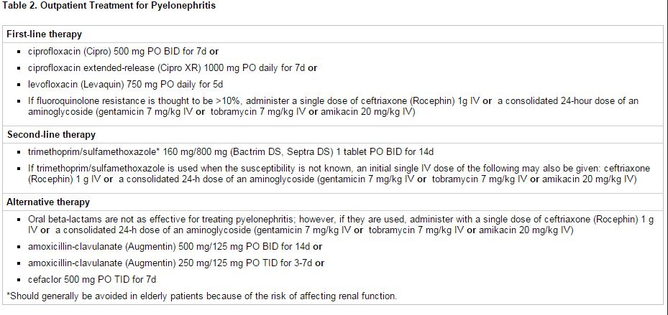
Management of Pyelonephritis
Notes:
http://emedicine.medscape.com/article/245559-treatment#d11

Slide 42
Management of Pyelonephritis
Notes:
http://emedicine.medscape.com/article/245559-treatment#d11

Slide 43
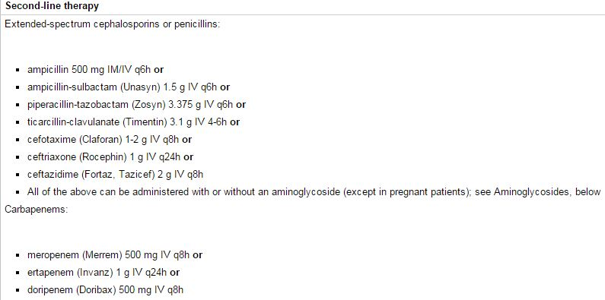
Management of Pyelonephritis
Notes:
http://emedicine.medscape.com/article/245559-treatment#d11

Slide 44
Prophylaxis “when and what to give”
Antimicrobial prophylaxis : Antimicrobial prophylaxis has been demonstrated to be highly effective in reducing the risk of recurrent UTI in women. Prophylaxis has been advocated for women who experience two or more symptomatic UTIs within six months or three or more over 12 months
Notes:
http://www.uptodate.com/contents/recurrent-urinary-tract-infection-in-women?source=search_result&search=prophylaxis+for+urinary+tract+infection&selectedTitle=1~150#H17

Slide 45
1- Continuous prophylaxis : Numerous studies have demonstrated that continuous prophylaxis decreases recurrences by up to 95 percent compared with placebo or with patients' prior experience
Notes:
http://www.uptodate.com/contents/recurrent-urinary-tract-infection-in-women?source=search_result&search=prophylaxis+for+urinary+tract+infection&selectedTitle=1~150#H17

Slide 46
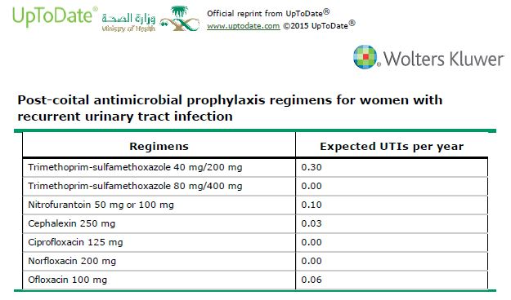
2- Postcoital prophylaxis : (a single postcoital dose) may be a more efficient and acceptable method of prevention than continuous prophylaxis in women whose UTIs appear to be temporally related to sexual intercourse. Depending upon the frequency of intercourse, postcoital prophylaxis usually results in receipt of smaller amounts of antimicrobials than continuous prophylaxis
Notes:
http://www.uptodate.com/contents/recurrent-urinary-tract-infection-in-women?source=search_result&search=prophylaxis+for+urinary+tract+infection&selectedTitle=1~150#H17

Slide 47
Education
You can take these steps to reduce your risk of urinary tract infections:
Drink plenty of liquids, especially water. Drinking water helps dilute your urine and ensures that you'll urinate more frequently — allowing bacteria to be flushed from your urinary tract before an infection can begin.
Drink cranberry juice. Although studies are not conclusive that cranberry juice prevents UTIs, it is likely not harmful.
Wipe from front to back. Doing so after urinating and after a bowel movement helps prevent bacteria in the anal region from spreading to the vagina and urethra.
Empty your bladder soon after intercourse. Also, drink a full glass of water to help flush bacteria.
Avoid potentially irritating feminine products. Using deodorant sprays or other feminine products, such as douches and powders, in the genital area can irritate the urethra.
Change your birth control method. Diaphragms, or spermicide-treated condoms, can all contribute to bacterial growth.
Notes:
http://www.mayoclinic.org/diseases-conditions/urinary-tract-infection/basics/prevention/con-20037892

Slide 48
A 32-year-old man came to the clinic because of burning on urination with increased frequency and urgency to urinate dysuria, For the last 7 days, with normal body temperature.
Case 1

Slide 49
What is your diagnosis?
Notes:
Acute cystitis

Slide 50
Which investigation you have to request?
- Urinalysis
- Urine culture is important when diagnosis is not clear or UTI is recurrent
- Sonogram and CT to know the cause
(for who do not respond to appropriate antimicrobial therapy, to rule out complications and other disorders)

Slide 51
A 25 year young man came to the x-ray department for ultrasound exam Complaints: - rapid onset of high fever - painful mass right flank
Case 2

Slide 52
What is your diagnosis?
Notes:
Acute pyelonephritis with severe perinephric inflammation

Slide 53
Which investigation you have to request?

Slide 54
Ultrasound findings…..
Enlarged right kidney with dilated pelvis with no hydrocalyx
Indistinct hypoechoic inferior pole

Slide 55
U/S finding contd…..
Huge heterogenous hyperechoic
perinephric mass lesion all over
involving inferior pole too
Bulky right psoas muscle

Slide 56
What is the management?

Slide 57
Question 1
What is the most common organism causing UTI?
proteus mirabilis
E.coli
Klibsiella pneumoniae
Pseudomonas aeruginosa

Slide 58
Question 2
Which of the following is considered as a risk factor for complicated UTI?
High grade fever
Severe flank pain
Urinary tract obstruction
Female gender

Slide 59
Question 3
Which one of the following is considered contraindicated in pregnant woman?
Penicillin
Cephalexin
Fosfomycin
Fluoroquinolone
Notes:
4

Slide 60
Question 4
How to differentiate between cystitis and pyelonephritis in urinalysis?
Nitrite
WBC Casts
RBC
WBC

Slide 61
Questions ??

Slide 62
Thank you

Slide 63
references
http://www.ncbi.nlm.nih.gov/pmc/articles/PMC2894375/
http://www.ncbi.nlm.nih.gov/pmc/articles/PMC2894375/
Acute bacterial pyelonephritis Dr Yuranga Weerakkody and Dr Frank Gaillard et al Radiopaedia.org
http://emedicine.medscape.com/article/245559-treatment#d11
https://www.nlm.nih.gov/medlineplus/ency/article/000521.htm
http://patient.info/health/cystitis-urine-infection-in-women
http://www.mayoclinic.org/diseases-conditions/urinary-tract-infection/basics/prevention/con-20037892
http://www.uptodate.com/contents/recurrent-urinary-tract-infection-in-women?source=search_result&search=prophylaxis+for+urinary+tract+infection&selectedTitle=1~150#H17
http://emedicine.medscape.com/article/245559-treatment#d11
http://www.gpnotebook.co.uk/simplepage.cfm?ID=x20140415114622216972
http://www.gpnotebook.co.uk/simplepage.cfm?ID=x20090320120038480651
http://www.ncbi.nlm.nih.gov/pmc/articles/PMC3202002/

