Slide 1
Approach to patient with Arthritis
Done by:-
Turki Alotaibi
Waleed AlTaliqi
Abdullah Alkhamri
Supervised by:-
Prof. Mohammed Al-Rukban

Slide 2
Objectives
Common causes of arthritis encountered in general practice.
What does it mean by arthropathy and arthritis.
Highlight on osteoarthritis, Septic arthritis, Gout, Rheumatoid arthritis.
Important aspects in History, Clinical examination, Investigations and Management.
Red Flags for patient with arthritis.
When to refer to specialty clinic.

Slide 3
MCQ
RA is characterized by which of the following patterns of joint involvement?
a) Episodic monoarthritis
b) Symmetrical polyarthritis
c) Migratory oligoarthritis
d) Spondylitis
Notes:
B

Slide 4
MCQ
The most specific test used in diagnosis of gout:
a) MRI
b) x-ray
c) synovial fluid analysis
d) serum uric acid
Notes:
C

Slide 5
MCQ
The most common offending organism in septic arthritis in adults is:
a) S. aureus
b) Streptococcus pyogenes
c) S. pneumoniae
d) H. influenzae
Notes:
A

Slide 6
MCQ
Which one of the following is a characteristic x-ray finding in case of osteoarthritis ?
a) chondrocalcinosis
b) osteopenia
c) Narrowing of joint space
d) sequestra
Notes:
C

Slide 7
Case
Roqaya 42 yo female, saudi book keeper gradually developed painful wrists over 3 months; she consulted the doctor only when the pain and early morning stiffness stopped her from work.
Medical history:-
roqaya’s medical history is unremarkable. Her current medications are iron ,Vitamin D and calcium supplement.

Slide 8
Case
Physical examination:-
On examination, both wrists and the metacarpophalangeal joints of both hands were swollen and tender but not deformed. There were no nodules or vasculitic lesions
Investigation:-
On investigation, she was found to have a raised C-reactive protein (CRP) level (27mg/l) (NR <10) but a normal haemoglobin and white-cell count. A latex test for rheumatoid factor was negative and antinuclear antibodies were not detected.

Slide 9
Case
Six months after initial presentation, she developed two subcutaneous nodules on the left elbow; these were small, painless, firm and immobile but not tender. A test for rheumatoid factor was now positive (titre 1/64). X-rays of the hands showed bony erosions in the metacarpal heads. She still had a raised CRP (43mg/l) but normal serum complement (C3 and C4) levels and, she had a biopsy, pannus would have been demonstrable histologically.
This woman now had definite X-ray evidence of rheumatoid arthritis and, in view of the continuing arthropathy, her treatment was changed to weekly low-dose methotrexate. This has controlled the arthritis for several years and no further erosions have developed.

Slide 10
Case:
A 54-year-old man complains of severe pain and swelling in his right first toe that developed overnight. He is limping because of the pain and states that this is the most severe pain he has ever had ('even covering my foot with the bed sheet hurts'). He has had no previous episodes.
Medical History:
His only medication is hydrochlorothiazide for hypertension,
He’s an alcoholic.

Slide 11
Case:
Physical Examination:-
There is swelling, erythema, warmth, and tenderness of the right first toe. There is also tenderness and warmth with mild swelling over the mid foot.
Investigation:-
Deposition of Crystals in synovial fluid among Aspiration.
Blood test result revealed Raised Creatine and uric acid.
X-ray showing aggressive erosions in PIP of the toe.

Slide 12
case:
the patient was treated with colchicine and NSAID’s to control the inflammation and pain.
And he was prescribed allopurinol as prophylaxis for controlling his blood uric acid levels.
Also he was advised to restrict alcohol intake and reduce meat consumption in his diet.
his diuretic was replaced due to it’s contribution to his condition.

Slide 13
Terminology
inflammation of the joints.
stiffness of joint.
Arthritis:
Ankylosis:
Arthrocentesis:
Arthroscope:
clinical procedure of using a syringe to collect synovial fluid from a joint capsule.
endoscope that's inserted into joint for visual examination.

Slide 14
Overview
NHIS 2010-2012 data analysis showed that 50 million US adults had reported doctor-diagnosed arthritis.
In 2007, CDC estimated that 294,000 U.S. children under age 18 have been diagnosed with arthritis or other rheumatic conditions .
A major cause of lost work time and serious disability for many people.
Its mainly a disease of adults, but it can also effect children.
Treatment of arthritis depends on its type and the main goal of treatment is to reduce the symptoms and improve the quality of life.

Slide 15
Causes
Injuries: Leading to degenerative arthritis
Abnormal metabolism : Gout
Inheritance: Osteoarthritis
Infection: Lyme disease
Over active immune system : RA and SLE

Slide 16
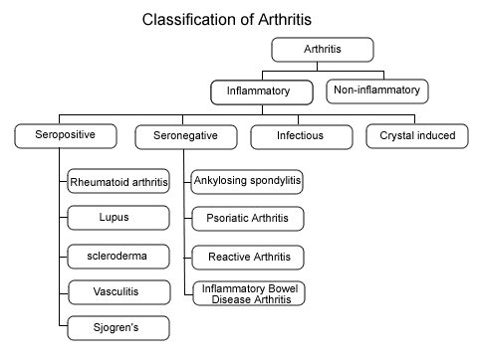

Slide 17
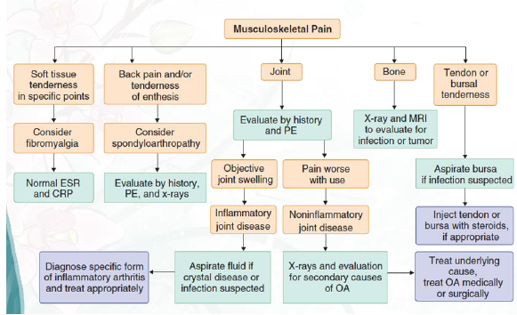
Diagnostic Approach to Musculoskeletal Pain

Slide 18
Important aspects in History
Duration of Complaints
Number of Joints Involved
Distribution of Joints Involved
Pattern of Involvement
Morning Stiffness

Slide 19
Important aspects in History
History of Joint Swelling.
Extra-articular Complaints.
Associated Medical Illness.
Significant Past History.
Family History of Rheumatic Disease.

Slide 20
Importance of Physical Examination
Local Warmth
Joint effusion
Redness
Range of Motion
Any Deformity

Slide 21
Symptoms
1.Pain
Inflammatory joint disease
present both at rest and with motion
worse at the beginning than at the end of usage.
Non-inflammatory
pain occurs mainly or only during motion and improves quickly with rest
Pain that arises from small peripheral joints
more accurately localized than pain arising from larger proximal joints.

Slide 22
Con.
2.Stiffness
sensation of tightness when attempting to move joints after a period of inactivity
subsides over time
Inflammatory arthritis
present upon waking
typically lasts 30-60 minutes or longer.
Non-inflammatory arthritis
experienced briefly (eg, 15 min) upon waking in the morning
following periods of inactivity.

Slide 23
Con.
3.Swelling
Inflammatory arthritis
synovial hypertrophy
synovial effusion
inflammation of periarticular structures
Non-inflammatory arthritis
formation of osteophytes
synovial cysts
Thickening
effusions

Slide 24
Con.
4.Limitation of motion
structural damage
Inflammation
contracture of surrounding soft tissues

Slide 25
Con.
5.Weakness
result of disuse atrophy
Weakness with pain
musculoskeletal cause (eg, arthritis, tendonitis)

Slide 26
Temporal pattern of arthritis
Abrupt onset
symptoms develop over minutes to hours
occur in trauma, crystalline synovitis, or infection.
Insidious pattern
symptoms develop over weeks to months
rheumatoid arthritis (RA) and osteoarthritis.

Slide 27
Duration of symptoms:
Acute <6 weeks in duration;
chronic is 6 or more weeks in duration.
Number of involved joints:
Monoarthritis - one joint.
Oligoarthritis - 2-4 joints.
Polyarthritis -5 or more joints.

Slide 28
Temporal Patterns in Polyarthritis
Migratory pattern
joints are sequentially affected where, as one joint settles, another becomes inflamed (e.g., acute rheumatic fever, disseminated gonococcal infection).
Intermittent pattern
the same joint is involved in different episodes of inflammation, but the joint is quiescent during intervening periods (e.g., gout).
Additive pattern
subsequent joints are involved while preceding ones are still inflamed (e.g. RA )

Slide 29
Distribution of affected joints
The DIP joints of the fingers
involved in psoriatic arthritis, gout, or osteoarthritis
spared in RA.
Joints of the lumbar spine
involved in ankylosing spondylitis
spared in RA.

Slide 30
Extra-articular manifestations
Constitutional symptoms
underlying systemic disorder.
include fatigue, fever, and weight loss.
Skin lesions
SLE, dermatomyositis, scleroderma, Lyme disease, psoriasis and Henoch-Schönlein purpura.
Ocular symptoms or signs
Episcleritis and Keratoconjunctivitis sicca -RA.
Anterior uveitis - ankylosing spondylitis,
Conjunctivitis -reactive arthritis

Slide 31
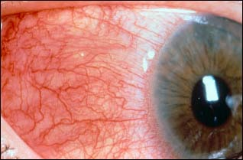
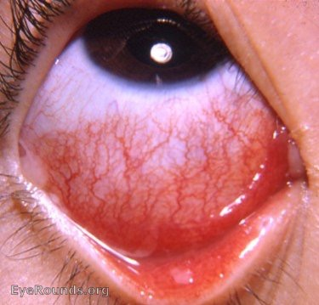
Ocular signs
Episcleritis and scleritis
Conjunctivitis

Slide 32
Signs of inflammatory joint disease
- Joint effusions
- Erythema and warmth
- Joint tenderness
- Bony overgrowth of the joints (osteophytes)
At the DIP joints - Heberden nodes.
At the PIP joints are called Bouchard nodes.
- Limited range of motion:
Crepitus during active or passive range of motion
Joint deformity

Slide 33
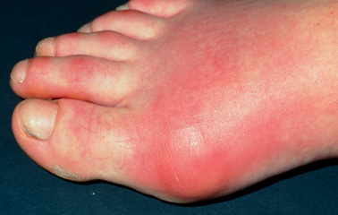
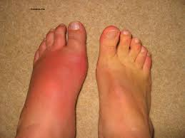

Slide 34
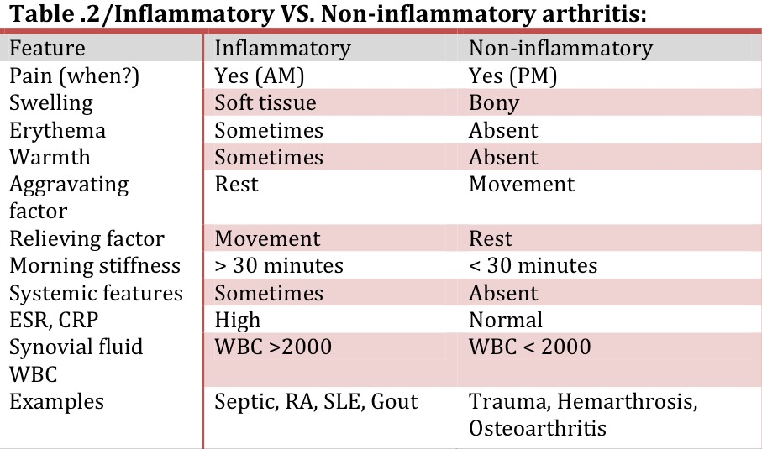

Slide 35
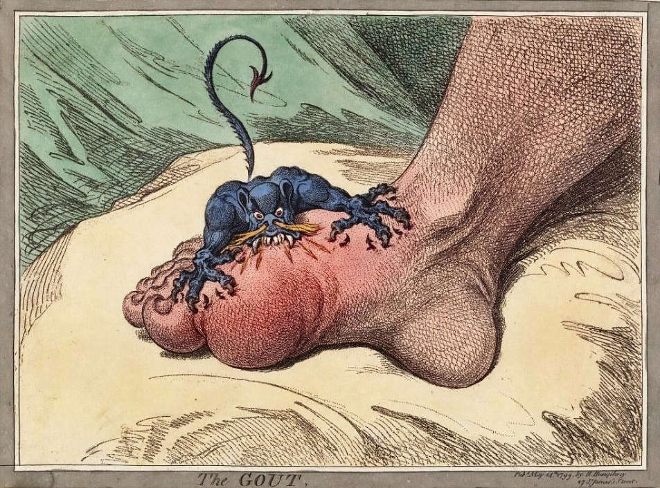

Slide 36
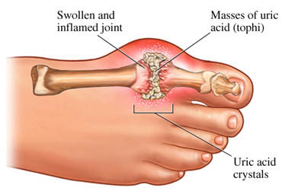
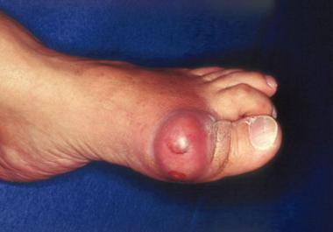
Highlight on Gout
Its an Intermittent attacks of acute joint pain due to deposition of uric acid crystals.
Usually affect men (10:1), rare in premenopausal female.
Most common joint affected is 1st MTP joint
Prevalence is approximately 20% in patients with a family history of gout.

Slide 37
Gout cont.
Causes:
Hyperuricemia is the most common cause and it could be because of:
1. Impaired excretion (90%):
renal disease, diuretics, NSAID use, and acidosis.
2. Increase production: like chemotherapy, chronic hemolysis, and blood cancers.
Risk factors:
Alcohol - Dehydration - Urate stones - Diuretics use

Slide 38
Types
Acute :
common in the late course of untreated gout
Chronic :
- Chronic tophaceous gout is characterized by collections of solid urate accompanied by chronic inflammatory and often destructive changes in the surrounding connective tissue
- often visible and/or palpable
- typically not painful or tender

Slide 39
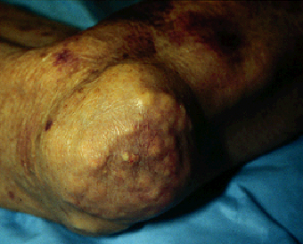
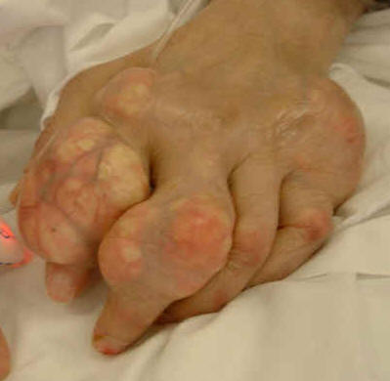
Chronic
Tophus of the knee
Acute
Large tophus and multiple superficial tophi of the knee in patient with chronic uncontrolled gout.
Doesn’t have tophi

Slide 40
Pathophysiology

Slide 41
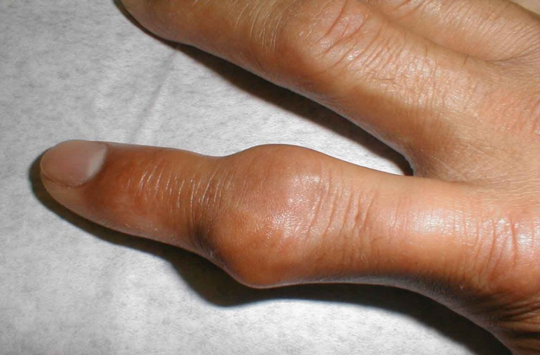
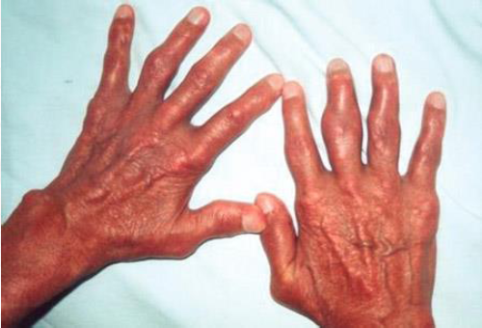
History
Mostly involve single joint.
Severe pain:
Often cannot wear socks.
Peak within 24 to 48 hours.
Swelling.
Redness.

Slide 42
Examination
ACUTE GOUT:
Fever
Mostly involve single joint.
Most commonly the first metatarsophalangeal joint "podagra".
Severe pain.
Erythema.
Cellulitis.
Chronic Gout:
Tophaceous gout. "deposits of monosodium urate crystals in soft tissue

Slide 43
Diagnosis
Blood: increase WBC, ESR and Urate
X-Ray: Next slide
synovial fluid or tophus aspiration with identification of:
light microscopy : needle shape crystal
compensated polarized light microscopy : positive birefringence with negative elongation

Slide 44
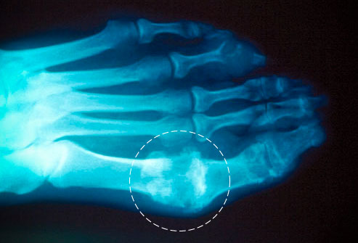
X-ray

Slide 45
Criteria Diagnosis from American college of Rheumatology (6 out of 12)

Slide 46
Management
Gout is managed in the following 3 stages:
Treating the acute attack
Providing prophylaxis to prevent acute flares
Lowering excess stores of urate to prevent flares of gouty arthritis and to prevent tissue deposition of urate crystals
Notes:
Short term: NSAID, ibuprofin, Colchicine.
Long tem: xanthine oxidase, Colchicine, pegloticase.

Slide 47
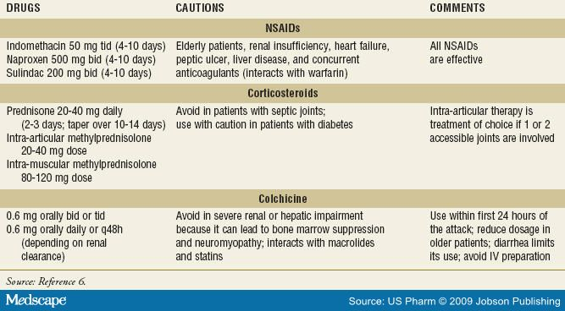
Pharmacological management of acute gout

Slide 48
Follow up the person 4–6 weeks after an acute attack of gout has resolved, and:
- Check the serum uric acid level.
- Measure their blood pressure and take blood for fasting glucose, renal function.
Consider the need to start prophylactic medication if the person is having two or more attacks of gout in a year.
Colchicine in low doses.
Daily NSAID’s.

Slide 49
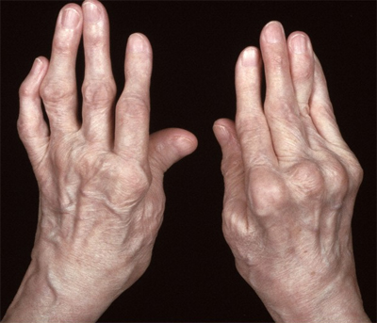
Rheumatoid Arthritis

Slide 50
Rheumatoid Arthritis
A chronic systemic disease primarily of the joints
In late stages, deformity and ankylosis develop.
- annual incidence of rheumatoid arthritis (RA) has been reported to be around 40 per 100,000.
female: male ration 3:1
Can present at any age—most common in middle age
Notes:
usually polyarticular, marked by inflammatory changes in the synovial membranes and articular structures and by atrophy and rarefaction of the bones.

Slide 51
Autoimmune disorder - Unknown etiology
Genetics – Environmental – Possible infectious component
Characterized by:
inflammation of the synovial capsule and hyperplasia (“swelling”)
autoantibody production (rheumatoid factor and Anti-cyclic citrullinated peptide[ACCP] antinucular antibodies[ANA]).
cartilage and bone destruction (“deformity”).
Systemic features, including :
cardiovascular, pulmonary, psychological, and skeletal disorders.

Slide 52
Notes:
Pannus = part of the thickned synovia that will invade the bony cartilage and bone (will show in x-ray)

Slide 53
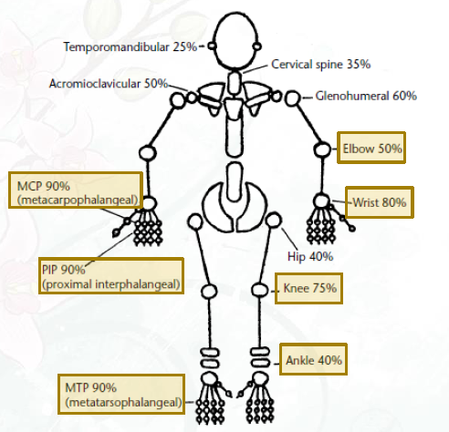

Slide 54
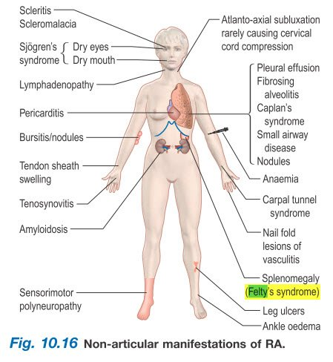
Extra-articular Manifistation

Slide 55
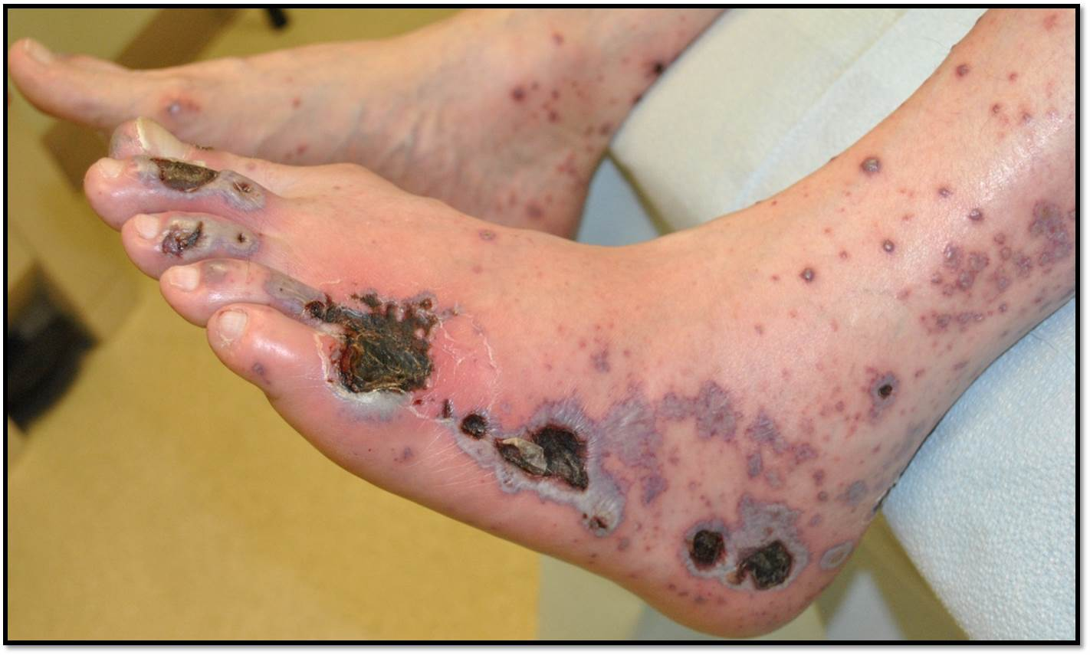
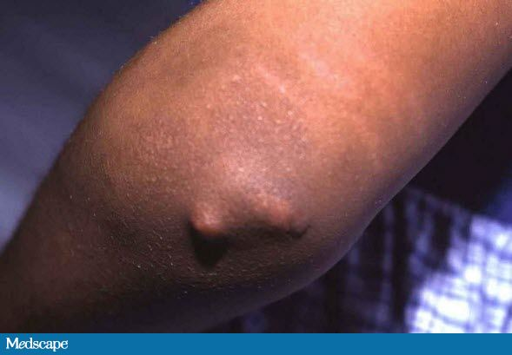
Small vessels Vasculitis
Subcutaneous nodule

Slide 56
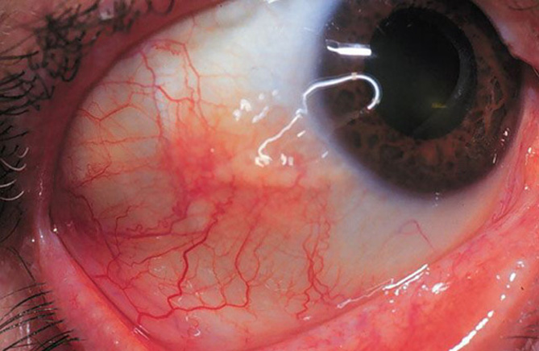
Episcleritis + scleritis

Slide 57
History
Duration of the complaint:
Acute (less than 6 weeks) OR chronic (6 weeks or more)
2. Number of joints involved: rheumatoid arthritis patients have a polyarticular joint involvement.
3. Distribution of Joints Involved: RA has a symmetrical joint involvement.
4. Pattern of involvement: Inflammation persists in involved joints as new ones become affected (Additive).
5. Duration of morning stiffness: Usually morning stiffness last for more than 30 minutes (it can reach one hour).
6. Aggravating and relieving factors: Pain worse after a period of inactivity and relieved by movement.
7. History of joint swelling , Extra-articular complaints Family history

Slide 58
Physical Examination
During the physical examination, it is important to assess the following:
Stiffness (may improve with heat and active exercise, but they do not prevent the return of stiffness).
Tenderness
Pain on motion
Swelling
Deformities (ulnar deviation, boutonniere and swan-neck deformities, hammer toes, and joint ankylosis)
Limitation of motion
Extra-articular manifestations
Rheumatoid nodules (occur in approximately 25% of patients with RA and most commonly found on extensor surfaces [proximal ulna])

Slide 59
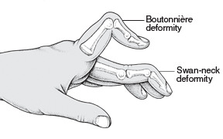
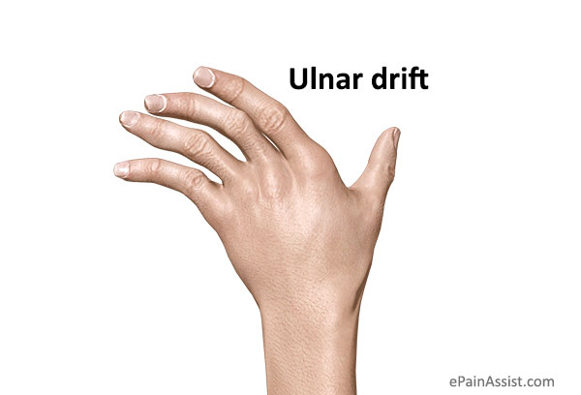
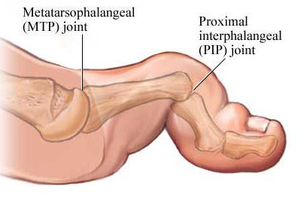

Slide 60
Diagnostic criteria
Notes:
ACR(American college of rheumatology),, 6/10 is needed to classify patient as having definite RA

Slide 61
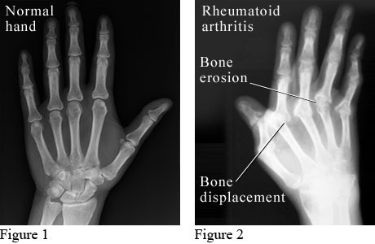
X-Ray

Slide 62
labs
RA is a clinical diagnosis; no laboratory test is diagnostic
1. Rheumatoid factor:
a. Auto antibodies to the Fc portion of IgG Support a diagnosis of Rheumatoid Arthritis but not diagnostic.
b. found in 75% to 80% of patients with RA.
c. associated with a poor prognosis.
d. seen in conditions other than RA like hepatitis C, sarcoidosis, pulmonary fibrosis, and many others.
2. Anti-citrullinated protein antibodies (ACPA):
a. These are auto antibodies directed against the body proteins, can be detected by ELISA.
b. Accuracy (Anti-CCP Assay) Specificity 79% .. Sensitivity 96-98%.
c. Diagnosis more accurate when combined with RF.

Slide 63
Management :
After confirming diagnosis of RA through (history, Physical exams, and investigations) a combination treatment should be started:
a. Start DMARD(s): Methotrexate within 3 months to Control symptoms and delay progression of the disease
b. Consider NSAIDs (if mild>> To relieve pain and inflammation)
c. Consider Local / Low-dose Steroid
d. Patient Education
e.Physical / Occupational Therapy.
f. Referral to rheumatology clinic.
g.Follow-UP

Slide 64
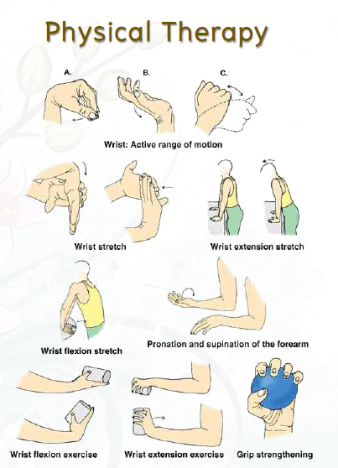

Slide 65
Degenerative Arthritis: Osteoarthritis (OA)
Definition:-
degeneration of joint cartilage and the underlying bone, most common from middle age onward. It causes pain and stiffness, especially in the hip, knee, and thumb joints.
Risk Factors:-
genetic predisposition, advanced age, obesity (for knee OA), female, trauma.
Signs and Symptoms:-
localized to affected joints (not a systemic disease).
The pain is often insidious, gradually progressive, with an intermittent course.

Slide 66
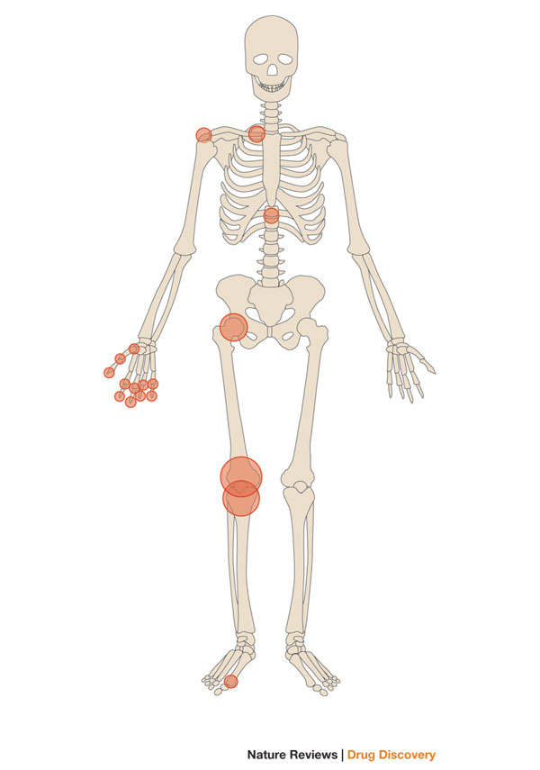

Slide 67
TYPES OF OSTEOARTHRITIS
Idiopathic osteoarthritis — Idiopathic OA can be categorized into localized or generalized forms of the disease.
Localized OA most commonly affects the hands, feet, knee, hip, and spine. Other joints are less commonly involved
Generalized OA consists of involvement of three or more joint sites.

Slide 68
Secondary osteoarthritis
Specific conditions may cause or enhance the risk of developing OA These include:
●Trauma
●Congenital or developmental disorders
●Calcium pyrophosphate dihydrate deposition disease (CPPD)
●Other bone and joint disorders including osteonecrosis, rheumatoid arthritis, gouty arthritis, septic arthritis, and Paget disease of bone
●Other diseases such as diabetes mellitus, acromegaly, hypothyroidism, neuropathic (Charcot) arthropathy, and frostbite.

Slide 69
Pathophysiology:-
deterioration of articular cartilage due to local biomechanical factors and release of proteolytic
and collagenolytic enzymes
OA develops when cartilage catabolism > synthesis
loss of proteoglycans and water exposes underlying bone
abnormal local bone metabolism further damages joint
altered joint function and damage
synovitis is secondary to cartilage damage; therefore, may see small effusions in OA

Slide 70
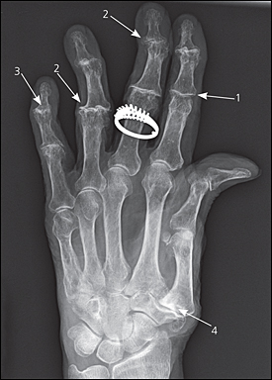
x-ray finding :
1/ joint space narrowing
2/ osteophytes formation
3/ joint destruction
4/ carpometacarpal joint

Slide 71
Septic Arthritis
Septic arthritis, also known as infectious arthritis, may represent a direct invasion of joint space by bacteria, virus and fungai.
It may lead to rapid joint destruction, there for immediate accurate diagnosis is essential. The majority of patients with bacterial septic arthritis will present with acute monoarthritis.
The incidence of septic arthritis has been estimated at 2 to 10 cases per 100,000 in the general population and as high as 30 to 70 cases per 100,000 in patients with rheumatoid arthritis.
The most common mode of spread hematogenous.
Notes:
various microorganisms, most commonly caused by a variety of bacteria .However, viruses, mycobacteria, and fungi have been implicated.
The joint cavity is normally sterile with synovial fluid and cellular matter including a few white blood cells

Slide 73
Neisseria gonorrhea (75% of cases) among younger sexually active individuals.
Staphylococcus aureus In Adults and children older than 2 years.
Pay attention to the following symptoms:
-Acute onset of the joint pain.
-Previous history of joint disease or trauma.
-The presence of extra-articular symptoms.
Septic artharitis is a medical emergancy

Slide 74
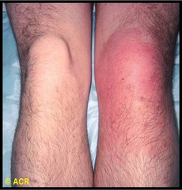
The most commonly involved joint in septic arthritis is the knee (50% of cases)

Slide 75
A classic presentation for septic arthritis is a patient with feaver who has rigors, an increased leukocyte count, and elevated sedimentation rate.
However, none of these is highly sensitive or specific for septic arthritis. In one series:,
40% to 60% of patients with septic arthritis were febrile.
25% to 60% had an elevated leukocyte count.
and 60% to 80% had a sedimentation rate greater than 50 mm/hr.
Signs and symptoms of infection may be muted in elderly, those who are immunocompromised (especially those with rheumatoid arthritis) and who abuse intravenous drugs.

Slide 76
Investigations of SA
Joint Fluid Analysis and Culture:
Normal synovial fluid is clear and colorless
- Culture results in patients with non gonococcal septic arthritis are almost always positive. - Cultures of the joint fluid in gonococcal infections yield positive results in only about 25-50% of cases.
Blood Cultures:
By Obtaining at least 2 sets of blood cultures to rule out a bacteremic origin of the septic joint.
Polymerase chain reaction:
For detection of bacterial DNA in joint fluid and synovial tissue.
Radiography and Ultrasonography:
it is most useful in ruling out underlying osteomyelitis caused by the joint infection itself Ultrasonography may be used to diagnose effusions in chronically distorted joints.
MRI and CT scanning:
More sensitive for distinguishing osteomyelitis, periarticular abscesses and joint effusions.

Slide 77
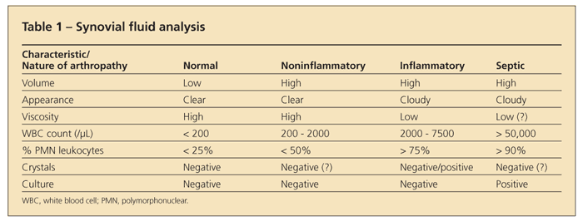
Synovial Fluid Analysis

Slide 78
Treatment and Management of septic arthritis
Medical management of infective arthritis focuses on adequate and timely drainage of the infected synovial fluid, administration of appropriate antimicrobial therapy, and immobilization of the joint to control pain
Antibiotic Therapy:
In native joint infections, antibiotics usually need to be administered parentally for at least 2 weeks. However, each case must be evaluated independently.

Slide 79
Synovial Fluid Drainage
Aspirating the joint 2-3 times a day may be necessary during the first few days

Slide 80
Joint Immobilization and Physical Therapy
Usually, immobilization of the infected joint to control pain is not necessary after the first few days.
Initial physical therapy consists of maintaining the joint in its functional position and providing passive range-of-motion exercises.
- The joint should bear no weight until the clinical signs and symptoms of synovitis have resolved.

Slide 81
Reactive Arthritis
Brief:
Reactive arthritis is joint pain and swelling triggered by an infection in another part of your body — most often the:
Intestines (campylobacter, Salmonella, Shigella and Yersinia)
Genitals (Clamidya Trachomatos) or urinary tract.
Usually affected parts
1-joints (knee, feet and ankles).
2-May affect eyes.
3-skin.
4-Urethra.
reactive arthritis is sometimes called Reiter's syndrome, which is specific rare type of reactive arthritis.
For most people, signs and symptoms of reactive arthritis come and go, eventually disappearing within 12 months.

Slide 82
Symptoms of Reactive Arthritis:
1- Painful urination and discharge from the penis if there’s inflammation of the urethra(Genitalia).
2- Diarrhea may occur if the intestines are affected(Bowel).
Both followed by arthritis from 4 to 28 days later that usually affects finger, tows, ankles, hips and knee joints.

Slide 83
Treatment:
Treat the main infection.
NSAIDS for swelling and joint pain.
Steroids for swelling.
DMARDS for protection of the joints.
TNF blockers a new treatment.
Physical therapy and exercise.
Immuno-suppressant drugs.

Slide 84
Highlights: Juvenile Arthritis
What is Juvenile Arthritis?
Juvenile arthritis. Also known as pediatric rheumatic disease, pediatric rheumatic diseases that can develop in children under the age of 16 of unknown etiology.
Although the various types of juvenile arthritis share many common symptoms, like pain, joint swelling, redness and warmth, each type of JA is distinct and has its own special concerns and symptoms. Some types of juvenile arthritis affect the musculoskeletal system. Juvenile arthritis can also involve the eyes, skin, muscles and gastrointestinal tract. May not involve the joints.

Slide 85
Types of Juvenile Arthritis
Juvenile idiopathic arthritis (JIA). Considered the most common form of arthritis, JIA includes six subtypes: oligoarthritis, polyarthritis, systemic, enthesitis-related, juvenile psoriatic arthritis or undifferentiated.
Juvenile dermatomyositis., causes muscle weakness and a skin rash on the eyelids and knuckles.
Juvenile lupus. Lupus can affect the joints, skin, kidneys, blood and other areas of the body.
Juvenile scleroderma. “Hard skin”
Kawasaki disease. This disease causes blood-vessel inflammation that can lead to heart complications.
Mixed connective tissue disease. This disease may include features of arthritis, lupus dermatomyositis and scleroderma.
Fibromyalgia. This chronic pain syndrome is an arthritis-related condition, which can cause stiffness and aching, along with fatigue, disrupted sleep and other symptoms. More common in girls,

Slide 86
Diagnosis & Treatment
Diagnosis is made by:
careful physical exam.
medical history.
Any specific tests a doctor may perform will depend upon the type of JA suspected.
No specific treatment exist The goal of treatment is to relieve inflammation, control pain and improve the child’s quality of life.
Most treatment plans involve a combination of medication, physical activity, eye care and healthy eating.

Slide 87
Juvenile Arthritis Self Care:
An important part of JA treatment is teaching the child the importance of how to follow the treatment prescribed by the healthcare team.
help the child address the emotional and social effects of the disease.
Self management encompasses the choices made each day to live well and stay healthy and happy.

Slide 88
Red Flags in patient with Arthritis
1: Bumps Arthritis sufferers commonly have small lumps on their finger joints. These are actually bone protrusions or bone spurs that tend to result in swelling of the finger joints.
Though these are especially common in women, they also tend to run in families, and may not produce any pain.

Slide 89
2: Pain Causing Lack of Sleep While normal aches and pains are common as we get older, persistent pain in the joints that interferes with regular sleep patterns is a warning sign of arthritis.
Osteoarthritis pain comes because the cartilage in your joints wears away and can cause your bones to grind against one another.
This persistent pain can lead you to lose considerable sleep.

Slide 90
3: Achy Hands
If you begin experiencing a loss of fine motor skills, such as an inability to use a fork and knife, this may be a sign of arthritis.
Pain in the knuckles and the finger joints, or at the base of the thumb, is very common in osteoarthritis sufferers.

Slide 91
Referral criteria:Patients with suspected inflammatory arthritis should be referred urgently if symptoms have been present for more than six weeks and any of the following apply:
swelling is present in two or more joints
there is a positive MCPJ or MTPJ squeeze test
early morning joint stiffness for more than 30 minutes
joint stiffness following periods of immobility
the presence of other conditions associated with inflammatory arthritis such as psoriasis, iritis or uveitis, inflammatory bowel disease.

Slide 92
Conclusion
Arthritis is a major cause of lost work time and serious disability for many people.
Temporal pattern of arthritis could be Abrupt (develop over minutes to hours),or Insidious (develop over weeks to months)
Rheumatoid Arthritis is a chronic systemic disease that can be presented with Extra-articular Manifestation

Slide 93
MCQ
RA is characterized by which of the following patterns of joint involvement?
a) Episodic monoarthritis
b) Symmetrical polyarthritis
c) Migratory oligoarthritis
d) Spondylitis
Notes:
B

Slide 94
MCQ
The most specific test used in diagnosis of gout:
a) MRI
b) x-ray
c) synovial fluid analysis
d) serum uric acid
Notes:
C

Slide 95
MCQ
The most common offending organism in septic arthritis in adults is:
a) S. aureus
b) Streptococcus pyogenes
c) S. pneumoniae
d) H. influenzae
Notes:
A

Slide 96
MCQ
Which one of the following is a characteristic x-ray finding in case of osteoarthritis ?
a) chondrocalcinosis
b) osteopenia
c) Narrowing of joint space
d) sequestra
Notes:
C

Slide 97
Refrences
1-Prevalence of Doctor-Diagnosed Arthritis and Arthritis-Attributable Activity Limitation United States .
National and State Estimates of Childhood Arthritis and Other Rheumatic Conditions.
3- Clarson LE, Hider SL, Belcher J, Heneghan C, Roddy E, Mallen CD. Increased risk of vascular disease associated with gout: a retrospective, matched cohort study in the UK Clinical Practice Research Datalink.Ann Rheum Dis. 2014 Aug 27.
4- Dalbeth N, Kalluru R, Aati O, et al. Tendon involvement in the feet of patients with gout: a dual-energy CT study. Ann Rheum Dis 2013; 72:1545.
5- Singh JA, Reddy SG, Kundukulam J. Risk factors for gout and prevention: a systematic review of the literature. Curr Opin Rheumatol. 2011 Mar. 23(2):192-202. [Medline].
6-McAdams-Demarco MA, Maynard JW, Coresh J, Baer AN. Anemia and the onset of gout in a population-based cohort of adults: Atherosclerosis Risk in Communities study. Arthritis Res Ther. 2012 Aug 20. 14(4):R193. [Medline]. 5. oxford handbook of general oractice, 4th ed.

Slide 98
Thank You..

