Slide 1
Dyslipidemia : Risk assessment and Management
Dr Mohammed Batais
Assistant Professor & Consultant , Family Medicine, Diabetes and Chronic Disease Management
King Saud University

Slide 2
Objectives
Definition and Lipid metabolism
CVD risk factors & FRS
Introduction to new guidelines on lipid management
Comparison with ATP III guidelines
Current statin treatment recommendations
Criticism to AHA/ACC

Slide 3
Dyslipidemia
  A disorder of lipoprotein metabolism, including lipoprotein overproduction or deficiency.
  May be manifested by elevation of the total cholesterol , (LDL) and the triglyceride concentrations, and a decrease in the (HDL) concentration in the blood

Slide 4
Two Types of Lipids
LIPIDS IN BLOOD
TOTAL CHOLESTEROL
TRIGLYCERIDES (TG)
GOOD CHOLESTEROL
HDL 1 and HDL 2
BAD CHOLESTEROL
LDL, VLDL (TG), Lp(a)

Slide 5
Lipoprotein
Lipids or Fats (Hydrophobic)
Size < RBC
TG, EC
Phospholipids Free Cholesterol (Hydrophilic)
Apoproteins A, B, C, E, (a) (Amphiphatic)

Slide 6
Lipoproteins
TG
EC
Apoprotein boat
Apo A I and A II for HDL Apo B100 for LDL
Apo B100+C+E for VLDL, IDL Apo B100+Apo(a) for Lp(a)

Slide 7
Apolipoprotein B
Measurements
Non-HDL-C
VLDL
VLDLR
IDL
LDL
SDL
TG-rich lipoproteins
Highly atherogenic

Slide 8
Types | Chylomicron | VLDL | LDL | HDL
Made by: | small intestines in the fed stat | the liver from excess dietary carbohydrate and protein along with the Chylomicron remnant | The Liver “VLDL once it has lost a lot of its TG’s” | the Liver and Small Intestine
Absorbed into | the lymph vessels, then into the blood
Rich in | TGs | TGs | Cholesterol
Function | transport fats from the intestinal mucosa to the liver | Deliver TGs to body cells | Deliver cholesterol to all body cells | Pick up cholesterol from body cells and take it back to the liver

Slide 9
Functions of Lipoproteins
-Chylomicrons carry triglycerides(fat) from the intestines to the liver, to skeletal muscle, and to adipose tissue.
(VLDL) carry (newly synthesized) triglycerides from the liver to adipose tissue.
(IDL) are intermediate between VLDL and LDL. They are not usually detectable in the blood.

Slide 10
Functions of Lipoproteins
(LDL) carry cholesterol from the liver to cells of the body - "bad cholesterol"
(HDL) collect cholesterol from the body's tissues, and take it back to the liver - "good cholesterol"

Slide 11
Lipid Metabolism

Slide 12
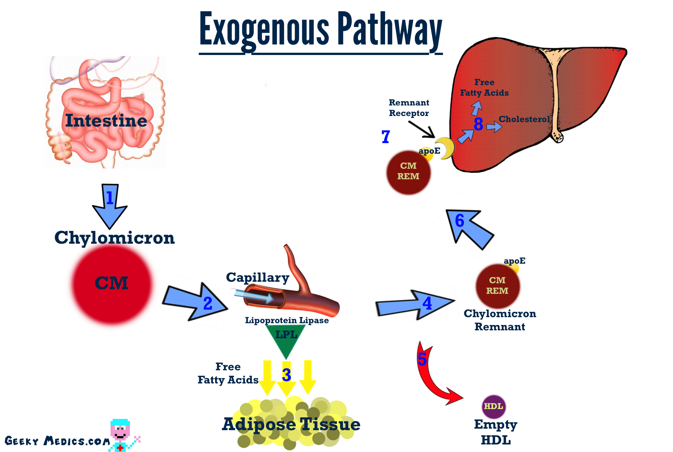

Slide 13
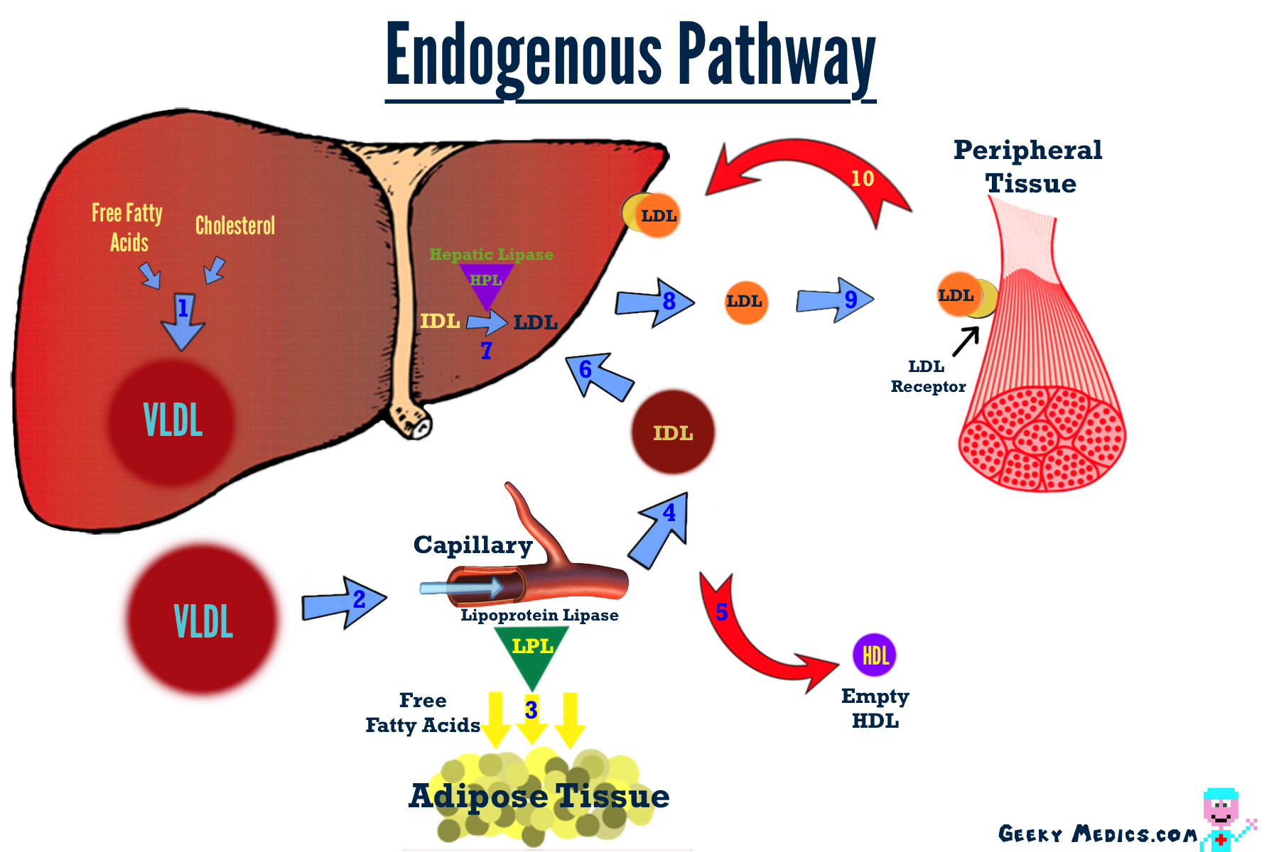
[ CLOSE WINDOW ]

Slide 14
CVD risk factors & FRS

Slide 15
CAD risk factors
Modifiable
Non-Modifiable
Cigarette and tobacco smoke
High blood cholesterol
High blood pressure
Physical inactivity
Obesity
Diabetes
Age
Gender
Family history of CVD

Slide 16
Emerging risk factors for CAD
Table 2. Emerging Risk Factors According to ATP III Final Report Update 2004
1. Elevated high-sensitivity C-reactive protein
2. Coronary artery calcification
3. Elevated lipoprotein (a)
4. Homocysteine
5. Fibrinogin

Slide 17
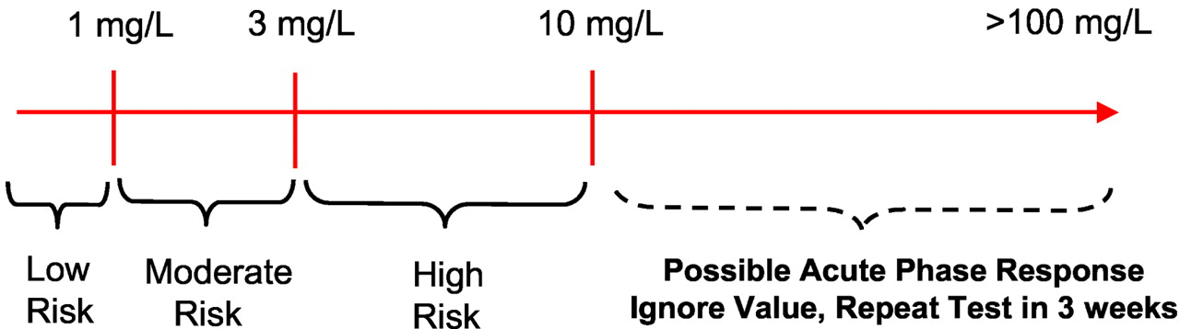

C-reactive protein
A person's baseline level of inflammation, as assessed by the plasma concentration of CRP, predicts the long-term risk of a first myocardial infarction.
In pt with chest pain and C reactive protein level is
Between 3 to 10 : → that indicate the pt is at high risk of develop an attack
If higher than 10 → that indicate that the pt is having an acute attack
Figure 4. clinical interpretation of hs-CRP for cardiovascular risk prediction.
Ridker P M Circulation 2003;108:e81-e85
Copyright © American Heart Association

Slide 18
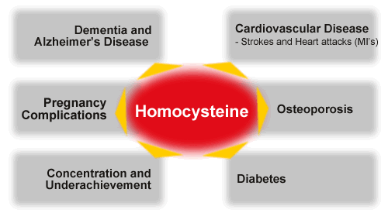

Homocysteine
Test: Fasting homocysteine level
A non-protein amino acid.
Elevated levels have been may cause:
Atherosclerosis.
Venous thrombosis
Normal < 13 umol/L
Moderate 13-16 umol/L
Severe >16 umol/L
Management:
B6, B12 & folate supplementation decrease homocysteine levels.
Notes:
Test: Fasting homocysteine level.

Slide 19
The Framingham risk score
Scoring system used to calculate a pt’s risk of coronary events
The Framingham Heart Study first introduced the term risk factor to medical literature
The following risk factors are used to assess cumulative risk:
Age
Smoking Status
Systolic BP
HTN treatment
Total cholesterol levels
HDL-C levels

Slide 20
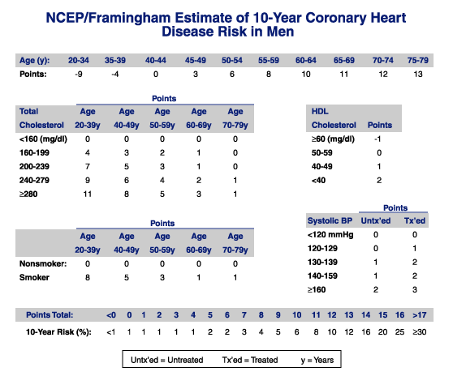

Slide 21
Calculating 10-Year Risk in Women
Age (years) 20-34 35-39 40-44 45-49 50-54 55-59 60-64 65-69 70-74 75-79
Points -7 -3 0 3 6 8 10 12 14 16
Points
Points
Total Age Age Age Age Age
Cholesterol 20-39 40-49 50-59 60-69 70-79
HDL
CHOLESTEROL Points
<160 (mg/dL) 0 0 0 0 0 ≥ 60 (mg/dL) -1
160-199 4 3 2 1 1 50-59 0
200-239 8 6 4 2 1 40-49 1
240-279 11 8 5 3 2 < 40 2
≥ 280 13 10 7 4 2
Systolic BP Untx”ed Tx”ed
Age Age Age Age Age
20-39 40-49 50-59 60-69 70-79
<120 0 0
120-129 3 1
130-139 4 4
140-149 5 3
≥ 160 6 4
Nonsmoker 0 0 0 0 0
Smoker 9 7 4 2 1
Points total: <9 9 10 11 12 13 14 15 16 17 18 19 20 21 22 23 24 ≥25
10 year Risk (%) <1 1 1 1 1 2 2 3 4 5 6 8 11 14 17 22 27 ≥30
Untx”ed = Untreated Tx”ed =Treated

Slide 22
FRS
Table 3. Classification of Patients based on The Framingham Risk Score
Low risk | <10% coronary heart disease risk at 10 years
Intermediate risk | 10-20% risk of coronary event at 10 years
High risk | >20% risk of coronary event at 10 years

Slide 23
Example
A 46-year-old man asymptomatic, non-smoker, because of being informed to have high cholesterol, a complete lipid profile was requested.
F/H: unremarkable
Bp 130/70 BMI 24.5 kg/m²
Chol. 6.2 mmol/L Trig. 2.32 mmol/L
Next Visit:
Cholesterol: 6.40 mmol/L (247 mg/dl)
LDL-C : ….. 4.31 mmol/L (166 mg/dl)
HDL-C: …… 1.13 mmol/L (44 mg/dl)
Trig.: ……… 2.12 mmol/L (188 mg/dl)
How are you going to measure his risk to decide his management?

Slide 24
The 10 year Framingham risk score
Points
Age 3
T. cholest. 6
Non-smoker 0
HDL-c 1
Systolic Bp 1
_________________
Total 11
10-year Risk 8%

Slide 25
Cases in which you don’t need FRS ?
Patients who already have a high risk due to other diseases:
We don’t need FRS if:
Stroke or TIA
Bypass surgery or balloon angioplasty
Type 2 diabetes
Kidney disease
Abdominal aortic aneurysm
Familial hypercholesterolemia
Peripheral artery disease
Carotid artery disease
They already have HIGH RISK to develop CHD

Slide 26
Introduction to new guidelines on lipid management

Slide 27
AHA/ACC vs IAS guidelines
International Atherosclerosis Society (IAS)
Apo B-containing lipoproteins is causally associated with ASCVD risk and that lowering “atherogenic cholesterol” (LDL-C and non-HDL-C) will reduce risk
ACC/AHA 2013
ACC/AHA (evolved from ATP IV/NHLBI efforts)
Many areas left to clinical judgment where RCT data were not available or limited
Recommendations based on what has been shown to reduce risk in RCTs
Treat to target
Fire and forget

Slide 28
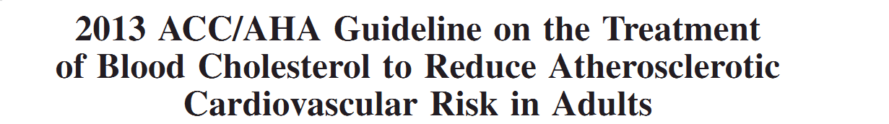
ACC/ AHA
Use Critical Questions (CQs) to create the evidence search from which the guideline is developed
Cholesterol Panel: 3 CQs
Risk Assessment Work Group: 2 CQs
Lifestyle Management Work Group: 3 CQs

Slide 29
What has changed compared to ATP3 guideline?
No specific LDL cholesterol target
Initiate either moderate-intensity or high-intensity statin therapy for patients who fall into the four categories
Measure lipids during follow-ups to assess adherence to treatment, not to achieve a specific LDL target

Slide 30
 | ATP-III | AHA/ACC
Basis for recommendations | Expert opinion based on pathophysiology, observational, & RCT data | Evidence-based recommendations based on RCTs and systematic reviews
Risk stratification | CHD equivalents, risk factors, 10-year risk of MI | 4 specific risk groups based on benefits in clinical trials
Risk calculation | Framingham risk score | Pooled cohort equation
Goals of therapy | LDL & non-HDL levels (stratified by risk) | Statin intensity (% LDL reduction)
Role for monitoring | Fasting lipid panel to assess achievement of goal | Fasting lipid panel to assess adherence/therapeutic response
Role of non-statin agents | Encouraged use if needed to achieve LDL or non-HDL goal | Discourages use in most patients because of lack of evidence on improving outcomes

Slide 31
Summary of Drug choice based on ATP III
Lipid abnormality type | First choice | Additional | Remarks
↑ LDL | Statin | Ezetimibe | Myopathy ↑
↑ TG | Fibrate | Niacin | ↓ CHO intake
↓ HDL | Niacin | Fibrate | Exercise
↑ LDL + ↑ TG | Statin + Fibrate | Niacin | Myo risk ↑ ↑
↑ LDL + ↓ HDL | Statin + Niacin | Fibrate | Exercise
↑ TG + ↓ HDL | Fibrate + Niacin | Statin | Exercise
↑ LDL + ↑ TG + ↓ HDL | Statin + Fibrate | E, N, BA, FO | Myo risk ↑ ↑ ↑

Slide 32
The scope of the new AHA/ACC 2013 guidelines
Focus on treatment of blood cholesterol to reduce ASCVD risk in adults
Emphasize adherence to a heart healthy lifestyle as foundation of ASCVD risk reduction
Identify individuals most likely to benefit from cholesterol-lowering therapy “4 statin benefit groups “
Identify safety issues

Slide 33
ACC/AHA - Why Not Continue to Treat to Target?
Major difficulties:
Current RCT data do not indicate what the target should be
Unknown magnitude of additional ASCVD risk reduction with one target compared to another
Unknown rate of additional adverse effects from multidrug therapy used to achieve a specific goal
Therefore, unknown net benefit from treat-to-target

Slide 34
4 Major Statin Benefit Groups
Individuals with clinical ASCVD
Individuals with LDL >190
Individuals with DM, 40-75 yo with LDL 70-189 and without clinical ASCVD
Individuals without clinical ASCVD or DM with LDL 70-189 and estimated 10-year ASCVD risk >7.5%

Slide 35
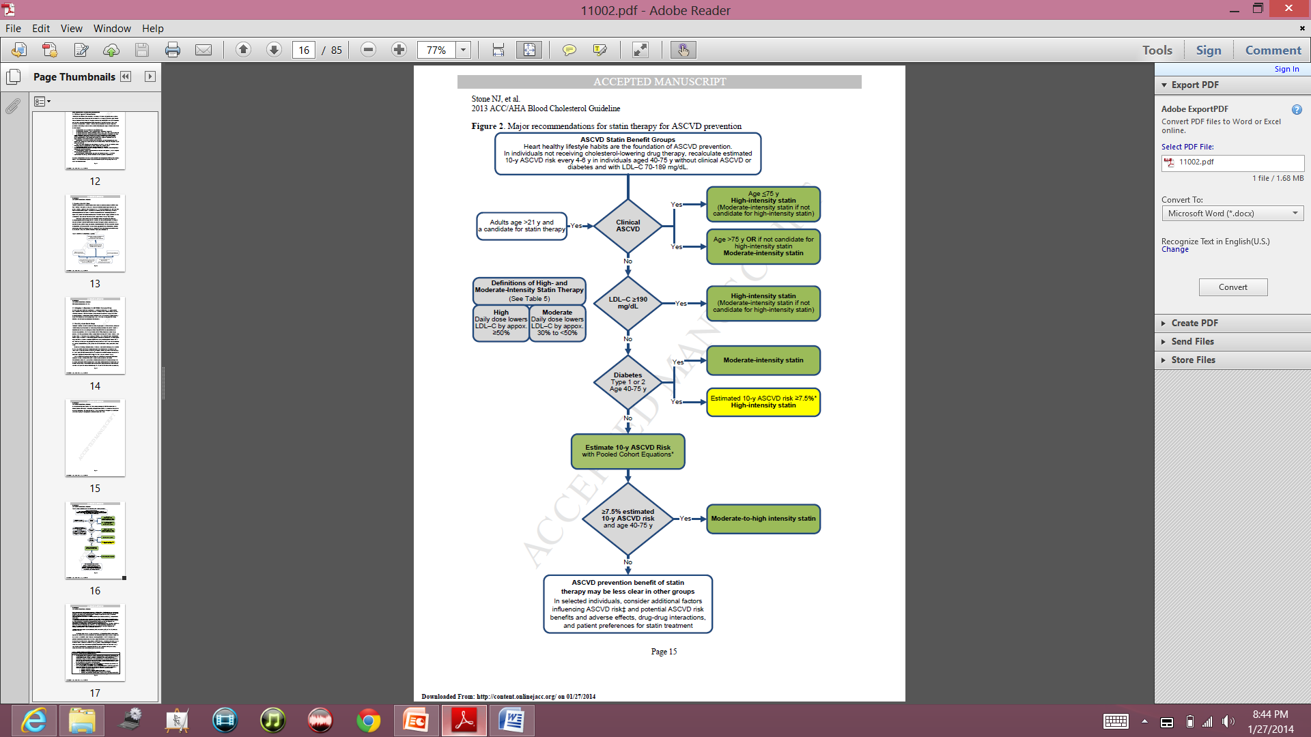
Notes:
This algorithim summarizes the major guidelines in one page
You see the 4 statin benefit groups in the middle: on top, you see the patient’s group with clinical ASCVD, below that you see the group with LDL >190, below that you see the patient’s with history of DM 40-75 years old, and in the bottom, you see patients who don’t have the characteristics of the first 3 groups but their 10 year ASCD risk is greater than 7.5%
For the first group: based on the guidline, if you have clinical ASCD, are younger than 75 and don’t have any history of intolerance to statin, you should be started on high intensity statin. On the other hand, if you are older than 75, or not a candidate for high intensity statin due to lets say intolerance to statins, you are a candidate for moderate-intensity statin
For the second group, if your LDL is greater than 190, you need to be started on high-intensity statin, unless you have contra-indication to high dose →start on moderate dose
For the third group, individuals with diabetes with above mentioned group age, you need to calculate the 10 year ASCVD risk using a new equation/calculater called “pooled Cohort Equations” →if the 10 year risk is greater than 7.5%, start them on high-intensity, otherwise, you can start them on moderate-intensity statin
For the last group, you need to calculate patient’s risk factor and start them on moderate-to-high intensity statin if their estimated 10-y ASCVD risk is greater than 7.5%
Keep that in mind that what we mean by “high intensity” statin, is the daily dose of statin that lowers the LDL by appox greater than 50%, and what we mean by moderate intensity statin, is the daily dose of statin that lowers the LDL by appox 30-50%.

Slide 36
Don’t Forget Healthy Lifestyle
Healthy diet
Regular exercise
No Smoking
Maintain healthy weight

Slide 37
2013 ACC/AHA/NHLBI Guideline on Lifestyle for CVD Prevention
Mediterranean or DASH-type diet
Restrict consumption of saturated fats, trans fats, sweets, sugar-sweetened beverages, and sodium.
Physical activity of moderate to vigorous intensity lasting 40 minutes per session 3-4 times per week
Notes:
Eat a dietary pattern that is rich in fruit, vegetables, whole grains, fish, low-fat dairy, lean poultry, nuts, legumes, and nontropical vegetable oils consistent with a Mediterranean or DASH-type diet.

Slide 38
1. Patients with clinical ASCVD

Slide 39
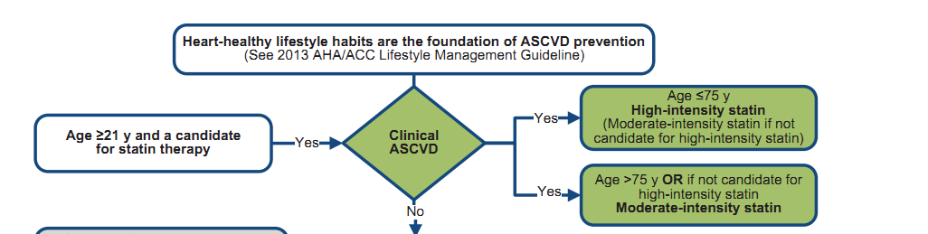
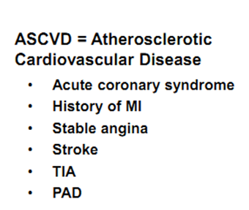

Slide 40
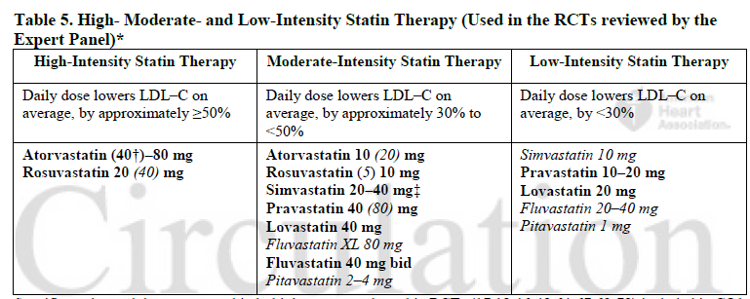
Dosing Statins

Slide 41
2. LDL greater than 190 mg/dl
These are patients with familial hyperlipidemia
They deserve special consideration
Often start with untreated LDL of 325-400 mg/dl

Slide 42
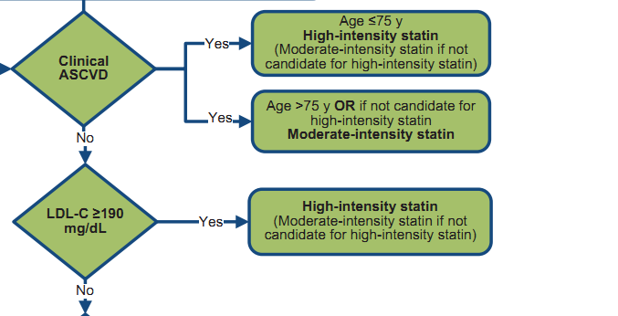

Slide 43
3. Patients with DM, age 40-75 years
All have indication for statin
Diabetics with > 7.5% 10 year risk get high intensity statin therapy
Diabetics with < 7.5% 10 year risk of CAD get moderate intensity statin therapy

Slide 44
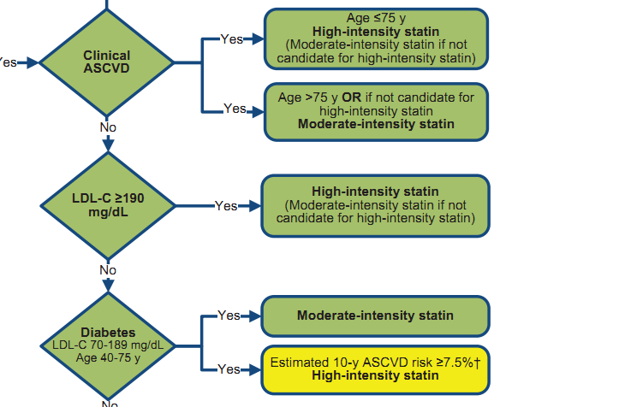

Slide 45
4. Age 40-75 years that do not meet above criteria, but have a 10 year risk of >7.5 %
10 year and lifetime risk as determined by CV Risk Calculator.
Specifically designed for this trial
Downloadable on AHA or ACC site

Slide 46
Notes:
This algorithim summarizes the major guidelines in one page
You see the 4 statin benefit groups in the middle: on top, you see the patient’s group with clinical ASCVD, below that you see the group with LDL >190, below that you see the patient’s with history of DM 40-75 years old, and in the bottom, you see patients who don’t have the characteristics of the first 3 groups but their 10 year ASCD risk is greater than 7.5%
For the first group: based on the guidline, if you have clinical ASCD, are younger than 75 and don’t have any history of intolerance to statin, you should be started on high intensity statin. On the other hand, if you are older than 75, or not a candidate for high intensity statin due to lets say intolerance to statins, you are a candidate for moderate-intensity statin
For the second group, if your LDL is greater than 190, you need to be started on high-intensity statin, unless you have contra-indication to high dose →start on moderate dose
For the third group, individuals with diabetes with above mentioned group age, you need to calculate the 10 year ASCVD risk using a new equation/calculater called “pooled Cohort Equations” →if the 10 year risk is greater than 7.5%, start them on high-intensity, otherwise, you can start them on moderate-intensity statin
For the last group, you need to calculate patient’s risk factor and start them on moderate-to-high intensity statin if their estimated 10-y ASCVD risk is greater than 7.5%
Keep that in mind that what we mean by “high intensity” statin, is the daily dose of statin that lowers the LDL by appox greater than 50%, and what we mean by moderate intensity statin, is the daily dose of statin that lowers the LDL by appox 30-50%.

Slide 47
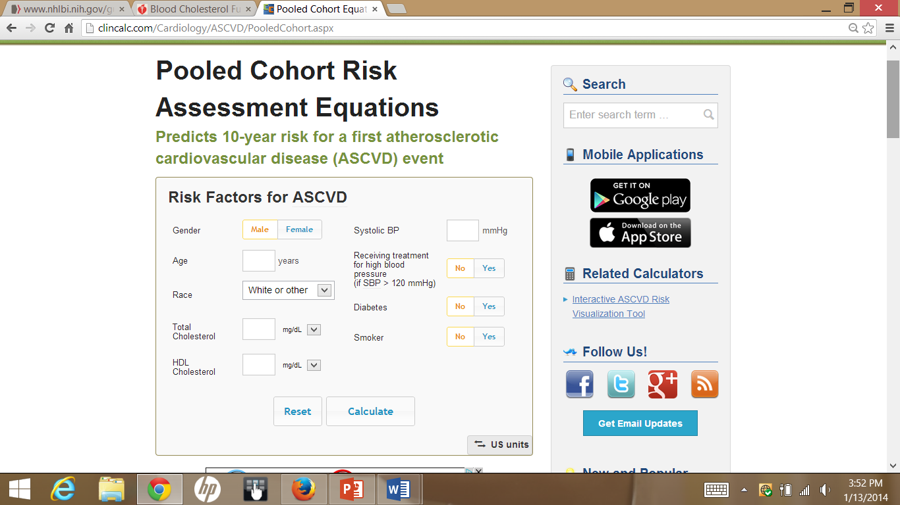
http://clincalc.com/Cardiology/ASCVD/PooledCohort.aspx
Notes:
This is the new equation, the pooled cohort risk assessment equation
As you can see, there are different parameters that you need to plug in to the equation to calculate the risk: gender, age, race, total cholesterol, HDL, systolic BP, whether or not you are on any anti-HTN meds, any history of DM or being a smoker

Slide 48
Clinical controversies
  Management of other patient groups
    Age <40 or >75 years without clinical ASCVD?
    10-year risk of 5%-7.5%?
    LDL >160mg/dl or other primary hyperlipidemias?
    Additional risk assessment may be necessary
      High sensitivity C-reactive protein
      Ankle-brachial index
      Coronary artery scores
      Family history of premature CHD
      Elevated lifetime risk of ASCVD

Slide 49
No recommendations on statin therapy for patients with
NYHA class II-IV
ESRD on dialysis

Slide 50
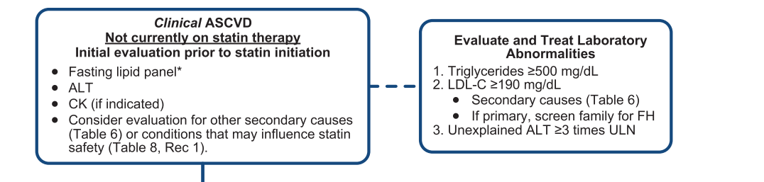
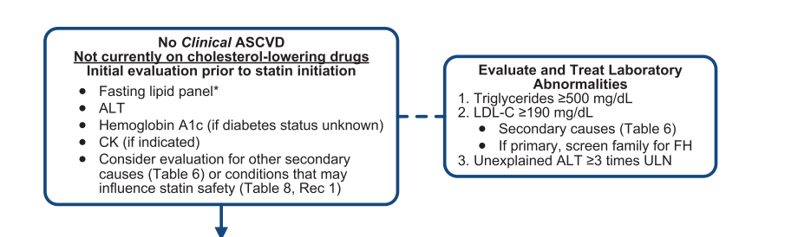

Slide 51
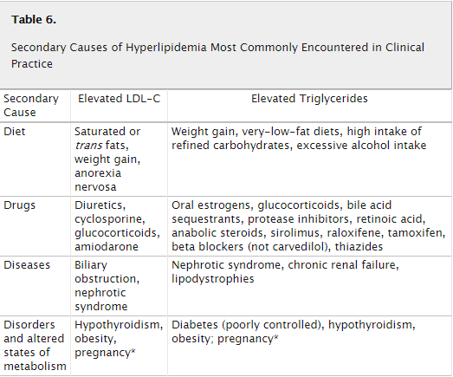

Slide 52
2013 AHA/ACC Cholesterol Guidelines
Monitoring of statins
  Baseline ALT prior to initiation
    Consider baseline CK in patients at risk for muscle disorders
    Routine ALT or CK levels not recommended unless symptomatic
  Baseline fasting lipid panel
    4-12 weeks to assess therapeutic response and every 3-12 months if clinically warranted
    Reinforce adherence if response is less than expected
    Dose may be decreased if 2 consecutive LDL <40

Slide 53
STATIN Safety recommendations

Slide 54
STATIN Safety recommendations
Conditions that could predispose pts to statin side effect:
Impaired renal or hepatic function
History of previous statin intolerance or muscle disorder
Age >75
History of hemorrhagic stroke
  Consider use of lower-intensity statin if any of these characteristics are present

Slide 55
STATIN Safety recommendations
Select the appropriate dose
Keep potential Side effects and drug-drug interaction In mind (grade A)
If high or moderate intensity statin not tolerated, use the maximum tolerated dose instead
It may be harmful to initiate simvastatin 80mg, or increase the dose of simvastatin to 80mg (Grade B)
Notes:
The next few slides tells you the new guidelines on the safety recommendations for statins

Slide 56
Management of adverse effects
  Mild to moderate muscle symptoms
    D/C statin until muscle symptoms resolve
    Re-challenge with a lower dose
    If symptoms resume, D/C statin and re-challenge with lower dose of different statin
    Gradually titrate to target dose
    If symptoms don’t resolve after 2 months, assume it is not statin-related and resume original statin
  New onset diabetes
    Reinforce lifestyle modifications
  Memory impairment
    Consider other potential causes before stopping statin

Slide 57
Non-statin therapies
Non statin therapies, alone or in combination with statins, do not provide acceptable risk reduction benefits compared to adverse effects.
These include:
  Zetia
  Fibrates
  Fish oil
  Niacin
For the most part, these should be avoided with few exceptions

Slide 58
Medications for Hyperlipidemia
Drug Class | Agents | Effects (% change)
HMG CoA reductase inhibitors | Statins | ↓LDL (18-55),↑ HDL (5-15) ↓ Triglycerides (7-30)
Cholesterol absorption inhibitor | Ezetimibe | ↓ LDL( 14-18), ↑ HDL (1-3) ↓Triglyceride (2)
Fibric Acids | Gemfibrozil Fenofibrate | ↓LDL (5-20), ↑HDL (10-20) ↓Triglyceride (20-50)
Omega 3 fatty acid ethyl ester | Lovaza | ↓Triglyceride

Slide 59
Medications for Hyperlipidemia
Drug Class | Agents | Effects (% change) | Side Effects
HMG CoA reductase inhibitors | Statins | ↓LDL (18-55),↑ HDL (5-15) ↓ Triglycerides (7-30) | Myopathy, increased liver enzymes
Cholesterol absorption inhibitor | Ezetimibe | ↓ LDL( 14-18), ↑ HDL (1-3) ↓Triglyceride (2) | Headache, GI distress
Fibric Aci ds (Fibrates) | Gemfibrozil Fenofibrate | ↓LDL (5-20), ↑HDL (10-20) ↓Triglyceride (20-50) | Dyspepsia, gallstones, myopathy
Bile Acid sequestrants | Cholestyramine | ↓ LDL ↑ HDL No change in triglycerides | GI distress, constipation, decreased absorption of other drugs
Omega-3- Fatty acids |  | ↓ non-HDL (VLDL, IDL) ↑ HDL C

Slide 60
The role of non-statin agents
  Limited evidence to support use of non-statin agents
  Consider use of non-statin agents in the following situations:
    In addition to statins in high-risk patients with less than anticipated response:
      Clinical ASCVD and age<75
      Baseline LDL>190
      Age 40-75 years with diabetes
    Completely statin-intolerant
    TG (>500)

Slide 61
Summary
Fire and forget approach
Know the 4 high risk groups
Use medications proven to reduce risk, ie statins
Encourage healthy lifestyle
Don’t forget patient preference

Slide 62
Case
62 year old male
Total cholesterol: 140
Low HDL: 35
SBP: 130 mmHg
Not taking anti-hypertensive medications
Non-diabetic
Non-smoker
Calculated 10 yr risk of ASCVD : 9.8%

Slide 63
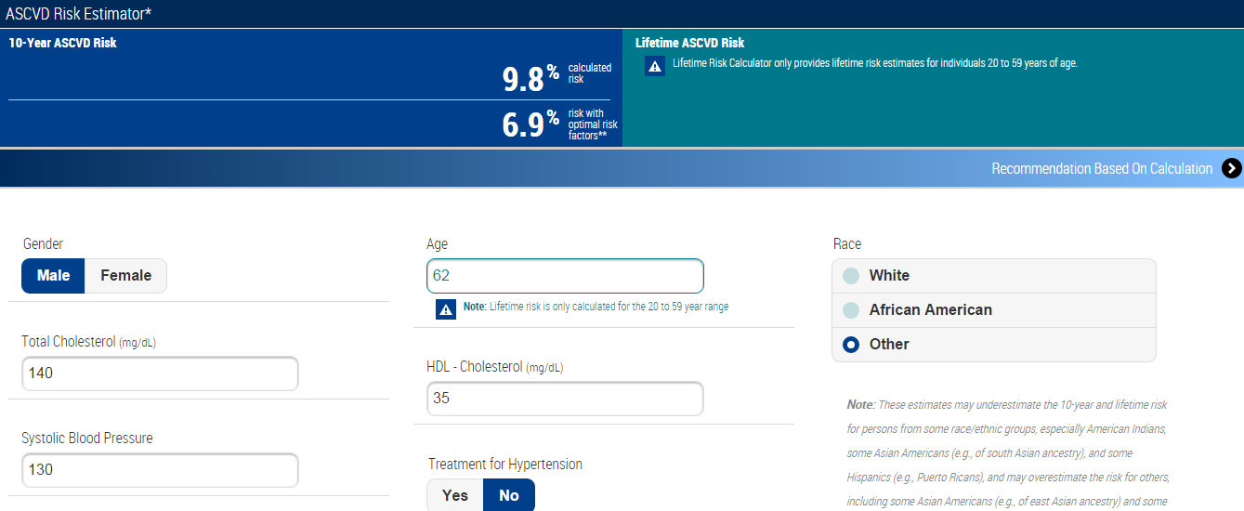

Slide 64
Notes:
Mention that patient belongs to the fourth group meeting the criteria for moderate to high intensity statin given the 10 year risk of ASCVD is greater than 7.5%

Slide 65
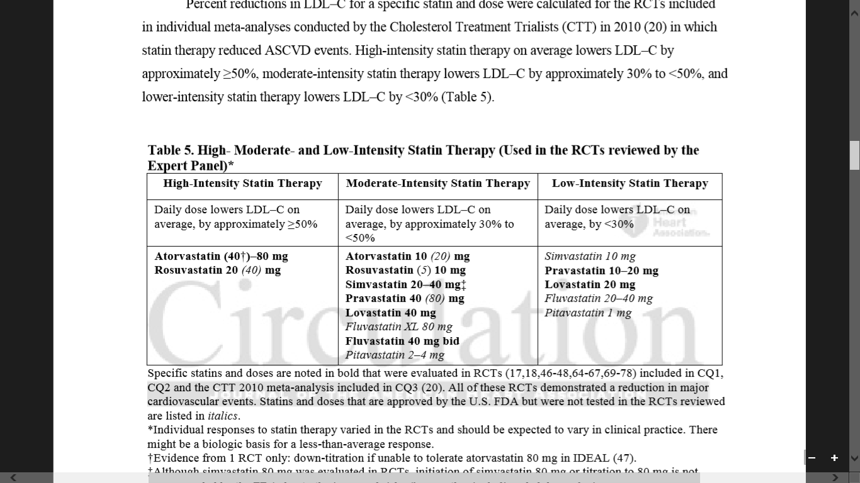
Moderate to high intensity statin

Slide 66
Pooled Cohort Equations: Criticism
    Estimates of 12 million to 45 million additional candidates for statin therapy based on CV risk estimates
      Pencina* et al. estimated 87.4% of men and 53.6% of women ages 60-75 would now be eligible for statins
    Validation attempts have yielded conflicting results:
      75%-150% when applied to data from the Women’s Health Study and the Physician’s Health Study
      Muntner‡ et al. reported good results in actual vs. predicted 5-year risks in a contemporary cohort of the REGARDS study

Slide 67
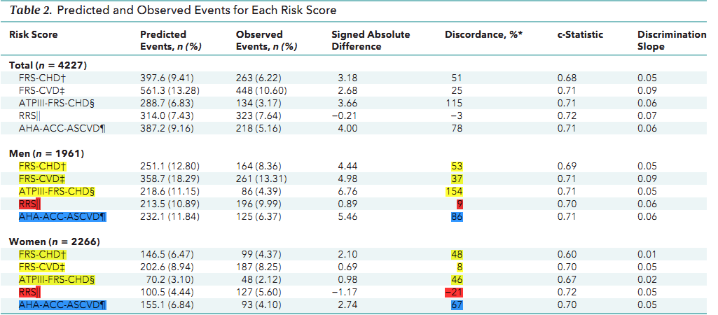
Observed and expected events for different scores were compared in MESA after a 10.2- year follow-up

Slide 68
Thank you

