Slide 1
Patient-Centered Care
Dr. Abdulaziz Alodhayani MD,MRCGP,ABFM,SBFM,AF,COE(C)

Slide 2
“I think the doctor has it wrong”
“The medication makes me feel worse”
“I can never remember”
“I’m afraid of needles”
“Did I take it?”
“The internet said…”
“I keep losing it”
“I feel better”
Intentional
Non-Adherence
Beliefs and perceptions about treatment and disease
Unintentional
Non-Adherence

Slide 3
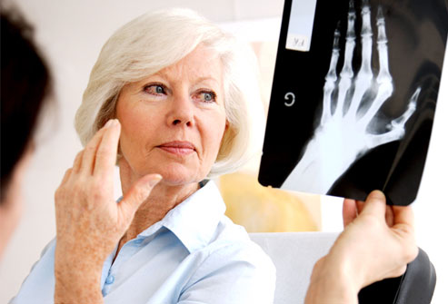
Attitudes to illness and management are important

Slide 4
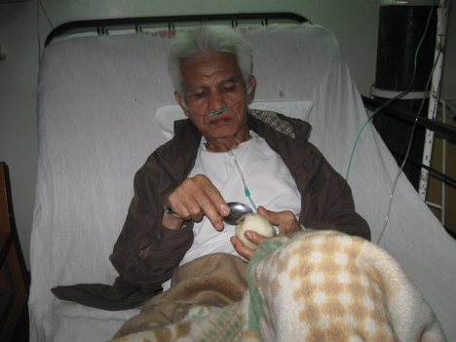
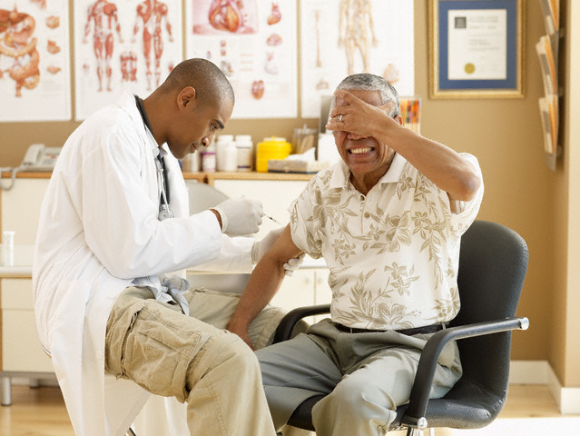
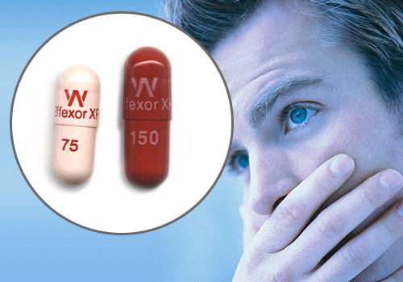
The ideal versus reality

Slide 5
Six aims for quality improvement in providing care
Health care should be . .
Safe
Effective
Patient-centered
Timely
Efficient
Equitable
IOM, 2001

Slide 6
Patient Centered Care(PCC)
“…care that is respectful of and responsive to individual patient preferences, needs and values, ensuring that patient values guide all clinical decisions”
IOM. (2001). Crossing the Quality Chasm: A new health system for the
21^{s} century. Washington, DC: National Academy Press.

Slide 7
PCC Definition
It’s an approach to care that empowers patients to become active participants in their own health care.
It can include anything from soothing room design, emotional support of patients, customization of meals, to support of patient decision making”
Its the experience of transparency, individualization, recognition, respect, dignity, and choice in all matters ”

Slide 8
PCC Concept
PCC requires patient knowledge and self-monitoring.
Shared decision-making (SDM) is a tenet of PCC.
Health literacy is a prominent component of PCC.

Slide 9
Characteristics of patient-centered care
Exploring both the disease and illness experience
Understanding the whole person
Finding common ground
Enhancing the physician-patient relationship
Incorporating prevention and health promotion
Being realistic
Stewart, 1995

Slide 11
Models of physician-patient relationship
Consumerist:
Physician as technical expert
Paternalistic:
Physician as guardian
Physician- controlled
Partnership:
Physician as partner
Patient- controlled
Adapted from Emanuel & Emanuel, 1992

Slide 12
Patient-Centered Clinical Model
Exploring both the disease & illness experience
Understanding the whole experience
Finding common ground
Cholangiocarcinoma
I will give the patient the best
treatment
Possible for palliative treatment
Physician
CONTEXT
Person
Problems
Patient presents cues
Mutual Decision
Goals
Disease
Illness
Illness
ca liver : die for sure
Symptoms relief
Roles
•
Patient •
I will go home .
I have no money
Adopted from Stewart, 199

Slide 13
Research says
In a study of 274 patients, receiving more information from the physician and taking part in decisions was the most desired patient choice .
In a survey of 2,500 adults visiting outpatient clinics, 76.2% desired to be told of all possible adverse effects.

Slide 14
Research Says
Tarn et al. found that physicians often fail to communicate critical elements of medication use.
Lin et al found that many physicians do not achieve blood pressure control in patients with hypertension because of incomplete sharing of relevant treatment information.
Hedblad et al. found that frequent BP measuring and patient communication with physicians correlated with attaining blood pressure goals.

Slide 15
Elements of Patient-Centered Care

Slide 16
1-Enhanced Clinician–Patient Communication.
Focused education and training on patient–clinician communication.
- Programs should emphasize empathy, educational skills, and skills in behavioral change strategies.

Slide 17
7 essential communication tasks:
Build the doctor–patient relationship;
Open the discussion;
Gather information;
Understand the patient's perspective;
Share information;
Reach agreement on problems and plans; and
Provide closure

Slide 18
2- Health Literacy
Clinicians should be familiar with the sources of knowledge appropriate for their patient populations, (e.g: Pamphlets, online programs, community events, or group education sessions,..)

Slide 19
Patients with low health literacy most often hide their inability to read or understand information, it is recommended to approach all patients as though they read at the sixth grade level

Slide 20
Electronic media enable patients to access information and facilitating more meaningful and targeted discussions with clinicians.
(e.g., pamphlet, online, library, organized programs, or group education sessions) facilitates accommodation of different learning styles, cultural realities, and socioeconomic status of patient subgroups

Slide 21
3- Clinician-Directed Patient Education
Patient education materials provided by clinicians should be individually relevant and culturally appropriate, incorporate actionable goals.

Slide 22
3- Clinician-Directed Patient Education
The well-informed patient is more likely to be actively engaged in his or her health management).
It is also important to recognize that education is an ongoing process and can be built upon over time.
The learning must also be clearly understood.

Slide 23
4- Assessment of Patient-Centered Outcomes
Healthcare policies including performance measurement systems including health status (symptoms, function, and quality of life).
Policies should support the periodic assessment of patients' experiences.

Slide 24
Remember
A primary goal of PCC is to assess the status of patients' diseases and its impact on their health, using this information as a foundation for recommending a patient's optimal therapy at a given state of their disease.

Slide 25
5- Shared Decision-Making
A tool for both physicians and patients that to be used when taking management plan.

Slide 26
5- Shared Decision-Making
Despite patients' strong desire for information and despite long-standing professed advocacy by physicians for patient involvement, patients vary in their desire to participate in medical decision-making

Slide 27
5- Shared Decision-Making
The use of SDM tools also has the potential to reduce healthcare costs.
patients in conjunction with their physicians often choose more conservative treatments.
SDM tools may make physicians less vulnerable to liability concerns .

Slide 28
6-Collaborative Care Planning and Goal Setting
Self-management systems and a reporting mechanism must be available to provide patient-collected data back to clinicians.
Patient can provide appropriate collaborative care planning and goal setting.

Slide 29
7-Patient Empowerment and Self-Management .
Patients should be encouraged to accept responsibility for managing their health condition and work collaboratively with their healthcare team.

Slide 30
7-Patient Empowerment and Self-Management .
Patients can self-identify problems.
Patient self-management skills are applied to physical health, psychological functioning, and social aspects of chronic illness .
Patients desire tools and services that help them better manage their conditions and achieve agreed upon goals.

Slide 31
Challenges in PCC

Slide 32
Challenges in PCC
1- Impact of Technology
Interventions need to be designed and implemented to support the patient and family caregivers.

Slide 33
2-Complexity of Care Strategies With Self-Care
Managing the complex therapeutic regimens for chronic conditions often requires lifelong behavioral change and self-care.

Slide 34
3- Systemic Approach to Episodic Care
The healthcare system may have accumulating and sharing information across all encounters of a single patient.
This information must be easily accessible, searchable, and organized with the ultimate goal of improving chronic disease management.

Slide 35
3- Systemic Approach to Episodic Care
Data show that there are improved outcomes with potentially lower costs among those individuals who have an established and continuous source of care by the same clinician

Slide 36
4- Personalized Care
The importance of personalized medicine is driven in part by increased longevity and by the high prevalence of multiple morbidities within the growing population of older adults.

Slide 37
Barriers to Patient-Centered Care

Slide 38
Barriers to Patient-Centered Care
Time needed to provide PCC.
Sufficient financial incentive to accommodate for additional clinician time to provide PCC
(!! Non-physician members of the care team should be empowered to provide PCC.)

Slide 39
Barriers to Patient-Centered Care
Cultural acceptance of Shared Medical decision concept.
Fear from things to go wrong.
Lack of knowledge background

Slide 40
Finally!
Why Patient-Centred Care?

Slide 41
Why Patient-Centred Care?
Enhances patient satisfaction.
Improves patient outcomes.
Has a positive impact on health care utilization costs.
Is associated with positive benefits for health.
professionals such as greater job satisfaction .
Is associated with fewer malpractice claims

Slide 42
Summary

