Slide 1
Suicide
By: Dr. Majid Al-Desouki
Consultant and Clinical Assistant Professor

Slide 2
Common Underlying Factors
Depressive disorder
Substance abuse
Schizophrenia
Personality disorder
Serious chronic physical disease – old age
Social isolation and lack of support
Financial problems

Slide 3
Suicide Methods
Hanging
Shooting
Burning
Poisoning
Rushing in front of running vehicles
Jumping from high places

Slide 4
Epidemiology
About half of suicides preceded by attempt
23 x more likely to die later
Females attempt much more
Males 4 x more likely to die

Slide 5
Risk Factors for Suicide
Age > 45 years old
Male > Female
Separated, divorced, widow > single > married
Previous suicide attempts or behavior
Family history of suicide behavior
Current psychopathologic conditions: Severe depression/Substance abuse/Psychosis/Personality disorder
Concurrent serious or chronic medical condition.
Lack of social support
Suicide note
Planning with precautions against discovery
Strong intent to die

Slide 6
Assessment of Suicide Risk
Evaluation of intentions
History of intentional self-harm
Presence of mental disorders
Presence of adverse social and medical conditions
Presence of homicidal ideation

Slide 7
Management of Suicide
Proper assessment
Should be taken very seriously
Hospitalization
Prevent access to all means of harm
Appropriate observation
Treat any psychiatric disorder (ECT/medications)
Less risk: Counseling/support/treatment & fu

Slide 8
Parasuicide
Definition: any act of self-damage carried out with the apparent intention of self- destruction; yet ineffective, half-hearted and vague.
Etiology:
Impulsive behavior: seen commonly in BPD
Unconscious motives: to influence others, a signal of distress or a cry for help (histrionic PD)
Failed suicide: 25 % of cases.
Risks Factors: young (15 – 35 years), females, PD, and situational stress

Slide 9
Methods & Management
Overdose (e.g. paracetamol) most common
Self-injury e.g. laceration of wrist
Jumping from heights
Full assessment
Treat psychiatric disorder
Problem solving and counseling
Prolonged f/u

Slide 10
Aggressive patient
By: Dr. Majid Al-Desouki
Consultant and Clinical Assistant Professor

Slide 11
Definition
Aggression “ feeling of anger or antipathy resulting in hostile or violent behavior, readiness to attack or confront “
The aggressive patient usually presents as a danger to others, to property and sometimes to himself
Aggression could occur in the A/E, OPD either psychiatry or others, the hospital ground or the wards, therefore the policy applies to all these situations accordingly.

Slide 12
Usually the majority of psychiatric patients are not hostile, dangerous or aggressive, BUT occasionally psychiatric illness presents with Aggressive Behavior

Slide 13
DDx and Causes
Brief psychosis /schizophreniform disorder/acute schizophrenia
Substance abuse (intoxication / withdrawal)
Acute confusional state (e.g. delirium), brain conditions and dementia
Mood disorders; mania - severe agitated depression
Personality disorders (e.g. borderline personality disorder)

Slide 14
Approach
Arrange for adequate help
Appear calm and helpful
Avoid confrontation
Take precautions:
Never attempt to evaluate an armed patient
Other persons should be present (security guards or police officers)
Keep the door open for an unavoidable exit
Restraints if needed by an adequate number of people using the minimum force
Carefully search for any kind of offensive weapon
Aim to save patient and others
Anticipate possible violence from hostile, threatening behavior and from restless, agitated abusive patient
Do not bargain with a violent person about the need for restraints, medication or psychiatric admission
Reassure the patient and encourage self-control and cooperation

Slide 15
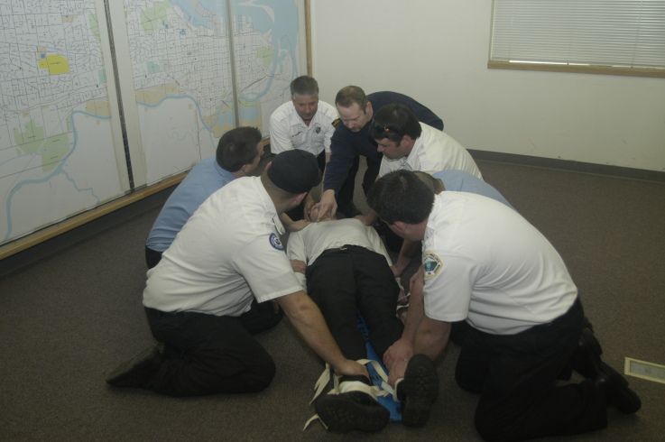
Restraint technique
Enough staff
One team member to pts head and each extremity.
Humane but firm, and do not bargain, start together to hold the patient and accomplish restraint quickly.

Slide 16
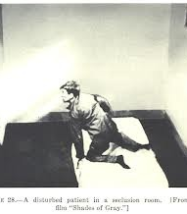
Seclusion
Not as a punishment
For the safety of pt., staff, property & others
On time-out basis
Regular check up on the pt.
Attend for the pt. basic needs
Evaluation of the condition by dr.
Monitor pt. through a screen.

Slide 17
Medications
Major Tranquilizers e.g. : Olanzapine 5-10mg IM, (Haloperidol 5 - 10 mg IM or Chlorpromazine 50 - 100 mg IM.)
Benzodiazepines: e.g. diazepam 5-10 mg (slow IV infusion to avoid the risk of respiratory depression).
Hospitalization:
For further assessment and treatment.

Slide 18
The end..

