Slide 1
Etiology,Diagnosis & Classification in Psychiatry
Dr.Noor Al-Modihesh
Child & Adolescent Pyschiatrist

Slide 2
Classification :
Primarily syndrome based (syndromes: collections of symptoms that tend to co-occur and appear to have a characteristic course and outcome.)
Clinical observations that signs and symptoms co-occur in groups of patients.
Depends on etiology.

Slide 3
Why to classify ?
introduces order and structure to our thinking and reduces the complexity of clinical phenomena.
facilitate communication among clinicians
help to predict outcome ( e.g schizophrenia has chronic course )
often used to choose an appropriate treatment
ensure that psychiatric research can be conducted with comparable groups of patients

Slide 4
I-Organic vs. Functional Classification
in everyday psychiatric practice the distinction between organic (neurocognitive ) and (functional) mental disorders is still commonly used and useful in the management.

Slide 5
Organic Mental Disorders
psychiatric disorders characterized by neurocognitive structural brain pathology that can be detected by clinical assessment or usual tests. E.g. delirium, dementia, substance-induced mental disorders, and medication-induced mental disorders.

Slide 6
Features Suggestive of Organic Mental Disorders :
Disturbed consciousness
+/- other cognitive disturbance in: attention, concentration, orientation or memory
Physical illness (e.g. diabetes, hypertension)
Vital signs disturbances (e.g. fever, high BP).
Neurological features (e.g. ataxia, dysarthria).

Slide 7
Non-organic (functional) Mental Disorders:
No obvious structural brain pathology.
Usually neurotransmitter pathology E.g. Schizophrenia, mood disorders, anxiety disorders, adjustment disorders.

Slide 8
II-Psychosis vs. Neurosis Classification
PSYCHOSIS :
Impaired insight
- Impaired reality testing.
- Impaired judgment.
Presence of active/positive psychotic features.or negative symptoms
NEUROSIS:
Abnormal quantity of symptoms.
No psychotic Sx

Slide 9
Positive Psychotic Features
Major disturbances in :
perception e.g. hallucination.
thinking e.g. delusions , FOI
mood e.g. extreme euphoria.
behavior e.g. disorganized beh.

Slide 10
Negative Features
Poverty of thoughts & speech.
Lack of ambition , interest & initiation.
Restricted affect.
Self-neglect.
Poor self care & hygiene

Slide 11
DSM-5 Classification (May 2013)
is an evidence-based manual useful in accurately and consistently diagnose mental disorders. In preparation for the release of DSM-5.
Reviewed by many experts who analyzed so many data and findings of trails.

Slide 12
DSM-5 Categories (example)
Schizophrenia Spectrum and Other Psychotic Disorders
Schizophrenia
Brief Psychotic Disorder
Schizophreniform Disorder
Schizoaffective Disorder
Delusional Disorder
Substance/Medication-Induced Psychotic Disorder
Psychotic Disorder Due to Another Medical Condition
Catatonia

Slide 13
Etiology in Psychiatry
The Complexity of etiology in Psychiatry
1. Time factor: causes are often remote in time from the effect they produce.
2. Single cause may lead to several psychological effects e.g. deprivation from parental affection may lead to depression or conduct disorder in children and adolescents.
3. Single effect may arise from several causes e.g. depression may be due to accumulation of several causes like endocrinopathies, psychosocial stresses and side effects of some drugs. Most psychiatric disorders are multifactorial.

Slide 14
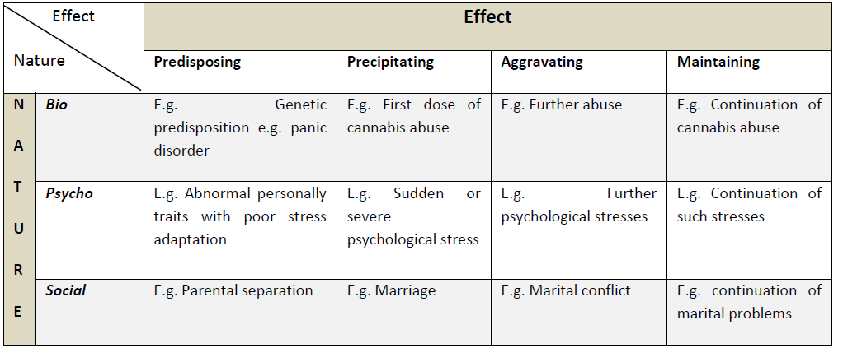

Slide 15
Main causative factors in psychiatry:
Genetic : e.g. in schizophrenia , mood disorders , panic disorder and agoraphobia.
Neuropathological: e.g. dementias ,delirium.
Endocrinopathological: e.g. hyperthyroidism / hypothyroidism.
Pharmacological: side effects of medications e.g. steroids > mood changes.
Social: e.g. marital discord /occupational problems/financial difficulties.
Psychological : behavioral ,cognitive , or psychodynamic problems

Slide 16
All rights reserved for prof. Al-Sughayir Introductory Textbook of Psychiatry,6th eddition

