Slide 1
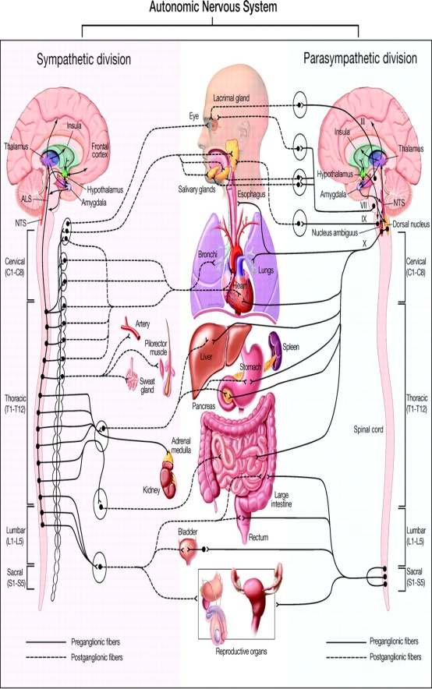
Psychosomatic Medicine
Fahad Alosaimi MBBS, SSC-Psych
Psychosomatic medicine psychiatrist
Associate professor
King Saud Medical city
King Saud University, Riyadh

Slide 2
Case Development 3
Past medical and psychiatric history indicated that the patient has left side CVA 7 years ago.
Post stroke, he had 3 months history of low mood, loss of interest, crying spells, excessive guilt feelings and death wishes.
Moreover, he had decreased sleep, appetite, energy and concentration.
He became isolated and not cooperative during physiotherapy session. After been assessed and managed by psychosomatic psychiatrist, patient’s mood and motor function have improved very well.

Slide 3
Stroke
After stroke, 25 to 40% of patients meet criteria for Depression.
Studies in the 80’s and 90’s demonstrated that post-stroke depression (PSD) was associated with left frontal brain lesions, worse physical and cognitive recovery, and increased mortality.
These depressions were shown to be treatable with antidepressants and successful treatment led to both improved recovery and survival.
There have now been RCTs showing PSD may be treated and prevented effectively with citalopram, nortriptyline, or reboxetine.

Slide 4
Stroke
Later, antidepressants (ADs) shown to improve physical and cognitive recovery over 1 year independent of dep.
Over 7 years, antidepressants shown to decrease mortality by 50% even among non-dep pts ...How?
Inflammatory proteins are released both by stroke and depression and can have long lasting negative effects on brain function.
ADs have been shown to decrease these Inflammatory proteins neurogenesis and synaptogenesis improved recovery and decreased mortality following stroke.
However, pts who take both NSAIDs & ADs should be monitored for intracranial hemorrhage.
Notes:
These findings might be construed to indicate that neurogenesis and synaptogenesis are enhanced by the attenuation of inflammatory proteins. This may lead to changes in brain function that last for many years and may ultimately lead to improved recovery and decreased mortality following stroke.

Slide 5
Primary VS secondary psychiatric disorders
Secondary | Primary
Etiology : one diagnosable systemic medical disease, CNS disease or substance. e.g. Depression due to SLE Psychosis due to amphetamine In medicine: like secondary HTN due to renal artery stenosis. Clues suggestive of being secondary: Disturbance of consciousness or vital signs Presence of : non-auditory hallucinations e.g. visual, hard neurological signs physical illness old age onset | Etiology is: Multi-factorial e.g. schizophrenia Major depressive disorder In medicine: like Essential hypertension Clues suggestive of being primary : Normal consciousness & vital signs. Presence of : Auditory hallucinations soft neurological signs Young age onset
Notes:
DEFINITION OF “ORGANIC MENTAL DISORDERS”
During the past few decades, the advent of newer pharmacological treatments and advances in fields such as neuroimaging, genetics, and molecular biology, have resulted in a growing recognition of brain pathology as the basis for mental disorders. Indeed, the introduction to the Diagnostic and Statistical Manual of Mental Disorders Fourth Edition Text Revision (DSM-IV-TR; American Psychiatric Association, 2000) agrees that the term “mental disorder” unfortunately implies a distinction between “mental” disorders and “physical” disorders that is a reductionist anachronism of mind / body dualism, and admits that the term “mental disorder” persists in the title of the Manual because an appropriate substitute have not been found.
The term "organic," as used for many years pointed to defined pathological lesions and was contrasted with the term "functional" or physiological abnormalities that could not be detected by existing laboratory procedures. The DSM-IV (American Psychiatric Association, 1994) and DSM-IV-TR abandon the categories of organic and functional mental disorders. DSM-IV introduced the category Mental Disorders due to a general medical condition to designate psychopathological syndromes which are known to be symptomatic manifestations of a systemic medical or cerebral disorder. Disorders are included in this category if they meet the following criteria: (1) There is evidence from the history, physical examination, or laboratory findings that the disturbance is the direct physiological consequence of a general medical condition; (2) The disturbance is not better accounted for by another mental disorder; (3) The disturbance does not occur exclusively during the course of a delirium. The term general medical condition refers to conditions that are coded on Axis III and are listed outside the “mental disorders” chapter of ICD (American Psychiatric Association, 2000).
ICD – 10 maintains "organic" as a superordinate category. The block F00 – F09 is titled “Organic, including symptomatic, mental disorders”, and comprises “a range of mental disorders grouped together on the basis of their common, demonstrable etiology in cerebral disease, brain injury, or other insult leading to cerebral dysfunction” (World Health Organization, 1992). ICD-10 indicates that the dysfunction may be primary, as in diseases, injuries and insults that affect the brain directly or with predilection, or secondary, as in systemic disorders that involve the brain. ICD-10 uses the term symptomatic for those organic disorders in which cerebral involvement is secondary to a systemic extracerebral disease or disorder. ICD-10 states that use of the term “organic” does not imply that conditions elsewhere in the classification are “nonorganic” in the sense that they have no cerebral substrate, and that the term means simply that the syndrome so classified can be attributed to an independently diagnosable cerebral or systemic disease. ICD-10 recommends four criteria for classifying a syndrome as organic: (1) evidence of cerebral disease, damage, or dysfunction, or of systemic physical disease, known to be associated with one of the listed syndromes; (2) a temporal relationship (weeks or a few months) between the development of the underlying disease and the onset of the mental syndrome; (3) recovery from the mental disorder following removal or improvement of the underlying presumed cause; and (4) absence of evidence to suggest an alternative cause of the mental syndrome (such as a strong family history or precipitating stress).

Slide 6
Medical factors/illnesses may affect individual vulnerability, course, & outcome of ANY psychiatric disorder.
Psychosocial factors/illnesses may affect individual vulnerability, course, & outcome of ANY type of disease.
Psychological factors may operate to facilitate, sustain, or modify the course of medical disease , even though their relative weight may vary…
from illness to illness !..
form one individual to another !..
between 2 different episodes of the same illness in the same individual! .

Slide 7
Illness Vs. Disease
Illness:
-The response of the individual and his/her family to symptoms
-Subjective !, psychosocial, cultural, religious factors
Disease:
-Defined by physicians and associated with pathophysiological processes and documented lesions
-Objective !
Implications !!

Slide 8
Illness Behavior
The manner in which individuals monitor their bodies, define and interpret their symptoms, take remedial actions, and utilize the health care system
Variety of factors
Achievement of objectives
Abnormal illness behavior:
Inappropriate or maladaptive mode of perceiving, evaluating or acting in relation to one’s own health status
Illness affirming………………………illness denying

Slide 9
Example of psychosocial factors affecting a medical d (CHD)
According to The Interheart study, the population attributable risk factor for MI of Hypertension was 17.9% , while the psychosocial risk factors, were responsible about :
5%
10%
15%
20%
>30%
Notes:
Lancet. 2004 Sep 11-17;364(9438):937-52.
Effect of potentially modifiable risk factors associated with myocardial infarction in 52 countries (the INTERHEART study): case-control study.
Yusuf S, Hawken S, Ounpuu S, Dans T, Avezum A, Lanas F, McQueen M, Budaj A, Pais P, Varigos J, Lisheng L; INTERHEART Study Investigators.
Population Health Research Institute, Hamilton General Hospital, 237 Barton Street East, Hamilton, Ontario, Canada L8L 2X2. yusufs@mcmaster.ca
Comment in:
Lancet. 2004 Sep 11-17;364(9438):912-4.
Lancet. 2005 Jan 8-14;365(9454):117-8; author reply 118.
Lancet. 2005 Jan 8-14;365(9454):117; author reply 118.
Lancet. 2005 Jan 8-14;365(9454):118; author reply 119-20.
Singapore Med J. 2006 Jun;47(6):555-6.
BACKGROUND: Although more than 80% of the global burden of cardiovascular disease occurs in low-income and middle-income countries, knowledge of the importance of risk factors is largely derived from developed countries. Therefore, the effect of such factors on risk of coronary heart disease in most regions of the world is unknown. METHODS: We established a standardised case-control study of acute myocardial infarction in 52 countries, representing every inhabited continent. 15152 cases and 14820 controls were enrolled. The relation of smoking, history of hypertension or diabetes, waist/hip ratio, dietary patterns, physical activity, consumption of alcohol, blood apolipoproteins (Apo), and psychosocial factors to myocardial infarction are reported here. Odds ratios and their 99% CIs for the association of risk factors to myocardial infarction and their population attributable risks (PAR) were calculated. FINDINGS: Smoking (odds ratio 2.87 for current vs never, PAR 35.7% for current and former vs never), raised ApoB/ApoA1 ratio (3.25 for top vs lowest quintile, PAR 49.2% for top four quintiles vs lowest quintile), history of hypertension (1.91, PAR 17.9%), diabetes (2.37, PAR 9.9%), abdominal obesity (1.12 for top vs lowest tertile and 1.62 for middle vs lowest tertile, PAR 20.1% for top two tertiles vs lowest tertile), psychosocial factors (2.67, PAR 32.5%), daily consumption of fruits and vegetables (0.70, PAR 13.7% for lack of daily consumption), regular alcohol consumption (0.91, PAR 6.7%), and regular physical activity (0.86, PAR 12.2%), were all significantly related to acute myocardial infarction (p<0.0001 for all risk factors and p=0.03 for alcohol). These associations were noted in men and women, old and young, and in all regions of the world. Collectively, these nine risk factors accounted for 90% of the PAR in men and 94% in women. INTERPRETATION: Abnormal lipids, smoking, hypertension, diabetes, abdominal obesity, psychosocial factors, consumption of fruits, vegetables, and alcohol, and regular physical activity account for most of the risk of myocardial infarction worldwide in both sexes and at all ages in all regions. This finding suggests that approaches to prevention can be based on similar principles worldwide and have the potential to prevent most premature cases of myocardial infarction.

Slide 10
Stress Vs CHD
According to The Interheart study, the population attributable risk factor for MI of Hypertension was 17.9% , while the psychosocial risk factors, were responsible about :
5%
10%
15%
20%
>30%
Notes:
Lancet. 2004 Sep 11-17;364(9438):937-52.
Effect of potentially modifiable risk factors associated with myocardial infarction in 52 countries (the INTERHEART study): case-control study.
Yusuf S, Hawken S, Ounpuu S, Dans T, Avezum A, Lanas F, McQueen M, Budaj A, Pais P, Varigos J, Lisheng L; INTERHEART Study Investigators.
Population Health Research Institute, Hamilton General Hospital, 237 Barton Street East, Hamilton, Ontario, Canada L8L 2X2. yusufs@mcmaster.ca
Comment in:
Lancet. 2004 Sep 11-17;364(9438):912-4.
Lancet. 2005 Jan 8-14;365(9454):117-8; author reply 118.
Lancet. 2005 Jan 8-14;365(9454):117; author reply 118.
Lancet. 2005 Jan 8-14;365(9454):118; author reply 119-20.
Singapore Med J. 2006 Jun;47(6):555-6.
BACKGROUND: Although more than 80% of the global burden of cardiovascular disease occurs in low-income and middle-income countries, knowledge of the importance of risk factors is largely derived from developed countries. Therefore, the effect of such factors on risk of coronary heart disease in most regions of the world is unknown. METHODS: We established a standardised case-control study of acute myocardial infarction in 52 countries, representing every inhabited continent. 15152 cases and 14820 controls were enrolled. The relation of smoking, history of hypertension or diabetes, waist/hip ratio, dietary patterns, physical activity, consumption of alcohol, blood apolipoproteins (Apo), and psychosocial factors to myocardial infarction are reported here. Odds ratios and their 99% CIs for the association of risk factors to myocardial infarction and their population attributable risks (PAR) were calculated. FINDINGS: Smoking (odds ratio 2.87 for current vs never, PAR 35.7% for current and former vs never), raised ApoB/ApoA1 ratio (3.25 for top vs lowest quintile, PAR 49.2% for top four quintiles vs lowest quintile), history of hypertension (1.91, PAR 17.9%), diabetes (2.37, PAR 9.9%), abdominal obesity (1.12 for top vs lowest tertile and 1.62 for middle vs lowest tertile, PAR 20.1% for top two tertiles vs lowest tertile), psychosocial factors (2.67, PAR 32.5%), daily consumption of fruits and vegetables (0.70, PAR 13.7% for lack of daily consumption), regular alcohol consumption (0.91, PAR 6.7%), and regular physical activity (0.86, PAR 12.2%), were all significantly related to acute myocardial infarction (p<0.0001 for all risk factors and p=0.03 for alcohol). These associations were noted in men and women, old and young, and in all regions of the world. Collectively, these nine risk factors accounted for 90% of the PAR in men and 94% in women. INTERPRETATION: Abnormal lipids, smoking, hypertension, diabetes, abdominal obesity, psychosocial factors, consumption of fruits, vegetables, and alcohol, and regular physical activity account for most of the risk of myocardial infarction worldwide in both sexes and at all ages in all regions. This finding suggests that approaches to prevention can be based on similar principles worldwide and have the potential to prevent most premature cases of myocardial infarction.

Slide 11
INTERHEART Study (EPIDEMIOLOGY, stress & CHD)
Percent
*Case control
study of:
n > 29000 in
52 countries.
*Effect of potentially modifiable risk factors associated with myocardial infarction in 52 countries (the INTERHEART study): case-control study. Yusef S et al. Lancet 2004
Notes:
Case-control study of n > 29000 in 52 countries.
Psychosocial risk factors, including stress, depression and low generalized locus of control, were responsible for 32.5% of the population attributable risk for MI.
This is independent of, and only slightly less than, the population attributable risk for lifetime smoking (35.7%), and greater than that for hypertension (17.9%) or obesity (20.0%).
Locus of control: the perceived ability to control life circumstances
Effect of potentially modifiable risk factors associated with myocardial infarction in 52 countries in a case-control study based on the INTERHEART study]
[Article in Hungarian]
Gyárfás I, Keltai M, Salim Y.
Gottsegen György Országos Kardiológiai Intézet.
An international, standardised case-control study was established to assess the importance of risk factors for coronary heart disease worldwide. From 52 countries representing every inhabited continent 15152 cases and 14820 controls were enrolled. The relation of smoking, history of hypertension and/or diabetes, waist/hip ratio, dietary patterns, physical activity, consumption of alcohol, blood apolipoproteins and psychosocial factors to myocardial infarction was reported. Odds ratios and their 99% confidence limits for the association of risk factors to acute myocardial infarction and their population attributable risks were calculated. Smoking (odds ratio 2.87 for current vs never, population attributable risk 35.7% for current and former smoker vs never), raised apolipoprotein B / apolipoprotein A1 ratio (3.25 for top vs lowest quintile, population attributable risk 49.2 for top four quintiles vs lowest quintile), history of hypertension (1.91, 17.9%), diabetes (2.37, 9.9%), abdominal obesity (1.12 for top vs lowest tertile and 1.62 for middle vs lowest tertile, 20.1% for top two tertiles vs lowest tertile), psychosocial factors (2.67, 32.5), daily consumption of fruits and vegetables (0.70, 13.7% for lack of daily consumption), regular alcohol consumption (0.91, 6.7%), and regular physical activity (0.86, 12.2%) were all significantly related to acute myocardial infarction (p < 0.0001 for all risk factors, and p = 0.03 for alcohol). These associations were noted in men and women, old and young and in all regions of the world. Collectively these nine risk factors accounted for 90% of the population attributable risk in men and 94% in women. This finding suggests that approaches to prevention can be based on similar principles worldwide

Slide 12
Introduction (psychosomatic medicine)
Psychosomatic medicine is the subspecialty of psychiatry whose practitioners have particular expertise in the diagnosis and treatment of psychiatric disorders and difficulties in complex medically ill patients (Gitlin et al. 2004)
Psychosomatic medicine resides at the interface of physical and mental illness.
The clinical practice of psychosomatic medicine is sometimes called consultation-liaison psychiatry (CLP)
Since 2001, Psychosomatic medicine has become a subspecialty recognized by the American Board of Medical Specialties

Slide 13
Advantages of psychosomatic medicine (CLP) service
1-Releive symptoms of distress & improve the quality of life of some patient with serious diseases.
2- May improve the course and prognosis of several major medical illnesses
3-Cost-effective :
A- Reduce the length of hospital stay.
B-Reduce the number of unnecessary investigations (performed for physical symptoms that may actually reflect underlying psychological distress )..

Slide 14
Approach
How to do it (effective psych. Consultation)
1-Review patient charts, asking nurses and physician.
2-Obtain good psychiatric history (paying attention to psychological & social factors).
3-MSE & MMSE if cognitive problem is suspected and possibly neuropsychological assessment.

Slide 15
Approach
How to do it (effective psych. Consultation)
4-Making logical differential diagnosis among medical , neurological and psychiatric diseases (use multi-axial Dx.)
5-Investigate based on that.
6-Make treatment plan.
7-Follow up plan ( as inpatient & outpatient).
8-Collaborate with both the patient and the referring team.

Slide 16
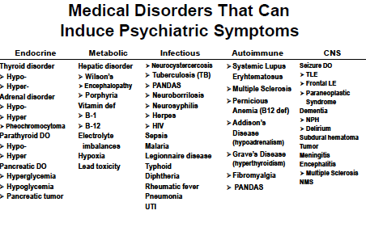

Slide 17
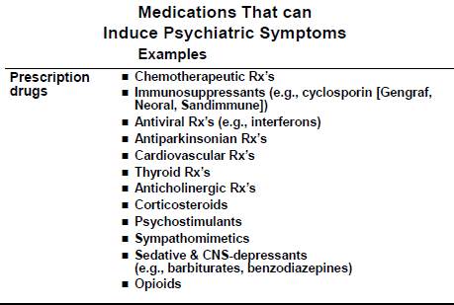

Slide 18
Clues Suggestive of “Organic” Mental Disorders(Psychiatric disorder 2ndary to general medical condition)
History:
▪Psychological symptoms occurring …
New onset psychiatric symptoms presenting after age 40.
During the course of a major medical illness which had impaired some organ function (e.g., neurological, endocrine, renal, hepatic, cardiac, pulmonary).
While taking medications/illicit substance, he had psychoactive effects.
▪ Family history of:
-ve for primary psychiatric illness..
+ve for medical disease that may present with psychiatric symptoms e.g.:
-Degenerative or inheritable neurological disorders
(e.g., Alzheimer’s disease, Huntington’s disease)
-Inheritable metabolic disorders (e.g., DM,
Pernicious Anemia, Porphyria)

Slide 19
Clues Suggestive of Psychiatric disorder 2ndary to general medical condition
Clinical Exam:
Abnormal vital signs.
Evidence of organ dysfunction, focal neurological deficits.
Eye exam:
• Pupilary changes—asymmetries
• Nystagmus (often a sign of drug intoxication)
Presence of altered states of mind, LOC, mental status changes, cognitive impairment; episodic, recurrent, cyclic course
Presence of visual, tactile or olfactory hallucinations
Signs of:
• Cortical dysfunction (e.g., dysphagia, apraxia, agnosia)
• Diffuse subcortical dysfunction
(e.g., slowed speech/mentation/movement, ataxia, incoordination, tremor, chorea,
asterexis, dysarthria)

Slide 20
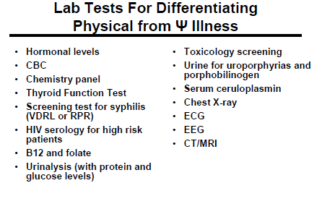

Slide 21
Depression & medical illnesses
Depression
Medical disorder
Stress

Slide 22
The global burden of disease, 1990−2020
Lower Respiratory Infections
Diarrheal Diseases
Perinatal conditions
Depression
Heart Diseases
Cerebrovascular D/O
Heart Diseases
Depression
Traffic accidents
Cerebrovascular D/O
COPD
Lower Respiratory Infections
Lopez et al :Global burden of disease and risk factors, Oxford University Press, New York (2006)
Notes:
Tarak Vasavada, MD
Associate Professor
Department of Psychiatry
UAB School of Medicine- Huntsville

Slide 23
Global burden of disease attributable to mental and substance use disorders: findings from the Global Burden of Disease Study 2010 (Whiteford, the lancet, 2013)
As part of the GBD 2010, epidemiological data was collected for 20 mental and substance abuse disorders in 187 countries.
In 2010, mental and substance use disorders accounted for 183·9 million DALYs or 7·4% of all DALYs worldwide.
Mental and substance abuse disorders were the leading cause of non-fatal illness worldwide in 2010 (22.8%),
The burden of mental and substance use disorders increased by 37·6% between 1990 and 2010.
Depressive disorders were responsible for 40% of the burden of illness due to mental and substance abuse disorders.
Notes:
http://www.youtube.com/watch?feature=player_embedded&v=DUhyDHWoh_o

Slide 24
Likelihood of Depression Increases with No. of Physical Symptoms at Presentation
Kroenke K, et al. Arch Fam Med 1994
Notes:
Out patient data. High utilizers are ususally depressed, anxious or somatization d/o or substance abuser

Slide 25

Epidemiology of depression in some medical illnesses
% prevalence
Notes:
Prevalence of depression (%)
Illness
Reference
23
Cerebrovascular accident
Burvill et al. (1995)
27 (Major depression)
20 (Minor depression)
Cerebrovascular accident
Robinson et al. (1984)
51
Parkinson disease
Sano et al. (1989)
11
Alzheimer disease
Greenwald et al. (1989)
18 (Major depression)
27 (Minor depression)
Myocardial infarction
Schleifer et al. (1989)
16
Myocardial infarction
Frasure-Smith et al. (1993)
17
Coronary artery disease (CAD)
Hance et al. (1989)
Prevalence of depression (%)
Illness
Reference
18
CAD
Carney et al. (1987)
42
Cancer
Burkberg et al.(1984)
25-38
Cancer
Kathol et al.(1990)
33
Cancer
Jaffe et al. (1986)
8.5-27.3
Diabetes mellitus
Goodnick et al. (1995)
5.6-12.2
HIV
Brown et al. (1986)

Slide 26

Depression as a risk factor for the development of medical illness (CANMAT, ANNALS OF CLINICAL PSYCHIATRY 2012;24(1):82-90)
Odds
ratio
Notes:
Medical illness
Comments
Coronary artery disease/ischemic heart disease
Depression increases the risk by 1.5 to 2 fold
Ischemic stroke
Depression increases the risk by 1.8 fold
Epilepsy
Depression increases the risk by 4 to 6 fold
Alzheimer’s disease
Depression increases the risk by 2.1 fold
Diabetes mellitus (type II)
Depression increases the risk by 60%
Cancer
Depression and life stressors increase the risk by 1.35 to 1.88 fold
HIV
Bipolar spectrum conditions (hyperthymic/cyclothymic) may increase the risk for HIV infection
HIV:
Bipolar spectrum conditions (hyperthymic/cyclothymic) may increase the risk for HIV infection

Slide 27
Depression plus Medically illness
Is it serious?
Poor outcomes of the medical illness
Increased mortality in cardiovascular disease, stroke, diabetes, and ?cancer
Chronic medical conditions and depression are interrelated and that treatment of one condition can affect the outcomes for the other.
Worse adherence to medical regimens, tobacco smoking, sedentary lifestyle, and overeating.
Increased functional disability, decreased self-care.
Four to five times greater levels of morbidity, premature mortality, health services use and health care expenditures compared to non- depressed patients with no GMC.
*Lin EH. Et al. Gen Hosp Psychiatry. 2006;28:482-486

Slide 28
Pathophysiology : mediating factors between Depression/Stress & medical illnesses
Physiological:
  hyperactivity of the hypothalamic- pituitary- adrenal (HPA) axis.
  immune activation with release of proinflammatory cytokines.
  activation of the sympathetic nervous system.
Behavioural:
  Physical inactivity.
  Smoking.
  High carbohydrate & high fat diet.
  Poor adherence to medications.
  Social isolation.

Slide 29
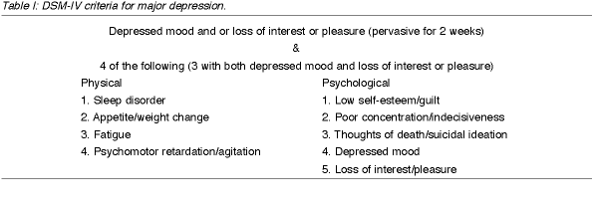
Dsm-5 criteria for major depression (physical & psychological symptoms)
Diagnostic Approach in the Medically Ill:
Inclusion approach: “count” all physical symptoms as part of depression even if possibly explained by the medical illness (to give patients, the benefit of doubt, by treating serious disabling illness like depression).

Slide 30
DIFFERENTIAL DIAGNOSIS
Depressive disorder due to another medical condition.
Substance-induced depressive disorder, iatrogenic versus other illicit substances.
Bipolar I/II disorder, most recent episode depressed.
Major depressive disorder(uni polar).
Persistent depressive disorder (Dysthymia).
Adjustment disorder with depressed mood ( common in medical setting).

Slide 31
Examples of Depression in medically ill patients

Slide 32
EPIDEMIOLOGY (depression & coronary heart disease)
Depression has repeatedly been found to predict :
early-onset CHD.
post-MI mortality (1.5- 5.07 times risk), esp. severe and chronic types.
e.g. (HAM-Depression) scale score in first 2 weeks post CHD event predict 7 years mortality risk.
increased CHD symptoms(chest pain, fatigue).
noncompliance on exercise/medication/smoking .
Glassman AH , et al ,Psychiatric characteristics associated with long-term mortality among 361 patients having an acute coronary syndrome and major depression: seven-year follow-up of SADHART participants, Arch Gen Psychiatry, Sep 2009
Keteyian SJ. Cardiovascular symptoms in coronary-artery disease patients are strongly correlated with emotional distress.] Psychosomatics,2008
Notes:
The authors tested the association of multiple cardiovascular symptoms with various measures of emotional distress (i.e., the scales of the Symptom Checklist-90-Revised) and the putative risk factors for disease status in 109 patients with documented coronary artery disease. RESULTS: Measures of emotional distress were stronger correlates of patient-rated distress due to the symptoms than were traditional risk factors. CONCLUSION: Treatment of emotional distress may be a viable strategy for symptom-control in cardiovascular disease.

Slide 33
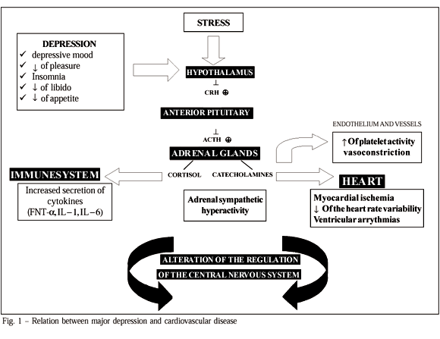
Pathophysiology (depression &CHD)
Notes:
The antidepressant itself had no impact on medical outcome, improvement in depression improved medical prognosis, and more-severe depression was associated with a worse prognosis. Mechanisms by which depression might affect the outcome of coronary heart disease include poor compliance with medical treatment, diet and exercise, heightened inflammatory state, and unstable autonomic tone. Whatever the cause, the results suggest that clinicians must not only recognize and treat depression in cardiac patients, but also treat it to remission. Simply prescribing an antidepressant is insufficient if it does not produce substantial improvement in depression.

Slide 34
Depression & diabetes

Slide 35
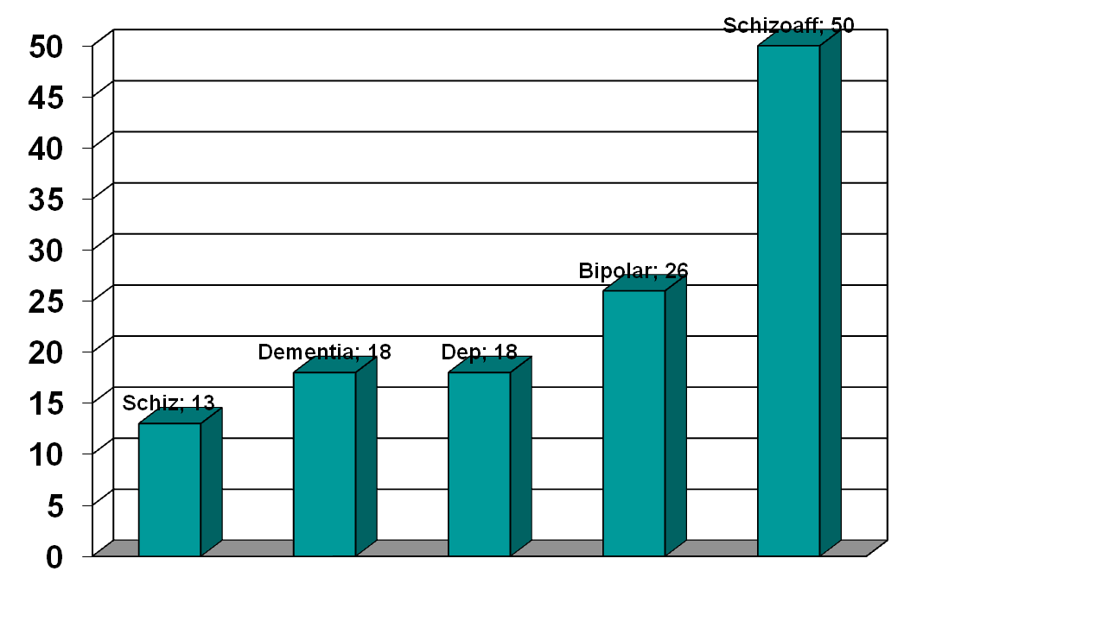
Prevalence of Diabetes among patients with major psychiatric disorders
J Affect Disord. 2002 Jun;70(1):19-26.

Slide 36
Bi-directional Relationship: Independent of multiple confounding factors
Depression
Type II Diabetes
Depression is associated with a 60 – 65% increased risk to develop Type II Diabetes
(Campayo et al. 2010; Mezuk et al. 2008; Musselman et al. 2003)

Slide 37
Type II Diabetes is associated with higher prevalence of depression
Type II Diabetes
2 – 3 x higher prevalence than in general population
Depression
Mezuk et al. 2008

Slide 38
CANCER
Many oncologists consider depression part of the illness and often conclude it therefore does not require treatment.
Many also believe that if the cancer can be treated, then the accompanying depression will remit on its own.
Many patients deal with the knowledge of having cancer through the expected grieving process. BUT , it may precipitates an episode of major depression in 25%.

Slide 39
Distress along the illness trajectory
Uncertainty
Time to
process
Existential
Diagnosis End of treatment Palliation
Start of treatment Recurrence
Tolerability
Body
image
Loss of
hope

Slide 40
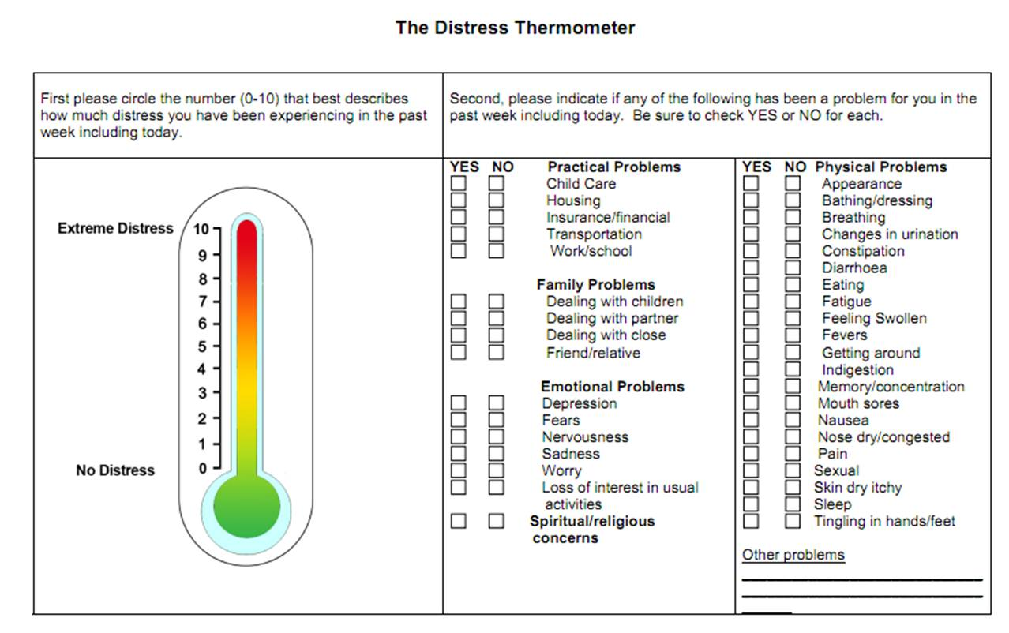

Slide 41
Summary (Depression in medically ill)
Historically, depression in the medically ill was often considered a natural and expected response to medical illness.
Treatment of depression was often considered secondary to treatment of the medical illness, if the depression was even treated at all.
Today, this perspective can no longer be accepted.
Depression is a systemic disease.
The effect of depression on the course of medical illness is multifaceted because there are systemic pathophysiologic implications, as well as psychological and behavioral ramifications.

Slide 42
Summary (Depression in medically ill)
The accurate diagnosis and appropriate treatment of depression in the medically ill improves quality of life, enhances the patient's ability to be actively engaged in his or her treatment, decreases symptom quantity and severity, and decreases cost utilization.
Most important, it decreases morbidity and mortality.

Slide 43
Four important messages ABOUT MEDS in ESRD
Most psychotropic medications are fat soluble, easily pass the blood-brain barrier, are not dialyzable, are metabolized primarily by the liver, and are excreted mainly in bile.
The majority of these drugs can be safely used with the ESRD populations.
Dosing often involves trial and error. The majority of patients with ESRD both tolerate and require ordinary doses of most psychotropic medications.
Toxicity is usually obvious, and we would caution more against undermedicating patients than against overmedication.
Cohen LM. Update on psychotropic medication use in renal disease. Psychosomatics. 2004

Slide 44
Summary of psychopharmacology for patients with liver disease
To guide pharmacotherapy in liver disease, use Childs-Pugh scores with closer monitoring to help to increase safety and tolerability.
When choosing psychotropic agents for patients with liver disease, consider the following:
  Drug interactions
    e.g : NSAIDs + SSRI for GI bleed
  Medical Disease
    E.g : Severity of liver disease, protein binding
  Age : e.g. : Decreased risk hepatotoxicity in adults
  Drug profile
    E.g.: Hepatotoxicity, hyperammonemia
  Hepatic modifications
    E.g: Bupropion vs. citalopram
Sanjeev Sockalingam, psychopharmacology updates, 2009

Slide 45
Case Development 4
Elaborating more in his past history, His wife reported that when she was pregnant with her last child 27 years ago, she has needed to get help of psychiatry -because of sadness, crying, anxiety and disturbed sleeping.
Also, after delivery, she became behaviorally disturbed plus hearing voices asking her to kill her child.

Slide 46
Analyze the symptoms (presented and expected) in this case and signs, including mood, thoughts, cognition, perception and physical aspects
Discuss other elements related to the case includes possible etiological reasons
Discuss the initial possible diagnosis of this case and different types of such clinical presentation
Discuss about Perinatal psychiatry

Slide 47
Perinatal psychiatry

Slide 48
CONSEQUENCES OF DEPRESSION IN PREGNANCY
Mother | Baby
Suicide unhealthy practices e.g. smoking Poor nutrition Less compliant with prenatal care Increased pain ,nausea, stomach pain, SOB, GI symptoms..etc | low birth weight, smaller head circumferences, premature delivery, etc poor mother-infant attachment, delayed cognitive and linguistic skills, impaired emotional development, and behavioral issues emotional instability and conduct disorders, attempt suicide, and require mental health services
Notes:
poor pregnancy and birth outcomes, low birth weight, smaller head circumferences, premature delivery, etc
If depression continues into the postpartum period :poor mother-infant attachment, delayed cognitive and linguistic skills, impaired emotional development, and behavioral issues
emotional instability and conduct disorders, attempt suicide, and require mental health services

Slide 49
Depression in pregnant Women
10% to 16% of pregnant women fulfill the diagnostic criteria for MDD, and even more women experience subsyndromal depressive symptoms
Many of depressive symptoms overlap with the physical and mental changes experienced during pregnancy

Slide 50
Treatment of Depression in pregnant Women
Antidepressants reduce risk for preterm birth and cesarean delivery compared with Depressed women untreated BUT has more neonatal complications, including low Apgar score (? Withdrawal syndrome) (Heli Malm, AJP, 2015).
Sertraline, Escitalopram and Citalopram are the Safest SSRIs in Pregnancy (Reefhuis J et al, BMJ 2015)
SSRIs : exposure show NO consistent information to support specific morphological teratogenic risks.
NO association between TCA use in pregnancy and structural malformations.
Presumed associations between antidepressants and malformations may be complicated by poly-drug interactions

Slide 51
Bupropion, venlafaxine, duloxetine, nefazodone, and mirtazepine: NO statistically significant difference or higher than expected rate of congenital anomalies
ECT has long been regarded as a safe and effective treatment for severe depression, life threatening depression, or failure to response to antidepressant drugs.
Psychotherapy: is considered to be an evidence-based treatment of mood disorders.
Mild depression: interpersonal psychotherapy (IPT) or cognitive behavioral therapy (CBT), both having solid evidence-based outcomes data for the treatment of depression.
Couples counseling
The American Psychiatric Association and the American College of Obstetricians and Gynecologists, 2009 Report

Slide 52
Treatment of mania & psychosis during pregnancy
Typical antipsychotics esp. high potent considered as relatively safe compared to other medications.
Atypical antipsychotics: no major malformations were found. However, limited data so far, Metabolic syndrome is more with olanzapine and clozapine.
Lithium is considered first line mood stabilizer during pregnancy despite rare cardiac anomaly.
Lamotrigine is the safest anticonvulsants mood stabilizers.
Avoid valproate & carbamazepinein child bearing women and pregnancy

Slide 53
Why to avoid Valproate in child bearing women and pregnancy?
• Neural tube defects secondary to interference with
folate metabolism with first trimester exposure
– Risk = 7-16%
• Craniofacial defects: mid-face hypoplasia, short nose
with anteverted nostrils, and long upper lip
• Hypoglycemia, hepatic dysfunction, fingernail
hypoplasia, cardiac defects, cleft palate, hypospadias,
polydactyly
• Neonatal toxicity possible
• Significantly lower mean IQ and verbal IQ

Slide 54
POSTPARTUM DEPRESSION
10% to 20% of women who give birth
Undetected and commonly underdiagnosed
Continuum of Affective Symptoms
‘‘baby blues’’………………………… postpartum psychosis

Slide 55
TREATMENT OF POSTPARTUM DEPRESSION
SSRIs are medications prescribed most commonly but other agents should be considered
?More positive response to SSRIs and Venlafaxine, than to TCAs
Pharmacotherapy should continue for at least 6 months to prevent a relapse of symptoms
Breastfeeding: All antidepressants are secreted to some degree into the breast milk!
Recommend sertraline or Paroxetine : Infant serum levels are low to undetectable.

Slide 56
Fluoxetine : higher rate of secretion into breast milk, long half-lives of metabolites, they can accumulate in an infant’s blood, reaching detectable levels
* NOT considered the first-line SSRI for breastfeeding women
Mirtazapine: no negative effects on infants with maternal use*
Research on long-term effects of SSRI and TCA exposure through breast milk on children shows NO alteration in IQ, language development, or behavior**
IPT and CBT are effective.
*Kristensen JH. et al. Br J Clin Pharmacol 2007;63:322
**Hale TW. Neo Reviews 2004;5:E451

Slide 57
Postpartum Psychosis
Rare: 1 in 500-1000 deliveries.
Typically presents within 2 weeks of delivery.
Often is a manifestation of bipolar disorder.
Signs/symptoms: Severe insomnia, Rapid mood swings, Anxiety, Psychomotor restlessness, Delusions (childbirth themes) ,hallucinations, cognitive disturbance, neglecting the infant.
Assess for suicidal, homicidal/ infanticidal ideations.
Treatment: mostly similar to Tx of bipolar disorder, consider ECT.
Notes:
Usually a psychiatric emergency and will require hospitalization

Slide 58
Case Development 4
At that time (27 years ago), our patient (Abdullah) started to complain of multiple pains in his body associated with headache and dizziness.
He spent his saving for medical checkup for years with no conclusive results tell he was met his psychiatrist and he started to improve.
Discuss about somatic symptoms and related disorders
Notes:
A 47 yr-old businessman referred to outpatient psychiatric clinic by GI group who investigated him for liver disease and found no abnormality. The patient is still suffering from abdominal vague symptoms and thinks he has undiscovered serious disease.
Discussion Guidelines:
Further history information needed and why.
The most likely diagnosis and why.
Differential diagnoses.
Comorbid psychiatric disorders.
Principles of Management:
Regarding mainline of treatment.
Regarding investigations.
Regarding abuse of health care.

Slide 59
Somatic Symptoms And Related Disorders
Notes:
I. Assessment:
- Definition of somatization
– Acute vs. chronic
– Persistent vs. transient
– Multiplicity of physical symptoms
– Relationship with life stressors
– Association with occupational and social dysfunction
– Personality features
– Illness behaviour and sick role
– Social support
– Health services abuse
- MSE:
How the patient describes his symptoms
Thoughts, behaviors and emotions associated with symptoms
Patient’s explanation of his physical symptoms and the meaning of negative tests.
- Physical Examination
- Investigations:
Minimum and for common diseases
Thyroid tests, LFT, FBS, skull x-ray, etc.
- Differential Diagnosis:
Mood disorders, depression
GAD
Schizophrenia
Drug abuse
Somatoform disorders
Factitious disorders
Malingering
II. Management:
To establish a therapeutic relationship
Explanation with emphasis on psychosomatic unity
Regular follow up
Treat concurrent psychiatric disorders
Avoid polypharmacy
Avoid Benzodiazepine dependence risk
Provide specific therapy when indicated
Social & marital intervention.

Slide 60
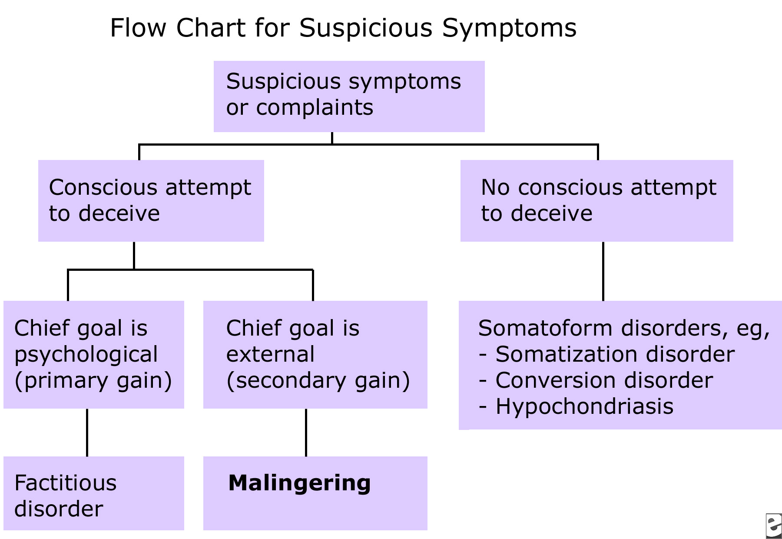
Medically unexplained symptoms
Somatic symptoms and related disorders:
Somatic symptoms disorder
Illness anxiety disorder
Conversion Disorder
http://emedicine.medscape.com/article/293206-workup

Slide 61
DSM-5 criteria of Somatic Symptom Disorder
A. One or more somatic symptoms that are distressing or result in significant disruption of daily life.
B. Excessive thoughts, feelings, or behaviors related to the somatic symptoms or associated health concerns as manifested by at least one of the following:
1. Disproportionate and persistent thoughts about the seriousness of one’s symptoms.
2. Persistently high level of anxiety about health or symptoms.
3. Excessive time and energy devoted to these symptoms or health concerns.
C. Although any one somatic symptom may not be continuously present, the state of being symptomatic is persistent (typically more than 6 months).

Slide 62
DSM-5 criteria of Illness Anxiety Disorder
A. Preoccupation with having or acquiring a serious illness.
B. Somatic symptoms are not present or, if present, are only mild in intensity. If another medical condition is present or there is a high risk for developing a medical condition (e.g., strong family history is present), the preoccupation is clearly excessive or disproportionate.
C. There is a high level of anxiety about health, and the individual is easily alarmed about personal health status.
D. The individual performs excessive health-related behaviors (e.g., repeatedly checks his or her body for signs of illness) or exhibits maladaptive avoidance (e.g., avoids doctor
appointments and hospitals).
E. Illness preoccupation has been present for at least 6 months, but the specific illness that is feared may change over that period of time.
F. The illness-related preoccupation is not better explained by another mental disorder, such as somatic symptom disorder, panic disorder, generalized anxiety disorder, body dysmorphic disorder, obsessive-compulsive disorder, or delusional disorder, somatic type.

Slide 63
DSM-5 criteria of Conversion Disorder
(Functional Neurological Symptom Disorder)
A. One or more symptoms of altered voluntary motor or sensory function.
B. Clinical findings provide evidence of incompatibility between the symptom and recognized neurological or medical conditions.
C. The symptom or deficit is not better explained by another medical or mental disorder.
D. The symptom or deficit causes clinically significant distress or impairment in social, occupational, or other important areas of functioning or warrants medical evaluation.
Specify symptom type:
*With weakness or paralysis *With abnormal movement (e.g., tremor, dystonic movement, myoclonus, gait disorder)
*With swallowing symptoms *With speech symptom (e.g., dysphonia, slurred speech)
*With attacks or seizures *With anesthesia or sensory loss
*With special sensory symptom (e.g., visual, olfactory, or hearing disturbance) *With mixed symptoms
Notes:
There must be clinical findings that show clear evidence
of incompatibility with neurological disease. Internal inconsistency at examination is one
way to demonstrate incompatibility (i.e., demonstrating that physical signs elicited
through one examination method are no longer positive when tested a different way). Examples
of such examination findings include
• Hoover's sign, in which weakness of hip extension returns to normal strength with contralateral
hip flexion against resistance.
• Marked weakness of ankle plantar-flexion when tested on the bed in an individual who
is able to walk on tiptoes;
• Positive findings on the tremor entrainment test. On this test, a unilateral tremor may
be identified as functional if the tremor changes when the individual is distracted away
from it. This may be observed if the individual is asked to copy the examiner in making
a rhythmical movement with their unaffected hand and this causes the functional
tremor to change such that it copies or "entrains" to the rhythm of the unaffected hand
or the functional tremor is suppressed, or no longer makes a simple rhythmical movement.
• In attacks resembling epilepsy or syncope ("psychogenic" non-epileptic attacks), the
occurrence of closed eyes with resistance to opening or a normal simultaneous electroencephalogram
(although this alone does not exclude all forms of epilepsy or syncope).
• For visual symptoms, a tubular visual field (i.e., tunnel vision).

Slide 64
DSM-5 criteria of Psychological Factors Affecting Other Medical Conditions
A. A medical symptom or condition (other than a mental disorder) is present.
B. Psychological or behavioral factors adversely affect the medical condition in one of the following ways:
1. The factors have influenced the course of the medical condition as shown by a close temporal association between the psychological factors and the development or exacerbation of, or delayed recovery from, the medical condition.
2. The factors interfere with the treatment of the medical condition (e.g., poor adherence).
3. The factors constitute additional well-established health risks for the individual.
4. The factors influence the underlying pathophysiology, precipitating or exacerbating symptoms or necessitating medical attention.
C. The psychological and behavioral factors in Criterion B are not better explained by another mental disorder (e.g., panic disorder, major depressive disorder, posttraumatic stress disorder).
Notes:
Psychological or behavioral factors include psychological distress, patterns of interpersonal
interaction, coping styles, and maladaptive health behaviors, such as denial of symptoms
or poor adherence to medical recommendations. Common clinical examples are
anxiety-exacerbating asthma, denial of need for treatment for acute chest pain, and manipulation
of insulin by an individual v^ith diabetes wishing to lose weight. Many different
psychological factors have been demonstrated to adversely influence medical conditions—
for example, symptoms of depression or anxiety, stressful life events, relationship style,
personality traits, and coping styles. The adverse effects can range from acute, with immediate
medical consequences (e.g., Takotsubo cardiomyopathy) to chronic, occurring over a
long period of time (e.g., chronic occupational stress increasing risk for hypertension). Affected
medical conditions can be those with clear pathophysiology (e.g., diabetes, cancer,
coronary disease), functional syndromes (e.g., migraine, irritable bowel syndrome, fibromyalgia),
or idiopathic medical symptoms (e.g., pain, fatigue, dizziness).

Slide 65
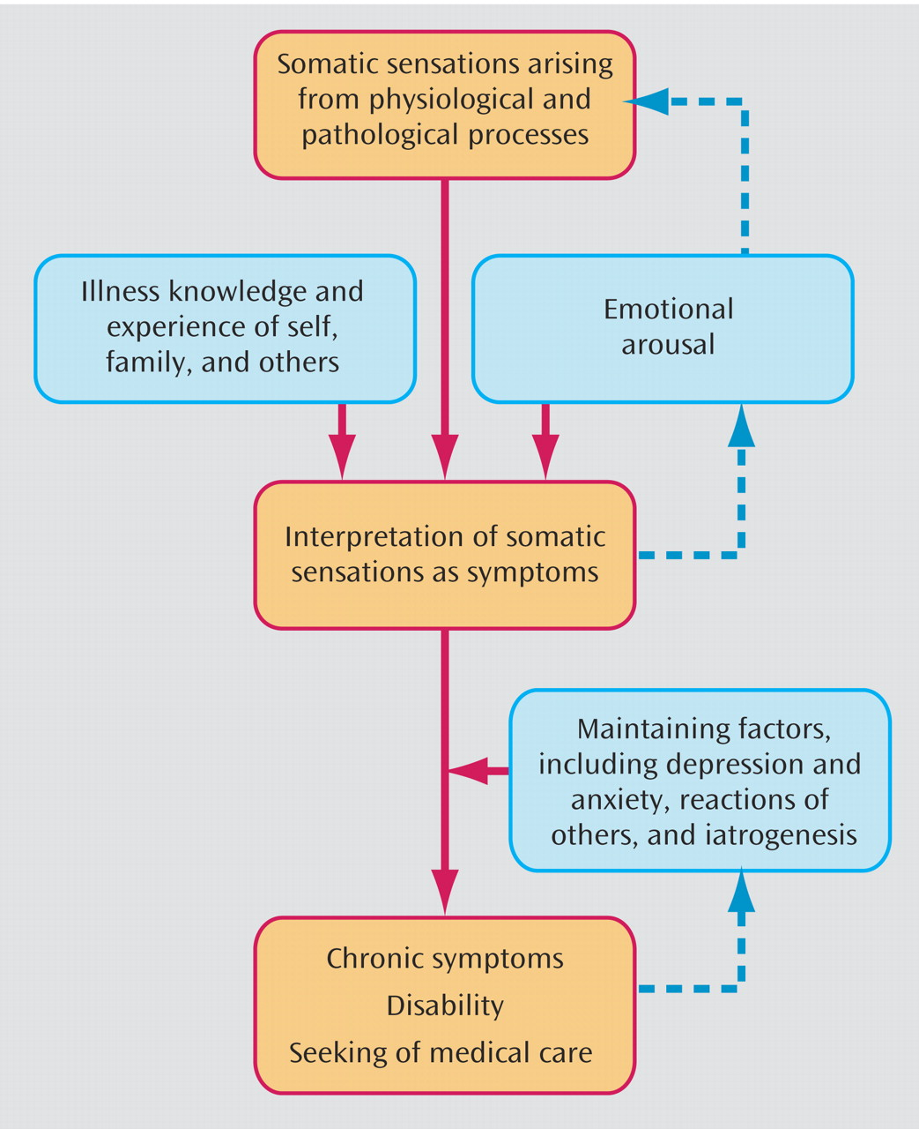
Etiology of Somatic Symptoms And Related Disorders

Slide 66
Diagnosis | Prevalence | Gender | Age of onset | course
Hypochondriasis (somatic symptom disorder+ illness anxiety d) | 1-5% (community) 2-7% (primary care outpatients) | M=F | early adulthood | chronic, waxes and wanes
Conversion disorder | 0.01-0.5% Esp. rural areas, lower SES, developing areas, and lower educational levels | F>M 2- 10 | Late childhood – early adulthood | acute or sudden remit in about 2 w *recur in 25%
Pain disorder (subtype of somatic symptom d) | Unknown 10-15% of U.S. adults experience chronic, disabling pain/year | M=F | Any age | Can be acute or chronic
Factitious Disorder | unknown,1% of hospital cases in which mental health professionals are consulted | F >M | early adulthood | Episodic

Slide 67
Management of Somatic Symptoms And Related Disorders
Do | AVOID
Allow patient role Concentrate on functions Frequent, short visits Single doctor Group therapy May individual Tx Drug treatment for psych co-morbidity. SSRIs, high doses for Hypochondraisis and BDD | Concentrating on Symptoms. Say (It’s just in your mind, take it easy..) Tests or Rx without Dx Unnecessary Referrals / consults.

Slide 68
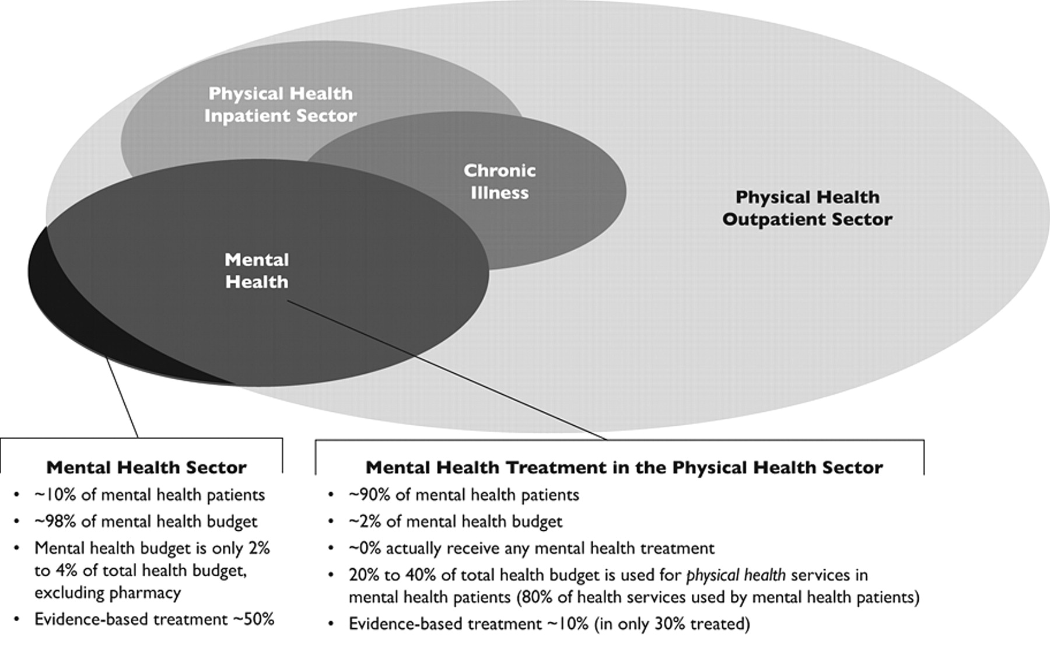
Future of Psychiatry

Slide 69

شعرت بالكثير من الخجل من نفسي لما عرفت سيرة هذا الطبيب !!!
https://www.youtube.com/watch?v=PQPl4quZZAA
د. عبدالرحمن السميط

Slide 70
Thank you

