Slide 1
Lower Genital Tract Infection
(Vulvar and Vaginal Disease)
433OBGYNteam@gmail.com

Slide 2
Objectives of the video:
• Formulate a differential diagnosis for vulvovaginitis.
• Interpret a wet mount microscopic examination.
• Describe the variety of dermatologic disorders of the vulva.
• Discuss the steps in the evaluation and management of a patient with vulvovaginal symptoms.
Objectives in the guide:
List the causes of vaginal discharge.
Outline a plan for diagnosis and management for yeast,bacterial vaginosis and trichomoniasisvulvovaginitis
This chapter is very short in the book, so we recommend you to read the book after studying this work =P
https://youtu.be/3aYm-WNjn1I?list=PLy35JKgvOASnHHXni4mjXX9kwVA_YMDpq

Slide 3
Video notes
American women who reported symptoms: - 8% Caucasian women - 18% African-American women Vulva vaginitis:
differential diagnosis: 1- Bacterial Vaginosis 22-25% 2- Vulvovaginal candidiasis 17-39%. 3- Trichomoniasis 4-35%. Taking a carful history will often help to narrow the diagnosis. -Thick white discharge with itching ➔ yeast -Thin white discharge with fishy odor ➔ Bacterial vaginosis -Yellow frothy discharge with increased odor ➔ Trichomonas
Itching + Burning + Irritation +discharge

Slide 4
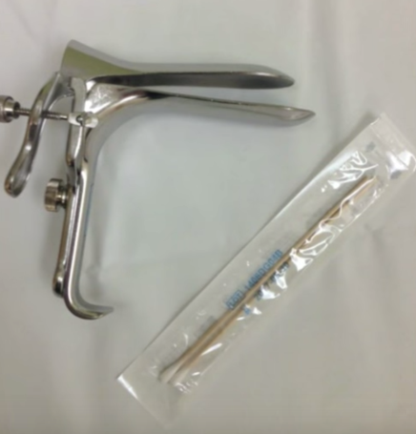
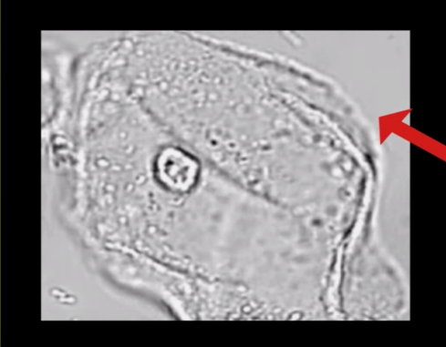
Video notes
The cornerstone of the diagnosis is the wet mount. wet mount: A dry speculum will space in the vagina and specimen of vaginal discharge will swapped, becarful not to get cervical mucus which is all to the Ph of the specimen.
*wet mount photograph with normal vaginal epithelial cell with nice smooth borders. * The Ph is a very helpful triage point, normal Ph in reproductive age women is as shown in this diagram
Normal Ph = 3.8 - 4.5
Ph < 4.5 yeast
Ph > 4.5 bacterial vaginosis or Trichomonas

Slide 5
Video notes
 | Definition | Signs in wet mount | Diagnosis | Treatment | notes
Bacterial vaginosis | is a polymicrobial infection characterized by lack of balance in the vagina, there is overgrowth of anaerobic organisms and a lack of normal lactobacilli. | clue cells bacterial vaginosis with stippled borders of the cell. | a diagnosis make clinically when a patient has: - Abnormal vaginal discharge. Ph > 4.5 Positive whiff test. Presence of clue cells. | oral or topical metronidazole is the drug of choice or topical clindamycin. | Add a few drops of potassium hydroxide to the vaginal discharge produces an amine or fishy odor ➔ commonly refer to positive “Whiff” test.
Vulvovaginal candidiasis | Candida albicans is the most common (90%), candida glabrate, candida tropicals. | body hyphae of vulvovaginal candidiasis or yeast. | Wet mount visualization of blastospores or pseudohyphae. Positive yeast culture. | *Treatment with azole results in relif of symptoms and negative culture in 80-90% of patients. *Oral antifungal and fluconazole is recommended. *Vaginal imidazole (miconazole, clotrimazole, terconazole) or single dose oral fluconazole. | More common in : pregnant, diabetic or obese women, on antibiotics, corticosteroid or oral contraception drugs, other practicis that keep the vaginal area warm and moist such as wearing tight clothing or habitual use of panti-liner.
Trichomonal vulvovaginitis | Trichomonas organism is transmitted via sexual contact, can survive in swimming pools and hot tubs, associated with PID, endometritis, facilitate HIV transmission. | trichomonas organism with characteristics vagilla. | By wet mount | Oral mertonidazole is the drug of choice or tinidazole. Partner should be treated as well. | Women diagnosed with trochomonas should also be screened for other STDs specially gonorrhea and chlamydia.

Slide 6
Video notes
Trichomonal vulvovaginitis
characteristic wet mount finding of the trichomonas organism with characteristics vagilla.
Bacterial vaginosis
in contrast you will see classic clue cells bacterial vaginosis, note the stippled borders of the cell.
Vuvovaginal candidiasis
wet mount slide shows a characteristic body hyphae of vulvovaginal candidiasis or yeast, it is often helpful to add some potassium hydroxide to the slide to better visualized the yeast.

Slide 7
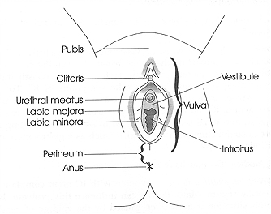
Video notes
Anatomy Review:
Vulva ➔ labia majora, labia minora,
vestibule and perineum in the outside
and vagina in the inside.
Many patients presenting with vaginitis symptoms will also have associated vulvar itching complaining.
Many patients assume that itching = yeast but this is defiantly not the case.
Report of 200 new patients to a vulvar specialty clinic, the etiology of itching vulva was:-
-Contact dermatitis 20%
-Recurrent yeast 20%
-Lichen sclerosis/ Lichen simplex 11%
-Bacterial vaginosis 7%
-Vulvar vestibulitis 13%
-Atrophic vaginitis 13%

Slide 8
Video notes
Common vulvar irritants:
-Shampoo and body washes
-Creative underwear ➔100% cotton is the best
-Maxi pads and panti liners.
Itch/scratch cycle: if the itching not getting better with topical steroid or not seems to make sense then a biopsy should be performed.
Biopsy will evaluate for dysplasia and cancer and can also diagnose benign vulvar conditions.

Slide 9
Video notes
Benign vulvar conditions
 | Lichen sclerosus | Lichen planus | Lichen simplex chronicus
Definition | Benign chronic dermatological condition characterized by: -marked inflammation. -epithelial thinning. -distinct dermal changes. | Rare inflammatory skin condition that can affect the skin, oral cavity, vulva and vagina. | Skin changes that occur with itch/scratch cycle
Signs | Crinkled skin, L.minora atrophy, constriction of V.orifice, adhesions, ecchymoses & fissures. |  | Contact dermatitis, erythema of labia majora.
Symptoms | Patient will experience vulvar itching and burning. | Women can experience chronic vulvar burning and itching, insertional dyspareunia, profuse vaginal discharge
Treatment | Topical corticosteroids |  | Topical corticosteroids, counseling on how to avoid skin irritants, breaking the itch/scratch cycle.
Notes | Patient with lichen sclerosus at increase risk of squamous cell carcinoma of the vulva. | Note that lichen planus can affect both vulva and vagina whereas lichen sclerosus can affect only vulva. | itch/scratch cycle: -scratching -mechanical irritation -epidermal thickening and inflammatory. -cell infiltrate.

Slide 10
Notes
3 most common etiologies of vaginal infection are: Vaginal candidiasis, Bacterial vaginosis,Trichomoniasis.
Bacterial vaginosis:
Most common cause of vaginitis in premenopausal women.
It is triggered by ↑ PH of the vagina (intercourse, douches)
It is not an STD. no need to screen for other STDs, nor screening the partner and treating him.
+ve whiff test (adding KOH to the vaginal secretions will give a fishy odor).
Fishy odor (especially after intercourse).
Vaginal candidiasis:
Less common in postmenopausal women, unless she’s taking estrogen.
90% of yeast infections are secondary to Candida Albican (Most common).
Other species (glabrata, tropicalis) tend to be resistant to treatment.
The discharge varies from watery to thick cottage cheese discharge.
Vaginal soreness and dysparunea.
Trichomoniasis:
Virtually always sexually transmitted.
Wet Mount very important
Trichomonas seen only in 50 – 70% .
Elevated pH.
Can increase leukocytes.
Pap smear.

Slide 11
Case
A 20 year-old female college student comes to see you because of a persistent vaginal discharge. She is also interested in discussing contraceptive options. She and her boyfriend have been sexually active for 6 months. They use
condoms “most of the time,” but she is interested in using something with a lower failure rate for birth control. She has regular menses and no significant past medical or gynecologic history. She describes her vaginal discharge as yellowish and also notes mild vulvar irritation. On physical exam, she has normal external female genitalia without lesions or erythema,
a gray/yellow discharge on the vaginal walls and pooled in the posterior fornix. Her cervix is grossly normal but bleeds easily with manipulation. The bimanual exam is unremarkable.

Slide 12
1. What is your differential diagnosis?
• Bacterial Vaginosis.
• Trichomoniasis (Trichomonas vaginalis).
• Gonorrhea.
• Chlamydia.
• Candida.
2. What tests are currently available to help in the diagnosis of these disorders?
• Saline Wet mount.
• 10% Potassium Hydroxide Microscopy (KOH test).
• Vaginal pH (important that sample come from mid portion of vaginal sidewall to prevent collection of cervical mucous, blood, or semen which may alter results) Can be a direct measurement or colorimetric testing.
• Amine or “Whiff” Test.
• Vaginal Culture.
• Polymerase Chain Reaction Tests are available for gonorrhea, chlamydia, candida, and trichomoniasis.
• Rapid tests forenzyme activity for bacterial vaginosis, trichomoniasis and candida are available.
• DNA or antigens testing is available for trichomoniasis, gonorrhea and clamydia.
• Vaginal Gram Stain for Nugent Scoring of the bacterial flora can be helpful in identifying bacterial vaginosis (this scoring system assigns a value to different bacterial morphotypes seen on Gram stain of vaginal secretions).

Slide 13
3. What test findings would suggest trichomoniasis?
• Vaginal pH greater than 4.5
• Flagellated motile trichomonads on saline microscopy
• Positive vaginal culture
• OSOM Trichomonas Rapid Test (tests for trichomonas antigens)
4. What two findings can be used to diagnose vulvovaginal candidiasis?
• Blastopores and pseudohyphae on saline or KOH wet mount
• Positive vaginal culture
5. What are Amsel’s Criteria for the diagnosis of Bacterial Vaginosis?
• Abnormal gray vaginal discharge
• Vaginal pH greater than 4.5
• Positive amine test
• More than 20% of epithelial cells are clue cells

Slide 14
6. The patient is diagnosed with trichomoniasis. What is your treatment plan for this patient?
• Treatment with a 2 gram single oral dose of metronidazole or 500 mg oral metronidazole twice daily for 7 days; an alternate treatment can be Tinidazole 2g single oral dose.
• Sexual partner must be treated simultaneously and treatment of both partners should be completed before resumption of sexual activity
• Side effects of metronidazole treatment including a disulfiram-like reaction (drowsiness, headache, and a metallic or garlic taste in the mouth) should be discussed with the patient and patient should be encouraged to abstain from alcohol during and for 24 hours after treatment with metronidazole.
7. What are the additional reproductive health issues you would want to discuss with this patient?
• STI protection
• Contraception. Although this patient desires a contraceptive method that has a higher efficacy rate than condoms, you should discuss the need for condom use for protection from STIs.
8. Would you recommend screening for additional sexually transmitted infections in this patient and if so, how?
• Yes, with serologic testing for hepatitis B, syphilis, HIV and cervical cultures for gonorrhea and chlamydia.

Slide 15
Done by: Hanan Aldossari.
Revised by:
Razan AlDhahri

