Slide 1
Intrauterine growth restriction
433OBGYNteam@gmail.com

Slide 2
Objectives: 1.define macrosomia and fetal growth restriction. 2.describe etiologies of abnormal growth. 3.list methods of detection for fetal growth abnormalities. 4.describe the management of fate growth abnormalities. 5.listed the associated morbidities and mortalities of fetal growth abnormalities.

Slide 3
definition
an estimated fetal weight of 4000-4500 grams or greater
Cusecs
Maternal: History of macrosomia pregnancy ,pregnancy weight gain, parity, glucose intolerance
Fetal: Male ,beckwith-widemann syndrome
risks
Maternal: Post partum hemorrhage ,vaginal laceration
fetal: Shoulder dystocia ,clavicular fracture ,lower abgar score, obesity later in life
macrosomia
Diagnosis
Fundal height measurement and clinical palpation of estimated fatal weight, US
Management
Not induction of labor , CS if EFW >5000 g , 4500g with diabetes

Slide 4
Intra Uterine Growth Restriction (IUGR)
an estimated fetal weight less than the 10th percentile for gestational age.
Early –Onset Growth Restriction (<32 weeks)
Can lead to irreversible effect.
The principle differential diagnosis is:
(a)Chromosomal abnormality or some other genetic problem
(b)Congenital infection
(c)Utero placental dysfunction
the commonest infection associated with IUGR is cytomegalovirus (CMV)
- Mother may have complained of flu-like illness - Fetus has sonographic findings compatible with CMV (e.g. microcephaly and cerebral calcification).
Other associated maternal factor:
Smoking, multiple pregnancy, chronic maternal disease.
Late-Onset Growth Restriction (>32 Weeks)
More amenable to restoration of fetal size with adequate nutrition.
Most likely cause is utero placental insufficiency, often associated with the development of pre-eclampsia.

Slide 5
Causes of IUGR
Fetal
Chromosomal (Most imp) Abnormal fetal karyotype can be responsible for up to 20% of growth restricted fetus.
Structural anomalies / Structural defects.
Infection: Malaria – major cause of IUGR – its treatment reduces the incidence of IUGR (area where is endemic) Rubella, Cytomegalovirus, Toxoplasmosis, Syphilis.
Multi fetal gestation
Maternal
Medical conditions (Most common in our country)(hypertension, renal disease, diabetes, vascular/autoimmune disease.
antiphospholipid syndrome).
Substance use and abuse (tobacco > 10 cigarettes/ day is significant ( MCQ), alcohol, cocaine)
Infections (viral, protozoal)
Teratogen exposure
Placental
a)primary placental disease (chorioangioma, mosaicism)
b)Abnormal placentation (previa, abruption, hematoma)

Slide 6
Clinical manifestation of IUGR

Slide 7
Diagnosis:
• The key screening tool for fetal growth disorders in low risk women is assessment of uterine size by fundal height measurement. However, fundal height assessment is not accurate as a diagnostic tool.
• Ultrasonography is the gold standard to assess fetal weight. The 4 standard fetal growth measurements include:
• Biparietal diameter
• Head circumference
• Femur length
• Abdominal circumference
• Umbilical artery Doppler velocimetry
Abnormal umbilical Doppler (absent or reversed end diastolic flow) can help predict fetuses at increased risk of poor fetal outcome
• Uterine artery systolic /diastolic (S/D):evaluate the fatal placental circulation ,as placental resistance increases the diastolic flow decreases therefore their is increase in S/D ratio. Absent /reversed end diastolic flow predicts worse prenatal out comes and its usually indicate for delivery .
• middle cerebral artery (MCA Doppler): its refluxes fetal adaptation this is because the fetus always try to spear fetus brain circulation , when there is decrease in placental perfusion, there is increase MCA flow.

Slide 8
Management of IUGR
Fetal monitoring
Monitoring the growth-restricted fetus involves serial fetal measurement
Abdominal circumference - Amniotic fluid index - Cardiotocography - Doppler ultrasound
*Fetuses with absent end-diastolic flow are hypoxaemic, these changes may appear up to 5 weeks before demise
*Reversed end-diastolic flow is suggestive of preterminal compromise; the fetus may die within 1-2 days if not delivered.
Amniotic Fluid Index
Fetal urine production is significantly lower in the SGA fetus than in the AGA fetus.
- Decreased renal perfusion results in oligohydramnios
Biophysical Profile
Breathing - Tone - Movement - Amniotic fluid volume – Cardiotocography
* Requires about 40 mins observation of fetal breathing movements. (Takes time not for every fetus only suspect IUGR)
-A persistently abnormal biophysical score is associated with absence of end-diastolic flow

Slide 9
*The objective of clinical management is to expedite delivery before the occurrence of fetal compromise, but after fetal lung maturation has been achieved. *The timing of delivery should be based on the results of the antenatal testing, fetal growth pattern, dopplers, and gestational age. *For women with antiphospholipid antibodies associated with the delivery of a prior IUGR infant, low-dose aspirin (81 mg/day) in early pregnancy may reduce the likelihood of recurrent IUGR. *For cases in which ultrasonic findings strongly suggest IUGR, with or without abnormal fetal surveillance, delivery is indicated at gestational ages of 34 weeks or later, or at any reasonable gestational age if pulmonary maturity is documented. *At birth, the infant should be carefully examined to rule out the possibility of congenital anomalies and infections. The monitoring of blood glucose levels is important because the fetuses do not have adequate hepatic glycogen stores, and hypoglycemia is a common finding.
Management of IUGR

Slide 10
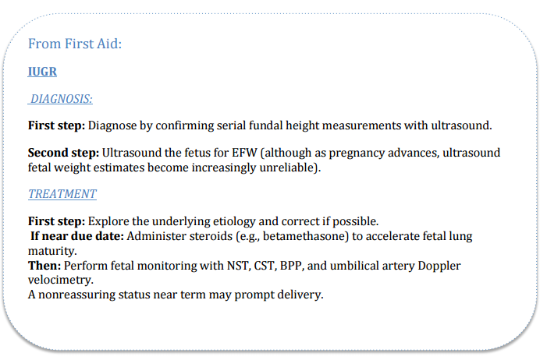

Slide 11
All women should be encouraged to stop smoking since it is the commonest risk factor - Even passive smoking is harmful – husbands should be persuaded to stop. - Early aspirin treatment before 17 weeks (100-150mg) for patients with previous IUGR babies (possible role of placental thrombosis) LOW DOSE!
Intrapartum: Increased risk of fetal heart rate abnormalities , Cesarean delivery , Low Apgar scores , Cord blood acidemia. Neonatal: Polycythemia ,Hyperbilirubinemia , Hypoglycemia , Hypothermia , Apneic episodes .
Long term: Largely dependent on the etiology of the IUGR and the gestational age at delivery , Lifelong increased risk of cardiovascular disorders , insulin resistant, obesity.
prevention
Risks

Slide 12
Done by:
Sarah alshehri
Revised by:
Razan AlDhahri

