Slide 1
Menopause
433OBGYNteam@gmail.com

Slide 2
Objectives :
Define menopause and describe changes in the hypothalamic-pituitary-ovarian axis associated with perimenopause/menopause
Describe symptoms and physical exam findings related to perimenopause/menopause
Discuss management options for patients with perimenopause/menopausal symptoms
Counsel patients regarding the menopausal transition
Discuss long-term changes associated with menopause

Slide 3
Menopause:
The “climacteric” refers to the phase in a woman’s reproductive life when a gradual decline in ovarian function results in decreased sex steroid production with its sequelae.
Menopause is defined as 12 months of amenorrhea , associated with elevation of (FSH, LH)
average age is 51.5 years.
Menopause occurs due to the programmed loss of ovarian follicles .
The perimenopause refers to the (several years of more gradually decreasing ovarian function that may be associated with the symptoms of reduced estrogen levels).
The signs and symptoms of the perimenopause and menopause are related to progressively decreasing secretion of estrogen from the ovarian follicle .
Premature menopause:
Occurs at 30-40 and is mostly idiopathic, but can also occur after radiation therapy or surgical oophorectomy.
Premature ovarian failure:
Occurs at < 30 and may be associated with autoimmune disease or Y chromosome mosaicism.

Slide 4
before the onset of menopause:
The hypothalamus produces GnRh which ⟶ stimulates the anterior pituitary to produce FSH and LH ⟶ this stimulates the ovary to produce estrogen .
With advancing age as the oocyte number decline ➜ estrogen levels decline .
The remaining oocytes become increasingly resistant to FSH and FSH plasma concentrations increase.
At the time of menopause FSH concentrations > 30 mIU/ml.
Germ cells number :
Peaks at 20 weeks in utero : 6-7 million.
At birth : 1 million
At puberty : 400,000
At menopause : 200-300
Changes in the menstrual cycle (beginning at age 40) :
Shortening or lengthening of menstrual cycle*.
The luteal phase stays the same at 13-14 days.
Variation in cycle length is related to follicular phase.
women may notice that their cycle is now 21 days.
*the Cycle length is = from the 1st day of one period to the 1st day of the next period .

Slide 5
Symptoms of Menopause:
Hot flushes :
Prevalence in the US is 50-82%.
Women describe the sudden sensation of extreme heat in the upper body particularly the face, neck, and chest .
The episodes typically last for 1-5 minutes .
For many women the hot flushes are tolerable and do not require any medical treatment .
However 33% of women experience > 10 hot flushes/ day.
the hot flushes can be associated with many significant adverse outcomes such as hampered job productivity, and sleep debravation.

Slide 6
Management of hot flushes :
Some women can simply use life style modifications , other women pursue medical therapy often based on the severity of their symptoms.
Systemic Hormone therapy:
It is the most effective treatment for hot flushes , it reduces the severity and frequency of hot flushes by 75%.
If she has a uterus we give estrogen + progesterone*.
If she has no uterus we give estrogen only.
Risks of Hormone therapy:**
The women's health initiative was a large randomized placebo, control trail.
Estrogen + Progesterone ⬆ risk of ( coronary heart disease, breast cancer, stroke and Venous thromboembolic events).
Estrogen + Progesterone ⬇ risk of ( colon cancer, fractures).
Estrogen only ⬆ risk of (stroke and Venous thromboembolic events )
* Estrogen alone will increase the risk of endometrial cancer.
** it is difficult to generalize the findings of this study on younger most recently menopausal women since the WHI examined women aged 50-77 years old and many were pass the menopausal transition at the time of the study .

Slide 7
Other treatment options:
SSRI/SNRI’s:
Reduce hot flushes by 50-62% .
Herbal therapy:
Have not been shown to be superior to placebo.
Bio-identical hormones therapy:
Limited evidence on their safety, potency and efficacy ,not preferred over traditional hormone therapy.
Sleep disturbances:
Decline in estrogen levels can induce a change in women’s sleep cycles independent of hot flushes.
Sleep disturbances are one of the most common and disabling effects of menopause.

Slide 8
Estrogen dependent tissue:
Increased risk of osteoprosis:
Bone density decreases post-menopausally by 1-2% per year compaired to 0.5% per year in peri-menopausal women.
Pelvic organ prolapse and atrophic urethritis:
Occurs when the paravaginal tissue that supports the bladder and rectum becomes atrophic .
Vaginal atrophy :
40% of women will experience one or more symptoms of vaginal atrophy .
May present with ( itching and burning , loss of vaginal rugae and elasticity can cause narrowing and shortening of the vagina).
Vaginal atrophy and vaginal dryness can be symptomatic during intercourse and an cause significant dyspareunia.
Vaginal lubrication and vaginal estrogens can provide symptom relief.

Slide 9
Case discussion
CASE: A 53-year-old, G3P3 woman, whose last menstrual period was 4 months ago presents to the office with hot flushes, emotional lability, and insomnia. She experiences hot flushes 2-3 times per day and occasionally at night. She has been having trouble sleeping and is extremely fatigued. Since age 14, her periods have been regular until 2 years ago, when they began to space out to every 2-3 months. She is sexually active and recently has noted some dyspareunia. The patient rarely exercises. She smokes 2 packs of cigarettes a day and drinks alcohol socially. She recently started taking a soy supplement. She does not have any pertinent gynecological, medical or surgical history. Her family history is significant for her mother sustaining a hip fracture at age 60 and a sister with breast cancer and high cholesterol. On examination, she has normal vital signs. She is 5’4” tall and weighs 123 lbs. On pelvic examination, she has decreased vaginal rugae and a pale, small cervix. No masses or tenderness are palpated on bimanual exam.

Slide 10
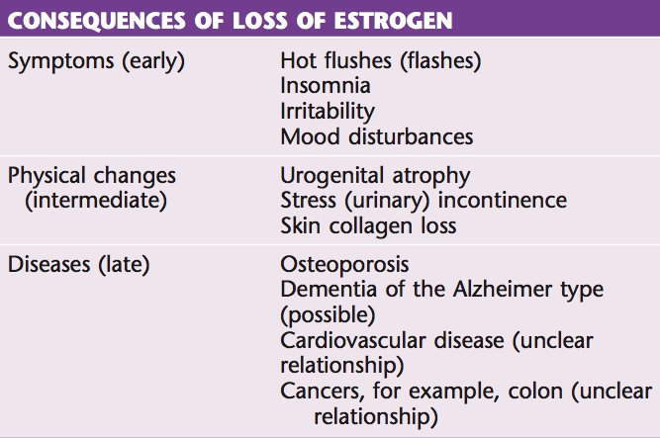
Case discussion
1. What are the symptoms of perimenopause and menopause?
• Hypoestrogenism is the basis for the common changes of menopause.
• The common signs and symptoms of menopause include amenorrhea (of 12 months duration), hot flashes, memory changes, sleep difficulty, decreased libido, dyspareunia, urinary symptoms, breast changes.
2. How do you make the diagnosis of menopause?
• Menopause is the permanent cessation of menses and usually occurs between the ages of 50 and 55, with an average of 50-52 years.
• The definition of menopause is the absence of menses for 12 consecutive months. It is, therefore, a retrospective diagnosis.
• Perimenopausal symptoms usually begin 3 to 5 years before amenorrhea or postmenopausal levels of hormones

Slide 11
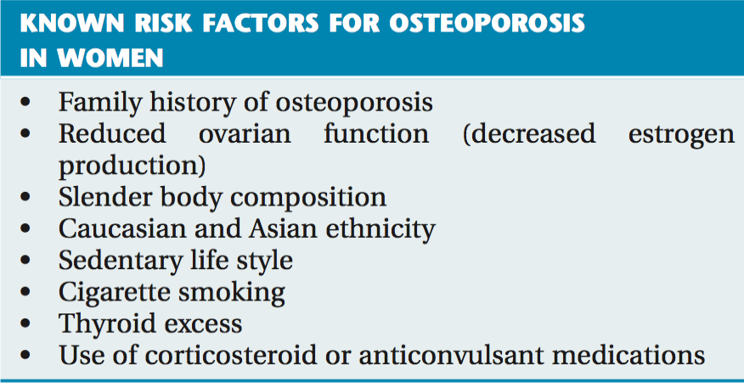
Case discussion
3. What are the patient’s risk factors for osteoporosis?
• This patient’s risk factors include menopause, family history of osteoporosis, cigarette smoking, and sedentary lifestyle.
• Additional risk factors for discussion include age at menopause or oophorectomy, white or Asian origin, small body frame or low BMI, high risk for osteoporosis related fracture per FRAX tool, vitamin D3 deficiency, poor calcium intake, alcohol and caffeine intake, and corticosteroid use.
Other risk factors:
Management :

Slide 12
Case discussion
4. How do you diagnose and treat atrophic vaginitis?
• Patients commonly have vaginal dryness, vulvar irritation, pruritus, and dyspareunia.
• Associated urinary symptoms may be present.
• Examination shows vulvar erythema.
• Excoriation may be present. Loss of vaginal rugae, a pale vaginal mucosa, with patches of erythema and even superficial blood vessels are consistent with atrophy.
• The pale or yellow discharge has a pH of 5.5 or higher.
• Basal cells replace superficial vaginal epithelial cells and can be seen on a saline wet prep or Pap test.
• Treatment is topical estrogen (allow 4 to 6 weeks for symptomatic relief).

Slide 13
Case discussion
5. How do you counsel a patient regarding estrogen and alternative therapies?
• Risks and benefits of therapy should be reviewed (WHI and other studies).
• Contraindications should be discussed.
• Treatment options for menopausal symptoms and osteoporosis should be outlined.
• Bio-identical (compounded) hormones do not have an inherent advantage over standard therapies and may vary in their potencies.
• Micronized progesterone and estradiol are bio-identical by definition.
• Any patient on systemic HT with an intact uterus needs a progestogen.
• Transdermal estrogen administration is preferable due to a beneficial effect on lipid balance and thromboembolism risk.
• Lifestyle modifications including smoking cessation should be stressed.
• The importance of evaluating any postmenopausal bleeding should be discussed.
• Acknowledge frequent use of complementary and alternative treatments.
• SSRI antidepressants can be used as an alternative in women who are not candidates for HT.
First-line treatment for the menopause should begin with lifestyle changes such as diet and exercise to control mild to moderate symptoms, reserving hormonal therapy for those women who have significant problems.

Slide 14
Case discussion
6. What laboratory and diagnostic tests would you order for this patient?
Laboratory and diagnostic tests should focus on the patient’s history and symptoms, as well as preventive screening. For example, a TSH and lipid panel is appropriate given her fatigue and family history.
General health maintenance/screening test guidelines (i.e. colonoscopy at age 50, bone density at age 65,etc.) should be discussed.
Tests include a mammogram, bone density (given patient’s smoking and family history of fracture), colonoscopy.
Discuss new cervical cytology screening recommendations.

Slide 15
Done by : Reem Almassoud
Revised by: Razan AlDhahri

