Slide 1
Premature Rupture of Membranes (PROM)
433OBGYNteam@gmail.com

Slide 2
Introduction
Amniotic fluid starts to be continuously produced approximately 16 weeks gestation. it is primarily dependant on fetal urine production.
Amniotic fluid allows for fetal movement and breathing which are important for fetal skeletal, lung and chest development.
Decrease in the absent amniotic fluid can lead to compression of the umbilical cord and decrease placental slow.
Disruption of the fetal membranes leads to a loss of these protective effects and the developmental roles of amniotic fluid.

Slide 3
Objectives
Define premature rupture of the membranes (PROM) and preterm PROM (PPROM).
Describe clinical presentation of patients PROM.
List the diagnostic tests to confirm PROM.
Describe the etiology and risk factors for PROM.
Compare the risks and benefits of conservative expectant management and immediate delivery.
Describe the methods used for maternal and fetal monitoring during expectant management.
Discuss the drugs used in the management of PPROM in terms of indications, contraindications and side effects (antibiotics, tocolytics, and glucocorticoids).
Describe the management of chorioamnionitis.

Slide 4
Premature rupture of the membranes (PROM) and preterm PROM (PPROM)
PROM
PPROM
Preterm premature rapture of membranes occurring before 37 weeks estimated gestational age
Premature rapture of membranes before the onset of labor
labor is defined as progressive dilation and effacement of the cervix in response to regular uterine contractions that occurs at least every 5 minutes and last 30 to 60 seconds.

Slide 5
PPROM is a leading cause of neonatal morbidity and mortality and is associated with 30% of preterm deliveries.
The consequences of PPROM depend on the gestational age at the time of occurrence, persistent oligohydraminos at less than 22 weeks estimated gestational age leads to:
Incomplete fetal alveolar development.
Development of pulmonary hypoplasia, infants born with a pulmonary hypoplasia cannot be adequately ventilated.
When PPROM occurs between 24 and 26 weeks there is likely to be survival, however there will be possible substantial morbidities from extreme prematurity.
Patient presentation : The classic clinical presentation of PPROM is a sudden "gush" of clear or pale yellow fluid from the vagina. However, many women describe intermittent or constant leaking of small amounts of fluid or just a sensation of wetness within the vagina or on the perineum. It can be confusing for during pregnancy because there are many fluids that can mimic amniotic fluid (e.g. urine, normal vaginal secretions of pregnancy, increase cervical discharge, semen or perineal sweat).

Slide 6
Diagnosis
Diagnosis of PROM is based on the history of vaginal loss of fluid and confirmation of amniotic fluid in the vagina.
Physical examination:
A sterile speculum examination should be performed to visually assess the cervix and swab for cervical gonorrhea and Chlamydia. A group B strep culture should be obtained as well.
On examination Pooling of amniotic fluid can be seen (pooling refers to the filling of the speculum with amniotic fluid).
Remember to minimize digital cervical examination to decrease the risk of infection
An ultrasound should be performed to assess fetal position as well as to assess the amount of amniotic fluid (oligohydramnios will be present).

Slide 7
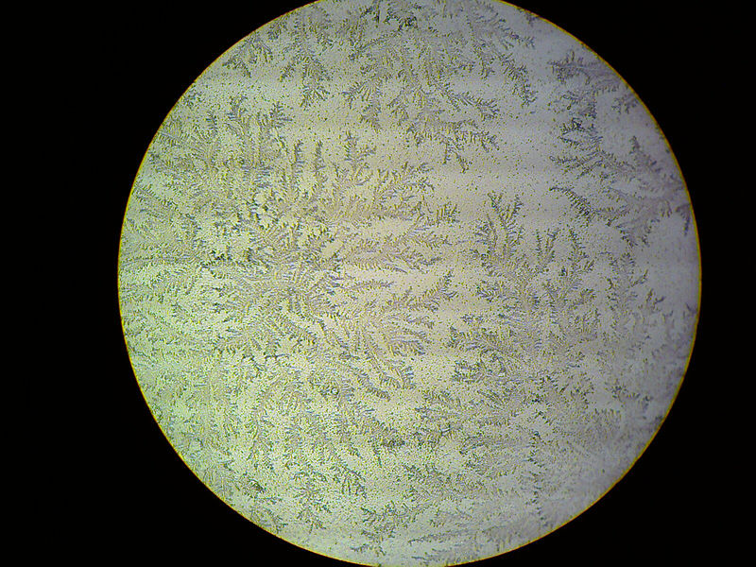
Confirmation of the diagnosis can be made by:
Testing the fluid with Nitrazine paper which will turn blue in the presence of alkaline amniotic fluid (amniotic fluid has a ph greater than 7.1 while vaginal secretions have a ph between 4.5 to 6).
Ferning which refers to the pattern of arborization when amniotic fluid is placed on a slide and is allowed to dry (branching fern leaf pattern caused by sodium chloride precipitates from amniotic fluid).
Ferning of amniotic fluid
Fern

Slide 8
The Etiology and risk factors for PROM
The etiology of PROM remains unclear.
The risk factors for PROM (anything that weakens the strength of the choreo amniotic membrane) including:
vaginal and cervical infections (An ascending infection from the vagina will weaken these membranes so sexually transmitted infections and other lower genital tract infections such as bacterial vaginosis play a role as risk factors).
A short cervix or an incompetent cervix.
The risk for PROM is doubled for women who smoke.
A history of prior PROM.
Abnormal membrane physiology.
Polyhydraminios and multiple gestations will basically descend the choreo amniotic membranes.
Other risk factors are similar risk factors for preterm delivery including a prior preterm delivery, bleeding during pregnancy, low socioeconomic status and low body mass index.

Slide 9
Management
How we decide an expectant management versus immediate delivery. The patient’s gestational age, presence of clinical infection, placental abruption, labor and fetal status all have to be taken into account.
If the patient is term > 37 weeks :
late preterm patients from 34 to 36 weeks and six days EGA
Approximately 90% of patient will go into spontaneous labor within 24 hours. labor should be induced either at the time of presentation or the patient can be expected managed .induction of labor reduces the time of delivery and the rates of chorioamnionitis and metritis and admission to the neonatal intensive care unit. If the patient does not go into spontaneous labor on her own then labor induction should be performed with oxytocin.
The management is the same as term for the risks of infection outweigh the risks of prematurity .An induction of labor has started for these patients once rupture of membranes is confirmed. If the fetus is breach then a cesarean section will have to be performed.

Slide 10
If PPROM occurs between 24 weeks and 33 and 6 days, the risk of fetal lung maturity from prematurity is very high. Preterm fetuses without chorioamnionitis should be treated with :
Corticosteroids which enhance fetal pulmonary maturity.
Tocolytics to decrease contraction.
Antibiotics to increase the latency period (which is the time between rupture of membranes and spontaneous labor). Note that antibiotics are administered because they have been shown to increase the amount of time before spontaneous labor, the antibiotics are not to treat an infection. If there is an infection present diagnosed by uterine tenderness, fever and /or increased white blood cell count then delivery needs to be initiated.
Assuming that there is no evidence of uterine infection a patient with PPROM from 24 to 33 and 6 days EGA will be admitted for inpatient hospitalization with ultrasounds to assess amniotic fluid volume and antepartum testing such as non-stress test. Delivery will be induced between 32 and 34 weeks, however if the patient develops evidence of uterine infection then delivery will be immediately initiated.

Slide 11
Pre-viable PPROM
pre-viable PPROM is premature rupture of membranes before the limit of viability (<24 weeks' gestation) .It occurs in less than 1% of pregnancies.
There are important risks of prematurity to discuss with this population:
Pulmonary hypoplasia rates are approximately 10-20 % .
Prolonged oligohydraminos can cause fetal deformations and limb contractures because the fetus cannot move freely within the amniotic sac.
Neonatal death and morbidity rated decrease with a longer latency period and advancing gestational age.
There are significant maternal complications that can occur with prolonged rupture of membranes with increased risks of systemic infections.
The management for patient with Pre-viable PPROM involves patient counseling and expectant management or induction of labor. Antibiotics and corticosteroids are not recommended before viability.

Slide 12
Chorioamnionitis
It is an infection of the fetal amnion and chorion membranes.
The characteristic clinical signs and symptoms of chorioamnionitis include the following:
Maternal fever (intrapartum temperature >100.4°F or >37.8°C)
Significant maternal tachycardia (>120 beats/min)
Fetal tachycardia (>160-180 beats/min)
Purulent or foul-smelling amniotic fluid or vaginal discharge
Uterine tenderness
Maternal leukocytosis (total blood leukocyte count >15,000-18,000 cells/μL)
Management:
includes cervical cultures, supportive care, early delivery, and IV antibiotics administration
(ampicillin and gentamicin in combination are the drugs of choice).

Slide 13
Summary of Management (from Kaplan lecture notes)
• If uterine contractions occur, tocolysis is contraindicated.
• If chorioamnionitis is present, obtain cervical cultures, start broad-spectrum
therapeutic IV antibiotics, and initiate prompt delivery.
• If no infection is present, management will be based on gestational age as follows:
– Before viability (<24 weeks), outcome is dismal. Either induce labor or manage
patient with bed rest at home. Risk of fetal pulmonary hypoplasia is high.
– With preterm viability (24–33 weeks), conservative management. Hospitalize the
patient at bed rest, administer IM betamethasone to enhance fetal lung maturity if
<32 weeks, obtain cervical cultures, and start a 7-day course of prophylactic ampicillin
and erythromycin.
– At term (≥34 weeks), initiate prompt delivery. If vaginal delivery is expected, use
oxytocin or prostaglandins as indicated. Otherwise, perform cesarean delivery.

Slide 14
Teaching Case
A 26-year-old G2P0100 woman, who is 31 weeks gestation, presents to the labor unit complaining of leakage of fluid and she thinks that her “bag of water broke.” She has had increased vaginal discharge and intermittent lower back pain for the last two days. She reports a gush of fluid about 2 hours ago. The fluid ran down her leg and appeared clear with no noticeable odor. Her prior pregnancy was complicated by preterm labor and premature rupture of the membranes at 26 weeks gestation. The neonate’s course was complicated by necrotizing enterocolitis, respiratory distress, and death at 28 days of life.

Slide 15
1. What risk factors are associated with premature rupture of membranes (PROM)?
• The definition of PROM is rupture of membranes before the onset of labor. Membrane rupture before labor
and before 37 weeks of gestation is referred to as preterm PROM.
• Risk factors for PROM include similar risks for preterm labor:
Vaginal, cervical and intraamniotic infections
Prior PROM
Prior preterm delivery
Low socioeconomic status
Second and third-trimester bleeding
Low body mass index
Cervical insufficiency
Cervical conization/LEEP
Connective tissue disorders (Ehlers-Danlos syndrome)
Nutritional deficiencies of copper and ascorbic acid
Maternal cigarette smoking
Illicit drug use
Pulmonary disease in pregnancy
Uterine overdistension
Amniocentesis

Slide 16
2. What should be the next step in this patient’s diagnosis?
• Confirmation of the diagnosis of PROM.
Sterile speculum examination to confirm the diagnosis
Pooling of fluid per cervical os
Fern – cervical mucus broad fern vs. amniotic fluid narrow fern
pH (Nitrazine) – turns blue as the pH of amniotic fluid is usually 7.1-7.3.
False positive Nitrazine may occur due to
Alkaline urine
Semen
Blood
Cervical mucus
Antiseptic solutions
Bacterial vaginosis
Ultrasound evaluation AFI in equivocal cases – not diagnostic
Test kits for amniotic proteins - considered ancillary to standard methods of diagnosis

Slide 17
3. What should be the next step in management once PROM has been confirmed?
• Assess fetal status: continuous fetal monitoring, ultrasound to assess the estimated fetal weight (EFW),amniotic fluid volume and fetal presentation.
• Rule out labor (uterine activity monitoring)
• Rule out intraamniotic infection: This diagnosis may be made clinically. In some cases amniocentesis may prove helpful to rule out an intraamniotic infection. Amniotic fluid may be sent for gram stain, aerobic and anaerobic cultures, glucose and cell count.
• Obtain swabs to rule out Chlamydia trachomatis, Neisseria gonorrhea and group B streptococcal infection.
• Digital cervical examinations should be avoided unless the patient appears to be in active labor or imminent delivery is planned. Digital exams are associated with an increased risk of infection and add little information to that available with speculum examination. Sterile speculum examination provides an opportunity to confirm the diagnosis of PROM, inspect for cervicitis and umbilical cord or fetal prolapse, assess cervical dilatation and effacement, and obtain cultures as appropriate.

Slide 18
Once labor and intraamniotic infection have been ruled out, if patient is preterm (< 34 weeks) consider:
Antibiotics: Ampicillin and erythromycin to prolong the latency period.
Steroids to enhance fetal lung maturation and decrease risk of RDS.
Patients with preterm PROM at a viable gestational age should be observed closely in the hospital on modified bedrest. They should be assessed periodically for evidence of infection, placental abruption, umbilical cord compression, fetal well-being, and labor. There is no consensus on the optimal frequency and type of assessment that is optimal. An acceptable strategy would include periodic ultrasound monitoring of amniotic fluid volume and daily or twice-daily fetal heart rate monitoring.

Slide 19
• The decision to deliver the fetus is based on gestational age and fetal status.
If there is evidence of intraamniotic infection or evidence of fetal compromise at any gestational age, the fetus should be delivered.
The timing of delivery may vary among institutions:
The patient who experiences PROM between 24 weeks and 31 completed weeks of gestation should be cared for expectantly if no maternal or fetal contraindications exist until approximately 34 weeks of gestation.
At 32–33 completed weeks of gestation, the risk of severe complications of prematurity is low if fetal pulmonary maturity is confirmed by amniotic fluid samples collected vaginally or by amniocentesis. Therefore, labor induction may be considered if pulmonary maturity has been documented. If pulmonary maturity cannot be established, expectant management may be beneficial.

Slide 20
4. What are the risks associated with preterm PROM?
• Maternal risks:
Chorioamnionitis
Cesarean delivery for malpresentation and failed induction
Abruption
• Fetal risks:
Cord prolapse
Respiratory Distress Syndrome
Necrotizing Enterocolitis (NEC)
Infection (sepsis)
Intraventricular hemorrhage- The risk for this varies with gestational age.
Pulmonary hypoplasia especially if < 19 weeks when PROM occurs (rare after 26 weeks gestation)
Skeletal deformities

Slide 21
5.What treatment can this patient be offered in a future pregnancy to decrease her recurrence risk for preterm PROM and preterm delivery?
• Recent studies have suggested progesterone therapy to reduce the risk of recurrent spontaneous preterm birth resulting from preterm labor or PROM.
APGO video :
https://youtu.be/e6YLras5ndg?list=PLy35JKgvOASnHHXni4mjXX9kwVA_YMDpq

Slide 22
References:
Apgo video case
Essentials of obstetrics and gynecology
USMLE step 2 ck Kaplan lecture notes
Up to date
Google images
Medscape
Done by:
F. A.
Revised by:
Razan AlDhahri

