Slide 1
Fetal Surveillance
Objectives:
1- Describe the techniques of fetal surveillance.
2- interpret electronic fetal heart rate monitoring.
433OBGYNteam@gmail.com

Slide 2
The goal of fetal surveillance is to detect events that occurs during labor that could compromise fecal oxygenation.
Fetal surveillance during labor is an essential element of good obstetric care. On the basis of intra partum maternal history, physical examination, and laboratory data.
20-30% of pregnancies are designated high risk
50% of perinatal morbidity and mortality occurs in high risk group
Methods of monitoring fetal heart rate:
1- Auscultation of fetal heart rate (FHR) every 30 minutes after a uterine contraction during the first stage. And at least every 15 minutes in the second stage of labor.
If high risk :
Auscultate the FHR every 15 minutes in the first stage of labor, and continuously or every 5 minutes in second stage.

Slide 3
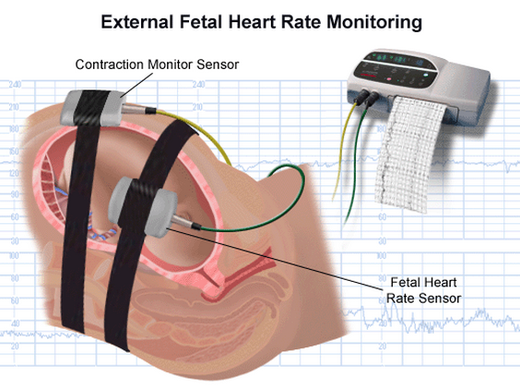
2- continuous electronic fetal monitoring (EFM):
Serve as a warning to enable the physician to intervene and prevent fetal death in utero or irreversible brain injury.
EFM allows continuous reporting of the fetal heart rate (FHR) and uterine contractions (UC).
(FHR-UC) are obtained using external transducers on the maternal abdomen or internally by placing a spiral electrode onto the fetal scalp and a plastic catheter transcervically into amniotic cavity to monitor UC.
Which one is more precise? Internal. Why? FHR is computed from the R-wave of the fetal electrocardiogram, and UC intensity is measured only internally. (Whereas external tocotransducer measures only frequency and duration of UC)
UC results in reduction of blood flow to the placenta, which causes decrease fetal oxygenation and corresponding alterations in the FHR.

Slide 4
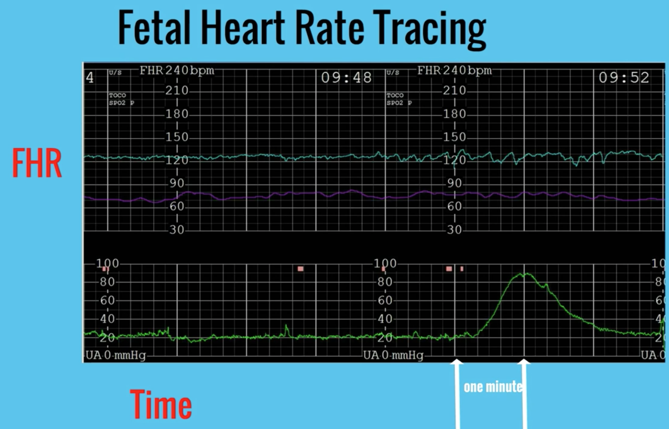
Fetal Heart Rate Tracing
Fetal
Heart Rate
Maternal Heart Rate
Uterine Contractions
One minute

Slide 5
The Hypoxia, acidosis, and FHR changes:
The fetal arterial blood oxygen tension in only 25± 5 mm HG
Normal fetus can withstand the temporary reduction in blood flow to the placenta without suffering from hypoxia because sufficient oxygen exchange occurs during the interval between contractions.
Hypoxia when sufficiently severe, will result in anaerobic metabolism, resulting in the accumulation of pyruvic and lactic acid and causing fetal acidosis.
Fetal acidosis is measured by sampling blood from the presenting part. Normally the pH varies between 7.25-7.30.
Fetal death occurs when 50% or more of the transplacental oxygen is interrupted.

Slide 6
Fetal oxygenation can be impaired at different anatomic locations:
1) Maternal conditions:
Such as in hypertensive or anemic mothers.
2) Fetal conditions:
Such as in hemolytic anemia in Rh-isoimmunization.
3) Uterine conditions:
Such as in hyperstimulation.
4) Placenta conditions:
Such as in infarction or abruption.
5) Umbilical cord conditions:
Such as in hematoma of the cord, short or ture knot of the cord.

Slide 7
Fetal Heart rate patterns:
It depends on the evaluation of the baseline pattern and the periodic changes related to the UC. It requires determination of the rate and variability of the FHR.
1- Short term or beat to beat variability:
Normally fluctuates between 5-25 beats\minutes. If decreased may indicate fetal acidosis, hypoxia, CNS and cardiac anomalies, quiet sleep state, prolong UC, or maternal sedation with drugs (morphine, magnesium). (see the table)
2- Long term variability:
The frequency and amplitude of changes in the baseline rate.
Normally 3 to 10 cycles per minute. Physiologically decreased during the sleep of the fetus, which usually lasts for about 25 minutes.

Slide 8
Periodic fetal heart rate changes:
FHR interpretation : Baseline, Variability, Acceleration, Deceleration.
The changes in the baseline FHR are related to the UC.
no change.
Acceleration. FHR increases in response to the UC. (normal “OK”)
Deceleration. FHR decrease in response to the UC.
Maybe:
Early (normal due to head compression),
Late (uteroplacental insufficiency)
Variable (cord compression)
Mixed (charactereristic of any of the aforementioned patterns)

Slide 9
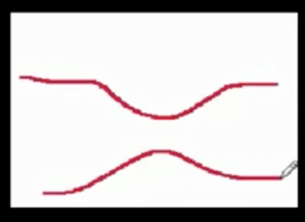
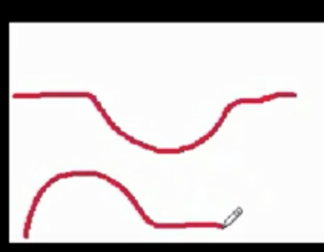
NOTE THE UNDERLINED LETTERS AS IN: VEAL CHOP
VARIABLE > CORD COMPRESION
EARLY > HEAD COMPRESION
ACCELERATION > OK
LATE > PLACENTAL INSUFFICIENCY

Slide 10
Fetal Heart rate tracings
CATEGORY I
Baseline: 110-160
Moderate variability
Late or variable decelarations: -
Early decelerations: +\-
Accelerations: +\-
CATEGORY III
Absent variability
And any of the following:
Baseline: Bradycardia
Sinusoidal wave pattern*
Recurrent late decelarations.
Recurrent variable decelarations.
CATEGORY II
Requires immediate delivery
Every thing between category I & III
*A sinusoidal fetal FHR pattern is defined as a pattern of fixed, uniform fluxuations of the FHR, cycle frequency: 3.5 \ minute for > 20 minutes.

Slide 11
Management of abnormal heart tracing during fetal monitoring:
Alter position to left or right side.
100% O2 by face mask.
Discontinue oxytocin.
Rule out cord prolapse.
Preform fetal scalp stimulation.
Consider terbutaline, 25 mg subcutaneously
Improved fetal condition
Persistent abnormal patterns
Prolonged deceleration
Continue monitoring
Consider fetal scalp blood pH
Consider immediate delivery
Consider immediate delivery
pH ≤ 7.20
pH ≥ 7.25
Continued surveillance

Slide 12
Meconium:
The presence of meconium in the amniotic fluid may be a sign of fetal distress.
Early passage:
Anytime before the rupture of membranes.
Light passage is not associated with poor outcome, but heavy passage is associate with lower 1- and 5- minute Apgar scores and associated with meconium aspiration.
2) Late passage:
During the second stage of labor after clear amniotic fluid has been noted.
Usually heavy and associated with some event (e.g., umbilical cord compression, or uterine hypertonus) that causes fetal distress.

Slide 13
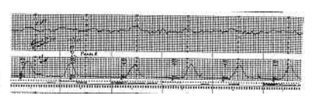
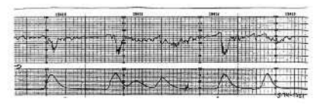
TEACHING CASE
A 27 year-old G3P2 woman at 39 weeks gestation is admitted to the labor and delivery unit in early labor. She has had an uncomplicated pregnancy similar to her other two pregnancies, both of which delivered vaginally. Her last labor was 4 hours in length, and the infant’s birth weight was 3900 grams after an uncomplicated delivery.
At the time of admission, her physical examination reveals a healthy appearing woman in moderate distress with contractions every 4-6 minutes, described as 7 on a pain scale of 1-10, with 10 being most severe. Her weight is 165 pounds, blood pressure is 135/82, and fundal height is 37 cm. The estimated fetal weight is around 4000 grams, the fetus is in the vertex presentation and her pelvic examination reveals a gynecoid pelvis with cervix dilated to 5cm/80% effacement/-1 station. Fetal heart rate is noted to be 120 beats per minute when the external monitor is applied.
This patient appears to be having a normal labor at term. The fetal heart rate is normal and the fetus is having accelerations of the fetal heart rate, also a reassuring finding. You determine she has a “category 1” tracing. Her contraction pattern appears normal, and we should expect a vaginal delivery in the next few hours.
Two hours later, the nurse calls you to the labor suite to review the fetal heart tracing below. She expresses concern about the changed appearance of the fetal heart tracing and asks for your opinion.

Slide 14
Questions
1
What is the purpose of intrapartum fetal heart rate monitoring?
• The goal of intrapartum fetal monitoring is to recognize changes in fetal oxygenation that could result in adverse outcomes.
2
What are the commonly used methods of intrapartum fetal monitoring?
• Electronic fetal monitoring is performed externally using a Doppler technology with computerized processing that interprets and counts the Doppler signals. Internal monitoring is performed using a fetal electrode in the form of a spiral wire placed on the fetal scalp or presenting fetal part.
3
What is the most important aspect in the evaluation of any fetal heart tracing?
• Baseline variability is the most important aspect and is defined as the fluctuation of the baseline FHR in amplitude and frequency. It is defined as absent, minimal (amplitude detectable to 5 beats per minute), moderate (amplitude 6-25 beats per minute), and marked (amplitude greater than 25 beats per minute). Moderate variability has been associated with an arterial umbilical cord pH higher than 7.00-7.15, and with reassuring fetal well-being and the absence of metabolic academia.

Slide 15
4
What are the periodic changes that occur in the FHT? What is the physiology, and what interventions, if any, would be appropriate?
• Current fetal heart rate (FHR) definitions were described as a result of the 2008 National Institute of Child
Health and Human Development workshop on electronic fetal monitoring
• Accelerations—abrupt increase in the FHR above the baseline that peaks at 15 beats per minute above the
baseline with a duration of 15 seconds (at > 32 weeks gestation) or peaking at 10 beats per minute for 10
seconds (before 32 weeks gestation). Presence of accelerations is usually associated with reassuring fetal
well-being and the absence of hypoxia and acidemia.
• Early decelerations—symmetrical, gradual decrease and return of the FHR with the nadir occurring at the
same time as the peak of the contraction. In most cases the onset and the recovery occur coincident with
the beginning and the end of the contraction. Early decelerations are usually the result of pressure on the
fetal head resulting in a physiologic vagal reflex response with acetylcholine release at the fetal sinoatrial
node, and therefore not concerning. Intervention is not required.
• Late decelerations—symmetrical decrease and return in FHR associated with a uterine contraction. The
nadir of the FHR deceleration and recovery occur after the peak and resolution of the contraction, respectively.
Particularly when late decelerations are repetitive and associated with decreased baseline FHR variability,
they are considered nonreassuring and a result of utero-placental insufficiency, decreased intervillous exchange of oxygen and carbon dioxide, and worsening hypoxia and acidemia. Interventions would include maternal repositioning, oxygen supplementation, intravenous fluid administration, and in some cases delivery of the fetus.
• Variable decelerations—abrupt decrease in FHR lasting less than 2 minutes, with onset to nadir less than
30 seconds; timing may or may not be associated with uterine contractions. Variable decelerations are also mediated by the vagus nerve’s sudden release of acetylcholine at the fetal sinoatrial node; these are associated with umbilical cord compression. Interventions may include maternal position change or amnioinfusion.

Slide 16
5
Define the three-tiered FHR interpretation system?
Category I
Category I fetal heart rate (FHR) tracings include all of the following:
• Baseline rate: 110–160 beats per minute (bpm)
• Baseline FHR variability: moderate
• Late or variable decelerations: absent
• Early decelerations: present or absent
• Accelerations: present or absent
Category III
Category III FHR tracings include either:
• Absent baseline FHR variability and any of the following:
§ Recurrent late decelerations
§ Recurrent variable decelerations
§ Bradycardia
• Sinusoidal pattern
Category II
Category II FHR tracings include all FHR tracings not categorized as Category I or Category III. Category II tracings may represent an appreciable fraction of those encountered in clinical care. Examples of Category II FHR tracings include any of the following:
Baseline rate
• Bradycardia not accompanied by absent baseline variability
• Tachycardia
Baseline FHR variability
• Minimal baseline variability
• Absent baseline variability not accompanied by recurrent decelerations
• Marked baseline variability
Accelerations
• Absence of induced accelerations after fetal stimulation
Periodic or episodic decelerations
• Recurrent variable decelerations accompanied by minimal or moderate baseline variability
• Prolonged deceleration ≥2 minutes but ≤10 minutes
• Recurrent late decelerations with moderate baseline variability
• Variable decelerations with other characteristics, such as slow return to baseline, “overshoots,” or “shoulders”

Slide 17
Done by: Amani Alotaibi Razan AlDhahri
Revised by:
433obgynteam@gmail.com

