Slide 1
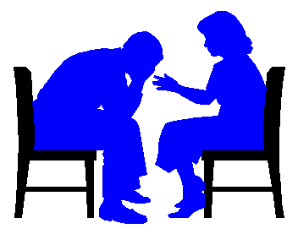
COUNSELLING IN FAMILY MEDICINE

Slide 2
OBJECTIVES
RECOGNIZE WHT IS COUNSELLING
APPRECIATE THEORIES AND APPROACHES TO COUNSELLING
RECOGNIZE VALUES IN COUNSELLING
APPLICATION OF KNOWLEDGE ON AN EXAMPLES

Slide 3
OVERVIEW
DEFINITION OF COUNSELLING
AIMS OF COUNSELLING
DIFFERENT APPROACHES
*PSHYCODYNAMIC
* HUMANISISTIC
*BEHAVIORAL
PHASES OF COUNSELLING
VALUES IN COUNSELLING
COUNSELLING IN PRACTICE

Slide 4
WHAT IS COUNSELLING?

Slide 5
IS T?
AN ADVICE
MOTIVATION
JUDGMENT ABOUT BEHAVIOR
HELPING OTHERS
INTERACTION
INTERVIEW
CONFRONTATION
CONVERSATION
FACILITATION

Slide 6



Slide 7


Advice given to someone
Simple Definition of counseling
advice and support that is given to people to help them deal with problems, make important decisions, etc.
To give advice, especially on social or personal problems

Slide 8
According to the Psychotherapy and Counselling Federation of Australia (PACFA), they say:
“Psychotherapy and Counselling are professional activities that utilise an interpersonal relationship to enable people to develop self understanding and to make changes in their lives.”

Slide 9
“Counselling is a structured conversation aimed at facilitating a client’s quality of life in the face of adversity”.
Structured ,not social
Conversation= dialouge and interaction
Facilitative rather than prescriptive

Slide 10
AIMS OF COUNELLING
HELP PEOPLE UNDERSTAND THEIR PROBLEMS BETTER
HELP PEOPLE MANAGE THEIR PROBLEMS
HELP TO IMPOWER CLIENTS/PATIENTS
HELP PEOPLE TO THINK POSITIVELY ABOUT THEIR PROBLEMS
HELP IN CHANGING BEHAVIOR POSITIVELY

Slide 11
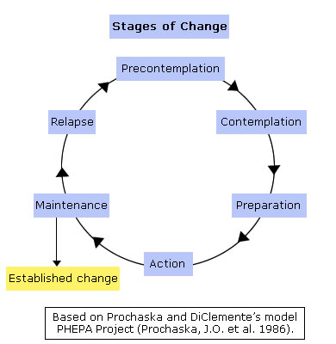
STAGES OF CHANGE

Slide 12
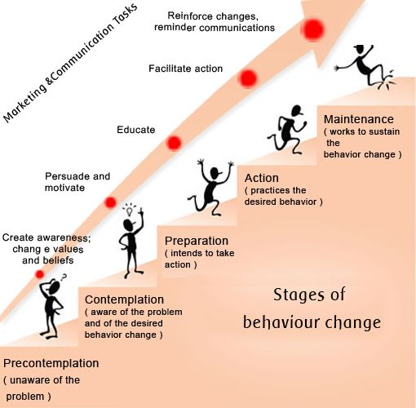

Slide 13
APPROACHES/THEORIES

Slide 14
DIFFERENT APPROACHES / THEORIES
*PSHYCODYNAMIC
* HUMANISISTIC
*BEHAVIORAL

Slide 15
HUMANISTIC
RECOGNIZE THE UNIQUENESS OF EVERY INDIVIDUAL
EVERYONE HAS A CAPACITY TO GROW EMOTIONALLY AND PSYCHOLOGICALLY TAWARDS PERSONAL FUFILMENT
LIFE EVENTS VS RESPONSE TO LIFE EVENTS
HELP PEOPLE TO EXPLORE TEIR OWN THOUGHTS AND WORK ON THEIR SOLUTIONS

Slide 16
BEHAVIORAL APRPROACH
ENVIRONMENT DETERMINES BEHAVIOR
REPONSES TO A GIVEN SITUATION IS DUE TO BEHAVIOUR THAT HAS BEEN REINFORCED A S A CHILD
Is based on the belief that behavior is learned
and can be changed
The initial concern in therapy is to help the client analyze behavior, define problems, and select goals.

Slide 18
PHASES OF COUNSELLING
DEFINING THE RELATIONSHIP
GATHERING INFORMATION
DESCRIBING THE PROBLEM DYNAMIC
MAKING INTERVENTION AND ACTION

Slide 19
DEFINING THE RELATIONSHIP
INTRODUCE YOUSELF/ESTABLISH RAPPORT
DEFINING THE OBJECTIVES AND ROLES
THE SETTING AND SEATING
ALLOW THE CLIENT/ PATIENT TO NEGOTIATE
OSERVATION SKILLS:
VERBAL AND NONVERBAL CUES
SNSITIVITY AND RESPONSE TO EMOTIONS

Slide 20
GATHERING INFORMATION
OBTAIN INFORMATION ABOUT THE CLIENT/PATIENT
ATTEMPTED INTERVENTION
ALLOW PATIENT/CLIENT TO TALK FREELY AND EXPRESS HIMSELF
USE FACLITATIVE QUESTIONS (OPEN-ENDED)
GIVE FEEDBACK WHEN APPROPRIATE
UNDERSTAND THE PTIENT,S WORLD

Slide 21
DESCRIBING THE PROBLEM DYNAMIC
THE FORMAL PHASE
EXPLAIN YOUR UNDERSTANDING OF THE PROBLEM
SHARING INFORMATION/UNDERSTANDING

Slide 22
MAKING INTERVENTION AND ACTION
HELP THE PATIENT/ CLIENT TO ANSWER THE QUESTIONS:
WHAT DO I DO TO SOLVE THE PROBLEM?
HOW DO I MAKE IT HAPPEN?
AND ALSO ….
COUNSELOR IS SUPPORTIVE/ AGENT OF CHANGE….BUT NON-DIRECTIVE

Slide 23
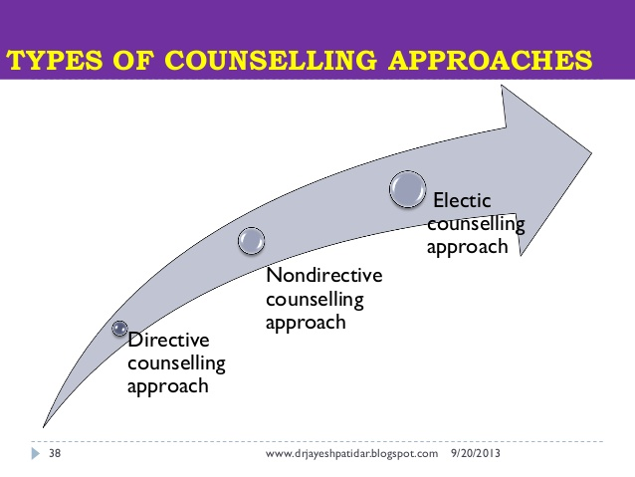
STYLES OF COUNSELLING
DIRECTIVE
NON-DIRECTIVE
ECLETIC(SELECTIVE)/COMBINATION

Slide 24
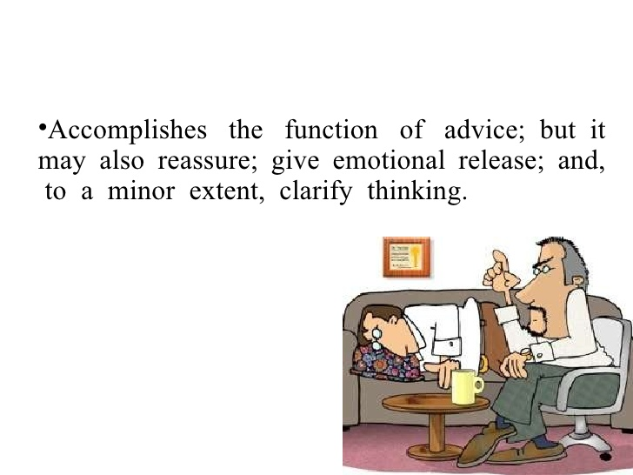
DIRECTIVE
COUNSELLOR-CENTERED
THE COUNSELOR DIRECT THE PATIENT/CLIENT
ALLOW THE COUNSELOR TO CONTROL THE SITUATION ALL THE WAY THROUGH

Slide 25
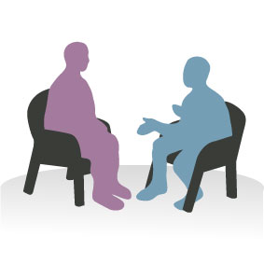
NON-DIRECTIVE
PATIENT/CLIENT-CENTERED
ALLOW CLIENT/PATIENT TO TELL HIS STORY IN HIS OWN WAY
THE ROLE OF THE COUNSELLOR IS TO CREATE AN ATMOSPHERE IN WHICH THE CLIENT CAN EXPRESS HISELF MORE FREELY
STRESS ON EMOTIONAL ELEMENTS AND DEVELOPMENT OF INSIGHT

Slide 26
ECLETIC(SELECTIVE)/COMBINATION
ALTERNATING BETWEEN PATIENT-CENTERED AND COUNSELLOR-CENTERED STYLES
CLIENT-SPECIFIC ( TAILORED ACCORDING TO SITUATION AND CLIENT)

Slide 27
VALUES IN COUNSELLING
RESPECT
ACCEPTANCE
RESPECT RIGHTS: PRIVACY,CONFIDENTIALITY
RESPECT UNIQUENESS OF EACH CLIENT
HONESTY
REFRAIN FROM JUDGMENT ????

Slide 28
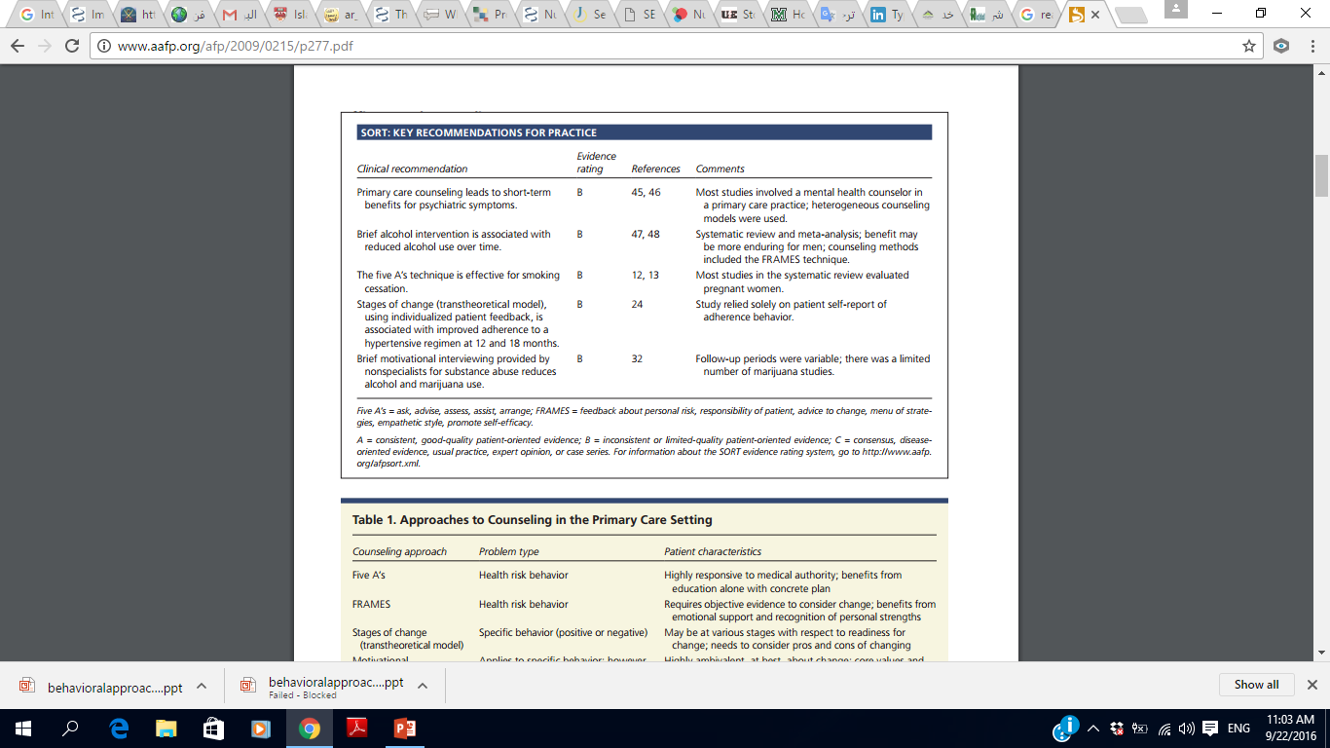

Slide 29
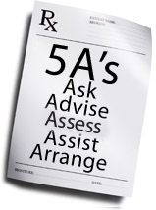
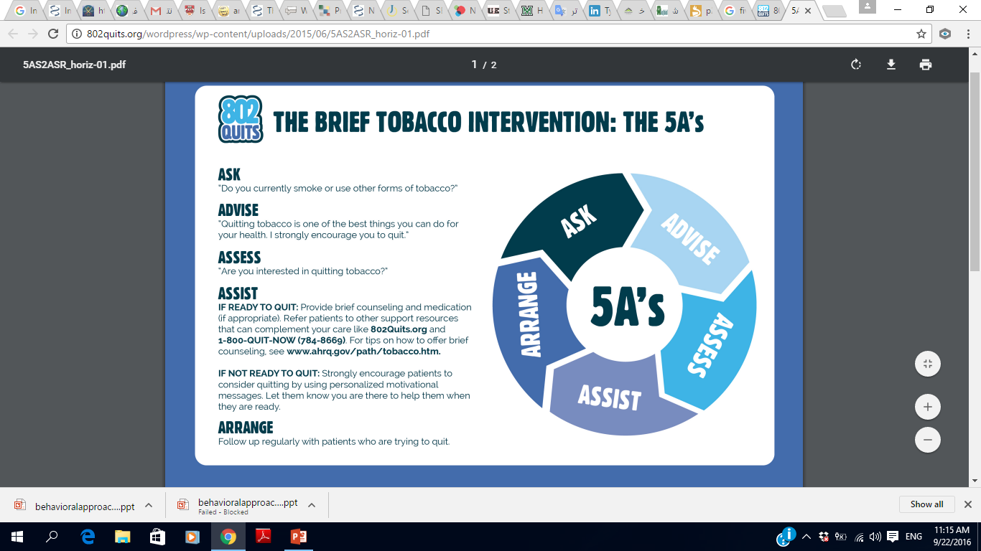

Slide 30
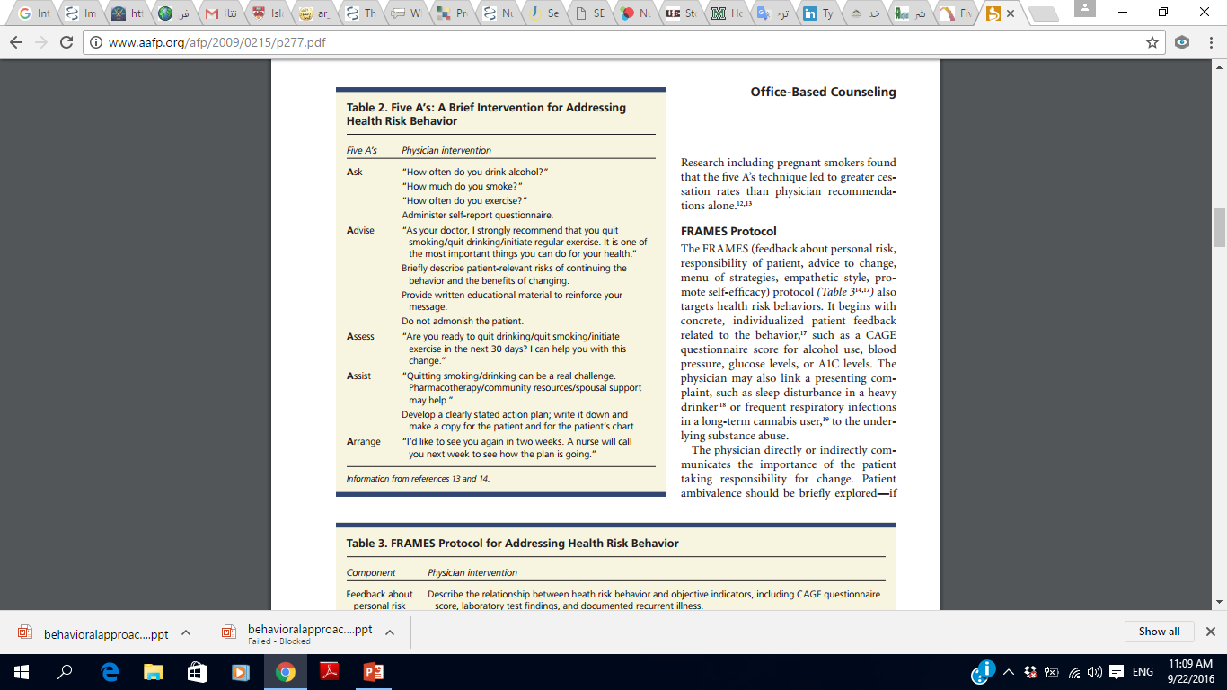

Slide 31
COUNSELLIING IS NOT…
ADVICE
JUDGMENT
GETTING EMOTIONALLY INVOLVED
LOOK AT THE PROBLEM FROM YOUR PERSPECTIVE

Slide 32

COUNSELLING IN PRACTICE

Slide 33



Slide 34



