Slide 1
Back Pain
Omar Al-Dhasee
Naif Al-Hefdhi
Sakhar Al-Bader
Turki Al-Otaibi

Slide 2
Objectives
Common causes
Diagnosis including history, Red Flags, Examination
Brief comment on Mechanical, Inflammatory, Root nerve compression, Malignancy
Role of primary health care in management
When to refer to specialist
Prevention and Education

Slide 3
Questions
Spondylolysis makes a defect in:
  Lamina
  Pedicle
  Pars interarticularis
  Vertebral body

Slide 4
Questions
Radiculopathy commonly occurs between:
  L1 – L2
  L5 – S1
  L2 – L3
  L4 – L5

Slide 5
Questions
If we suspect a salmonella infection with back pain which one of the following is the most specific test?
  ESR
  CPR
  CBC
  Agglutination test

Slide 6
Introduction
Back pain is a common reason to visit the PHC physician
The prevalence of back pain in KSA was found to be pattern ranging from 53.2% to 79.17%
In nations like the United States, its prevalence is 13.8%.
The global point prevalence of [low back pain] is 12%.

Slide 7

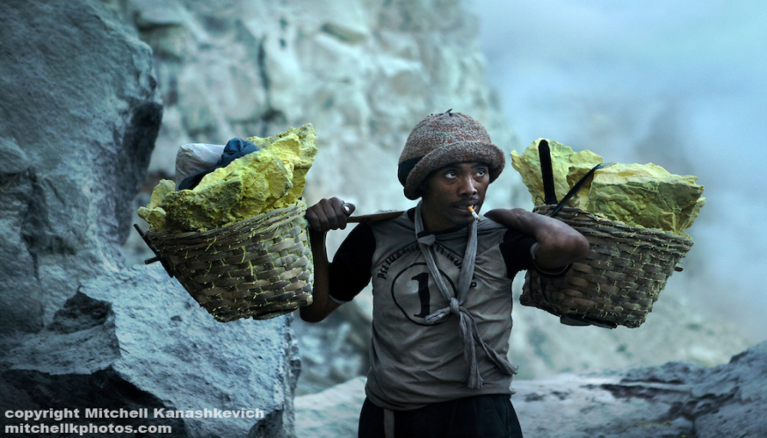
Risk Factors
Smoking
Obesity
Female
Age
Work type
Psychological factors

Slide 8
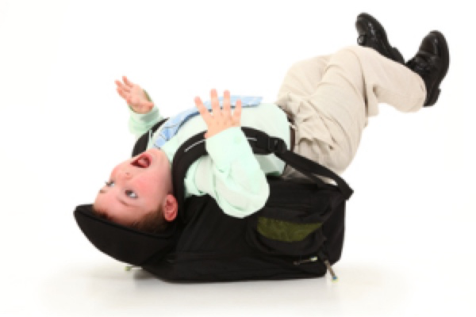
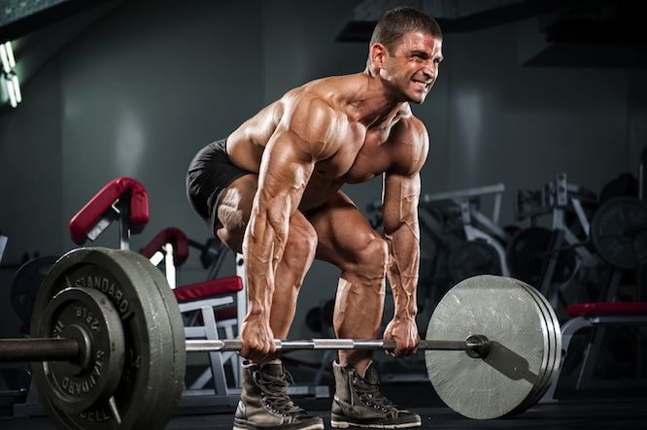
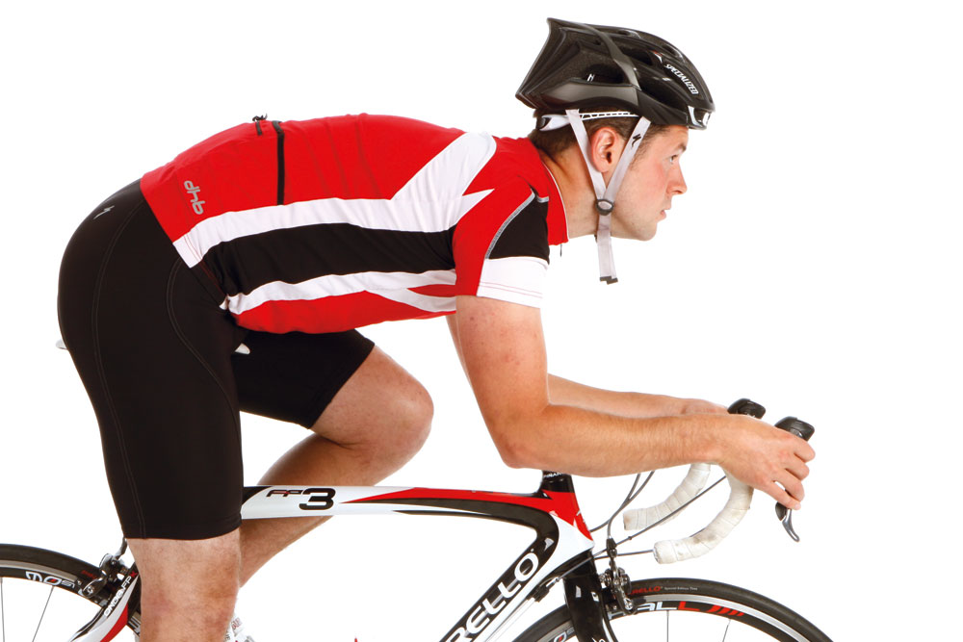
Differential Diagnoses
Muscle – related pain (non-specific):
  Some sports
  Soft matress
  Heavy backpack

Slide 9
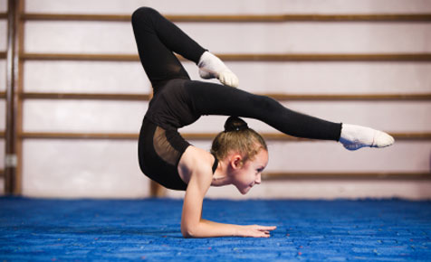
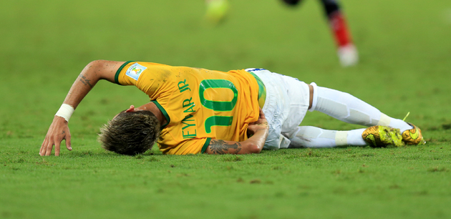
Differential Diagnoses
Bone – related pain:
  Spondylolysis and spondylolisthesis:
    Related to each other
  Spondylolysis:
    Commonly occur in young athletes who prone to repetitive stress on the back
    Stress fracture in the pars interarticularis “usually L5”
    Unilateral or bilateral
    Exacerbated by hyperextention

Slide 10
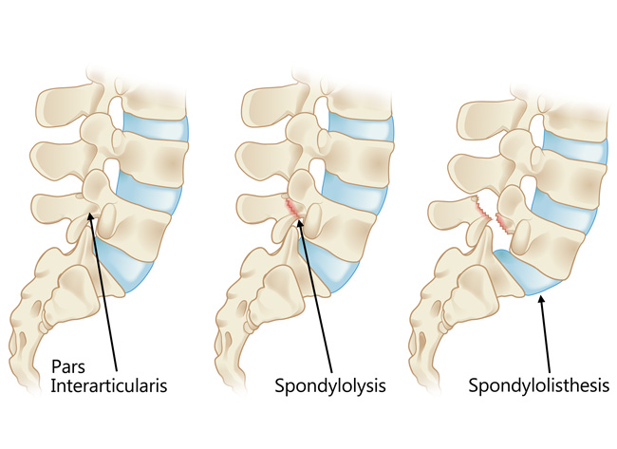
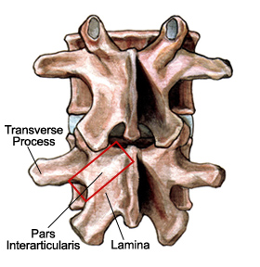
Differential Diagnoses
Spondylolisthesis:
  With bilateral defects, the vertebral body slips anteriorly

Slide 11
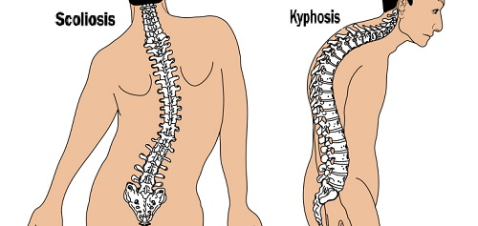
Differential Diagnoses
Scoliosis:
  Abnormal lateral curvature of the spine
  Usually idiopathic
Kyphosis:
  Anterior wedging
  Of at least three adjacent vertebral bodies
  Thoracic

Slide 12
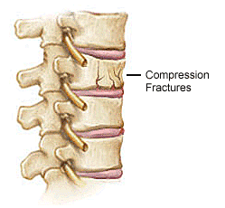
Differential Diagnoses
Metastatic cancer:
  The bone is the commonest sites of metastasis
  From breast, prostate, lung and kidney
Vertebral compression fracture:
  Osteoporotic
  Weaken bone
  Or trauma

Slide 13
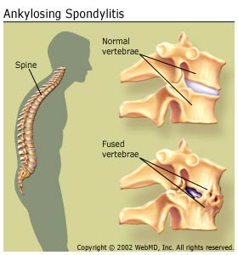
Differential Diagnoses
Ankylosing spondylitis:
  Spine fusion
  Age <40
  Sudden onset
  Improved with exercise
  Pain at night and morning stiffness
Osteoarthritis

Slide 14
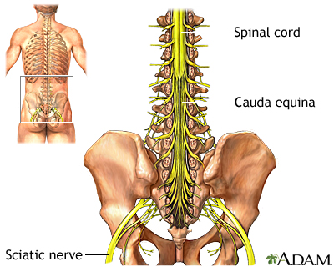
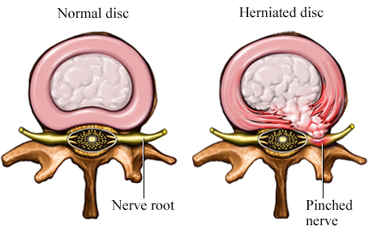
Differential Diagnoses
Disc – related pain:
  Disc herniation:
    Tear in annulus fibrosus nucleus pulposus protrusion
  Cauda equina syndrome:
    Conus medullaris ends at L1-L2
    Saddle anesthesia, fecal incontinence and urinary retention and sciatica
    Motor and sensory lower extremity loss

Slide 15
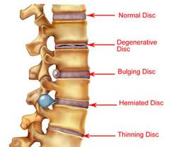
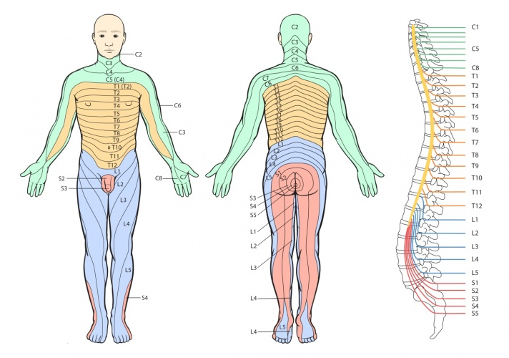
Differential Diagnoses
Radiculopathies:
  Refers to impairments related to a spinal nerve root
  Different causes
  Over 90 percent are L5 and S1 radiculopathies
  Presents with pain, sensory loss, weakness and reflex changes

Slide 16
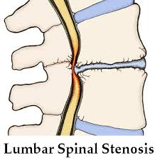
Differential Diagnoses
Spinal stenosis:
  Spondylolysis and spondylolisthesis are commonest causes
  Pain localized to calf (neurogenic claudication)
  Resolves with sitting or leaning forward

Slide 17
Differential Diagnoses
Other – related pain:
  Pancreatitis
  Nephrolithiasis
  Pyelonephritis
  Abdominal aortic aneurysm

Slide 18
Classification
  Acute = <4 weeks
  Subacute = 4 weeks – 12 weeks
  Chronic = > 12 weeks

Slide 19
Risk factors:
Modifiable:
  Obesity
  Smoking
  Occupational hazards
  Deformity
  Previous injury
Non-Modifiable:
  Genetics
  Aging

Slide 20

Red flags:
Age more than 50 years
History of cancer
Unexplained weight loss
Persistent fever
History of intravenous drug use
Immunocompromised state
Recent bacterial infection
Urinary or stool incontinence
Urinary retention
Extremity weakness
Neurologic deficit
Trauma

Slide 21
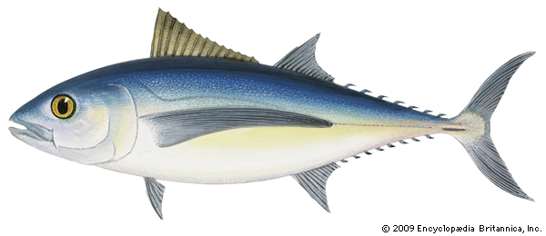
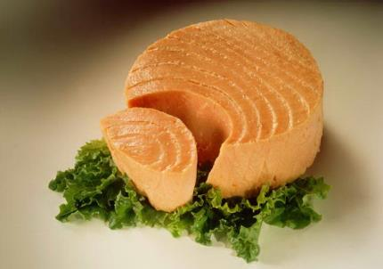
Red flags
TUNA FISH
Trauma
Unexplained weight loss
Neurological Symptoms
Age>50
Fever
IVDU
Steroid Use
History of cancer (prostate, renal, breast, lung)

Slide 22
History
Personal data
The course of pain
Any evidence of a systemic disease
Any evidence of neurologic problems (associated conditions)
Past medical history
Family history
Trauma
Menstrual history
Occupational and social history
Red flags

Slide 23
Investigations
Plain x-rays: (anteroposterior and lateral views)

Slide 24
Investigations
Radioisotope scanning: (pick up areas of increased activity, suggesting a fracture, a local inflammatory lesion or a ‘silent’ metastasis.)
Computed tomography CT: (diagnosis of structural bone changes and intervertebral disc prolapse)
Magnetic resonance imaging MRI: (done with the need for myelography, discography and facet arthrography, spinal canal and disc spaces are clearly outlined in various planes and we can see the physiological state of the disc)

Slide 25
Investigations

Slide 26
Investigations
Special investigations:
Pulmonary function tests
The white cell count
C-reactive protein (CRP) level
erythrocyte sedimentation rate (ESR)
antistaphylococcal antibodies may be present in high titres
Agglutination tests for Salmonella and Brucella should be performed, especially in endemic regions and in patients who have recently visited these areas.
Blood culture is essential in patients who are febrile though it is often negative in the early stages of infection.

Slide 27
Case

Slide 28
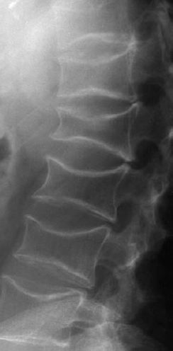
Case

Slide 29
Examination
First: standing/walking position:
A. Look :
Expose the trunk and lower limbs properly.
Any deformity, swelling, or skin changes.
Are shoulders & pelvis level.
Gait:
1. Abnormal types: Antalgic, Trendelenberg, waddling.
2. Heel and toe walking: unable to heel walk= L4 weakness, unable to toe walk= S1 weakness .

Slide 30
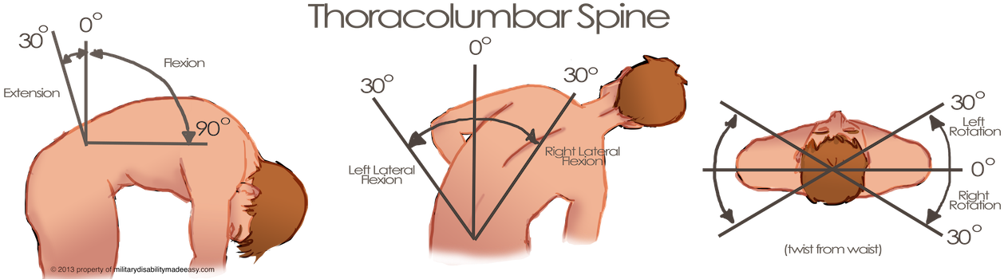
Examination
B. Feel:
Palpate spinous processes for tenderness, steps or gaps.
Soft tissues: temperature, tenderness.
C. Move:
Flexion.
Extension
Lateral bending
Rotation

Slide 31
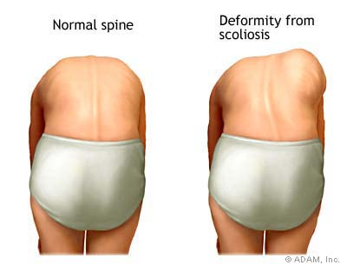
Examination
Special test :
Adams Forward bending test
Rib hump

Slide 32
Examination
Second: Supine position
Look:
  Any muscle waisting in the lower limbs.
Feel:
  Check for LLD
  (ASIS to medial malleolus).

Slide 33
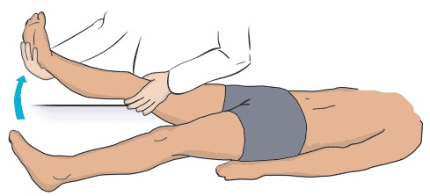
Examination
Special tests:
Straight leg raising test (SLRT):
A positive test is reproduction of sciatica .
The pain is aggravated with dorsiflexion
and relieved with knee flexion.

Slide 34
Examination
Neurologic examination:
Motor:
  Hip flexion L2
  Knee extension L3
  Ankle dorsiflexion L4
  EHL L5
  Ankle plantar flexion S1

Slide 35
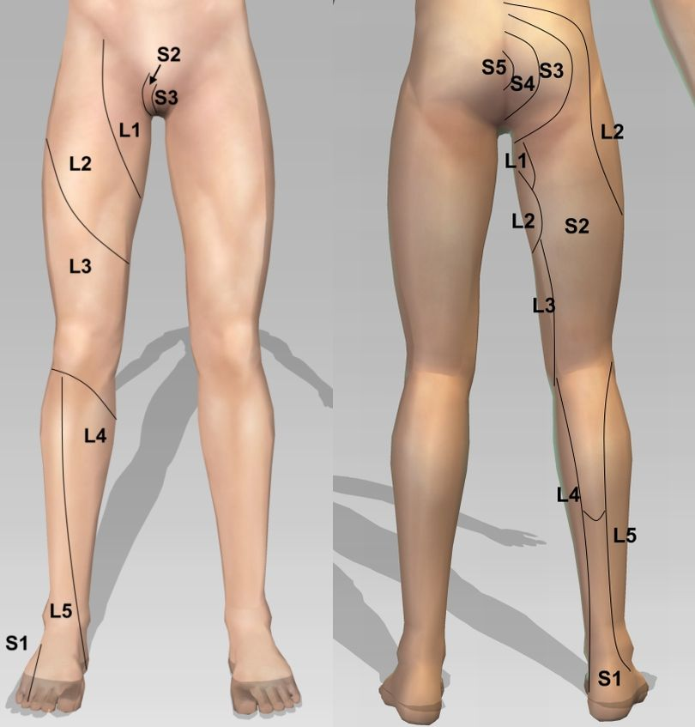
Examination
Sensory
Tone
reflexes

Slide 36
Examination
Vascular examination:
  Pedal pulses (DP & PT).
  Capillary refill

Slide 37
Role of primary health care in management
1-initial evaluation.
2-initial management of simple cases.
3-referal of complicated cases.
4-prevention and education

Slide 38
instructions or recommendations
Bed rest
Physical activity
Ice and heat application

Slide 39
When to refer
patients with back pain to specialist?

Slide 40
Where to refer ?
neurosurgery,
orthopedics,
ER,
or psychiatry.

Slide 41
When to refer ?
IN GENERAL, PRESENCE OF RED FALGS IS INDICATION FOR REFFERAL .

Slide 42
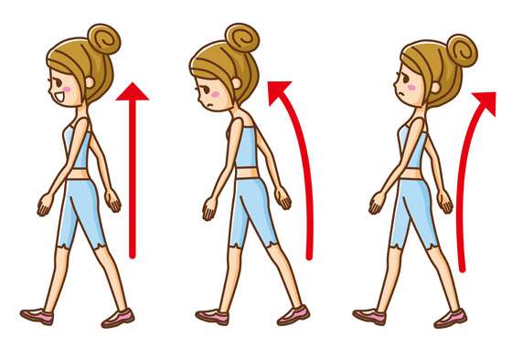
Prevention and education
Posture:
  How you sit, stand and lie down can have an important effect on your back.
Standing:
  Stand upright, with your head facing forward and your back straight. Balance your weight evenly on both feet and keep your legs straight.

Slide 43
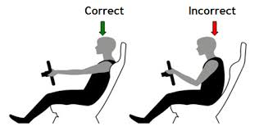
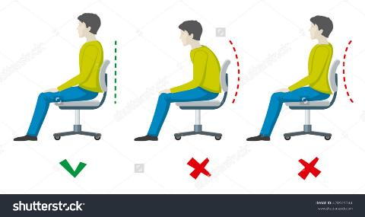
Prevention and education
Sitting and driving:
  Make sure you sit upright with support in the small of your back. Your knees and hips should be level and your feet should be flat on the floor.

Slide 44
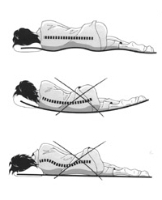
Prevention and education
Sleeping:
  Your mattress should be firm enough to support your body while supporting the weight of your shoulders and buttocks, keeping your spine straight.

Slide 45
Prevention and education
Lifting and carrying:
  Think before you lift:
    can you manage the lift?
  Push rather than pull
    – if you have to move a heavy object across the floor, it is better to push it rather than pull it.

Slide 46
Prevention and education
Exercise:
  Exercise is an excellent way of preventing back pain and of reducing it,
  Partial sit-up
    With bent knee, slowly raise your head and shoulders off the floor, and hold for 10 seconds.
  Knee-to-Chest Raise.
    Lie down. Slowly pull knees to chest, relaxing your neck and back, hold for 10 seconds. Repeat 10 times.
  Press-up.
    Lie down with hands near shoulders and pelvis on floor. Press up painlessly, hold for 10 seconds, and repeat 10 times

Slide 47
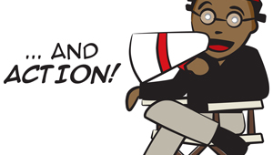
ROLE PLAY

Slide 48
ROLE PLAY

Slide 49
Questions
Spondylolysis makes a defect in:
  Lamina
  Pedicle
  Pars interarticularis
  Intervertebral body

Slide 50
Questions
Radiculopathy commonly occurs between:
  L1 – L2
  L5 – S1
  L2 – L3
  L4 – L5

Slide 51
Questions
If we suspect a salmonella infection with back pain which one of the following is the most specific test?
  ESR
  CPR
  CBC
  Agglutination test

Slide 52
References
Awaji, M. A. “Epidemiology of Low Back Pain in Saudi Arabia”.‏Journal of Advances in Medical and Pharmaceutical Sciences. (2016):1-9.
‪Deyo, Richard A., and Yuh-Jane Tsui-Wu. "Descriptive epidemiology of low-back pain and its related medical care in the United States." Spine 12.3 (1987): 264-268.‏‬
‪Hoy, Damian, et al. "A systematic review of the global prevalence of low back pain." Arthritis & Rheumatism 64.6 (2012): 2028-2037.‏‬
https://www.uptodate.com
http://bestpractice.bmj.com
https://www.nice.org.uk
Apley’s System of Orthopaedics and Fractures, Ninth Edition
Clinical Examination, 7th Edition “Talley and O’Connor

Slide 53
THANK YOU ☺
Omar Al-Dhasee
Naif Al-Hefdhi
Sakhar Al-Bader
Turki Al-Otaibi

