Slide 1


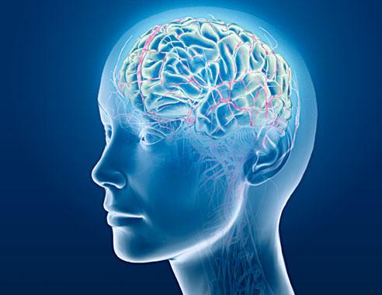
Common Psychiatric Problems in Primary Care
Group 2B
Turki Salah Aldeen Bukhari
Abdulmalik Abdullah Al-Qahtani
Naif Hussain Abdullah

Slide 2
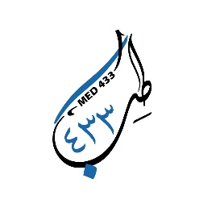
Objectives
Highlight the prevalence of anxiety, depression , and somatic symptom disorder in Saudi Arabia
Highlight the aetiology of anxiety, depression and somatic symptom disorder
Highlight on use of Tricyclic antidepressants and Selective Serotonin Reuptake Inhibitors “SSRI”
Discuss the clinical features and management of anxiety in family medicine setting
Discuss the clinical features and management of depression in family medicine setting
Discuss the clinical features and management of psycho-somatic illness in family medicine setting
Brief discussion about the role of counseling and psychotherapy in the management of common psychiatric problems in family medicine
When to refer to Psychiatrist

Slide 3

Quick Quiz

Slide 4
Q1
Which of the following is the overall best anti depressant ?
TCAs
NSAIDs
SSRI
MAOIs

Slide 5
Q2
A 20-year-old college student presented with repeated bouts of palpitation, sweating, and excessive worries when he uses public transport. The most likely diagnosis is:
Generalized anxiety disorder
Posttraumatic disorder
Agoraphobia with panic attacks
Social phobia

Slide 6
Q3
A 23-year-old man presented with extreme fear whenever he enters an elevator . The most appropriate statement about his treatment is:
Psychodynamic therapy
Olanzapine 5 mg
Behavior therapy
Insight-oriented therapy

Slide 7
Q4
which of the following is a risk factor for Somatic symptom disorder “SSD”?
Male
Female
High socioeconomic status
High education level

Slide 8
Q5
Which of the following can exacerbate Somatic symptom disorder “SSD”?
Anxiety
Depression
Interpersonal conflicts
All the above

Slide 9


DEPRESION!

Slide 10
Case
A 41-year-old man presented with a 3-week-history of lack of motivation, fatigue, excessive self-blame, poor appetite, social isolation, and delaying his tasks. He has no previous history of psychiatric or medical disorders.

Slide 11

Depression
Is a mood disorder that causes a persistent feeling of sadness and loss of interest.
The mood can affects your Feeling, your Thinking and your Behavior to a certain situation,
It can be Normal, Depressed or Elevated

Slide 12
Prevalence of Depression
Females are more prone to have depression compared to males 2:1.
Depression is more common in younger adults.
Depression is estimated to affect 350 million people worldwide (WHO 2012).
In a study done on 822 male patients that attended Primary Health Care Centers, Eastern Saudi Arabia: The overall prevalence of depression was 32.8% with mild depression accounting for 22.9%.

Slide 13
Prevalence of Depression
Cross-sectional study was conducted in three large primary care centers in Riyadh .They used Arabic version of PHQ-2 and PHQ-9. Patients included in the survey analysis were 477. The study found the point-prevalence of screened depression (showing signs of depression) to be 49.9% among the adult visitors to primary healthcare.
Need further exploration of these symptoms .

Slide 14
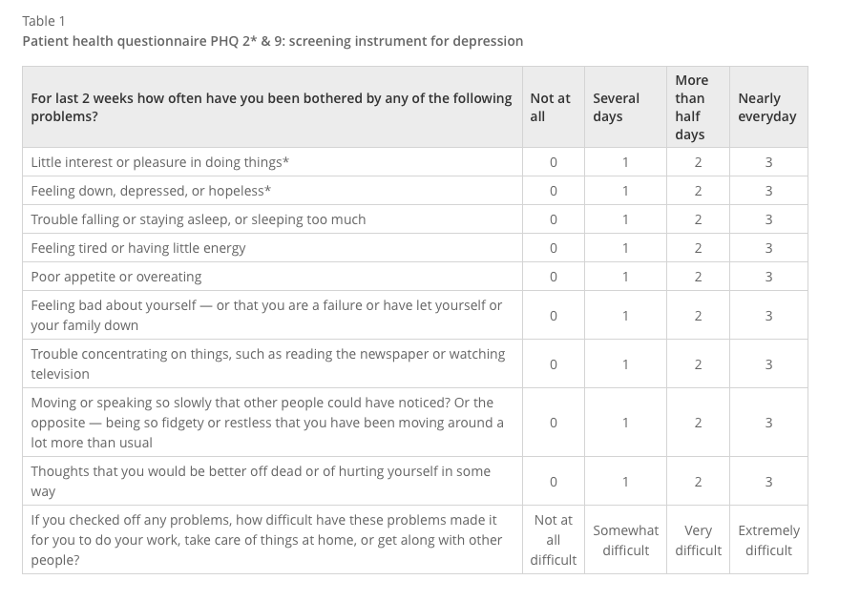
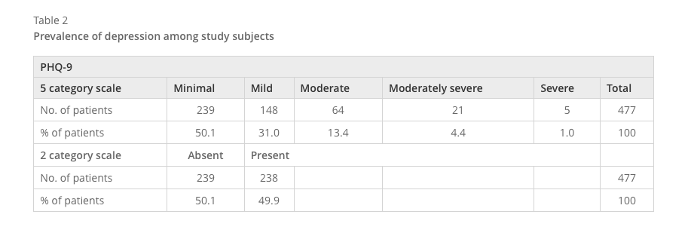

Slide 15
Causes of Depression
Genetical
Biological
Psychological

Slide 16
Causes of Depression
Mental, Physical or Sexual Abuse.
Major events: Death or loss of loved one.
Social Isolation due to Other mental illnesses.
Co-exists with a Major illness or may be triggered by it.
Certain Medications (isotretinoin , interferon-alpha, and corticosteroids).
The Abuse Substance, nearly 30% of them have major or clinical depression.

Slide 17
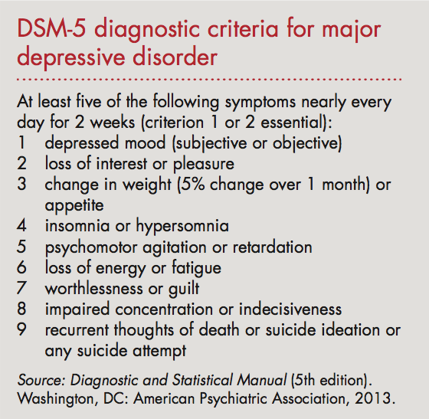
Clinical Features (DSM5)
Depressed mood.
Loss of interest in pleasurable activities (anhedonia).
Appetite or body weight change (5% change over 1 month).
Insomnia or hypersomnia.
Psychomotor agitation or retardation.
Fatigue or loss of energy.
Feelings of worthlessness or excessive guilt.
Diminished concentration.
Recurrent thoughts of death or suicide ideation or any suicide attempt.

Slide 18
Major Depressive Disorder
≥ 5 of the previous symptoms have been present during the same 2-week period and represent a change from previous functioning; at least one of the symptoms is either #1 or #2
Significant distress or impairment in functioning.
The symptoms do not meet criteria for a mixed episode.
Not due to substance abuse , a medication or a medical condition(e.g., hypothyroidism)

Slide 19
Dysthymic Disorder
Dysthymic disorder is a chronic depressed mood that lasts most of the day and presents on most days.
≥ 2 years history of chronic low mood.
No remission periods more than two months.

Slide 20
Post-partum Depression
About 10 - 15 % recently delivered women develop disabling depression within 6 weeks of childbirth .
Which if not treated may continue for six months or more and cause considerable family disruption.
It is associated with increasing age, mixed feelings about the baby, physical problems in the pregnancy and prenatal period, family distress and past psychiatric history.

Slide 21
Post-partum Depression
Depressed mood may be associated with irritability, self-blame and doubt of being a good mother, excessive anxiety about the baby’s health and death wishes.
Counseling, additional help with child-care may be needed. Antidepressants or ECT are indicated if there are biological features of depression.

Slide 22
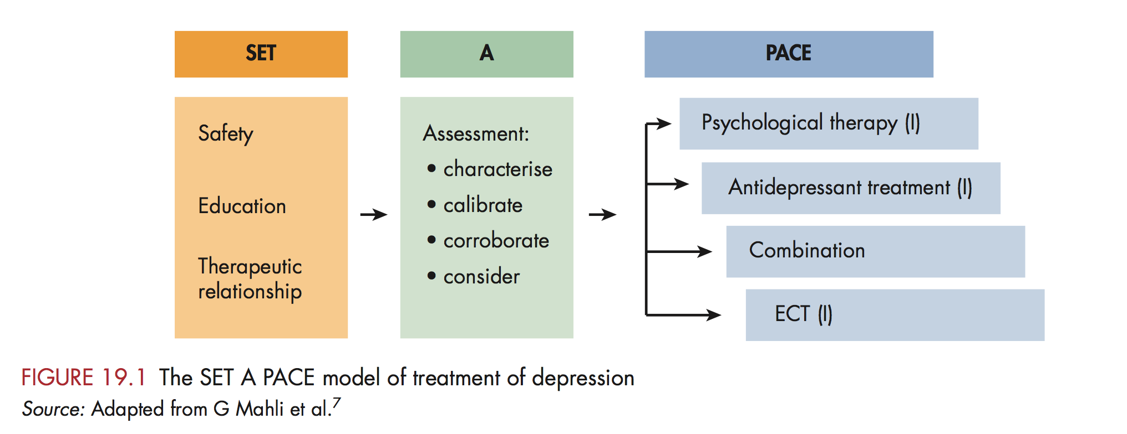
Management

Slide 23
Anti Depressants
Selective-Serotonin- Reuptake Inhibitors (SSRIs):
E.g. paroxetine (seroxat), fluoxetine (prozac), citalopram (cipram)
They are considered to have the most favorable balance of benefit to harm.
Side Effects:
Sexual dysfunction
Gastrointestinal side effects

Slide 24
Anti Depressants
Seretonin and noradrenaline reuptake inhibitors (SNRIs):
E.g. Venlafaxine (Effexor-Efexor), desvenlafaxine (Pristiq), duloxetine (Cymbalta).
Higher rates of remission in depressed patients than the SSRIs.
More Side effects compared to SSRI

Slide 25
Old Anti depressant
Tricyclic Antidepressants (TCAs):
E.g. Amitriptyline, imipramine, clomipramine.
They are of proven effectiveness and commonly used though they have many side effects. They are generally less expensive than other antidepressants. But should be avoided on suicidal patients because overdose can cuase (cardiac toxicity).
Side Effects :
Dry mouth/urinary retention/constipation.
Impaired visual accommodation
Worsening of glaucoma central anticholinergic toxicity(delirium).
Postural hypotension.
delayed ejaculation. Sweating/weight gain. arrhythmia. Tremor. precipitation of mania in susceptible patients.

Slide 26
Old Anti depressant
Monoamine Oxidase Inhibitors (MAOIs):
Because of their serious interactions with tyramine – containing foodstuffs and other drugs, they are almost obsolete nowadays.
Side effects:
Dry mouth/urinary retention/constipation.
Postural hypotension.
Sexual dysfunction.
Weight gain
Hepatotoxicity.
Hypertensive crisis.

Slide 27
When to refer to a specialist ?
Substantial suicide risk.
Severe depression.
Psychotically depressed (with delusions or hallucinations).
Failure of response to routine antidepressant therapy.
Depression in the elderly where diagnosis includes dementia.
Children with major depression.
Uncertainty about diagnosis.
Inpatient care obviously necessary.

Slide 28
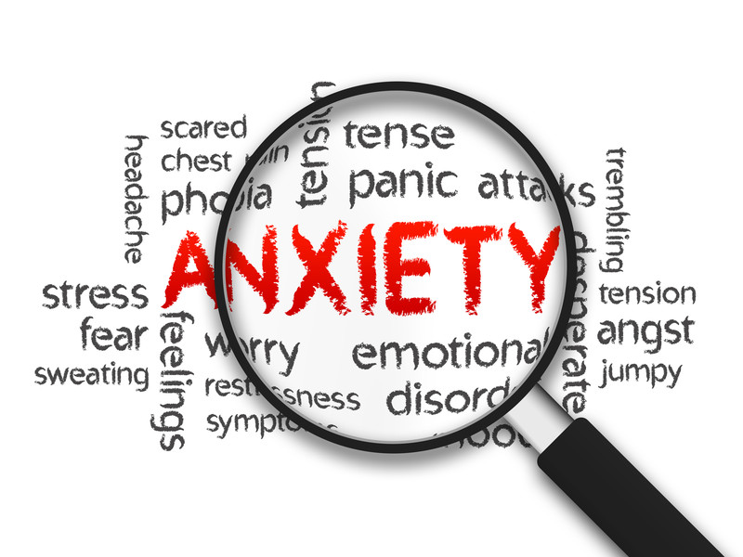
Anxiety

Slide 29
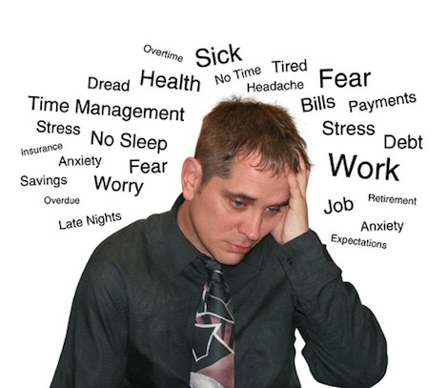
Anxiety
Subjective feeling of worry, fear, and apprehension accompanied by autonomic symptoms (such as palpitation, sweating, and muscles), caused by anticipation of threat/danger.

Slide 30

Fear , Panic , Phobia
Fear: anxiety caused by realistic consciously recognized danger.
Panic: acute, self-limiting, episodic intense attack of anxiety associated with overwhelming dread and autonomic symptoms.
Phobia: irrational exaggerated fear and avoidance of a specific object, situation or activity

Slide 31
Prevalence
In a study done on 822 male patients that attended Primary Health Care Centers, Eastern Saudi Arabia : The overall prevalence of anxiety was 22.3% with 17.0% of the attendees having mild degree of anxiety.
[Shaher Z. Al-Shehri, Amr A. Sabra, Attia Z. Taha , Ammar H. Khamis, Ahmed S. Hafez. Depression and Anxiety among Males Attending Primary Health Care Centers, Eastern Saudi Arabia: Prevalence and Predictors. Life Sci J 2012;9(3):128-133]. (ISSN: 1097-8135).

Slide 33
Anxiety disorders
Panic Disorder
Phobias (Agoraphobia , Social phobia , Specific phobia)
Generalized Anxiety Disorder ( GAD)
OCD
PTSD

Slide 34
Case
Mr. Ali is a 30-year-old man came to the clinic complaining of 3- month history of recurrent sudden attacks of severe fear of death, palpitation, shortness of breath, excessive sweating, and impaired concentration.
The attack lasts for about 20 minutes then disappears completely. Between, the attacks, although he is free from physical symptoms, he is anticipating the next attack.

Slide 35

Panic attack
Sudden self-limited attack of intense anxiety, with feeling of imminent doom or death and an urge to escape. last for several minutes to an hour
Panic attacks are symptoms that can occur in a variety of psychiatric disorders

Slide 36

Panic Disorder
Recurrent panic attacks, at least some of which are not triggered or expected, and one month or more of either worry about future attacks/consequences, or a significant maladaptive change in behavior related to the attacks, such as avoidance of the precipitating circumstances

Slide 37
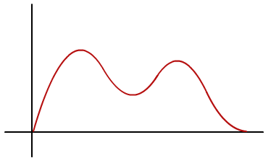
Epidemiology
Women > men.
Lifetime prevalence is 1 – 3 % throughout the world .
Age at onset: bimodal distribution, with one peak in late adolescence and a second smaller peak in the mid 30s.

Slide 38
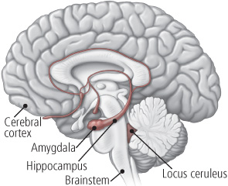
Etiology
Poorly regulated autonomic responses to stressors
Pathological hyperactivity in Locus Ceruleus “alarm system”
Genetic basis (panic disorder occurs more often among relatives)
The biochemical hypothesis

Slide 39

Diagnosis
Recurrent sudden unexpected panic attacks.
At least one of the attacks has been followed by ≥ 1 month of ≥ one of the following:
  Persistent concern about having additional attacks.
  Worry about the implications / consequences of the attacks (e.g. going mad or death).
  A significant change in behavior related to the attacks.
Not due to medical disease, substance abuse or psychiatric disorder.

Slide 40
Treatment
Cognitive Behavior therapy (CBT): detection and correction of wrong thoughts and thinking process (negative cognition) about the origin, meaning, and consequence of symptoms & relaxation training.
Medications: Choose one of SSRIs (selective serotonin reuptake inhibitors). All are effective for panic disorder although the most widely used is paroxetine. Also tricyclic antidepressants can be a good alternative. For rapid onset of action add a benzodiazepine (lorazepam ).

Slide 41
Case
Mr. Saad is a 25-year-old married man seen by his Family doctor for a 7-month history of persistent disabling anxiety, irritability, muscle tension, and disturbed sleep

Slide 42
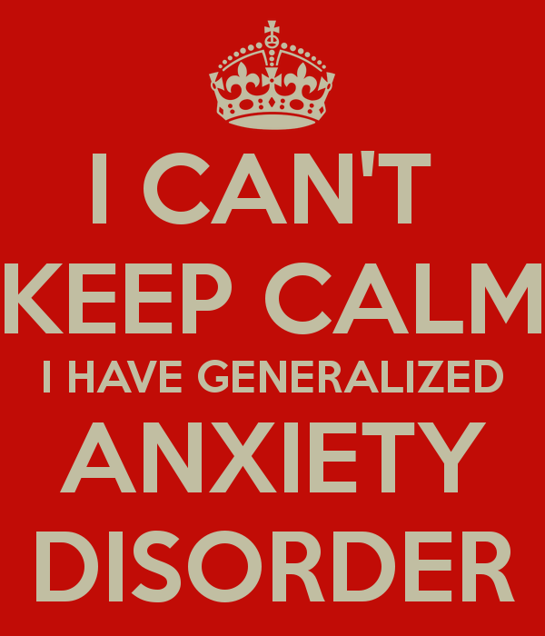
Generalized Anxiety Disorder ( GAD)
Excessive worry and anxiety that are difficult to control, cause significant distress and impairment, and occur on more days than not.

Slide 43
Epidemiology
Women > men (2:1).
One year prevalence rate 3% . Life time prevalence rate 5% .
Age at onset: Often begins in early adult life, but may occur for the first time in middle age.

Slide 44

Etiology
Combination of genetic and environmental influences in childhood.
Maladaptive patterns of thinking may act as maintaining factors.
Anxiety as a trait has a familial association.

Slide 45
Diagnostic Criteria
≥ 6 months history of excessive anxiety occurring most of the days.
The person finds it difficult to control the worry.
The anxiety and worry are associated with ≥ 3 of 6:-
1- Restlessness. 2- Irritability.
3- Easily Fatigued. 4- Muscle Tension.
5- Difficulty In Concentrating. 6- Sleep Disturbance.
The focus of the anxiety is not confined
It causes significant distress or functional impairment
The disturbance is not due to the direct physiological effects (drugs, medical co,..)

Slide 46
Treatment
Rule out medical causes.
Cognitive – behavior therapy (CBT):
relaxation with cognitive therapy to control worrying thoughts.
Medications:
Antidepressants :- SSRIs (e.g. paroxetine) or SNRIs( e.g. Venlafaxine).
Buspirone :- it is effective in reducing the cognitive symptoms of GAD.
Benzodiazepines :- for a limited period (to avoid the risk of dependence)

Slide 47

When To Refer ?
If the diagnosis is DOUBTFUL
If drug and alcohol dependence or withdrawal complicate the management
If depression or a psychosis appears to be involved
Failure of response to basic treatment

Slide 48
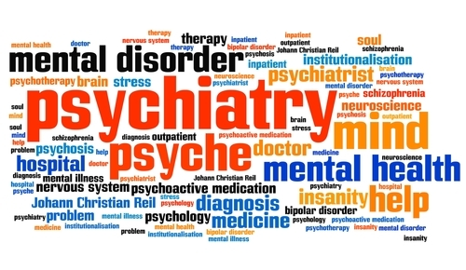
Somatic symptom disorder

Slide 49
Case scenario
Abdullah is 24 years old came to the PHC complaining of dizziness, migraines, and stomach pain. He went to multiple doctors but his condition didn’t improve. From history all these symptoms started after his father passed away 6 months ago.

Slide 50
What is Somatic Symptom Disorder ?
SSD is a syndrome of physical symptoms that cause substantial distress or psychosocial impairment, and in some instances, are not explained by a known general medical disease after appropriate investigation.
the symptoms may be caused or exacerbated by:
  anxiety
  depression
  interpersonal conflicts
it is common for SSD, depression, and anxiety to all occur together

Slide 51
Epidemiology
SSD is common in the general population. More than 50 percent of patients presenting to outpatient medical clinics with a physical complaint do not have a medical condition.
Risk factors for SSD include:
  Female sex
  Fewer years of education
  Minority ethnic status
  Low socioeconomic status

Slide 52
Prevalence
Netherlands
Study of sample size of 1046. The prevalence of Somatic Symptom Disorders was 16.1%

Slide 53
Prevalence
Saudi Arabia
A study was done in Aseer 2008, on a sample of 224. The prevalence of SSD was 16% .Women displayed higher levels of somatization than men.
Another study done in Abha 2014, on sample of 400. The prevalence of SSD was 60.8%. High prevalence of SSD among the age group 51-60 years.

Slide 54
Prevalence
United States
A study done in the US showed that SSD occurred in 17% of patients in primary care settings and 4% of the general US population.

Slide 55
People prone to have SSD ?
Having a family member with a chronic illness during childhood may be a precursor to SSD.
Faulty perception and assessment of somatosensory inputs due to characteristic attention impairment.
Displacement of unpleasant emotions into a physical symptom.
Childhood sexual abuse and recent exposure to physical or sexual violence
To obtain attention or sympathy

Slide 56
Clinical features
Pain symptoms, Ex: headache & back pain.
Gastrointestinal symptoms, Ex: nausea, vomiting, abdominal pain, bloating, gas, and diarrhea.
Cardiopulmonary symptoms, including chest pain, dizziness, shortness of breath, and palpitations.
Neurologic symptoms, including fainting, muscle weakness, double or blurred vision, difficulty walking.

Slide 57
DDx
Medical diseases (e.g. SLE, endocrinopathies, chronic infections).
Depression
Anxiety
Hypochondriasis (the emphasis is on over-concern with a serious disease).
Psychogenic pain disorder

Slide 58
How to diagnose Somatic Symptom Disorder
According to the Diagnostic and Statistical Manual of Mental Disorders, 5th Edition (DSM5) criteria:
The patient has one or more somatic symptoms that are distressing or result in significant disruption of daily life.
any one somatic symptom may not be continuously present, the state of being symptomatic is persistent (typically more than 6 months).

Slide 59
Cont’d
C. Excessive thoughts, feelings, or behaviors related to the somatic symptoms or associated health concerns as manifested by at least one of the following:
Disproportionate and persistent thoughts about the seriousness of one's symptoms
Persistently high levels of anxiety about health or symptoms
Excessive time and energy devoted to these symptoms or health concerns.

Slide 60
Management
The number of medical staff involved is better limited
Arrange brief regularly scheduled appointments, e.g. every month.
Repeat physical examination.
Avoid additional diagnostic procedures.
Shift the patient’s awareness to psychological factors, and support him.
Minimize the use of psychotropic drugs.
Encourage graded return to normal activities.
Antidepressants are useful when secondary depression develops.
Notes:
(patients tend to use drugs unreliably and erratically)

Slide 61
When to refer to a psychiatrist ?
The patient has a psychiatric disorder, on psychotropic medications, or has a past history of such.
Patient with disturbing, demanding, manipulative behavior
The Patient has suicidal thoughts.
Suspicion of a psychiatric problem behind the physical symptoms.
The patient has asked to see a psychiatrist.

Slide 62

Counseling and Psychotherapy
ROLEPLAY AND DISCUSSION

Slide 63
Quick Quiz

Slide 64
Q1
Which of the following is the overall best anti depressant ?
TCAs
NSAIDs
SSRI
MAOIs

Slide 65
Q2
A 20-year-old college student presented with repeated bouts of palpitation, sweating, and excessive worries when he uses public transport. The most likely diagnosis is:
Generalized anxiety disorder
Posttraumatic disorder
Agoraphobia with panic attacks
Social phobia

Slide 66
Q3
A 23-year-old man presented with extreme fear whenever he enters an elevator . The most appropriate statement about his treatment is:
Psychodynamic therapy
Olanzapine 5 mg
Behavior therapy
Insight-oriented therapy

Slide 67
Q4
which of the following is a risk factor for Somatic symptom disorder “SSD”?
Male
Female
High socioeconomic status
High education level

Slide 68
Q5
Which of the following can exacerbate Somatic symptom disorder “SSD”?
Anxiety
Depression
Interpersonal conflicts
All the above

Slide 69

Take home message
anxiety, depression , and somatic symptom disorder are common psychiatric diseases in Saudi Arabia
Depression is more common in younger adults
Panic attacks are Sudden self-limited attacks of intense anxiety
SSD is a syndrome of physical symptoms that cause substantial distress or psychosocial impairment

Slide 70
References
Manual of psychiatry
John Murtagh's General Practice - 6th Edition (2015
http://www.lifesciencesite.com/lsj/life0903/017_9353life0903_128_133.pdf
https://www.ncbi.nlm.nih.gov/pmc/articles/PMC4744283/
http://ijp.sagepub.com/lookup/pmid?view=long&pmid=12489702
https://www.ncbi.nlm.nih.gov/pmc/articles/PMC3377053/
http://www.who.int/mental_health/management/depression/who_paper_depression_wfmh_2012.pdf
http://bmcpsychiatry.biomedcentral.com/articles/10.1186/1471-244X-14-190
DSM 5

Slide 71

Thank You

