Slide 1
Sexually Transmitted disease
Abdullah Al-Atar
Alwaleed Al-Subaie
Hisham Ghabbani
Faisal S. Al-Ghamdi

Slide 2
Question 1
Most common STIs in KSA ?
HIV
Chlamydia
Gonorrhea
Syphilis

Slide 3
Question 2
A patient went 3 days ago to one of the gulf countries. He complains of urethral discharge. What do you expect :
HIV
Chlamydia
Gonorrhea
Syphilis

Slide 4
Question 3
Patient comes to you complaining of urinary frequency. When you examined her you found Frothy yellowish vaginal discharge and strawberry cervix:
What is the most likely diagnosis?
HIV
Trichomoniasis
Gonorrhea
Syphilis

Slide 5
Question 4
Which of the following is required to diagnose a patient with AIDS?
A CD4 count of less than 200 cells/mm3
A CD4 count of less than 1000 cells/mm3
A CD4 count of less than 2000 cells/mm3
A CD4 count of less than 100 cells/mm3

Slide 6
Question 5
Which of the following is the drug of choice in the treatment of Trichomoniasis :
Azithromycin
Doxycycline
Ceftriaxone
Metronidazole

Slide 7
Question 6
Which is the most common STD caused by bacteria?
Gonorrhea
Syphilis
Chlamydia
Genital warts

Slide 8
What is an STD?
An infection that can be transmitted through sexual contact with an infected individual.
Sometimes called sexually transmitted infections (STIs).
There are more than 30 different sexually transmissible bacteria, viruses and parasites.
World Health Organization (WHO)

Slide 9
Ways of Transmission
STDs can be transmitted many different ways, but most can be passed by:
Vaginal sex
Anal sex
Oral sex
Skin-to-skin contact
Infected Mother to child

Slide 10
Why is this important?
Often no signs or symptoms
People are unaware of infection, and don’t receive treatment.
Long-term damage
May have passed infection to others
20 million new infections every year in the United States.²
More than 1/2 of all people will have an STD at some point in their lifetime.³

Slide 11
Taking Sexual History
Reassurance.
Play the helper rule, not the judge rule.
History must cover the 5Ps:
Past STIs .
Partners .
Practices .
Prevention of STIs and HIV.
Pregnancy history and plans .

Slide 12
Method of Taking History
Use open ended questions.
Relieve pressure of patients.
Avoid medical terminologies .
Don’t make assumptions .
Specific sexual practices: ask about anal, oral, or vaginal sex.

Slide 13
Why Sexual History is Important?
Diagnosis & treatment
Detection of asymptomatic disease
Prevent serious complication (i.e. infertility, PID…)
Promote behavior changes to prevent future infections

Slide 14
PARASITIC
VIRAL
BACTERIAL
MOST COMMON SEXUAL TRANSMITTED INFECTIONS

Slide 15
Most Common Sexual transmitted Infections:
Bacterial infections :
Chlamydia trachomatis (causes chlamydial infections)
Neisseria gonorrhoeae (causes gonorrhoea or gonococcal infection)
Treponema pallidum (causes syphilis)
Haemophilus ducreyi (causes chancroid)
Klebsiella granulomatis (causes granuloma inguinale or donovanosis).

Slide 16
Most Common Sexual Infections
Viral infections:
Human papillomavirus (causes genital warts and certain subtypes lead to cervical cancer in women).
Herpes simplex virus type 1 and type 2 (causes genital herpes)
Human Immunodeficiency Virus (causes HIV infection)
Hepatitis B virus (causes hepatitis and chronic cases may lead to cancer of the liver)
Parasitic infections:
Trichomonas vaginalis (causes trichomoniasis)

Slide 17
Bacterial STDs
Chlamydial Infection

Slide 18
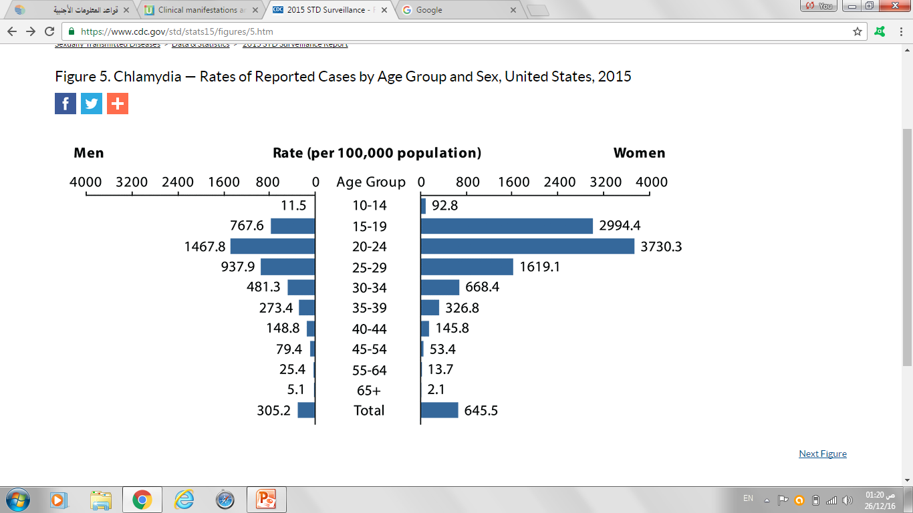

Slide 19
Chlamydia Trachomatis
It is the most common bacterial STI in the world.
It is the most common STI in KSA
More in female
Large majority are asymptomatic
Etiology:
It is caused by the bacterium Chlamydia trachomatis.
It has an incubation period of 1–3 weeks.
Mode of transmission:
Sexual contact

Slide 20
Clinical Presentation of Chlamydial Infection
Males (asymptotic in 50%) | Female (asymptotic in 70%)
Painful urination
Burning Sensation on the genitalia
Conjunctivitis
Pharyngitis
Cloudy or clear discharge from the penis | Abnormal vaginal discharge
Painful and swollen testicles | Pain during intercourse
 | Abdominal pain with fever
 | Intermenstrual bleeding

Slide 21
Diagnosis
Diagnosis: Using the following methods after a urine sample (specimen of choice) or swab is obtained:
Nucleic acid amplification test (NAAT) .
Antigen detection
Enzyme immunoassays (EIAs) .

Slide 22
Treatment
Tetracyclines or Macrolides antibiotics such as Azithromycin or Doxycycline
In pregnancy, Erythromycin is the drug of choice.

Slide 23
Complications
Women
Pelvic inflammatory disease (PID)
Cervicitis
Salpingitis (causing ectopic pregnancy)
Men
Urethritis
Epididymitis
Reactive arthritis

Slide 24
Bacterial STDs
Gonorrhea

Slide 25
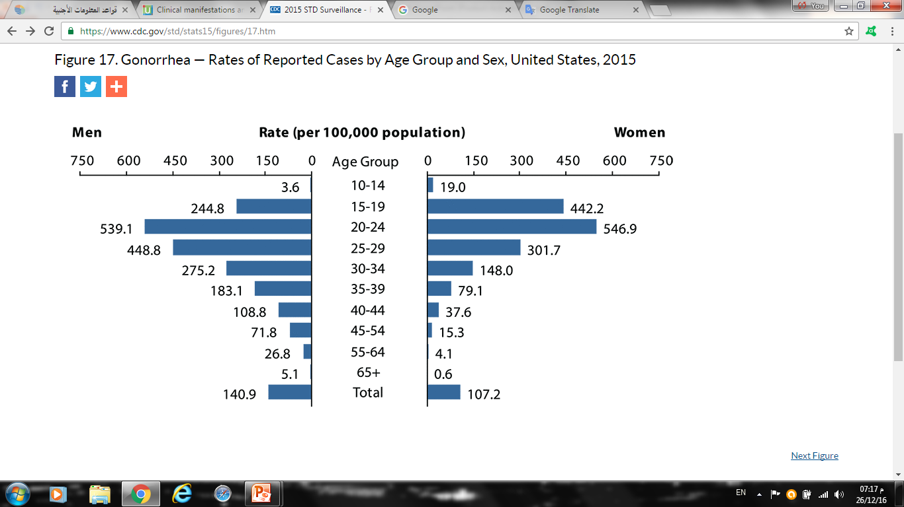

Slide 26
Gonorrhea
Etiology:
Neisseria gonorrhea (Gram -ve intracellular diplococcus).
Incubation period is 2-14 days.
Modes of transmission:
Sexual contact (most symptoms present between 2-5 days)
Mother to child transmission

Slide 27
Gonorrhea Presentation
 | Men | Women
Asymptomatic | 10% | 50%
Signs and symptoms | Dysuria Urethral discharge In MSM rectal infection may produce proctitis. Pharyngitis (both) | Dysuria Pelvic pain vaginal discharge Intermenstrual bleeding Conjunctival infection: seen in neonates born to infected mothers.
Notes:
MSM = men who have sex with men

Slide 28
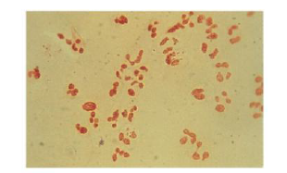
Diagnosis of Gonorrhea
Gram-negative intracellular diplococcic may be seen on microscopy of smears from infected sites (see the Figure).
The diagnosis must be confirmed by culture or nucleic acid amplification test (NAAT)
Figure This is gram stain urethral smear for men with gonococcal urethritis.
Notes:
disseminated GC = Gonococcal infection , The diagnosis must be confirmed by culture or nucleic acid amplification test (NAAT) such as polymerase chain reaction (PCR).

Slide 29
Treatment of Gonorrhea :
Ceftriaxone (IM) Cefixime (oral)
Azithromycin or Doxycycline to cover Chlamydia.

Slide 30
Complications of Gonorrhea
Women
Bartholin’s abscess
Pelvic inflammatory disease
Infertility
Men
Epididymitis
Prostatitis

Slide 31
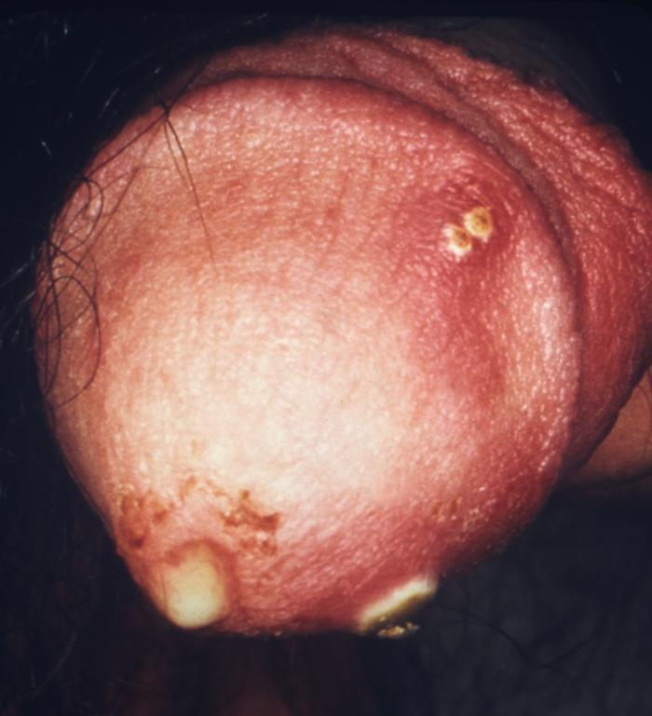
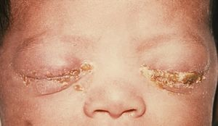
purulent penile discharge due to gonorrhea with an overlying penile pyodermal lesion.
Gonococcal ophthalmia neonatorum

Slide 32
Name of This Lesion?

Slide 33
Bacterial STDs
Syphilis

Slide 34
Syphilis
Etiology:
spirochete Treponema pallidum
Disease progresses in stages,(Primary , Secondary , latent , Tertiary).
Modes of Transmission :
Sexual and vertical
Most contagious to sex partners during the primary and secondary stages

Slide 35
Primary Syphilis
The first stage present with chancre (a firm, painless, non-itchy skin ulceration) form at the site of infection about 2-3 weeks after you are first infected.

Slide 36
Secondary Syphilis
Within weeks to a few months after the chancre develops, approximately 25 percent of individuals with untreated infection develop a systemic illness that represents secondary syphilis
These symptoms (diffuse rash which frequently involves the palms of the hands and soles of the feet). “ if you see this type of rash think of two diffrentials!!”
● Constitutional symptoms — Patients with secondary syphilis may develop systemic symptoms including fever, headache, malaise, anorexia, sore throat, myalgias, and weight loss.
● Adenopathy — Most patients with secondary syphilis have lymph node enlargement with palpable nodes present in the posterior cervical, axillary, inguinal, and femoral region

Slide 37
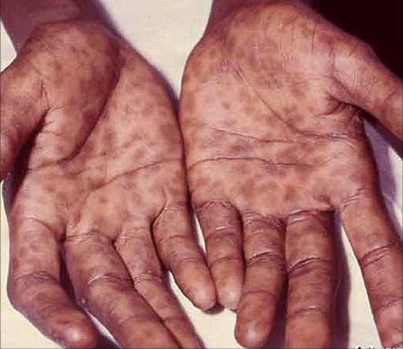
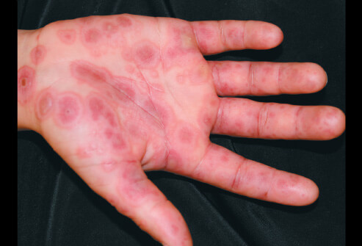
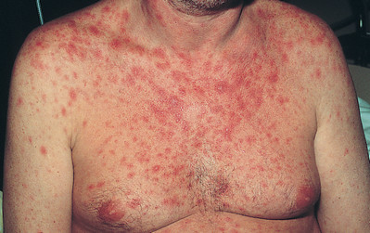
Secondary syphilis
Erythema Multiforms

Slide 39
Diagnostic test
Serologic tests — Serologic tests provide a presumptive diagnosis of syphilis. There are two types of serologic tests for syphilis: nontreponemal tests and treponemal-specific tests. The use of only one test is insufficient for diagnosis since serologic testing (especially nontreponemal tests) can be associated with false positive results.
Nontreponemal tests :these screening tests are nonspecific, and therefore not definitive, they have traditionally been used for initial syphilis screening due to their relatively low cost, ease of performance, and ability to be quantified for the purpose of following response to therapy
Treponemal tests:more complex and expensive to perform than nontreponemal tests. Thus, they have traditionally been used as confirmatory tests for syphilis when the nontreponemal tests are reactive

Slide 40
Diagnosis of Syphilis:
The diagnosis of syphilis is most commonly made by serologic testing
a- Dark field microscopy of smear
from primary or secondary lesions. May be negative.
b- Serologic tests: (commonly used) VDRL and TPHA
i-Nontreponemal tests
ii-Treponemal tests
iii- IgM

Slide 41
Treatment of syphilis
Antibiotics: effective early
Penicilen is treatment of choice
Benzathine penicillin (2.4 million unit 1 dose, IM), if allergic: doxycycline (2 weeks)

Slide 42
Viral STDs
Genital Herpes

Slide 43
Genital Herpes
Etiology
Genital Herpes caused by Herpes Simplex Virus type 2 (HSV-2)
Oral Herpes caused by HSV-1
HSV-1 can cause genital lesions
Mode of transmission
Contact with person who is infected (either sexual contact of regular physical contact)
Vertical transmission (very rare)
Through the birth canal

Slide 44
Signs and symptoms of Genital Herpes
It is a lifelong infection with exacerbations and remissions
Primary Herpes Infection:
Painful shallow ulcers (Around the mouth or on genitalia)
Dysuria, fever, tender local inguinal lymphadenopathy, and headache
In Immunocompromised patients, symptoms are more severe with increased instances of shedding .

Slide 45
Diagnosis and Complications of Genital Herpes
Diagnosis:
Clinical presentation and history
Viral culture
PCR ( most sensitive and specific)
Complications:
Rectal infection may lead to proctitis (specially in men to men)
Aseptic meningitis
Involvement of sacral autonomic plexus leading to urine retention

Slide 46
Transmission of Genital Herpes from mother to baby
If a woman with genital herpes has virus present in the birth canal during delivery, herpes simplex virus (HSV) can be spread to an infant, causing neonatal herpes, a serious and sometimes fatal condition.
Neonatal herpes can cause an overwhelming infection resulting in lasting damage to the central nervous system, mental retardation, or death. Medication, if given early, may help prevent the infection .

Slide 47
Delivery in a mother with genital herpes
If you have an active outbreak at the time of delivery, the safest course is a Cesarean section to prevent the baby from coming into contact with virus in the birth canal. If you do not have an active outbreak, you can have a vaginal delivery.

Slide 48
Treatment and management of Genital Herpes
Primary
Acyclovir for 5 days when new lesions are still forming
Recurrence
Caring for patients mental health
Long term suppressive therapy (Acyclovir 6-12 months) therapy should be discontinued after 12 months

Slide 49
Consultation
Sexual intercourse must be avoided during times of exacerbations
Condoms may not be effective (Lesions may be present outside the covered area)
Partners must be tested
Mothers who are expecting are encouraged to give birth via Caesarean section

Slide 50
Genital Herpes

Slide 51
Oral Herpes

Slide 52
Parasitic STDs
Trichomoniasis

Slide 53
Trichomoniasis
Etiology:
Trichomonas Vaginalis (Flagellated protozoa).
Mode of transmission:
Sexual contact.
Perinatally, from mother to child.

Slide 54
Signs and symptoms
Men:
Usually present asymptomatic (three-quarters of cases)
clear or mucopurulent urethral discharge.
urinary frequency, dysuria
Women:
The major complaint are vaginal discharge
Local irritation.
Examination often reveals green-yellow, frothy, malodorous discharge
The cervix may have multiple small hemorrhagic areas which lead to the description ‘strawberry cervix’.

Slide 55
Strawberry cervix

Slide 56
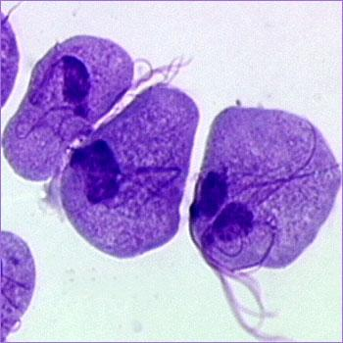
Diagnosis and Treatment
Diagnosis:
Dark-ground microscopy:
Positive in 40-80% of women.
Positive in 30% of men.
Culture techniques are good and confirm the diagnosis.
Elevated vaginal pH (>4.5)

Slide 57
Treatment
Metronidazole is the treatment of choice.
(Both symptomatic and asymptomatic) + partner
screened for other STDs

Slide 58
Complications
Genital inflammation, UTI
During pregnancy
Preterm delivery
Low birth weight

Slide 59
Viral STDs
HIV

Slide 60
HIV
Etiology:
Retrovirus, either HIV-1 or HIV-2
HIV-2 is almost entirely confined to West Africa
Modes of Transmission:
Sexual intercourse (Vaginal or Anal)
Mother-to-child (transplacental, perinatal, breastfeeding).
Contaminated blood, blood products and organ transplantation
Contaminated needles
Notes:
Worldwide, the predominant virus is HIV-1, So when we generally say HIV, we are referring to HIV-1. The relatively uncommon HIV-2 type is concentrated in West Africa and is rarely found elsewhere
There are two types of HIV: HIV-1 and HIV-2. Both types are transmitted by sexual contact, through blood, and from mother to child, and they appear to cause clinically indistinguishable AIDS. However, it seems that HIV-2 is less easily transmitted, and the period between initial infection and illness is longer in the case of HIV-2. less pathogenic
HIV-1 and HIV-2 have many similarities including their intracellular replication pathways, transmission modes and clinical effects leading to acquired immune deficiency syndrome (AIDS). However, HIV-2 is less likely to progress into AIDS because of its lower transmissibility. Thus, individuals infected by HIV-2 mostly remain non-progressors for a long period of time, while patients infected by HIV-1 progress faster and contract AIDS.

Slide 61
Risk factors and stages of HIV infection
Risk factors:
STIs (due to open sores)
Unprotected sexual intercourse
Multiple sexual partners
Uncircumcised males
Notes:
Stages of HIV infection
Acute HIV infection
Chronic HIV infection
AIDS

Slide 63
Diagnosis of HIV
ELISA
Screening
High sensitivity
PCR
Measure the viral load
(Qualitative, Quantitative)
Western Blot
Confirmatory test

Slide 64
When to use ELISA
This test is the initial test to detect infection with HIV (Antibodies)
2 weeks after infection
If antibodies to HIV are present (positive), if not (negative) the test is usually repeated to confirm the diagnosis.

Slide 65
When to use Western blot
It is done to confirm the results of two positive ELISA tests.

Slide 66
When to use PCR
This test may be done in the days or weeks after exposure to the virus, before development of the antibodies.
This test is done to confirm the presence of virus RNA and viral Load.

Slide 67
Treatment of HIV
Antiviral Therapy
Triple therapy HAART:
Reverse transcriptase inhibitors
Zidovudine, Nevirapine
Protease inhibitor
Saquinavir, Indiniavir
Opportunistic infection prophylaxis
TB
PCP
Toxoplasmosis

Slide 68
Treatments to prevent mother-to-baby transmission :
UK guidelines recommend that you start taking AZT (zidovudine) in the final three months (third trimester) of your pregnancy.
You will also need to take an intravenous injection of AZT during delivery and have a caesarean .

Slide 69
Prevention Of STDs
Sexual Behavior
Vaccination
Screening
Abstinence.
Mutual monogamy.
Consistent use of latex condom.
hepatitis B, and HPV
Notes:
Sexual behavior :
Abstinence.
Mutual monogamy.
Consistent use of latex condom.
Using condoms are highly effective in reducing STIs transmission, but they do not guarantee 100% prevention. (e.g. Herpes, HPV)
Reduce number of sex partners.
Vaccination:
Vaccines are a recommended way to prevent hepatitis B, and HPV
Screening :
First identify population at risk : Young age (15-35)
Recent travel history
Sexual practices:
New partner
Multiple partners
Partner with multiple partners
Symptoms need to check :
Sores or bumps anywhere on the body
Recurrent genital sores
Generalized skin rash
Pain during intercourse
Scrotal pain, redness and swelling
Pelvic pain

Slide 70
Questions

Slide 71
Question 1
Most common STIs in KSA ?
HIV
Chlamydia
Gonorrhea
Syphilis

Slide 72
Question 2
A patient went 3 days ago to one of the gulf countries. He complains of urethral discharge. What do you expect:
HIV
Chlamydia
Gonorrhea
Syphilis

Slide 73
Question 3
Patient comes to you complaining of urinary frequency. When you examined her, you found Frothy yellowish vaginal discharge and strawberry cervix:
What is the most likely diagnosis?
HIV
Trichomoniasis
Gonorrhea
Syphilis

Slide 74
Question 4
Which of the following is required to diagnose a patient with AIDS?
A CD4 count of less than 200 cells/mm3
A CD4 count of less than 1000 cells/mm3
A CD4 count of less than 2000 cells/mm3
A CD4 count of less than 100 cells/mm3

Slide 75
Question 5
Which of the following is the drug of choice in the treatment of Trichomoniasis :
Azithromycin
Doxycycline
Ceftriaxone
Metronidazole

Slide 76
Question 6
Which is the most common STD caused by bacteria?
Gonorrhea
Syphilis
Chlamydia
Genital warts

Slide 77
References
Chlamydia trachomatis UK Testing Guidelines
British Association of Sexual Health and HIV (BASHH)
Kumar and Clark's Clinical Medicine (9th Ed)
CDC website
AVERT.org
World Health Organization
AVERT. STD Pictures. from AVERT: http://www.avert.org/std-pictures.htm
American Academy of Family Physicians
http://www.webmd.com/hiv-aids/human-immunodeficiency-virus-hiv-test
http://www.aidsmap.com/Mother-to-baby-transmission/page/1044918/

Slide 78
Thank you
Any questions ?
Abdullah Al-Atar
Alwaleed Al-Subaie
Hisham Ghabbani
Faisal S. Al-Ghamdi

