Slide 1
Osteoporosis and Vitamin D deficiency
SLS Presentation

Slide 2
Q1:
10 months Old female, presented to the clinic with bowed legs, dental problems and her growth profile is disturbed, what is the most likely diagnoses?
A. Osteomalacia.
B. Rickets.
C. Osteoporosis.
D. Hypothyroidism.

Slide 3
Q2.
Which of the following is the optimal daily intake of calcium for postmenopausal women?
A- 1200 mg
B- 1000 mg
C- 1500 mg
D- 900 mg

Slide 4
Q3. Which of the following is the best way for adequate vitamin D levels:
A- Using sunscreens
B- Exposure to sunlight
C- Using supplements
D- Smoking cessation

Slide 5
Q4. Which one of the following isn't a risk factor for osteoporosis?
1-smoking
2-post-menopause
3-history of fragility fracture
4-D.M

Slide 6
Q5. Which of the following DEXA values is diagnostic for osteopenia?
A- -1.5 SD
B- -2.5 SD
C- -3
D- -0.9

Slide 7
Osteoporosis

Slide 8
Low bone mass and structural deterioration of bone tissue.
Consequent increase in bone fragility and susceptibility to fracture.
200 million people worldwide suffer from this disease.
Osteoporosis leads to nearly 9 million fractures annually worldwide.

Slide 9
A study done 2015 the epidemiological analysis showed that 34% of healthy Saudi women, and 30.7% of men.
With a reported increased life expectancy in KSA increasing to 75.7 years.

Slide 10
Types:
Primary osteoporosis:
most common type of osteoporosis.
A person reaches peak bone mass (density) at about age 30. After that, the rate of bone loss slowly increases, while the rate of bone building decreases.
Secondary osteoporosis:
same symptoms as primary osteoporosis.
occurs as a result of hyperparathyroidism, hyperthyroidism, or leukemia.

Slide 11
Cont.
Osteogenesis imperfecta:
is a rare form of osteoporosis that is present at birth.
Break the bones for no apparent reason.
Idiopathic juvenile osteoporosis:
Is a rare disease that occurs in children between the ages of 8 and 14 or during times of rapid growth.
There is no known cause for this type of osteoporosis.

Slide 12
Vitamin D

Slide 13
Essential for skeletal growth and bone health.
On 2008 a study shown the prevalence of vitamin D deficiency worldwide is still uncertain, as there is data lacking from many countries. About 1 billion people have low vitamin D levels and this is found in all ethnicities and age groups.

Slide 14
In US, 2011 estimated that the overall prevalence rate of vitamin D deficiency is 41.6%.
A study was done on 2013 shows Twenty-nine percent were vitamin D deficiency, 22.7% were in relative insufficiency, and 47.5% had normal levels of 25-hydroxy vitamin D.

Slide 16
Osteomalacia / Rickets

Slide 17
Inadequate or defective mineralization of the skeleton.
Soft or fragile bones.
Vitamin D – Calcuim.

Slide 18
Vitamin D Deficiency:
Causes:
Decreased intake or absorption
Reduced sun exposure,
Increased hepatic catabolism
Decreased endogenous synthesis (via decreased 25-hydroxylation in the liver or 1-hydroxylation in the kidney),
End-organ resistance to vitamin D

Slide 19
Groups at high risk of Vit D deficiency:
Older people (Cutaneous production of vitamin D decline, dietary vitamin D intake is lower).
Dark skinned
Obese
Medications such as phenytoin (increase metabolism of vitamin D)
Limited effective sun exposure (clothing and sun screens)
Osteoporosis
Malabsorption (IBD and celiac)

Slide 20
Clinical manifestations:
Depend upon the severity and duration of the deficiency.
1- The majority of patients with moderate to mild vitamin D deficiency (15-20 ng/mL [37.5 to 50 nmol/L]) are asymptomatic.
- Serum calcium, phosphorus, and alkaline phosphatase are normal.
- Serum parathyroid hormone (PTH) levels is sometimes elevated.
2- Severe vitamin D deficiency:
Hypocalcemia occurs, causing secondary hyperparathyroidism, which leads to phosphaturia, demineralization of bones which leads to osteomalacia in adults and rickets and in children. Symptoms may then include bone pain and tenderness, muscle weakness, fracture, and difficulty walking.

Slide 21
Osteoporosis

Slide 22
Risk factors:
Advanced age
Previous fracture or low trauma
Long-term glucocorticoid therapy
Low body weight (less than 58 kg)
Family history
Smoking
Alcohol

Slide 23
Clinical manifestations :
— Osteoporosis has no clinical manifestations until there is a fracture.
Vertebral fracture — Vertebral fracture is the most common clinical manifestation of osteoporosis. Most of these fractures are asymptomatic; they are diagnosed as an incidental finding on chest or abdominal radiograph.
Other fractures:
Hip fractures are relatively common in elderly.
Subchondral insufficiency fractures of the femoral head.
Distal radius fractures (Colles fractures).

Slide 24
How to diagnose osteoporosis??

Slide 25
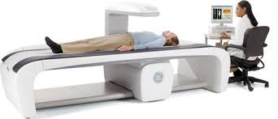
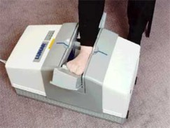
DEXA Scan (Dual X-ray Absorptiometry) The gold standard test to diagnose osteoporosis is dual X-ray absorptiometry. It measures people’s spine, hip, or total body bone density to help gauge fracture risk.

Slide 26
DEXA Scan Results:
DEXA scores are reported as "T-scores" and "Z-scores."
The T-score is a comparison of a person's bone density with that of a healthy 30-year-old of the same sex.
The Z-score is a comparison of a person's bone density with that of an average person of the same age and sex.

Slide 29
When It's Time to Treat:
The National Osteoporosis Foundation recommends treatment for:
Postmenopausal women with T-scores less than -2.0, regardless of risk factors.
Postmenopausal women with T-scores less than -1.5, with osteoporosis risk factors present.
In addition, anyone with a fragility fracture (a fracture from a minor injury) should be treated for osteoporosis. regardless of the DEXA scan results.

Slide 30
Management:
Non-pharmacological
Pharmacological

Slide 31
The first drug to start with is Bisphosphonate Other choices are: 1- Estrogens (hormone replacement therapy). 2- Calcitonin. 3- Teriparatide. 4- Raloxifene.

Slide 32
Examples, who to treat ?

Slide 33
Who should get tested??
Depends on:
age
risk factors
if diagnosed with thinning bones.

Slide 34
But we can say that:
All Women over age 65
Postmenopausal women under age 65 and having one of the following:
History of bone fracture as an adult
Current smoking
History of ever taking oral steroids for more than 3 months
Body weight under 127 pounds
Having an immediate family member with a fragility fracture

Slide 35
Fractures:

Slide 38
Role of vitamin D and calcium

Slide 39
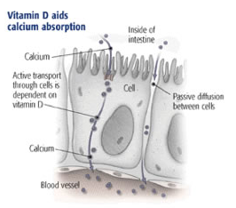
Ca : building block of bones
Vitamin D : Help in absorbing Ca.
They work together to maintain your bones health.
Notes:
Your bones contain 99.5% of the total calcium in your body
Vitamin D enhances intestinal absorption of calcium and phosphate. Low concentrations of vitamin D are associated with impaired calcium absorption, a negative calcium balance, and a compensatory rise in parathyroid hormone (PTH), which results in excessive bone resorption.

Slide 40
Calcium:
Bones are the reservoir of calcium in the body.
When other calcium-dependent organs need it, they get it form the main storehouse.
Notes:
So, calcuim has to be within normal levels throught life .espicially as you age

Slide 41
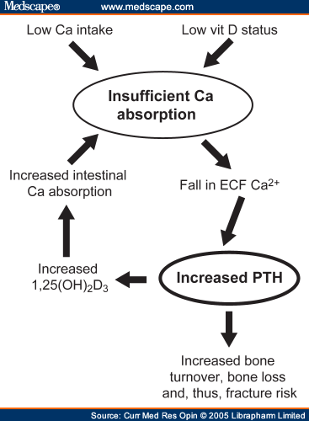

Slide 42
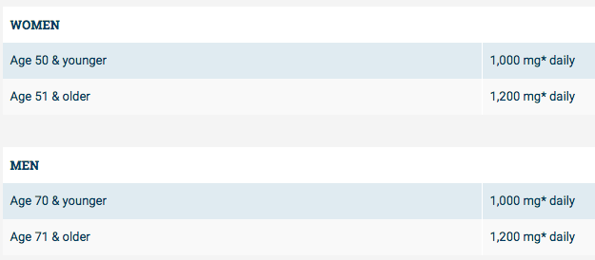
Optimal intake of calcium:
From national osteoporosis foundation

Slide 43
Optimal intake of Calcitriol:
From national osteoporosis foundation

Slide 44
Prevention and advice
Notes:
Getting enough calcium and vitamin D—either through your diet or a supplement—is an essential part of any osteoporosis prevention plan.

Slide 45
Prevention starts from childhood.
Primary VS secondary causes of the disease.
HRT in postmenopausal women?
Notes:
Primary : senile , postmenopausal
2ry: drug induced, chronic disease, malignancy.

Slide 47
Weight-bearing exercise:
Walking, jogging, stair climbing, dancing, or weight lifting are effective in increasing bone density and strength.
Aerobics, and resistance exercises using weights or elastic bands to help improve muscle strength (support bones).

Slide 48
Meta analysis of 43 RCT (4320 participants) :
FRACTURE:
7 women out of 100 who exercised had a fracture.
11 women out of 100 who did not exercise had a fracture.
Bone loss
People who exercised had on average 0.85% less bone loss than those who didn't exercise.
People who engaged in combinations of exercise types had on average 3.2% less bone loss than those who did not exercise.

Slide 49
Stop smoking and alcohol:
580 postmenopausal women aged 45–59 years were recruited.
The aim was to compare the effects of different measures of cigarette, alcohol and caffeine consumption upon BMD.
DEXA was used to monitor.
BMD was more strongly related to the number of months spent smoking (p <0.05)
Heaviest beer drinkers in the sample had a particularly low bone density.
Caffeine consumption at various ages was not associated with BMD
Notes:
Alcohol : affect bone formation + high risk of falling

Slide 50
Adequate Ca intake:
Dietary sources: dairy products (milk, cheese, yogurt) and some green vegetables (high elemental calcium content, high absorptive rate, and relative low cost)
Supplements: 2 forms, calcium carbonate and calcium citrate.
Notes:
best sources of calcium due to their

Slide 51
Adequate Vitamin D level:
Sunlight.
Diet (fatty fish such as salmon, mackerel, and sardines, fortified foods such as milk)
Supplements

Slide 52
Sunlight exposure:
Sunlight is the most common source of vitamin D.
Serum 25(OH)D levels are lower in individuals who use sunscreens and in those with pigmented skin.
Recommendation for adequate vitamin D from sunlight is five to 15 minutes of sun exposure from the hours of 10 AM to 3 PM

Slide 54
Prevent falls:
Outdoors:
Wear low-heeled shoes with rubber soles
Turn on the light outside your front door
Use a walker or cane as needed.
Consider wearing hip protectors or hip pads for added protection should you fall.

Slide 55
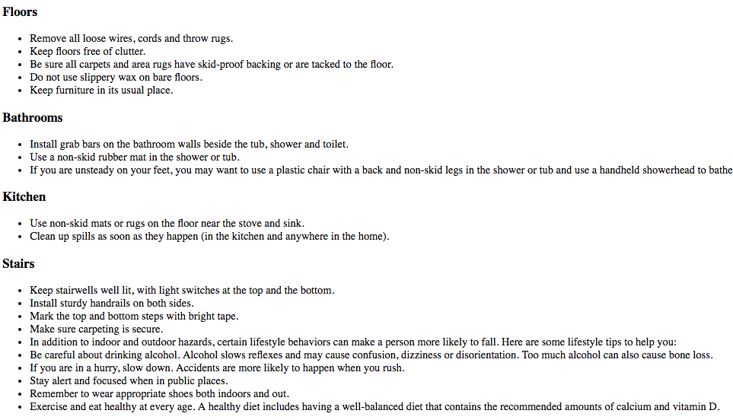
Indoors:

Slide 56
Q1:
10 months Old female, presented to the clinic with bowed legs, dental problems and her growth profile is disturbed, what is the most likely diagnoses?
A. Osteomalacia.
B. Rickets.
C. Osteoporosis.
D. Hypothyroidism.

Slide 57
Q2.
Which of the following is the optimal daily intake of calcium for postmenopausal women?
A- 1200 mg
B- 1000 mg
C- 1500 mg
D- 900 mg

Slide 58
Q3.
Which of the following is the best way for adequate vitamin D levels:
A- Using sunscreens
B- Exposure to sunlight
C- Using supplements
D- Smoking cessation

Slide 59
Q4.
Which one of the following isn't a risk factor for osteoporosis?
1-smoking
2-post-menopause
3-history of fragility fracture
4-D.M

Slide 60
Q5. Which of the following DEXA values is a diagnostic for osteopenia?
A- -1.5 SD
B- -2.5 SD
C- -3
D- -0.9

Slide 61
References:
Vitamin D deficiency. N Engl J Med. 2007 Jul 19;357(3):266-81.
Saudi Med J. 2015 Oct; 36(10): 1149–1150.
Iofbonehealth.org
Saudi Med J. 2013 Aug;34(8):814-8.
Holick MF, Chen TC. Vitamin D deficiency: a worldwide problem with health consequences. Am. J. Clin. Nutr. 2008;87(4):1080S–1086S.
https://www.nof.org/patients/fracturesfall-prevention/

