Slide 1
Approach to different types of shock
Dr.Abdulaziz Alrabiah, MD
Emergency Medicine, Trauma & EMS specialist

Slide 2
Objectives
types of shocks
recognition
management

Slide 3
overview
definition of shock
circulatory insufficiency that creates an imbalance between tissue O2 supply (Delivery) and O2 demand (consumption)
result in lactic acidosis
types of Shock
hypovolemic
Cardiogenic
distributive
Obstructive

Slide 4
Causes of shock types: 1
Hypovolamic Shock
GI fluid losses
e.g. gastroenteritis
renal losses
osmotic diuresis (e.g. DKA)
adrenocortical insufficiency (partly)
skin losses
burns
blood loss
penetrating injuries
ruptured ectopic pregnancy
third space losses
ileus from pancreatitis

Slide 5
Causes of shock types: 2
cardiogenic
arrhythmia
reduced contractility
MI
myocarditis
cardiomyopathy
poisons

Slide 6
Causes of shock types: 3
Obstructive Shock
Pericardial tamponade
tension pneumothorax
massive PE

Slide 7
Causes of shock types: 4
Redistributive Shock
septic shock
neurogenic shock
anaphylaxis
poisoning
adrenal insufficiency

Slide 8
Assessment of shock
vital signs : may be normal !
Signs of cause
hypovolaemic
cold, dry skin
low JVP
cardiogenic
cold, clammy skin
elevated JVP
features of LVF
obstructive
skin often normal
markedly increased JVP
redistributive
warm skin
JVP normal or low

Slide 9
Assessment of shock2
investigation
ECG : ACS, arrhythmia and electrical aternans and low voltage ( cardiac tamponade )
FBE : WCC may change in sepsis, Hb doesn't increase initially in acute bleeding
cultures if sepsis expected
VBG : high anion gap metabolic acidosis due to high lactate
coagulation profile : coagulopathy in sepsis
BHCG : female ? rupture ectopic
BGL : DKA / HHS
Ultrasound : AAA , intraperitoneal fluid , IV measurement
Echocardiography : wall motion , hypovelmia ( reduce LV function) , RV dysfunction ( indirect sign of massive PE) , cardiac tamponade
chest X-ray : tension pneuthorax, pneumonia . aortic dissection,

Slide 10
Management

Slide 11
Management of Hypovolemic shock
stop fluid loss i.e. bleeding control
IV fluid
Normal saline / ringer lactate
blood
IV hydrocortisone 200 mg i.e. adrenal insufficiency
may need surgery if bleeding internally

Slide 12
Management of Card shock
IV fluid challenge
treat arrhythmia
treat ACS i.e. re-perfusion PTCA
inotropes : Dobutamine infusion
Intra - aortic ballon pump insertion ??

Slide 13
Management of obstructive shock
tension pneumothorax
needle decompression then insertion of chest drain
pericardial tamponade
pericardiocentesis
massive PE
thrombolysis i.e. tPA

Slide 14
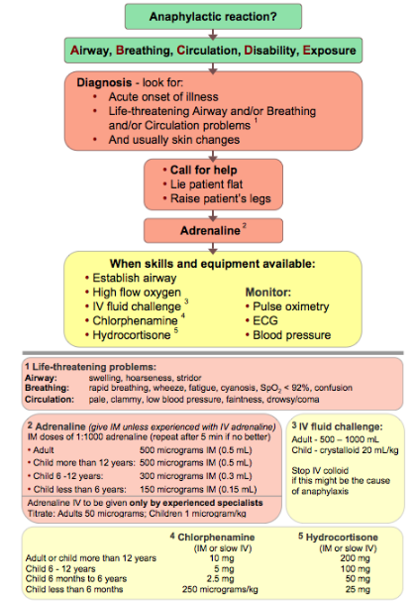
Management of distributive shock
anaphylaxis

Slide 15
Management of distributive shock
Neurogenic Shock
spinal cord injury i.e. trauma
hypotension and bradycardia , due to loss sympathetic nervous supply
treatment :
IV fluid ( keep MAP > 65mmHg)
inotropes : Nor-adrenaline , Doubatmine
atropine for bradycardia
high dose steroids ( no it is malpractice)

Slide 16
Management of distributive shock

Slide 17
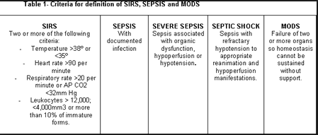
Management of distributive shock
septic shock

Slide 18
Management of distributive shock
septic shock treatment
circulatory support
IVF challenge normal saline 0.9% 20-30 ml /kg
+/- blood transfusion i.e. anaemia
vasopressor support i.e. noradrenaline infusion
aim
urine output >0.5 ml /kg/hr
CVP > 8-12
MAP > 65 mmHg
SCV O2 >70%
antibiotics
within 3 hours from presentation
ceftriaxone1-2gm IV 12hr , ( kids 50mg /kg )
other : flucloxacillin, Gentamicin, Tazocin, Vancomycin
infection source control

Slide 19
Thank you

