Slide 1
Case 10:
APPROACH
TO
Patient Monitoring
Group A

Slide 2
A-65 years old patient attended the operating theatre for vaginal hysterectomy.
She is a known diabetic, controlled with oral medication.
After induction of general anesthesia the patient developed hypotension so inhalational agent reduced to 1%
Anesthesia was maintained by sevoflurane 1 % and frequent dose of muscle relaxant then patient ex-tubated and shifted to the PACU
2 days after, the surgeon call the anesthesia because patient complain of recall all conversation in OR and she was paralyzed feeling pain can’t alert anybody because tube of in her throat (awareness under anesthesia )

Slide 3
Q1: Discuss the ASA standard monitoring for this patient?

Slide 4
The patient Is classified as ASA class 2 because she has a controlled systemic disease. (DM on oral hypoglycemics)
The patient’s oxygenation, ventilation, circulation and temperature shall be continually evaluated.

Slide 5
Q2: What are the methods for monitoring awareness under anesthesia?

Slide 6
Mentoring During Anesthesia
Cardiovascular
Temperature
Peripheral nerve stimulation
Urine output
Respiratory
Neurological
Notes:
In general
Cardiovascular:
1)Arterial Blood Pressure Monitoring (non invasive/invasive)
2) ECG
3) Central Venous Catheterization
Respiratory:
Pulse Oximetry
Capnography
Stethoscope
Neurological
1)EEG

Slide 7
No single technique or equipment is perfect for monitoring and detecting awareness.
Currently, bispectral index monitoring is popular.
The autonomic changes that are monitored include:
Pupil size and reactivity: Unreliable indicators. Mydriasis may be caused by anticholinergics (e.g. atropine, hyoscine ), whilst opiates cause miosis.
Changes in blood pressure: May be related to other factors, such as circulating catecholamines and drugs (e.g. beta blockers).
Heart rate variability: There is a reduction in respiratory sinus arrhythmia with anaesthesia.
Sweating and lacrimation are also warnings of awareness.
Notes:
Warnings of awareness:
Hypertension, tachycardia, sweating, lacrimation, pupil dilatation
Changes in blood pressure: May be related to other factors, such as circulating catecholamine's and drugs (e.g. beta blockers), and there is no consistent relationship between blood pressure and the patient’s level of consciousness.
Heart rate variability: There is a reduction in respiratory sinus arrhythmia with anaesthesia. In normal sinus arrhythmia the heart rate increases on inspiration and decreases on expiration as a result of variations in preload.

Slide 8
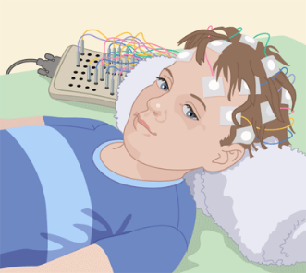
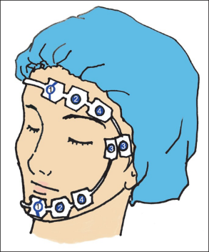
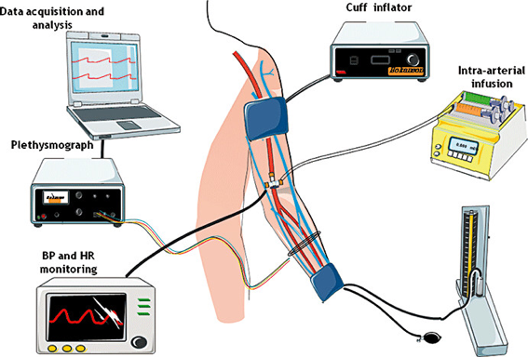
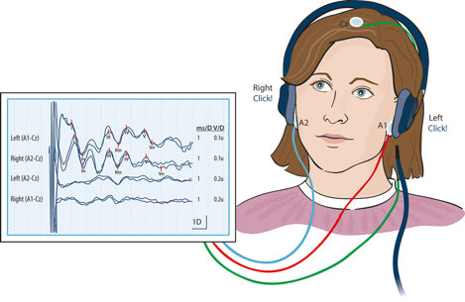
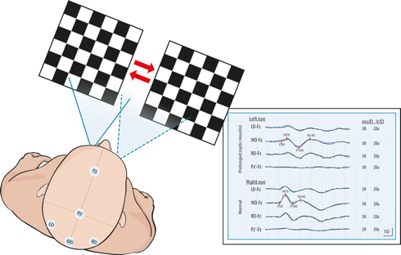
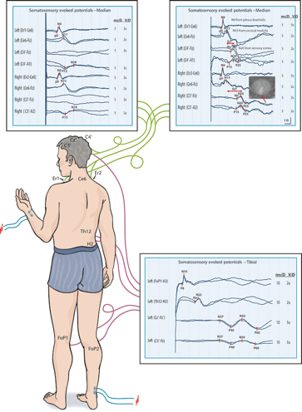
methods available to monitor awareness include the following:
Electroencephalograph (EEG):
Tracks and records brain wave patterns
Bi-spectral index (BSI):
a simplified EEG which uses an algorithm that converts EEG signals into an index of hypnotic level.
Isolated forearm technique (IFT):
Blood pressure cuff before giving neuromuscular block agents then patients asked to squeeze their hands.
Evoked potentials :
1)Auditory evoked potentials (AEPs) Auditory clicks via headphones
2)Visual evoked potentials
3)Somatosensory evoked potentials Peripheral Stimuli (median nerve)
Notes:
Warnings of awareness:
Hypertension, tachycardia, sweating, lacrimation, pupil dilatation

Slide 9
Q3:Discuss non routine monitors to detect awareness under anesthesia?

Slide 10
Isolated forearm technique (Mainly used as a research tool) :
A blood pressure cuff is inflated and maintained above systolic BP.
Done before any neuromuscular blocking drug is given, leaving the limb distal to the cuff unaffected and able to mount a motor response.
Movement, either spontaneous or in response to command, can then be observed.
Limb ischemia caused by the tourniquet occurs and the adequacy of motor response is insufficient after 20 minutes.
Notes:
An arm blood pressure cuff is inflated and maintained above systolic BP at the onset of anaesthesia. This is done before any systemic neuromuscular blocking drug is given, thereby leaving the limb distal to the cuff unaffected and able to mount a motor response if attempted. Movement, either spontaneous or in response to command, can then be observed. A patient might respond to command, for example to move a finger, without having postoperative recall. It is mainly used as a research tool. Limb ischemia caused by the tourniquet occurs and the adequacy of motor response is insufficient after 20 minutes.

Slide 11
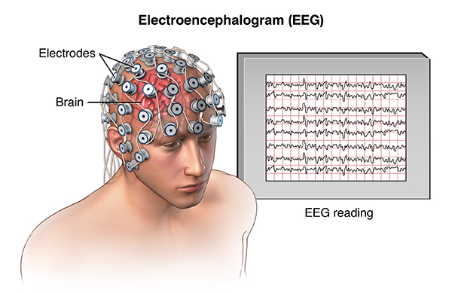
Electroencephalogram (EEG):
Not practical to be used routinely (both in terms of equipment and interpretation)
With increasing depth of anesthesia, there is an increase in average wave amplitude and a decrease in average frequency.
There is also a progressive change from beta to delta waveform.
Patient state analyzer index (PSA):
Works by processing changes in anterior-posterior distribution of EEG, using more extensive electrode sensor than BSI.
Notes:
Electroencephalogram (EEG): Not practical to be used routinely (both in terms of equipment and interpretation) the overall pattern of EEG reading whilst anaesthetized shows similarities with different anaesthetic agents. With increasing depth of anaesthesia there is an increase in average wave amplitude and a decrease in average frequency. There is also a progressive change from beta to delta waveform.

Slide 12
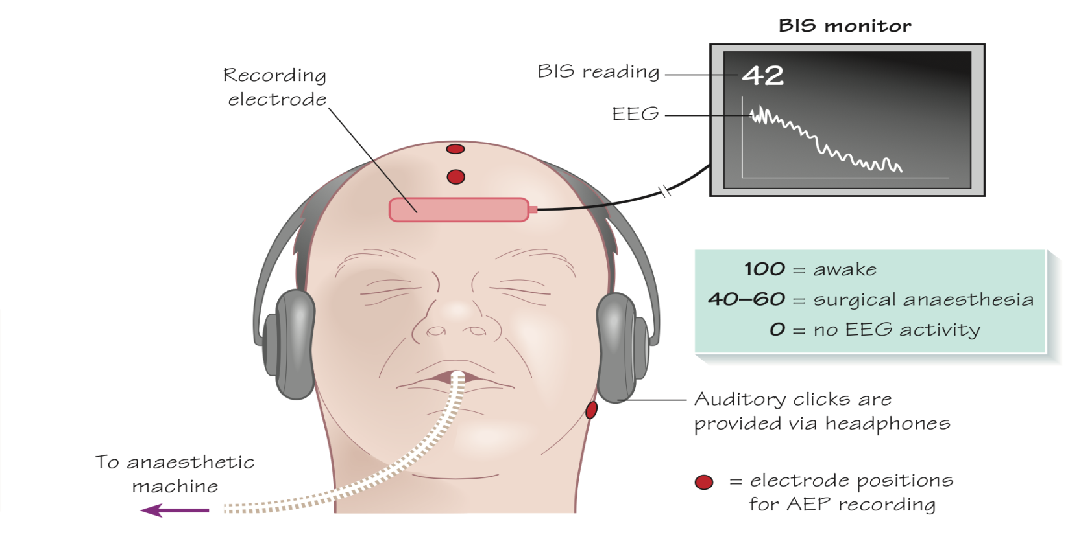
Bispectral index (BIS)
a simplified EEG which uses an algorithm that converts EEG signals into an index of hypnotic level.
Readings range from 0 to 100 .
100 | Awake
60-80 | measure of sedation
40-60 | General anesthesia
0 | No EEG activity
https://www.youtube.com/watch?v=EAtdFwbZ3I8

Slide 13
Evoked potentials :
Auditory-evoked potentials | Visual-evoked potentials | Somatosensory-evoked potentials
Electrical activity passing from the cochlea to auditory cortex. | The patient wears goggles with light-emit-ting diodes lying within them. | stimuli are placed peripherally (e.g. median nerve) and the response is recorded over the cervical vertebrae and the contralateral somatosensory cortex.
EEG analysis shows characteristic waveforms whose amplitude decreases and latency increases with depth of anaesthesia | Visual-evoked potentials, which are detected and recorded over the visual cortex. | Each calculation takes over 1 minute and results are inconsistent.
Notes:
Evoked potentials Whilst the EEG incorporates the response of thousands of neurons across the cerebral cortex, evoked potentials record the response of a far smaller and more localized group of neurons (e.g. brainstem, midbrain, cerebral cortex) to a specific stimulus or set of stimuli. The signals are time-locked and then averaged in order to limit other EEG components such as random noise.
Auditory-evoked potentials: electrical activity passing from the cochlea to auditory cortex in response to stimulus is recorded. EEG analysis shows characteristic waveforms whose amplitude decreases and latency increases with depth of anaesthesia. This correlates well with transition from sleep to awake but is a poor predictor of response to painful stimuli.
Visual-evoked potentials: the patient wears goggles with light-emit-ting diodes lying within them. The flashing diodes create visual-evoked potentials, which are detected and recorded over the visual cortex. This may be useful for assessing sedation in intensive care patients.
Somatosensory-evoked potentials: stimuli are placed peripherally (e.g. median nerve) and the response is recorded over the cervical vertebrae and the contralateral somatosensory cortex. Each calculation takes over 1 minute and results are inconsistent

Slide 14
Evoked potentials :
Auditory-evoked potentials | Visual-evoked potentials | Somatosensory-evoked potentials
Electrical activity passing from the cochlea to auditory cortex. | The patient wears goggles with light-emit-ting diodes lying within them. | stimuli are placed peripherally (e.g. median nerve) and the response is recorded over the cervical vertebrae and the contralateral somatosensory cortex.
EEG analysis shows characteristic waveforms whose amplitude decreases and latency increases with depth of anaesthesia | Visual-evoked potentials, which are detected and recorded over the visual cortex. | Each calculation takes over 1 minute and results are inconsistent.
Notes:
Evoked potentials Whilst the EEG incorporates the response of thousands of neurons across the cerebral cortex, evoked potentials record the response of a far smaller and more localized group of neurons (e.g. brainstem, midbrain, cerebral cortex) to a specific stimulus or set of stimuli. The signals are time-locked and then averaged in order to limit other EEG components such as random noise.
Auditory-evoked potentials: electrical activity passing from the cochlea to auditory cortex in response to stimulus is recorded. EEG analysis shows characteristic waveforms whose amplitude decreases and latency increases with depth of anaesthesia. This correlates well with transition from sleep to awake but is a poor predictor of response to painful stimuli.
Visual-evoked potentials: the patient wears goggles with light-emit-ting diodes lying within them. The flashing diodes create visual-evoked potentials, which are detected and recorded over the visual cortex. This may be useful for assessing sedation in intensive care patients.
Somatosensory-evoked potentials: stimuli are placed peripherally (e.g. median nerve) and the response is recorded over the cervical vertebrae and the contralateral somatosensory cortex. Each calculation takes over 1 minute and results are inconsistent

Slide 15
Q4:Which patient has risk of awareness?

Slide 16
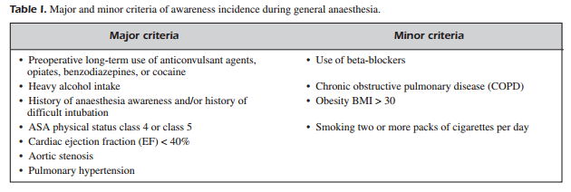
Table I shows the major and minor criteria of awareness frequency during general anaesthesia. The patient with the higher risk for awareness is the one with at least one major risk criterion or two minor risk criteria.
Notes:
It has been suggested that there may be a higher frequency of awareness in obese patients for several reasons, including often prolonged time for endotracheal intubation, the use of higher concentrations of oxygen in nitrous oxide-oxygen mixtures and the difficulty of giving appropriate doses of drugs without causing postoperative respiratory depression
Regarding the different kinds of surgical interventions, awareness is more frequent at major traumas that are followed by hypovolemia and hypotension, cardiac surgeries, C-sections, intervention that are carried out at night, procedures for which muscle relaxants are used, operation of patient who undergo general anaesthesia for the first time

Slide 17
RISK FACTORS
Anesthetic underdosing — The most important contributing factor for awareness
with recall (AWR) is underdosing of anesthesia relative to a given patient's specific
requirements. This can occur for the following reasons:
The anesthetic technique results in inadequate anesthesia.
A specific patient's needs are underappreciated.
It is judged unsafe to administer sufficient anesthesia.
There is a mistake or failure in the delivery of anesthesia.

Slide 18
Total intravenous anesthesia — Total intravenous anesthesia (TIVA) is probably associated with a higher risk for AWR compared with techniques based on a volatile inhalation agent .
Neuromuscular blockade — Use of an NMBA is associated with increased risk and severity of AWR.
Resistance or tolerance to anesthetics — Patients who have a history of AWR may be at higher risk for future events.
Type of surgery — Surgical procedures with higher risk for AWR include trauma or cardiac surgery and cesarean delivery.
Technical issues — Equipment malfunction and human error are infrequent causes of AWR. During a TIVA technique, infiltration of the intravenous (IV) catheter or a dosage miscalculation may result in inadequate anesthesia.

Slide 19
References :
Anesthesia at glance by Julian & William
https://www.ncbi.nlm.nih.gov/pmc/articles/PMC2900098/
http://www.europeanreview.org/wp/wp-content/uploads/1038.pdf

Slide 20
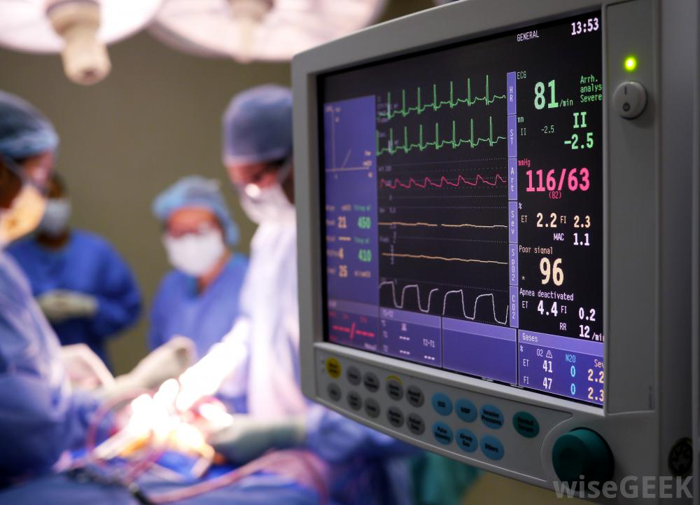
Kholoud Fadel Aldosari
Shahad Abdullah Almuhaideb
Zhour Abdullah Alhedyan
Norah Fahad Alnaeim
Waad Fahad Aldahlawi
Shaikha Mohammed Almoqati
Deema Ibrahim Alturki
Fadah Abdlkarim Alanazi
Najoud Marzooq Alotaibi
Fay Saad Alruwais
Hadeel Khaled Alsaif
Ethar Ali Alqarni

