Slide 1
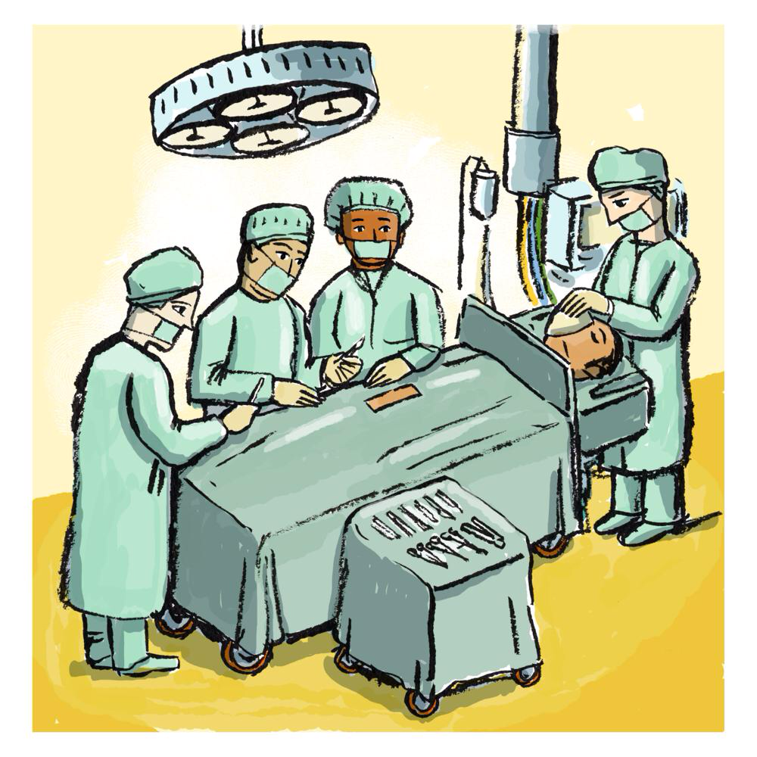
CASE 6- INTRAOPERATIVE MANAGEMENT

Slide 2
HOW YOU WILL ASSESS THIS PATIENT PREOPERATIVELY.
A 4- YEARS OLD MALE PATIENT BOOKED FOR RIGHT EYE SQUINT SURGERY

Slide 3
Previous Illnesses
Family History Malignant Hyperthermia
History and examination
Medication and Allergies
Dentition Pre-existing Damage, Risk of Damage
Rapport should be established with the
child and his/her parent(s)
Past Anaesthetic History
Weight and Age

Slide 4
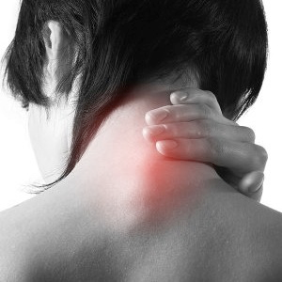
Previous difficulties with airway management
Small mouth
Cervical spine problems
Obesity- obstructive sleep apnoea (OSA)
Airway
Assessment
Protruding/ 'buck' teet
surgery/Radiotherapy to head and neck
Conditions affecting tongue size
Infection to the airway
URTI common in young children and place the child at increased risk of perioperative respiratory problems.
Ideally, several weeks should have elapsed following a URTI. Child with a productive cough, chest signs or a temperature should not be submitted to elective surgery

Slide 5
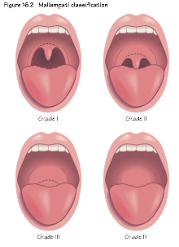
Atlanto-occipital mobility
Interincisor gap 4–6 cm
Sternomental distance >12.5 cm
Airway Assessment
Mallampati score
Thyromental distance >6 cm
Mandibular protrusion

Slide 6
Preoperative tests :
Common tests include full blood count, electrolytes and urea, coagulation screen, ECG and chest X ray.
For patients at risk and/or those undergoing major surgery (particularly vascular surgery) further, more detailed tests might include: • liver function tests; • arterial blood gas analysis; • respiratory function tests; • cardiac echocardiography and other imaging (including angiography) to assess left ventricular function, valve gradients and quantify ischaemic heart disease.
cervical spine X ray may be required in those with suspected cervical spine degeneration, surgery and trauma as neck mobility is a key determinant of ease of tracheal intubation.

Slide 7
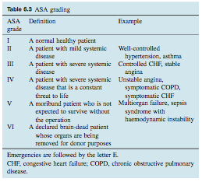
Perioperative medication :
Generally, all medication is continued perioperatively except: • drugs that affect coagulation (warfarin, heparin, aspirin, clopidogrel); • hypoglycaemics; • some hypotensive drugs, e.g.ACE inhibitors are stopped only on the day of surgery.
Assessment of risk :
There are many general risk-scoring systems; the most well known is the American Society of Anesthesiologists (ASA) grading

Slide 8
DISCUSS FASTING TIME AND PREMEDICATION

Slide 9
Fasting
To prevent aspiration elective surgery should not proceed unless the patient has had:
>2 hours since last clear fluid
>4 hours since milk
>6 hours since last solid food.
Premedication:
The 6 As of premedication
Anxiolysis ➢E.g. benzodiazepines | Amnesia ➢E.g. lorazepam | Anti-emetic ➢e.g. dopamine antagonists
Antacid ➢E.g. Oral sodium citrate | Anti-autonomic ➢Preoperative drying of secretions | Analgesic

Slide 10
WHAT ARE THE PHYSIOLOGICAL DIFFERENCE BETWEEN ADULT AND PEDIATRIC PATIENT
The patient seen in preoperative anesthesia clinic and cleared for squint surgery under general anesthesia, bwt: 16 kg

Slide 11
Body water:
The increased metabolic rate characteristic of neonates results in accelerated turn overs of ECF and dictates meticulous attention to intraoperative fluid replacement.
Thermoregulation:
The infant is especially vulnerable to hypothermia because of both the large ratio of body surface area to weight and a limited ability to cope with cold stress
This problem is compounded by cold operating rooms, wound exposure, intra venous fluid administration, dry anesthetic gases and the direct effect of anesthetic agents on temperature regulation.
Heat lost by conduction is reduced by placing the baby on a warm mattress and warming the operating room.

Slide 12
Respiratory system:system:
Oxygen consumption of neonates is more than 6 ml/kg which is about twice that of adults on a weight basis.
To satisfy this high demand alveolar ventilation is doubled compared with that in adults.
Because the tidal volume on a weight basis is similar for infants and adults, the increased alveolar ventilation is accomplished by an increased breathing rate
Cadiac system:
Care must be directed to keep the infant warm, maintaining normal arterial oxygen and carbon dioxide tension and minimizing anesthetic induced myocardial depression
Renal:
the ability to handle free water and soluble loads may be impaired in neonates and the half-life of medications excreted by means of glomerular filtration will be prolonged

Slide 13
DISCUSS ANESTHESIA CONSIDERATION AND SPECIAL CONCERN FOR SUCH THIS SURGERY

Slide 14
The airway is covered by drapes and needs to be secured by LMA or in small children ( 2 yo ) a tracheal tube is often preferred
The oculocardiac reflex: pressure/ tension on the globe or eye muscles can cause a marked bradycardia : pretreatment with atropine for prevention
Postoperative N/V : pretreatment with antiemetic for prevention
Postoperative malignant hyperthermia : suxamethonium is best avoided as this is a trigger for MH

Slide 15
DISCUSS ANESTHESIA PLAN , INDUCTION, MEDICATIONS METHODS FOR SECURING THE AIRWAY , MAINTENANCE OF ANESTHESIA AND INTRAVENOUS FLUID REQUIREMENT.

Slide 16
Anesthesia plan
A plan of anesthesia should be discussed with parents includes the method of induction, postoperative analgesia and what to expect in term of i.v cannulae , infusions , nasogastric tube, etc
Induction
Anesthesia can be induced intravenously or by inhalation. IV access may be challenging, as the veins may be small, poorly visible due to subcutaneous fat and painful even with topical anesthesia. Inhalation requires the ability to minimize entrainment of air and allow high concentration of anesthetic to reach alveoli.
The medication
Paracetamol: is often given in the word followed by regular postoperative doses.
NSAIDS: Diclofenac per rectum.
Opioids: can be intravenously administrated as PCA or NCA.
Local anesthesia: administrated into the wound or via nerve blocks.

Slide 17
Method for securing airway:
Face mask : this is the most fundamental skill and should be familiar to all who deal with unconscious patient. A number of adjuncts can be used including chain lift , jaw thrust , guedel airway or nasal airway.
Laryngeal mask airway (LMA) : easy to insert , safe and reliable airway for spontaneous ventilation and short episodes of intermittent IPPV
Tracheal tube: allowing full protection and IPPV
maintenance of anesthesia
Maintenance of anesthesia in older children by spontaneously breathing techniques and short procedures.
IV fluid requirement
Most would give 0.9% saline or hartmann solution. For resuscitation of children up to 20% ml\kg of colloid may be used as a bolus. Glucose containing solution are not usually used except in babies and those with hypoglycemia

Slide 18
During surgery the patient developed sever bradycardia , discuss the cause and treatment

Slide 19
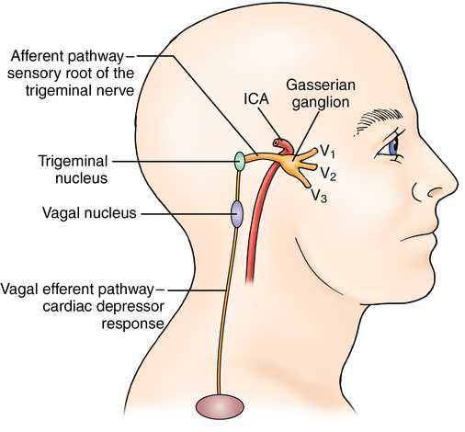
Cause: The oculocardiac reflex: pressure/tension on the globe or eye muscles can cause a marked bradycardia.
Treatment: avoided by pretreatment with atropine
Afferent Limb
Trigeminal Nerve (ciliary ganglion to ophthalmic division of trigeminal nerve to gasserian ganglion to the main trigeminal sensory nucleus). Also afferent tracts from maxillary and mandibular divisions of trigeminal nerve have been documented.
Efferent Limb
Vagus Nerve (afferents synapse with visceral motor nucleus of vagus nerve located in the reticular formation and efferents travel to the heart and decrease output from the sinoatrial node).
Triggering Stimuli
Triggered by traction on the extraocular muscles (especially medial rectus), direct pressure on the globe, ocular manipulation, ocular pain.

Slide 20
The surgery lasted 2 hrs and the patient was excubated and shifted to recovery room, What is your postoperative analgesia plan

Slide 21
Postoperative analgesia
Although squint surgery is one of the most painful ophthalmic procedures, intraoperative opioids should be avoided. They undoubtedly increase the incidence of vomiting and are usually unnecessary for adequate analgesia, which can usually be achieved satisfactorily using:
paracetamol and a non-steroidal anti-inflammatory analgesic, e.g. diclofenac, ibuprofen.
Peribulbar block is effective in producing good analgesia, as well as reducing the incidence of the oculocardiac reflex. However, most paediatric anaesthetists remain cautious about utilizing this technique in children because of the risks of globe perforation and retrobulbar haemorrhage.
Pain relief can be enhanced significantly if a sub-Tenon block is administered at the end of the procedure.
Alternatively, satisfactory postoperative analgesia following squint surgery can be obtained using either diclofenac 0.1% or oxybuprocaine 0.4% eye drops alone. If these are administered selectively to the operative site by the surgeon prior to suturing the conjunctiva, the problems associated with an anaesthetic cornea can be minimized.

