Slide 1
Case 8 -anesthesia for CS
Group C

Slide 2
Case 8 -anesthesia for CS
Group C
A24 – years female patient 39 weeks pregnant booked for Elective CS

Slide 3
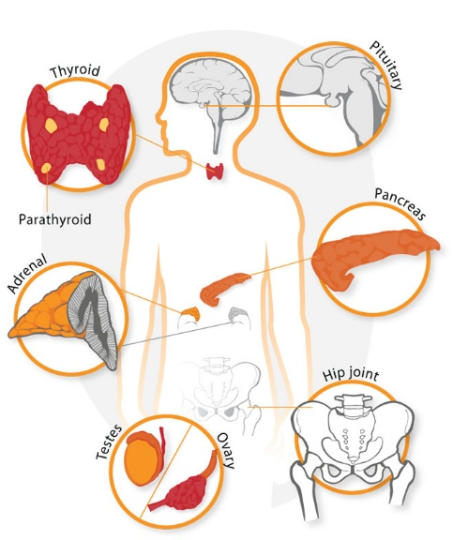
Case 8 -anesthesia for CS
Group C
1)Discuss physiological changes in pregnancy and its anesthesia consideration

Slide 4
Cardiovascular system: 1-↑cardiac output
2- risk of aortocaval compression
Airway: difficult tracheal intubation (e.g upper airway edema)
Respiratory system: ↓functional residual capacity, risk of hypoxia
Blood: dilutionalanemia,
hypercoagulablestate
GI system risk of esophageal reflux
Many of the physiological changes that take place in pregnancy are of relevance to all obstetric anaesthesia.
There are a variety of methods of pain relief in labour (e.g.TENS, entonox and pethidine) that are provided without anaesthetic input, methods with anaesthetic input are provided as well.

Slide 6
Case 8 -anesthesia for CS
Group C
2)What are The benefits of regional anesthesia over GA for this case ?

Slide 7
The benefits of regional anaesthesia over GA for LSCS include:
failed intubation
aspiration of stomach contents
neonatal depression
and awareness under GA
• Avoidance of the risks of GA
• Good analgesia immediately postoperatively;
• Possible reduction in blood loss and pulmonary thromboembolism;
• Usually a positive experience for both mother and partner.

Slide 8
Case 8 -anesthesia for CS
Group C
3)What are the contraindication of regional anesthesia ?

Slide 9
contraindication of regional anesthesia
Absolute
Relative
– Patient refusal
– Abnormal clotting
– Infection – local on back, septicaemia
– Allergy to local anaesthetic drug
– Raised intracranial pressure
– Hypovolaemia
– Chronic spinal disorders
– Central nervous system disease
– Drugs
- aspirin
-other NSAIDs
-low-dose heparin.

Slide 10
Case 8 -anesthesia for CS
Group C
After giving intrathecal dose of bupivacaine and fentanyl the patient vomited and developed tachycardia , hypotension

Slide 11
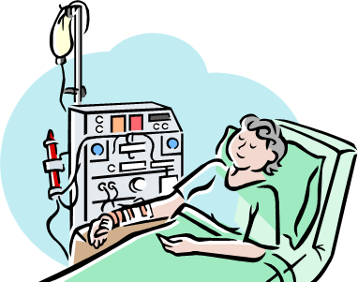
Case 8 -anesthesia for CS
Group C
4)Describe the cause of hypotension

Slide 12
Usually the cause of hypotension after spinal anaesthesia is sympathetic block which lead to peripheral vasodilation.
But in case of pregnant patient with hypotension after regional anesthesia , the cause is most likely aortocaval compression by gravid uterus which is preventing venous return and compressing the aorta, causing hypotension and a marked reduction in cardiac output)
(supine hypotension)→First change position to left lateral rather than supine to relieve the compression.
Next,give fluids Then administer ephedrine if no improvement

Slide 13
Case 8 -anesthesia for CS
Group C
5)Describe management

Slide 14
1
Administering intravenous (IV) fluid, or administering drugs that provide vasoconstriction to increase venous pressure and preload
2
Improve venous return by compression of the lower limbs
3
Increase myocardial contractility (inotropy) using drugs that activate beta-1 receptors on myocardial cells, providing a positive inotropic influence.

Slide 15
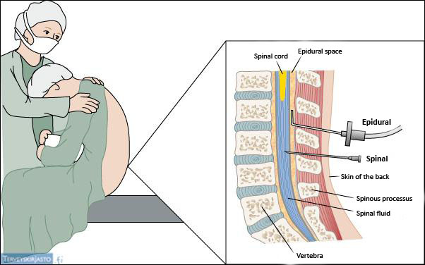
Case 8 -anesthesia for CS
Group C
6)What is the difference between spinal and epidural

Slide 16
The difference between spinal and epidural

Slide 17
Case 8 -anesthesia for CS
Group C
7)What are the complication of regional anesthesia

Slide 18
The complication of regional anesthesia
Hypotension
Weakness
Urinary retention
Headache
Catheter misplacement
Neurological damage
Duration of labour may be increased.
Hematoma

Slide 19
Group C
Aisha Khalid AlRaddadi
Awatif fahad alenazi
Khwlaa Mohammed alshakrah
Hanan Abdullah Aldossari
Nawal Ali Asiry
Reem Bader Almassoud
Afnan Mohammed Al-Shenaifi
Hajar Zayed Al-Otaibi
Arwa Suliman Al-Naseeb
Nada Dawood bin Dawood
Yasmine Mohammad AlShehri
Mariam Adel Bawazir
Fatimah Saad Alshamrany

Slide 20
Reference
Anaesthesia at a Glance BOOK

