Slide 1
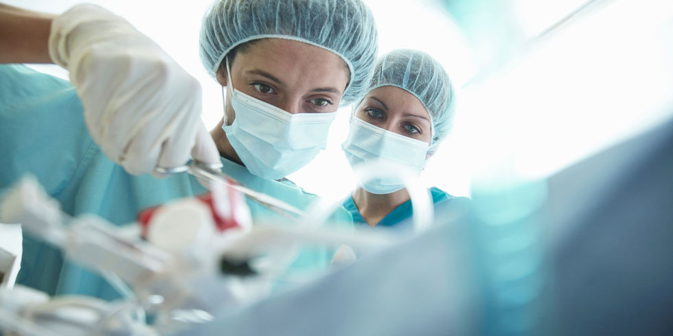
9
Postoperative Hypotension
Group B

Slide 2
- 78 years old patient attended as inpatient transurethral prostatectomy under spinal anesthesia known case of diabetics and hypertension on treatment , when the patient came to postoperative care units (PACU) patient was agitated shivering .
The patient blood pressure was 89/40 , HR: 85/MIN , RR: 23/ MIN
SPo2 difficult to read because of patient shivering.

Slide 3
Q1-What are the routine monitor in PACU:
• Vital signs BP,TEMP, RR
• Oxygen monitoring
• Electrocardiogram monitor
• Pain score
Q2-What is your assessment plan:
• Assess the airway
• Circulation
• Respiration

Slide 4
Q3-Discuss the way for intraoperative heat loss:
Body heat is lost in several ways, and there are four major mechanisms at work:
1-Radiation 40% : Transfer of electromagnetic energy between two bodies of different temperature.
2-Convection 30% : Energy transfer will be greater if the air immediately adjacent to a patient skin is repeatedly disturbed.

Slide 5
3- Evaporation 25%: As water becomes vapour, heat energy is lost as latent heat of vaporization. This type of heat loss will be increased if a large surface is exposed to evaporation, e.g. loops of bowel during a laparotomy. Surgical skin prep increases heat loss in this way. 10% is lost via respiratory water vapour.
4- Conduction 5%: Transfer of heat energy by direct contact between two objects of differing temperatures, e.g. a patient being in direct contact with the operating table. A patient lying in a pool of fluid or wet sheets will lose an increased amount of heat via conduction.

Slide 6
Q4-Methods to maintain temperature in anesthetized patient:
Warmed/humidified gases A heat and moisture exchange filter is usually incorporated into the breathing circuit. This absorbs heat and water vapour from exhaled respiratory gases and helps warm and humidify the next delivery of gases to the patient. It is not as effective as active warming methods.
Forced air warmer This blows warm air into a double-layered sheet that covers as much of the patient as possible.

Slide 7
Fluid warmer/warmed fluids If >500mL of fluid is given it should be warmed to 37°C using a fluid warmer, as should all blood products.
Warmed blankets Simple and effective for short cases.
Ambient temperature In modern operating theaters temperature can be accurately controlled and should be at least 21°C.
Silver-lined space blankets/hats These reduce radiation heat loss.

Slide 8
Q5-What are the causes for post-operative shivering:
• hypothermia.
• general anaesthesia itself.
• regional anaesthesia (e.g. spinal or epidural anaesthesia).

Slide 9
Q6- What is your management plan:
1- Increase the blood pressure: fluid replacement is the immediate step to correct the Hypotension.
2- Treat the underlying causes of hypotension :
identify the causes of postoperative hypotension is essential , causes include : OR deficit, haemorrhage , cardiac cause or it could be related to regional anesthesia
and treat accordingly.

Slide 10
Q7-Discuss the drugs that used to prevent and treat shivering:
• Pethidine
• Ondaserton
• Propofol
• Doxapram
• Anticholinesterase

Slide 11
Thank you

