Slide 1
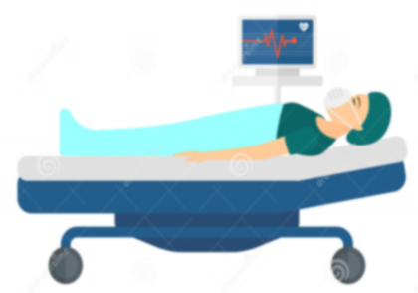
Approach to Patient Monitoring
Presented by: Rheema Alfadhil and Sara Alkharashi
Done by: Sara Alkharashi – Sara Aljabri
Rawan Albadia – Dahna Alkahtani
Assembled by: Norah Almajed

Slide 2
Case 10- Approach To Patient Monitoring
A 65 year-old patient was brought to the operating theatre for a vaginal hysterectomy.
She is a known case of diabetes that is controlled on oral medication.

Slide 3
Q. Discuss the ASA standard monitoring for this patient?
The patient is classified as ASA class 2 since her diabetes is well controlled on oral medication.
We should do what is called Minimum Mandatory Monitoring (MMM) which is continuous evaluation of patient’s oxygenation, ventilation, circulation, and temperature during the entire period where the patient is under anesthesia (Anesthesia time).

Slide 4
For Oxygenation
Inspired gas : oxygen analyzer ( measuring FiO2&FeO2).
For Ventilation
Auscultation of breath sounds.
For Circulation
ECG.
Blood oxygenation by pulse oximetry.
Capnography.
Observation of the reservoir bag.
Arterial blood pressure and heart rate
Evaluation of circulation by : Palpation of pulse, auscultation of heart sounds, pulse plethysmography, pulse oximetry, intrarterial pressure tracing (Only when needed).
temperature probe.
noticing any temperature change .
For Temperature

Slide 5
As for the diabetics we should consider a few things :
Infections: These are more common and great care should be taken with any invasive procedures.
The airway Glycosylation of collagen in the cervical vertebrae and temporomandibular joints: can cause difficulties in tracheal intubation.
Gastroparesis: Patients with diabetes may have a delay in gastric emptying with autonomic neuropathy and may require tracheal intubation.
Regional anesthesia: Avoiding general anaesthesia with a quicker return to diet and medication is desirable but patients with diabetes may compensate poorly following sympathetic blockade and the infec- tion risk (e.g. epidural abscess) is increased.
Many of the endocrine changes that occur following major surgery (e.g. increase in catecholamines, cortisol, and glucagon): may increase blood glucose further so intensive monitoring for diabetics is required . Plus, we should monitor to prevent any vascular event and to prevent the ER consequences of poor glycemic control like DKA or HONK.

Slide 6
Monitoring :
Preoperatively.
Recovery;
Non-insulin- dependent diabetes mellitus (NIDDM) patients require 8-hourly measurements. Patients on insulin initially require 2-hourly blood glucose measurement increasing to 4-hourly when stable.
Whilst hyperglycemia is less dangerous than hypoglycemia, ‘permissive hyperglycemia’ is no longer acceptable, and blood glucose being kept between 6 and 10mmol/L.

Slide 7
General management of diabetic patients undergoing surgery
HbA1c is a marker of glycaemic control. A non-diabetic HbA1c is 3.5–5.5%. In patients with diabetes, 6.5% (48mmol/mol) represents good control and >8% (64 mmol/mol) poor control, and thus more prone to micro- vascular complications.
Assessment of major diabetic complications. especially vascular. The degree of compromise from cardiovascular, cerebrovascular and renovascular impairment should be estimated from simple tests (e.g. serum urea and electrolytes) to more detailed investigations such as exercise testing, cardiac scans and cerebrovascular scan.

Slide 8
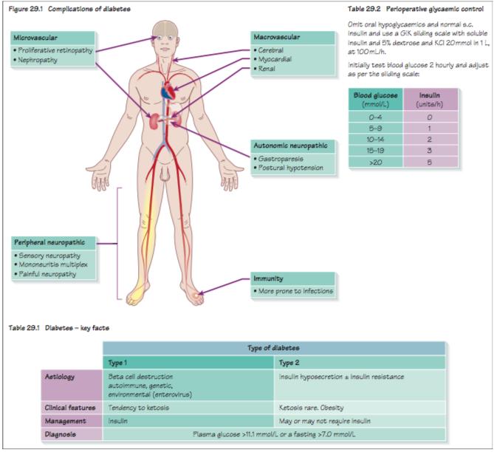

Slide 9
Q. What are the methods for monitoring awareness under anesthesia?
After induction of general anesthesia the patient developed hypotension so inhalational agent reduced to 1%,so anesthesia was maintained by sevoflurane 1 % and frequent dose of muscle relaxant then patient extubated and shifted to the PACU , 2 days after , the surgeon call the anesthesia because patient complain of recall all conversation in OR and she was paralyzed feeling pain can’t alert anybody because tube of in her throat (awareness under anesthesia).

Slide 10
Continue:
There is no single technique, set of clinical data or piece of equipment that is perfect for the monitoring and detection of awareness.
Pulse, blood pressure, respiratory rate.
Autonomic nervous system changes:
Sweating, pupil dilation, lacrimation.
Agent monitoring;
Inspired and expired anesthetic agent/nitrous oxide concentration.

Slide 11
Continue:
Anesthetist: The anesthetist observes all physiological functions and monitoring equipment to ensure adequate depth of anesthesia.
Bispectral Index (BIS) –popular-
Simplified EEG that uses algorithms to convert EEG signals into an index of hypnotic level ranging from 0-100.
Isolated forearm technique:
Tourniquet is inflated and maintained above systolic BP at the onset of anesthesia. This is done before any systemic neuromuscular drug is given, thereby leaving the limb distal to the cuff unaffected and able to mount a motor response if attempted (spontaneous or on command). Limb ischemia can be caused by tourniquet and the adequacy of motor response is insufficient after 20 minutes.
Auditory Evoked Potentials (AEPs)
Electroencephalogram- not practical to be used routinely

Slide 12
Q. Discuss the non-routine monitors to detect awareness under anesthesia?
1-Isolated forearm technique (It is mainly used as a research tool.)
2-Electroencephalogram (EEG): With increasing depth of anaesthesia there is an increase in average wave amplitude and a decrease in average frequency.
3-Bispectral index (BIS)
4-Evoked Potentials:

Slide 13
Continue:
Auditory-evoked potentials: EEG analysis shows characteristic waveforms whose amplitude decreases and latency increases with depth of anaesthesia.
-Visual-evoked potentials: This may be useful for assessing sedation in intensive care patients.
-Somatosensory-evoked potentials: Stimuli are placed peripherally (e.g. median nerve) and the response is recorded over the cervical vertebrae and the contralateral somatosensory cortex

Slide 14
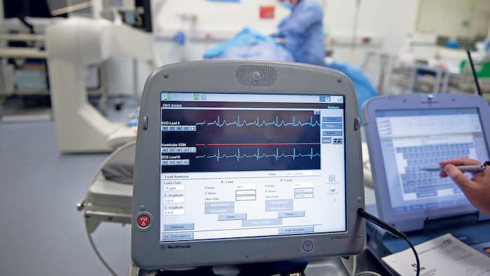

Slide 17
Q. Which patient are at higher risk of awareness?
Although any patient undergoing anasthesia has the potential to experience awareness, those at high risk include:
A previous history of awareness.
Difficult intubation including protracted attempts to perform this procedure.
Emergency surgery in shocked/critically ill patients.
Obstetric patients.
Cardiac surgery.

Slide 18
Thank You

