Slide 1
Complications of Central Line Insertion
Group B

Slide 2
Central Line or Central Venous Catheter
It is a tube that doctors place in a large vein in the neck, chest, groin, or arm to give fluids, blood, or medications or to do medical tests quickly.
These long, flexible catheters empty out in or near the heart, allowing the catheter to give the needed treatment within seconds.
A central venous catheter can remain for weeks or months, and some patients receive treatment through the line several times a day.
Central venous catheters are important in treating many conditions, particularly in intensive care units (ICUs).

Slide 3
Uses
medicines for treatment of pain, infection, or other medical issues
provide fluids for nutrition
help conduct certain medical tests

Slide 4
Types of CVC
Peripherally Inserted Central Catheter (PICC)
Line is placed into a vein in the arm.
Tunneled Catheter
Surgically placed into a vein in the chest or neck and then passed under the skin.
Implanted Port
Placed entirely under the skin.

Slide 5
Case
A 25-year-old male presented with road traffic accident. He was scheduled as emergency exploratory laparotomy.
After induction of anesthesia, the patient was positioned for a central line insertion through IJV.
While insertion of the catheter the patient has sudden tachyarrhythmia and a sudden drop in end tidal CO2, also drop in saturation and hypotension was noticed.

Slide 6
What may be the possible diagnosis?

Slide 7
Atrial Fibrillation
Air Embolism
Hypoxic Brain Injury
Fat Embolism
Hemorrhagic Shock
Pulmonary Embolism

Slide 8
Air Embolism
The result of inadvertent introduction of air into the circulation, usually via venous system.
These bubbles can then pass to the pulmonary circulation, causing ventilation-perfusion mismatch and hypoxia.
Air bubbles pass into the right atrium and ventricle and cause ↓ in right ventricular cardiac output.

Slide 9
Imaging
Invasive:
Trans esophageal echocardiography (TEE)
Non-invasive:
Doppler, CT, MRI
Laboratories
ABG: hypoxemia, hypercapnia and metabolic acidosis
Investigations

Slide 10
TEE
Highest sensitivity for detecting the presence of air in the right ventricular outflow tract or major pulmonary veins. Also identifies paradoxical air embolism (PAE)
Doppler US
Most sensitive noninvasive method for detecting venous air emboli.
CT
MRI
MRI of the brain may show increased water concentration in affected tissues, but this finding alone may not be reliable for the detection of gas emboli.
Can detect air emboli in the central venous system (especially the axillary and subclavian veins), right ventricle, and/or pulmonary artery.

Slide 11
How you can prevent air embolism while inserting central venous catheter?

Slide 12
Ensure that all lumens are capped or clamped
Use Luer-lock connections for needleless IV ports
Expel air from syringes prior to any injection or infusion
Use infusion pumps

Slide 13
How will you manage this case?

Slide 14
100% Oxygen
Airway, breathing, circulation and call for help.
Flood surgical site with saline.
Position patient in Trendelenburg/left lateral decubitus position.
Consider inserting a central venous catheter to aspirate gas.
Consider hyperbaric chamber if indicated.

Slide 15
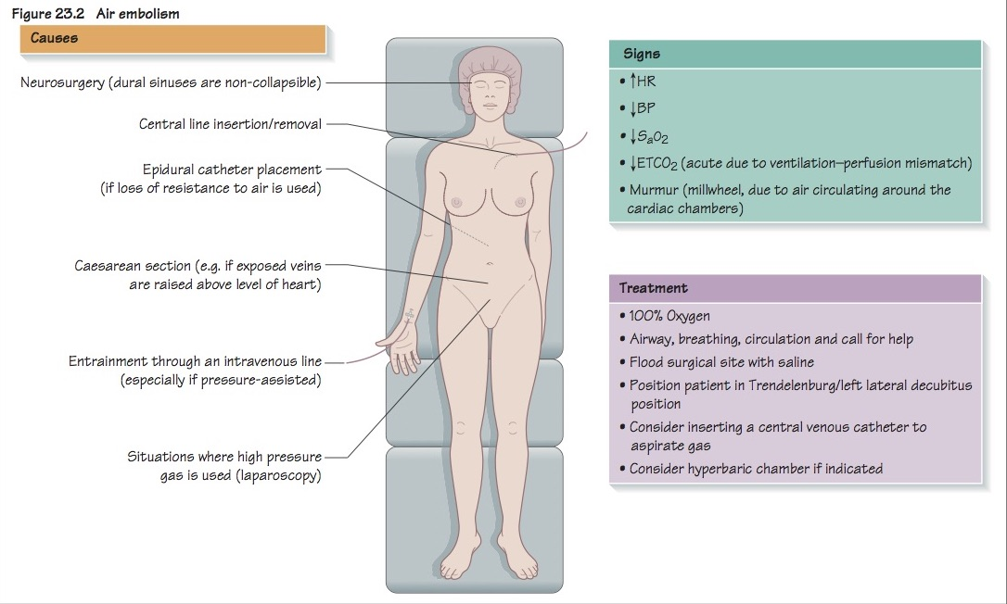
Summary

Slide 16
Thank you Any Questions ?

