Slide 1
Post-operative Pain Management
Group E

Slide 2
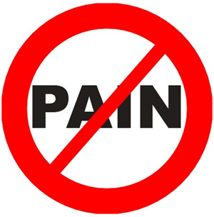
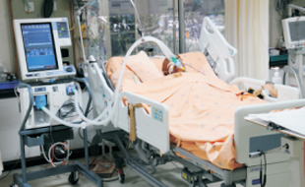
A55 years old patient had explorative laparotomy with midline incision under general anesthesia the intraoperative course was uneventful and surgery lasted 3 hours, the final diagnosis was perforated duodenal ulcer, patient extubated and send to recovery room .

Slide 3
1- Discuss the Methods for post-operative management for this case.
Analgesia:
The most painful operations are thoracic and abdominal, so we should give the patients analgesia to control the pain. Multimodal analgesia is used, which works on the principle that drugs acting by different mechanisms can result in additive or synergistic analgesia with lowered adverse effects. The mainstay of analgesia is paracetamol, non-steroidal anti-inflammatory drugs (NSAIDs), local anesthetics and opioids.
Pain management using analgesia should be based on the intensity of pain reported by the pt. rather than its specific etiology
If the pain is persistent or increasing, we move to the next step.
Mild: Acetaminophen • NSAIDs • ± Adjuvants
Moderate: Codeine • Hydrocodone • Oxycodone • Tramadol • ± Adjuvants
Severe: Morphine • Hydromorphone • Fentanyl • Methadone • Pethidine • ± Adjuvants

Slide 4
Cont.
Fluids:
Patients will require i.v. fluids until they are able to drink normally.
Oxygen therapy:
All patients need to apply oxygen and monitor
The monitoring for: vital signs, respiration(rhythm, pulse oximetry)
Circulation( pulse, blood pressure, ECG) level of consciousness, score of pain

Slide 5
Cont.
Others:
Patients may need prescribing:
anticoagulants: the timing of heparin administration to prevent pulmonary
thromboembolism needs to be balanced against the risks of
postoperative bleeding, especially if an epidural is in situ;
antibiotics;
insulin.

Slide 6
Blood pressure was 176/89 HR: 98/min bolus of 5 mg morphine intravenous was given.
Patient started to be tachycardia HR: 128/ min tachypnea SPO2 dropped to 65 % with expiratory wheezing on chest examination.

Slide 7
2- What is the differential diagnosis?
1- Allergy to morphine.
2- Airway Obstruction.
3-Postoperative nausea and vomiting.
4-Fluid Overload.
5-Exessive use of Vasopressors.
6- Residual anesthesia.

Slide 8
3- Discus the management.
Airway Obstruction:
The main causes of early postoperative hypoxaemia are a degree of airway obstruction, central respiratory depression usually caused by opiates, and respiratory muscle weakness resulting from inadequate reversal of neuromuscular blocking drugs.
Signs of airway obstruction in our case includes hypertension, tachycardia, expiratory wheezing on chest examination.
How to prevent this?
Patients are turned routinely into the lateral or “recovery position” to help prevent this problem.

Slide 9
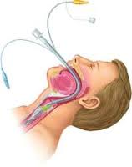
The treatment of airway obstruction is to identify the cause, and clear the airway, often with suction, to ensure patency. Extension of the neck, jaw thrust, and insertion of an oropharyngeal airway are often required. Laryngeal oedema is treated by intravenous dexamethasone 8 mg. Oxygenation of the patient is the priority and, if you are in doubt, reintubation must be undertaken.
If the patient is conscious, oropharyngeal airway is contraindicated, go with the nasopharyngeal.
Others: Tracheal intubation, Cricothyroidotomy, and Tracheotomy

Slide 10
Hypoventilation
Might happen due to post-operative analgesia.
Treatment of Hypoventilation:
Close observation
Assess the problem
Treatment of the cause:
Reverse (or Antidote):
Muscle relaxant ⇦ Neostigmine
Opioids ⇦ Naloxone
Midazolam ⇦ Anexate

Slide 11
Hypertension
Common causes:
Pain
Full Bladder
Hypertensive patients
Fluid overload
Excessive use of vasopressors
Treatment of Hypertension:
Effective pain control
Sedation
Anti-hypertensives:
Beta blockers
Alpha blockers
Hydralazine (Apresoline)
Calcium channel blockers

Slide 12
Thank You !

