Slide 1
Postoperative Hypotension
Case 9

Slide 2
Case..
78 years old patient attended as inpatient transurethral prostatectomy under spinal anesthesia known case of diabetics and hypertension on treatment , when the patient came to postoperative care units (PACU) patient was agitated shivering.

Slide 3
What are the routine monitor in PACU?
Vital signs.
Respiration:
RR/min, Rythm
Pulse oximetry
Circulation:
PR/min & Blood pressure
ECG
Level of consciousness
Pain scores

Slide 4
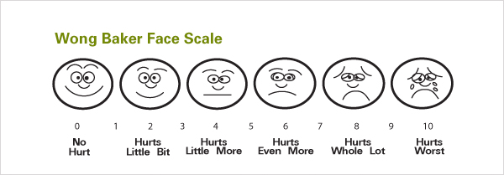
Pain scores:
Numerical pain rating scale:
Modified wong baker faces scale:

Slide 5
Continue…
The patient blood pressure was 89/40 , HR: 85/MIN , RR: 23/ MIN
SPo2 difficult to read because of patient shivering.

Slide 6
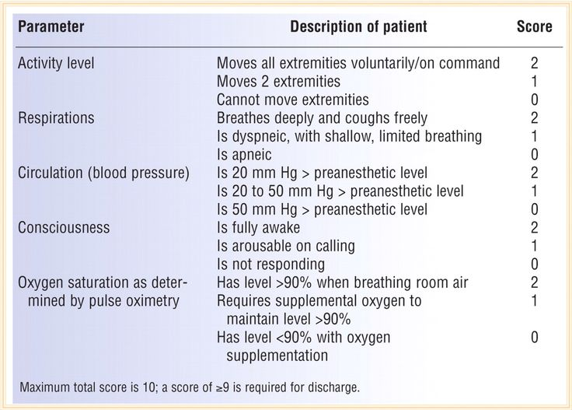
What is your assessment plan?
Color , Respiration, Circulation, Consciousness, Activity

Slide 7
Look out for the following in recovery:
Airway obstruction
Hypoxia
Haemorrhage: internal or external
Hypotension and/or hypertension
Postoperative pain
Shivering, hypothermia
Vomiting, aspiration
Falling on the floor
Residual narcosis

Slide 8
Discuss the way for intraoperative heat loss
The body loses heat in four ways:
1
Radiation 40% Transfer of electromagnetic energy between two bodies of different temperature .
2
Convection 30% Energy transfer will be greater if the air immediately adjacent to a patient skin is repeatedly disturbed .

Slide 9
3
Evaporation 25% As water becomes vapour, heat energy is lost as latent heat of vaporization. This type of heat loss will be increased if a large surface is exposed to evaporation, e.g. loops of bowel during a laparotomy. Surgical skin prep increases heat loss in this way. 10% is lost via respiratory water vapour
4
Conduction 5% Transfer of heat energy by direct contact between two objects of differing temperatures, e.g. a patient being in direct contact with the operating table. A patient lying in a pool of fluid or wet sheets will lose an increased amount of heat via conduction .

Slide 10
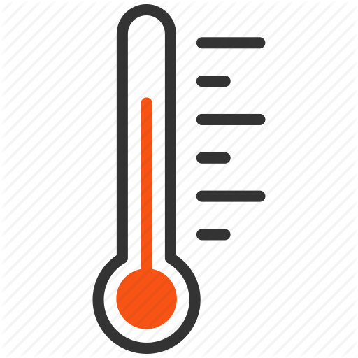
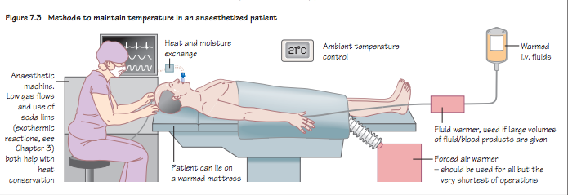
Methods to maintain temperature in anesthetized patient

Slide 11
Anesthetic machine. Low gas flows and use of soda lime (exothermic reactions) both help with heat conservation.
lie on a warmed mattress
Warmed blankets.
Simple and effective for short cases.
Warmed/humidified gases: A heat and moisture exchange filter is usually incorporated into the breathing circuit. This absorbs heat and water vapour from exhaled respiratory gases and helps warm and humidify the next delivery of gases to the patient.
It is not as effective as active warming methods.
Ambient temperature. In modern operating theatres temperature can be accurately controlled and should be at least 21°C.

Slide 12
Continue..
Fluid warmer/warmed fluids.
If >500mL of fluid is given it should be warmed to 37°C using a fluid warmer, as should all blood products.
Forced air warmer.
This blows warm air into a double-layered sheet that covers as much of the patient as possible.
Silver-lined space blankets/hats.
These reduce radiation heat loss.

Slide 13
What are the causes for post-operative shivering?
Postoperative shivering can occur due to:
1
Hypothermia
2
General anaesthesia itself
3
Regional anaesthesia (e.g. spinal or epidural anaesthesia).

Slide 14
What is your management plan?
Treatment of Hypotension:
Initially treat with fluid bolus (Main treatment of hypotension is fluid replacement )
Vasopressors
Correction of the cause:
You must know the cause in order to treat accordingly (deficit from OR/ bleeding or cardiac cause/regional anesthesia)
If cardiac cause Dysfunction: do all cardiac related tests, consult cardiology.

Slide 15
Discuss the drugs that used to prevent and treat shivering
1
Pethidine
2
Ondaserton
3
Propofol
4
Doxapram
5
Anticholinesterase, e.g. physostigmine

Slide 16
THANK YOU!
Group D

