Slide 1
Case 3
Anaesthasia For Healthy Patient group C
Anesthesia

Slide 2
A 52-year-old man has had progressive knee pain with swelling, His orthopedic surgeon has tentatively diagnosed a torn meniscus, and recommended an arthroscopy as an outpatient. The patient has had no major illnesses other than the typical childhood diseases. He has had no previous operations or anesthetics, nor a family history of problems with anesthesia. He has no allergies to medications, does not smoke, diabetics on oral medication blood sugar is controlled. His laboratory results and physical examination by an internist were all normal. He has had nothing to eat or drink since he went to bed last night.
Scenario

Slide 3
How are a patient’s general medical condition ASA standard classifications?
- ASA stage 2
First question

Slide 4
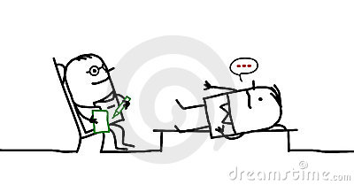
On examination, the patient weighs 75 Kg and is 182 Cm, in tall. His neck appears to be flexible and mobile. He opens his mouth without difficulty, and with his head extended and tongue protruding, his uvula is completely visible.
Scenario ..

Slide 5
Discuss the airway assessment for this patient ?
Airway assessment Traditionally, the gold standard of airway management is tracheal intubation, and the majority of assessments relate to the ease or difficulty of this process.
Second question

Slide 6
In history ask about:
• Past anesthetic history
• Surgery/radiotherapy to head and neck.
• Obstructive sleep apnea (OSA).
• Conditions affecting tongue size (e.g. acromegaly, infections, tumors)
• Conditions affecting neck mobility (e.g. ankylosing spondylitis, infections, tumors).
• Conditions affecting mouth opening (e.g. temporomandibular joint dysfunction).
Second question

Slide 7
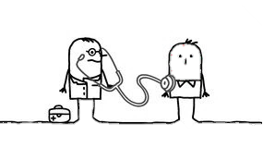
General examination
This includes:
• Look for external signs of surgery/radiotherapy to head and neck.
• Assess the airway from in front of the patient, including: receding jaw, protruding upper incisors, large tongue, large neck, obesity.
• Tumors, infection, trauma, swelling or burns and scarring of the airway strongly suggest problems.
Second question

Slide 8
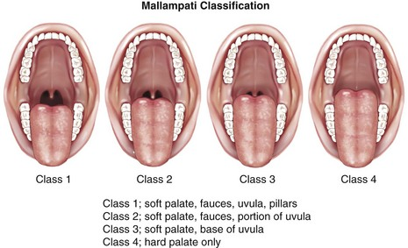
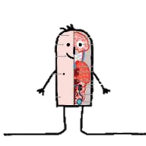
Tests:
include:
• mouth opening: this should be 4–6cm;
• Mallampati classification (Figure 16.2): on full opening of the mouth the facial pillars, uvula and soft palate sequentially disappear; scores of 3 and 4 are associated with difficult intubation.
• Movement of the jaw, i.e. ability to protrude the lower teeth in front of the upper teeth;
• Thyromental distance (chin to thyroid notch): this should be >6cm.
• Sternomental distance (chin to sternum): this should be >12.5cm.
• atlanto-occipital mobility: this is difficult to assess >> radiological imaging.
Second question

Slide 9
What is the check list for sign in
Third question
Sign in occurs before anesthesia The patient’s details are checked, as well as the operation, consent, appropriate marking of site, allergies, potential airway issues and the anticipated blood loss.
Patient has confirmed | • Identity • Site • Procedure • Consent
Site marked/not applicable
Anesthesia safety check completed
Pulse oximeter on patient and functioning
Does patient have a Known allergy? | No Yes
Difficult airway/aspiration risk? | No Yes, and equipment/assistance available
Risk of >500mL blood loss (7mL/kg in children)? | No Yes, and adequate intravenous

Slide 10
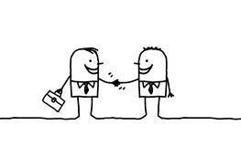
Discuss anesthesia plan for this patient.
1) Preoperative Management:
Patients attend a preoperative assessment clinic. Questionnaires filled out in advance identify patients needs.
Anesthetic consent should be taken.
Discuss type of anesthesia (e.g. local vs. general)
Explain the side effects:
common side effects, e.g. postoperative nausea and vomiting.
2)Intraoperative Management:
To establish IV access.
Apply monitoring:
ECG.
pulse oximeter.
non-invasive blood pressure. before moving into the operating theatre.
Airway must be secured (e.g. with an LMA or endotracheal tube).
Then further motoring/interventions are performed
(e.g. nasogastric tube urinary catheter insertion occur, if indicated.
Fourth question

Slide 11
3) Postoperative Management:
At the end of the operation, the patient is either:
extubated in the operating theatre (and an oropharyngeal airway inserted if needed).
or transferred to the recovery room with an LMA still in situ. All patients receive supplemental oxygen during transfer.
Once in the recovery room, we should check on:
patients name and age.
operation details.
blood loss
analgesia given
antiemetic's given
Antibiotics
thromboprophylaxis.
Patients stay in the recovery room until they are:
awake and in complete control of airway reflexes.
pain free.
no/minimal nausea and vomiting.
no/minimal bleeding from surgical site.
normothermic.
Fourth question

Slide 12
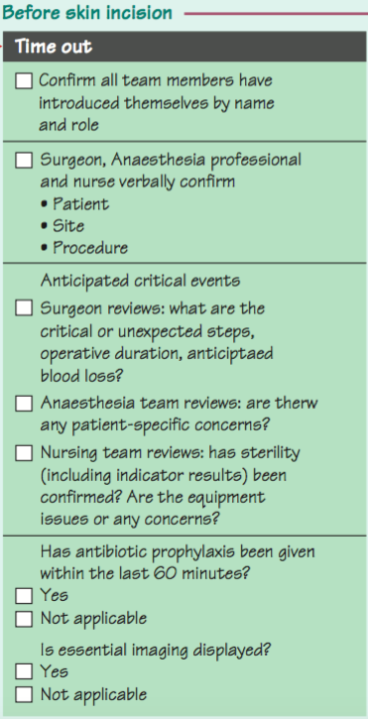
Discuss the chick list for time out.
Time out occurs in the operating theatre before the start of the operation.
The team should double check:
ID of the patient
planned operation and site (including anticipated blood loss)
Any medical concerns about the patient.
A check of availability of all equipment and imaging for the proposed operation is also established.
Fifth question

Slide 13
Discuss the safety features of anesthesia machine
Sixth question
Non-interchangeable screw threads (NISTs) prevent the incorrect pipeline gas being connected to the machine inlet.
A pin index system is used to prevent incorrect cylinder connection.
Barotrauma to both patient and machine is avoided by using pressure reducing valves/regulators and low restrictors.
The oxygen failure warning alarm is pressure driven and alerts of imminent pipeline or cylinder failure.
Accurate gas delivery: flow delivered through the anesthetic machine give a digital representation.
Hypoxic guard: Oxygen is delivered distal to N2O within the rotameter, preventing hypoxic gas delivery if the O2 rotameter is faulty or cracked.
Interlocking vaporizers on the back bar prevent two anesthetic vapours being given simultaneously.
Ventilator alarms warn of high and low pressure.
Emergency oxygen flush: when pressed, oxygen bypasses the back bar and is delivered to the CGO at >35 L/min. This must be used with caution as gas is delivered at 4 bar and does not contain anesthetic.
Suction: adjustable negative-pressure-generated suction is used to clear airway secretions/vomit and must be available for all cases.
Scavenging of vented anesthetic gases is active, passive or a combination. Scavenged gases are usually vented to the atmosphere. Scavenging tubing has a wider bore (30mm), preventing accidental connection to breathing circuits.

Slide 14
Low gas flows reduce environmental impact and cost. Operating theatre air exchange occurs through the air conditioning system (e.g. 15 times per hour). The main aim is infection control; it also serves to remove unscavenged gases.
Sixth question

Slide 15
Any question?

