Slide 1
Difficult Airway

Slide 2
Case
A 35-year-old woman presented for laparoscopic lysis of adhesions. Her first laparotomy occurred 10 years prior to this admission. After induction of anesthesia the patient had airway obstruction

Slide 3
Q1) What is the causes of airway obstruction after induction of general anesthesia?
Depends on the type of general anesthesia whether inhalational or IV, and depends largely on mean alveolar concentration (MAC).
Inhalational anesthesia will lead to
Aspiration, obstruction, pneumonia, bronchospasm, atelectasis, hypoventilation
Decreased CNS activity which will lead to decreased o2 consumption
Decreased muscle tone which will lead to difficulty in respiration
Increased salivary and respiratory secretions
Increased RR which will lead to decreased tidal volume which will decrease alveolar minute ventilation
IV anesthesia will lead to
Respiratory depression and apnea
Response to hypercarbia and hypoxia will decrease
Laryngeal and pharyngeal muscle relaxation
Decreased in tracheal reflexes

Slide 4
Q2) What are the devices can be used to restore airway patency?
Respiratory airway patency can be achieved by simple maneuvers such as (chin lift and jaw thrust)
REMEMBER: DO NOT insert your finger into a patients mouth and take good care of a patient who has lose or crowned teeth.
In emergency situations some devices can be used to allow a patent airway when intubation and ventilation cant be achieved. Such devices include (cannula)
Direct surgical access such as cricothyrotomy and tracheostomy

Slide 5
At that time, the process of tracheal intubation consumed 1 hour. She awakened with a very sore throat, but she does not know the details of the intubation.
The old records are unavailable.

Slide 6
Q3) What are the predictors of difficult mask ventilation?
Any form of obstruction
Laryngospasm or pharanygospasm
Previous head\neck\thoracic\abdominal surgeries
Facial deformities
Tongue size (acromegaly\tumors)
Mouth opening (temporamandibular joint dysfunction)
*Mouth opening must be 4-6 cm in mallampati classification, scores 3-4 will have difficult intubation*
Obesity
Nasal blockage (polyps\septum deviation)
Trauma, down syndrome, rheumatoid arthritis *Must stabilize neck properly or it will lead to spinal cord damage*

Slide 7
Q4) How is the anticipated difficult intubation approached?
Before embarking on anaesthesia/sedation in a patient with a known or suspected difficult airway ask:
Do you need to give GA – what about a regional technique?
Do you need tracheal intubation – what about LMA ?
If you need intubation, is it safe/appropriate to have a look?
Experienced senior help will be required.
Other adjuncts to tracheal intubation including:
Fibre-optic intubation, in which the larynx is visualized and then a tube railroaded over the top of the ’scope. This is a very useful technique and can be performed with the patient awake or asleep. With the patient awake the airway is maintained at all times. The airway needs prior preparation (local anaesthesia and nasal vasoconstriction). Any blood in the airway may make this difficult.
The intubating laryngeal mask airway (ILMA) provides a technique whereby a tracheal tube is inserted down the inside of the LMA.
Blind nasal intubation is a technique whereby a tracheal tube is passed through the nose and into the trachea without the use of a laryngoscope. It has largely been replaced by fibre-optic intubation.
Other equipment, such as bougies, may help in the correct placement of a tracheal tube at laryngoscopy.

Slide 8
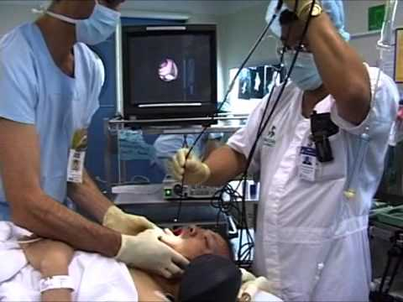
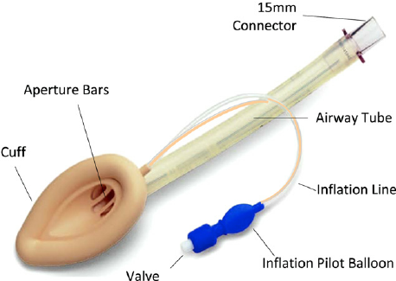

Slide 9
Q5) Describe the management options for a patient who can’t ventilate cant intubate?
Cannula cricothyrotomy
Surgical cricothyrotomy in extremis is lifesaving.
For some operations (e.g. large upper airway cancers) a tracheostomy under local anesthesia may be performed at the start of the procedure.

Slide 10
Q6) How you can verify successful tracheal intubation?
Direct visualization of endotracheal tube between cords.
Continuous trace of capnography.
Esophageal detector device.
Bronchoscopy; carina seen.
3 point auscultation.
Others: bilateral chest movement, mist in the tube, chest x-ray.
‘ If in doubt, take it out’

