Slide 1
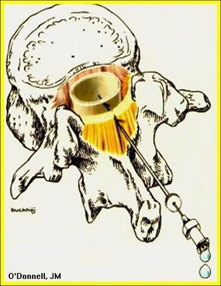
Neuraxial Blokade
Dr: Ahmed Thallaj
Associate Professor, college of medicine, KSU
Head of regional Anesthesia division

Slide 2
Objectives
Relevant anatomy and surface landmark for Neuraxial block.
Differences between spinal and epidural.
Equipment and local anesthetics.
Indication and contraindication.
Side effects, complications and treatment.
LAST

Slide 3
Knowledge of anatomy for neuraxial blockade is essential!
7 cervical vertebrae
12 thoracic vertebrae
5 lumbar vertebrae
Sacrum
Coccyx

Slide 4
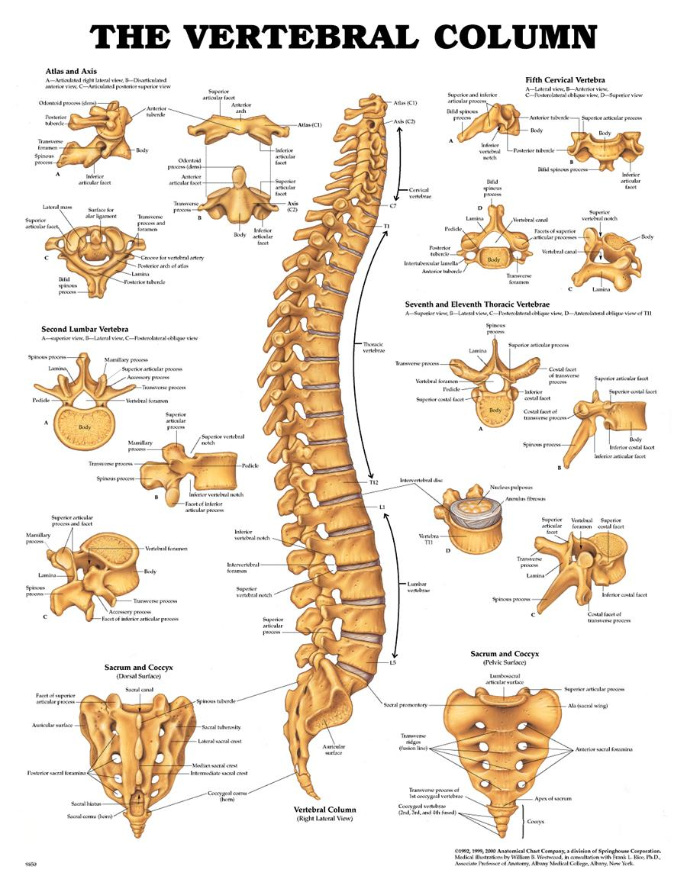
Cervical
Vertebrae
Thoracic
Vertebrae
Lumbar
Vertebrae

Slide 5
Individual Vertebral Anatomy
Each vertebra consists of a pedicle, transverse process, superior and inferior articular processes, and a spinous process.
Each vertebra is connected to the next by intervertebral disks.
There are 2 superior and inferior articular processes (synovial joints) on each vertebra that allows for articulation.
Pedicles contain a notch superiorly and inferiorly to allow the spinal nerve root to exit the vertebral column.

Slide 6
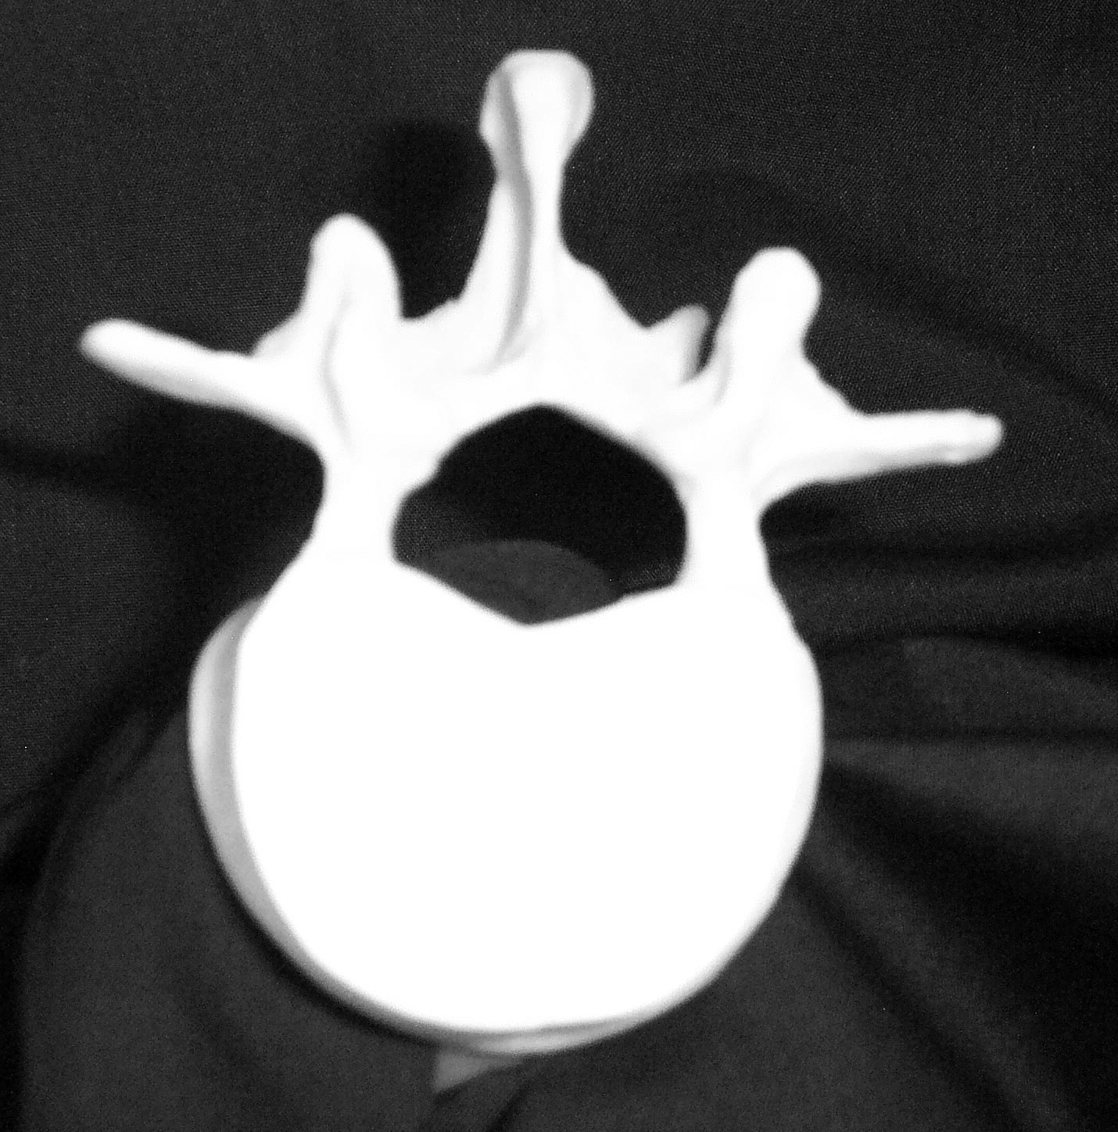
Vertebral Anatomy- Top View
Transverse Process
Spinous Process
Lamina
Spinal Canal
Vertebral Body

Slide 7
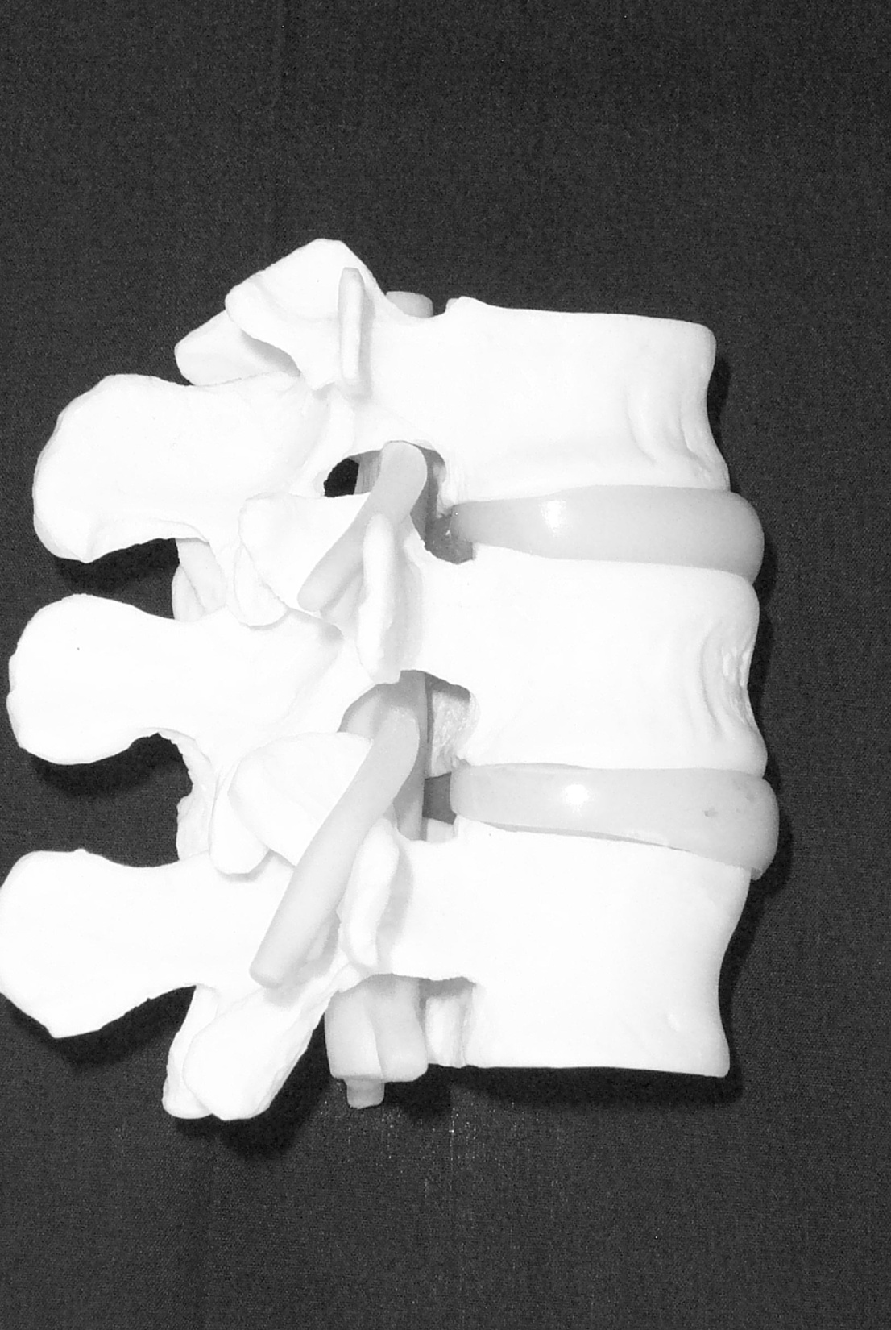
Intervertebral Disc
Intervertebral Foramina
Spinal Nerve
Root

Slide 9
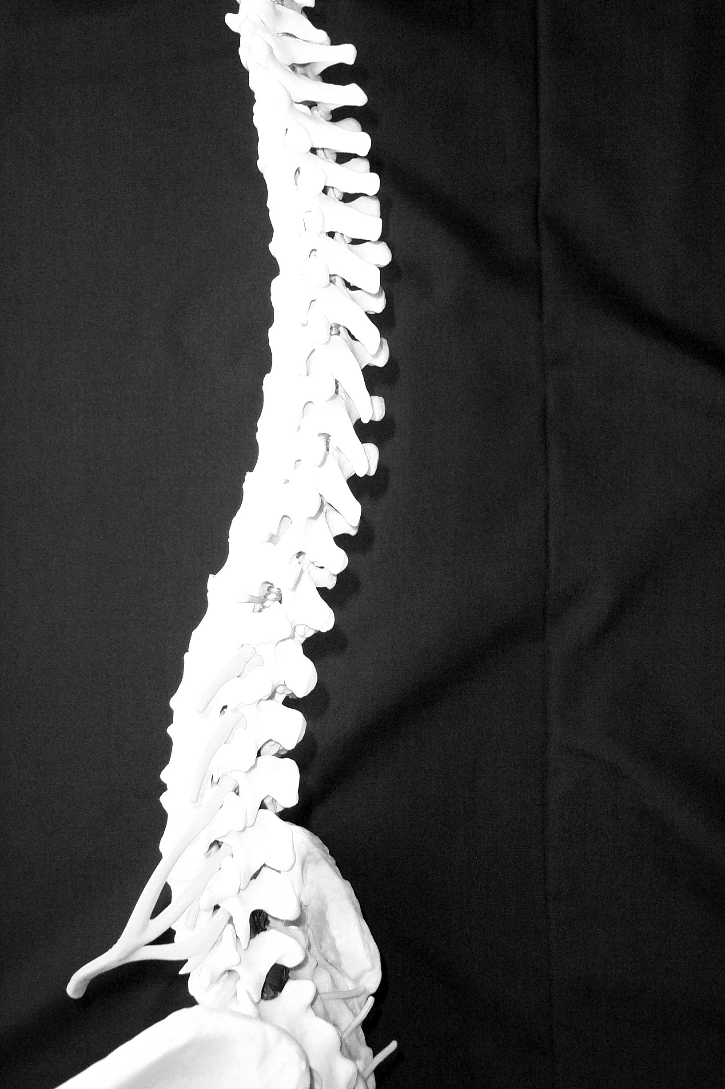
Thoracic
Vertebrae
Angle of transverse process will affect how the needle is orientated for epidural anesthesia or analgesia.
With flexion the spinous process in the lumbar region is almost horizontal. In the thoracic region the spinous process is angled in a slight caudad angle.
Lumbar
Vertebrae

Slide 10
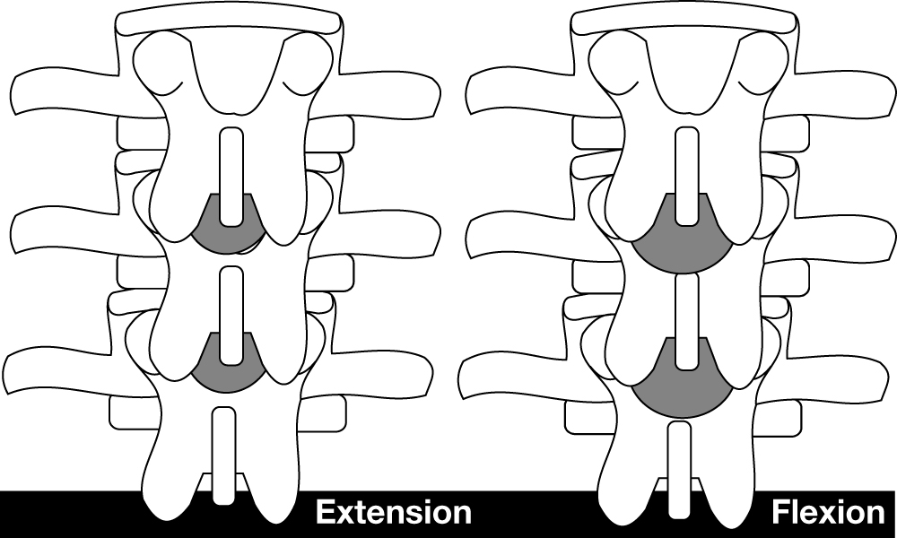
Lumbar Extension versus Flexion

Slide 11
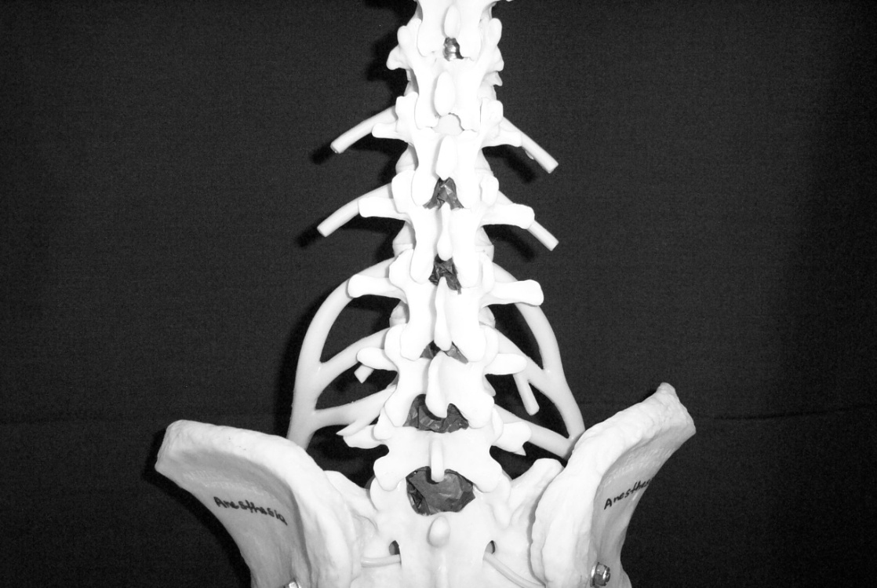
L 2
L 5
Interlaminar spaces are larger in the lower lumbar region. If an anesthesia provider finds it challenging at one level it is important to remember that moving down one space may provide a larger space.

Slide 12
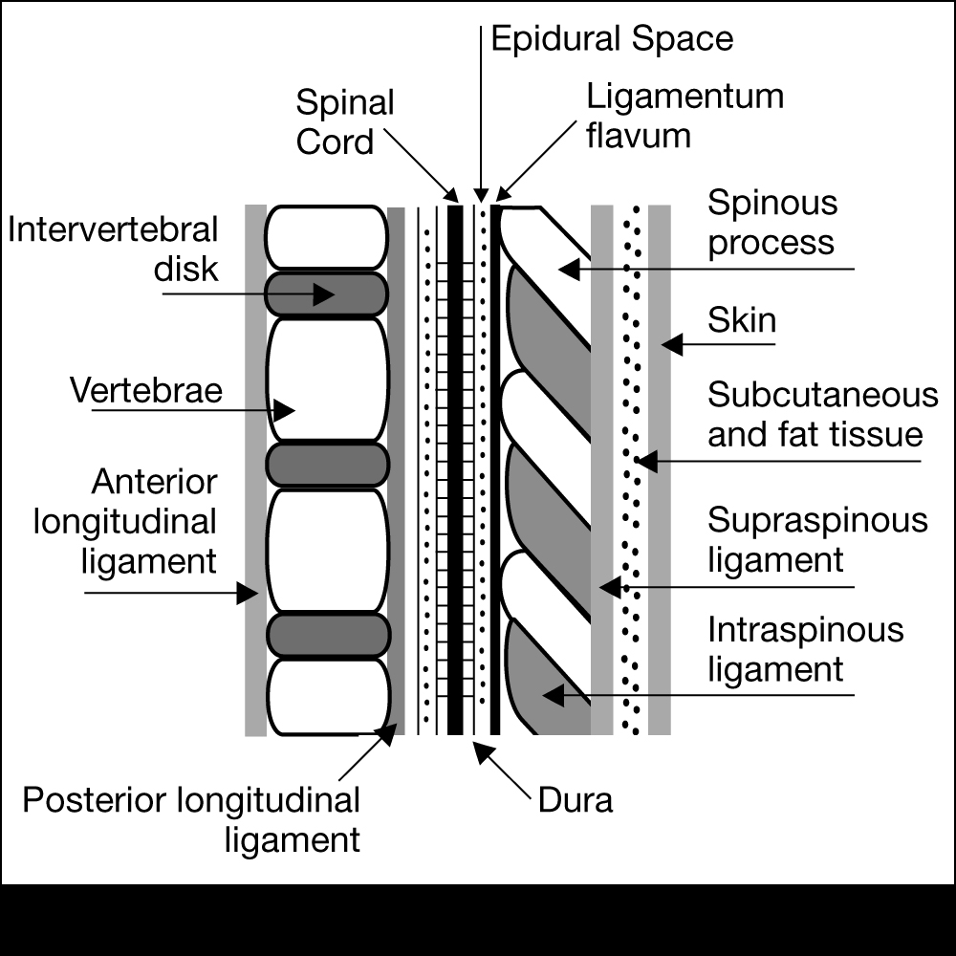
Ligaments that support the vertebral column
Ventral side:
Anterior and posterior longitudinal ligaments
Dorsal side:
Important since these are the structures your needle will pass through!

Slide 13
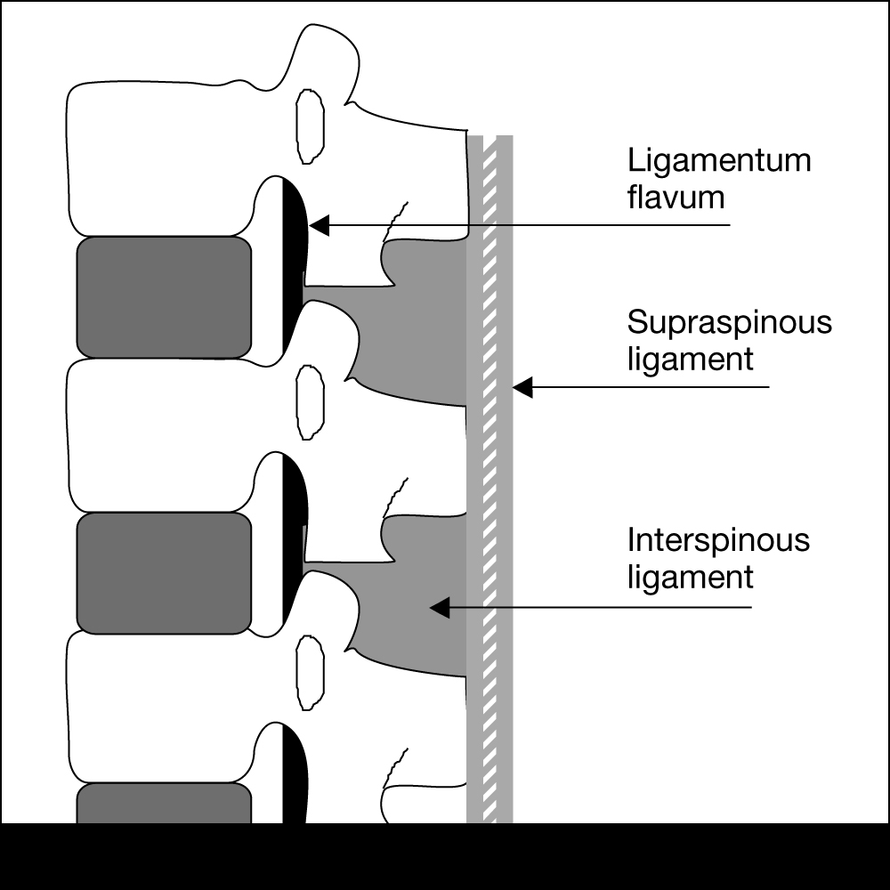
Ligaments are identified by tactile sensation (feel)
Dorsal ligaments transversed during neuraxial blockade. With experience the anesthesia provider will be able to identify anatomical structures by “feel”.

Slide 14
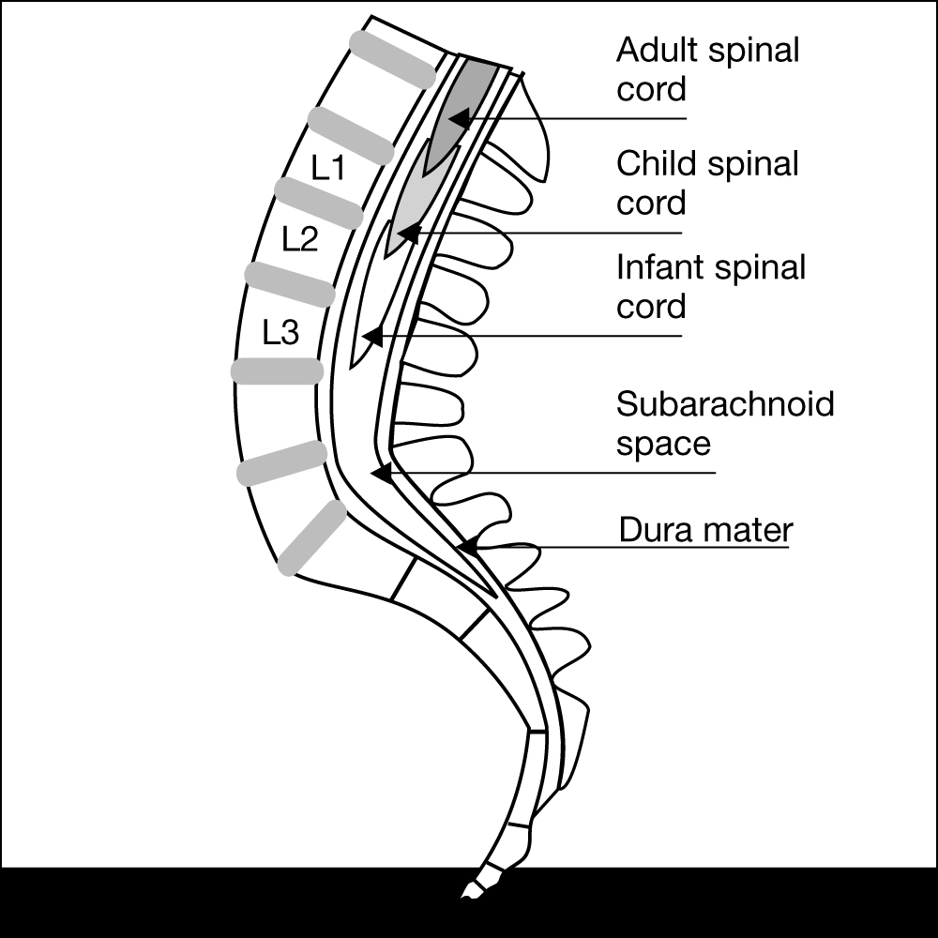
Termination of Spinal Cord
In adults usually ends at L1.
Infants L3
There are anatomical variations. For most adults it is generally safe to place a spinal needle below L2.

Slide 15
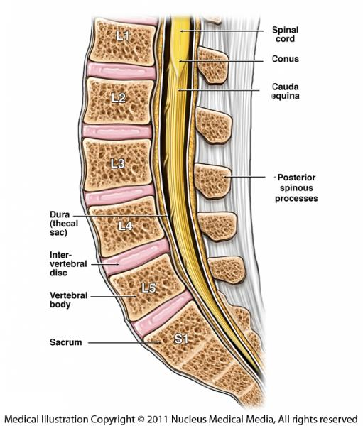

Slide 16
Surface Anatomy and Landmarks

Slide 17
Locating prominent cervical and thoracic vertebrae
C2 is the first palpable vertebrae
C7 is the most prominent cervical vertebrae
With the patients arms at the side the tip of the scapula generally corresponds with T7

Slide 18
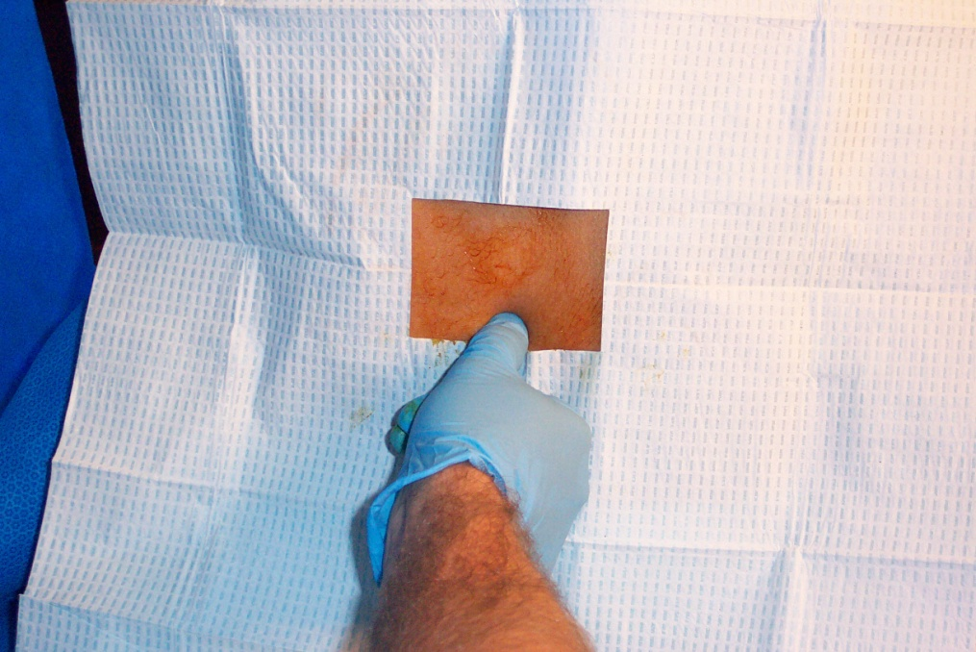
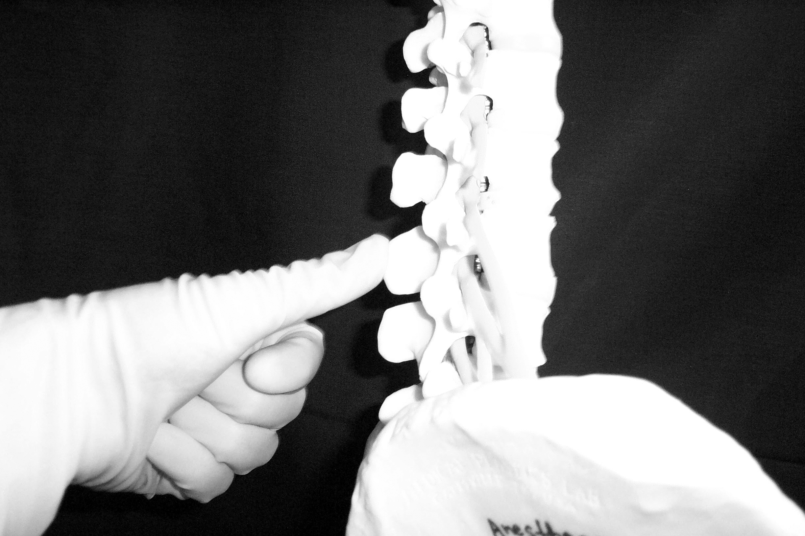
Palpation of Spinous Process

Slide 19
Spinous Processes
Generally are palpable to help identify the midline
If unable to palpate the spinous process one can look at the upper crease of the buttocks and line up the midline as long as there is no scoliosis or other deformities of the spine

Slide 20
What is Tuffier’s Line?
A line drawn between the highest points of both iliac crests will yield either the body of L4 or the L4-L5 interspace.

Slide 21
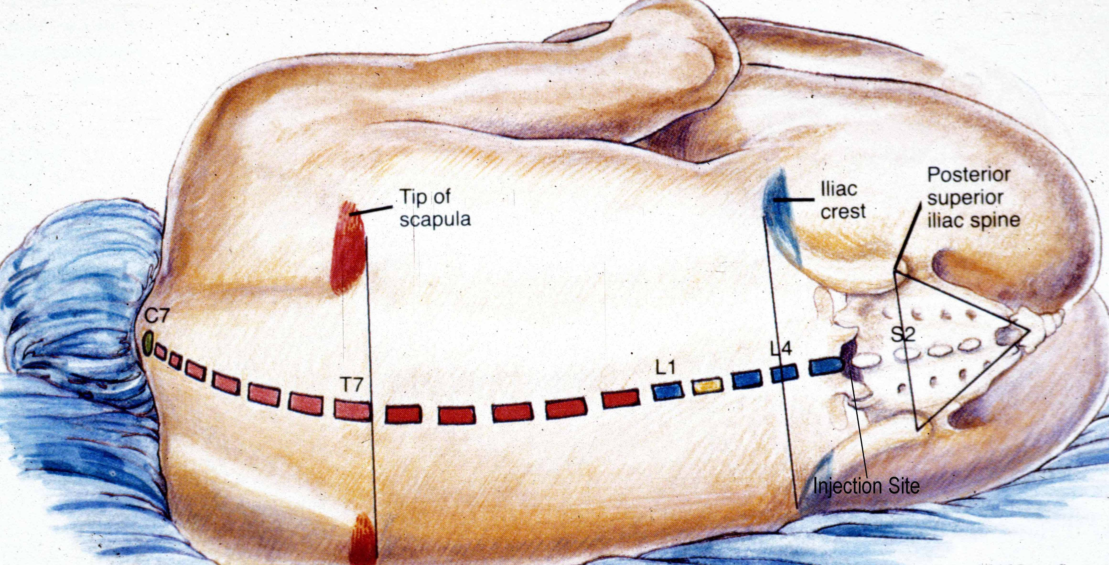

Slide 22
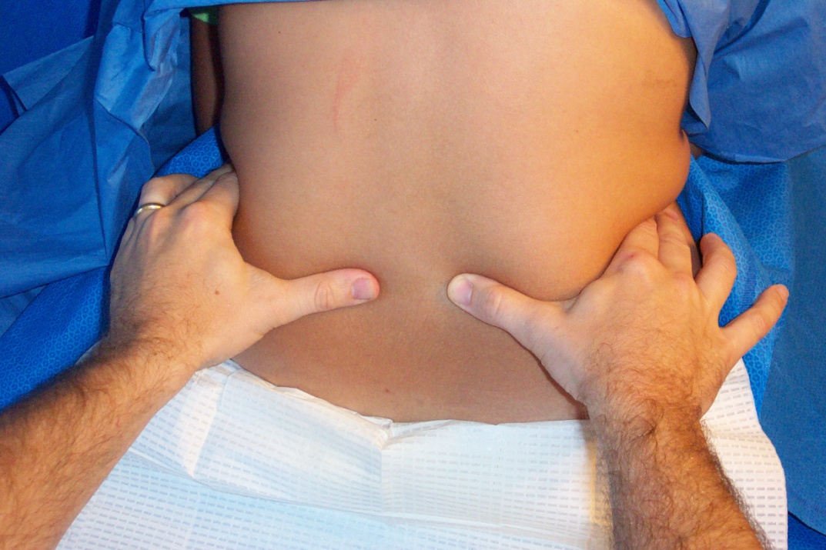
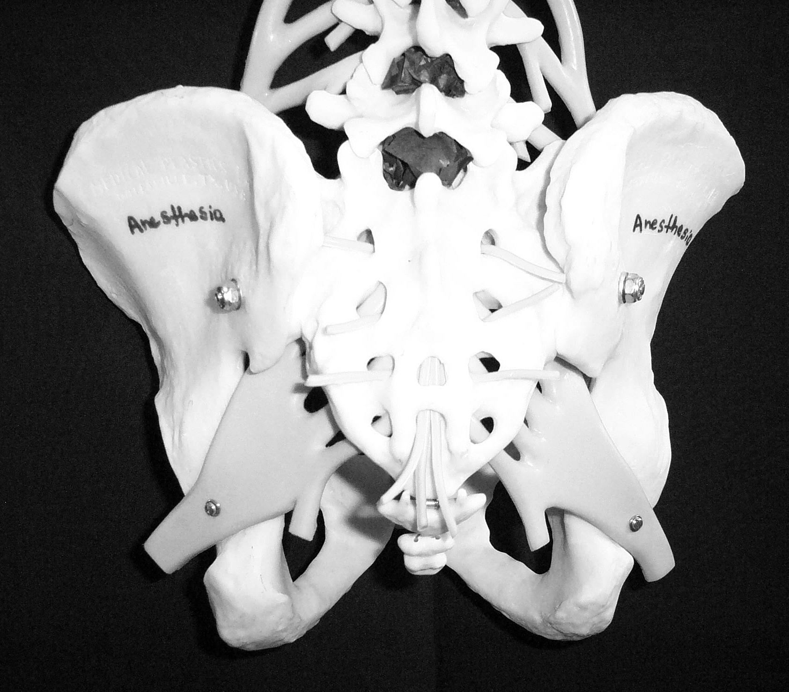

Slide 23
Anatomical Considerations of the Spinal Cord and Neuraxial Blockade.

Slide 24
The Subarachnoid Space is a continuous space that contains
CSF
Spinal cord & nerves

Slide 25
CSF
Clear fluid that fills the subarachnoid space
Total volume in adults is ~100-150 ml (2 ml/kg)
Volume found in the subarachnoid space is ~35-45 ml
Continually produced at a rate of 450 ml per 24 hour period replacing itself 3-4 times

Slide 26
CSF
Reabsorbed into the blood stream by arachnoid villi.
Specific gravity is between 1.003-1.007 (this will play a crucial role in the baracity of local anesthetic that one chooses)
CSF plays a role the patient to patient variability in relation to block height and sensory/motor regression (80% of the patient to patient variability)
Body wt is the only measurement that coincides with CSF volume (this becomes important in the obese and pregnant).

Slide 27
Membranes that surround the spinal cord
Pia mater- highly vascular, covers the spinal cord and brain, attaches to the periosteum of the coccyx ( Filum terminalis)
Arachnoid mater- non vascular and attached to the dura mater. Principal barrier to the migration of medications in and out of the CSF.
Dura mater (“tough mother”)- extension of the cranial dura mater, extends from the foramen magnum to S2.

Slide 28
Filum Terminale
An extension of the pia mater that attaches to the periosteum of the coccyx.

Slide 29
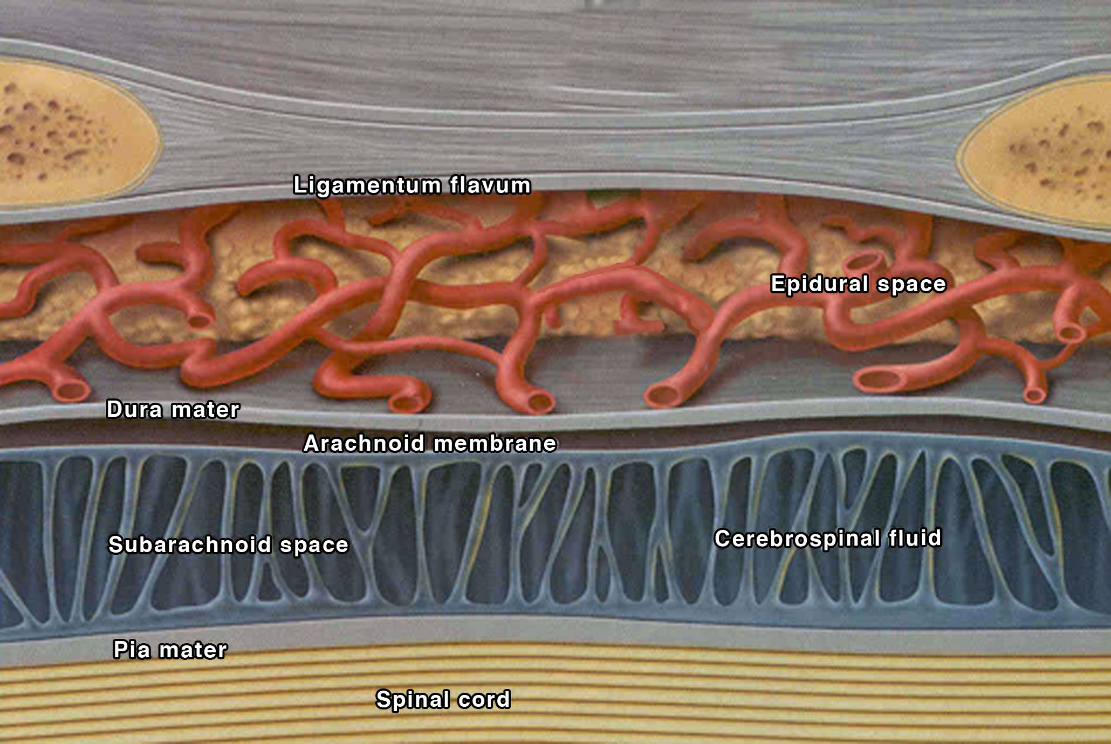

Slide 31
Epidural Space Anatomy

Slide 32
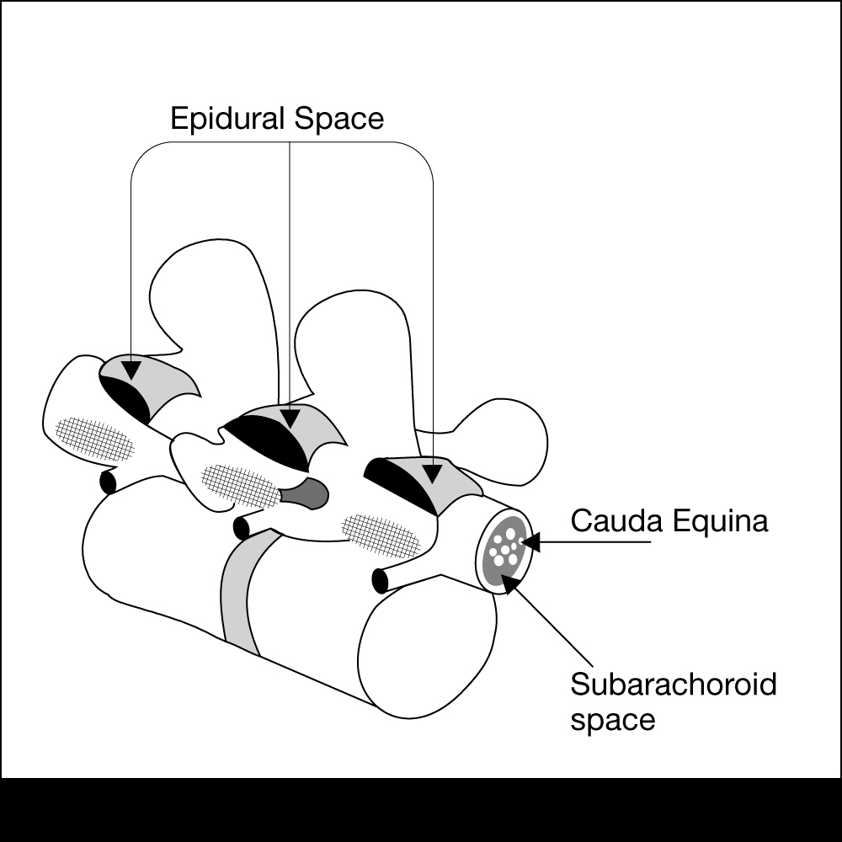
Epidural Space Anatomy
Extends from the formen magnum to the sacral hiatus

Slide 33
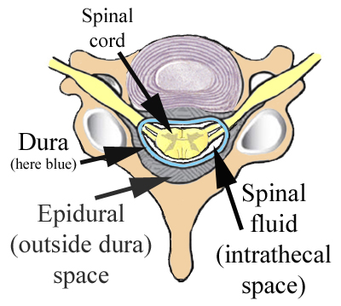
Epidural Space Anatomy
The epidural space surrounds the dura mater anteriorly, laterally, and most importantly to us posteriorly.

Slide 34
The Bounds of the Epidural Space are as follows:
Anterior- posterior longitudinal ligament
Lateral- pedicles and intervertebral ligaments
Posterior- ligamentum flavum

Slide 35
Ligamentum Flavum
Posterior to the epidural space
Extends from the foramen magnum to the sacral hiatus
Distance from skin to ligament varies from 3-8 cm in the lumbar area. It is 4 cm in 50% of the patients and 4-6 cm in 80% of the patients.
Thickness of the ligamentum flavum also varies. In the thoracic area it can range from 3-5 mm and in the lumbar it can range from 5-6 mm

Slide 36
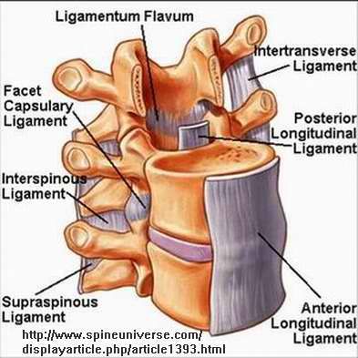

Slide 37
Contents of the Epidural Space
Fat
Areolar tissue
Lymphatics
Blood vessels including the Batson venous plexus

Slide 40
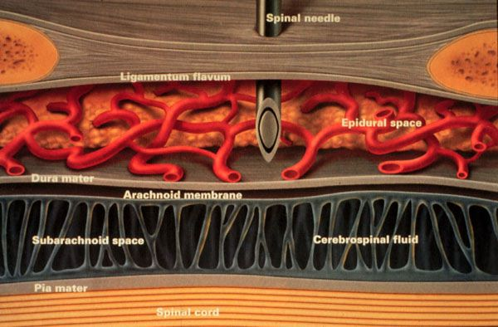

Slide 41
Definition
Spinal anesthesia :
Injection of small amounts ( 2-3 ml) of local anaesthetics into the CSF at the level below ( L2 ) ,where the spinal cord ends, anesthesia of the lower body part below the umbilicus is achieved.
Indication
Operations below the umbilicus: hernia repairs, gynaecological, urological operation, orthopedics,
Any operation on the perineum or genitalia.

Slide 42
Spinal Anesthesia
Contraindications
Absolute:
Refusal
Infection
Coagulopathy & anticoagulated patient
Severe hypovolemia
Increased intracranial pressure
Severe aortic or mitral stenosis
Relative:
Use your best judgment

Slide 43
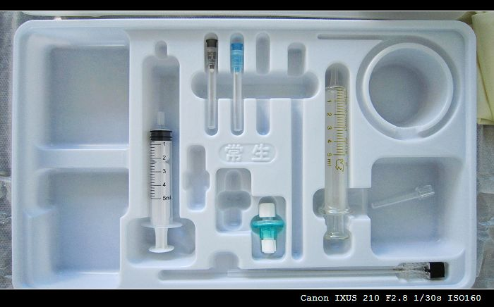
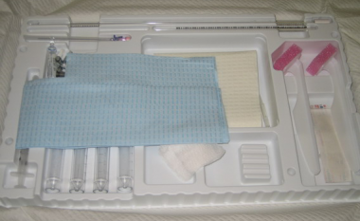
Sterility

Slide 44
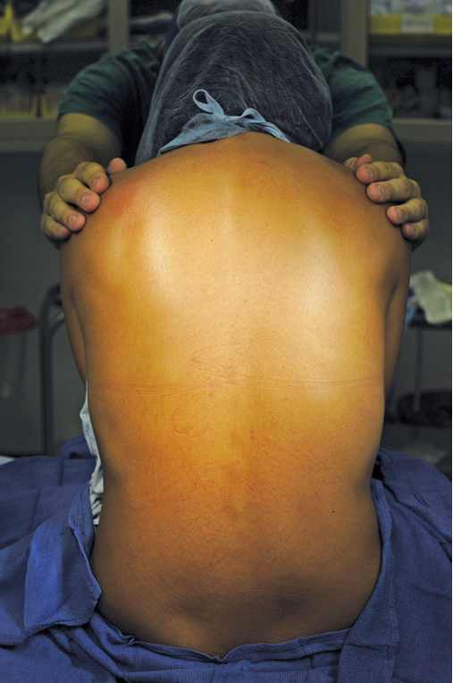
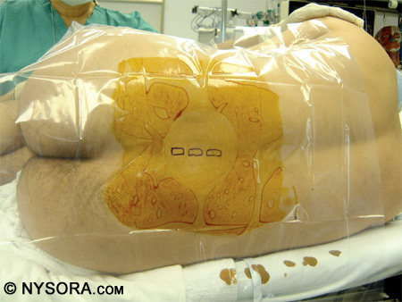
Sitting Vs. Lateral decobitus

Slide 45
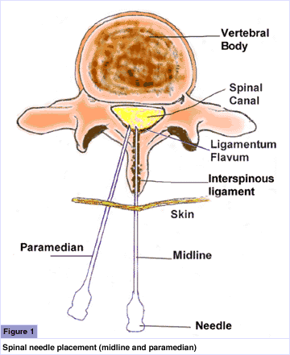
Spinal Technique
Midline Approach
Skin
Subcutaneous tissue
Supraspinous ligament
Interspinous ligament
Ligamentum flavum
Epidural space
Dura mater
Arachnoid mater
Paramedian or Lateral Approach
Same as midline excluding supraspinous & interspinous ligaments

Slide 46
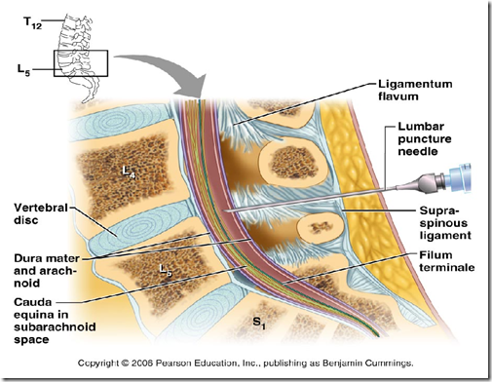

Slide 47
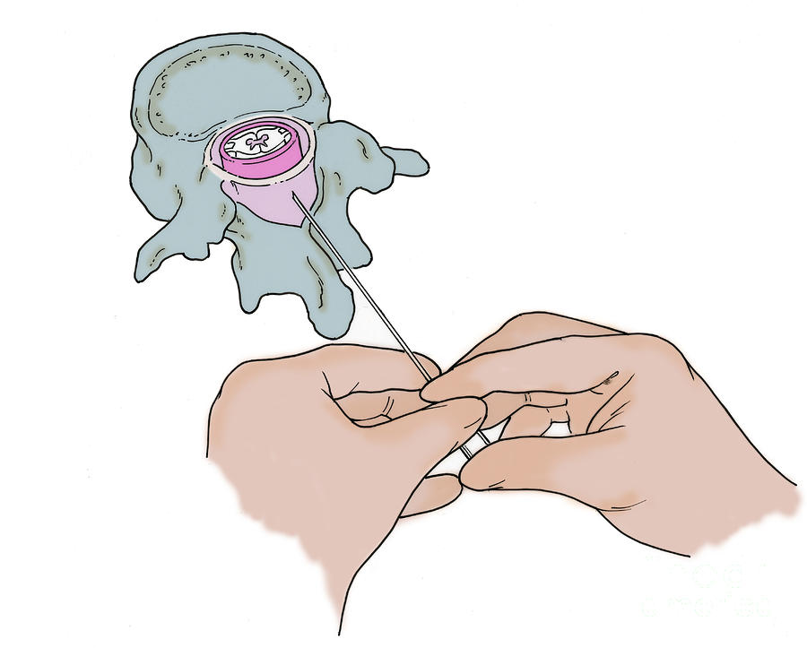

Slide 48
Spinal needles type

Slide 49
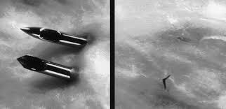
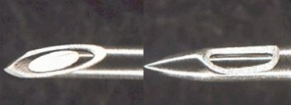

Slide 50
PDPH
Develop 12-48 hours after spinal anesthesia.
Headache improve when lying supine.

Slide 53
PDPH; Treatment
Conservative.
Epidural blood patch.

Slide 54
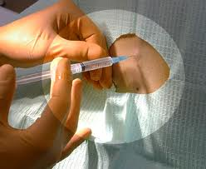
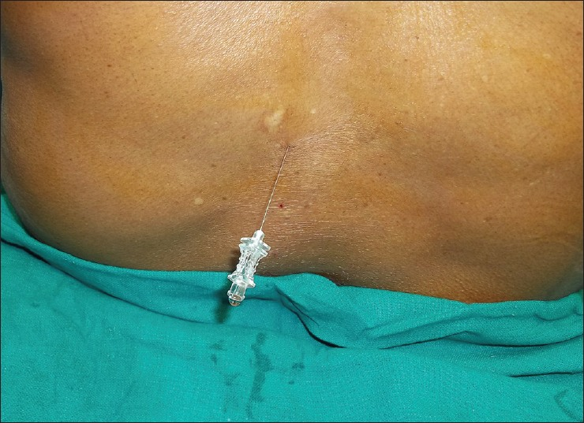
Spinal anesthesia; single shot technique

Slide 56
Baricity( a concern only in spinal anesthesia)
Hyperbaric
Typically prepared by mixing local with dextrose
Flow is to most dependent area due to gravity
Very predictable spread
Hypobaric
Prepared by mixing local with sterile water
Flow is to highest part of CSF column
Isobaric
Neutral flow that can be manipulated by positioning
Increased dose has more effect on duration than dermatomal spread
Note: Be cognizant of high & low regions of spinal column

Slide 57
Hyperbaric bupivacaine is prepared by mixing it with dextrose
Sterile, clear
Preservative free
3 ml ampoules
See the expiry date
Be sure it is bupivacaine??

Slide 58
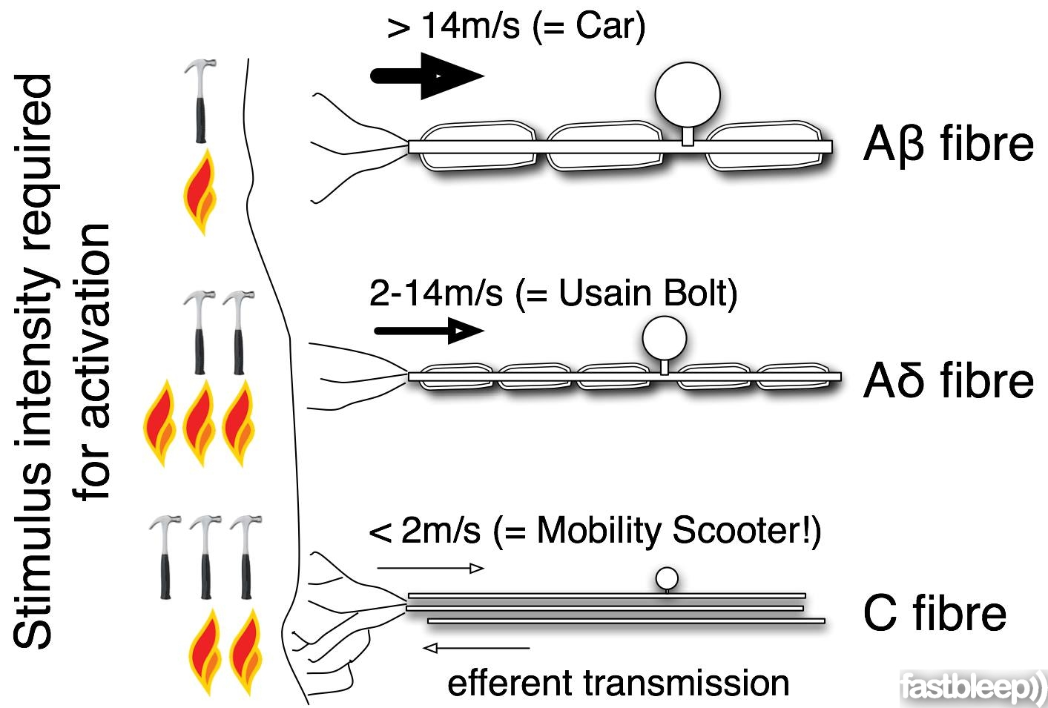

Slide 59
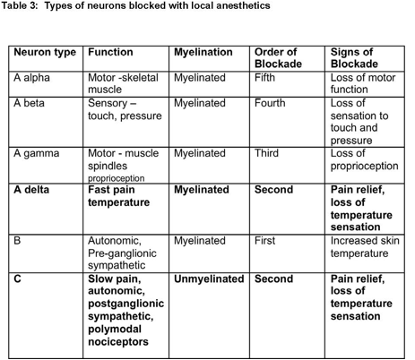

Slide 60
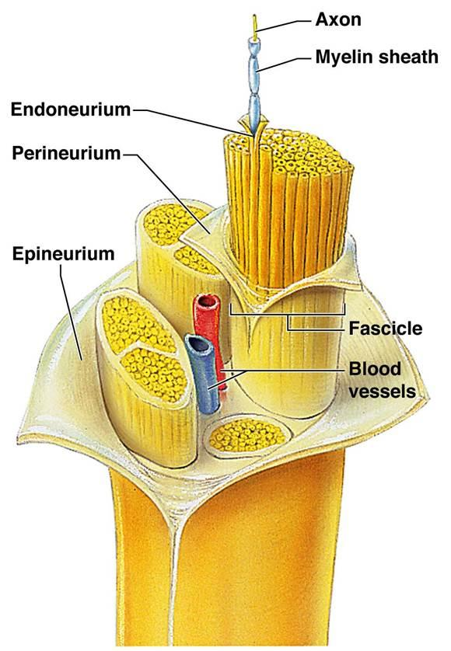

Slide 61
Sympathetic, Sensory & Motor Blockade
Spinal Injection
Sympathetic block is 2 dermatomes higher than sensory block
Motor block is 2 dermatomes lower than sensory block
Detect the sensory level by cold sensation test,
( Ice cubes).
Block order B> C=A delta> A beta>A alfa

Slide 62
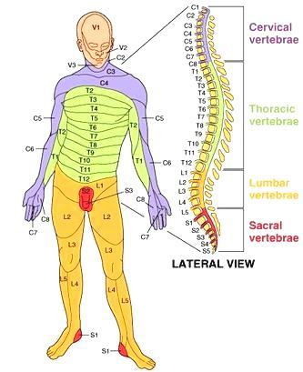
Dermatomes of the Body

Slide 63
Spinal Anesthesia Levels

Slide 64
Spinal Anesthesia
Complications
Failed block
Back pain (most common)
Spinal head ache
More common in women ages 13-40
Larger needle size increase severity
Onset typically occurs first or second day post-op
Treatment:
Bed rest
Fluids
Caffeine
Blood patch

Slide 65
Spinal Anesthesia
Complications
Epidural hematoma
Epidural abscess
Meningitis
Cauda equina
Neurological deficit
TNS
Bradycardia--- Cardiac arrest

Slide 66
Hypotension
Treatment
Best way to treat is physiologic not pharmacologic
Primary Treatment
Increase the cardiac preload
Large IV fluid bolus within 30 minutes prior to spinal placement, minimum 1 liter of crystalloids
Secondary Treatment
Pharmacologic
Ephedrine

Slide 67
EPIDURAL ANESTHESIA
EPIDURAL ANESTHESIA

Slide 68
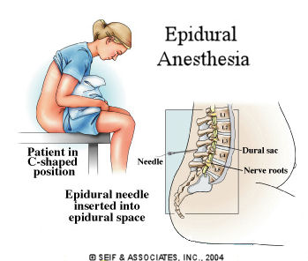
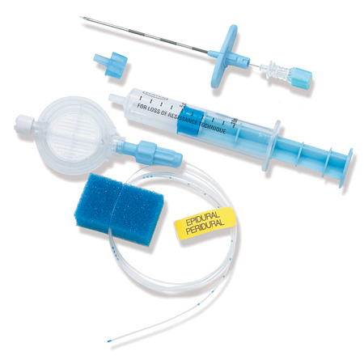
Epidural anesthesia; catheter technique

Slide 69
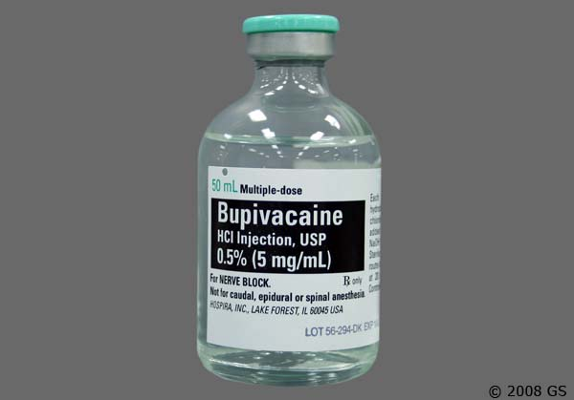
Isobaric bupivacaine (20 ml)

Slide 70
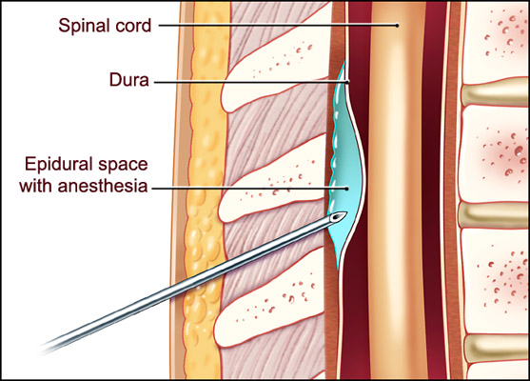
Slow onset (30 min), less dense block

Slide 71
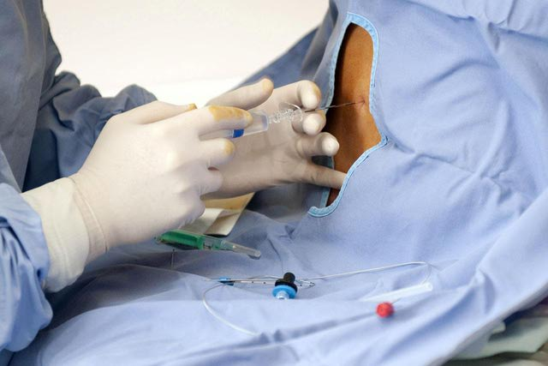
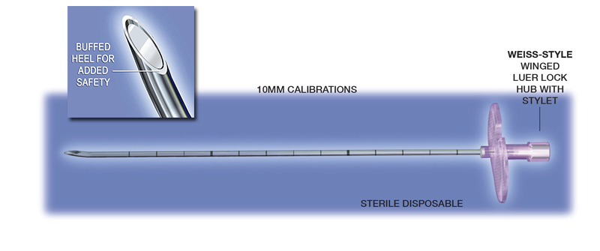
Touhy needle

Slide 72
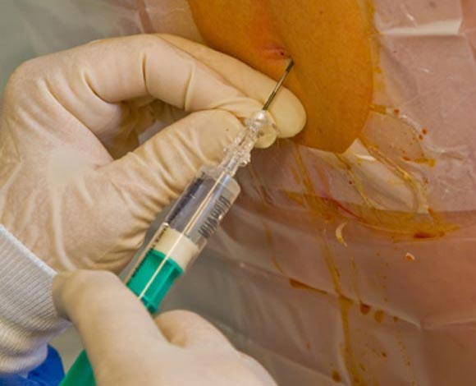
Loss of resistance technique

Slide 73
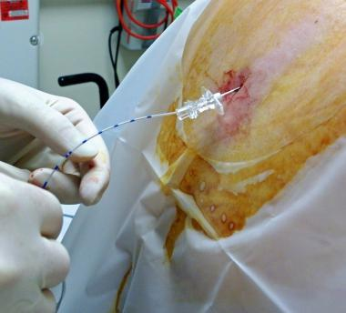
Catheter technique

Slide 74
Epidural Test dose
After checking the catheter
Careful aspiration, NO blood or CSF
3 ml Lidocaine 1.5% mixed with epinephrine 5 micg/ml
With careful monitoring, give the epidural injection15-20 ml bupivacaine in allequete.

Slide 75
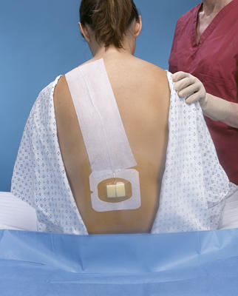

Slide 76
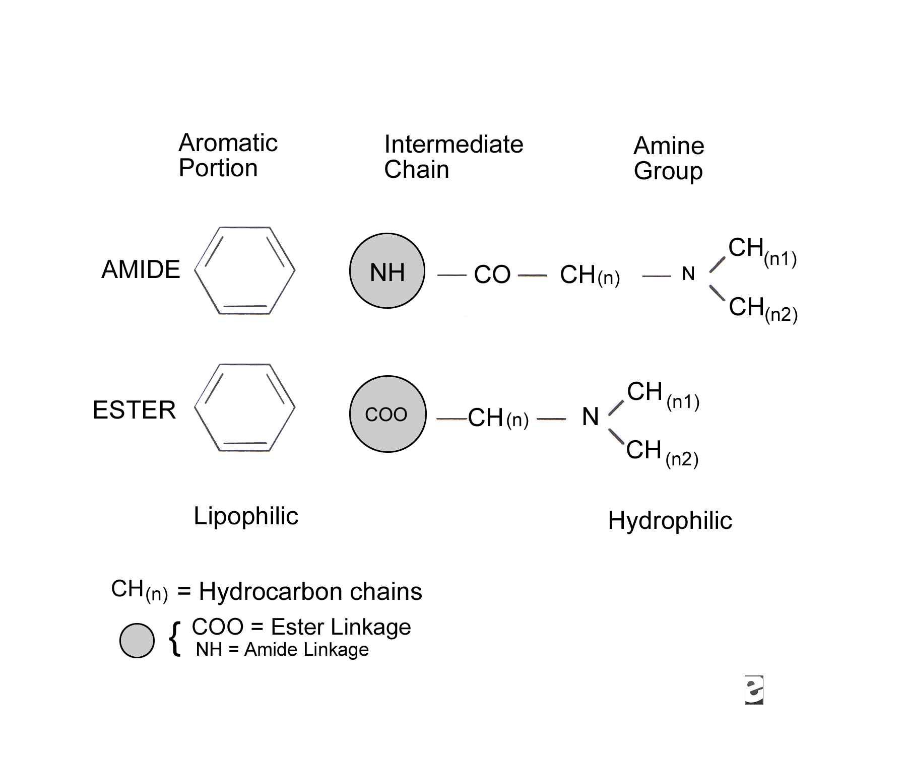
Local anesthetics

Slide 77
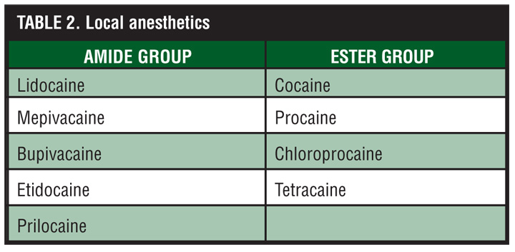

Slide 78
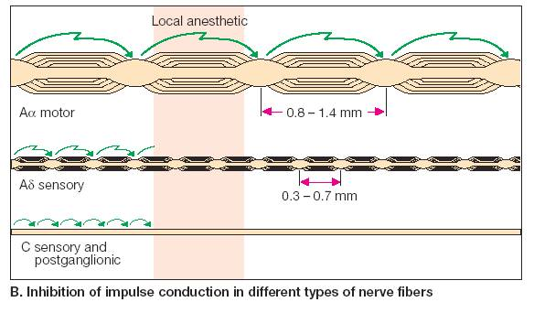

Slide 80
Mechanism of Action
Un-ionized local anesthetic defuses into nerve axon & the ionized form binds the receptors of the Na channel in the inactivated state

Slide 81
Duration of Action
The degree of protein binding is the most important factor
Lipid solubility is the second leading determining factor
Greater protein bound + increase lipid solubility = longer duration of action

Slide 82
Toxicity & Allergies
Esters: Increase risk for allergic reaction due to para-aminobenzoic acid produced through ester-hydralysis
Amides: Greater risk of plasma toxicity due to slower metabolism in liver

Slide 83
LAST
Exceeding the maximum save dose( Bupivacaine 2mg/kg), Lidocaine (5mg/kg)
Intravascular injection

Slide 84
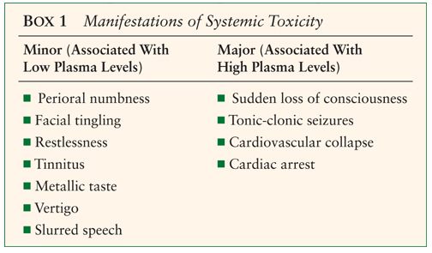
LAST(CNS)

Slide 85
LAST (CVS)
Tachycardia & Hypertension
Hypotension
Wide QRS
VF
Cardiac arrest

Slide 86
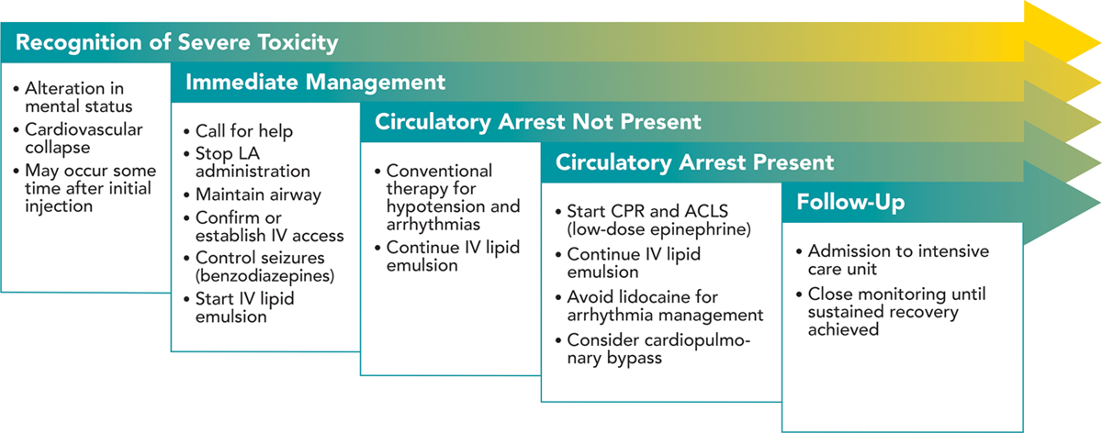
LAST; Management

Slide 87
References
Brown, D.L. (2005). Spinal, epidural, and caudal anesthesia. In R.D. Miller Miller’s Anesthesia, 6th edition. Philadelphia: Elsevier Churchill Livingstone.
Burkard J, Lee Olson R., Vacchiano CA. (2005) Regional Anesthesia. In JJ Nagelhout & KL Zaglaniczny (eds) Nurse Anesthesia 3rd edition. Pages 977-1030.
Kleinman, W. & Mikhail, M. (2006). Spinal, epidural, & caudal blocks. In G.E. Morgan et al Clinical Anesthesiology, 4th edition. New York: Lange Medical Books.
Warren, D.T. & Liu, S.S. (2008). Neuraxial Anesthesia. In D.E. Longnecker et al (eds) Anesthesiology. New York: McGraw-Hill Medical.

