Slide 1

Lecture Title: PERIOPERATIVE FLUID THERAPY
Lecturer name: Dr. Mansoor Aqil
Lecture Date: 03.05.2017

Slide 2
Objectives..
Students at the end of the lecture will be able to know about
Fluid Requirements and Fluid Therapy
What perioperative factors affect the patient’s fluid requirements?
How do you estimate maintenance fluid requirements?
What are some common conditions associated with preoperative fluid deficits?
List the potential physical and laboratory findings seen in a patient with a volume deficit.
How do you calculate the patient’s preoperative fluid deficits?

Slide 3
Intravenous Fluids
Crystalloids
What is the difference between normal saline, and Ringer's lactate?
What are the advantages and disadvantages of crystalloids?
Colloids
What colloid preparations are available for clinical use?
What are some advantages and potential side effects of hetastarch?
When to use 5% or 25% albumin preparation in volume resuscitation?
When is plasma indicated?

Slide 4
Blood Products
What is the minimal acceptable hemoglobin? What factors affect the minimal acceptable hemoglobin level?
How do you calculate the acceptable blood loss during surgery?
What is the difference between autologous and banked blood?
What are the routine screening tests of banked blood?
What administration set do you use for red blood cell, plasma and platelet transfusion?
How much increase in Hb level do you expect from transfusing one unit of RBCs?
What side effects can occur with the transfusion of blood products?
What are the side-effects (potential complications) of massive or rapid blood transfusion?
What is the indication for the transfusion of fresh frozen plasma, cryoprecipitate, and platelets?

Slide 5
Total Body Water (TBW)
Varies with age, gender
55-60% body weight in males
45-50% body weight in females
80% body weight in infants
Less in obese: fat contains little water

Slide 6
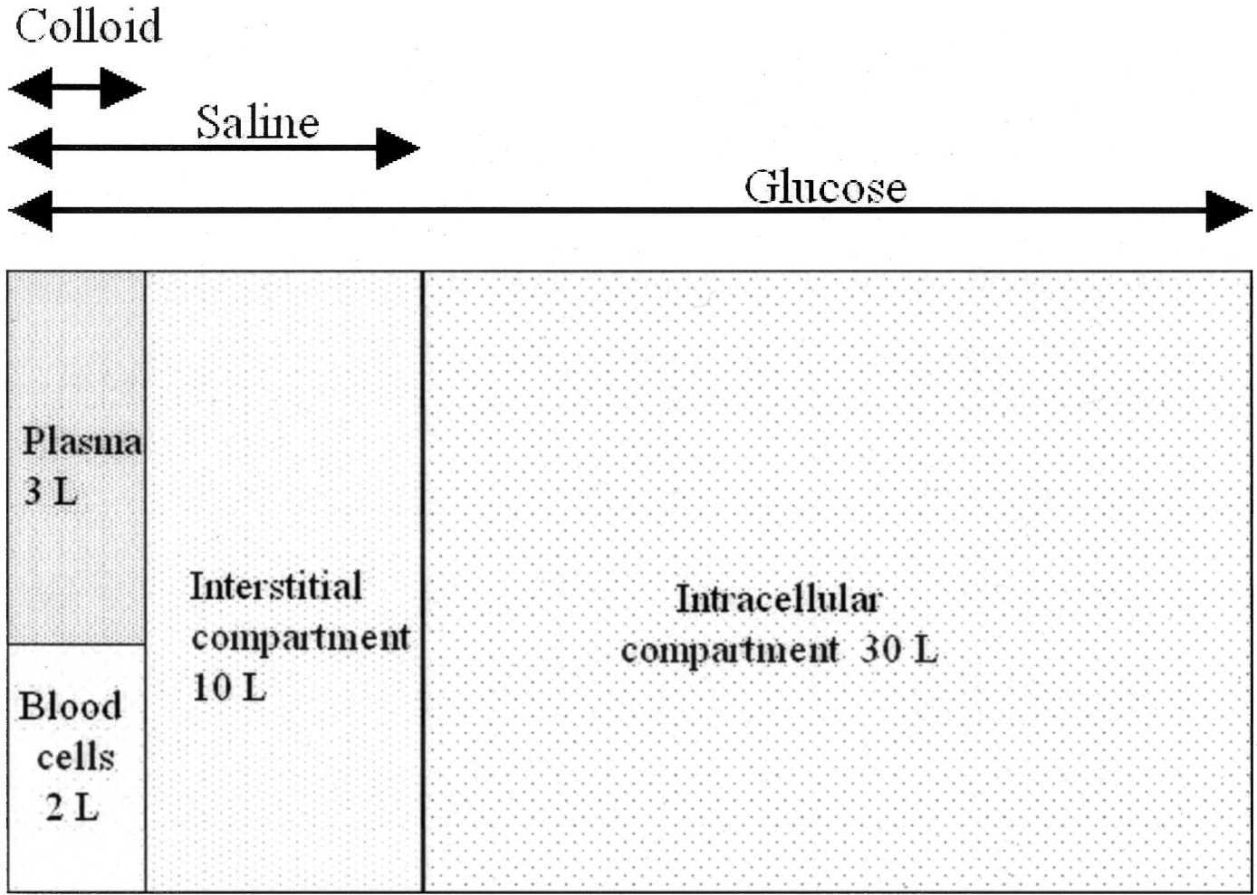
70 Kg Patient
60% water
70 X 0.6 = 42 Liters
20%
40%

Slide 7
Body Water Compartments
Intracellular water: 2/3 of TBW
Extracellular water: 1/3 TBW
  - Extravascular water: 3/4 of extracellular water
  - Intravascular water: 1/4 of extracellular water

Slide 8
Fluid and Electrolyte Regulation
Volume Regulation
  Antidiuretic Hormone
  Renin/angiotensin/aldosterone system
  Baroreceptors in carotid arteries and aorta
  Stretch receptors in atrium and juxtaglomerular aparatus
  Cortisol

Slide 9
Fluid and Electrolyte Regulation
Plasma Osmolality Regulation
  Arginine-Vasopressin (ADH)
  Central and Peripheral osmoreceptors
Sodium Concentration Regulation
  Renin/angiotensin/aldosterone system
  Macula Densa of JG apparatus

Slide 10
Preoperative Evaluation of Fluid Status
Factors to Assess:
  H/o intake and output
  Blood pressure: supine and standing
  Heart rate
  Skin turgor
  Urinary output
  Serum electrolytes/osmolarity
  Mental status

Slide 11
Final Goals of Fluid resuscitation
- Achievement of normovolemia & hemodynamic stability
- Correction of major acid-base disturbances
- Compensation of internal fluid fluxes
- Maintain an adequate gradient between COP & PCWP
- Improvement of microvascular blood flow
- Prevention of cascade system activation
- Normalization of O2 delivery
- Prevention of reperfusion cellular injury
- Achievement of adequate urine output

Slide 12
Orthostatic Hypotension
Systolic blood pressure decrease of greater than 20mmHg from supine to standing
Indicates fluid deficit of 6-8% body weight
  - Heart rate should increase as a compensatory measure
  - If no increase in heart rate, may indicate autonomic dysfunction or antihypertensive drug therapy

Slide 13
Perioperative Fluid Requirements
The following factors must be taken into account:
1- Maintenance fluid requirements
2- NPO and other deficits: NG suction, bowel prep
3- Third space losses
4- Replacement of blood loss
5- Special additional losses: diarrhea

Slide 14
1- Maintenance Fluid Requirements
  Insensible losses such as evaporation of water from respiratory tract, sweat, feces, urinary excretion. Occurs continually.
  “4-2-1 Rule”
    - 4 ml/kg/hr for the first 10 kg of body weight
    - 2 ml/kg/hr for the second 10 kg body weight
    - 1 ml/kg/hr subsequent kg body weight
    - Extra fluid for fever, tracheotomy, denuded surfaces

Slide 15
2- NPO and other deficits
NPO deficit = number of hours NPO x maintenance fluid requirement.
Bowel prep may result in up to 1 L fluid loss.
Measurable fluid losses, e.g. NG suctioning, vomiting, ostomy output, biliary fistula and tube.

Slide 16
3- Third Space Losses
Isotonic transfer of ECF from functional body fluid compartments to non-functional compartments.
Depends on
  Location and duration of surgical procedure,
  Amount of tissue trauma,
  Ambient temperature,
  Room ventilation.

Slide 17
Replacing Third Space Losses
Superficial surgical trauma: 1-2 ml/kg/hr
Minimal Surgical Trauma: 3-4 ml/kg/hr
  - head and neck, hernia, knee surgery
Moderate Surgical Trauma: 5-6 ml/kg/hr
  - hysterectomy, chest surgery
Severe surgical trauma: 8-10 ml/kg/hr (or more)
  - AAA repair, nehprectomy

Slide 18
4- Blood Loss
Replace 3 cc of crystalloid solution per cc of blood loss (crystalloid solutions leave the intravascular space)
When using blood products or colloids replace blood loss volume per volume

Slide 19
5- Other additional losses
Ongoing fluid losses from other sites:
  - Gastric drainage
  - Ostomy output
  - Diarrhea
Replace volume per volume with crystalloid solutions

Slide 20
Example
54 y/o male, 70 kg, for Laparotomy and bowel resection (hemicolectomy)
NPO after 2200, surgery at 0800, received bowel prep
3 hr. procedure, 500 cc blood loss
What are his estimated intraoperative fluid requirements?

Slide 21
Example (cont.)
Fluid deficit (NPO):
“4-2-1 Rule” for 70 Kg =110 ml/hr x 10 hrs = 1100 ml + 1000 ml for bowel prep = 2100 ml total deficit:
(Replace 1/2 first hr, 1/4 2nd hr, 1/4 3rd hour).
Maintenance: 110 ml/hr x 3hrs = 360mls
Third Space Losses: 6 ml/kg/hr x 3 hrs =1440 mls
Blood Loss: 500ml x 3 = 1500ml
Total = 2100+360+1440+1500=5400mls

Slide 22
Intravenous Fluids:
Conventional Crystalloids
Colloids
Hypertonic Solutions
Blood/blood products and blood substitutes

Slide 23
Crystalloids
Combination of water and electrolytes
  - Balanced salt solution: electrolyte composition and osmolality similar to plasma; example: lactated Ringer’s, Plasmalyte, Normosol.
  Hypotonic salt solution: electrolyte composition lower than that of plasma; example: D₅W
  Hypertonic salt solution: 2.7% NaCl.

Slide 24
Crystalloids in trauma
Advantages:
-Balanced electrolyte solutions
-Buffering capacity (Lactate)
-Easy to administer
-No risk of adverse reactions
-
No disturbance of hemostasis
-Promote diuresis
-Inexpensive

Slide 25
Crystalloids contin…
Disadvantages:
-Poor plasma volume support
-Large quantities needed
-Risk of Hypothermia
-Reduced plasma COP
-Risk of edema

Slide 26
Hypertonic Solutions
Fluids containing sodium concentrations greater than normal saline.
Available in 1.8%, 2.7%, 3%, 5%, 7.5%, 10% solutions.
Hyperosmolarity creates a gradient that draws water out of cells; therefore, cellular dehydration is a potential problem.

Slide 27
Hypertonic saline
Advantages:
-Small volume for resuscitation.
-Osmotic effect
-Inotropic effect (increase calcium influx in sarculema)
-Direct vasodilator effect
-Increase MAP, CO
-Increase renal, mesenteric, splanchnic, coronary blood flow.

Slide 28
Hypertonic saline
Disadvantages:
Increase hemorrhage from open vessels.
Hypernatremia
Hyperchloremia.
Metabolic acidosis.

Slide 29
Crystalloid solutions NaCl
Isotonic 0.9%:
9g/l , Na 154, Cl 154,
Osmolarity: 304 mosmol/l
Disadvantages: Hyper-chloremic acidosis

Slide 30
Crystalloids
Lactated Ringer's
Composition: Na 130, Cl 109, K 4, ca 3, Lactate 28, Osmolarity 273mosmol/l
-Sydney Ringer 1880
-Hartmann added Lactate=LR
-Minor advantage over NaCl
Disadvantages:
-Not to be used as dilatant for blood (Ca citrate)
-Low osmolarity, can lead to high ICP

Slide 31
Crystalloids
Dextrose 5%
Composition: 50g/l, provides 170 kcal/l
Disadvantages:
-Enhance CO2 production
-Enhance lactate production
-Aggravate ischemic brain injury

Slide 32
Composition

Slide 33
Colloids
Fluids containing molecules sufficiently large enough to prevent transfer across capillary membranes.
Solutions stay in the space into which they are infused.
Examples: Hetastarch (Hespan), albumin, dextran, Gelatins.

Slide 34
Colloids
Advantages:
-Prolonged plasma volume support
-Moderate volume needed
-Minimal risk of tissue edema
-Enhances microvascular flow

Slide 35
Colloids
Disadvantages:
Risk of volume overload
Adverse effect on hemostasis
Adverse effect on renal function
Anaphylactic reaction
Expensive

Slide 36
Dextran
Composition: 40/70
    Inhibit platelet aggregation
      Bleeding

Slide 37
Gelatins
Derived from hydrolyzed bovine collagen
Metabolized by serum collagenase
0.5-5hr
Histamine release (H1 blockers recommended)
Decreases Von W factor (VWF)
Bovine Spongiform Encephalopathy 1:1,000,000

Slide 38
Albumins
Heat treated preparation of human serum
5% (50g/l), 25% (250g/l)
Half of infused volume will stay intravascular
COP=20mmHg = plasma
25%, COP=70mmHg, it will expand the vascular space by 4-5 times the volume infused
25% used only in case of hypo-albuminemia

Slide 39
Cochrane studies support increased mortality following albumin infusion
Cardiac de-compensation after rapid infusion of 20 - 25% albumin
Decreased Ionized ca++
Aggravate leak syndrome MOF
Enhance bleeding
Impaired Na+ Water excretion Renal dysfunction

Slide 40
Hetastarch 6%
Composition: synthetic colloid, 6% preparation in isotonic saline MW 240,000 D- DS 0.7
Advantages: low cost, more potent than 5% albumin (COP 30)
Disadvantages: Hyper-glycemia, allergy, coagulopathy
Dose: 15-30ml/kg/day

Slide 41
Pentastarch 10%
-MW: 200,000 D- DS 0.5
-Low cost
-Extensive clinical use in sepsis, burns..
-Low permeability index
-Good clinical safety
-Decreases PMN-EC activation
-Potential to diminish vascular permeability and reduces
tissue edema

Slide 42
Tetrastarch (Voluven)
MW 130,000 D- DS 0.4
Used for volume therapy
Dose: 50ml/kg/day

Slide 43
Comparison of different Starch solutions
MW Max dose
Hetastarch 240,000 1,500/day
Pentastarch 200,000 2,500/day
Tetra starch 130,000 3,500/day
(Voluven)

Slide 44

Crystalloids Colloids
IVVP Poor Good
Hemod Stability Transient Prolong
Infusate volume Large Moderate
Plasma COP Reduced Maintain
Tissue edema Obvious Insignificant
Anaphylaxis Non-exist low-mod
Cost Inexpensive Expensive

Slide 45
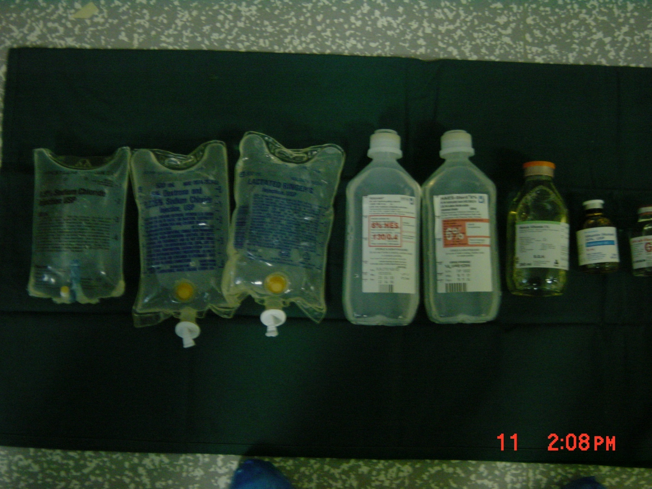

Slide 46
Crystalloids OR Colloids
ACS protocol for ATLS: replace each ml of blood loss
with 3 ml of crystalloid fluid. 3 for 1 rule.
Patient response:
Rapid
Transient
Non-responsive

Slide 47
Clinical Evaluation of Fluid Replacement
1. Urine Output: at least 1.0 ml/kg/hr
2. Vital Signs: BP and HR normal (How is the patient doing?)
3. Physical Assessment: Skin and mucous membranes no dry; no thirst in an awake patient
4. Invasive monitoring; CVP or PCWP may be used as a guide
5. Laboratory tests: periodic monitoring of hemoglobin and hematocrit

Slide 48
Summary
Fluid therapy is critically important during the perioperative period.
The most important goal is to maintain hemodynamic stability and protect vital organs from hypoperfusion
All sources of fluid losses must be accounted for.
Good fluid management goes a long way toward preventing problems.

Slide 49
Thank You ☺
Dr.
Date:

Slide 50
PBL case discussion

Slide 51
Example
62 y/o male, 80 kg, for hemicolectomy
NPO after 2200, surgery at 0800, received bowel prep
3 hr. procedure, 500 cc blood loss
What are his estimated intraoperative fluid requirements?

Slide 52
Example (cont.)
Fluid deficit (NPO):
Maintenance:
Third Space Losses:
Blood Loss:
Total =

Slide 53
Example (cont.)
Fluid deficit (NPO): 120 ml/hr x 10 hrs = 1200 ml + 1000 ml for bowel prep = 2200 ml total deficit: (Replace 1/2 first hr, 1/4 2nd hr, 1/4 3rd hour).
Maintenance: 120 ml/hr x 3hrs = 360mls
Third Space Losses: 6 ml/kg/hr x 3 hrs =1440 mls
Blood Loss: 500ml x 3 = 1500ml
Total = 2200+360+1440+1500=5500mls

Slide 54
Lecture Title:
Transfusion of blood and Blood products
Lecturer name: Dr. Mansoor Aqil
Lecture Date: 14.02.2017

Slide 55
Transfusion Therapy
  - 60% of transfusions occur perioperatively.
  Responsibility of transfusing perioperatively is with the anesthesiologist.

Slide 56
Objective
Indication of blood transfusion
Blood groups
Blood component
Blood transfusion complication & treatment
Alternatives to Blood Products

Slide 57
Blood Transfusion
Up to 30% of blood volume loss can be treated with crystalloids

Slide 58
Blood Transfusion
Why?
Increase oxygen carrying capacity
Restoration of red cell mass
Correction of bleeding caused by platelet dysfunction
Correction of bleeding caused by factor deficiencies

Slide 59
When is Transfusion Necessary?
“Transfusion Trigger”: Hgb level at which transfusion should be given.
  - Varies with patients and procedures
Tolerance of acute anemia depends on:
  - Maintenance of intravascular volume
  - Ability to increase cardiac output
  - Increases in 2,3-DPG to deliver more of the carried oxygen to tissues

Slide 60
Oxygen Delivery
Oxygen Delivery (DO₂) is the oxygen that is delivered to the tissues
DO₂= CO x CaO₂
Cardiac Output (CO) = HR x SV
Oxygen Content (CaO₂):
  - (Hgb x 1.34)O₂ saturation + PaO₂(0.003)

Slide 61
Oxygen Content (CaO₂)
  - (Hgb x 1.34)O₂ saturation + PaO₂(0.003)
  Hgb is the main determinant of oxygen content in the blood
Hb = 14 gm /dl | Hb= 10 gm/dl | Hb= 7 gm/dl
14x 1.34x 0.99+ (100X0.003) | 10 X 1.34 x0.99 +(100X 0.003) | 7 X 1.34 x0.99 + (100X0.003)
18.87 ml/dl | 13.56 ml/dl | 9.58 ml/dl
Hgb is the main determinant of oxygen content in the blood

Slide 62
Oxygen Delivery (cont.)
Therefore: DO₂ = HR x SV x CaO₂
If HR or SV are unable to compensate, Hgb is the major determinant factor in O₂ delivery
Healthy patients can tolerate Hgb levels of 7 gm/dL.
Compromised patients may require Hgb levels above 10 gm/dL.

Slide 63
Blood Groups
Antigen on Plasma Incidence
Blood Group erythrocyte Antibodies White African-
Americans
A A Anti-B 40% 27%
B B Anti-A 11 20
AB AB None 4 4
O None Anti-A 45 49
Anti-B
Rh Rh 42 17

Slide 64
Cross Match
Major:
  - Donor’s erythrocytes incubated with recipients serum
Minor:
  - Donor’s serum incubated with recipients erythrocytes
Agglutination:
  - Occurs if either is incompatible
Type Specific:
  - Only ABO-Rh determined; chance of hemolytic reaction is 1:10,000 with TS blood

Slide 65
Type and Screen
Donated blood that has been tested for ABO/Rh antigens and screened for common antibodies (not mixed with recipient blood).
  - Used when usage of blood is unlikely, but needs to be available (hysterectomy).
  - Allows blood to available for other patients.
  - Chance of hemolytic reaction: 1:10,000.

Slide 66
Component Therapy
A unit of whole blood is divided into components; Allows prolonged storage and specific treatment of underlying problem with increased efficiency:
    Packed red blood cells (pRBC’s)
    Platelet concentrate
    Fresh frozen plasma (contains all clotting factors)
    Cryoprecipitate (contains factors VIII and fibrinogen; used in Von Willebrand’s disease)
    Albumin
    Plasma protein fraction
    Leukocyte poor blood
    Factor VIII
    Antibody concentrates

Slide 67
Whole Blood
Storage
  4° for up to 35 days
Indications
  Massive Blood Loss/Trauma/Exchange Transfusion
Considerations
  Use filter as platelets and coagulation factors will not be active after 3-5 days
  Donor and recipient must be ABO identical

Slide 68
Packed Red Blood Cells
1 unit = 250 ml. Hct. = 70-80%.
1 unit pRBC’s raises Hgb 1 gm/dL.
Mixed with saline: LR has Calcium which may cause clotting if mixed with pRBC’s.
Do NOT mix with medications

Slide 69
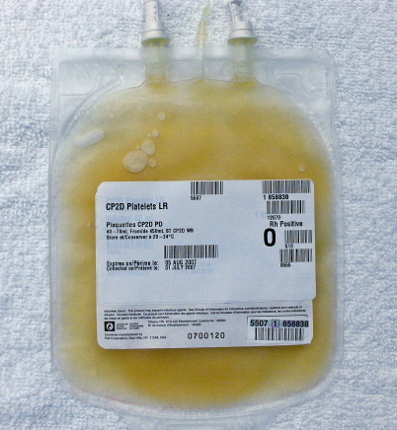
Platelet Concentrate
Storage
Up to 5 days at 20-24°
Indications
  Thrombocytopenia, Plt <15,000
  Bleeding and Plt <50,000
  Invasive procedure and Plt <50,000

Slide 70
Platelet Concentrate
Considerations
  Contain Leukocytes and cytokines
  1 unit/10 kg of body weight increases PLT count by 50,000
  Apheresis unit increases PLT count 30,000- 60,000.
  Donor and Recipient must be ABO identical
  Risks:
  - Sensitization due to HLA on platelets
  - Viral transmission

Slide 71
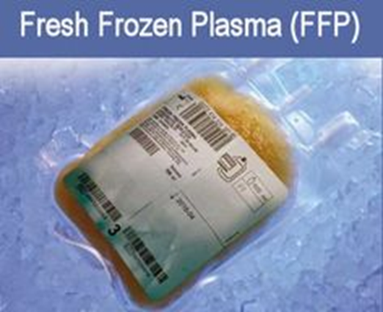
Fresh Frozen Plasma
Plasma from whole blood frozen within 6 hours of collection.
  Contains coagulation factors (1 unit/ml)
  Indications:
  Used when PT and PTT are >1.5 normal
  Coagulation Factor deficiency, fibrinogen replacement, DIC, liver disease, exchange transfusion, massive transfusion
  Reversal of Coumadin effect, TTP, etc.

Slide 72
Fresh Frozen Plasma (FFP)
Storage
  FFP– for 12 months at (– 25 degree C) or colder
Considerations
  Plasma should be recipient ABO compatible
  In children, should also be Rh compatible
  Usual dose is 20 cc/kg to raise coagulation factors approx 20%
  Should be transfused within 24 hours after thawing

Slide 73
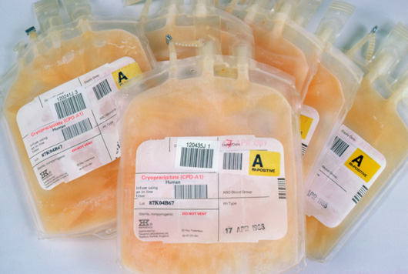
Cryoprecipitate
Rich in Fibrinogen, Factor VIII and XIII
A single bag Cryo contains:
100units factor VIII and VWF+
150-250mg fibrinogen with XIII and fibronectin
von Willebrand factor 100-150 U with a half-life of 24 hours
Factor XIII 50–75 U with a half-life of 150–300 hours.
Indication: hypo-fibrinogenemia<100mg/dl

Slide 74
Cryoprecipitate
-Dose 10-20 ml/kg
Or
Number of bags= 0.2 X wt. in Kg
Or Standard dose 10 bags
Will increase fibrinogen level by 1 gm/L
-No compatibility test required
Ten bags of cryo (obtained from 10 units of plasma) contain about 2 g of fibrinogen and will raise the fibrinogen level about 70 mg/dL in a 70 kg recipient

Slide 75
Blood transfusion complication
Hemolytic transfusion reaction
  Acute
  Delayed
Non hemolytic reactions:
  Febrile (WBC or PLT sensitization)
  Urticarial Reaction
  Type 1 Hypersensitivity (Anaphylactic reaction)
  Graft versus host reactions
  TRALI
  Transfusion related immune modulation
Infective
Physical
  Circulatory overload
  Embolism (air, micro aggregate)
  Hypothermia
Biochemical
  Acid base disturbances
  Hyper-kalaemia
  Citrate toxicity
  Impaired oxygen release

Slide 76
Transfusion Reactions
    Hemolytic Reactions (Acute or delayed )
Febrile Reactions (FNHTR)
Allergic Reactions
TRALI
Coagulopathy with Massive transfusions
Bacteremia

Slide 77
Complications of Blood Therapy (cont.)
Hemolytic:
  Wrong blood type administered (oops).
  Activation of complement system leads to intravascular hemolysis, spontaneous hemorrhage.

Slide 78
Hemolytic Reaction:
Signs: hypotension, fever, chills, dyspnea, skin flushing, substernal pain.
Signs are easily masked by general anesthesia.
Free Hgb in plasma or urine
Acute renal failure
Disseminated Intravascular Coagulation (DIC)

Slide 79
What to do?
If an AHTR occurs
STOP TRANSFUSION
ABC’s
Maintain IV access and run IVF (NS or LR)
Monitor and maintain BP/pulse
Give diuretic
Obtain blood and urine for transfusion reaction workup
Send remaining blood back to Blood Bank

Slide 80
Blood Bank Work-up of AHTR
Check paperwork to assure no errors
Check plasma for free hemoglobin
Repeat crossmatch
Repeat Blood group typing
Blood culture

Slide 81
Monitoring in AHTR
Monitor patient clinical status and vital signs
Monitor renal status (BUN, creatinine)
Monitor coagulation status (DIC panel– PT/PTT, fibrinogen, D-dimer/FDP, Plt, Anti-thrombin-III)
Monitor for signs of hemolysis (LDH, bili, haptoglobin)

Slide 82
Other Complications
  Decreased 2,3-DPG with storage: ? Significance
  Citrate: metabolism to bicarbonate; Calcium binding
  Microaggregates (platelets, leukocytes): micropore filters controversial
  Hypothermia: warmers used to prevent
  Coagulation disorders: massive transfusion (>10 units) may lead to dilution of platelets and factor V and VIII.
  DIC: uncontrolled activation of coagulation system

Slide 83
Complications (cont.)
Transmission of Viral Diseases:
  Hepatitis C; 1:30,000 per unit
  Hepatitis B; 1:200,000 per unit
  HIV; 1:450,000-1:600,000 per unit
  22 day window for HIV infection and test detection
  CMV may be the most common agent transmitted, but only effects immuno-compromised patients
  Parasitic and bacterial transmission very low

Slide 84
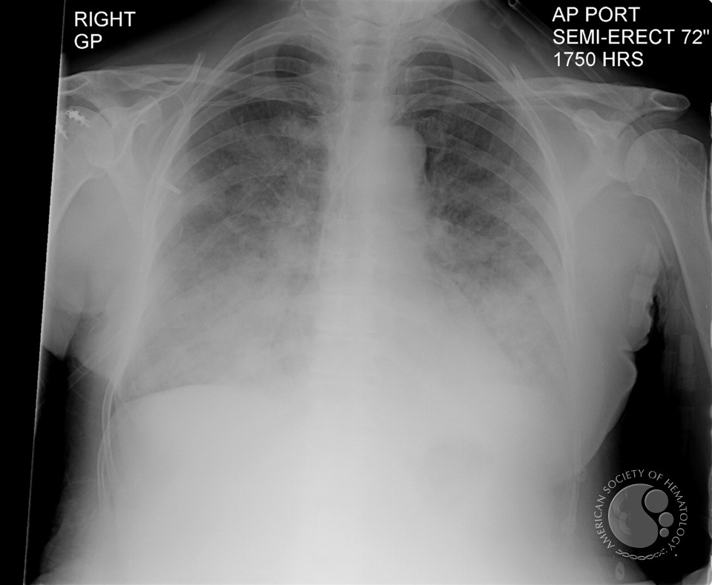
TRANSFUSION RELATED ACUTE LUNG INJURY
Absence of cardiac failure or intravascular volume overload
Transfused leuko-agglutinating antibodies bind to recipients' neutrophils localized to pulmonary endothelium resulting in activation and release of oxidases and other damaging modifiers that cause capillary leak

Slide 85
Administering Blood Products
  Consent necessary for elective transfusion
  Unit is checked by 2 people for Unit #, patient ID, expiration date, physical appearance.
  pRBC’s are mixed with saline solution (not LR)
  Products are warmed mechanically and given slowly if condition permits
  Close observation of patient for signs of complications
  If complications suspected, infusion discontinued, blood bank notified, proper steps taken.

Slide 86
Blood volume formula
Neonate - 90 ml/kg
Infants 2 years ago - 80ml/kg
Adult male - 70ml/kg
Adult female - 60ml/kg

Slide 87
Massive blood transfusion
  The replacement of patients blood volume by stored bank blood in less than 24 hours

Slide 88
Massive blood transfusion
Basic screening test after six-unit transfusion
  Hemoglobin and platelets count
  Coagulation profile (PT & APTT)
  Plasma fibrinogen concentration
  Fibrin degradation products
  pH from arterial blood gas analysis
  Plasma Electrolyte

Slide 89
Massive Blood Transfusion complications
Coagulopathy due to dilutional thrombocytopenia. And dilution of the coagulation factors
Citrate Toxicity does not occur in most normal patients unless the transfusion rate exceeds 1 U every 5 min
Hypothermia
Acid–Base Balance The most consistent acid–base abnormality after massive blood transfusion is postoperative metabolic alkalosis

Slide 90
Massive Blood Transfusioncomplications
Serum Potassium Concentration
The extracellular concentration of potassium in stored blood steadily increases with time.
The amount of extra-cellular potassium transfused with each unit less than 4 mEq per unit.
Hyperkalemia can develop regardless of the age of the blood when transfusion rates exceed 100 mL/min.

Slide 91
Massive blood transfusion
Diagnosis of DIC
  Increase APTT , PT , fibrin degradation product (>10 mg/L)
  Decrease platelet count , fibrinogen concentration
Treatment
  4 units of FFP
  6-8 units of platelets
  Cryoprecipitate if fibrinogen level less than 1 g/l
  PH less than 7.2 administrate 50 mmol bicarbonate
  Recombinant activated factor VIIa if bleeding continue in spite of use FFP platelets and cryoprecipatate

Slide 92
Thromboelastography
Bleeding is leading cause of death results from trauma.
Hemorrhage is responsible for 30% to 40% of trauma mortality
On admission, 25% to 35% of trauma patients present with coagulopathy, which is associated with a sevenfold increase in morbidity and mortality.
The literature supports that routine plasma based routine coagulation tests, such as prothrombin time, activated partial thromboplastin time, and international normalized ratio, are inadequate for monitoring coagulopathy and guided transfusion therapy in trauma patients.

Slide 93
Thromboelastography
TEG® assesses both thrombosis and fibrinolysis.
Conventional tests are performed in plasma without platelets and tissue bearing cells (the cellular component) while TEG® is done in whole blood.

Slide 94
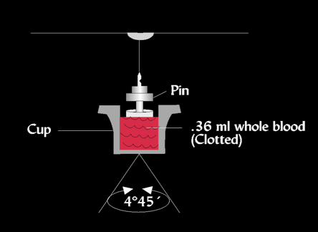
Thromboelastography

Slide 95
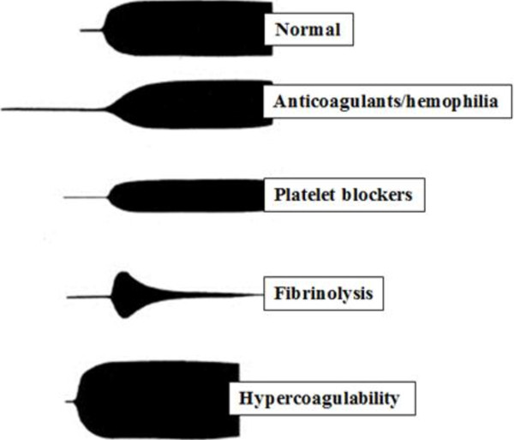
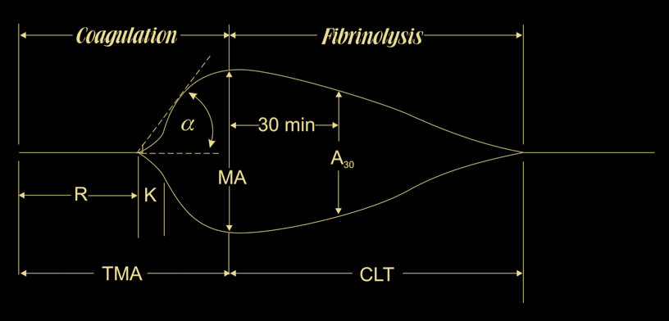
Thromboelastography

Slide 96
Thromboelastography
It measures viscoelastic changes of entire clotting process,
  Its formation,
  First fibrin strands,
  Evaluates clot formation strength
  Platelet function
  Until clot lysis
There is growing interest in its clinical use in trauma resuscitation, particularly for managing acute coagulopathy of trauma and assisting decision making concerning transfusion.

Slide 97
Alternatives to Blood Products
Autotransfusion
Blood substitutes

Slide 98
Auto-transfusion
Techniques:
Pre-deposit transfusion
Intra-operative acute normovolemic hemodilution
Intra-operative cell salvage

Slide 99
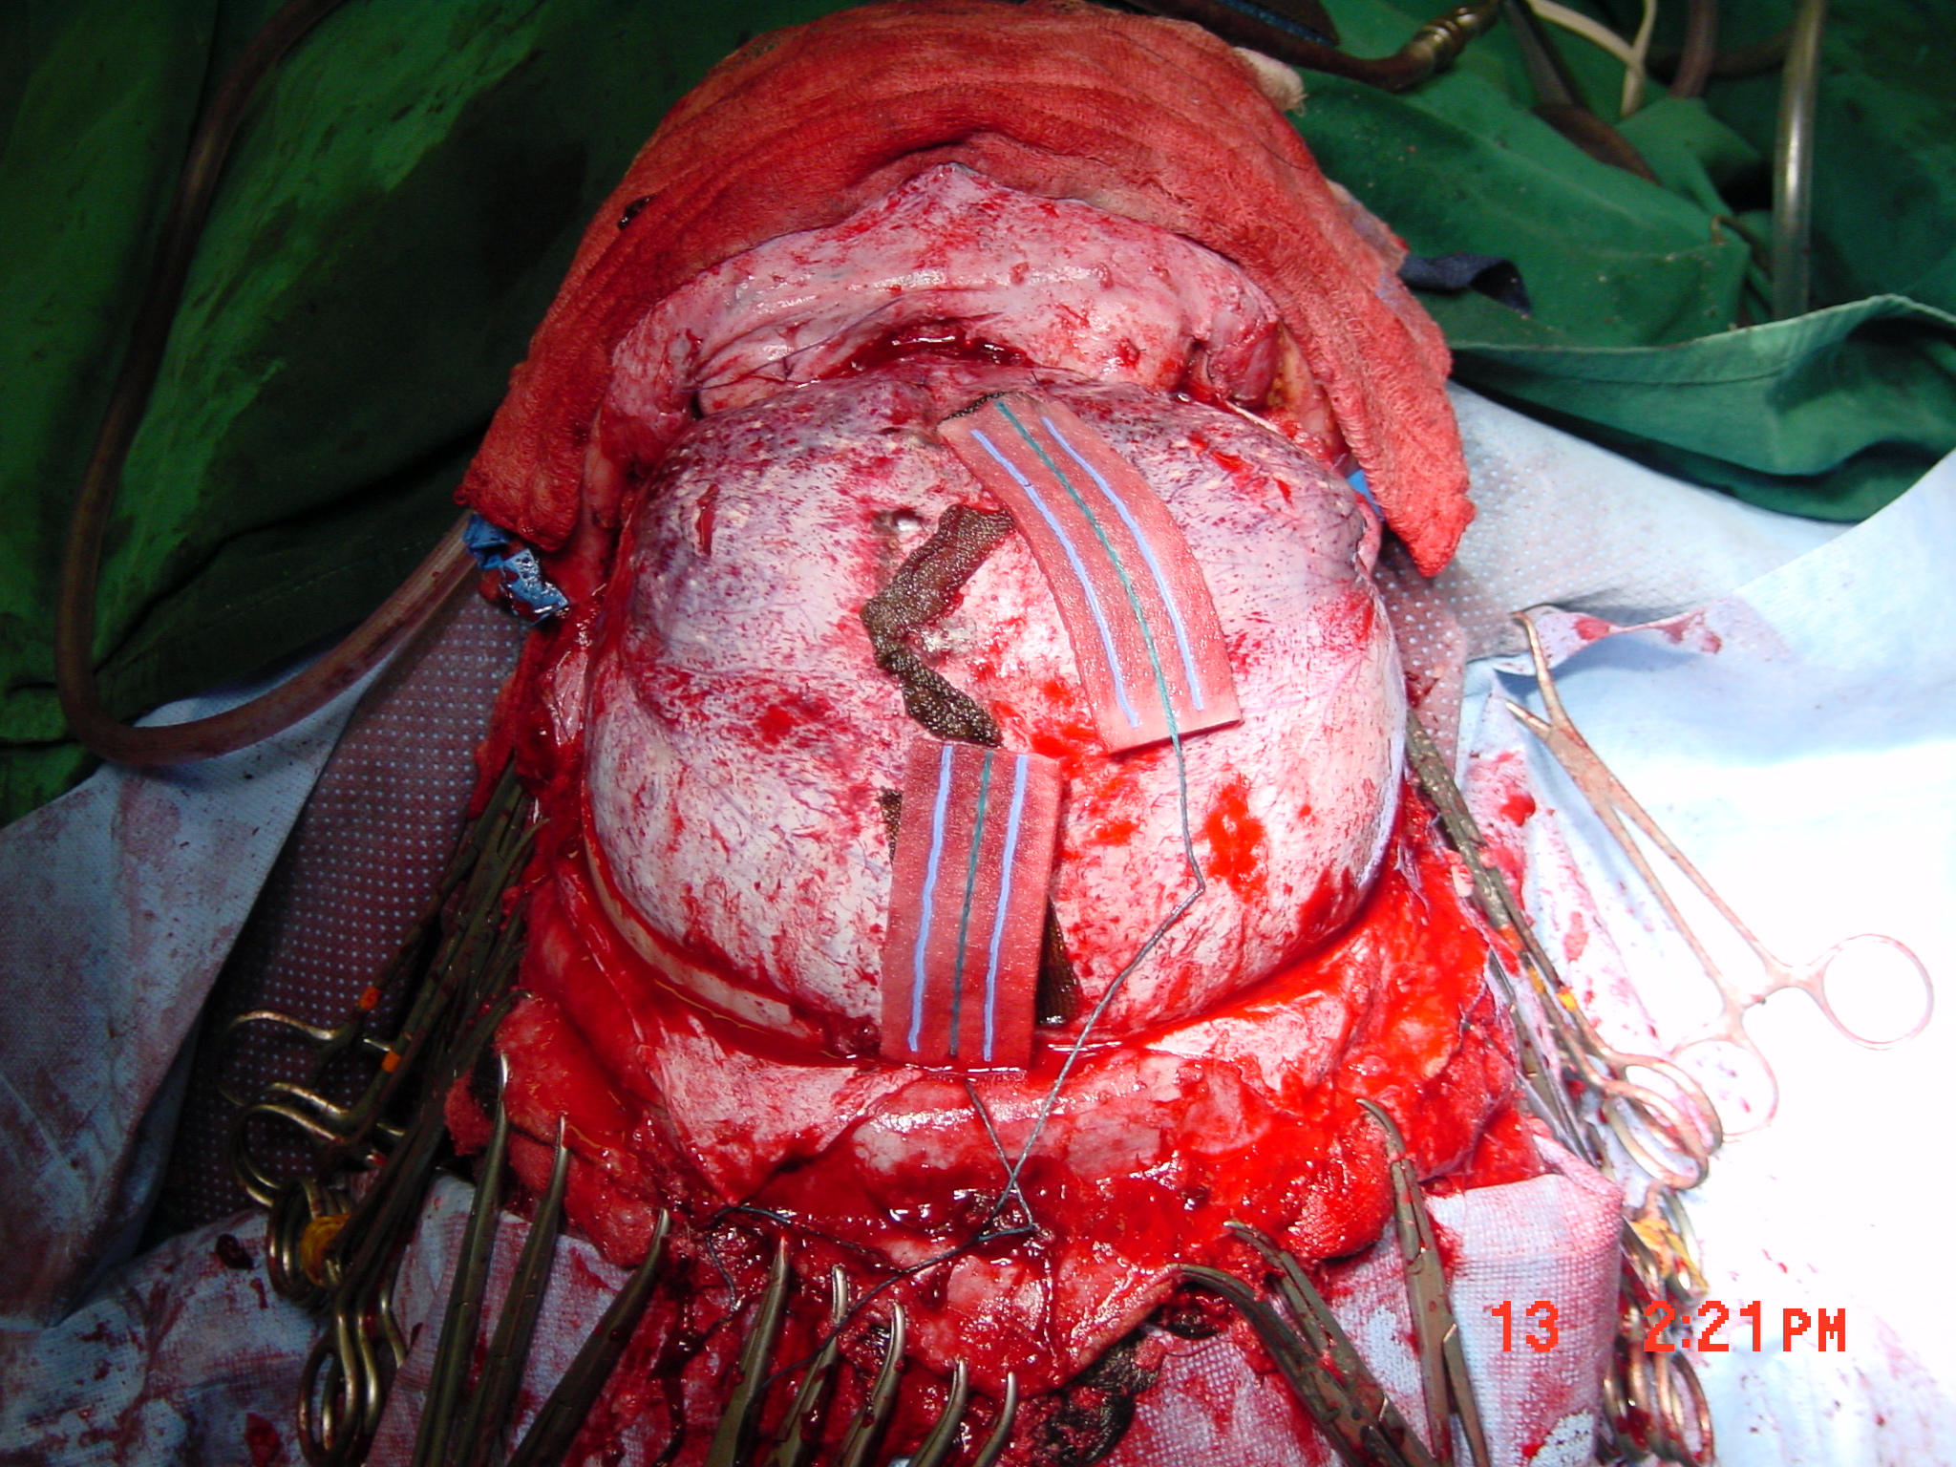

Slide 100
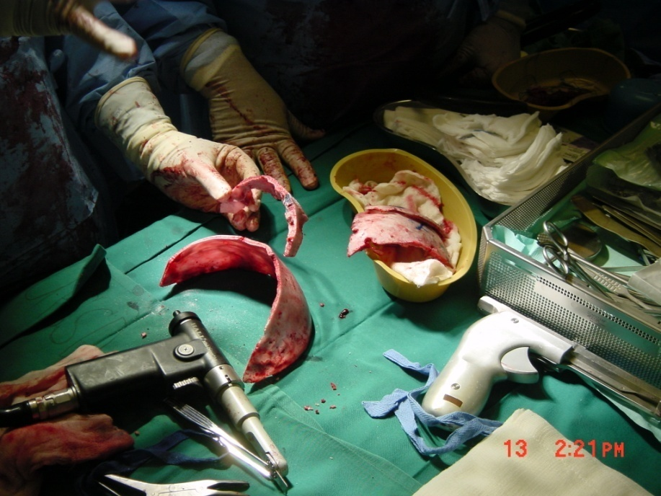
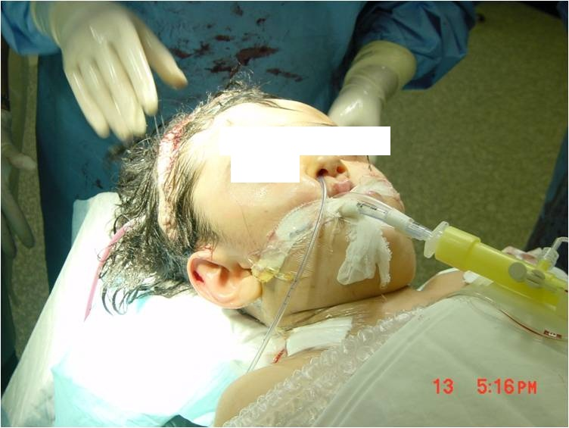

Slide 101
Pre-donation or pre-deposit
Pre-donation of patient’s own blood prior to elective surgery
1 unit donated every 4 days (up to 3 units)
Last unit donated at least 72 hrs prior to surgery
Reduces chance of hemolytic reactions and transmission of blood-bourne diseases
Not desirable for compromised patients

Slide 102
Intra-operative acute normovolemic hemodilution
1-1.5L can be collected with volume replacement
-Blood stored in OR
-Re-infused during or after surgery
-Cheaper than pre-deposit
-Little risk of clerical error
-Suitable for elective surgery

Slide 103
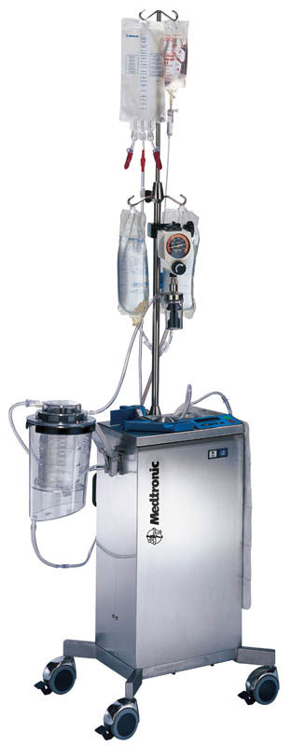
Intra-operative cell salvage
Commonly known as “Cell-saver”
Allows collection of blood during surgery for re-administration
Shed blood is collected from surgical field
-Heparin added
RBC’s washed with saline and concentrated by centrifugation.
Effective when > 1000ml are collected

Slide 104
Intra-operative cell salvage
Large volume could be used
-Platelets and clotting factors are consumed
-Suitable for cardiac surgery
-Contraindicated in contaminated surgical field

Slide 105
Blood Substitutes
  Experimental oxygen-carrying solutions: developed to decrease dependence on human blood products
  Military battlefield usage initial goal
  Multiple approaches:
    Outdated human Hgb reconstituted in solution
    Genetically engineered/bovine Hgb in solution
    Liposome-encapsulated Hgb
    Perflurocarbons

Slide 106
Blood Substitutes (cont.)
Potential Advantages:
  No cross-match requirements
  Long-term shelf storage
  No blood-bourne transmission
  Rapid restoration of oxygen delivery in traumatized patients
  Easy access to product (available on ambulances, field hospitals, hospital ships)

Slide 107
Blood Substitutes (cont.)
Potential Disadvantages:
  - Undesirable hemodynamic effects:
    Mean arterial pressure and pulmonary artery pressure increases
  Short half-life in bloodstream (24 hrs)
  Still in clinical trials, unproven efficacy
  High cost

Slide 108
Transfusion Therapy Summary
Decision to transfuse involves many factors
Availability of component factors allows treatment of specific deficiency
Risks of transfusion must be understood and explained to patients
Vigilance necessary when transfusing any blood product

Slide 109
Reference book and Journal reference
American Society of Anesthesiologists Task Force on Perioperative Blood Transfusion and Adjuvant Therapies. Practice guidelines for perioperative blood transfusion and adjuvant therapies. http://www.asahq.org/publicationsAndServices/practiceparam.htm#blood.

Slide 110
Thank You ☺
Dr.
Date:

