Slide 1

Lecture Title:
Transfusion of blood and Blood products
Lecturer name: Dr. Mansoor Aqil
Lecture Date: 24.1.2017

Slide 2
Transfusion Therapy
  - 60% of transfusions occur perioperatively.
  Responsibility of transfusing perioperatively is with the anesthesiologist.

Slide 3
Objective
Indication of blood transfusion
Blood groups
Blood component
Blood transfusion complication & treatment
Alternatives to Blood Products

Slide 4
Blood Transfusion
Up to 30% of blood volume loss can be treated with crystalloids

Slide 5
Blood Transfusion
Why?
Increase oxygen carrying capacity
Restoration of red cell mass
Correction of bleeding caused by platelet dysfunction
Correction of bleeding caused by factor deficiencies

Slide 6
When is Transfusion Necessary?
“Transfusion Trigger”: Hgb level at which transfusion should be given.
  - Varies with patients and procedures
Tolerance of acute anemia depends on:
  - Maintenance of intravascular volume
  - Ability to increase cardiac output
  - Increases in 2,3-DPG to deliver more of the carried oxygen to tissues

Slide 7
Oxygen Delivery
Oxygen Delivery (DO₂) is the oxygen that is delivered to the tissues
DO₂= CO x CaO₂
Cardiac Output (CO) = HR x SV
Oxygen Content (CaO₂):
  - (Hgb x 1.34)O₂ saturation + PaO₂(0.003)
  Hgb is the main determinant of oxygen content in the blood
Hb = 14 gm /dl | Hb= 10 gm/dl | Hb= 7 gm/dl
14x 1.34x 0.99+ (100X0.003 | 10 X 1.34 x0.99 +(100X 0.003) | 7 X 1.34 x0.99 + (100X0.003)
18.87 ml/dl | 13.56 ml/dl | 9.58 ml/dl

Slide 8
Oxygen Delivery (cont.)
Therefore: DO₂ = HR x SV x CaO₂
If HR or SV are unable to compensate, Hgb is the major determinant factor in O₂ delivery
Healthy patients can tolerate Hgb levels of 7 gm/dL.
Compromised patients may require Hgb levels above 10 gm/dL.

Slide 9
Blood Groups
Antigen on Plasma Incidence
Blood Group erythrocyte Antibodies White African-
Americans
A A Anti-B 40% 27%
B B Anti-A 11 20
AB AB None 4 4
O None Anti-A 45 49
Anti-B
Rh Rh 42 17

Slide 10
Cross Match
Major:
  - Donor’s erythrocytes incubated with recipients serum
Minor:
  - Donor’s serum incubated with recipients erythrocytes
Agglutination:
  - Occurs if either is incompatible
Type Specific:
  - Only ABO-Rh determined; chance of hemolytic reaction is 1:10,000 with TS blood

Slide 11
Type and Screen
Donated blood that has been tested for ABO/Rh antigens and screened for common antibodies (not mixed with recipient blood).
  - Used when usage of blood is unlikely, but needs to be available (hysterectomy).
  - Allows blood to available for other patients.
  - Chance of hemolytic reaction: 1:10,000.

Slide 12
Component Therapy
A unit of whole blood is divided into components; Allows prolonged storage and specific treatment of underlying problem with increased efficiency:
    Packed red blood cells (pRBC’s)
    Platelet concentrate
    Fresh frozen plasma (contains all clotting factors)
    Cryoprecipitate (contains factors VIII and fibrinogen; used in Von Willebrand’s disease)
    Albumin
    Plasma protein fraction
    Leukocyte poor blood
    Factor VIII
    Antibody concentrates

Slide 13
Whole Blood
Storage
  4° for up to 35 days
Indications
  Massive Blood Loss/Trauma/Exchange Transfusion
Considerations
  Use filter as platelets and coagulation factors will not be active after 3-5 days
  Donor and recipient must be ABO identical

Slide 14
Packed Red Blood Cells
1 unit = 250 ml. Hct. = 70-80%.
1 unit pRBC’s raises Hgb 1 gm/dL.
Mixed with saline: LR has Calcium which may cause clotting if mixed with pRBC’s.
Do NOT mix with medications

Slide 15
Platelet Concentrate
Storage
Up to 5 days at 20-24°
Indications
  Thrombocytopenia, Plt <15,000
  Bleeding and Plt <50,000
  Invasive procedure and Plt <50,000

Slide 16
Platelet Concentrate
Considerations
  Contain Leukocytes and cytokines
  1 unit/10 kg of body weight increases PLT count by 50,000
  Donor and Recipient must be ABO identical
  Risks:
  - Sensitization due to HLA on platelets
  - Viral transmission

Slide 17
Fresh Frozen Plasma
Plasma from whole blood frozen within 6 hours of collection.
  Contains coagulation factors (1 unit/ml)
  Indications:
  Used when PT and PTT are >1.5 normal
  Coagulation Factor deficiency, fibrinogen replacement, DIC, liver disease, exchange transfusion, massive transfusion
  Reversal of Coumadin effect, TTP, etc.

Slide 18
Fresh Frozen Plasma (FFP)
Storage
  FFP– for 12 months at (– 25 degree C) or colder
Considerations
  Plasma should be recipient ABO compatible
  In children, should also be Rh compatible
  Usual dose is 20 cc/kg to raise coagulation factors approx 20%

Slide 19
Blood transfusion complication
Hemolytic transfusion reaction
  Acute
  Delayed
Disseminated intravascular coagulation
Physical
  Circulatory overload
  Embolism (air, micro aggregate)
  Hypothermia
Immunological
Pyrogenic
Type 1 Hypersensitivity (Anaphylactic reaction)
Graft versus host reactions
Biochemical
  Acid base disturbances
  Hyperkalaemia
  Citrate toxicity
  Impaired oxygen release
Infective

Slide 20
Cryoprecipitate
Rich in fibrinogen and Factor VIII and III
Dose 10-20 ml/kg
Or
0.2 X wt. in Kg
Will increase fibrinogen level by 1 gm/L

Slide 21
Transfusion Reactions
    Hemolytic Reactions (Acute or delayed )
Febrile Reactions (FNHTR)
Allergic Reactions
TRALI
Coagulopathy with Massive transfusions
Bacteremia

Slide 22
Complications of Blood Therapy (cont.)
Hemolytic:
  Wrong blood type administered (oops).
  Activation of complement system leads to intravascular hemolysis, spontaneous hemorrhage.

Slide 23
Hemolytic Reaction:
Signs: hypotension, fever, chills, dyspnea, skin flushing, substernal pain.
Signs are easily masked by general anesthesia.
Free Hgb in plasma or urine
Acute renal failure
Disseminated Intravascular Coagulation (DIC)

Slide 24
What to do?
If an AHTR occurs
STOP TRANSFUSION
ABC’s
Maintain IV access and run IVF (NS or LR)
Monitor and maintain BP/pulse
Give diuretic
Obtain blood and urine for transfusion reaction workup
Send remaining blood back to Blood Bank

Slide 25
Blood Bank Work-up of AHTR
Check paperwork to assure no errors
Check plasma for free hemoglobin
Repeat crossmatch
Repeat Blood group typing
Blood culture

Slide 26
Monitoring in AHTR
Monitor patient clinical status and vital signs
Monitor renal status (BUN, creatinine)
Monitor coagulation status (DIC panel– PT/PTT, fibrinogen, D-dimer/FDP, Plt, Anti-thrombin-III)
Monitor for signs of hemolysis (LDH, bili, haptoglobin)

Slide 27
Other Complications
  Decreased 2,3-DPG with storage: ? Significance
  Citrate: metabolism to bicarbonate; Calcium binding
  Microaggregates (platelets, leukocytes): micropore filters controversial
  Hypothermia: warmers used to prevent
  Coagulation disorders: massive transfusion (>10 units) may lead to dilution of platelets and factor V and VIII.
  DIC: uncontrolled activation of coagulation system

Slide 28
Complications (cont.)
Transmission of Viral Diseases:
  Hepatitis C; 1:30,000 per unit
  Hepatitis B; 1:200,000 per unit
  HIV; 1:450,000-1:600,000 per unit
  22 day window for HIV infection and test detection
  CMV may be the most common agent transmitted, but only effects immuno-compromised patients
  Parasitic and bacterial transmission very low

Slide 29
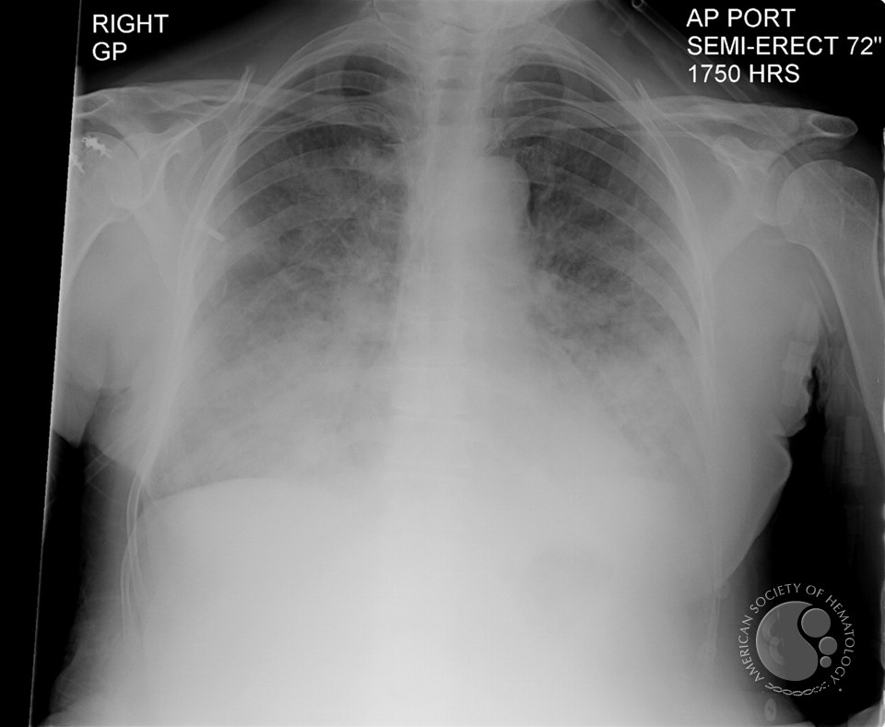
TRANSFUSION RELATED ACUTE LUNG INJURY
Absence of cardiac failure or intravascular volume overload
Transfused leuko-agglutinating antibodies bind to recipients' neutrophils localized to pulmonary endothelium resulting in activation and release of oxidases and other damaging modifiers that cause capillary leak

Slide 30
Administering Blood Products
  Consent necessary for elective transfusion
  Unit is checked by 2 people for Unit #, patient ID, expiration date, physical appearance.
  pRBC’s are mixed with saline solution (not LR)
  Products are warmed mechanically and given slowly if condition permits
  Close observation of patient for signs of complications
  If complications suspected, infusion discontinued, blood bank notified, proper steps taken.

Slide 31
Blood volume formula
Neonate - 90 ml/kg
Infants 2 years ago - 80ml/kg
Adult male - 70ml/kg
Adult female - 60ml/kg

Slide 32
Massive blood transfusion
  The replacement of patients blood volume by stored bank blood in less than 24 hours

Slide 33
Massive blood transfusion
Basic screening test after six-unit transfusion
  Hemoglobin and platelets count
  Coagulation profile (PT & APTT)
  Plasma fibrinogen concentration
  Fibrin degradation products
  pH from arterial blood gas analysis
  Plasma Electrolyte

Slide 34
Massive Blood Transfusion complications
Coagulopathy due to dilutional thrombocytopenia. And dilution of the coagulation factors
Citrate Toxicity does not occur in most normal patients unless the transfusion rate exceeds 1 U every 5 min
Hypothermia
Acid–Base Balance The most consistent acid–base abnormality after massive blood transfusion is postoperative metabolic alkalosis

Slide 35
Massive Blood Transfusioncomplications
Serum Potassium Concentration
The extracellular concentration of potassium in stored blood steadily increases with time.
The amount of extra-cellular potassium transfused with each unit less than 4 mEq per unit.
Hyperkalemia can develop regardless of the age of the blood when transfusion rates exceed 100 mL/min.

Slide 36
Massive blood transfusion
Diagnosis of DIC
  Increase APTT , PT , fibrin degradation product
  Decrease platelet count , fibrinogen concentration
Treatment
  4 units of FFP
  6-8 units of platelets
  Cryoprecipitate if fibrinogen level less than 1 g/l
  PH less than 7.2 administrate 50 mmol bicarbonate
  Recombinant activated factor VIIa if bleeding continue in spite of use FFP platelets and cryoprecipatate

Slide 37
Thromboelastography
Leading cause of death results from trauma.
Hemorrhage is responsible for 30% to 40% of trauma mortality
On admission, 25% to 35% of trauma patients present with coagulopathy, which is associated with a sevenfold increase in morbidity and mortality.
The literature supports that routine plasma based routine coagulation tests, such as prothrombin time, activated partial thromboplastin time, and international normalized ratio, are inadequate for monitoring coagulopathy and guided transfusion therapy in trauma patients.

Slide 38
Thromboelastography
TEG® assesses both thrombosis and fibrinolysis.
Conventional tests are performed in plasma without platelets and tissue bearing cells (the cellular component) while TEG® is done in whole blood.

Slide 39
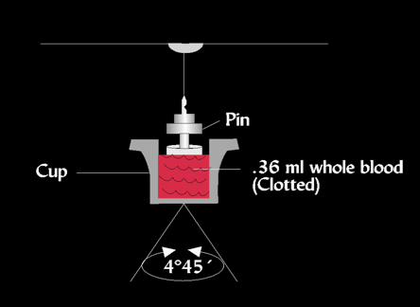
Thromboelastography

Slide 40
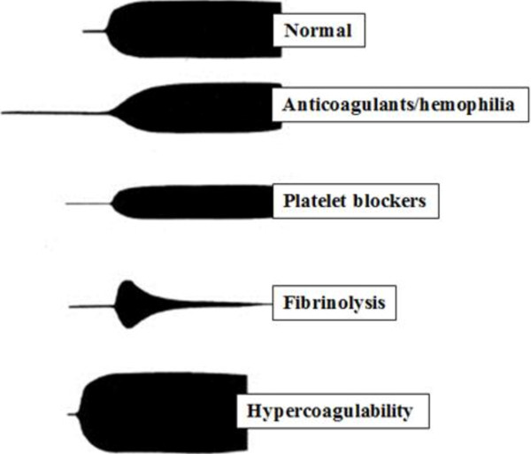
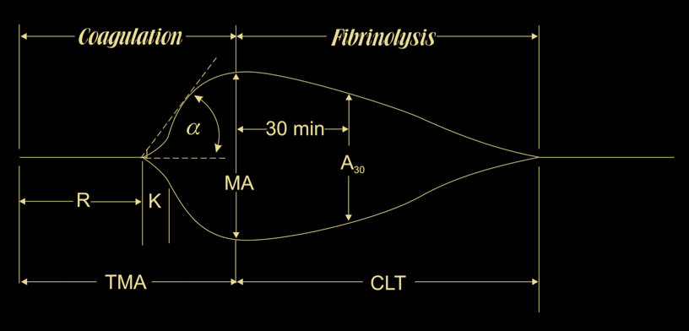
Thromboelastography

Slide 41
Thromboelastography
It measures viscoelastic changes of entire clotting process,
  Its formation,
  First fibrin strands,
  Evaluates clot formation strength
  Platelet function
  Until clot lysis
There is growing interest in its clinical use in trauma resuscitation, particularly for managing acute coagulopathy of trauma and assisting decision making concerning transfusion.

Slide 42
Alternatives to Blood Products
Autotransfusion
Blood substitutes

Slide 43
Auto-transfusion
Techniques:
Pre-deposit transfusion
Intra-operative acute normovolemic hemodilution
Intra-operative cell salvage

Slide 44
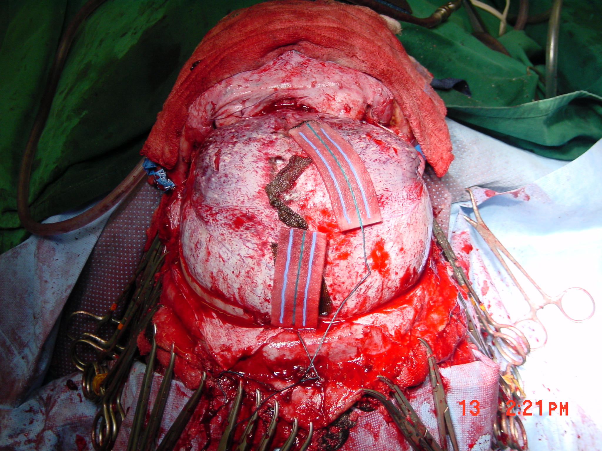

Slide 45
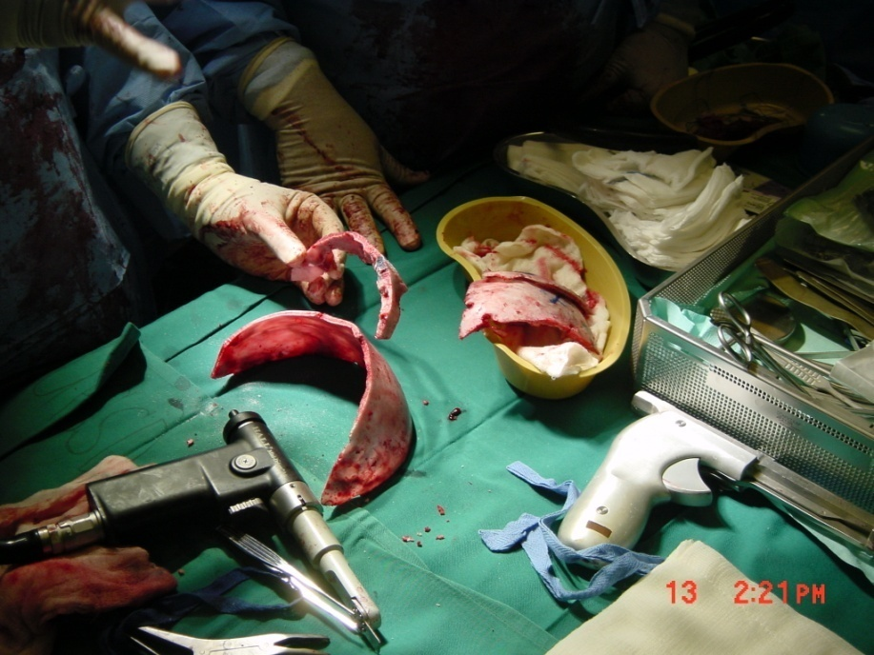
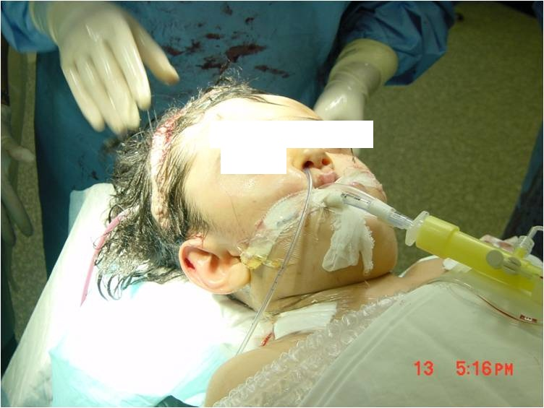

Slide 46
Pre-donation or pre-deposit
Pre-donation of patient’s own blood prior to elective surgery
1 unit donated every 4 days (up to 3 units)
Last unit donated at least 72 hrs prior to surgery
Reduces chance of hemolytic reactions and transmission of blood-bourne diseases
Not desirable for compromised patients

Slide 47
Intra-operative acute normovolemic hemodilution
1-1.5L can be collected with volume replacement
-Blood stored in OR
-Re-infused during or after surgery
-Cheaper than pre-deposit
-Little risk of clerical error
-Suitable for elective surgery

Slide 48
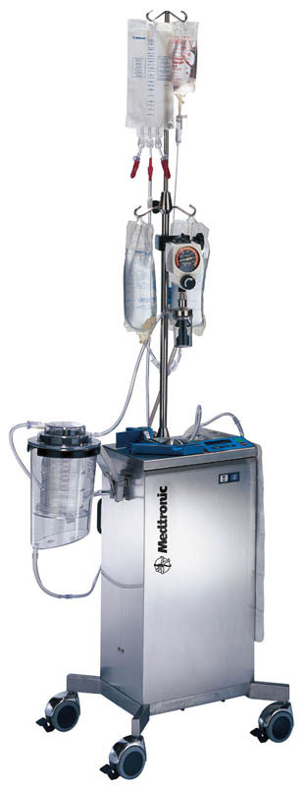
Intra-operative cell salvage
Commonly known as “Cell-saver”
Allows collection of blood during surgery for re-administration
Shed blood is collected from surgical field
-Heparin added
RBC’s washed with saline and concentrated by centrifugation.
Effective when > 1000ml are collected

Slide 49
Intra-operative cell salvage
Large volume could be used
-Platelets and clotting factors are consumed
-Suitable for cardiac surgery
-Contraindicated in contaminated surgical field

Slide 50
Blood Substitutes
  Experimental oxygen-carrying solutions: developed to decrease dependence on human blood products
  Military battlefield usage initial goal
  Multiple approaches:
    Outdated human Hgb reconstituted in solution
    Genetically engineered/bovine Hgb in solution
    Liposome-encapsulated Hgb
    Perflurocarbons

Slide 51
Blood Substitutes (cont.)
Potential Advantages:
  No cross-match requirements
  Long-term shelf storage
  No blood-bourne transmission
  Rapid restoration of oxygen delivery in traumatized patients
  Easy access to product (available on ambulances, field hospitals, hospital ships)

Slide 52
Blood Substitutes (cont.)
Potential Disadvantages:
  - Undesirable hemodynamic effects:
    Mean arterial pressure and pulmonary artery pressure increases
  Short half-life in bloodstream (24 hrs)
  Still in clinical trials, unproven efficacy
  High cost

Slide 53
Transfusion Therapy Summary
Decision to transfuse involves many factors
Availability of component factors allows treatment of specific deficiency
Risks of transfusion must be understood and explained to patients
Vigilance necessary when transfusing any blood product

Slide 54
Reference book and Journal reference
American Society of Anesthesiologists Task Force on Perioperative Blood Transfusion and Adjuvant Therapies. Practice guidelines for perioperative blood transfusion and adjuvant therapies. http://www.asahq.org/publicationsAndServices/practiceparam.htm#blood.

Slide 55
Thank You ☺
Dr.
Date:

