Slide 1
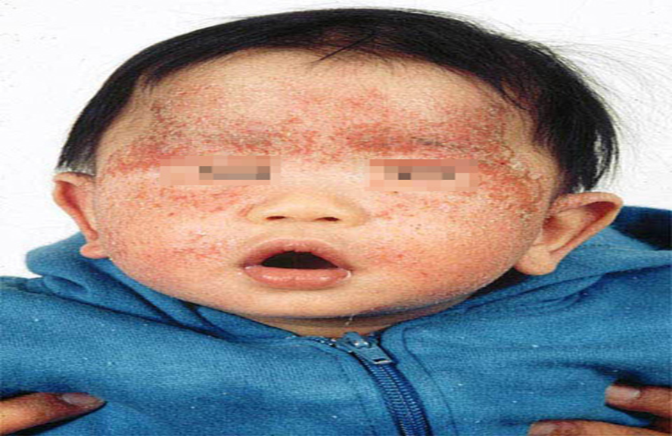
Dermatitis (eczema and related disorder).
Dr. Eman Almukhadeb
Assistant professor & Consultant dermatologist , KSU

Slide 2
Objectives :
To know the definition & classification of Dermatitis/Eczema
To recognize the primary presentation of different types of eczema
To understand the possible pathogenesis of each type of eczema
-To know the scheme of managements lines

Slide 3
Dermatitis
Atopic
Seborrheic
Contact
  Allergic
  Irritant
Nummular
Asteatotic
Stasis
Dyshidrotic eczema.
Neurodermatitis/Lichen Simplex Chronicus

Slide 4
Hypersensitivity Reaction
Type 1: Immediate Hypersensitivity Reaction
  Mediated by IgE to specific antigens
    Mast cells stimulated and release histamine
  Reaction within 15-30 minutes of exposure
  Examples: Anaphylaxis (e.g.penicillin) ,Urticaria , Angioedema .
Type 2: Cytotoxic Antibody mediated Reaction
  Mediated by IgG and IgM to specific antigens
  Examples: Transfusion Reaction ,Rhesus Incompatibility (Rh Incompatibility), Hashimoto‘ thyroiditis.

Slide 5
Cont…
Type 3: Immune Complex Reaction
  Antigen-Antibody complexes deposit in tissue
  Reaction within 1-3 weeks after exposure
  SLE, serum sickness , vasculitis:Examples
Type 4: Delayed-Type Hypersensitivity
  Mediated by T-Lymphocytes to specific antigens
    Reaction within 2-7 days after exposure
  Examples: Allergic contact dermatitis (e.g. Nickel allergy)

Slide 6
Eczema (Dermatitis)
Definition:
is an inflammatory skin disease.
Skin inflammation characterized by:
-itchy, scaly, patches of erythema
Pathogenesis:
It is an epidermal reaction to specific Antigens; these antigens may be internal or external, acting singularly or in combination

Slide 7
Clinical picture:
Most eczemas share certain general features, and each different type of eczema will have some distinguishing markers of their own. Eczema can be broadly classified as acute, subacute, and chronic

Slide 8
Clinical picture (cont….)
- Acute:
-eryhema
- papules & vesicles
- oozing
-Subacute:
- scales
- Excoriation
-Chronic:
-lichenificaion & hyperkeratosis
Clinically an eczematous disease may start at any stage and evolve into another

Slide 9
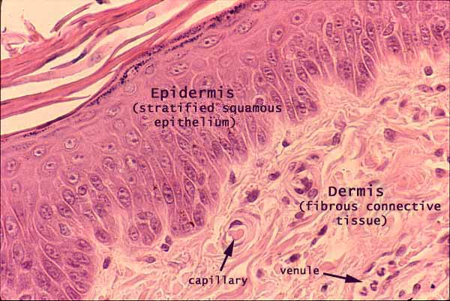
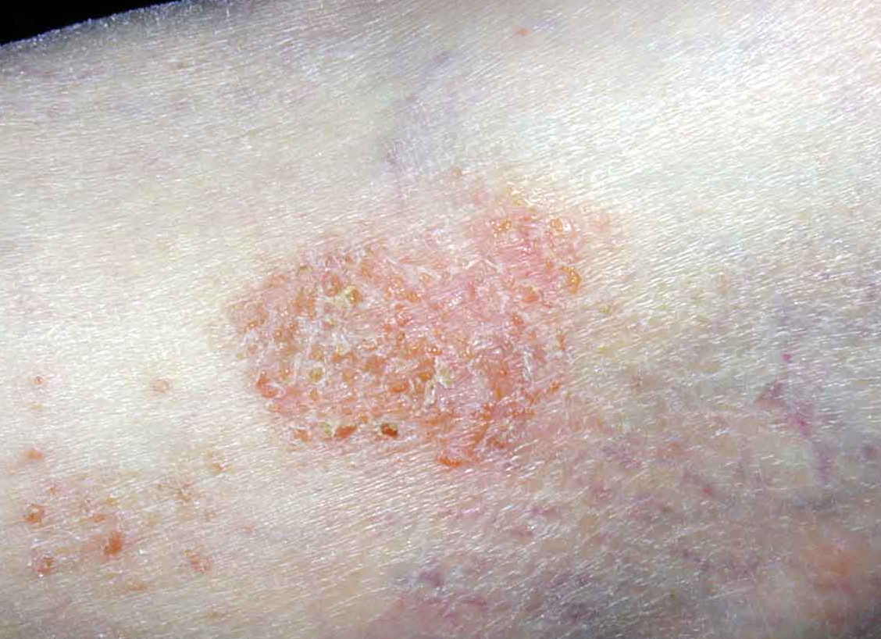
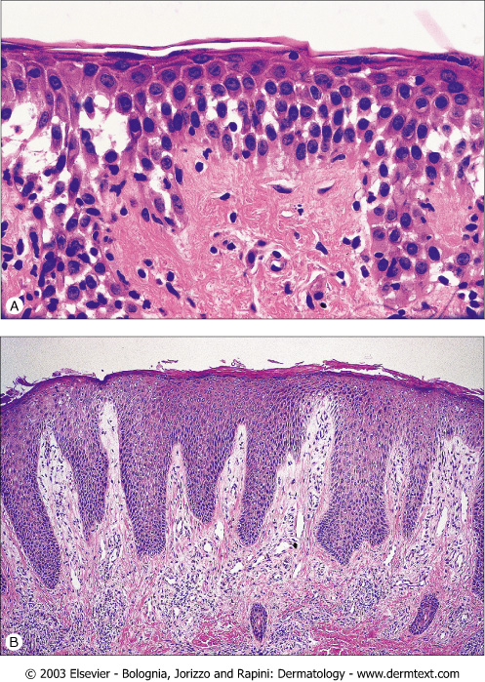
Dermatitis
Dermatitis=“Eczema”=Spongiosis

Slide 10
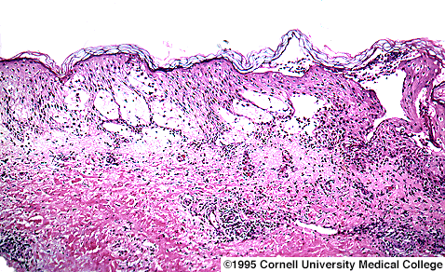
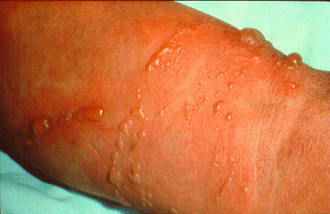
Acute Dermatitis

Slide 11
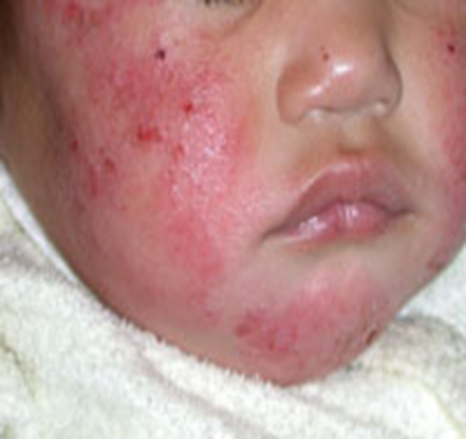
erythema and edema
papules, vesicles, and sometimes bullae accompanied by exudation and crusting

Slide 12
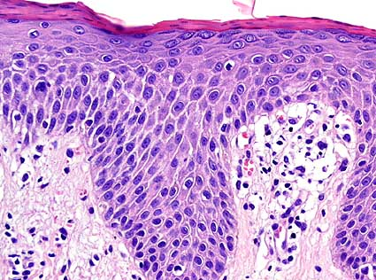
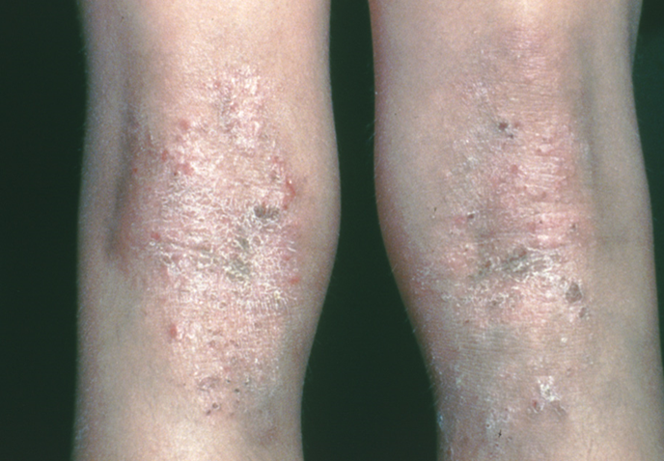
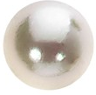
Subacute Dermatitis
Commonly misdiagnosed as tinea

Slide 13
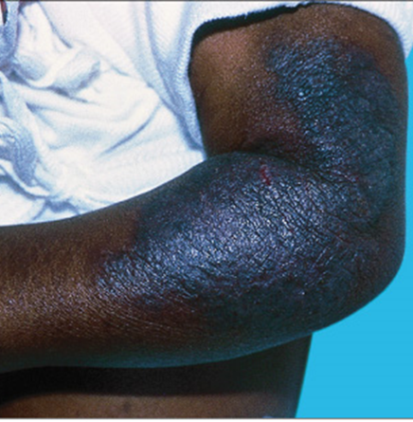
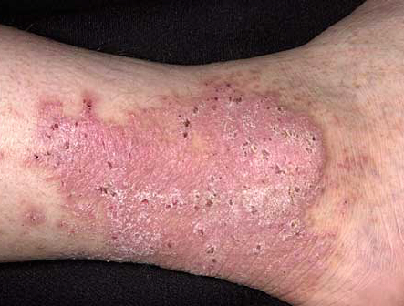
Chronic Dermatitis
Commonly misdiagnosed as psoriasis

Slide 14
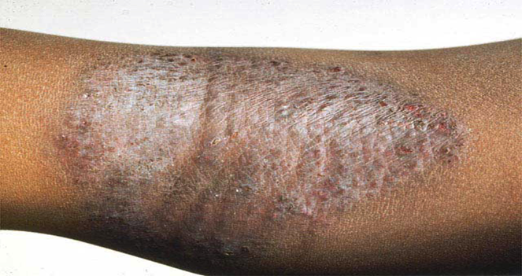
less erythema and edema
presence of lichenification, scaling,
and fissuring

Slide 15
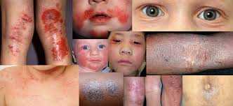
Atopic dermatitis

Slide 16
Atopic Dermatitis
chronic relapsing itchy skin disease in genetically predisposed patients
associated with personal or family history of asthma, allergic rhinitis, conjunctivitis
or atopic eczema

Slide 17
Affects 15-30% of children, 2-10% of adult
60% begin during the first year
85% begin before 5 years
Up to 70%: spontaneous remission before adolescence

Slide 18
Pathogenesis:
-Genetic pedisposition
-immune mediated (increase IgE), T-helper cell2 activation
-Impaired skin barrier.
■ defective epidermal differentiation (filaggrin mutations) and resultant impaired barrier function of the skin
- Allergy, increased tendency to certain allergens
- Infection : skin of pts with AD is colonized by S aureus. infection with S aureus often causes a flare of AD
- AD and Food! minor role

Slide 19
AD associated with local infiltration of Th 2 that secrete IL-4, IL-5, IL-13, IL-31
More than 50% develop asthma
75% develop Allergic Rhinitis
Complex interrelationship of genetic, environmental, and immunologic.

Slide 20
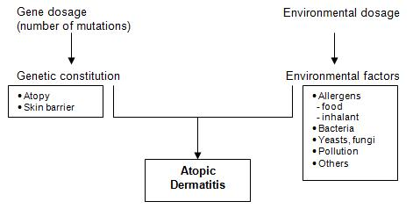
No single etiology
=
No “magic bullet” cure

Slide 21
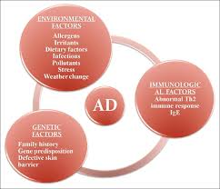

Slide 22
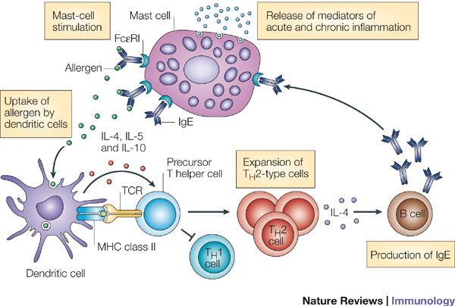
Allergens are taken up by dendritic cells and presented to T cells. In the absence of childhood microbial exposure, the balance between T helper 1 (TH1) and TH2 cells is altered. TH2 cells encourage the production of immunoglobulin E (IgE) by B cells. Allergen-specific IgE then binds to the high-affinity receptor for IgE (FcepsilonRI) on mast cells. Allergen exposure induces crosslinking of receptor-bound IgE with subsequent mast-cell degranulation and the release of pro-inflammatory molecules.
IL, interleukin; TCR, T-cell receptor.

Slide 23
Clinical picture:
- Acute:
-eryhema
- papules & vesicles
- oozing
-Subacute:
- scales
- Excoriation
-Chronic:
-lichenificaion & hyperkeratosis

Slide 24
Three stages:
-Infantile
-Childhood
-Adulthood
-Acute inflammation & extensor/facial involvement is more common in infant whereas chronic inflammation increase in prevalance with age as does localization to flexures.

Slide 25
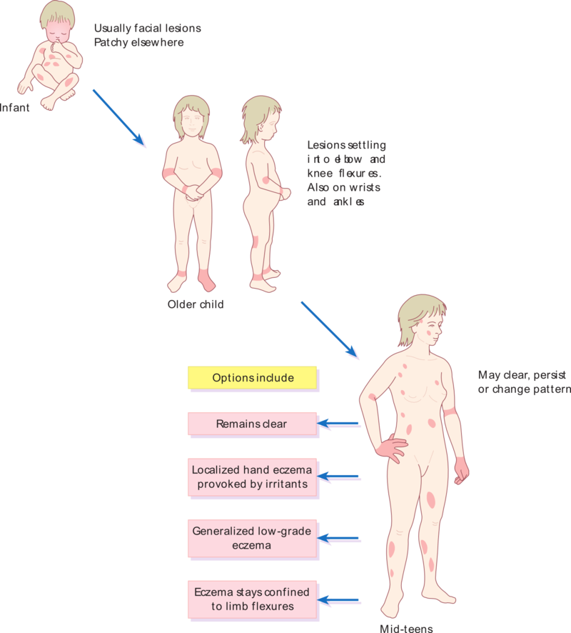
Pattern of atopic eczema varies with age

Slide 26
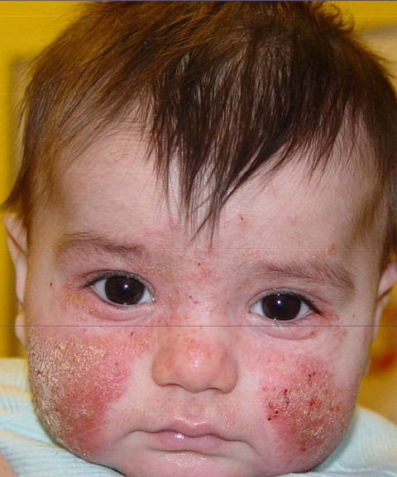
Infantile atopic
dermatitis
Infants develop an itchy
vesicular eczema on
cheeks and hands
often with secondary
infection.

Slide 27
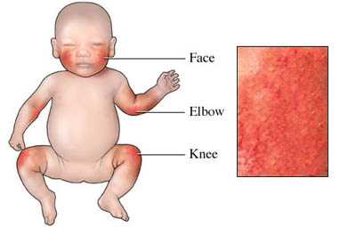
Infantile

Slide 28
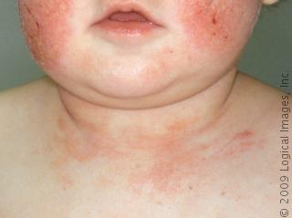

Slide 29
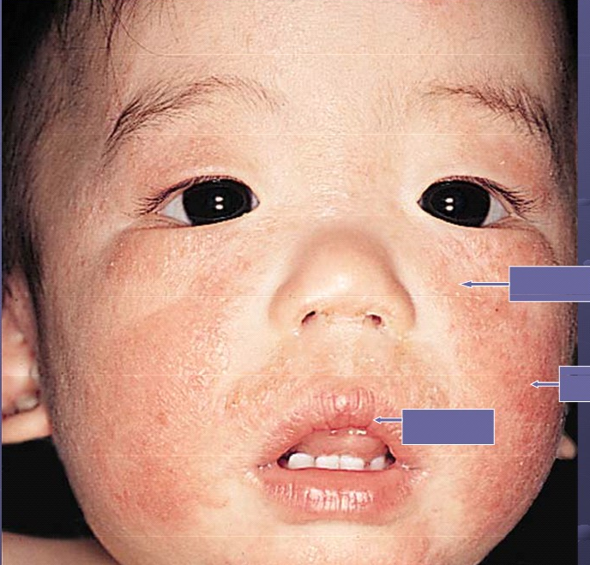
scaling
erythema
fissures

Slide 30
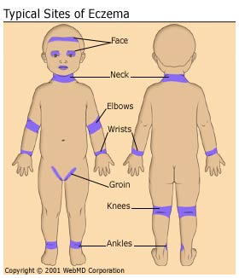
Childhood

Slide 31
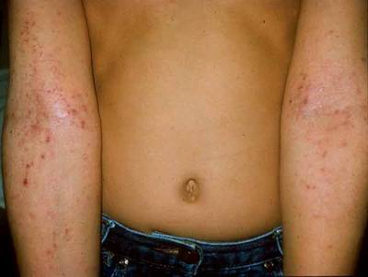

Slide 32
Childhood atopic dermatitis
Children develop lesions at antecubital and popliteal fossae, neck, wrists, and ankles.
Lichenification, excoriations, and dry skin are common as well as post-inflammatory hyperpigmentation

Slide 33
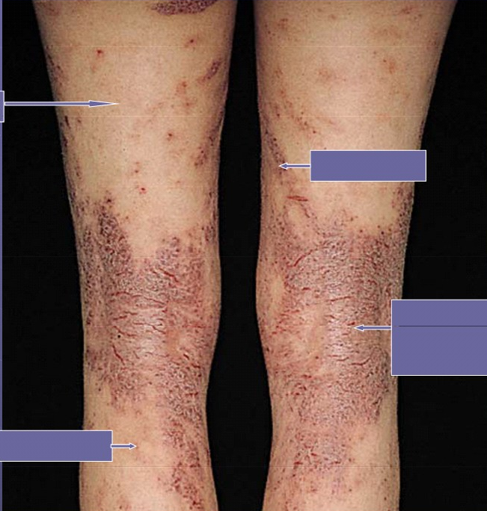
Flexural involvement
xerosis
excoriations
Erythematous
patches,
fissures
hyperpigmentation

Slide 34
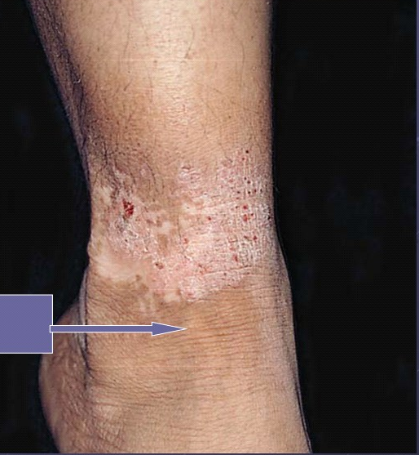
Lichenification
Accentuation of normal skin markings

Slide 35
Adult atopic dermatitis
In adults
most common manifestation: hand dermatitis.
chronic severe form of generalized and lichenified atopic eczema.

Slide 36


Slide 37
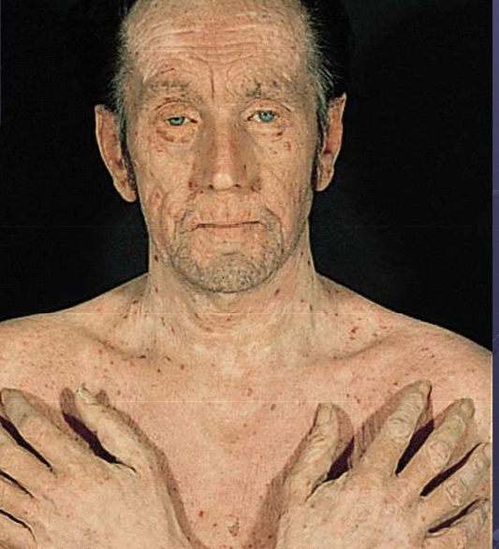
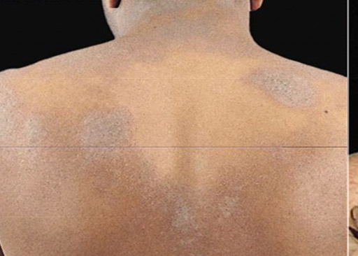
Widespread
chronic atopic
dermatitis

Slide 38
Diagnosis

Slide 39
criteria
Major
1.pruritus
2.typical morhology and distribution
3.chronicity
4.Personal or family history of atopy

Slide 40
Minor criteria
-Xerosis
-Icthyosis/hyperlinear palms/keratosis pilaris.
-IgE reactivity
-Elevated IgE level
-Early onset
-Skin infection
-Chelitis
-Nipple eczema
-Recurrent conjuctivitis
-Keratoconus
-Dennie morgan fold
-Anterior cataract
-Orbital darkening
-Facial erythema
-Pityriasis alba
-Food hypersensitivity
-White dermatographism

Slide 41
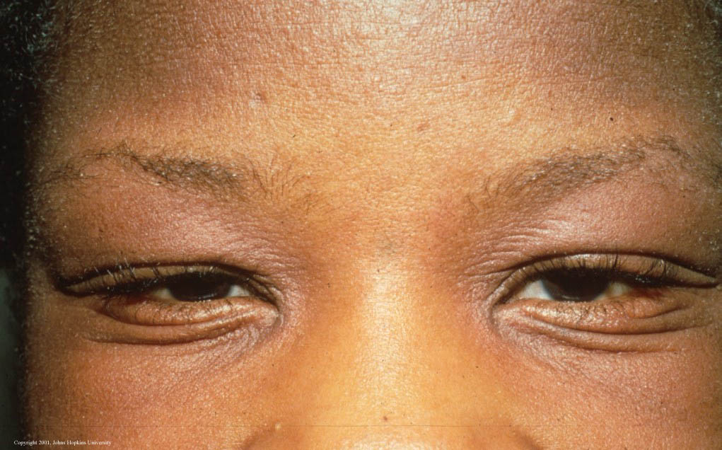
Dennie morgan fold

Slide 42
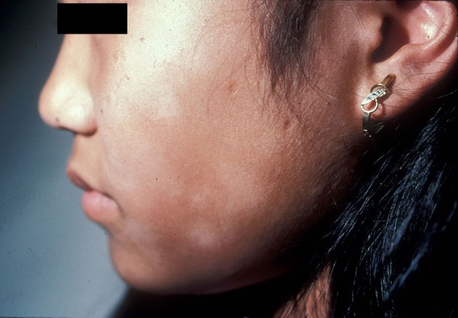
Pityriasis alba

Slide 43
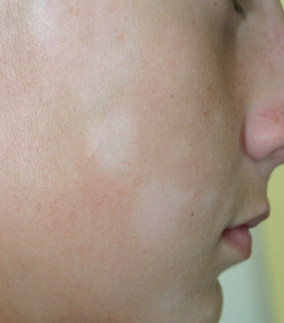
Pityriasis alba

Slide 44
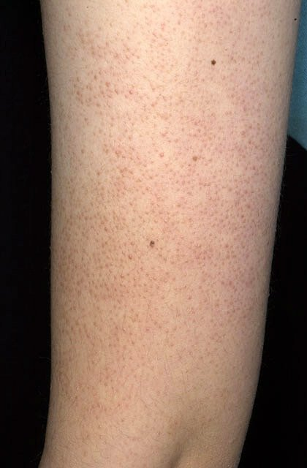
Keratosis pilaris

Slide 45
Complication

Slide 46
Infection:
- Bacterial: Impetigo(STAPH AURIOUS)
- Viral infection: eczema herpeticum )Herpes Simplex Virus)
widespread molluscum
Cataracts
Growth retardation.

Slide 47
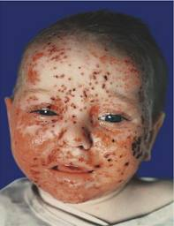
Eczema Herpeticum

Slide 48
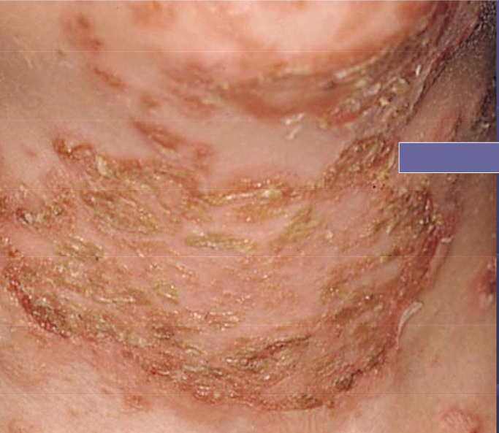
Impetiginised dermatitis
Golden yellow crust

Slide 49
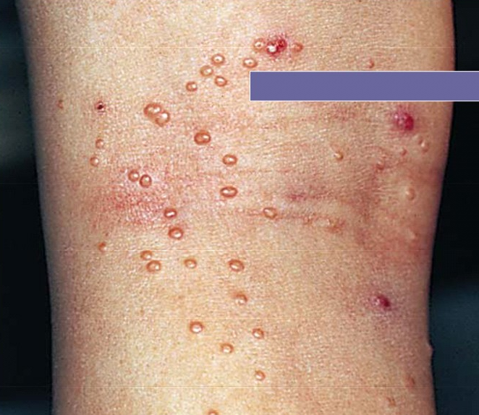
Mollusca Contagiosa
Dome-shaped 1-2mm firm papules

Slide 50
MANAGEMENT

Slide 51
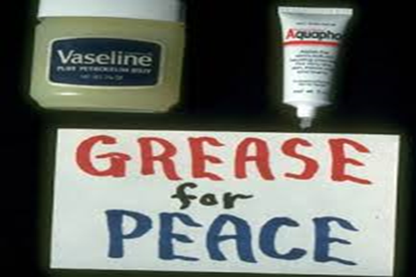
Frame work for Treating Dermatitis
Dry Skin:
  Bathing, soap
  Emollients/barrier repair
Inflammation:
  Topical steroids
  Topical calcineurin inhibitors

Slide 52
Pruritus/Sleep:
  Sedating antihistamines
Infection:
  Contributing factors

Slide 53
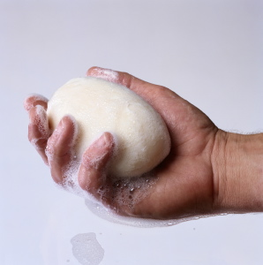
Education :
Avoid alkali soaps
Avoid woolen clothes and wear cotton instead

Slide 54
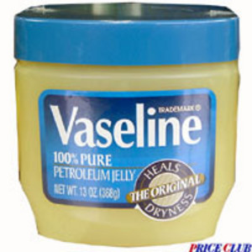
Emollient

Slide 55
Treatment
-Education.
-Emollient.
-topical steroid
-topical immunomodulators (tacrolimus & pimecrolimus)
-oral antihistamine
-oral Antibiotic (for 2ry bacterial infection)
-ultraviolet light
-systemic steroid
-others: cyclosporin , methotrexate ,azathioprine, IVIG , Biologic

Slide 56
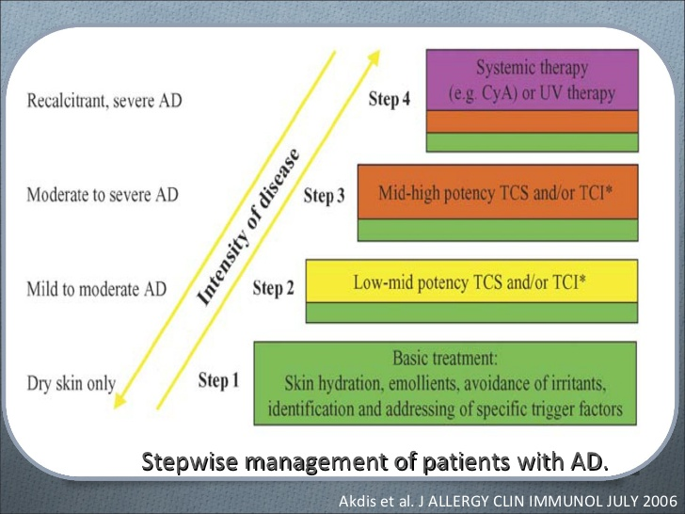

Slide 57
What are the side effects of topical steroid?

Slide 58
Steroid Side Effects Are Rare!
Reversible:
  Telangiectasia/prominent blood vessels
  Epidermal Atrophy/thin skin
  Acne/rosacea
  Increased hair growth
Non-reversible: dermal atrophy

Slide 59
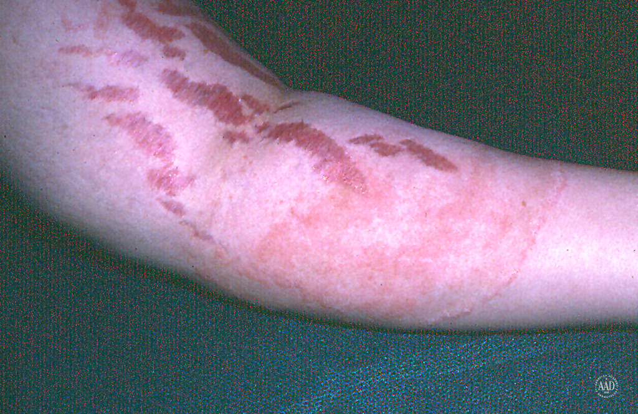
25 y/o male treated for eczema in antecubital fossa with “some cream”

Slide 60
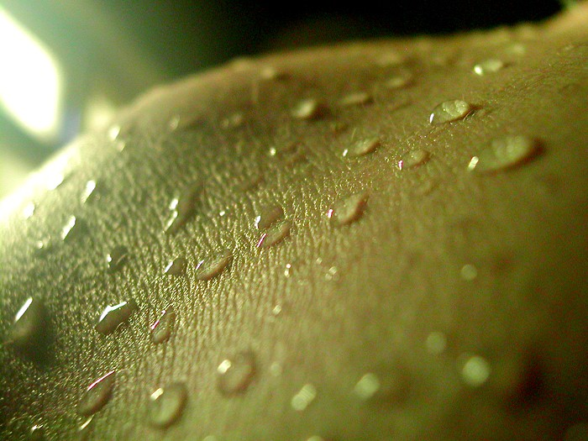

Slide 61
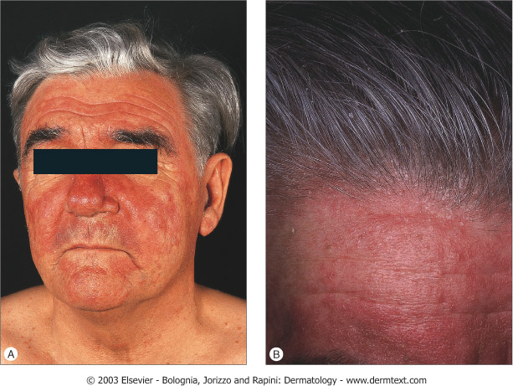
52 y/o male with erythematous, scaly patches of face and scalp

Slide 62
Seborrheic Dermaitis
Is a common mild chronic eczema typically confined to skin regions with high sebum production & the body folds

Slide 63
Pathogenesis
-Seborrhea & abnormal sebum production.
-Commensal yeast Malassezia furfur (pityrosporum ovale)

Slide 64
Clinical Picture:
Seborrheic dermatitis is defined by clinical
parameters which include:
1-erythematous red-yellow , poorly circumscribed patches & thin plaques with bran-like to flaky (greasy) scales.
2-Limitation to those periods of life when sebaceous gland are active i.e. the 1st few months of life & post puberty (infantile & adult forms).

Slide 65
Cont….
3- A predilection for areas rich in sebaceous glands
e.g: scalp , face, ears , presternal region & flexural areas (axillae, inguinal & inframammary folds , umbilicus).
4-A mild course with moderate discomfort.

Slide 66
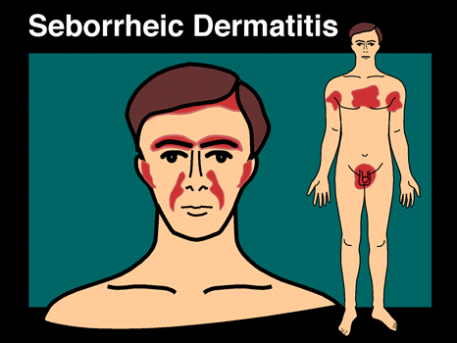
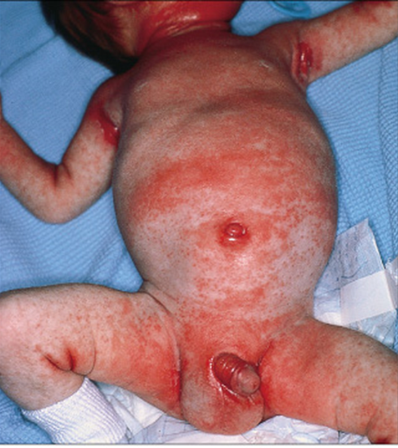

Slide 67
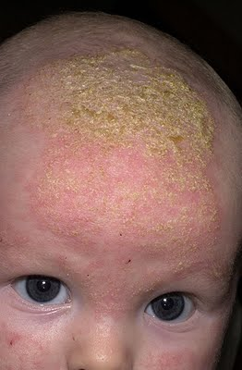
Cradle cap: is coherent scaly & crusty mass covering most of the scalp & can be seen in infanile seborreic dermatitis.

Slide 68
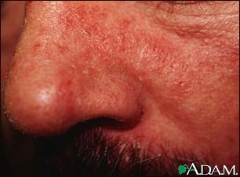

Slide 69
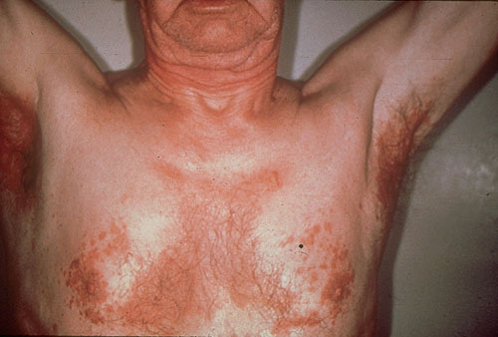

Slide 70
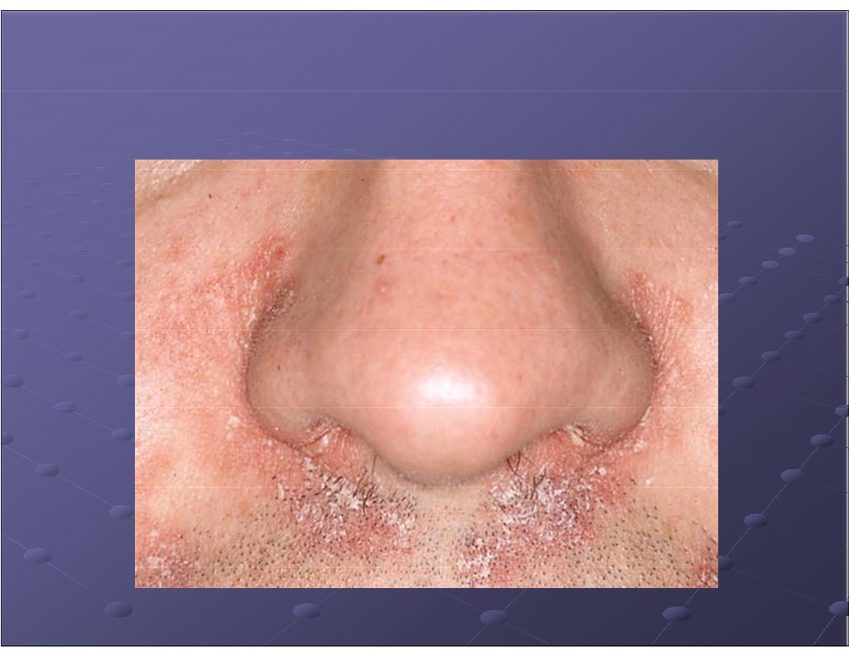
Seborrheic dermatitis

Slide 71
Treatment:
-Medicated shampoo (e.g. containing coal tar,
selenium sulfide or ketoconazole)
-Topical antifungal.
-low potency topical steroid.
- Topical immunomodulators (tacrolimus & pimecrolimus)
- A preparation of salicylic acid (2–5%, depending upon the scaling) can be used for the scalp.

Slide 72
Infantile atopic dermatitis | Infantile Seborrheic dermatitis
-Markedly pruritic -Presents as erythema, papules and vesicles -Prominent on the cheeks and extensor surface of the limbs. | -Asymptomatic -Present as greasy scales over an erythematous base -Prominent on the scalp , nasolabial fold and body folds

Slide 73
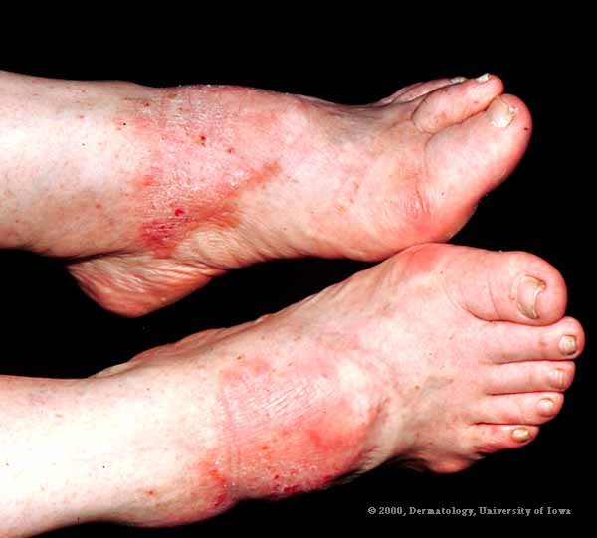
24 y/o male 2 year h/o red, scaly feet

Slide 74
Contact Dermatitis
Dermatitis precipitated by an exogenous agent:
Allergic contact dermatitis.
Irritant contact dermatitis.

Slide 75
Allergic contact dermatitis (ACD)
Definition:
Dermatitis resulting from type 4 reaction following exposure to topical substances in sensitized individuals (requires induction and elicitation phase (lag time to reaction).
Common allergens eliciting contact dermatitis:
nickel (affects 10% of women and 1% of men),
perfumes, fragrances , preservatives.
hair dyes,
rubber latex

Slide 76
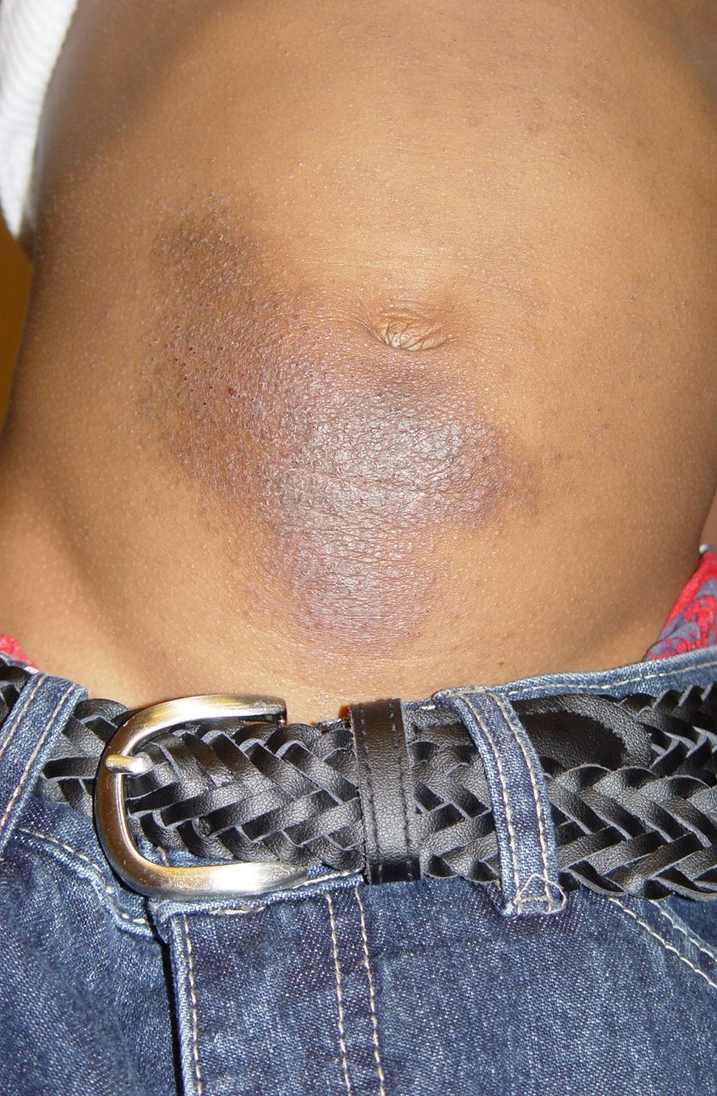
Clinical picture:
-Acute form present with crusted erythematous papules, vesicles & bullae that is well demarcated & localized to the site of contact with the allergen.
-ACD can be more diffuse in distribution.

Slide 77

Nickel Allergy - belt buckle

Slide 78

ACD

Slide 79

Nickel Allergy - bracelet

Slide 80

Suspect if dermatitis shows geometric patterns

Slide 81


Slide 82



Allergic Contact Dermatitis
linearity
Poison Ivy

Slide 83

Hair dye allergy

Slide 84

Hair dye allergy

Slide 85
Allergic Contact Dermatitis
Potassium Dichromate
in Leather

Slide 86


Allergic Contact Dermatitis
Latex
Cleaning products
Cosmetics
Occupational
exposures
Check the feet and nails!!!

Slide 87



Slide 88
Diagnosis:
-Hx.
-Examination.
-PATCH testing remain the gold standard for accurate diagnosis.

Slide 89

Patch test

Slide 90
Treatment of ACD:
-Avoidance.
-topical steroid
-systemic steroid
-Oral antihistamine

Slide 91
Irritant contact dermatitis (ICD)
-Is localized non immunologically mediated inflammatory reaction.
-ICD results from direct cytotoxic effect d.t single or repeated application of a chemical substance to the skin.
Most common irritants are:
Water
Abrasives
Chemicals, e.g. acids and alkalis
Solvents and detergents

Slide 92
Clinical picture:
-Similar to ACD but ICD never extend beyond the area of contact.
-tend to be painful rather than pruritic .
-can occur from the 1st exposure to the irritant unlike ACD which only occur in previously sensitized individual.

Slide 93

Irritant Contact Dermatitis

Slide 94

Eg. Irritant contact hand dermatitis

Slide 95


Lip licker dermatitis
Blunting of vermillion
Accentuation of angles

Slide 96
Treatment:
Same as ACD.

Slide 97

45 y/o female with intermittent “fungus all over”

Slide 98


Slide 99
Nummular (discoid) dermatitis
-Sharply circumscribed eczema , nummular means ( coin -shaped)
-Pathogenesis: Probably microbial in origin i.e. 2ry to bacterial colonization or disseminaion of bacterial toxins.

Slide 100


Clinical picture:
-Coin shaped eczematous plaques .
-Typically affects limbs of middle-aged or elderly
-Usually very pruritic.

Slide 101
Treatment:
-Topical steroid
-Topical antibiotic
Oral antibiotic-

Slide 102
Dyshidrotic dermatitis (pompholyx)
Acute dermatitis which is often vesicular with tiny deep seated vesicles along the sides of the fingers associated with pruritus

Slide 103
Cont..
-Not considered as a separate disease
-Can be associated with atopy , of patients with dyshidrosis, 50% have atopic dermatitis.
-Exogenous factors (eg, contact dermatitis to nickel,chemicals) also play a role.
-Affect hands & feet.

Slide 104

Dyshidrotic dermatitis

Slide 105


Slide 106


Slide 107
Treatment:
-Avoidance of triggering factor.
-topical steroid.

Slide 108

Stasis dermatitis
-seen in patient with signs of venous hypertension like chronic lower limb edema, varicose vein.
-can be complicated by superimposed allergic contact dermatitis.

Slide 109

Stasis eczema

Slide 110

Elephantiasis Verrucosa Nostras

Slide 111

Xerotic dermatitis

Slide 112


Slide 113
Xerotic dermatitis (Asteatotic Dermatitis)
Diffuse background skin dryness with associated dermatitis
typically affects limbs of the elderly.
Aggravated by:
harsh cleansers, dry winter conditions, hypothyroidism, use of diuretics
Treat with emollients 1st;
+/- mild steroid ointments

Slide 114

Asteatotic Dermatitis
Extreme case of xerosis
Riverbed type cracking

Slide 115

14 y/o anxious female who can’t stop itching

Slide 116
Neurodermatitis
-Include dermatitis which results from repeated rubbing & scratching of the skin .
-Chronic itching and scratching can cause the skin to thicken and have a leather texture with exaggeration of skin marking.
-A scratch-itch cycle occurs which is difficult to break .

Slide 117
Neurodermatitis
-Can be triggered by stress and anxiety.
-Occur commonly in atopic patient.

Slide 118
lichen simplex chronicus
Present as thick hyperkeratotic plaque with accentuation of skin marking that occurs on any site that the patient can reach, including the following:
  -Scalp
  -Nape of neck
  -Extensor forearms and elbows
  -Vulva and scrotum
  -Upper medial thighs, knees, lower legs, and ankles

Slide 119

lichen simplex chronicus

Slide 120


Slide 121
Treatment:
-control itching (break itch scratch cycle).
-topical or intralesional steroid.
-oral antihistamine
- Oral Anxiolytic

Slide 122
Common Pitfalls
Misdiagnosis
  Scabies (intensely pruritic, burrows/vesicles, others itch)
  Psoriasis (elbows/knees/inflammatory arthritis/nail changes)
  Fungus (central sparing, well marginated, scaly border)

Slide 123
What unique features are
associated with different types
of dermatitis?

Slide 124
Distinctive morphological features of different forms of dermatitis
type | Features of dermatitis | Other skin findings
Atopic | Symmetry, changes with age | Xerosis
Seborrheic | Greasy scale, face and scalp affected | Oiliness
Nummular | Coin-shaped or discoid macules and patches | Xerosis
Stasis | Affects lower legs, ankles | Edema,
Xerotic | Mild, widespread; typically fall & winter | Xerosis, hyper-pigmentation
Allergic contact | sites of contact, may have geometric patterns
Irritant contact | typically affects hands, face | Xerosis, fissuring.

Slide 125
Summary
Describe the cutaneous features of dermatitis.
-Differentiate acute from chronic dermatitis
Contrast irritant versus allergic contact dermatitis
Describe the presentation of atopic dermatitis at different ages
Indicate cutaneous findings that are unique for each type of dermatitis

Slide 126


Slide 127

THANK YOU

Slide 128


